Slide 1
Wealth Tax Act, 1957

Slide 2
Sec. 1:
Applicability
Provisions related to wealth-Tax are given in the wealth-Tax Act 1957.
It extends to whole of India
It applicable from 1-4-1957

Slide 3
Charging section
Every Individual | HUF | Company
Shall be charged to wealth-Tax @ 1%
On the amount by which his net wealth
exceeds Rs. 30,00,000 on the Valuation date
Net wealth of the Above assessee shall be determined on the basis of nationality & Residential Status

Slide 4
(Means person who is liable to pay tax)
ASSESSEE :
INDIVIDUAL,
HINDU UNDIVIDED FAMILY (HUF),
COMPANY

Slide 5
Who are not liable to pay Wealth-Tax ?
As per sec. 45
(a) Company
registered U/S 25 of Companies Act, 1956
(b) Co-operative society
(c) Social Club
(d) Political Party
(e) Mutual Fund
(f) Reserve Bank Of India
Besides the above, the following are also not liable to pay wealth-tax:
1. Partnership Firm
2. AOP / BOI
3. Local Authority
4. Any other Artificial person

Slide 6
ASSESSEE :
INDIVIDUAL,
HINDU UNDIVIDED FAMILY (HUF),
COMPANY
RATE OF TAX :
1%
x
(NET WEALTH – 30 LAKH)

Slide 7
Example
Suppose Mr. X having Net-wealth of Rs. 70lakh calculate Wealth-Tax Liability?
Net Wealth 70, 00, 000
LESS: Basic Exemption 30, 00, 000
Taxable Wealth 40, 00, 000
Rate of wealth tax @1% of RS. 4000000
Wealth-Tax Liability 40000

Slide 8
ASSESSEE :
INDIVIDUAL,
HINDU UNDIVIDED FAMILY (HUF),
COMPANY
RATE OF TAX :
1%
x
(NET WEALTH – 30 LAKH)
VALUATION DATE :
LAST DAY and OF THE PREVIOUS YEAR
NOTE : PREVIOUS YEAR MEANS SAME AS IN INCOME TAX ACT
For JUNE exam 1-4-2014 to 31-3-15
Therefore valuation date is 31-3-15

Slide 9
Example
As on 30th march 2015
Net wealth = 70 lakh
As on 31th march 2015
Net wealth = 40 lakh
Calculate wealth tax liability
Answer
Net wealth
=
40 lakh
Less basis exemption
=
30 lakh
Taxable wealth
=
10 lakh
Wealth Tax
Liability
1% of Rs. 10 Lakh
=
10000

Slide 10
Example
As on 31th march 2015
Morning 8 o clock
Net wealth = 70 lakh
At 10 pm
Net wealth = 40 lakh
Calculate wealth tax liability
Answer
Net wealth
=
40 lakh
Less basis exemption
=
30 lakh
Taxable wealth
=
10 lakh
Wealth Tax Liability :
1% of Rs. 10 Lakh
=
10000
Crux
LAST DAY and
LAST MOMENT
OF THE PREVIOUS YEAR

Slide 11
Example
Gold confiscated by Custom Department on
1.
29 – 3 – 2015
Not Included
2.
31 – 3 – 2015
Not Included
3.
02 – 4 – 2015
Included

Slide 12
ASSESSEE :
INDIVIDUAL,
HINDU UNDIVIDED FAMILY (HUF),
COMPANY
RATE OF TAX :
1%
x
(NET WEALTH – 30 LAKH)
VALUATION DATE:
LAST DAY and LAST MOMENT OF THE PREVIOUS YEAR
?
NET WEALTH :

Slide 13
NET WEALTH
How to compute Net wealth
Aggregate value of 6 assets u/s 2(ea)
XXXX
Aggregate value of Deemed assets u/s 4
XXXX
Less Exemption u/s 5
XXXX
Less debts owed
XXXX
Net wealth
XXXX

Slide 14
Definition of Asset
Sec. 2(ea)
Section 2 (ea)(i)
House property
Section 2 (ea)(ii)
Motor car
Section 2 (ea)(iii)
Jewellery | Bullion etc
Section 2 (ea)(iv)
Yacht , Boat and aircraft
Section 2 (ea)(v)
Urban land
Section 2 (ea)(vi)
Cash in hand

Slide 15
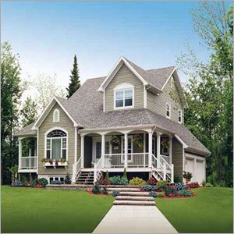
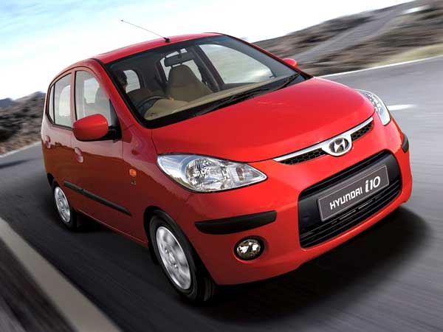
Section 2 (ea)(i)
House property
Section 2 (ea)(ii)
Motor car

Slide 16
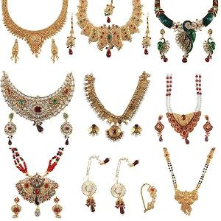

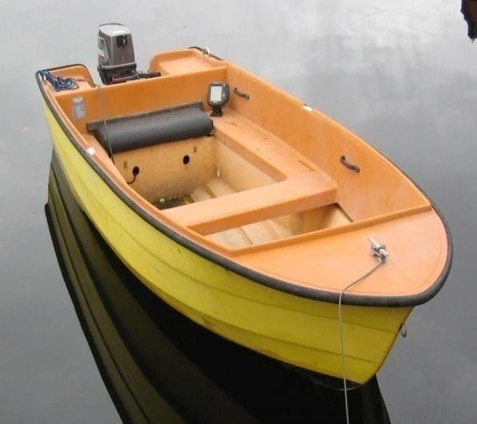
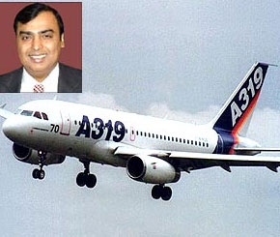
Section 2 (ea)(iii)
Jewellery | Bullion etc
Section 2 (ea)(iv)
Yacht
Boat
Aircraft

Slide 17
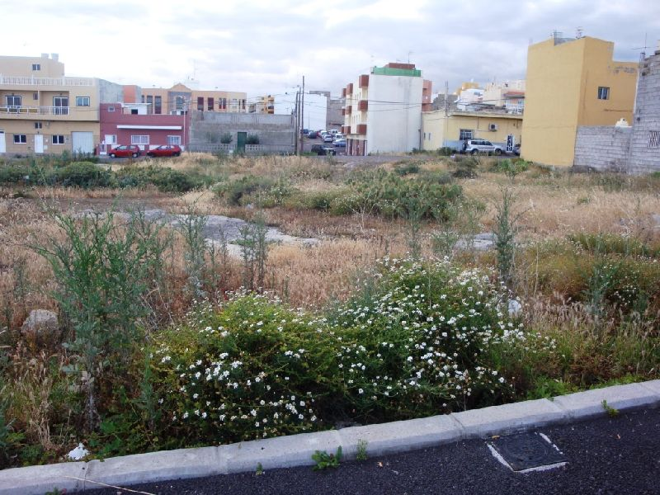
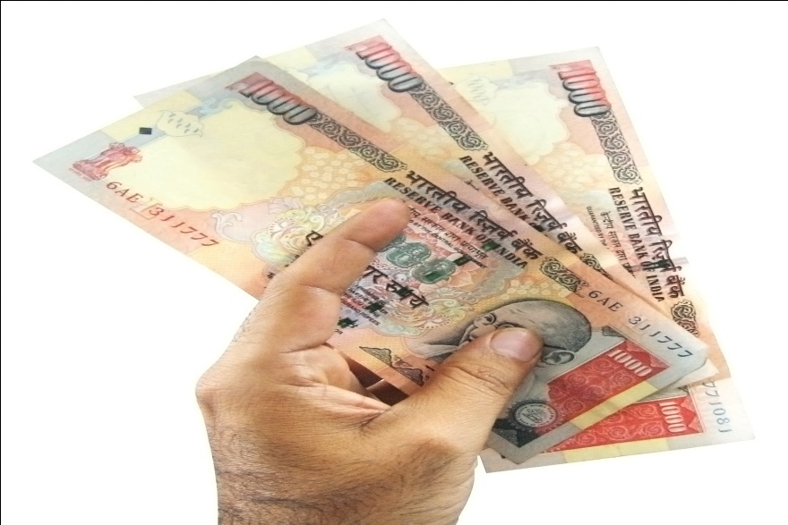
Section 2 (ea)(v)
Urban land
Section 2 (ea)(vi)
Cash in hand

Slide 18
House Property : Sec. 2(ea) (i)
ASSET

Slide 19
House property
means
Any building or land appurtenant thereto
There must be building . Land may or may not there . If land is there then it must attach to the building( i.e. land should also be used for the same purpose for which building is used)
Only building
Covered u/s 2(ea) (i)
Building + land
Covered u/s 2(ea) (i)
Only land (i.e. there is no building)
Not Covered u/s 2(ea) (i)

Slide 20
House Property
Section 2(ea)(i)
Asset
whether
Used for Residential Purpose
Used for Commercial Purpose
Maintaining as a Guest House
Or Otherwise

Slide 21
FARM HOUSE
Question:
Whether farm house is an asset?
Answer:
Yes, if it is situated within 25km of ANY municipality etc.

Slide 22
25 Km
Municipality
Limit
F | H
F | H
Asset
Not an asset

Slide 23
Question :
Whether F|H is an asset or not
Answer :
Yes.
Noida
Delhi
32 Km
28 Km
F | H
22 Km
26 Km
27 Km
Gaziabad
Gurgaon
Faridabad

Slide 24
FARM HOUSE
Question:
Whether farm house is an asset?
Answer:
Yes, if it is situated within 25km of ANY municipality etc.

Slide 25
Question
1
Farm house situated within 20 km from local limits of MCD of DELHI
Asset
2
Farm house situated within 28 km from local limits of MCD of DELHI (i.e. beyond 25 km)
Not anAsset
3
Farm house situated within 28 km from local limits of MCD of DELHI but within 23 km of gurgaon
Asset
4.
Guest house situated 29 km away from local limit
Asset

Slide 26
But does not include i.e. Not an Asset
House Property is an Asset
1
COMPANY
allot
EMPLOYEE
or
RESIDENTIAL
HOUSE
OFFICER
or
Whole time employment
DIRECTOR
and
Gross annual salary less than RS.10 lakh

Slide 27
Example
1
Asset allotted by individual to its employees
Asset
2
House allotted by company to its employee whose salary is 2,00,000 pm
Asset
3
Commercial house allotted by company to its employees
Asset
4
R|H allotted to finance Manger whose Salary is 600000 p.a by company
Not
an asset

Slide 28
2
Any house held as stock in trade
Not an asset
Any house means whether for residential purpose or commercial purpose
This exclusion is applicable even if assessee has more than one house but houses must be held as stock in trade
Whether a house is residential or commercial is to be known from the records of government
as SIT
Not an Asset
Example
Property held by a property dealer
for his
Own Residence
Purpose
Asset

Slide 29
3
Any house which the assessee may occupy for the purpose of his business or profession(PGBP)
Not an asset
Any house means whether for residential purpose or commercial purpose
Occupy for the purpose of his business or profession means assessee is carrying his own business or profession in the building
Example
Doctor carrying his profession in his own clinic and therefore such clinic will be excluded from the definition of asset
This exclusion is applicable even if assessee has more than one house but houses must be use as PGBP

Slide 30
Ist Floor
Self - Occupied
Asset
Ground Floor
Clinic
Not an asset

Slide 31
4
Residential house let out for minimum period of 300 days during the previous year
Not an asset
Let out
300 days or more
299 days or less
Not an asset
Asset

Slide 32
Example
Mr. X let out his residential property on 10th June 2013
Valuation date : 31/3/15
As the property was let out from 10th June 2013 so it can be reasonably presumed that property is being let out for the entire year i.e. from 1st April 2014 to 31st March 2015. Therefore such residential property is not an asset

Slide 33
Example
Mr. X let out his residential property on 10th June 2014
Valuation date : 31/3/15
As the property is let out for 295 days that is minimum 300 days condition not satisfied and therefore it is an asset and will be included in the computation of net wealth
Total no . of days in a year
365
Period when property is not let out
April 30
May 31
June 09
70
Let out period
295 days

Slide 34
5
Commercial establishment or Commercial Complex
Not an asset
Example
Ansal plaza
Super market in chennai
DDA Market

Slide 35
ABC
Partnership
firm
Let out his building
Mr. A
(Partner
in ABC
firm)
Such buildingShall not be included
In wealth of Mr. A
(RABINDRA NATH DHAL)
RABINDRANATH DHAL (HC):- In this case the High Court held that if a building owned by a person is made available to the partnership firm in which such person is a partner and the partnership firm uses the building for the purposes of its business or profession, then it can be said that the building is being used by the partner for the purpose of his business or profession and consequently such building is not an asset. The said building shall not be included in wealth of the partner since it is not an asset.

Slide 36
Analysis of house property
Every residential house is an asset
Every commercial house is asset
Except
Except
1
Residential house allotted by company to its full time employee whose salary below 10 lakh
1
Held as SIT
2
Use as PGBP
2
House held as SIT
3
House use as PGBP
4
Residential house let out for at least 300 days

Slide 37
MOTOR CAR :
Sec. 2 (ea) (ii)
Asset
However it does not include
1.
Motor Car held as stock-in-trade
2.
Motor Car used in the business of Running them on hire i.e. TAXI.

Slide 38
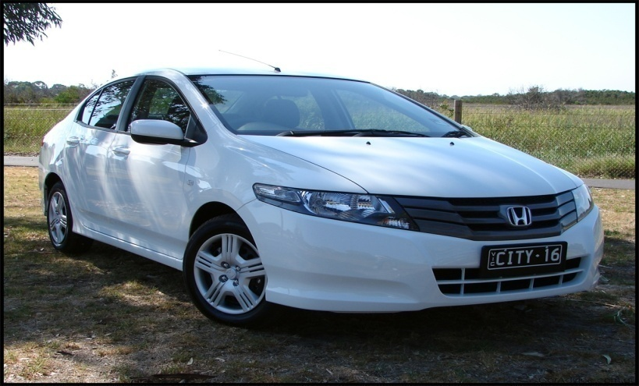
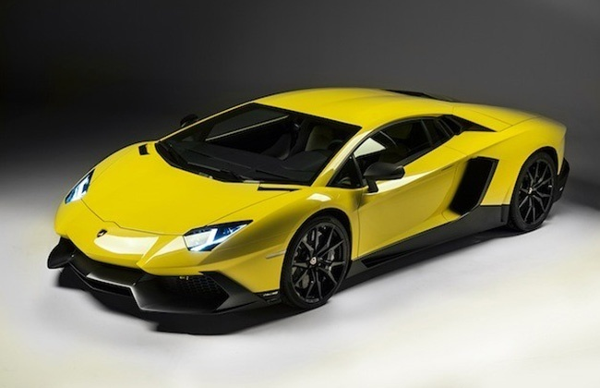
INDIAN
MOTOR
CAR
Asset
Imported
MOTOR
CAR
Asset
Motor Car is an asset whether Indian or Imported.

Slide 39
1.
Motor Car used for the Purpose of his
business or profession
E.g.
Mr. X uses his Motor Car for office purpose
Asset
2.
Motor Car used for personal purposes
Asset

Slide 40
Q:-
Reliance Company having 500 Cars and allotted to each of his employees for their office as well as personal purposes.
Whether 500 Cars is an asset for Reliance company.
Answer:
Yes

Slide 41
Motor bike, Auto, Bus, truck are not Motor Car
therefore no question of Asset
Not an asset

Slide 42
Jeep, Jonga, Metador, MUV, SUV
are Motor Car
& therefore AN ASSET

Slide 43
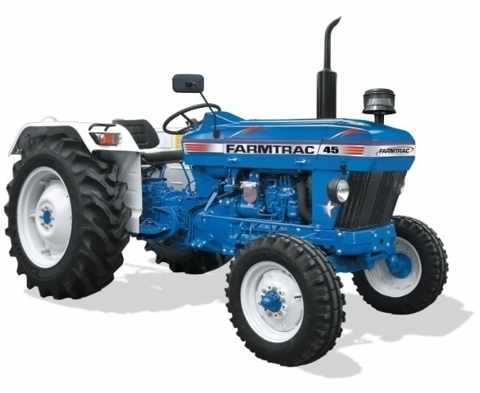
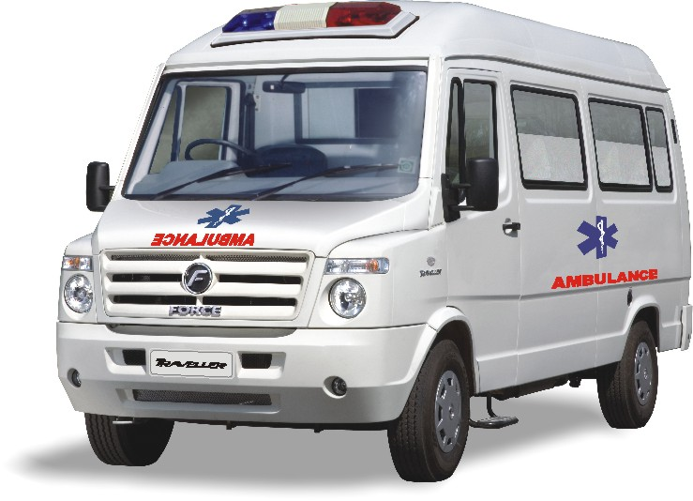
Tractor
Not an asset
Ambulance
Not an asset

Slide 44
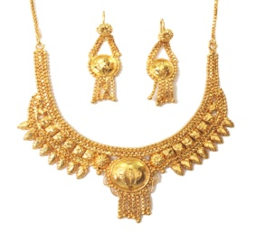

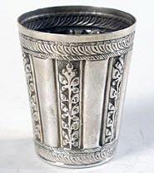
ORNAMENTS
MADE OF GOLD, SILVER, PLATINUM OR OTHER PRECIOUS METAL
ASSET
BULLION
GOLD BISCUIT
SILVER BRICKS
DIAMOND ETC
ASSET
MADE OF GOLD, SILVER,
PLATINUM OR OTHER PRECIOUS METAL
FURNITURE , UTENSILS
ASSET
MADE OF COSTLY WOOD , STEEL ETC
NOT AN ASSET

Slide 45
WHEN JEWELLERY IS TREATED AS
NOT AN ASSET
Held as Stock In Trade

Slide 46
WHEN JEWELLERY IS TREATED As
NOT AN ASSET
Gold Deposit Bonds

Slide 47
YACHTS , BOATS AND AIRCRAFT
ASSET
1:
SHIP IS NEITHER YACHT NOR BOAT AND THEREFORE
NOT AN ASSET
2:
HELICOPTER IS AN AIRCRAFT AND THEREFORE AN ASSET

Slide 48
YACHTS , BOATS AND AIRCRAFT
USED FOR COMMERCIAL PURPOSE
NOT AN ASSET
1:
AS PER GUIDELINES OF ICAI , STOCK – IN – TRADE WILL BE TREATED AS COMMERCIAL PURPOSE AND THEREFORE NOT AN ASSET
2:
WHETHER THESE ASSETS USED FOR COMMERCIAL PURPOSE OR NOT IS TO BE DETERMINEDFROM THE LICENCE GIVEN BY THE PRESCRIBED AUTHORITY
3:
FOR EG: SAHARA INDIA AIRLINE , JET KING ETC.

Slide 49
Aircraft Used
For Transportation
of Goods
For meeting of
Directors / Employee
of Company
Example
Courier
agency
DTDC
Asset
Not an Asset

Slide 50
URBAN LAND
Vacant land or plot of land
Asset
For the purpose of wealth tax , land must be in urban area
*
Land Situated in Rural area
Not an Asset

Slide 51
Example :
MrX Purpose Urban Land for industrial purpose on 1.8.2012
1.8.12
31.7.2014
Valuation Date
31|3|13
NA
31|3|14
NA
31|3|15
A

Slide 52
But does not include:
1:
Land classified as agricultural land in the records of the government and used for agricultural purposes; or
2:
Land on which construction of a building is not permissible under any law for the time being in force in the area in which such land is situated.
3:
Land occupied by any building which has been constructed with the approval of the appropriate authority.
4:
Any unused land held by the assessee for industrial purposes for a period of two years from the date of its acquisition by him.
5:
Land held as stock in trade by the assessee for a period of ten years from the date of its acquisition by him.

Slide 53
Mr.X Purchase Urban Land on 1.8.2012
Construction of Factory building
Start on :
1.11.14
Completed on :
10.10.17
1.8.12
31.7.2014
VD :
31|3|13
Not an Asset
Because industrial Land is not an Asset for 2 yrs.
31|3|14
31|3|15
Not an Asset
31|3|16
Incomplete structure
Not an Asset
31|3|17
as per Smt. Neena Jain
31|3|18
Factory
i.e. Land
+
Building as per Sec. 2 (ea) (i)
Not an Asset
Because it can be reasonable presumed that Factory Building is used for purpose of Business or Profession

Slide 54
Mr.X Purchase Urban Land on 1.8.2012
Construction of Residential | Building
Start on :
1.11.14
Completed on :
10.10.17
1.8.12
31.7.2014
VD :
31|3|13
Asset
31|3|14
31|3|15
Not an Asset
31|3|16
Incomplete structure
Not an Asset
31|3|17
as per Smt. Neena Jain
31|3|18
Building
i.e. Land
+
Building as per Sec. 2 (ea) (i)

Slide 55
Urban land means land situate :
(i)
In any area which is comprised within the jurisdiction of a municipality (whether known as a municipality, municipal corporation, notified area committee, town area which has a population of not les than 10,000;)
or
(ii)
In any area within the distance, measured aerially, -
(I)
not being more than two kilometres, from the local limits of any municipality or cantonment board referred to in sub-clause (i) and which has a population of more than 10,000 but not exceeding 1,00,000; or
(II)
not being more than six kilometres, from the local limits of any municipality or cantonment board referred to in sub-clause (i) and which has a population of more than 1,00,000 but not exceeding 10,00,000; or
(III)
not being more than eight kilometres, from the local limits of any municipality or cantonment board referred to in sub-clause (i) and which has a population of more than 10,00,000,

Slide 56
Urban Area
Urban Land
If situated within Jurisdiction of Municipality
If Situated outside
the of Jurisdiction
of Municipality
Population Should
not be less than 10000
Up to 2 km
Population more than
10000
but not exceeding 100000
Up to 6 km
Population more than
100000
but not exceeding
1000000
Up to 8 km
Population more than
1000000

Slide 57
Rural
Within MCD Limit but population Less than 10,000
Rural
Outside MCD Limit
More than 8 km.
Rural

Slide 58
Q:-
Land held as stocke in trade. (Acquired on May 2004)
Valaution Date :
upto
31|3|14
Not an Asset
31|3|15
Asset

Slide 59
Cash-in-Hand
For individual / HUF
For others
Asset
Cash-in-hand
in excess of Rs. 50000
Amt not recorded in the books of A/C
Amount recorded in the books of an account
E.g.
Cash-in-hand
1000000
Asset
Not an asset
Exempt
50000
NOTE:
Limit of Rs. 50000 is not Applicable in case of others
Asset
950000

Slide 60
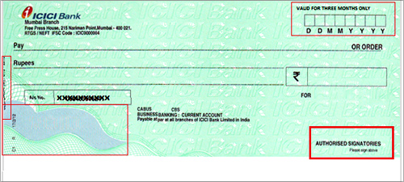

1
Cash at bank, cheque in hand are Not an asset
2
Cash-in-transist, cash in foreign currency is an asset

Slide 61
Question
Mr. X having Wealth as follow
Rs.
Cash as per cash book
200000
(Recorded in the books of Account)
SoL:
Cash as per cash book
200000
150000
50000
Note:
For IND | HUF : Cash in hand is an asset to the extent it exceeds Rs. 50,000 whether recorded in the books or not.

Slide 62
Assessee :
Company
B | S
CIH
600000
Raid
Officer found CIH 6,20,000
then Rs. 20000 is not Recorded in the Book of A|C & Treated as an asset.

Slide 63
TAX Planning
Cash in HAND
31st March :
50,00,000
AT 5.00 Pm :
Deposited cash in bank
Answer:-
31.3.14
Not an asset

Slide 64
Answer
1.
Commercial flat lying vacant
2.
Commercial building in which assessee’s office is located
3.
House given to an employee who has Substantial interest in the company & whose gross annual salary is Rs. 8 lakh per annum
4.
House held by a property dealer.
5.
R|H letout to an employee of the company whose salary is 12 Lakh p.a. This house is letout for 320 days
6.
Motor Car shown in the B|S as fixed asset
7.
Motor Car of Company given to the director for official use
8.
Semi-precious stones.
9.
Aircrafts held by king-fisher Airlines
10.
Cash of Rs. 40000 held by a company assuming that recorded in the books
11.
Land acquired on 1.4.2010. Construction started on 10-6-13 but not yet Completed.

Slide 65
Deemed Assets :
Sec. 4
Sec. 4 (1) (a)
:Sec. 4 (1) (b)
1.
Transferred to the spouse
:Sec. 4 (1A)
2.
Transferred to Minor
child Except minor married
daughter
Conversion of Self-Acquired Property into joint family
Property.
3.
Transferred to Son’s wife
:Sec. 4 (6)
Holder of Impartiable estate
4.
Transferred to Any Person or AOP
for the benefit of
:Sec. 4 (7)
Member of a Co-Operative
Housing Society
Individual or
Spouse | Son’s wife
5.
Transferred to Any person under
:Sec. 4 (8)
Revocable transfer
Deemed ownership an
Possession of immovable
Property.

Slide 66
Deemed Assets :
Sec. 4
i.e. Assets required to be included in the Net Wealth of the assessee.
ALSO known as clubbing of wealth.

Slide 67
Mr. X
GOLD
30 Lakh
Motor
Car
30 Lakh
60 Lakh
(-)
Basic
exemption
30 Lakh
Taxable
wealth
30 Lakh
W.Tax
Liability
1% of Rs. 30 Lakh
i.e. 30000

Slide 68
Mr. X
Gift
Mrs. X
GOLD
30 Lakh
Motor
Car
30 Lakh
Mr. X
Mrs. X
Motor
Car
30 Lakh
GOLD
30 Lakh
Not Liable to
Wealth-Tax
Not Liable to
Wealth-Tax
To stop-this practice, Section 4 i.e. clubbing of wealth Came into existence
Now Asset which is transferred by Mr X to Mrs X (i.e. without consideration) shall be included in the net wealth of Mr.X

Slide 69
Spouse
INDIVIDUAL
Son’s wife
Asset transferred without adequate consideration
Any other
Person
for the benefit
Clubbed

Slide 70
Wealth of a minor child
Clubbed
in the
hands of Parent

Slide 71
Asset transferred to the Spouse
transfer
(Gift)
Mr. X
Mrs. X
H|P
H/P Shall be clubbed in the hands of Mr.X

Slide 72
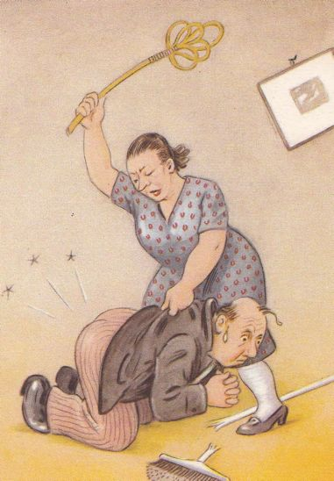


However No Clubbing in the following Cases
If transfer
is for adequate
Consideration
If transfer is
under an agreement
to live apart
Relationship
of H|W
does not exist
either
at the time of
transfer or
at the time of
Valuation
Date.
or Both

Slide 73
If transfer is for adequate Consideration i.e. Sale with proper Consideration
Sale of
Mr. X
Mrs. X
GOLD
of Rs. 100000
( MV of GOLD
is Rs. 100000)
will not be clubbed in the wealth of Mr. X

Slide 74
Sale of
Mr. X
Mrs. X
GOLD
of Rs. 50,000
( MV of GOLD
is Rs. 100000)
Rs. 50,000 will be clubbed
in the hands of Mr. X

Slide 75
Sale of
Mr. X
Mrs. X
GOLD
of Rs. 40,000
( MV of GOLD
is Rs. 100000)
Rs. 60,000 will be clubbed
in the hands of Mr. X

Slide 76
adequate
Consideration
No Clubbing
transfer
Individual
asset
Inadequate
Consideration
then Asset
belongs to inadequate Portion will be Clubbed

Slide 77
If Relationship of H|W Does not exist
either
at the time of transfer or
at the time of Valuation Date
Or both

Slide 78
Example
5|3|2014
31|3|2015
Date of Transfer
Valuation
Date
Clubbing or not
F
F
No
F
W
No
W
W
Yes
W
F
No
F- Friend
W- Wife

Slide 79
Ques.
Karan made a gift to Sujata during their engagement which took place on 15th May, 2009. After their marriage which was held on 15th June 2009, they decide to live apart owing to some reasons and they obtained a legal divorce on 15th Sep. 2009. Whether such transferred asset shall be clubbed in the hands of Karan?

Slide 80
Answer
No Clubbing
For the purpose of clubbing, relationship of husband and wife must exist both the time i.e. at the time of transfer as well as Valuation Date.

Slide 81
Asset transferred to Son’s Wife
Shall be clubbed in the
hands of Mr. FIL | MIL
GOLD
Father/Mother in law
Son’s wife
Gift

Slide 82
However No Clubbing in the following Cases
If transfer
is for adequate
Consideration
Relationship
Of FIL|Sons Wife
does not exist
either
at the time of
transfer or
at the time of
Valuation
Date
or both

Slide 83
Indirect Transfer
shall be clubbed
Gift
of
H|P
Gift
Mr. X
Friend
Son’s Wife

Slide 84
Gift
from
Friend
Gift from
Uncle
Gift from
Any Person
Wealth
of a Minor child
Shall be clubbed
In the hands
of Parent
whose Net wealth (other than wealth of child) is greater

Slide 85
Wealth of Minor Child
Asset of minor child shall be clubbed in the Net Wealth of his parents whose Net Wealth is Greater (before including wealth of such Minor Child)
Example
Mr. X (father)
Net Wealth 40 L
Mrs. X (Mother)
Net Wealth 60 L
Master X (Minor child)
Asset Rs. 1 L
Asset of Rs. 1lakh shall be clubbed in the Net Wealth of Mrs. X

Slide 86
First Year
Mr. X
Asset
40 L
Mrs. X
Asset
60 L
Master X
Asset
1 L
Asset of Master X shall be clubbed in the Net wealth of Mrs. X
Next Year
Mr. X
Net wealth
60 L
Mrs. X
Net wealth
40 L
Master X
Asset
1 L
Asset of Master X shall be clubbed in the Net wealth of Mrs. X only.

Slide 87
Minor child
(below the age of 18 years)
Minor
Unmarried
Son
Minor
Married
Son
Minor
Unmarried
daughter
Minor
Married
daughter
Clubbed
Clubbed
Clubbed
Not to be clubbed

Slide 88

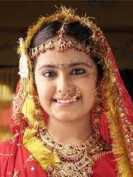
INDIVIDUAL
Minor
Married
daughter
Transfer
GOLD
GOLD shall not be clubbed in the Net wealth of Father but it will be taxable in the hands of Minor Married daughter only.

Slide 89
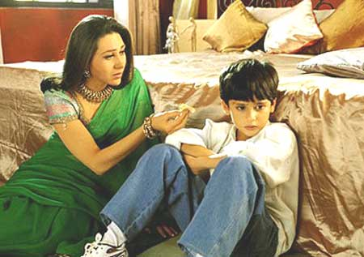
Where relationship does not Subsist between Parents
Wealth of Minor Child shall be clubbed in the hands of that Parent who maintain minor child during the Previous year

Slide 90
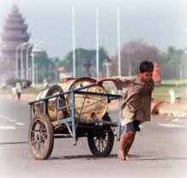

Circumstances
where Asset of the minor child is not to be clubbed
i.e. Asset of minor child will be assessed in the hands of Minor Child only.
ASSET acquired on account of Manual work
Asset acquired on account of activity involving application of his skill. talent, knowledge experience

Slide 91
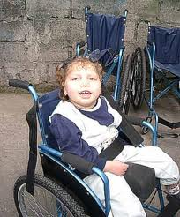

Where child is Suffering from disability mentions U|S 80 U of Income Tax Act. i.e Physically handicapped or totally blind etc
Where Parent of Minor child does not alive

Slide 92
Conversion of Self-acquired Property into joint Family Property
Hindu Undivided Family
Mr. X
Convert it into Joint family property without adequate consideration
(Member of HUF)
Self acquired
Property
Such Property shall be clubbed in the hands of Mr. X.

Slide 93
After Partition
HUF
Partition
Mr. X
Mrs. X
Minor Child
Major Son
Major Daughter
(Member)
(Member)
(Member)
(Member)
(Member)
Share
2 lakh
Share
2 lakh
Share
2 lakh
Share
2 lakh
Share
2lakh
Clubbed in the hands of Mr. X
Clubbed in the hands of parents whose income is GREATER

Slide 94
Transfer of Asset
Revocable
transfer
Irrevocable
transfer
Asset transferred shall be clubbed
Asset transferred shall not be clubbed
However such asset shall be clubbed in the wealth of transferrer as and when the power to revoke arise
Which is not a
Irrevocable transfer
(i)
Revocable after 6 years
or
(ii)
Not Revocable during life time of transfree or beneficiary
And
transferor derives no direct or indirect benefit
But does not include
(a)
Where there is a provision for re-transfer, directly or indirectly of the income or asset to the transferor during the transfer is not revocable
(b)
transferor having right to re-assume power directly or indirectly over the whole or any part of income or asset

Slide 95
Q:-
Gift H|P
Mr. X
Mr. Y
for 5 years
Answer:-
Nature of transfer :
Revocable
So H|P shall be clubbed with the wealth of Mr. X

Slide 96
Q:-
Gift of H|P
Mr. X
Mr. Y
for 7 years
The transfer deed also provides that Mr. A can re-transfer the asset within the period of 7 years also
Answer:-
Nature :
Revocable
So H|P shall be clubbed with the wealth of Mr. X

Slide 97
Q:-
What will be your answer if deed did not Provide the Provision of such Re-transfer
Answer:-
Nature :
Irrevocable
So H|P shall be Taxable in the hands of Mr. Y only for 7 years.
After 7 years it will be clubbed in the wealth of Mr. X

Slide 98
Transfer H|P
Mr. X
Mr. Y
to Mr. Y for his life time on 15.2.13
died on
16.1.16
However Mr. X takes actual possession on 20.4.2016
1.
The building is transferred under Irrevocable transfer
2.
No clubbing Provision will be applied till the death of Mr. Y
3.
Building shall be taxable in the hands of Mr. Y on Valuation Date:
31|3|14
31|3|15
4.
Immediate after death (i.e. Power to Revoke arise) Building will be taxable in the hands of Mr. X irrespective of the date of actual possession of the asset
i.e. Taxable in the hands of Mr. X on Valuation Date 31|3|16.

Slide 99
Interest of a partner of a Firm|AOP
Where the assessee is a partner of a firm or a member of any AOP
the value of the interest of the assessee in the assets of the Firm |AOP
shall be determined as per Schedule III
shall be included in his net wealth
However
Where a minor is admitted to the benefits of Partnership in a firm
the value of the interest of such minor will be included in the net wealth of the Parent.

Slide 100
Exemption u|s 5(i)
Property held under trust
wealth
Any Property held under
trust or
other Legal obligation
for any Public purpose of a
Charitable or
religious nature in India
is Exempt u|s 5(i)

Slide 101
Important to Note
Exemption is not available in respect of business asset of the trust.
However
Business asset will also be exempt if
business is incidental to the attainment of the objective of the trust and
Separate books of account are maintained by such trust in respect of Such business
Very Important Note :
Where business assets are not exempt, then trust will be liable to wealth-tax as an Individual

Slide 102
Gangabai Charities (SC)
Where under a trust deed, the purpose for which trust property could be put to use were not confined to charitable or religious use and the property could be used for social, cultural and allied purposes at the discretion of the trust, the assess trust was not entitled to exemption under section 5(i).

Slide 103
SHARE
(i.e. exempt)
Co-parcenary Interest in the property of HUF
HUF
Itself
Assessee
Liable to
Pay wealth Tax
interest to Co-parcener
exempt u|s 5(ii)

Slide 104
Exemption u|s 5(iii)
One House in the occupation of a Ruler
declared as his official Residence
by Central Govt.
exempt u|s 5(iii)
GAJSINGH (SC)
Where the assessee opted to adopt Umed Bhavan Palace as his house for the purpose of exemption under section 5(iii) which is specific for the purpose, he shall not be entitled to seek exemption for another house namely Sardar Samand Palace under section 5(vi)

Slide 105
Exemption u|s 5(iv)
Recognition of C.G
Heir loom Jewellery
exemption u|s 5(iv)
But subject to certain condition
1.
Jewellery shall be permanently kept in India & shall not be removed outside India. Except for a purpose and period approaved by CBDT
E.g. Exhibition
2.
Reasonable step shall be taken for keeping the Jewellery Substantially in its original shape.
3.
Reasonable Facalities
to officer of Govt.
authorised by CBDT
to examine Jewellery as and when necessary

Slide 106
If any | all of the Condition are not satisfied
Wealth Tax shall be levied Retrospectively i.e. exemption shall be withdrawn retrospectively
Example:
Recognition withdrawn on 14.02.2014
FMV as on
31.3.13
28 L
31.3.14
30 L
14.02.2014
18 L
18 L
18 L
18 L
18 L
18 L
18 L
18 L
Rate
Rate
Rate
Rate
Rate
Rate
Rate
VD : 31.3.13
Wealth Tax
FMV
28 L
50%
W.e. is Less
14 L

Slide 107
Example:
The Jewellery of a Ex ruler was recognised as his heirloom Jewellery from assessment year 1975-76. The recognition is withdrawn on 1.3.2013 when the fair market value is `30 crores. The fair market value of the jewellery as on 31.3.2013 is `40 crores and as on 31.03.2012 is `22 crores. Discuss the taxability in the hands of the former ruler.
Answer:
CBDT can withdrawn the exemption under section 5(iv) retrospectively from Assessment Years 1975-76 to 2012-13. The value of jewellery for these assessment years shall be taken to be `30 crores. However, the total wealth tax payable for Assessment Years 1975-76 to 2012-13 shall not exceed `11 crores. The tax rate applicable shall be that of the respective assessment years.

Slide 108
Exemption u|s 5(v)
This Section is applicable to
INDIVIDUAL
Either
Citizen
of
India
or
Person of indian origin
Returning to India (Permanently)
1
Money + Asset brought along with
2
Asset Purchase – within one year immediate Preceding date of Return
3
Asset Purchase – Any time on or after date of Return
Shall be exempt u|s 5(v)
for 7 Successive A|Y

Slide 109
Mr X
Money
and |or Asset
exempt u|s 5(v)
Money Sended from abroad
and | or
NRE A|C
Returned to India
Money brought from abroad
and | or
NRE A|C
11-2-2014
on 10-2-2015
Asset
Asset
V D
exempt
u|s 5(v)
31|3|15
(A|Y 15-16)
exempt u|s 5(v)
31|3|16
(i)
Money and|or asset and
31|3|17
(ii)
Assets acquired within 1 year Prior and
31|3|18
31|3|19
(iii)
Assets acquired on or after the date of Return
31|3|20
31|3|2021
are exempt u|s 5(v)
for SEVEN Successive Assessment years
Commencing with the A|y next following the date on which he Returned to India

Slide 110
Mr X
11-2-2014
Returned to India
on 10-2-2014
Asset 3
Asset 2
Asset 1
Asset 4
10-1-2014
15-2-2014
20-4-2014
16-2-2018
V D
Asset 1
Asset 2
Asset 3
Asset 4
31|3|14
Taxable
Taxable
31|3|15
Exempt
Exempt
Taxable
31|3|16
”
Exempt
Taxable
31|3|17
”
Exempt
Taxable
31|3|18
”
Exempt
Taxable
Exempt
31|3|19
”
Exempt
Taxable
Exempt
31|3|20
”
Exempt
Taxable
Exempt
31|3|21
”
Exempt
Taxable
Exempt

Slide 111
Important Note:
1.
Money Standing to the Credit of NRE A|C as on the date of Return to India and shall be deemed to be Moneys brought by him into India on that date & therefore exempt u|s 5(v).
Person of Indian Origin
A person shall be deemed to to Indian Origin if he, or either of his parents or any of his grandparents, was born in Undivided India
*
grandparents include maternal grandparents also.

Slide 112
K.O.MATHEWS
(KERALA HIGH COURT)
Even if the assessee has converted assets, which were brought by him from outside India, into money, and has used that money for acquisition if other asset, the asset which is acquired with the sale consideration of original asset, is also eligible for exemption.

Slide 113
Question:-
He brought imported motor cars into India while coming back to India. Imported motor cars are sold and jewellery is purchased out of the sale proceeds as on 31.3.2015.
Answer:-
Exemption u/s 5(v) is available for the assets purchased out of the sale proceeds of assets brought into India. Therefore, value of jewellery is not taxable.

Slide 114
Question:-
Out of the moneys brought from abroad, he purchased a house property on 21.6.2014. The house property is sold and out of the sale proceeds jewellery is purchased as on 31.3.2015.
Answer:-
Exemption u/s 5(v) is not available for assets purchased out of the sale proceeds of assets acquired from foreign funds, therefore, exemption under section 5(v) if not available in respect of the jewellery.

Slide 115
Exemption U/S 5(vi)
Important Points
This Exemption is available only to Individual & HUF.
Exemption is in respect of
One house / part of house
OR
Plot of land of 500 Sq. meters or less
If area of plot of land exceed 500 Sq. meters then such land will not be allowed for exemption.

Slide 116
Exemption u|s 5(vi)
whether Residential or Commercial or Farm House | Guest House or Self occupied or Let out etc.
(i)
One House or
Exemption U|S 5(vi)
Not available
to COMPANY
(ii)
Part of a House or
(iii)
Plot of land not exceeding 500 Sq.meter
is exempt u|s 5(vi)
to Individual or HUF only.
Important Note:
Any House | Plot of Land if Not an asset as per sec. 2(ea), then no question of claiming exemption.
E.g.
R|H let out 300 DAYS or more is not an asset & therefore no question of claiming exemption u|s 5(vi)
Note:
If Plot of Land is mort than 500 Sq.meter then Exemption u|s 5(vi) Cannot be claimed in respect of Such asset.

Slide 117
Mr. X have the following property:
HOUSE A
200 LAKHS
HOUSE B
250 LAKHS
PLOT OF LAND (SQ. METER 500)
300 LAKHS
Answer:-
Plot of Land 300 lakhs

Slide 118
Mr. X have the following property:
HOUSE A
200 lakhs
HOUSE B
250 lakhs
HOUSE C
300 lakhs
Plot of land (400Sq. METER)
250 lakhs
Answer:-
House C 300 lakhs

Slide 119
Mr. X have the following property:
HOUSE A (self-occupied)
20 lakhs
HOUSE B (stock-in-trade)
70 lakhs
HOUSE C (let-out for 200 days)
40 lakhs
Answer:-
House C 40 lakhs

Slide 120
Mr. X have the following property:
HOUSE A
50 lakhs
HOUSE B
70 lakhs
HOUSE C
90 lakhs
Plot of land (600Sq. METER)
400 lakhs
Plot of land (300Sq. METER)
200 lakhs
Answer:-
Plot of Land (300Sq. Meter) 200 lakhs

Slide 121
Mr. X have the following property:
HOUSE A
50 lakhs
HOUSE B
70 lakhs
HOUSE C
90 lakhs
Farm House (20km from local limits)
300 lakhs
Plot of land (600Sq. METER)
400 lakhs
Plot of land (300Sq. METER)
200 lakhs
Answer:-
Farm House 300 lakhs

Slide 122
Debts
Debts owed by the assessee
on the valuation date
are deductible
if these debts are incurred on the assets included in the net wealth.
In Simple words
If debt (Loan) incurred in relation to Asset
Which is asset as per Sec. 2(ea) and included in the Net wealth
Which is not an
asset as per
Sec. 2(ea)
Debts (Loan) is allowed to be deducted
Debts (Loan) is not to be deducted.

Slide 123
Situation
Debt
Reason
(i)
Assessee took a loan of Rs. 500000
& Purchase Motor car of Rs. 500000
Deducted
(ii)
Assessee took a loan of Rs. 500000
& Purchase a Motor car However Motor car held as SIT.
Not to be
deducted.
(iii)
Assessee took a Loan of Rs. 10 Lakh
from bank & Purchase Gold of
Rs. 10 lakh
Deducted
Schedule III Value of Gold (as on 31.3.14)
(i)
15 lakh
10 lakh
(i)
8 lakh
10 lakh
(iv)
Assessee took a Loan of Rs. 10 Lakh
from bank.
Assessee utilised
Rs. 8 Lakh for Purchasing Motor Car
Rs. 8 Lakh Deducted only.
Rs. 2 Lakh for Purchasing Shares

Slide 124
Situation
Debt
Reason
(v)
Assessee has a Gold valued at Rs. 10 lakh He takes a loan of Rs. 6 lakh against the Security of Gold & invest Rs. 8 lakh in shares
Not to be
deducted
(vi)
Wealth Tax Liability
Not to be
deducted
(vii)
Assessee takes a loan of Rs. 1 Lakh and the Same is deposited in the Bank A|C.
Not to be
deducted

Slide 125
Q :
Mr. X owns a H|P Valued at Rs. 1 crore. He has taken a loan of Rs. 50 Lakh for purchasing the said H|P. Assume other Assets are Rs. 50 Lakh
Answer
Other Assets
50 Lakh
H|P
1 Crore
Less:
Exempt
u|s 5(vi)
1 Crore
NIL
50 Lakh
Less:
Debt owed
NIL
Net wealth
50 Lakh

Slide 126
Q :
Mr. X owns two house properties. The details are as under:
House
Value
Loan taken to acquire the property
A
20,00,000
5,00,000
B
30,00,000
28,00,000
Other assets are Rs. 50 lakhs.
Answer:
Other Assets
50,00,000
House A
20,00,000
Less:
Exempt u|s 5(vi)
20,00,000
NIL
House B
30,00,000
Total Assets
80,00,000
Less:
Debt owed
28,00,000
Net wealth
52,00,000
Exemption under section 5(vi) should be claimed for House A and not House B.

Slide 127
Sec. 6
Asset & debts ---- Located outside India.
INDIVIDUAL | HUF
Citizen of India (only for + Ind.)
Resident and ordinary Resident in India
Any other Case
Assets in India
Included in the
Net Wealth of Assessee
Assets in India
Included
in the net wealth of the assessee
Assets located outside India
Not to be included in the Net Wealth of Assessee
Assets outside India
Whether taken from India or outside India.
Debts (Loan) will be deducted only if it is in relation to that Assets which are included in the Net Wealth.

Slide 128
Company
Resident in India
Non-Resident in India
Assets in India
Included
in the
Net Wealth
of Assessee
Assets in India
Included in the
Net Wealth of Assessee
Assets outside India
Assets located outside India
Not to be included in the Net Wealth of Assessee
Whether taken from India or outside India.
Debts (Loan) will be deducted only if it is in relation to that Assets which are included in the Net Wealth.

Slide 129
Q:
Mr X (NOR) having the following wealth
Rs.
Loan
Asset in Punjab
40 Lakh
10 Lakh
from India
Asset in Bangkok
90 Lakh
30 Lakh
from India
Asset in Delhi
20 Lakh
10 Lakh
from U.K
Asset in U.K
50 Lakh
30 Lakh
from Delhi
Answer:
Mr. X (NOR)
Asset in Punjab
40 Lakh
Asset in Bangkok
Not An Asset
Asset in Delhi
20 Lakh
Asset in U.K
Not An Asset
60 Lakh
(-) Debts
(10 Lakh)
(10 Lakh)
40 Lakh

