Slide 1
SERVICE TAX

Slide 2
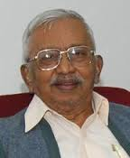
Head of Tax Reforms Committee
Often knowns as
Father of Tax Reforms
Raja J. Chelliah
(Raja Jesudoss Chelliah)
The Tax Reforms Committee headed by Dr. Raja J. Chelliah recognized the revenue potential of the service sector in India and recommended imposition of “Service Tax” on select services.

Slide 3
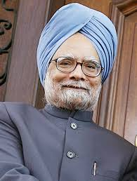
Based on these recommendations (Dr. Raja J. Chelliah), Dr. Manmohan Singh, the then Union Finance Minister, in his Budget Speech for the year 1994-95 introduced the new concept of Service tax and stated as under:
Formar Budget Speech
“There is no sound reason for exempting services from taxation, where goods are taxed and many countries treat goods and services a like for tax purposes. I, therefore, purpose to make a modest effort in this direction by imposing a tax on services of telephones, non-life insurance, and stock brokers”.
Dr. Manmohan Singh

Slide 4
SERVICE TAX
is a part of indirect Tax
Means Taxes on Services
ENTRY No. 97 of Union List
(Introduced through ENTRY No. 92 C of Union List but governed by ENTRY No. 97 i.e. residuary entry)

Slide 5
In the year 1994
(Service Tax @ 5% on these 3 Services)
Service TAX
Telephone
Service
Stock-exchange
Service
Non-Life Insurance
Service
Later On
119
Services are covered under Service TAX
(Selective approach)
w.e.f.
1.7.2012
All Services are Covered under Service TAX
(17 Services)
Except :
Mentioned in Negative list or
Specified in Mega exemption List
This is known as Comprehensive approach

Slide 6
Who administrate Service Tax?
Ministry of FINANCE
Department of Revenue
CBDT
CBEC
(Central Board
of Direct Tax)
(Central Board of Excise and Custom)

Slide 7
Applicability
Service tax Extends to WHOLE OF INDIA
Except
But including
Services Provided in
the territory of J & K.
Services Provided upto 200 nautical miles i.e. upto EEZ

Slide 8
Example :
H O
Service
Provided
Applicability
J & K
In DELHI
Yes
DELHI
J & K
No
U.K
INDIA
Yes
DELHI
U.K
No
CRUX :
Service Tax is Destination based tax.
जहाँ
Services finally Consumed
होती है

Slide 9
Base Line
12 N.M
TWI
--------------------------------------------------------------------------------------------------------------------------------------------------------------------------------------------------------------------------------------------------------------------------------------------------------------------------------------------------------------------------------------------------------------------------------------------------------------------------------------------------------------------------------------------------------------------------------------------------------------------------------------------------------------------------------------------------------------------------------------------------------------------------------------------------------------------------------------------------------------------------------------------------------------------------------------------------------------------------------------------------------------------------------------------------------------------------------------------------------------------------------------------------------------------------------------------------------------------------------------------------------------------------------
INDIA
High Seas
200 N.M
Exclusive Economic Zone
Continental Shelf
Significance of:
TWI - To determine import – export
EEZ - Exclusive Economic Zone

Slide 10
What is taxable territory
*
Land Part of India
(Excluding J&k)
*
TWI
(Continental Shelf, Air space etc)
*
EEZ

Slide 11
Chargeability (Sec.66-B of Finance Act, 1994)
Service Tax
Levied
@12%
except mentioned
in negative list
Collected
Quarterly
Monthly
On value of all services
in such manner as
may be prescribed
Whether
Provided
or
agreed to be Provided
(i.e. Advance Received against Services which are to be provided in future)
in the taxable territory
by one person to another person

Slide 12
Meaning of Agreed to be provided / Services to be provided in future
Mere verbal / written agreement
to provide service
will not attract
Service Tax
Receipt of Advance against those
services which are to be provided in future
will Levy attract
Service Tax
ICOS
Student
An educational institute
providing Coaching for CS students
Advance Paid to ICOS
Fees Rs.
20000
+
S.Tax
2472
22472

Slide 13
Meaning of Service
Service Means
Any activity carried out
by a Person
for another
(i.e. Self-Service
not taxable)
for consideration
(i.e. No Consideration
No Service TAX)
AND INCLUDES declared Services
(i.e. 9 Services)
But does not include
(a)
An Activity which Constitute
t|f of title in Good | Inmovable
Property
deemed
Sales
transaction in Money & Actionable Claim
(i.e. Sale|Gift etc)
(b)
Services by an Employee
(i.e. ER-Eyee Relationship)
(c)
Fees taken in any Court or tribunal

Slide 14
Meaning of Service
an act done or Agreeing
not to do an Act.
Any Activity
XXX
by one person for another person
for Consideration
Add :
Declared Services
[9 Services]
XXX
XXX
Less :
Exclusions
XXX
Taxable Services
XXX
Employee
ER
3 Exclusion
Deemed Sales
Fee taken by Court.

Slide 15
Activity
Do Something|Active
Not to do Something
i.e. Negative Act|Passive
Act.
Eg. Non-Competition
Contract
*
An act which are illegal or immoral
Example:
Prostitution,
gambling,
hiring Sharp-Shooter
Can not Serve as a consideration for enforceable contracts.

Slide 16
i.e. Self - Service
Not taxable
By one person to another person
i.e. there must be two parties
(1)
Incorporated
AOP|BOI
Distinct
Member
ST
(2)
Unincorporated
AOP|BOI
Distinct
Member
ST
(3)
T.T
H.O|Branch
SELF
T.T
H|B
ST
×
(i.e. Self-Service)
(4)
N.T.T
H.O|Branch
Distinct
T.T
H|B
ST
Distinct
(5)
C.G Govt
S.G
ST

Slide 17
Not defined in Finance Act, 1994
Consideration
As per Indian Contract Act, 1872
Consideration means & Something in return, i.e. quid pro - quo
Monetry
Non - monetry

Slide 18
Consideration
If does not exist
i.e. Service without consideration
Consideration exist i.e. Service with consideration
No service tax will Levy
Service tax will Levy.
In otherwords
No Service
No Service tax
Note:
Consideration is an important element for holding an activity as Service within the meaning of Sec. 65B (44)

Slide 19
Consideration
*
Should be exist|certain at the time of Provisions of Services
*
May be in monetry or non-monetry form
Monetry Consideration
Non-Monetry Consideration
Currency
Shares
Cheque
Debentures
D|D
Moveable|immoveable
Property
etc
Old currency which is
not in use i.e. 1 Anna

Slide 20
Consideration must arise out of
i.e. activity done at wish of other person
Contractual relationship and
must have reciprocity.
+
Consideration
Examples
1.
Awards
No Service Tax
2.
Pocket Money
No Service Tax
on a street
No Service Tax
3.
Artist Performing
on payment of amount of money
in club etc
Service Tax
4.
Gifts
No Service Tax
5.
Income Tax| Wealth Tax paid
No Service Tax

Slide 21
Court fee / Tribunal fee
Specific Exclusions
Not taxable
Fees Paid to
High Court / Supreme
Court
for Hearing
of Case
Not taxable
CCE
(Appeal)
for Hearing
of Case
Not taxable
ITAT | CESTAT
for Hearing
of Case
Not taxable
Arbitral Tribunal
for Hearing
of Case
TAXABLE
(Constituted by Parties for Settlement of Mutual disputes)
(Under Reverse Charge)
(However, in certain cases it is exempted in Mega Exemption List)

Slide 22
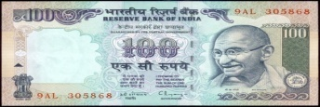
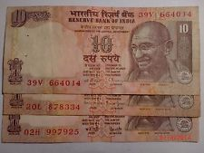
Transaction in Money or Actionable Claim
Exclusion from the definition of Service
Transaction in Money
Actionable Claim
Not defined
Claim to any unsecure dept.
However transaction in Money
Claim to any beneticial interest in any movable
Property
does not include
Activity relating to
use of Money
(i.e. Loan)
or
its conversion
$ Cash
Cash $
by cash or by any other Mode from one form, Currency or denomination
to another
form, Currency or denomination
for which a separate consideration is charged.
(liable to Service tax as it is a Part of does not included).

Slide 23
Example
Nature
Service Tax
(w|o int.)
Loan
Transaction in Money
Mr.X
Mr.Y
Not Levied
of Rs. 200000
Promise to Return
after 3 Month
(int. @ 16%)
ABC Bank
Loan
*
Loan Amount
Mr.Y
Not Levied
of Rs. 300000
+
Processing
fee
*
Interest
Not Levied
Rs. 30000
(because Mentioned in Negative List)
*
Processing fee
S. Tax Levied

Slide 24
Nature
Service Tax
Rs. 100 Note
Mr.X
Mr.Y
Transaction in Money as
there is
No Consideration
Not Levied
10 Note of Rs. 10
Rs. 100 Note
Mr.X
Mr.Y
Rs. 10 treated
as Commission
(Not a transaction in Money)
S. Tax Levied
9 Note of Rs. 10

Slide 25
Negative List

Slide 26
Levy
Collection
In negative List
×
×
Services
Not in negative List
but Provided in
(Must be an activity)
non-taxable territory
×
×
Not in negative List
Provided in TT
but Exempted by CG
×

Slide 27
Service Provided by Govt. / Local authority

Slide 28
Meaning of
Govt
Local Authority
Includes
Central Govt | State Govt
(i)
Panchyat
Except
(ii)
Municipality
(i)
Corporations formed under Central Act
(iii)
Municipal Committee
(ii)
Corporations formed under State Act
(iv)
Cantonment Board
(iii)
Govt. Company Registered under
Companies Act, 1956
(v)
Regional Council
(iv)
Institutions Set up by a Special Act.
(e.g. ICSI)
(vi)
Development Board

Slide 29
Govt
(C|G or S|G)
to Any Person
=
Not Liable to Service TAX
or
Services
Provided
Local Authority
(MCD, Municipality etc)
Except
i.e. Liable to Service Tax
Services Provided by Deptt. of Posts by way of
Services in relation to Aircraft or vessel
Services in relation to
Support Services provided by Govt./Local authority
Irrespective of the fact whether the Services are provided inside or outside the precincts of a port or an airport
Transport of Goods or Passengers.
Speed post
to any Business entity.
eg :
eg :
express parcel post
Indians
Railways
life insurance and
(i)
Manpower Security Services
:
State transport corporations
agency Services
eg :
Repair &
Maintenance Services
(ii)
Renting of immovable property etc
to a person Other than
Govt
:
Parking Services etc

Slide 30
Services Provided by Deptt. of Posts by way of
Note :
Speed post, Express parcel post etc
Services if Given to Non-Govt
then it is Liable to Service TAX.
However
other mail Services eg. Post card, Inland Letter, Money order etc.
are not liable to Service TAX whether Provided to Govt or to the non-Govt.

Slide 31
Exp :
1
Support Services
Govt. Security Services
(i.e. Support Services)
is taken by
Mr. Ratan TATA
Mr. Arvind Kejriwal
(Business entity)
(Non - Business entity)
Liable to
Service TAX
Not Liable to Service TAX

Slide 32
Service provided by the Reserve Bank of India

Slide 33
(Services Provided
To RBI )
(Services Provided by RBI)
RBI
Reserve Bank of INDIA
Any
Person
to Any
Person
Services
Provided
Services
Provided
Liable to Service TAX
Not Liable to Service TAX
Eg:
Technical Consultancy
Eg:
Manage Public Debts
Legal Services etc
Service of Agent etc

Slide 34
Service provided by Foreign Diplomatic Mission

Slide 35
(Services Provided
to Foreign Diplomatic
Mission )
(Services Provided by
Foreign Diplomatic
Mission)
FOREIGN DIPLOMATIC MISSION
Any
Person
to Any
Person
Services
Provided
Services
Provided
Liable to Service TAX
Not Liable to Service TAX
However it is exempt under (NN : 27 / 2012)
However :
Services Provided by UN | International Organisation | WHO
are not Covered under Negative list & therefore liable to Service TAX.

Slide 36
(Services Provided
to International Organization)
(Services Provided
by International Organization)
United Nation Organization
(International Organization)
Any
Person
to Any
Person
Services
Provided
Services
Provided
Liable to Service TAX
Liable to Service Tax
(as it is not Covered Under Negative List)
(as it is not Covered Under Service Tax)
However such services exempted [E|N: 25/2012]

Slide 37
Services Relating to Agriculture

Slide 38
Service Relating to Agriculture | Agriculture Produce
Food
+
Non - Food
+
Animal Produce
Cultivation
Animal Raising except Rearing of Horse
Raw Agriculture Produce
Processed agricultural produce if it does not alter its characterstics but makes it marketable for Primary Market
Eg. Cleaning of wheat
Potato chips or tomato ketchup
Not quality as agricultural produce
Rice is not agriculture produce.

Slide 39
Service Provided by Agricultural Produce Marketing Committee or Boards
Covered Under Negative List
Not Liable to Service Tax
Such Committee or Board Setup
Under State law
For the purpose of Regulating
Marketing of Agricultural Produce.
by way of
Providing
Support Services

Slide 40
Services related to
Agriculture or
Agricultural produce by way of
Agricultural Operations
Supply of Farm Labour
Any process carried out at an agricultural farm
including tending, pruning, cutting, harvesting, drying, cleaning etc
Which do not alter the essential characterstics of agricultural produce but make it only marketable for the primary market
Renting of Leasing of
agromachinery
vacant land
Loading|Unloading, Packing, storage or w|h of agricultural produce
Agricultural extension Services
Services by any Agricultural Produce Marketing Committee or Board or services provided by a commission agent for sale or purchase of agricultural produce.

Slide 41
ANALYSIS
Services Relating to -
Agriculture / Agriculture Produce
खेती
फसल
“Agriculture Produce” Includes:-
All Cereals, Pulses, fruits, Nuts & Vegetables, Spices, Copra, Cotton, Unmanufactured, Leaves, Coffee, Tea, Rubber etc.
But does Not Includes:
Sugar, edible oil, processed foods,
processed Tobacco.
Chips
चैनी

Slide 42
Trading of Goods

Slide 43
All Kinds of Movable Property
(including securities)
Other than
Trading of Goods
Actionable Claim & Money
Buying|Selling
liable to VAT|CST
i.e. Not Liable to Service TAX

Slide 44
Trader
Sale
Like
Commission
Agent
Auxiliary
Services
GTA Services
liable to Service Tax

Slide 45
What is Not trading of Goods
Taxable Services provided in relation to trading of Goods
eg. Services of Commission Agent etc
Example
Commission Agent
Not become owner
of Goodsv
Liable to
S.Tax
Imp. to Note:
Sale|Purchase of Goods
Matter of State List

Slide 46
Any process amounting to manufacture or
production of goods

Slide 47
Any Process Amounting to
Manufacture|Production
of Goods
Covered
under
Negative List
Not Liable
to Service TAX
Amounts to Manufacture
Liable
to Excise
Duty
Not Liable
to Service TAX
PROCESS
Does not amount to Manufacture
Not Liable
to Excise
Duty
Liable to Service TAX
(unless other
wise mentioned in negative list)

Slide 48
Selling of space or time slots for advertisements other than advertisements broadcast by radio or television

Slide 49
TAXABILITY
Services COVERED
IN NEGATIVE LIST
Services Not Covered
In negative list

Slide 50
Sale of space for advertisement in print media ONLY | Sale of space or time slots for advertisement to be broadcast on radio/television etc
Advertisemnt on books pamphlets newspaper are not taxable However Advertisement on business directories yellow pages trade catalogues which are primarily meant for commercial purpose …..are taxable | Sale of space for advertisement in :- Bill boards Film screen in theaters Internet websites Online and mobile advertisement Public places(metro) Buildings(metro piller) Conveyances(auto) A.T.M. Internets Aerial Advertising Canvassing i.e Booking Ad for Adv. Agencies
…………….. | Service Relating to preparation /making Advertisment/i.e. Auxilary Services.

Slide 51
Services provided by way of access to a road or a bridge on payment of toll charges

Slide 52
Services by way of
access to a road (NH|SH)
or bridge
on payment of toll charges
Covered Under Negative List & therefore Not liable to S.Tax
However, Services provided by
Collection Agency on Commission basis
Liable to Service Tax
Note:-
It is a matter of State list

Slide 53
Betting, gambling or lottery

Slide 54
Betting, gambling or Lottery
Covered Under Negative List &
therefore Not liable to Service Tax
However
Auxiliary Services that are used for organizing or promoting betting or gambling events are liable to Service tax
Note:-
It is a matter of State List
Example:-
Services of Lottery agent will attract Service Tax

Slide 55
Admission to entertainment events or access to amusement facilities

Slide 56
Entertinment Events
(Movie tickets/Music events/drama etc)
Admission to
Or
Entry Fee
access to amusenment facilities
(Fun or recreation is provided -
Rides, gaming, bowling, amusement parks, water parks etc)
AND|INCLUDING
Cultural Programmes, drama or ballet in open garden, stand alone Ride in a Mall.
But Does not include
Membership of a club
Event manager organizing an entertainment event i.e. Auxiliary Services

Slide 57
Transmission or distribution of electricity by an electricity transmission or distribution utility

Slide 58
Services by way of
Transmission
distribution of electricity
By
an electricity transmission or
distribution utility.
Covered Under Negative List &
therefore Not liable to Service Tax
Except
i.e. Liable to Service TAX
Services provided by way of installation of
Genset – by private contractors for distribution of electricity.

Slide 59
Specified Services Relating to Education

Slide 60
Service by way of
Pre-School Education (Play way)
Education as a part of curriculum
Education as a part of an approved
vocational education course
and
for obtaining a
Education up to Higher Secondary School or equivalent i.e. upto +2
qualification recognised by any law
eg:
Diploma
From Annamali university.
(i.e. Indian Law)
in Finance & Taxation
for the time being in force
Covered under Negative List
& therefore Not liable to S.Tax.
(whether Regd. or not)
Eg:
ICMAI established under separate Act
Covered under Negative List
& therefore not liable to S.Tax.
University, Colleges recognised.
Covered under Negative List& therefore
not liable to S.Tax.
Eg. Graduation, Post graduation, Professional Course (CA, CS, CMA)
are covered under Negative List & therefore not Liable to Service tax

Slide 61
OMS Academy private coaching center Providing Coaching Services
Liable to Service TAX.
Private tuitions
(Girls|boys teaching at home)
Liable to Service TAX.

Slide 62
Providing Education
Services
No Service Tax at all
Covered under Negative list
ICMAI
Renting of Auditorium
Liable to S.Tax
taking Services of
Renting of immovable Property
No Service TAX
Exemption List
(Mega Exemption list)

Slide 63
Vocational Education Courses
*
The course run by Industrial Traning institute (I.T.I) or Industrial Training Center affiliated to NCVT
(National Council of Vocational Training.)
*
Approved Modular Employee Skill Courses (MES) Approved by NCVT.
eg. Banking & Accounts, Chemical, electrical electronics, fashion Design, printing, Automotive Repair, Mechanic, Plumber etc.
*
A course run by an Institute Affiliated to the N.S.D.C (National Skill)
*
However other vocational courses like Air Hostess/ Acting/ Dancing are still taxable
Service Tax Leviable

Slide 64
Particular
Service Tax
Q:-1.
What about Computer Course run by NIIT etc.
×
Q:-2.
What about service provided by Boarding School.
×
Q:-3.
What about IIT, IIM, ICAI etc.
×
Q:-4.
What about private Tuitions.
Q:-5
What about placement service provided by IIM, ICAI etc.
Q:-6
Whether service of conducting Admission Test for Admission to college liable to S.T?
×

Slide 65
Services by way of renting of residential dwelling for use as residence

Slide 66
Service by way of
Renting of Residential Dwelling for use as Residence
Renting of Residential Dwelling
Covered under Negative List
& therefore not liable to
Service Tax.
For Residential use
Except
Renting of
Hotel
Motel
Inn
Not Covered under Negative List
Guest house
Lodge
Liable to Service tax
House boat or
like places meant for temporary Stay

Slide 67
Q:-
Service Tax
1.
Residential House but for commercial use like 3|10 East Patel Nagar for commercial Coaching Center
2.
Hotel|Motel
Rent out
3.
Govt provide accommodation to its employees
& their family
×
4.
Furnished flat given on Rents
×
House Boat
In Kashmir
GOA
×

Slide 68
Certain services provided by financial sector

Slide 69
Service by way of
Extending deposit|Loan|Advances
Foreign exchange transactions
in so far as
Consideration is represented by way of
Bank
Bank
Dealer
Dealer
Interest|discount
Bank
Dealer
No Service TAX
Dealer
Bank

Slide 70
Loan processing fee|charges
Liable to Service TAX
(Say .5%/ 1% etc)
Discount Received by Bank or Discounting bill of Exchange
=
No Service TAX
Bank
General Public
Dealer in
Foreign
Currency
=
Liable to Service TAX
General
Public
Bank

Slide 71
Services relating to transportation of passengers

Slide 72
Services of
transportation of Passengers
with or without accompanied belongings by -
(i)
A stage Carriage
(ii)
Railway in a class other than
First class or
Liable to
Service TAX
An air-conditioned coach
(iii)
Metro, Monorail or tramway
Liable to Service TAX
(iv)
Inland Waterways
(v)
Public transport, other than predominantly for tourism purpose, in a vessel, between places located in India and
(vi)
Metered Cabs(other than radio taxis) or auto-rickshaws

Slide 73
Contract Carriage
ROHINI
Shivaji Stadium
(Non-Stop)
Direct Service
Not Covered in negative list
i.e. Liable to S.Tax
However it is exempt under Mega Exemption List.
Inland Waterways
National water ways
eg. A river, Canal, Channel used as a means of travel or
transport.

Slide 74
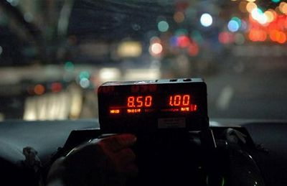
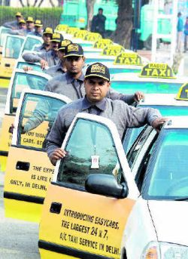
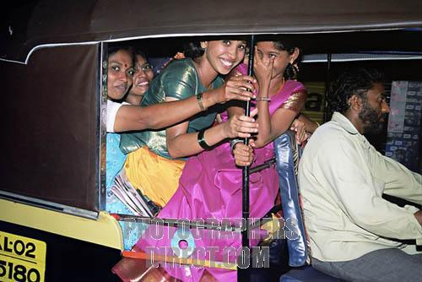
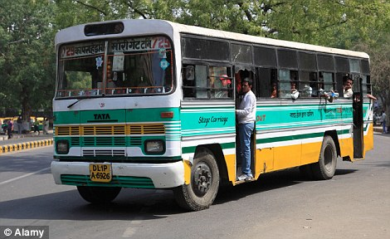
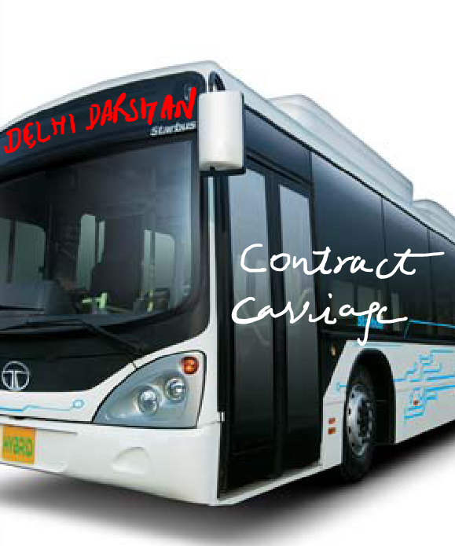
Metered Cabs
Radio Taxes
Auto Rickshaw
No Service Tax
No Service Tax
Service Tax
Stage Carriage
Contract Carriage
No Service Tax
Service Tax

Slide 75
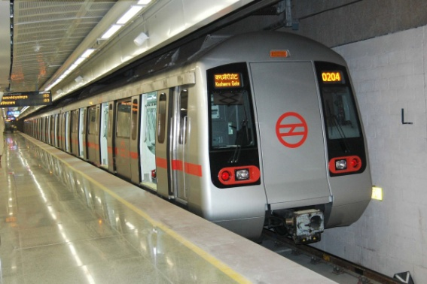
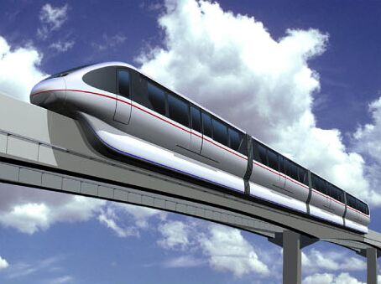
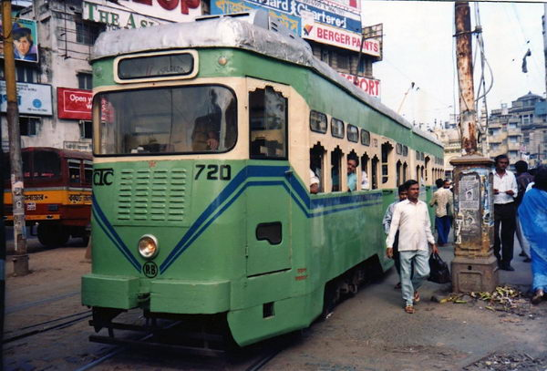
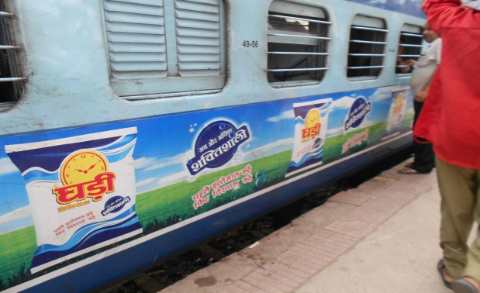
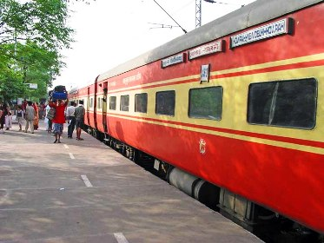

Metro
Monorail
Tramway
No Service Tax
No Service Tax
No Service Tax
Non AC Coach
AC Coach
Air Route
No Service Tax
Service Tax
Service Tax

Slide 76
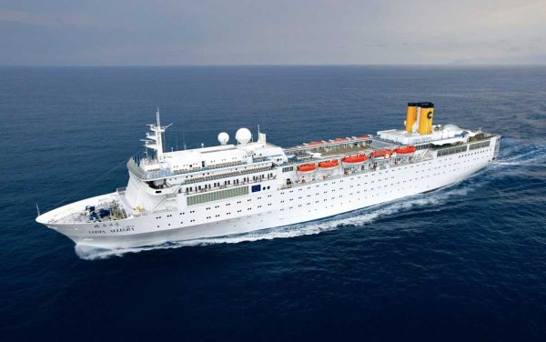
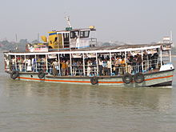
Crusie Ship
Inland Waterways/PublicTransport
Service Tax
No Service Tax

Slide 77
Services provided by way of transportation of goods

Slide 78
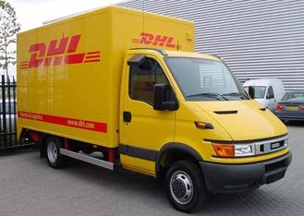
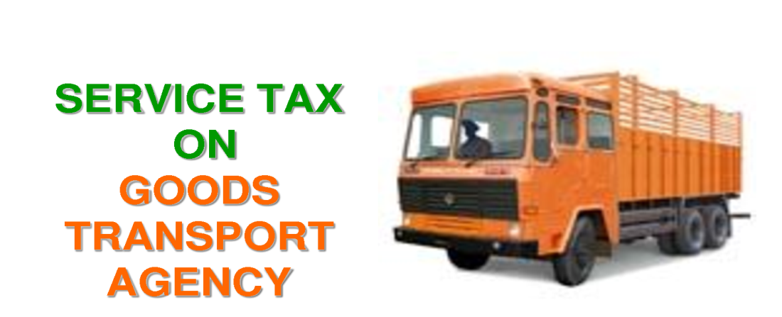
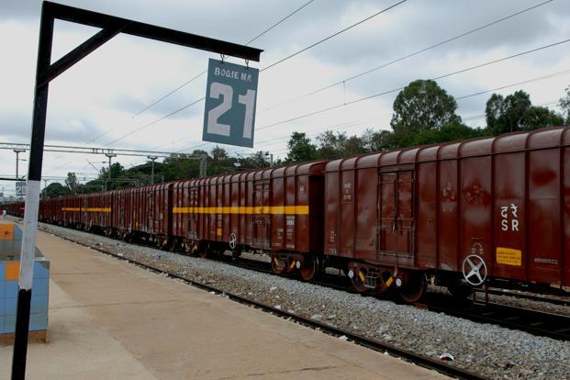
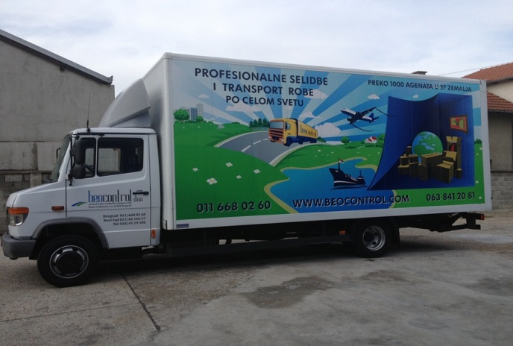
Courier/ अन्गाडिया
GTA
Service Tax
Service Tax
मालगाड़ी
By Road other than GTA
Service Tax
No Service Tax

Slide 79
Funeral, burial, crematiorium or mortury services
including transportation of the deceased

Slide 80
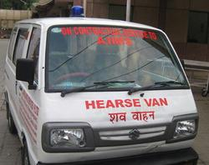
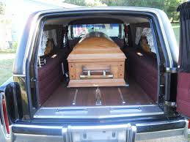
Funeral, burial, crematorium or mortuary services including the transporation of deceased.
शमशान घाट की Services
Services of transporation of deceased
Cover under the negative list
Not liable to Service Tax

