Slide 1
PORTFOLIO
The old age wisdom about not putting “all your eggs in one basket” applies very much in the case of portfolios
A portfolio is a combination of multiple securities.
Decisions to invest wealth in assets or securities under risk
Extend the portfolio theory to derive a framework for valuing risky assets.
Portfolio Approaches
Traditional
Modern

Slide 2

Portfolio Investment Avenues
Gold
Silver
Real Estate
Shares
Bonds
Mutual Funds
Debentures
PF
Indira Vikas Patra
Post Office Deposits
Bank Deposits
NSC

Slide 3
Portfolio Return: Traditional Approach
Analysis of constraints
(needs, liquidity, safety of principal,
time horizon, tax consideration and temperament)
Determination of objectives
(current income, income growth,
capital appreciation and preservation of capital)
Selection of portfolio
Bond & Common stock
Bond
Common stock
Assessment of Risk & Return
Diversification

Slide 4
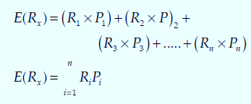
Modern approach
Morkowitz model is
Analysis of risk and return
Inter-relationships through the statistical analysis for measuring risk
We can use the following equation to calculate the expected rate of return of individual asset
We can use the following equation to calculate the expected rate of return of individual asset:

Slide 5
Expected Rate of Return: Example
Suppose you have an opportunity of investing your wealth either in asset X or asset Y. The possible outcomes of two assets in different states of economy are as follows:

Slide 6
Security Variance

Slide 7
Markowitz Portfolio Theory

Slide 8
Markowitz Portfolio Theory
Measure of Return – Probability Distribution and its Weighted Average Mean.
Measure Risk – Standard Deviation (Variability) of Expected Return of a Portfolio?
Investors do not like risk and like return.
Nonsatiation – always prefer higher levels of terminal wealth to lower levels of terminal wealth.
Risk Aversion – investor choose the portfolio with smaller S.D. ( not like Fair Gamble).
Investors get positive utility with return as they help them in maximising wealth and vice-versa with Risk.

Slide 9
Measuring Portfolio Risk & Return

Slide 10
Portfolio Risk:
Risk of individual assets is measured by their variance or standard deviation.
We can use variance or standard deviation to measure the risk of the portfolio of assets as well.
The risk of portfolio would be less than the risk of individual securities, and that the risk of a security should be judged by its contribution to the portfolio risk.

Slide 11
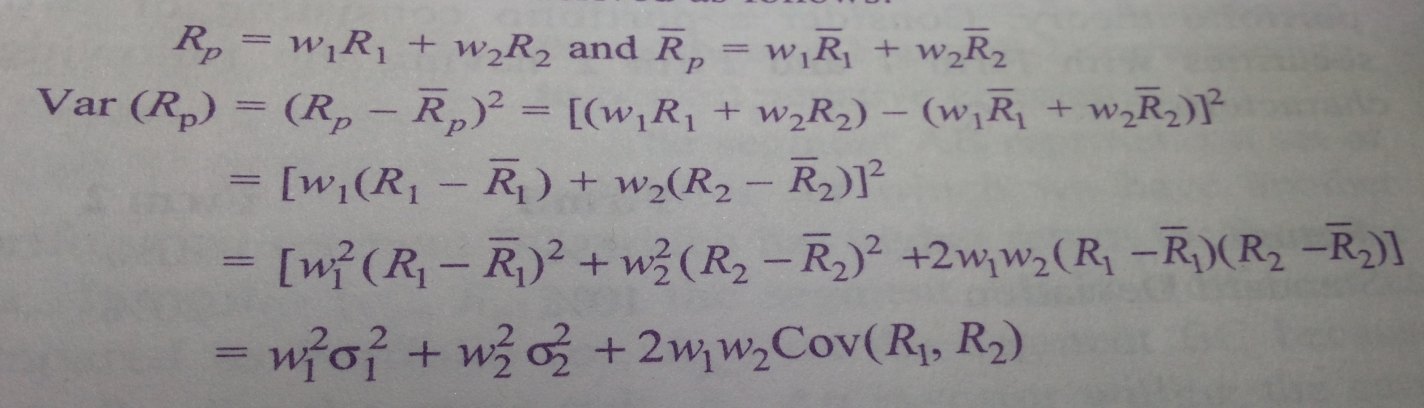
Measuring Portfolio Risk
Risk is not a simple weighted average of risk with securities like we did in measuring Expected Return………..we need to know following things to measure risk of a Portfolio.
Covariance between two securities
Correlation Coefficient between two securities
Variance of securities,Standard Deviation of Securities

Slide 12
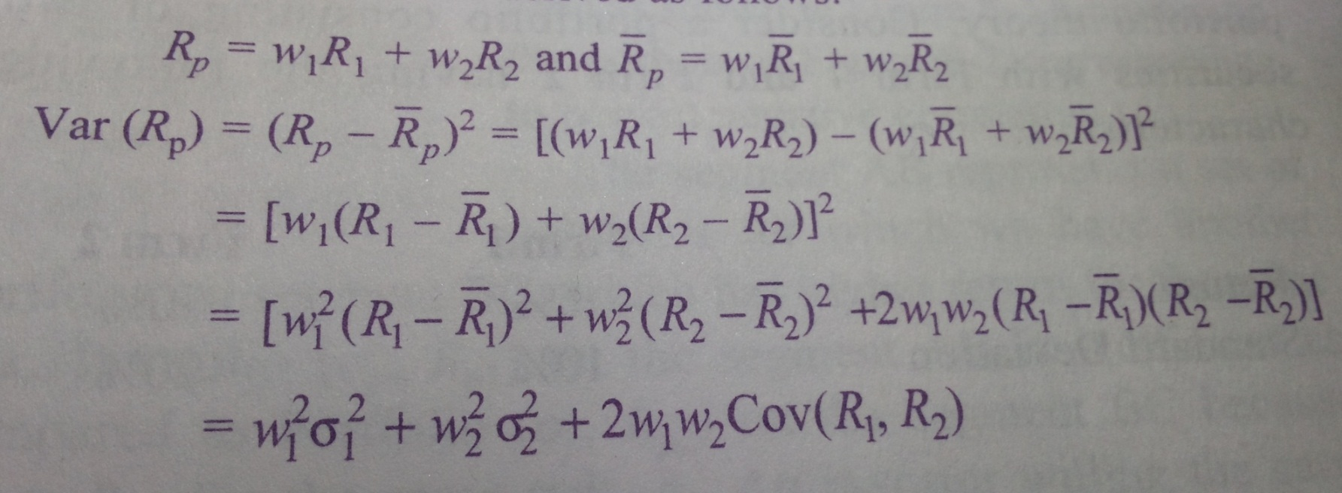
Markowitz Portfolio Risk

Slide 13
Measuring Portfolio Risk for Two Assets
The portfolio variance or standard deviation depends on the co-movement of returns on two assets.
Covariance of returns on two assets measures their co-movement.
Correlation is the measure of the linear relationship between two variables (say, returns of two securities, X and Y in our case)
Covariance XY
= Standard deviation X * Standard deviation Y * Correlation XY

Slide 14
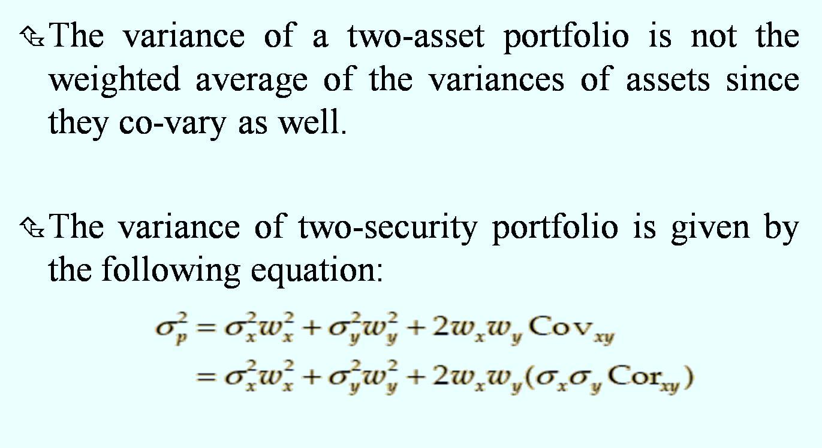
Variance and Standard Deviation of Two-Asset Portfolio

Slide 15
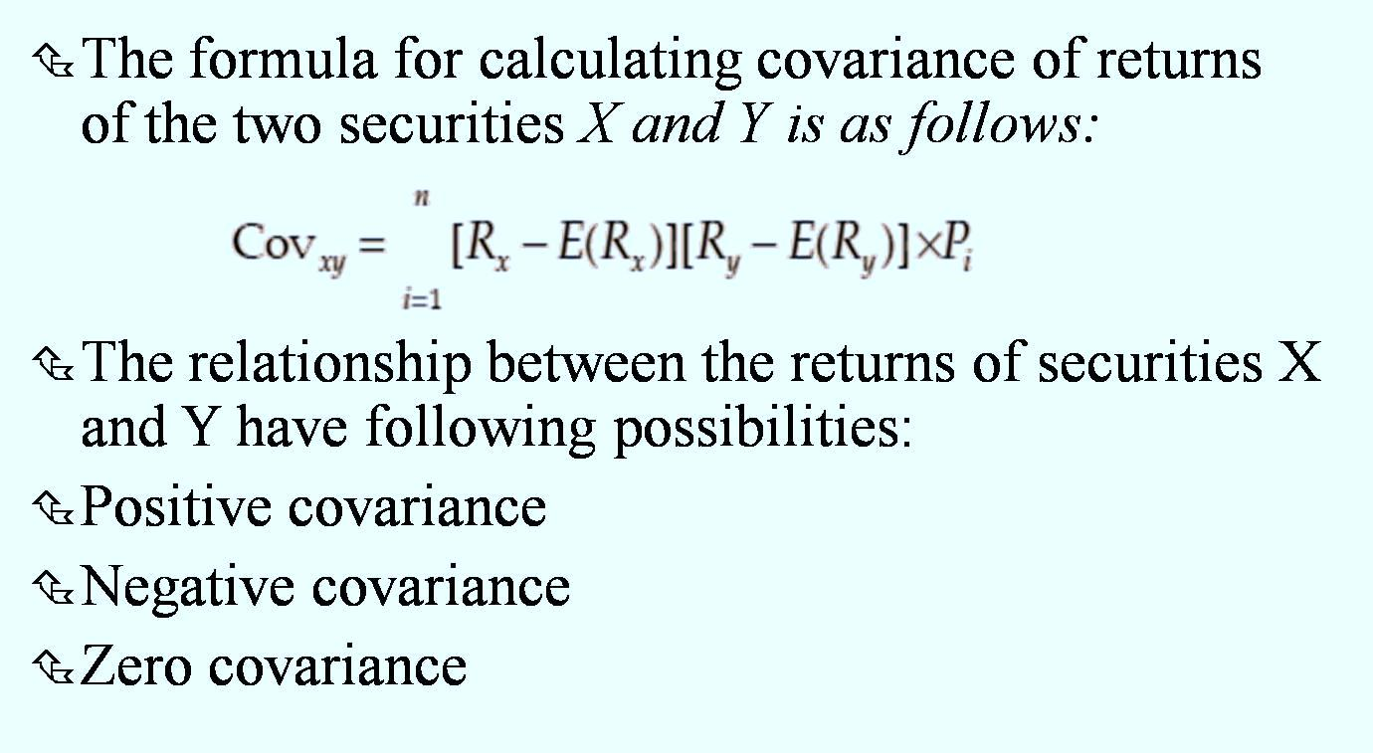
Measuring Portfolio Risk for Two Assets Covariance XY = Standard deviation X * Standard deviation Y * Correlation XY

Slide 16
covariance
Securities X and Y are negatively correlated. The correlation coefficient of – 0.746 indicates a high negative relationship.

Slide 17
Correlation
The value of correlation, called the correlation coefficient, could be positive, negative or zero.
The correlation coefficient always ranges between –1.0 and +1.0.
A correlation coefficient of +1.0 implies a perfectly positive correlation while a correlation coefficient of –1.0 indicates a perfectly negative correlation.

Slide 18
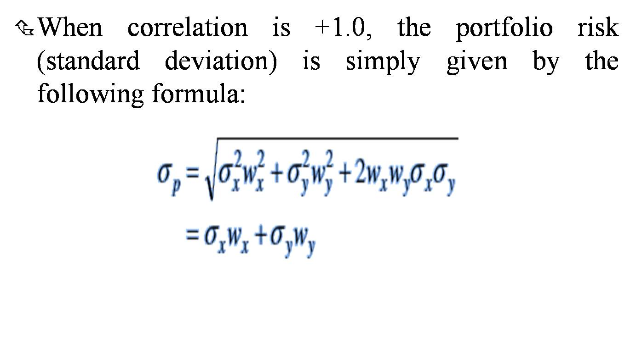
Perfect Positive Correlation

Slide 19
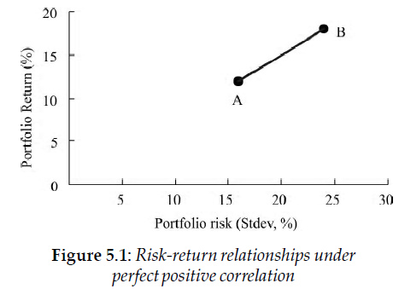
There is no advantage of diversification when the returns of securities have perfect positive correlation.

Slide 20
Perfect Negative Correlation
In this the portfolio return increases and the portfolio risk declines.
It results in risk-less portfolio.
The correlation is -1.0.

Slide 21
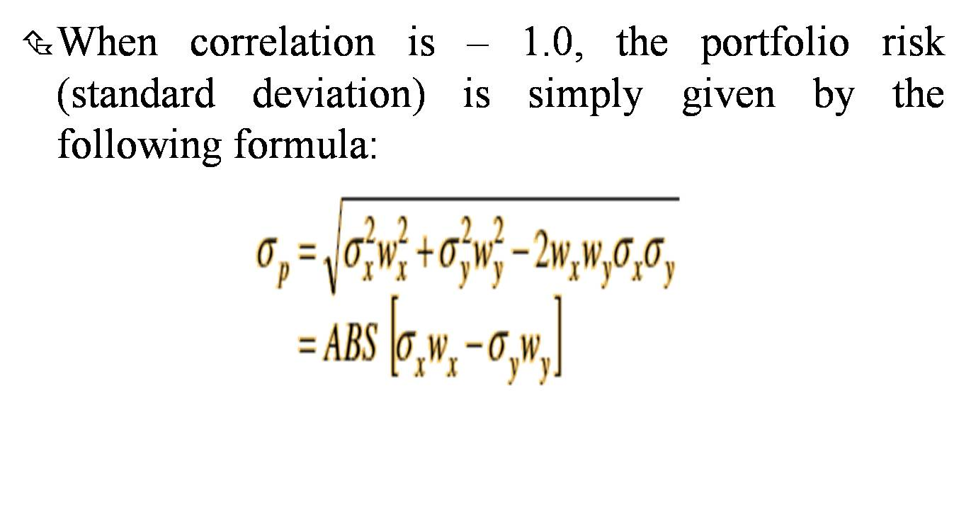
Perfect Negative Correlation

Slide 22
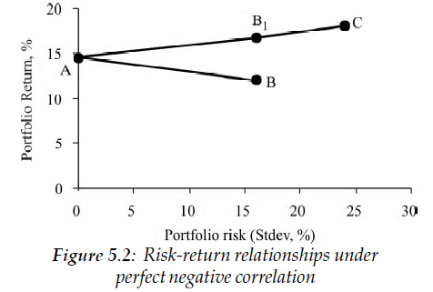

Slide 23
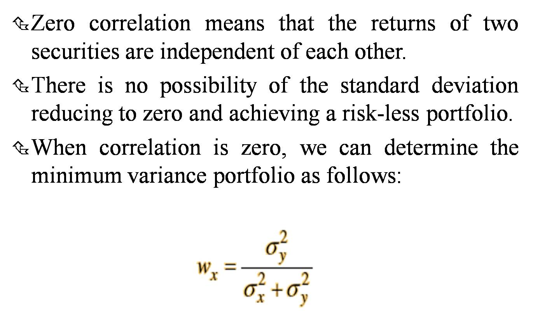
Zero Correlation

Slide 24
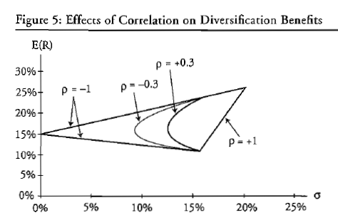

Slide 25
Efficient Frontier

Slide 26
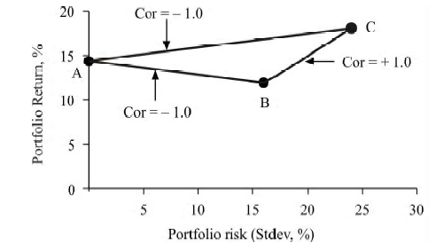
Limits to diversification

Slide 27
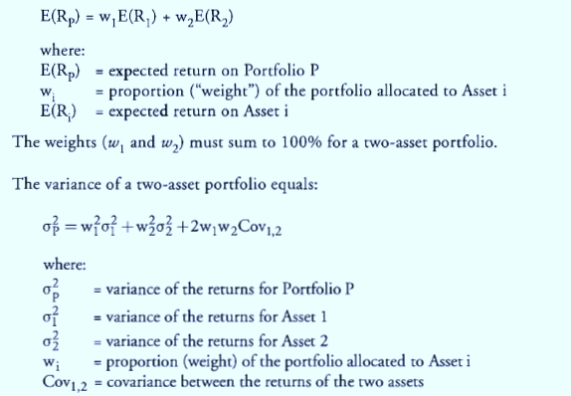
Portfolio Return: Modern approach

Slide 28
Portfolio Return: Modern approach

Slide 29
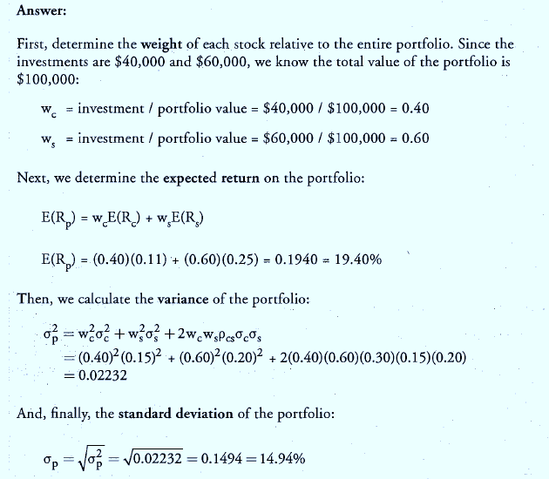
Portfolio Return: Modern approach

Slide 30
Markowitz Portfolio Theory – Efficient Frontier

Slide 31
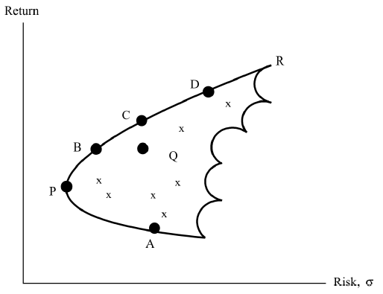
Efficient Portfolios of risky securities (Inefficient portfolios- have lower return and higher risk)
An efficient portfolio is one that has the highest expected returns for a given level of risk. The efficient frontier is the frontier formed by the set of efficient portfolios. All other portfolios, which lie outside the efficient frontier, are inefficient portfolios.

Slide 32
Expected Return for Portfolios
Portfolios | Proportion in X | Proportion in Y | Return
A | 1 | 0 | 5.00%
B | 0.8 | 0.2 | 7.00%
C | 0.75 | 0.25 | 7.50%
D | 0.5 | 0.5 | 10.00%
E | 0.25 | 0.75 | 12.50%
F | 0.2 | 0.8 | 13.00%
G | 0 | 1 | 15.00%

Slide 33
Feasible Sets of Portfolios

Slide 34
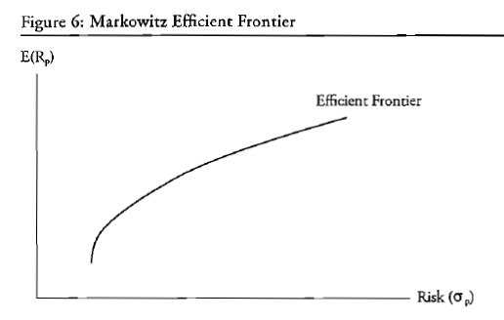

Slide 35
Eliminating Inferior Portfolios
Two Conditions
Offer Maximum Return for varying levels of Risk, and
Offer Minimum Risk for varying levels of expected return
All the feasible sets are not efficient unless it passes through this test

Slide 36
Efficient Sets of Portfolios

Slide 37
Utility
An economic term referring to the total satisfaction received from consuming a good or service
Risk Aversion
Risk Neutral
Risk Seeker

Slide 38
Utility Utility increases with increasing returns & decreases with increasing risk. Curve will be positively sloped if investor want more return for increased risk.
Utility
U₂
U₁
Wealth

Slide 39
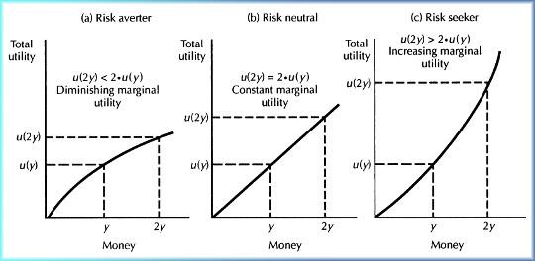
Utility Curve

Slide 40
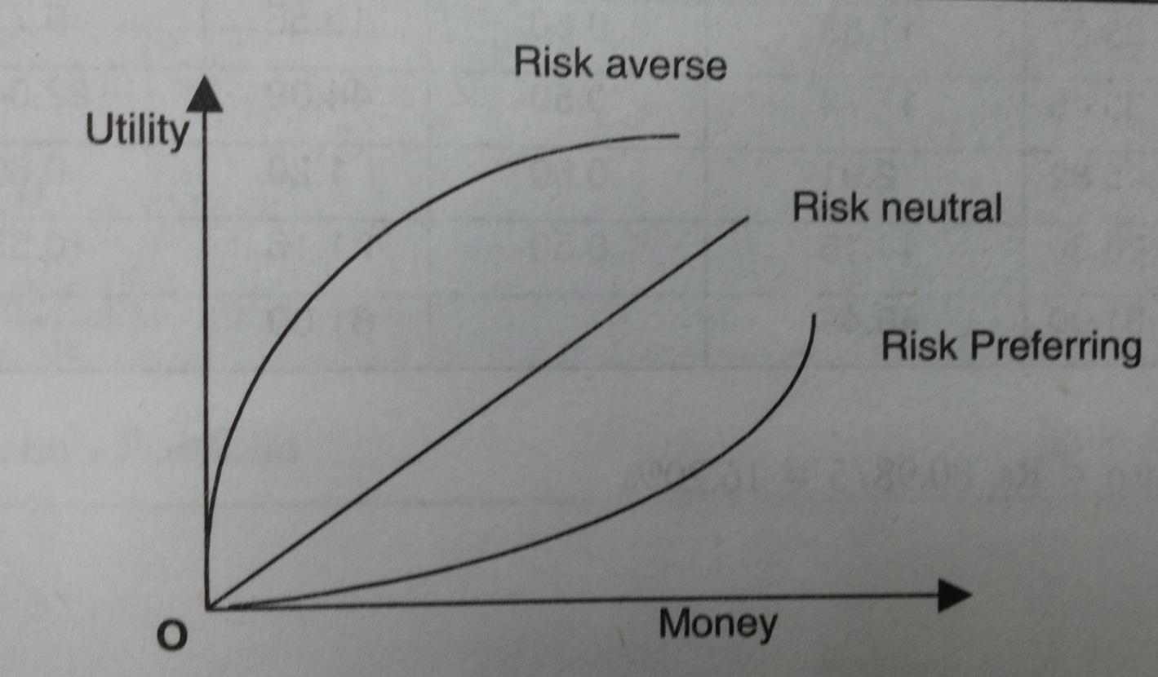
Utility Graph

Slide 41
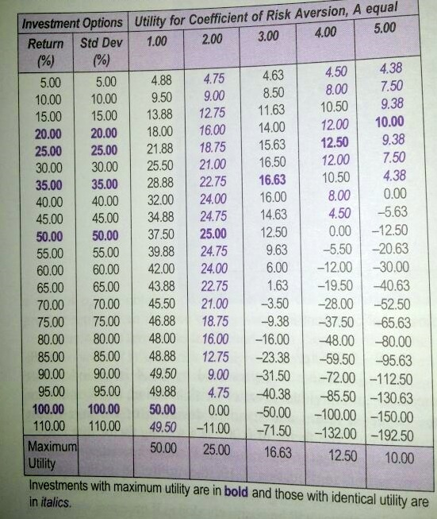
Investment Selection by Investors with Different Risk Aversion
Risk Aversion (A) 1 means risk seeker where as (A=5) means Risk Averse

Slide 42
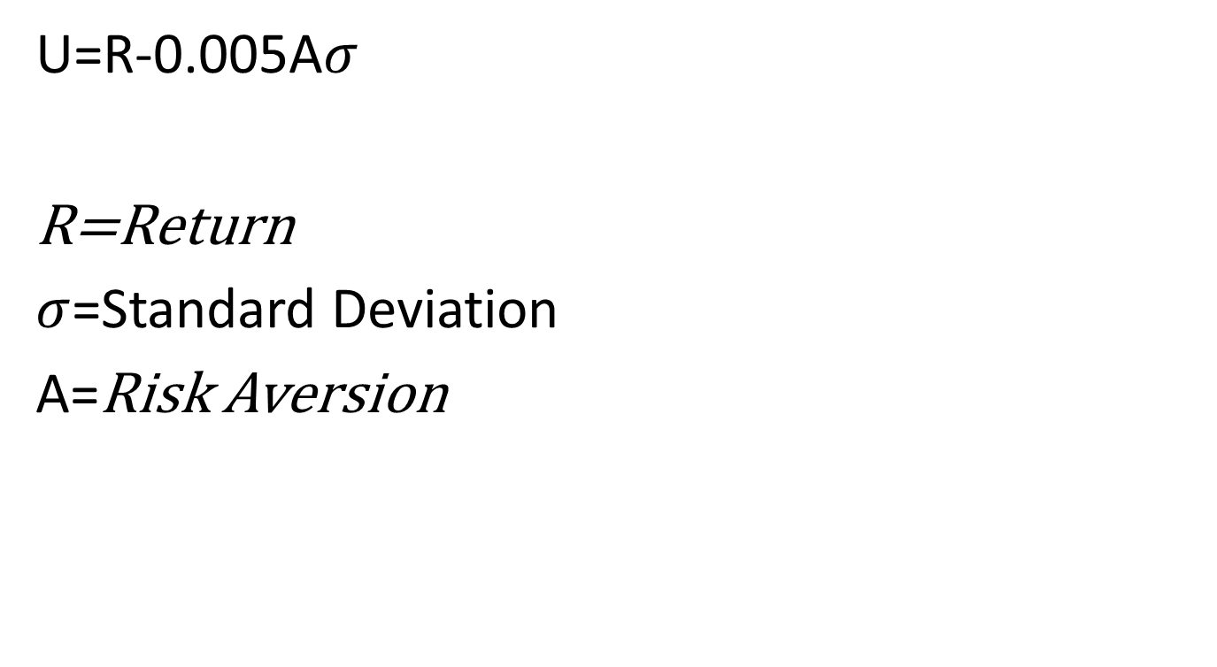
Utility Formula

Slide 43
Risk Tolerance Questionnaire
1. Your age is:
Under 30
30-40
41-50
51-60
60 or over
2. You have saved a long while to buy a car. A week before you buy the car, you lose your job. You.
postpone your purchase.
buy a new car but do not buy the expensive car you have saved for.
go ahead with your purchase plan and buy the expensive new car.
buy the car and go on a one week vacation to celebrate the new purchase.
3. Your current annual take-home income is:
under Rs100,000.
between Rs100,000 and Rs200,000.
between Rs200,000 and Rs400,000.
over Rs400,000.
4. You are financially responsible for (exclude dependants who can be supported by your spouse's income)
only yourself.
1 other person in your household besides yourself
between 2 and 3 other persons besides youself
between 4 and 5 other persons besides youself
more than 5 other persons besides yourself

Slide 44
Cont.
5. Your current job/career/business:
Is not dependable.
Is secure.
doesn't matter because you expect a large inheritance/have enough wealth already.
doesn't matter because you expect to change your career path soon.
6. After you have made an investment, your feeling on the decision is:
excited.
satisfied.
doubtful.
sorry.
You are offered a job by a company with a bright future. Which compensation option would you choose?
A 3-year job guarantee.
An upfront bonus of Rs1,00,000.
A 10% pay increase on your salary of Rs4,00,000.
employee stock options with a current value of Rs1,00,000 & prospects for further appreciation.
8. What is your practice on saving money
I don't believe in saving.
I'd like to save, but my expenses and other financial commitments do not permit me to.
I try to save whenever and wherever possible.
I save 15 percent or more of my take-home salary without exception.

Slide 45
Cont.
9. You invest Rs1,00,000 in a share that goes down by 8% the next day. You.
average your cost by investing another Rs1,00,000 at a lower price.
do not bother because you had done enough research on the company.
book your loss and invest in fixed deposits or bonds.
hold on till the share comes back to your cost price and sell it.
10. Which of the following statements would best describe your level of knowledge as an investor
I don't understand investment terminology at all.
I am a proficient investor who's able to explain concepts such as EVA, beta and hedging.
I know how to identify and invest in mutual funds and secondary market debentures.
I understand investment principles and trade shares in the secondary market.
I am not very familiar with investment options and financial planning.
11. How would you `honestly' describe yourself as a risk-taker?
reckless
willing to take evaluated risks.
careful.
low risk taking capability.
extremely averse to risk.

Slide 46
Cont.
12. Which would best describe your awareness about finance?
I read most of the business and investment magazines and watch business updates on television daily.
I read a financial newspaper daily and regularly read at least one specialized business magazine.
I read the finance section of the daily newspaper everyday.
I often look up the market prices of my shares in the newspaper.
I never read the finance section of the newspaper.
13. In how many years from now will you have saved up for all your future financial commitments and needs?
less than 3 years.
3 to 6 years.
6 to 10 years.
more than 10 years.
14. What is your approach to making a financial decision?
take a random decision.
lose sleep over the issue
seek friendly advice.
take an educated guess.
analyse the various options.

Slide 47
Cont.
15. When you suffer a financial loss, what are your feelings?
I think it has happened because it was my destiny.
I blame myself.
I take it as a personal failure.
I view it as a hurdle that one needs to cross.
I almost never suffer losses, because I stick to investments that do not depreciate in principal value.
16. Your company has an attractive Voluntary Retirement Scheme(VRS) open only to 10% of employees on a first-come-first-serve basis. You:
enrol for the scheme as early as possible.
enrol for it only if you had been looking for alternate opportunities and could take one of them.
do not take up the VRS, but start looking for other work as the company's future does not seem bright.
do not take the VRS because you intend to spend the rest of your working life in this company.
17. You have invested in shares that you expect will become 5-baggers in 2-3 years. These share prices drop 30% soon after you buy them. You:
sell.
average your cost by buying more.
wait and watch.
see your cash flow at the end of the year and buy more if the prices of these shares are still low.

Slide 48
Cont.
18. Excluding your house, your savings inclusive of employment benefits, add up to:
nothing.
less than six months' take home pay.
between 6-15 months' take home pay.
between 15-36 months' take home pay.
more than 36 months' take home pay.
19. What is the status of your accomodation? Those who own a house, choose from last two options only.
I stay with my parents/ spouse.
I live in company accomodation.
I live in an apartment that I have rented.
I own a house but am saving to buy a better house.
I own as good a house that I would ever want to.
20. How would you describe your overall income status?
Just about manage to make ends meet; no monthly savings.
My PF and other employment benefits are my only source of savings.
I put aside atleast 10% of my take-home salary every month in savings.
I save more than 30% of my take-home salary every month.
My income from my wealth more than adequately provides for my cost of living.

Slide 49
Indifference Curve -A diagram depicting equal levels of utility (satisfaction) for a consumer faced with various combinations of goods.
Expected
Return of
Portfolio
S.D. of
Portfolio

Slide 50
Rules of Indifference Curve
All the portfolios on a given indifference curve provide same level of utility.
They Never Intersect Each Other otherwise they will violate law of transitivity.
An investor has an infinite number Indifference Curves.
A risk-averse investor will find any portfolio that is lying on an indifference curve that is “farther north-west” to be more desirable than any portfolio lying on an indifference curve that is “not as far northwest”.

Slide 51
Indifference Curve
Every investor has an indifference map representing his/her preferences for expected returns and standard deviations.
An investor should determine the expected return and standard deviation for each potential portfolio.
The two assumptions of Nonsatiation and risk aversion cause indifference curves to be positively sloped and convex.
The degree of risk aversion will decide the extent of positiveness in slope of indifference curves.
More Flat is the indifference curves of an individual – higher risk aversion and vice-versa.

Slide 52
Risk Averse - Taker
Expected
Return of
Portfolio
Risk Averse
Risk Taker
S.D. of
Portfolio

Slide 53
Efficient Sets and Feasible Sets
B
D
Feasible Sets
C
A

Slide 54
Efficient Sets and Feasible Sets
IC 3
B
D
IC 2
Feasible Sets
C
IC 1
A

Slide 55
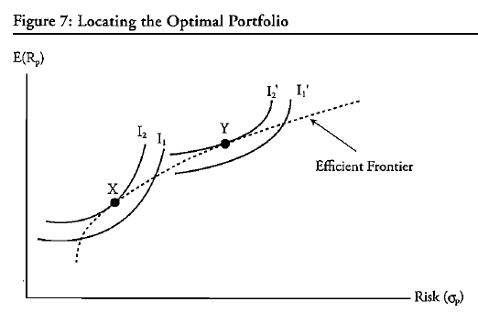

Slide 56
How a Portfolio can be optimized using Markowitz Portfolio Theory

Slide 57
Linear Efficient Frontier
Indifference
Curve
Return
Linear Efficient
Curve
M
Risky Securities
Efficient Curve
Risk
Free Rate
Risk

Slide 58
PORTFOLIO RISK: THE n-ASSET CASE
The calculation of risk becomes quite involved when a large number of assets or securities are combined to form a portfolio.

Slide 59
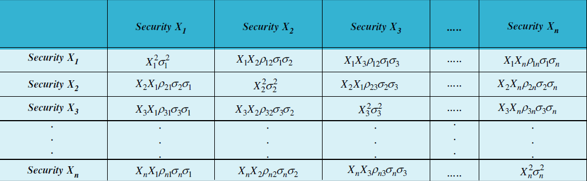
N-Asset Portfolio Risk Matrix

Slide 60
Capital Market Theory - Assumptions
Markowitz investors
Unlimited risk free lending and borrowing
Homogenous expectations
One – period horizon
Divisible assets
Frictionless markets
No inflation and constant interest
Equilibrium

Slide 61
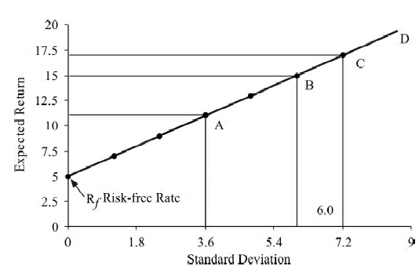
Borrowing and Lending
Risk-return relationship for portfolio of risky and risk-free securities

Slide 62
MULTIPLE RISKY ASSETS AND A RISK-FREE ASSET
In a market situation, a large number of investors holding portfolios consisting of a risk-free security and multiple risky securities participate.

Slide 63
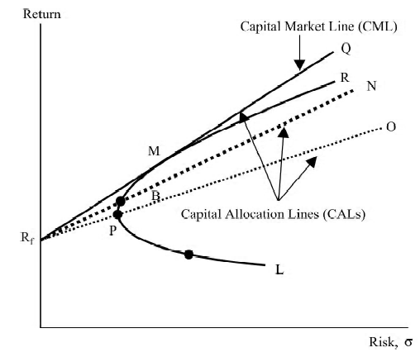
Risk-return relationship for portfolio of risky
and risk-free securities
We draw three lines from the risk-free rate (8%) to the three portfolios. Each line shows the manner in which capital is allocated. This line is called the capital allocation line.
Portfolio M is the optimum risky portfolio, which can be combined with the risk-free asset.

Slide 64
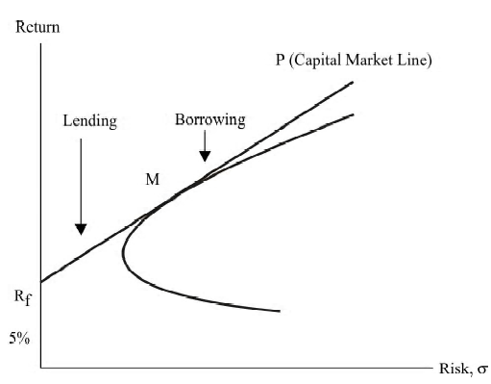
The capital market line
The capital market line (CML) is an efficient set of risk-free and risky securities, and it shows the risk-return trade-off in the market equilibrium.

Slide 65
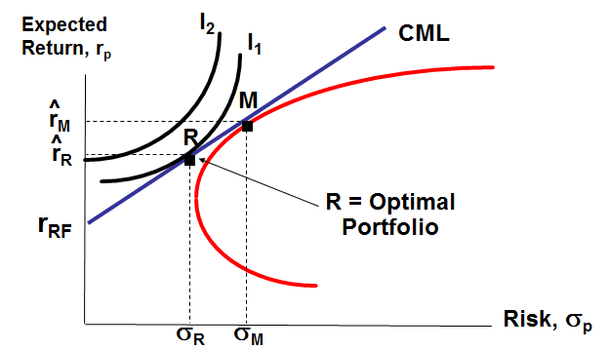
CML

Slide 66
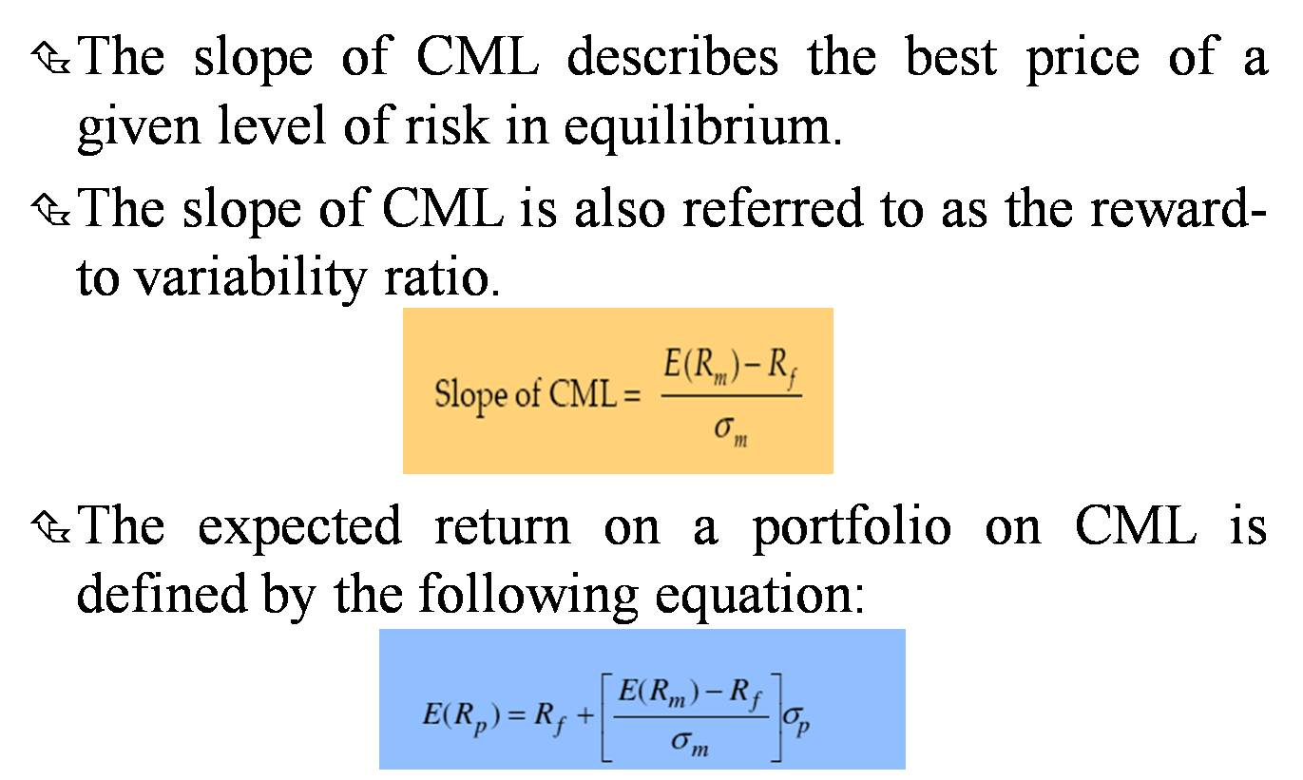
Slope of CML

Slide 67
Separation Theory
According to the separation theory, the choice of portfolio involves two separate steps.
The first step involves the determination of the optimum risky portfolio.
The second step concerns with the investor’s decision to form portfolio of the risk-free asset and the optimum risky portfolio depending on her risk preferences.

Slide 68
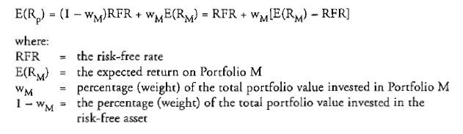
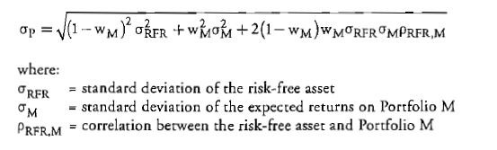
Inroduction of Riskless Security

Slide 69
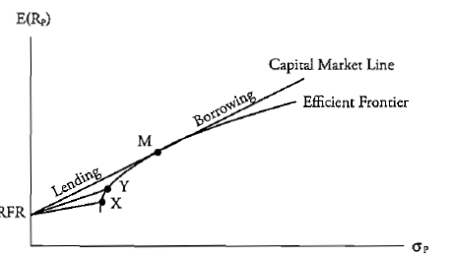
Capital Market Line

Slide 70
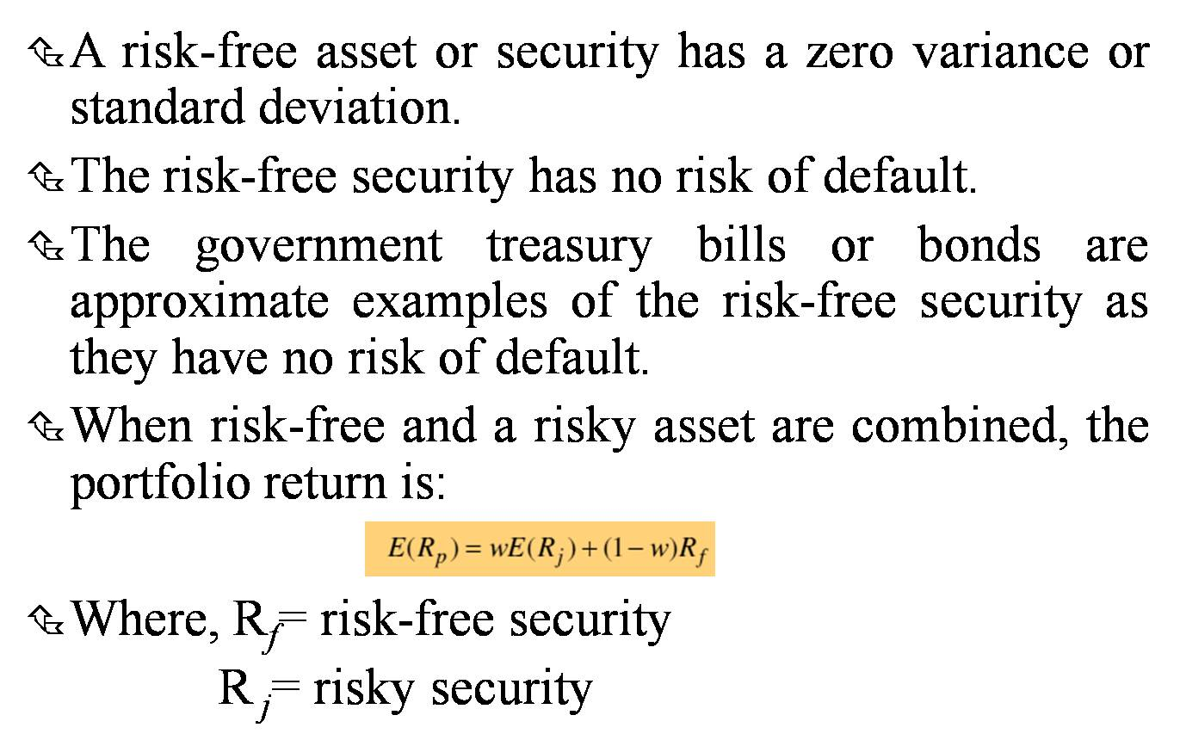
COMBINING A RISK-FREE ASSET AND A RISKY ASSET

Slide 71
A Risk-Free Asset and A Risky Asset: Example
R_{f}, risk-free rate

Slide 72
Question Time

