Slide 1

CA Raman Singla
Budget’2015 Analysis-
Indirect Taxes
CA Raman Singla
[B.com(H), C.A., LLB]

Slide 2
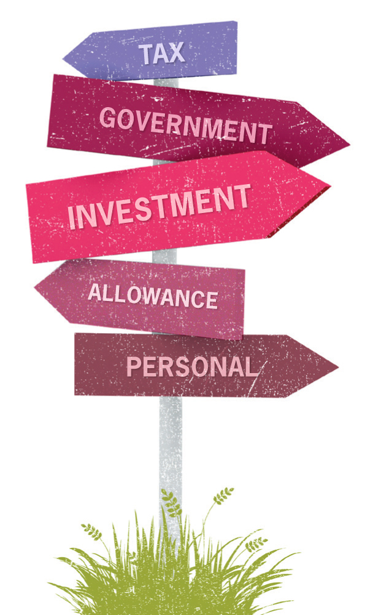
Budget’ 2015 Highlights
Service Tax
Efforts being made on various fronts to implement GST from next year.
Rate of service tax has been increased to consolidated 14% w.e.f. such date as notified by central government. This has been done to facilitate transition to GST.
Education cess and the SHEC to be subsumed in Service Tax of 14%
Enabling provision to levy Swachh Bharat cess at a rate of 2% or less on all or certain services, if need arises. Thus, effective rate would be 16%.
Negative List and exemption notification amended.
Penalty provision are being rationalised to encourage compliance and early dispute resolution.

Slide 3
Budget’ 2015 Highlights
Central Excise
Education cess and the SHEC to be subsumed in Central Excise Duty
Rate of Excise Duty has been increased to 12.5% w.e.f. 1st March’ 2015
Online central excise and service tax registration to be done in two working days.
Central excise/Service tax assesses to be allowed to use digitally signed invoices and maintain record electronically
Penalty provision are being rationalised to encourage compliance and early dispute resolution.

Slide 4
Budget’ 2015 Highlights
Custom Duty
Basic Custom duty on certain inputs, raw materials, inter mediates and components in 22 items, reduced to minimise the impact of duty inversion.
SAD reduced on import of certain inputs and raw materials.
No change in Education cess and the SHEC on BCD.

Slide 5
NEW TAX RATES’ 2015
S. No. | Nature of Tax | Existing Rates | New Rates
1. | Service Tax | 12.36% | 14% (No cess) [w.e.f. the date to be notified]
2. | Central Excise | 12.36% | 12.50% (No cess) [w.e.f. 1st March’ 2015]
3. | Custom Duty BCD CVD Spl. CVD | 20.6%(generally) 12.36% 4% | 20.6%(generally) 12.50% (No cess) 4% (For detailed rates refer other slides) [w.e.f. 1st March’ 2015]

Slide 6

New Tax Rates’2015
Under Service Tax
Levy of Swachh Bharat Cess
Section 117 of the Finance Bill’ 2015 empowers the Central Government to levy Swachh Bharat Cess @ 2% on all or any of the taxable services.

Slide 7
New Tax Rates’2015
Under Central Excise
Clean Energy Cess
Increased from Rs. 100/tonne to Rs. 200 per tonne.
Increase in some Tariff Rates
Items | Old Rate | New Rate
Cement | Rs. 900/tonne | Rs. 1000/tonne
Waters, including mineral waters and aerated waters | 12% | 18%
Cut tobacco | Rs.60/kg | Rs. 70/kg

Slide 8
New Tax Rates’2015
Under Custom Duty-Basic Custom Duty (BCD)
Items | Old Rate | New Rate
Butanes | 5% | 2.5%
Sub-parts, parts, components or accessories for manufacture of tablet computer | 7.5% | Nil
Over Load Protector (OLP), positive thermal coefficient, c-block compressor and crankshafts for manufacture of refrigerator compressor | 7.5% | 5%
Active Energy Controller (AEC) for manufacture of Renewable Power System (RPS) inverters | 7.5% | 5%
Styrene, Ethylene dichloride (EDC) and Vinyl chloride monomer (VCM) 2.5 2 | 2.5% | 2%

Slide 9
New Tax Rates’2015
Under Custom Duty- Changes in SAD Rate
Items | Old Rate | New Rate
All goods [except populated PCBs] for manufacture of ITA bound goods | 4% | Nil
Specified goods for manufacture of pacemakers | 4% | Nil
All inputs for manufacture of LED driver or MCPCB for LED lights and fixtures or LED lamps | 4% | Nil
Naphtha, Styrene, Ethylene dichloride, Vinyl chloride monomer | 4% | 2%
Copper, brass and aluminium scrap | 4% | 2%

Slide 10
Special rates under service tax
Nature of service |  | Old Provision | New Provision
Air Travel Agent | Air ticket for domestic travel Air ticket for international travel | 0.60% 1.2% | 0.70% 1.4%
Insurance Agent | Insurance premium for 1st year Insurance premium for subsequent years | 3% 1.5% | 3.5% 1.75%
Money Changer | Gross amount of currency exchange upto Rs.1,00,000 Gross amount of currency exchange exceeding Rs.1,00,000 and upto Rs.10,00,000 Gross amount of currency exchange exceeding Rs.10,00,000 | 0.12%,subject to minimum Rs.30 120and0.06% 660 and0.012%,subject to maximum of Rs.6,000 | 0.14%,subject to minimum Rs.35 140 and 0.07% 770/-and 0.014%, subject to maximum of Rs.7,000

Slide 11
New Tax Rates’2015
Under Service Tax- Reverse Charge
Items | Old Rate |  | New Rate
 | Provider | Receiver | Provider | Receiver
Manpower Supply & Security Service provided by Individual, HUF or Partnership Firm to Body Corporate | 50% | 50% | Nil | 100%
Services provided or agreed to be provided by a mutual fund agent or distributor, to a mutual fund or asset management company | - | - | Nil | 100%
Service provided or agreed to be provided by a selling or marketing agent of lottery tickets to a lottery distributor or selling agent | - | - | Nil | 100%
Services provided by a person involving and aggregator in any manner | - | - | Nil | 100%

Slide 12

Penalty revamped
Under Service Tax
Provision | Old Provision | New Provision
Section 76 (Bonafied Cases) | 1% p.m. of Tax or Rs. 100 per day (Upto 50% of tax) | If paid before or within 30 days of SCN No Penalty If paid within 30 days of Order 2.5% of Tax Otherwise 10% of Tax
Section 77 | Rs. 10000 for various defaults | No change (Same as earlier)

Slide 13
Penalty revamped
Under Service Tax (Cont.)
Provision | Old Provision | New Provision
Section 78 (Fraud cases) | If paid before SCN 1% p.m. of Tax upto 25% If paid within 30 days of SCN 25% of Tax Otherwise 50% / 100% of Tax | If paid before or within 30 days of SCN 15% If paid within 30 days of Order 25% of Tax Otherwise 100% of Tax
Section 80 | Waiver of penalty u/s 76 & 77 where there was reasonable cause for failure. | Deleted (Therefore penalty cannot be waived in any case)

Slide 14
Penalty revamped
Under Central Excise & Customs Duty
Provision | Old Provision | New Provision
Section 11AC (Excise) | If paid before SCN 1% p.m. of Tax upto 25% If paid within 30 days of SCN 25% of Tax Otherwise 50% / 100% of Tax | For Non-Fraud Cases If paid before or within 30 days of SCN No Penalty If paid within 30 days of Order - 2.5% of Tax Otherwise - 10% of Tax For Fraud Cases If paid before or within 30 days of SCN - 15% If paid within 30 days of Order - 25% of Tax Otherwise - 100% of Tax

Slide 15

Service Tax
Central Excise
Customs Duty
On Facebook @ “Indirect Tax Professionals”
For Detailed Budget Amendments
See our Analysis

Slide 16

Keep in Touch and Get Updated…
(Like us on Facebook as ‘’Indirect Tax Professionals’’ for latest updates)

