Slide 1
Welcome all @ IFRS
and Ind AS incl.
Companies Act,2013
By Eish Taneja
CA, CPA (USA), C-IFRS (ACCA,UK)
Green Belt (6 sigma)-USA, DISA (ICAI)

Slide 2
Session -1
IFRS- Need in India
Sec -211 (3c)- Companies need to follow Accounting Standards prescribed under the Companies Act,1956

Slide 3
Session -1
IFRS- Need in India
As per Companies Act,2013:
Section 129(1) (notified wef 1st April-2014) - The financial statements shall give a true and fair view of the state of affairs of the company or companies, comply with the accounting standards notified under section 133 and shall be in the form or forms as may be provided for different class or classes of companies in Schedule III:
Provided that the items contained in such financial statements shall be in accordance with the accounting standards:
Section 133 (notified wef 12th Sep-2013)- The Central Government may prescribe the standards of accounting or any addendum thereto, as recommended by the Institute of Chartered Accountants of India, constituted under section 3 of the Chartered Accountants Act, 1949, in consultation with and after examination of the recommendations made by the National Financial Reporting Authority (NFRA).

Slide 4
Session -1
IFRS- Need in India
As per Companies Act,2013:
Definition of Accounting Standards
Section 2.(2)- “Accounting standards” means the standards of accounting or any addendum thereto for companies or class of companies referred to in section 133;

Slide 5
Listing of AS
Name of Accounting Standard | AS
Disclosure of Accounting Policies | AS 1
Inventories | AS 2
Statement of Cash Flows | AS 3
Events after the Reporting Period | AS 4
Accounting Policies, Changes in Accounting Estimates and Errors | AS 5
Property, Plant and Equipment- Depreciation | AS 6
Construction Contracts | AS 7
Revenue Recognition | AS 9
Property, Plant and Equipment- Fixed Asset | AS 10
The Effects of Changes in Foreign Exchange Rates | AS 11
Accounting for Government Grants and Disclosure of Government Assistance | AS 12
Accounting For Investments | AS 13
Amalgamations (vs. Business Combinations) | AS 14
Employee Benefits | AS 15
Borrowing Costs | AS 16
Operating Segments | AS 17
Name of Accounting Standard | AS
Related Party Disclosures | AS 18
Leases | AS 19
Earnings per Share | AS 20
Consolidated and Separate Financial Statements | AS 21
Income Taxes | AS 22
Investments in Associates | AS 23
Non-Current Assets Held for Sale and Discontinued Operations | AS 24
Interim Financial Reporting | AS 25
Intangible Assets | AS 26
Interests in Joint Ventures | AS 27
Impairment of Assets | AS 28
Provisions, Contingent Liabilities and Contingent Assets | AS 29
Financial Instruments: Recognition and Measurement | AS 30
Financial Instruments: Presentation | AS 31
Financial Instruments: Disclosures | AS 32

Slide 6
Inherent weakness in the Indian Accounting Standards
No standard to prescribe the method of making our Financial Statements – Captured by IAS 1 ( Presentation of Financial Statements )
Our Financial Statements are Historical in Nature and somewhat does not reflect the current values or fair values (IFRS talks about fair value approach)
Concept of Functional Currency approach being
introduced which is a much better concept while
measuring the foreign exchange impact

Slide 7
Inherent weakness in the Indian Accounting Standards
Lot many new terms and concepts introduced and these are used all over world :
Investment property ( IAS 40)
Classification of Financial Assets into 4 new categories covering HTM, AFS, HFT and FVTPL
Constructive Obligation concept
Functional Currency concept
OCI
And some more which we are going to cover later today…

Slide 8
IFRS – Terms used for Classification
FINANCIAL ASSETS – 4 CATEGORIES
Financial Assets at fair value through profit or loss (FvPL) | Loans & Receivables (L&R) ( at Amortized cost)
Held-to-maturity (HTM) (Amortized cost) | Available for sale (AFS) )at Fair Value)
Fair Value items – At MTM (Mark to Market basis)
FINANCIAL LIABILITIES – 2 CATEGORIES
Financial Liabilities at fair value through profit or loss | Other financial liabilities

Slide 9
IFRS Objective
Global ONE Accounting language
Principles based (vs. Rule Based) high quality global standards
Emphasis on Relevance and Disclosures
Cost Effective – transparency on disclosures

Slide 10
IFRS Structure
The term “IFRSs” currently comprises of:
14 IFRSs, 8 Ind As ( 101 to 108)
20 IFRIC (merged into Ind AS)
28 IASs (originally 41), 27 Ind As (1 to 40) only
11 SIC interpretations, (merged into Ind AS)
The Framework No separate framework
IFRS- SME has been
issued in July 2009. No separate SME Ind AS

Slide 11
IFRS –Current Scenario
• India had committed itself at the G20 summit to converge its Accounting Standards with IFRS in a phased manner starting April1,2011. After that what has happened ????
• India has not adopted the IFRS in full, it has converged its AS’s to get those in line with the IFRS with certain carve-outs to better reflect the Indian economic and business environment.
• In compliance of G20 commitment, the process of convergence of Indian AS’s with IFRS has been carried out by the Ministry of Corporate Affairs(MCA) through wide ranging consultative exercise with all the stakeholders.
•Thirty Five Indian AS’s converged with IFRS (named as “Ind-AS”) and have been notified by the MCA and placed on its website at www.mca.org . The List has increased not in Ind-AS ???

Slide 12
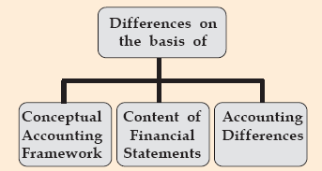
IFRS IN INDIA

Slide 13
Conceptual Changes
Standard | Description | Differences
IAS-1 | Presentation of Financial Statements | 2 new statements a) OCI or Other Comprehensive Income
 |  | b) SOCIE or Statement of Change in Equity
 |  | & “Substance over Form Concept” Redeemable Preference shares are treated as Liability & not Share & also their cost is Interest & not Dividend
IAS-8 | Changes in A/c estimate & Error's | a) Estimates- Prospective b) Errors - Retrospective Back date c) Policy change- Retrospective Back date with difference in Opening retained earnings
IAS-10 | Events after Balance sheet date | Dividend Proposed- cannot be in the year untill approved

Slide 14
Conceptual Differences
Standard | Descripition | Differences
IAS-16 | Fixed Assets | Based on Fair values And
 |  | Component based capitalization and depreciation
IAS-34 | Interim Financial Reporting | IFRS does not recognize any law/regulator precribing
 |  | Statement- Compliance of IAS-34
 |  | Also needs to make SOCIE & OCI for all
IFRIC-4 | Lease Accounting | a) Needs to validate the Vendor Contracts - they might fall under the definition of Lease Accounting (Conditions specified like Control and Fixed quantity Orders)

Slide 15
IFRS IN INDIA
Contents of Financial Statements
Statement | IFRS | US GAAP | INDIAN GAAP
Balance Sheet | Required | Required | Required
Income Statement | Required | Required | Required
Statement of Comprehensive Income | Required | Other Income Statement | Not Required
Cash Flow Statement | Required | Required | Not for All Entities
SOCIE | Separately Required | May be combined | No Separate Statement
Explanatory Notes | Required | Required | Required

Slide 16
IFRS IN INDIA
Accounting Differences
Depreciation-IFRS is Useful life only vs. India-Schedule XIV or useful life whichever is higher
Depreciation on Revalued Assets- IFRS- Cannot be recouped from the Revaluation Reserve
Change in Method of Depreciation- IFRS it is prospectively and in Indian GAAP it is retrospectively
Reporting Currency & Functional Currency- IFRS requires measurement of profit using the functional Currency. In India, INR is the reporting currency.
Disclosure of Extra-Ordinary Items- IFRS prohibits such disclosure and No such items in IFRS .Indian GAAP talks of disclosure in Notes

Slide 17
IFRS in India
Significant conceptual matters
to be considered

Slide 18
GENERAL APPROACH
IFRS
“Principle-Based Accounting” with limited
application guidance
IGAAP
also “Principle-Based Accounting” with limited application guidance
influenced by legal/tax perspectives
( Schedule VI from Companies Act Instead of the IAS-1 giving the format of the balance Sheet)
Notes:
18

Slide 19
IFRS in India – Significant conceptual matters to be considered
Area IFRS Impact
Time value of money- Discounting –Defer cases
Fair value option – Use of Fair Values & MTM
Significance of Consolidated- Consolidated –All in IFRS
Financial Statements India- Consolidation not prescribed in the AS and SEBI has made it mandatory for Listed companies.

Slide 20
IFRS in India – Significant conceptual matters to be considered
Area IFRS Impact
Control Definition of Control is different
Reliance + Swan / Essar + Loop
Uniform accounting policies Prior Statements Impact (Retro)
Deferred Tax adjustment On Inventory(unsold) & during Consolidation Subsy Income

Slide 21
IFRS in India – Significant conceptual matters to be considered
Area IFRS Impact
Component based PPE Based on Components (Capex & Depreciation)
Major Inspection/overhaul India Inspection - No Cap, IFRS-You
expenses can Capex
Discounting of provisions Time value (Effective Interest)
Current and Non current IFRS –IAS1 + Revised Schedule VI
classification

Slide 22
Area IFRS Impact
Constructive obligation Need to Give in Notes/Provide for
Prior To Real Obligation

Slide 23
Area IFRS Impact
Constructive obligation Need to Give in Notes/Provide for
Principal- BOD Approval
Formulation –Draft Scheme
Draft Scheme- Approval for BOD
Constructive Obligation Explained-
Example VRS- Process
Scheme Finalization with Union
Real Obligation
Constructive
Acceptance & Contract Formation
Receipt of applications
Communication –Target Employees

Slide 24
IFRS in India – Significant conceptual matters to be considered
Area IFRS Impact
Business combination – India – Both Purchase Method Purchase method only Pooling of Interest Method allowed
Good will – testing for – Impairment only
impairment & not amortised
Prohibition of extra ordinary items- Not in IFRS

Slide 25
DSL Software Ltd.
Enterprise Value Calculation |  |  |  |  |  |  |  | Amount in US$ '000
Business value computation of DSL
Particulars | Explicit Period |  |  |  |  |  |  | Perpetuity > 5 YEARS
 |  | FY 2006-07 | FY 2007-08 | FY 2008-09 | FY 2009-10 | FY 2010-11 | FY 2011-12
Operating PBDIT |  | 57,465 | 62,907 | 72,264 | 84,817 | 101,576 | 123,865 | 134,891
Less: Tax |  | 3,165 | 3,451 | 7,723 | 21,826 | 26,040 | 31,629 | 34,301
Operating Cash Flows |  | 54,300 | 59,456 | 64,541 | 62,991 | 75,536 | 92,236 | 100,590
Less: Capital Expenditure |  |  | 4,118 | 4,103 | 5,538 | 7,477 | 10,094 | 10,094
Less: Changes in Working Capital |  |  | 5,423 | 5,403 | 7,294 | 9,846 | 13,293 | 13,293
Free Cash Flow |  |  | 49,916 | 55,035 | 50,159 | 58,213 | 68,850 | 77,203
 |  |  | 49,940 | 55,164 | 50,160 | 58,344 | 68,886
Discount Factor |  |  | 84.5% | 71.5% | 60.3% | 51.0% | 43% | 43%
Discounted Cash Flow |  | - | 42,179 | 39,350 | 30,221 | 29,688 | 29,605 | 33,197
WACC for projection period | 18.40%
WACC for perpetuity | 18.40%
PV of FCF | 170,849
Growth rate beyond March 31, 2009 | 11.49%
Perpetuity value | 1,117,934
PV of Perpetuity Value | 480,712
Business Value | 651,561
Add: Surplus assets
Net Business Value | 651,561
Carrying value in Books | 190,739
Surplus value | 460,822
No Impairment

Slide 26
IFRS in India – Significant conceptual matters to be considered
Disclosure of items in Profit and Loss account bases on Nature - (Nature / Function)
Alternative Classifications
By Nature | INR | By Function | INR
Revenue | X | Revenue | X
Other Income | X | Less Cost of Sales | X
Less- Change in Inventories | X | Gross Profit/Loss | X
Work Performed | X | Other Income | X
Raw material & consummables | X
Employee Cost | X | Distribution Costs | X
Depreciation & Amortization | X
Other Expenses | X | Admin Expenses | X
Interest Cost | X | Finance Charges | X
Share of Profit from Associates |  | Share of Profit from Associates | X
Profit before Tax | X | Profit before Tax | X
Taxes- Normal | X | Taxes- Normal | X
Defer Taxes | X | Defer Taxes | X
Profit after Taxes | X | Profit after Taxes | X

Slide 27
IFRS in India – Significant conceptual matters to be considered
Segment reporting based on CODM (Chief Operating Decision Maker)
Geographical Based
Product
Based
CODM
Based

Slide 28
IFRS, Ind AS and AS- some Basics
IFRS | IFRS Name | Ind AS | IFRIC,SIC etc. | Existing AS | Indian Scenario
IFRS 1 | First-time Adoption of IFRS | Ind AS 101 |  | None | Only to be used once
IFRS 2 | Share-based Payment | Ind AS 102 |  | None | Guidance Note issued by ICAI (on employee shares only)
IFRS 3 | Business Combinations | Ind AS 103 |  | AS 14 | Our AS covers Amalgamations only whereas IFRS covers Absorption also
IFRS 4 | Insurance Contracts | Ind AS 104 |  | None | Covers Insurance and Reinsurance contracts, talks about Liability Adequacy Test
IFRS 5 | Non-Current Assets Held for Sale and Discontinued Operations | Ind AS 105 | IFRIC -17 | AS 24 + AS 10 | AS-24 is Discontinuing Operations and there is no specific standard to cover IFRS

Slide 29
IFRS, Ind AS and AS- some Basics
IFRS | IFRS Name | Ind AS | IFRIC,SIC etc. | Existing AS | Indian Scenario
IFRS 6 | Exploration for and Evaluation of Mineral Resources | Ind AS 106 |  | None | Guidance Note issued by ICAI (accounting for oil and gas producing activities )
IFRS 7 | Financial Instruments: Disclosures | Ind AS 107 |  | AS 32 | No big difference between AS-32 and IFRS-7. As-32 is not mandatory
IFRS 8 | Operating Segments | IND AS 108 |  | AS 17 | India - Product wise or Geographical wise, IFRS it is based on CODM wise
IFRS 9 | Financial Instruments – Assets (effective date Jan-2015) | Not yet | Not yet made | AS 13,AS- 11, AS-30 | IFRS 9 is supposed to replace IAS-39, effective date Jan-2018
IFRS 10 | Consolidated Financial Statements (to replace IAS 27) | Not yet | Not yet made | None | IFRS 10 is supposed to replace IAS-27
IFRS 11 | Joint Arrangements - revised 28 June 2012 | Not yet | Not yet made | None | IFRS 11 is supposed to replace IAS-31,effective date jan-2016
IFRS 12 | Disclosure of Interests in Other Entities | Not yet | Not yet made | None | This is a reporting standard only
IFRS 13 | Fair Value Measurement | Not yet | Not yet made | None | Covers Fair values and their hierarachy
IFRS 14 | Regulatory Deferral Accounts | Not yet | Not yet made | None | Effective date is jan-2016
IFRS 15 | Revenue from Contract with Customers | Not yet | Not yet made | None | Effective date is jan-2017

Slide 30
IFRS, Ind AS and AS- some Basics
IFRS |  | IFRS Name | Ind AS | IFRIC,SIC etc. | Existing AS | Indian Scenario
IAS 1 |  | Presentation of Financial Statements | Ind AS 1 |  | AS 1,AS-5 & Schedule III (new Co. Act) | For Financial Statements, reference taken from AS and Company law
IAS 2 |  | Inventories | Ind AS 2 |  | AS 2 | Indian AS does not covers Inventory for Service providers
IAS -3, 4, 5,6 are deleted |  |  | Ind AS -3,4,5,6 are not made
IAS 7 | Statement of Cash Flows |  | Ind AS 7 |  | AS 3 | small changes
IAS 8 | Accounting Policies, Changes in Accounting Estimates and Errors |  | Ind AS 8 |  | AS 5 | AS-5 - Net Profit or Loss for the period, prior period items, changes in accounting policies. Our system talks of changes in the current year, IFRS talks of retrospective application with impact in previous F/S.
IAS 10 | Events after the Reporting Period |  | Ind AS 10 |  | AS 4 | AS-4-Contigencies and events occurring after the Reporting period- Dividends to be reported in the year reported/declared

Slide 31
IFRS, Ind AS and AS- some Basics
IFRS | IFRS Name | Ind AS | IFRIC,SIC etc. | Existing AS | Indian Scenario
IAS 11 | Construction Contracts | Ind AS 11 | IFRIC 12, IFRIC 15, SIC 29 | AS 7 | In India, we have Guidance note on accounting by Real estate Developers and also IFRIC 15 is not implemented
IAS 12 | Income Taxes | Ind AS 12 | SIC 21 , SIC 25 | AS 22 | In India, primarirly the defer taxes are computed based on P&L, in IFRS, these are computed based on carrying value of Assets/Liabilities values
IAS 16 | Property, Plant and Equipment | Ind AS 16 | IFRIC -1 | AS 6 & AS 10 | IFRS talks about component basis assets and useful life depreciation
IAS 17 | Leases | Ind AS 17 | IFRIC-4, SIC 15, SIC 27 | AS 19 | 4 major Criteria's define the lease-OWNS(picked up from US GAAP)
IAS 18 | Revenue | Ind AS 18 | SIC-31, IFRIC 13 & IFRIC 18 | AS 9 | Covered in Detail

Slide 32
IFRS, Ind AS and AS- some Basics
IFRS | IFRS Name | Ind AS | IFRIC,SIC etc. | Existing AS | Indian Scenario
IAS 19 | Employee Benefits | Ind AS 19 | IFRIC 14 | AS 15 | In India, Acturial gains and Losses are taken into P&L, In IFRS-you can take into P&L/OCI or defer with a Limit
IAS 20 | Accounting for Government Grants and Disclosure of Government Assistance | Ind AS 20 | SIC 10 | AS 12 | Indian stanadrd talks about accounting for Govt. grant and does not specifically deal with disclosure of Govt. assistance
IAS 21 | The Effects of Changes in Foreign Exchange Rates | Ind AS 21 |  | AS 11 | There is no concept of Functional currency In India.No Concept of Translation and Transaction gain or Loss
IAS 23 | Borrowing Costs | Ind AS 23 |  | AS 16 | Concept of effective interest rate not there in India, much used in IFRS
IAS 24 | Related Party Disclosures | Ind AS 24 |  | AS 18 | Much wider definition of a related party in IFRS as compared to Indian system.
IAS 26 | Accounting and Reporting by Retirement Benefit plan | Not made |  | None | These organizations are following practices issued by IRDA
IAS 27 | Consolidated and Separate Financial Statements | Ind AS 27 |  | AS 21 | Being replaced by IFRS-10
IAS 28 | Investments in Associates | Ind AS 28 |  | AS 23 | Potential voting rights are not considered in India which validating the control aspect, in IFRS-these are considered

Slide 33
IFRS, Ind AS and AS- some Basics
IFRS | IFRS Name | Ind AS | IFRIC,SIC etc. | Existing AS | Indian Scenario
IAS 29 | Financial Reporting in Hyperinflationary Economies | Ind AS 29 | IFRIC-7 | None | No such type of standard exist in India
IAS 31 | Interests in Joint Ventures | Ind AS 31 |  | AS 27 | Being replaced by IFRS-11
IAS 32 | Financial Instruments: Presentation | Ind AS 32 |  | AS 31 | AS-31 is not mandatory in India however there are no major differences between them
IAS 33 | Earnings per Share | Ind AS 33 |  | AS 20 | Certain additional disclosures in IFRS in the EPS
IAS 34 | Interim Financial Reporting | Ind AS 34 | IFRIC-10 | AS 25 | Indian System talks about some formats given by various Bodies like SEBI etc. which needs to be followed
IAS 36 | Impairment of Assets | Ind AS 36 |  | AS 28 | Impairment in IFRS is on yearly basis, in Indian-when the conditions are as such
IAS 37 | Provisions, Contingent Liabilities and Contingent Assets | Ind AS 37 | IFRIC 5, IFRIC 6 | AS 29 | Concept of Constructive obligation in IFRS, not in India
IAS 38 | Intangible Assets | Ind AS 38 |  | AS 26 | In India, presumtion of useful life of 10 years not in IFRS

Slide 34
IFRS, Ind AS and AS- some Basics
IFRS | IFRS Name | Ind AS | IFRIC,SIC etc. | Existing AS | Indian Scenario
IAS 39 | Financial Instruments: Recognition and Measurement | Ind AS 39 |  | AS 30 | AS-30 is not mandatory in India however there are no major differences between them
IAS 40 | Investment Property | Ind AS 40 |  | None | Property held for earning rentals or capital appreciation are called as Investment property, no such classification in India
IAS 41 | Agriculture | Not made |  | None | India- There is no standard whereas in IFRs, the method of accounting is based on Fair Value, less cost to sell

Slide 35

ABOUT THE
IFRS INDIA
TRANSITION

Slide 36

Indian IFRS
In India, the Indian IFRS are called as Ind AS
There are some basic differences in the concept of - Ind AS & IFRS
These differences are classified in three categories based on the Impacts
These are also termed as - ‘Carve Outs’.

Slide 37
Ind AS ( Issues for Implementation)
Three category of ‘Carve Outs’.
Category 1- Removal of Policy Choices ( IFRS offers multiple policy choices while Ind AS restrict these policy choices)
Category 2- Additional Policy Choices ( Ind AS gives you a Choice which are not there in IFRS)
Category 3- Significant mandatory deviations from IFRS (very less though)

Slide 38

Ind AS ( Issues for Implementation)
Three category of ‘Carve Outs’.
Category 1-
IFRS is giving you Choice’s, Ind-AS does not
Single Statement (P&L + OCI) . IFRS allows you to make 2 statements
Classification of Expenses by Nature (IFRS allows by Function / Nature)
Cash Flows Statements – Interest & Dividends are Financing/ Investing cash flow (IFRS permits Operating classification)
No choice to carry Investment property at Fair Value (IFRS allows this)
Recognition of Actuarial gains and Losses directly in Reserves (IFRS permits alternates including recognition in P&L)
No
Much
Tension

Slide 39


Ind AS ( Issues for Implementation)
Tension
Hi
Tension
(may not be acceptable abroad)
Three category of ‘Carve Outs’.
Category 2-
Ind AS gives a Choice & not there in IFRS
Choice to defer exchange differences on Long term Foreign currency Monetary Assets & Liabilities and to recognize such differences over the period of the underlying asset/liability.
(IFRS requires all such differences to immediate charge to P&L)
b) Choice to consider Indian GAAP carrying value as “deemed cost” for (as existing on transition date)
i) Fixed Assets
ii) Investment Property
iii) Intangible Assets
(IFRS offers no such choice but gives 2 choices – Retrospective IFRS values or “Fair Values” – Ind AS gives the 3rd choice)

Slide 40


Ind AS ( Issues for Implementation)
Tension
Hi
Tension
(may not be acceptable abroad)
Three category of ‘Carve Outs’.
Category 3-
High Impact Area’s
Revenue Recognition for Real Estate Sales on the basis of %age completion method (IFRS requires basis when the Final possession is given to the Customer).
Accounting for the Equity portion (Foreign Currency Convertible Bond) as Equity component . (IFRS requires the conversion option to be periodically Marked to Market (MTM)) .
Not so High Impact Area’s
Use of Govt. Bond rates ( Ind AS) vs. Corporate Bond Rates (IFRS) in the calculation of Discounted Employee Benefit Obligations
Ind AS has defer the application of “accounting of embedded lease arrangements” & “service Concession arrangements”
Mandatory deviations from IFRS

Slide 41
Overview of Ind AS and AS (Basic Comparison)

Slide 42
Indian Accounting Standards (Ind AS)
On February 25, 2011, the Ministry of Corporate Affairs (‘MCA’) has notified 35 Indian Accounting Standards (‘Ind AS’) through a press release.
Ind AS are converged with International Financial Reporting Standards (‘IFRS’).
The date of implementation of Ind AS is to be notified by the Ministry.

Slide 43
Basic Comparison
Indian AS | Ind AS Name | Existing AS
Ind AS 103 | Business Combinations | AS 14
Ind AS 105 | Non-Current Assets Held for Sale and Discontinued Operations | AS 24
Ind AS 107 | Financial Instruments: Disclosures | AS 32
Ind AS 108 | Operating Segments | AS 17
Ind AS 1 | Presentation of Financial Statements | AS 1
Ind AS 2 | Inventories | AS 2
Ind AS 7 | Statement of Cash Flows | AS 3
Ind AS 8 | Accounting Policies, Changes in Accounting Estimates and Errors | AS 5
Ind AS 10 | Events after the Reporting Period | AS 4
Ind AS 11 | Construction Contracts | AS 7
Continued…

Slide 44
Basic Comparison
Indian AS | Ind AS Name | Existing AS
Ind AS 12 | Income Taxes | AS 22
Ind AS 16 | Property, Plant and Equipment | AS 6 & AS 10
Ind AS 17 | Leases | AS 19
Ind AS 18 | Revenue | AS 9
Ind AS 19 | Employee Benefits | AS 15
Ind AS 20 | Accounting for Government Grants and Disclosure of Government Assistance | AS 12
Ind AS 21 | The Effects of Changes in Foreign Exchange Rates | AS 11
Ind AS 23 | Borrowing Costs | AS 16
Ind AS 24 | Related Party Disclosures | AS 18
Ind AS 27 | Consolidated and Separate Financial Statements | AS 21
Continued…

Slide 45
Basic Comparison
Indian AS | Ind AS Name | Existing AS
Ind AS 28 | Investments in Associates | AS 23
Ind AS 31 | Interests in Joint Ventures | AS 27
Ind AS 32 | Financial Instruments: Presentation | AS 31
Ind AS 33 | Earnings per Share | AS 20
Ind AS 34 | Interim Financial Reporting | AS 25
Ind AS 36 | Impairment of Assets | AS 28
Ind AS 37 | Provisions, Contingent Liabilities and Contingent Assets | AS 29
Ind AS 38 | Intangible Assets | AS 26
Ind AS 39 | Financial Instruments: Recognition and Measurement | AS 30

Slide 46
Overview of Ind AS and AS (Basic Comparison)

Slide 47
Indian Accounting Standards (Ind AS)
On February 25, 2011, the Ministry of Corporate Affairs (‘MCA’) has notified 35 Indian Accounting Standards (‘Ind AS’) through a press release.
Ind AS are converged with International Financial Reporting Standards (‘IFRS’).
The date of implementation of Ind AS is to be notified by the Ministry.

Slide 48
IFRS Hierarchy Statements
International Financial Reporting Standards (IFRS)
International Accounting Standards (IAS)
International Financial Reporting Interpretations (IFRIC)
Standard Interpretations (SIC)
Notes:
48

Slide 49
IFRS - Standards
Starts with……………….
Preface to International Financial Reporting Standards
Framework for the Preparation and Presentation of Financial Statements

Slide 50
IFRS – Standards Contd.
IFRS 1 First-time Adoption of International Financial Reporting Standards
IFRS 2 Share-based Payment
IFRS 3(2008) Business Combinations
IFRS 4 Insurance Contracts

Slide 51
IFRS – Standards Contd.
IFRS 5 Non-current Assets Held for Sale and Discontinued Operations
IFRS 6 Exploration for and Evaluation of Mineral Resources
IFRS 7 Financial Instruments: Disclosures
IFRS 8 Operating Segments

Slide 52
IFRS – Standards Contd.
IFRS 9 - Financial Instruments – Assets (effective date Jan-2015)
IFRS 10 -Consolidated Financial Statements (to replace IAS 27)
IFRS 11 -Joint Arrangements - revised 28 June 2012
IFRS 12- Disclosure of Interests in Other Entities
IFRS 13- Fair Value Measurement

Slide 53
IFRS – Standards Contd.
IAS 1(2007) Presentation of Financial Statements
IAS 2 Inventories
IAS 7 Statement of Cash Flows
IAS 8 Accounting Policies, Changes in Accounting Estimates and Errors

Slide 54
IFRS – Standards Contd.
IAS 10 Events after the Reporting Period
IAS 11 Construction Contracts
IAS 12 Income Taxes
IAS 16 Property, Plant and Equipment

Slide 55
IFRS – Standards Contd.
IAS 17 Leases
IAS 18 Revenue
IAS 19 Employee Benefits
IAS 20 Accounting for Government Grants and Disclosure of Government Assistance

Slide 56
IFRS – Standards Contd.
IAS 21 The Effects of Changes in Foreign Exchange Rates
IAS 23 Borrowing Costs
IAS 24 Related Party Disclosures
IAS 26 Accounting and Reporting by Retirement Benefit Plans

Slide 57
IFRS – Standards Contd.
IAS 27(2008) Consolidated and Separate Financial Statements
IAS 28 Investments in Associates
IAS 29 Financial Reporting in Hyperinflationary Economies
IAS 31 Interests in Joint Ventures (move towards IFRS 11)

Slide 58
IFRS – Standards Contd.
IAS 32 Financial Instruments: Presentation
IAS 33 Earnings per Share
IAS 34 Interim Financial Reporting
IAS 36 Impairment of Assets
IAS 37 Provisions, Contingent Liabilities and Contingent Assets

Slide 59
IFRS – Standards Contd.
IAS 38 Intangible Assets
IAS 39 Financial Instruments: Recognition and Measurement
IAS 40 Investment Property
IAS 41 Agriculture

Slide 60
IAS 1 (Presentation of Financial Statements )
IAS -1
Presentation of Financial Statements

Slide 61
Ind AS 1 and IAS 1 (Presentation of Financial Statements )
Key Features of IAS-1
A complete set of Financial Statements under IFRS comprises :
Statement of Financial Position (also called as balance Sheet)
Statement of Comprehensive Income ( 2 methods – single statement and 2 different statements covering P&L and Other comprehensive Income)
Statement of cash flows
Statement of Changes in equity (SOCIE)
Notes to accounts covering Accounting policies and Explanatory Notes
5 Statements

Slide 62
AS 1 (Disclosure of Accounting Policies )
AS-1 Covers :
Accounting policies are the specific accounting principles and the methods of applying those principles adopted by an enterprise in the preparation and presentation of financial statements.
All significant accounting policies should be disclosed.
Such disclosure form part of financial statements.
All disclosures should be made at one place.
Specific disclosure for the adoption of fundamental accounting assumptions is not required.
Disclosure of accounting policies cannot remedy a wrong or inappropriate treatment of the item in the accounts.
Any change in accounting policies which has a material effect in the current period or which is reasonably expected to have material effect in later periods should be disclosed.

Slide 63
Ind AS 1 and AS 1 (Presentation of Financial Statements )
AS-1 Covers :
Fundamental Accounting Assumption: (GCA) :
1] Going Concern
2] Consistency
3] Accrual
Major considerations governing the selection of accounting policies:
1] Prudence
2] Substance over form
3] Materiality

Slide 64
Ind AS 1 and AS 1 (Presentation of Financial Statements )
AS-1 to include:
AS-1 - Disclosure Of Accounting Policy
+
Revised Schedule VI to Companies Act
+
AS-5- Net Profit Or Loss For The Period, Prior Period Items
And Changes In Accounting Policies
=
Ind AS-1 /IAS-1 to include:
Ind AS-1 – Presentation of Financial Statements

Slide 65
Ind AS 1 and AS 1 (Presentation of Financial
Statements )
Basic Conclusions :
The format of Financial Statements in AS is given by
Company Law whereas in Ind AS is given by
Standard – Law Vs Standard
Ind AS-1/IAS-1 coverage is wider in Scope
India- Companies Act govern Company Financial Statements, Bank’s are governed by Schedule III of Banking Act,1949, Insurance are by IRDA regulations etc.

Slide 66
Indian GAAP with IFRS with Ind AS
Indian GAAP | IFRS | Ind AS
Components of Financial statements are 4 –B/Sheet, P&Loss A/c, Cash Flow (criteria based) & notes to Accounts | 5 Statements | The Balance Sheets includes SOCIE (part of Balance sheet), Comprehensive Income not included
AS-21 has not made it mandatory for consolidation . Only Listed companies are required to prepare “Standalone” and Consolidated Financial Statements . | Consolidation is mandatory in case the criteria is met. | Does not mandate the consolidation.

Slide 67
Indian GAAP with IFRS with Ind AS
Indian GAAP | IFRS | Ind AS
Follow the Format as mentioned in the Revised Schedule VI-Companies Act | Only illustrative formats for presentation are given | No illustrative formats are given
Departure from Companies act and accounting standards are prohibited unless permitted by other regulatory framework | It may depart from standard in extreme rare situations (when following, it shall give misleading information) which is rare circumstances, however reason and financial impact needs to be disclosed. | Similar to IFRS

Slide 68
Indian GAAP with IFRS with Ind AS
Indian GAAP | IFRS |  |  |  | Ind AS
Classification of Liabilities (Non Current) upon breach of Covenants :
Practically In India, banks do not demand or recall the Loan so the Liabilities can remain classified as Non current. |  | Immediately into current (since Banks can recall the Loan) however if lender has given a grace period of 12 months, then it will be as Non current |  | Similar to IFRS
Presentation of Financial Statements
Expenses classified by Nature (Revised Schedule VI) |  |  | Expenses can be classified by Nature or Function | By Nature Only
Item such as Revaluation reserve is a part of Reserve (equity part) |  |  | Same is classified as OCI | Single Statement only

Slide 69
Indian GAAP with IFRS with Ind AS
Indian GAAP | IFRS | Ind AS
Presentation of financial statements:
Extraordinary Items are disclosed separately in P&Loss statement | Extraordinary is prohibited | Similar to IFRS
Not required A simple statement that amounts are reclassified without additional info. | When comparative amounts are reclassified- Nature, amount & reason for reclassification are disclosed. | Similar to IFRS
Not required | Requires disclosure of all critical judgments made by management in applying accounting policies | Similar to IFRS

Slide 70
Indian GAAP with IFRS with Ind AS
Indian GAAP | IFRS | Ind AS
Presentation of financial statements:
Does not require | Requires disclosure of all key estimates and assumptions that it makes about the future which may cause a material adjustment to the carrying assets and liabilities within the next financial year | Similar to IFRS
Does not require | Requires disclosure of information about management of capital and compliance with capital requirements | Similar to IFRS

Slide 71
IAS 2 ( Valuation of Inventories)
IAS -2
Valuation of Inventories

Slide 72
Ind AS 2 and AS 2 (Inventories)
AS-2 Covers :
Inventories are assets:
Held for sale in ordinary course of business;
In the process of production for such sale (WIP);
In the form of materials or supplies to be consumed in the production process or in the rendering of services.
However, this standard does not apply to the valuation of following inventories:
WIP arising under construction contract (Refer AS – 7);
WIP arising in the ordinary course of business of service providers;
Shares, debentures and other financial instruments held as stock in trade; and
Producers’ inventories of livestock, agricultural and forest products, and mineral oils, ores and gases to the extent that they are measured at net realizable value in accordance with well established practices in those industries.
Inventories should be valued at the lower of cost and net realizable value.

Slide 73
Ind AS 2 and AS 2 (Inventories)
AS-2 Covers :
The cost of inventories should comprise
All costs of purchase
Costs of conversion
Other costs incurred in bringing the inventories to their present location and condition.
The costs of purchase consist of :
The purchase price
Duties and taxes ( other than those subsequently recoverable by the enterprise from the taxing authorities like CENVAT credit)
Freight inwards and other expenditure directly attributable to the acquisition.
Trade discounts (but not cash discounts), rebates, duty drawbacks and other similar items are deducted in determining the costs of purchase.
The costs of conversion include direct costs and systematic allocation of fixed and variable production overhead.

Slide 74
Indian GAAP with IFRS with Ind AS
Indian GAAP | IFRS | Ind AS
As per the requirements of Schedule VI, Inventories need to be classified as : a) Raw Material b) WIP c) Finished Goods d) Stock-in-trade e) Loose Tools f) Others Goods in Transit needs to be mentioned separately | No specific classification, should be appropriate to the entity | Similar to IFRS
No Specific guidance | Reversal of write down of Inventory can happen when circumstances that previously caused Inventories to be written below cost, no longer exit. Amount of reveresal is limited to the amount of original write-down | Similar to IFRS

Slide 75
IND AS 2 (Inventories) and AS 2 (Valuation of Inventories)
IAS 2 | AS 2
Deals with the subsequent recognition of cost/carrying amount of inventories as an expense. These can be cases where Inventories are used for self constructed assets. | It does not provide any provision for the same.
Provides explanation with regard to inventories of service providers. | Does not contain such an explanation
Inventories do not include machinery spares which can be used only in connection with an item of fixed asset. | Doesn't contain specific explanation in respect of such spares

Slide 76
Ind AS 2 and AS 2 (Inventories)
AS-2 to include:
AS-2 – Valuation of Inventories
IAS-2/Ind AS-2 to include:
Ind AS-2 – Inventories
Basic Conclusions :
a) Ind AS-2 coverage is wider in Scope
Ind AS-2 covers Inventories of Service Providers like CA’s, Doctor’s etc.
In case the Inventory is purchased on credit (defer payment terms), the difference
between purchase price (normal credit terms) and deferred settlement basis is treated
as Interest expense
Ind-AS-2 does not apply to Commodity- Brokers Traders( No such exemption in
AS-2)

Slide 77
IAS 7 and AS 3 (Cash Flow Statements)
IAS -7
Statement of Cash Flows

Slide 78
Indian GAAP with IFRS with Ind AS (IAS 7)
Indian GAAP | IFRS | Ind AS
Bank Overdraft are considered as Financing Activities | Bank OD’s are considered as cash & cash equivalent | Similar to IFRS
Any extraordinary item can be reported as Operating, Investing or Financing and separately disclosed | No item is reported as extraordinary | Similar to IFRS
No specific guidance | Entities might routinely sell items of PP&E that they have held previously for rental to others. Cash recd. in respect of acquisition/disposal of such assets are classified as operating activities | Similar to IFRS

Slide 79
IAS 8 (Accounting Policies, Changes in Accounting Estimates and Errors)
Ind AS 8
Accounting Policies, Changes in Accounting Estimates and Errors

Slide 80
IAS 8 (Accounting Policies, Changes in Accounting Estimates and Errors)
Key Features of IAS-8
Covers 3 things- Changes in estimates, changes in accounting policies and errors and also says how to deal with them
It says deal with them as under :
i) Estimates- Prospective
ii) Errors - Retrospective Back date
iii) Policy change- Retrospective Back date
with difference in Opening retained earnings
(this implies changing the last year balance sheet balances also)
c) Also, it treats Depreciation as a estimate (based on useful life) vs in India as policy (part of Accounting policy)
Most Problematic Standard

Slide 81
IAS 8 (Accounting Policies, Changes in Accounting Estimates and Errors) & AS 5 (Net Profit or Loss for the Period, Prior Period Items and Changes in Accounting Policies)
IAS 8 | AS 5
Changes in accounting policies should be accounted for with retrospective effect. | All Impact should be reflected in the current period with a note explaining the impact which pertains to prior periods.
Requires rectification of material prior period errors with retrospective effect subject to limited exceptions, where it is impracticable. | Requires the rectification of prior period items with prospective effect.
IAS 8 specifically states that errors include frauds | Frauds are not covered in errors

Slide 82
Indian GAAP with IFRS with Ind AS (IAS 8)
Indian GAAP | IFRS | Ind AS
Not required | New Accounting prouncements that have been issued but are not yet effective as at the end of reporting period are to be disclosed. Also the possible financial impact of them on initial application needs to be disclosed. | Similar to IFRS
No specific guidance | In case of absence of standard or interpretation that specifically applies to a transaction, permits considering recent pronouncements by other standard-setting bodies say example US-GAAP | Similar to IFRS

Slide 83
IAS 10 and AS 4 (Contingencies and Events after the Balance Sheet date)
AS -4
Contingencies and Events occurring after balance sheet date
&
IAS -10
Events after the Reporting period

Slide 84
Ind AS 10( Events after the Reporting period) and AS 4 (Contingencies and Events occurring after balance sheet date)
IAS 10 | AS 4
Material non-adjusting events are required to be disclosed in the financial statements. | The same to be disclosed in the report of approving authority.
Dividend proposed or declared after the reporting period, cannot be recognised as a liability in the financial statements. Those to be disclosed in the notes in the financial statements | The same is required to be adjusted in financial statements. (Prescribed in the Schedule VI).
Gives guidance on accounting for non-cash distributions to owners. | Does not contain this guidance.

Slide 85
IAS 11 and AS 7 (Construction Contracts)
AS -7
Construction Contracts
&
IAS 11
Construction Contracts

Slide 86
Indian GAAP with IFRS with Ind AS (IAS 11)
Indian GAAP | IFRS | Ind AS
Construction Contracts – primary literature :
a)AS-7 – Construction Contracts b) Guidance Note on Recognition of Revenue by Real Estate Developers | a) IAS 11- Construction Contracts b) IFRIC 12- Service Concession arrangements c) IFRIC 15- Arrangements for construction of real estate d) SIC 29- Service concession arrangements :disclosures | IFRIC 15 is not applicable and not converged . IFRIC 12 and SIC 29 are a part of Ind AS 11 as annexures

Slide 87
Indian GAAP with IFRS with Ind AS (IAS 11)
Indian GAAP | IFRS | Ind AS
IFRIC 15 was not made into converged IFRS– Why????
There are 2 ways to recognize revenue in real estate sales – Percentage of Completion basis and Completed Sale basis (on transfer of ownership)
If the Buyer is able to specify the major structural elements of the design of real estate (modify as per his requirements) then we should follow the percentage of completion.
If the Buyer is not able to specify any changes (then it should be covered as normal sale like in IAS 18- where the sales happens on transfer of significant risk and rewards.
Can we book the sales of property based on (key hand over) Final possession…

Slide 88
Indian GAAP with IFRS with Ind AS (IAS 11)
Indian GAAP | IFRS | Ind AS
IFRIC 15 was not made into converged IFRS– Why????
So….
IFRIC 15 was not made a part of Ind AS (In India only percentage of completion basis to be used for revenue recognition)
IFRIC -12- Services concession arrangements recognition :
Financial asset is recognized when the operator has the unconditional right to receive cash or other financial asset from the grantor over the life of arrangement
Intangible asset is recognized when the operator receives cash directly from public and where future cash flows vary depending on the usage of infrastructure
Both financial asset and intangible asset where the operators return is provided partly by a financial asset and partly by an intangible asset.

Slide 89
IAS 11 and AS 7 (Construction Contracts)
Ind AS 11 | AS 7
Contract revenue shall be measured at fair value of consideration received/receivable. | Does not recognise fair value concept as contract revenue is measured at consideration received/receivable.
Deals with accounting and disclosure aspects on Service Concession Arrangements (IFRIC 12) involved in such arrangements. | Does not deal with accounting for Service Concession Arrangements, i.e., the arrangement where private sector entity constructs or upgrades the infrastructure to be used to provide the public service and operates and maintains that infrastructure for a specified period of time.

Slide 90
AS 22 (Accounting For Taxes on Income ) & Ind AS 12 (Income Tax)
AS -22
Accounting For Taxes on Income
&
IND AS -12
Income Tax

Slide 91
IAS 12 and AS 22 (Income Taxes)
IAS 12 | AS 22
Defer Taxes are based on Balance sheet approach. It requires recognition of tax consequences of differences between the carrying amounts of assets and liabilities and their tax base. | Defer Taxes are based on Income statement approach. It requires recognition of tax consequences of differences between taxable income and accounting income.
Subject to limited exceptions, deferred tax asset is recognised for all deductible temporary differences to the extent that it is probable that taxable profit will be available against which the deductible temporary difference can be utilized. | Deferred tax assets are recognised and carried forward only to the extent that there is a reasonable certainty that sufficient future taxable income will be available against which such deferred tax assets can be realised.

Slide 92
Understanding Tax Base
 | Book Value Rs. in million | Tax Base Rs. in million | Comment
Non-current Assets Property , Plant & Equipment Intangibles | 2000 400 2400 | 1200 500 1700 | While computing temporary difference, difference between carrying amount and tax base taken into account in earlier periods is eliminated.

Slide 93
Understanding Tax Base….
Balance b/d Available for Sale investments Held to Maturity Investments Loans and Receivables | Book value 2400.00 300.00 203.16 100.77 | Tax Base 1700.00 300.00 202.40 100.60 | Capital gains Book value 200 plus unamoritsed misc. expense 2.40 Book value 100 plus unamoritsed misc. expense 0.60
Total Non-current Assets | 3003.93 | 2303.00

Slide 94
Balance b/d Current Assets Inventories Trade receivables Held for Trading Investments Dividend Receivables Interest Accrued but not received Cash and bank balances | 3003.93 200 100 300 100 40 56.07 | 2303.00 200 100 300 100 40 56.07 | No tax consequence No tax consequence Capital gains No tax consequence No tax consequence No tax consequence
Total Current Assets | 796.07 | 796.07
Total Assets Temporary differences in assets | 3800.00 | 3099.07 700.93

Slide 95
Liabilities and Equity
Non-current Liabilities Loans | 1000.14 | 1009.00 | Book value Rs. 1000 plus unamortised misc. expenses
Current Liabilities Trade payables Outstanding Wages Outstanding Retirement Benefits Contribution | 100.86 30.00 9.00 | 100.86 30.00 0 | No tax consequence No tax consequence Para 8, IAS 12
Total Liabilities Temporary difference | 1140.00 | 1139.86 -0.14

Slide 96
Temporary Difference in Assets Temporary Difference in Liabilities Temporary difference for carried forward tax credit |  | 700.93 -0.14 -30.00
Taxable temporary difference |  | 670.79
Deferred Tax Expense @34% ( assumed tax rate) |  | 228.07

Slide 97
IAS 12 and AS 22 (Income Taxes)
IAS 12 | AS 22
Current and deferred tax are recognised as income or an expense and included in profit or loss for the period, except to the extent that the tax arises from a transaction or event which is recognised outside profit or loss. | Does not specifically deal with this aspect.
Deferred tax asset/liability arising from revaluation of assets shall be measured on the basis of tax consequences from the sale of asset rather than through use. | Does not deal with this aspect.
Does not deal with this aspect except that it requires that income tax relating to each component of other comprehensive income shall be disclosed as current or non-current asset/liability | Deals with disclosure of deferred tax assets and liabilities in the balance sheet.

Slide 98
IAS 12 and AS 22 (Income Taxes)
IAS 12 | AS 22
Provides guidance as to how an entity should account for the tax consequences of a change in its tax status or that of its shareholders. | Doesn’t specifically deal with this aspect
Doesn’t specifically deal with this aspect | Provides guidance regarding tax rates to be applied in measuring deferred tax assets/liability in a situation where a company pays tax under section 115JB (section covering MAT)
Doesn’t specifically deal with these situations | Provides guidance regarding recognition of deferred tax in the situations of Tax Holiday and also regarding recognition of deferred tax asset in case of loss under the head ‘Capital Gains’.

Slide 99
Ind AS 16 ( Property Plant & Equipment)
IAS 16
Property Plant & Equipment

Slide 100
IAS 16 (Property, Plant and Equipment) and AS 10 (Accounting for Fixed Assets) and AS 6 (Depreciation Accounting)
IAS 16 | AS 10 & AS 6
It Deals accounting for property, plant and equipment and their depreciation which are covered in AS 10 and AS 6 Respectively. | AS 10 deals with accounting for fixed assets whereas depreciation is covered under AS 6.
Includes the same under the scope. | Excludes accounting for real estate developers from its scope

Slide 101
Indian GAAP with IFRS with Ind AS (IAS 16)
Indian GAAP | IFRS | Ind AS
Accounting for Fixed Assets /PP&E
Cost of major inspections are generally expensed when incurred | Major inspections and overhauls are capitalized if it meets certain criteria | Similar to IFRS
No concept of investment property in Indian GAAP (covering property held for rental or capital appreciation purpose) | Property under development for future use as Investment property are out of scope in IAS16 and are part of IAS 40 | Similar to IFRS
No such requirement on frequency of revaluation | If the companies follows the revaluation model, revaluations are required at sufficient regularity | Similar to IFRS

Slide 102
Ind AS 16 (Property, Plant and Equipment) and AS 10 (Accounting for Fixed Assets) and AS 6 (Depreciation Accounting)
Ind AS 16 | AS 10 & AS 6
Replacement cost of an item of property, plant and equipment is capitalised if replacement meets the recognition criteria | Replacement cost of an item of property, plant and equipment is generally expensed when incurred. Only expenditure that increases the future benefits from the existing asset beyond its previously assessed standard of performance is capitalised
Based on the component approach. Each major part of an item of property plant and equipment with a cost that is significant in relation to the total cost of the item is depreciated separately. | Not mandatorily require full adoption of the component approach. AS 10 nor AS 6 deals with the aspects such as separate depreciation of components, capitalising the cost of replacement, etc.

Slide 103
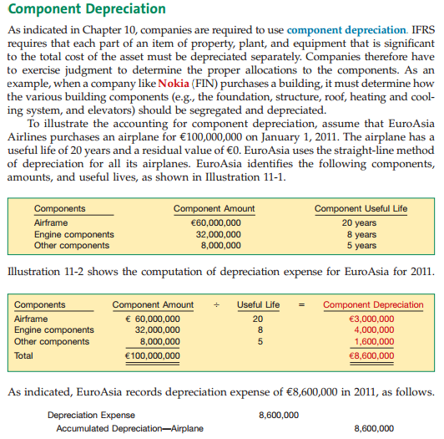
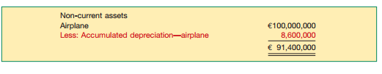
Ind AS 16 (PP&E) and AS 10 (Fixed Assets) and AS 6 (Depreciation)

Slide 104
Ind AS 16 (Property, Plant and Equipment) and AS 10 (Accounting for Fixed Assets) and AS 6 (Depreciation Accounting)
Ind AS 16 | AS 10 & AS 6
Cost of major inspections should be capitalised with consequent derecognition of any remaining carrying amount of the cost of the previous inspection. | Doesn’t deal with this aspect.
Initial estimate of the costs of dismantling and removing the item and restoring the site should be included in the cost of the respective item of property plant and equipment. | Does not contain any such requirement.

Slide 105
Ind AS 16 (Property, Plant and Equipment) and AS 10 (Accounting for Fixed Assets) and AS 6 (Depreciation Accounting)
Ind AS 16 | AS 10 & AS 6
Revaluation surplus included in equity in respect of an item of property plant and equipment may be transferred to the retained earnings when the asset is derecognised. | Neither existing AS 10 nor existing AS 6 deals with the transfers from revaluation surplus.
Ind AS 16 does not specifically deal with this aspect as these would basically be covered by Ind AS 31 as jointly controlled assets. | Specifically deals with the fixed assets owned by the entity jointly with others

Slide 106
Ind AS 16 (Property, Plant and Equipment) and AS 10 (Accounting for Fixed Assets) and AS 6 (Depreciation Accounting)
Ind AS 16 | AS 10 & AS 6
For self-constructed assets, specifically states that the cost of abnormal amounts of wasted material, labour, or other resources incurred in the construction of an asset is not included in the cost of the assets. | While dealing with self-constructed fixed assets does not mention the same.
The residual value and useful life of an asset be reviewed at least at each financial year-end and, if expectations differ from previous estimates, the change(s) should be accounted for as a change in an accounting estimate. | Such a review is not obligatory as it simply provides that useful life of an asset may be reviewed periodically.

Slide 107
Ind AS 16 (Property, Plant and Equipment) and AS 10 (Accounting for Fixed Assets) and AS 6 (Depreciation Accounting)
Ind AS 16 | AS 10 & AS 6
Depreciation method applied to an asset should be reviewed at least at each financial year-end and, if there has been a significant change in the expected pattern of consumption of the future economic benefits embodied in the asset, the method should be changed to reflect the changed pattern. | Change in depreciation method can be made only if the adoption of the new method is required by statute or for compliance with an accounting standard.

Slide 108
Ind AS 16 (Property, Plant and Equipment) and AS 10 (Accounting for Fixed Assets) and AS 6 (Depreciation Accounting)
Ind AS 16 | AS 10 & AS 6
Change in depreciation method should be considered as a change in accounting estimate and treated accordingly. | It is considered as a change in accounting policy and treated accordingly.
Deals with the situation where entities hold the items of property, plant and equipment for rental to others and subsequently sell the same. | No such provision is there in AS 10.
Doesn’t deals with situation where several assets are purchased for a consolidated price. | Has the provision for the same.

Slide 109
IAS 17 (Leases )
IAS -17
Leases

Slide 110
IAS 17 (Leases )
Conditions that define the Lease into Operating and Finance Lease
O- Ownership Transfer
W- Written Bargain Offer
N- Ninety percent of Fair market value
S- Seventy Five percent of useful life
If any one condition is satisfied, it is a Finance Lease, otherwise an Operating Lease
Condition as per US GAAP (similar as per IFRS)

Slide 111
Ind AS 17 and AS 19 (Leases)
Ind AS 17 | AS 19
Has specific provisions dealing with leases of land and building. | Excludes leases of land from its scope.
Provides guidance on accounting for incentives in the case of operating leases, evaluating the substance of transactions involving the legal form of a lease and determining whether an arrangement contains a lease. | The existing standard does not contain such guidance.

Slide 112
Ind AS 17 and AS 19 (Leases)
Ind AS 17 | AS 19
Require current/non-current classification of lease liabilities if such classification is made for other liabilities | These matters are not addressed in the existing standard.
Retains the deferral and amortisation principle, it does not specify any method of amortisation. | If a sale and leaseback transaction results in a finance lease, excess of the sale proceeds over the carrying amount shall be deferred and amortised by the seller-lessee over the lease term in proportion to depreciation of the leased asset.

Slide 113
TREATMENT OF INITIAL DIRECT COSTS
Subject | IAS 17 | AS 19
Finance lease Lessor accounting Non manufacturer/ Non-dealer: | Interest rate implicit in the lease is defined in such a way that the initial direct costs included automatically in the finance lease receivable; there is no need to add them separately. | Either recognized as expense immediately or allocated against the finance income over the lease term.
Operating lease- Lessor accounting | Added to the carrying amount of the leased asset and recognised as expense over the lease term on the same basis as lease income. | Either deferred and allocated to income over the lease term in proportion to the recognition of rent income, or recognized as expense in the period in which incurred.

Slide 114
IAS 18 (Revenue Recognition)
IAS 18
Revenue

Slide 115
IAS 18 and AS 9 (Revenue)
IAS 18 | AS 9
Revenue Covers all economic benefits that arise in the ordinary course of activities of an entity which result in increases in equity, other than increases relating to contributions from equity participants. | Revenue is gross inflow of cash, receivables or other consideration arising in the course of the ordinary activities of an enterprise.
Revenue to be measured at fair value of the consideration received or receivable. | Revenue is recognised at the nominal amount of consideration receivable.
Deals with the exchange of goods and services with goods and services of similar and dissimilar nature (barter system clarified). | This aspect is not dealt with in AS 9.

Slide 116
IAS 18 and AS 9 (Revenue)
IAS 18 | AS 9
Recognition of Service revenue using percentage of completion method only. | For recognition of revenue in case of rendering of services permits the use of completed service contract method also.
Interest to be recognised using effective interest rate method. | Recognition of revenue from interest on time proportion basis.

Slide 117
IAS 18 and AS 9 (Revenue)
IAS 18 | AS 9
Provides guidance regarding revenue recognition in case the entity is under any obligation to provide free or discounted goods or services or award credits to its customers due to any customer loyalty programme. | No any guidance
Doesn’t specifically deal with the same. | Deals with disclosure of excise duty as a deduction from revenue from sales transactions (Exclusive method or Inclusive method).

Slide 118
IAS 19 (Employee Benefits)
IAS -19
Employee Benefits

Slide 119
IAS 19 and AS 15 (Employees Benefits)
IAS 19 | AS 15
Employee benefits arising from constructive obligations are also covered. | Doesn’t deal with the same.
Employee includes directors. | Employee includes whole-time directors
Deals with situations where there is a contractual agreement between a multi-employer plan. | The existing AS 15 does not deal with it.

Slide 120
IAS 19 and AS 15 (Employees Benefits)
IAS 19 | AS 15
Participation in a defined benefit plan sharing risks between various entities under common control is a related party transaction for each group entity and some disclosures are required in the separate or individual financial statements of an entity. | Doesn’t contain similar provisions.
Financial assumptions shall be based on market expectations, at the end of the reporting period, for the period over which the obligations are to be settled. | The existing standard does not clarify the same.

Slide 121
Ind AS 20 and AS 12 (Accounting for Govt. Grants)
AS -12
Accounting for Government grants
&
Ind AS 20
Accounting for Government Grants and Disclosure of Government Assistance

Slide 122
Ind AS 20 (Accounting for Government Grants and Disclosure of Government Assistance)&AS 12 (Accounting for Government Grants)
Ind AS 20 | AS 12
Deals with the other forms of government assistance which do not fall within the definition of government grants. | Not any guidance
Specifically prohibits recognition of grants directly in the shareholders’ funds. | If grant is in respect of non-depreciable assets, the grant should be shown as capital reserve which is a part of shareholders’ funds.
Provides an option to value non-monetary grants at their fair value. | Government grants in the form of non-monetary assets, given at a concessional rate, should be accounted for on the basis of their acquisition cost. If asset is given free of cost, it should be recorded at a nominal value

Slide 123
IAS 21 and AS 11 (The Effects of Changes in Foreign Exchange Rates)
IAS 21
The effects of Changes in Foreign Exchange rates

Slide 124
Ind AS 21 and AS 11 (Effects of Changes in Foreign Exchange Rates)
Ind AS 21 | AS 11
Based on the functional currency approach. | Based on integral foreign operations and non-integral foreign operations approach.
Presentation currency can be different from local currency and it gives detailed guidance on this. | Whereas the existing AS 11 does not explicitly states so.

Slide 125
Functional Currency
How to determine?
®
125

Slide 126
Functional Currency
Example
P&L rate
1 USD = Rs. 50.3
P&L rate
1 USD = EUR .79
B/sheet rate 1USD=Rs.50.5
B/sheet rate 1USD=EUR 0.80
Original Currency
Functional Currency
Reporting Currency
(Amount in INR)
(Amount in USD)
(Amount in EUR)
Sales
5000
99.40
78.53
Expense
3000
59.64
47.12
Equity
2000
39.60
31.68
Fixed Assets (PP&E)
3000
59.41
47.52
Current Assets
1000
19.80
15.84
7000
7000
138.85
139.01
111.08
110.21
Difference
0
(0.16)
0.87
Transaction
Translation
Moves to P&L
Moves to B/sheet

Slide 127
IAS 23 (Borrowing Cost)
IAS -23
Borrowing Cost

Slide 128
IAS 23 and AS 16 (Borrowing Costs)
IAS 23 | AS 16
Does not require an entity to apply this standard to borrowing costs directly attributable to the acquisition, construction or production of a qualifying asset measured at fair value. e.g. ‘a biological asset’. | Does not provide for such scope relaxation.
Interest expense is calculated using the effective interest rate method as described in Ind AS 39 (Financial Instruments: Recognition and Measurement). | Borrowing Costs include the following: Interest and commitment charges on bank borrowings and other short-term and long-term borrowings, Amortisation of discounts or premiums relating to borrowings, Amortisation of ancillary costs incurred in connection with the arrangement of borrowings.

Slide 129
IAS 23 and AS 16 (Borrowing Costs)
IAS 23 | AS 16
When the Standard on Financial Reporting in Hyperinflationary Economies is applied, part of the borrowing costs that compensates for inflation should be expensed as required by that Standard (and not capitalised in respect of qualifying assets). | Doesn’t contain a similar clarification.
It is appropriate to include all borrowings of the parent and its subsidiaries when computing a weighted average of the borrowing costs while in other circumstances, it is appropriate for each subsidiary to use a weighted average of the borrowing costs applicable to its own borrowings. | No such provision has been provided.
Requires disclosure of capitalisation rate used to determine the amount of borrowing costs eligible for capitalisation. | Doesn’t have this disclosure requirement.

Slide 130
IAS 24 (Related Party Disclosure )
IAS -24
Related Party Disclosure

Slide 131
IAS 24 and AS 18 (Related Party Disclosures )
IAS 24 | AS 18
Covers key management personnel's (‘KMPs’) of the parent as well. | Covers key management personnel's (‘KMPs’) of the entity only.
Co-ventures or co-associates are not related to each other. | There is extended coverage in case of joint ventures.
Includes post employment benefit plans for the benefit of employees of an entity or its related entity as related parties. | Does not specifically cover entities that are post employment benefit plans, as related parties.
The amount of the transactions need to be disclosed. | Provides an option to disclose the “Volume of the transactions either as an amount or as an appropriate proportion”.

Slide 132
IAS 26 (Accounting and Reporting by Retirement Benefit Plan )
IAS -26
Accounting and Reporting by Retirement Benefit Plan
No Corresponding Plan in India

Slide 133
IAS 27 (Consolidated and Separate Financial Statements )
IAS -27
Consolidated and Separate Financial Statements

Slide 134
Ind AS 27 (Consolidated and Separate Financial Statements) and AS 21 (Consolidated Financial Statements)
Ind AS 27 | AS 21
Preparation of consolidated financial statement mandatory for all the parents except where parents meets certain conditions. Further separate financial statement is not required. | Is not mandatory ,further in addition to consolidated financial statement separate financial statement is required to be prepared.
Deals with investments in jointly controlled entities and associates to be presented in the separate financial statements. | Does not deal with the same.

Slide 135
Ind AS 27 (Consolidated and Separate Financial Statements) and AS 21 (Consolidated Financial Statements)
Ind AS 27 | AS 21
Minority interest should be presented in the consolidated balance sheet separately from liabilities and equity of the parent’s shareholders. | Minority interests shall be presented in the consolidated balance sheet within equity separately from the parent shareholders’ equity.
The length of difference in the reporting dates of the parent and the subsidiary should not be more than three months. | The length of difference in the reporting dates of the parent and the subsidiary should not be more than six months but after making adjustments regarding effects of significant transactions.
Use of uniform accounting policy in preparation of consolidation. | Use of uniform accounting policy if not practicable, to use disclosure of the same to be made.

Slide 136
IAS 27 (Consolidated and Separate Financial Statements)
Ind AS 27 | AS 21
Does not give any such exemption from consolidation except that if a subsidiary meets the criteria to be classified as held for sale. | Subsidiary is excluded from consolidation when control is intended to be temporary or when subsidiary operates under severe long term restrictions
No clarification has been provided in this regard. | Provides clarification regarding consolidation in case an entity is controlled by two entities.

Slide 137
IAS 28 (Investments in Associates)
IAS -28
Investment in Associates

Slide 138
Ind AS 28 and AS 23 (Investments in Associates )
Ind AS 28 | AS 23
Investments in associates held by venture capital organizations, mutual funds, unit trusts and similar entities including investment-linked insurance funds are excluded from its scope. | No such exclusion are made.
If investment in an associate is not accounted for as per equity method, the same is to be accounted for in accordance with Ind AS 39 (Financial Instruments; Recognition and Measurement). | If investment in an associate is not accounted for as per the equity method, the same is accounted for in accordance with existing AS 13 (Accounting for investments).
Length of difference in the reporting dates of the investor and the associate should not be more than three months unless it is impracticable. | Permits the use of financial statements of the associate drawn up to a date different from the date of financial statements of the investor when it is impracticable to draw the same.

Slide 139
Ind AS 28 and AS 23 (Investments in Associates )
Ind AS 28 | AS 23
Requires that after application of equity method, including recognising the associate’s losses, the requirements of Ind AS 39 shall be applied to determine whether it is necessary to recognise any additional impairment loss. | With regard to impairment, the existing AS 23 requires that the carrying amount of investment in an associate should be reduced to recognise a decline, other than temporary, in the value of the investment.
Carrying amount of investment in the associate as well as its other long term interests in the associate is part of the investor’s net investment and is considered for recognising investor’s share of losses. | Investor’s share of losses in the associate is recognised to the extent of carrying amount of investment in the associate.

Slide 140
IAS 29 (Financial Reporting in Hyperinflationary Economies)
IAS -29
Financial Reporting in Hyperinflationary Economies
Economies where the cumulative inflation rate over 3 years is approaching or exceeds 100%

Slide 141
AS 27(Financial Reporting of Interests in Joint Ventures) & Ind AS 31(Interest in Joint Ventures)
AS -27
Financial Reporting of Interests in Joint Ventures
&
IND AS -31
Interest in Joint Ventures

Slide 142
IAS 31 and AS 27 (Interests in Joint Ventures )
IAS 31 | AS 27
Excludes joint venture investments made by venture capital organization, mutual funds, unit trusts and similar entities including investment linked insurance funds. | Doesn’t make such exclusion.
A venturer can recognise its interest in jointly controlled entity using either proportionate consolidation method or equity method. | Use of only proportionate consolidation method is prescribed.
Requires consolidation of jointly controlled entities subject to a few exemptions, even if the venturer does not have any subsidiary in the financial statements. | Requires application of the proportionate consolidation method only when the entity has subsidiaries and prepares Consolidated Financial Statements

Slide 143
Ind AS 31 and AS 27 (Interests in Joint Ventures )
Ind AS 31 | AS 27
Requires it to be recognised at cost or in accordance with Ind AS 39. | In case of separate financial statements, interest in jointly controlled entity is accounted for cost less provision for other than temporary decline in the value of investment.
Deals with the venturer’s accounting for non-monetary contributions to a jointly controlled entity. | Doesn’t deal with this aspect.

Slide 144
AS 31(Financial Instruments: Presentation) & Ind AS 32(Financial Instruments: Presentation)
AS -31
Financial Instruments: Presentation
&
IND AS -32
Financial Instruments: Presentation

Slide 145
IAS 32 and AS 31 (Financial Instruments: Presentation)
IAS 32 | AS 31
Does not exempt such contracts. | Does not apply to contracts for contingent consideration in a business combination in case of acquirers.
IAS 32 includes the definition of puttable instruments and deals with the same and also specifies conditions for offsetting a financial liability or financial asset. | Doesn’t have guidance on any of them.

Slide 146
Ind AS 32 and AS 31 (Financial Instruments: Presentation)
IND AS 32 | AS 31
Mention about classifications as financial assets in case of the issuer of a non-derivative financial instrument who is required to evaluate the terms of the financial instrument to determine whether it contains both a liability and an equity component. | No provision for the same.
Related amount of income taxes recognised directly in equity is included in the aggregate amount of current and deferred income tax credited or charged to equity. | No provision for the same.

Slide 147
Ind AS 107 and AS 32 (Financial Instruments: Disclosures)
Ind AS 107 | AS 32
Apply to contracts for contingent consideration in a business combination in case of acquirers. | Does not apply to contracts for contingent consideration in a business combination in case of acquirers.
Specifies disclosures in case of reclassification of a financial asset. | Does not provide for same.
Requires enhanced disclosures about fair value measurements and liquidity risk. | No such Requirements.

Slide 148
AS 20 (Earning per share) & Ind AS 33 (Earning per share )
AS -20
Earning per share
&
IND AS -33
Earning per share

Slide 149
Ind AS 33 and existing AS 20 (Earnings per Share)
Ind AS 33 | AS 20
Deals with the same. | Doesn’t specifically deal with options held by the entity on its shares, e.g. purchased options, written put option, etc.
Requires presentation of basic and diluted EPS from continuing and discontinued operations separately. | Doesn’t require such disclosure.
Doesn’t require the disclosure as required in AS 20. (As per Ind AS 1, Presentation of Financial Statements, no item can be presented as extraordinary item). | Requires the disclosure of EPS with and without extraordinary items.

Slide 150
AS 25(Interim Financial Reporting) & Ind AS 34 (Interim Financial Reporting)
AS -25
Interim Financial Reporting
&
IND AS -34
Interim Financial Reporting

Slide 151
Ind AS 34 and AS 25 (Interim Financial Reporting)
Ind AS 34 | AS 25
Applies only if an entity is required or elects to prepare and present an interim financial report in accordance with Accounting Standards. | If an entity is required or elects to prepare and present an interim financial report, it should comply with that standard.
In addition to the requirement in AS 25, a condensed statement of changes in equity is required. | The contents of an interim financial report include, a condensed balance sheet, a condensed statement of comprehensive income, presented as either (i) a condensed single statement or (ii) a condensed separate income statement and a condensed statement of comprehensive income, a condensed cash flow statement and selected explanatory notes.

Slide 152
Ind AS 34 and AS 25 (Interim Financial Reporting)
Ind AS 34 | AS 25
Prohibits reversal of impairment loss recognised in a previous interim period in respect of goodwill or an investment in either an equity instrument or a financial asset carried at cost. | There is no such specific prohibition in the existing standard
Requires furnishing of information on both contingent liabilities and contingent assets. | Requires furnishing of information on contingent liabilities only.

Slide 153
Ind AS 34 and AS 25 (Interim Financial Reporting)
Ind AS 34 | AS 25
It neither requires nor prohibits the inclusion of the parent's separate statements in the entity's interim report prepared on a consolidated basis. | If an entity’s annual financial report included the consolidated financial statements in addition to the separate financial statements, the interim financial report should include both the consolidated financial statements and separate financial statements, complete or condensed.
Requires furnishing of information, in interim financial report, on dividends paid, aggregate or per share separately for equity and other shares. | The existing standard requires furnishing information, in interim financial report, of dividends, aggregate or per share (in absolute or percentage terms), for equity and other shares.

Slide 154
AS 28(Impairment of Assets) & Ind AS 36(Impairment of Assets)
AS -28
Impairment of Assets
&
IND AS -36
Impairment of Assets

Slide 155
Ind AS 36 and AS 28 (Impairment of Assets)
Ind AS 36 | AS 28
Annual impairment testing is required for an intangible asset with an indefinite useful life or not yet available for use and goodwill acquired in a business combination. | No any requirement for annual impairment testing for the goodwill unless there is an indication of impairments.
Provides additional guidance on the following aspect compared to the AS 28: Estimating the value in use of an asset, For managements to assess the reasonableness of the assumptions on which cash flows are based, Using present value techniques in measuring an asset’s value in use. | No such guidance is available

Slide 156
Ind AS 36 and AS 28 (Impairment of Assets)
Ind AS 36 | AS 28
Goodwill is allocated to Cash-Generating units (‘CGUs’) or groups of CGUs that are expected to benefit from the synergies of the business combination from which it arose. | Goodwill is allocated to CGUs only when the allocation can be done on a reasonable and consistent basis.
Recognition of reversals of impairment loss for goodwill is prohibited. | Requires that the impairment loss recognised for goodwill can be reversed in a subsequent period when it was caused by a specific external event of an exceptional nature.

Slide 157
AS 29(Provisions, Contingent Liabilities and Contingent Assets) & Ind AS 37(Impairment of Assets)
AS -29
Provisions, Contingent Liabilities and Contingent Assets
&
IND AS -37
Provisions, Contingent Liabilities and contingent Assets

Slide 158
Ind AS 37 and AS 29 (Provisions, contingent Liabilities and Contingent Assets)
Ind AS 37 | AS 29
Requires creation of provisions in respect of constructive obligations also. | Requires creation of provision arising out of normal business practices, custom and a desire to maintain good business relations or to act in an equitable manner.
Requires discounting the amounts of provisions, if effect is material. | Prohibits discounting the amounts of provisions.
Requires disclosure of contingent assets in the financial statements when the inflow of economic benefits is probable. | Requires disclosure of contingent assets in the report of the approving authority but prohibits disclosure of the same in the financial statements.

Slide 159
Ind AS 37 and AS 29 (Provisions, contingent Liabilities and Contingent Assets)
Ind AS 37 | AS 29
Before a separate provision for an onerous(Heavy/Burdensome) contract is established, an entity should recognise any impairment loss that has occurred on assets dedicated to that contract. | There is no such specific provision in the existing standard.
Gives an exception to this principle viz. such losses related to an onerous (Heavy/Burdensome) contract. | Identifiable future operating losses up to the date of restructuring are not included in a provision.

Slide 160
AS 26(Intangible Assets) & Ind AS 38(Intangible Assets)
AS -26
Intangible Assets
&
IND AS -38
Intangible Assets

Slide 161
Ind AS 38 and AS 26 (Intangible Assets)
Ind AS 38 | AS 26
(Definition) Intangible asset as an identifiable non-monetary asset without physical substance . | (Definition) Intangible asset as an identifiable non-monetary asset without physical substance held for use in the production or supply of goods or services, for rental to others, or for administrative purposes
In the case of separately acquired intangibles, the criterion of probable inflow of expected future economic benefits is always considered satisfied, even if there is uncertainty about the timing or the amount of the inflow. | There is no such provision in the existing standard.
If payment for an intangible asset is deferred beyond normal credit terms, the difference between this amount and the total payments is recognised as interest expense over the period of credit unless it is capitalised. | There is no such provision in the existing standard.

Slide 162
Ind AS 38 and AS 26 (Intangible Assets)
Ind AS 38 | AS 26
Deals in detail in respect of intangible assets acquired in a business combination. | Refers only to intangible assets acquired in an amalgamation in the nature of purchase and does not refer to business combinations as a whole.
If an intangible asset is acquired in exchange of a non-monetary asset, it should be recognised at the fair value of the asset given up unless the fair value of the asset received is more clearly evident. | Principles of existing AS 10 to be followed which includes an alternative accounting treatment.

Slide 163
Ind AS 38 and AS 26 (Intangible Assets)
Ind AS 38 | AS 26
When intangible assets are acquired free of charge or for nominal consideration by way of government grant then should record both the grant and the intangible asset at fair value. | Recognised at nominal value or at acquisition cost, as appropriate plus any expenditure that is attributable to making the asset ready for intended use.
The useful life of an intangible asset can even be indefinite subject to fulfillment of certain conditions, in which case it should not be amortised but should be tested for impairment. | Based on the assumption that the useful life of an intangible asset is always finite, and includes a rebuttable presumption that the useful life cannot exceed ten years from the date the asset is available for use.

Slide 164
Ind AS 38 and AS 26 (Intangible Assets)
Ind AS 38 | AS 26
Gives guidance for the treatment of such expenditure. | Is silent regarding the treatment of subsequent expenditure on an in-process research and development project acquired in a business combination.
Guidance is available on cessation of capitalisation of expenditure, derecognition of a part of an intangible asset and useful life of a reacquired right in a business combination. | There is no such guidance on these aspects.
Permits an entity to choose either the cost model or the revaluation model as its accounting policy. | Revaluation model is not permitted.

Slide 165
Ind AS 38 and AS 26 (Intangible Assets)
Ind AS 38 | AS 26
Change in the method of amortisation is change in accounting estimate. | Change in the method of amortisation is a change in accounting policy
If payment of consideration on disposal of an intangible asset is deferred, the consideration is recognised initially at the cost is cash price equivalent. | There is no such provision in the existing standard.
They would be covered by Ind AS 105 | Intangible assets retired from use and held for sale are covered.

Slide 166
AS 30(Financial Instruments: Recognition and Measurement) & Ind AS 39(Impairment of Assets)
AS -30
Financial Instruments: Recognition and Measurement
&
IND AS -39
Financial Instruments: Recognition and
Measurement

Slide 167
Ind AS 39 and AS 30 (Financial Instruments: Recognition and Measurement )
Ind AS 39 | AS 30
Doesn’t exempt contracts for contingent consideration in a business combination from its scope. | The exemption applies only to the acquirer.
A financial asset or financial liability at fair value through profit or loss is classified as held for trading if ‘on initial recognition it is part of a portfolio of identified financial instruments’. | A financial asset or financial liability at fair value through profit or loss is classified as held for trading if ‘it is part of a portfolio of identified financial instruments that are managed together and for which there is evidence of a recent actual pattern of short-term profit taking’.
Provides application guidance on effective interest rate. | Doesn’t have any guidance on the same.

Slide 168
IAS 40(Investment property)
IAS -40
Investment Property

Slide 169
Indian GAAP with IFRS with Ind AS (IAS 40)
Indian GAAP | IFRS | Ind AS
No such standard and classification | Investment properties are those which are held for any of these 2 purpose : a) Used for capital appreciation b) Held For Rental purpose | Similar
Classified as Non-Current Investment | Can be measured using the cost or fair value model with changes in fair value , recognized in profit or loss a/c. | Measured, using cost model only

Slide 170
IAS 41(Agriculture)
IAS -41
Agriculture

Slide 171
Indian GAAP with IFRS with Ind AS (IAS 41)
Indian GAAP | IFRS | Ind AS
No such standard and classification | Measured at fair value less cost to sell | No corresponding standard issued so far.

Slide 172
AS 14 (Accounting for Amalgamations) and Ind AS 103- (Accounting for Business Combinations)
AS -14
Accounting for Amalgamations
&
IND AS -103 & IFRS -3
Business Combinations

Slide 173
Ind AS 103 and AS 14 (Business Combination)
AS-14 to include:
AS-14 – Accounting for Amalgamations
Ind AS-103 to include:
Ind AS-2 – Business Combination
Basic Conclusions :
Business Combinations include Amalgamation and Absorptions (wider in scope)
Pooling of Interest method is not allowed in the IFRS. Under the Pooling of Interest method, the assets, liabilities and reserves of the transferor company are recorded by the transferee company at their existing carrying amounts (after making the adjustments required for conflicting accounting policies).
In the Purchase method, the assets are acquired using the Fair value or the
Book value of the identifiable assets/liabilities.

Slide 174
Ind AS 103 (Business Combinations) and AS 14 (Accounting For Amalgamation)
Ind AS 103 | AS 14
Covers Business combination which has a wider scope. It covers amalgamation and absorption as well. | Deals only with amalgamation only
Method of Amalgamation Accounting: Purchase method only | Method of Amalgamation Accounting: Pooling of interest method or Purchase method

Slide 175
Ind AS 103 (Business Combinations) and AS 14 (Accounting For Amalgamation)
Ind AS 103 | AS 14
Valuation at Fair Value | Valuation at Book Value or at Fair Value
Goodwill is not amortized but tested for impairment on annual basis | Goodwill arising on amalgamation in the nature of purchase is amortized over a period not exceeding five years.
Deals with reverse acquisitions (the acquisition of a public company by a private company so that the private company can bypass the lengthy and complex process of going public) | Does not deal with the same.

Slide 176
AS 17 (Segment Reporting) & Ind AS 108 (Operating Segments )
AS -17
Segment Reporting
&
IND AS -108
Operating Segments

Slide 177
Ind AS 108(Operating Segments) and AS 17 (Segment Reporting)
Ind AS 108 | AS 17
Identification of segments is based on ‘management approach’ i.e. operating segments are based on the internal reports regularly reviewed by the entity’s COD (chief operating decision) maker. | Requires identification of two sets of segments – Based on related products and services On geographical areas based on the risks and returns approach. One set is regarded as primary segments and the other as secondary segments.
The amounts reported for each operating segment shall be measured on the same basis as used by the chief operating decision maker for the purposes of allocating resources to the segment and assessing its performance. | Segment information to be prepared in conformity with the accounting policies adopted for preparing and presenting the financial statements. It also defines segment revenue, segment expense, segment result, segment assets and segment liabilities.

Slide 178
Ind AS 108(Operating Segments) and AS 17 (Segment Reporting)
Ind AS 108 | AS 17
Requires certain disclosures even in case of entities having single reportable segment. | In case there is neither more than one business segment nor more than one geographical segment, segment information as per this standard is not required to be disclosed. However, proper disclosure to be made.
Disclosures of revenues from external customers for each product and service. | Disclosures are based on the classification of the segments as primary or secondary segments. Disclosure requirements for primary segments are more detailed as compared to secondary segments.

Slide 179
AS 24(Discontinuing Operations) & Ind AS 105 (Non-Current Assets Held for Sale and Discontinued Operations)
AS -24
Discontinuing Operations
&
IND AS -105
Non-Current Assets Held for Sale and Discontinued Operations

Slide 180
Ind AS 105 and AS 24 (Non-Current Assets Held for Sale and Discontinued Operations )
AS-24 to include:
AS-24 – Discounting Operations
AS-10 – Accounting For Fixed Assets
Ind AS-105 to include:
Ind AS-105 -Non-Current Assets Held for Sale and Discontinued Operations
Basic Conclusions :
There is no standard in India dealing with non-current assets held for sale though AS-10 deals with Assets held for disposal.. Though AS-10 deals with assets held for
disposal
b) Conditions are specified in IFRS to be qualified as HFS (PAPOA conditions)

Slide 181
Ind AS 105 and AS 24 (Non-Current Assets Held for Sale and Discontinued Operations )
Ind AS 105 | AS 24
Specifies the accounting for noncurrent assets held for sale, and the presentation and disclosure of discontinued operations. | It does not deal with the non-current assets held for disposal. (These are dealt in existing AS 10).
Discontinued operation is a component of an entity that either has been disposed of or is classified as held for sale. | No concept of discontinued operations but it deals with discontinuing operations.

Slide 182
Four Conditions – for classification “Assets Held for Sale”
For a non-current asset (Fixed Asset) to be classified as 'held for sale', all of the following 4 conditions must be satisfied:
PAPOA Conditions
P- The successful sale of the asset must be highly probable, signified by both:
i) The management's commitment to the asset-selling plan; and
ii) Existence of active marketing to support the sale of the asset.
A - The asset must be available for immediate sale in its present condition and location;
P- There must be no expectation that the plan for selling the asset will be withdrawn or changed significantly; and
O- The asset's sale is expected to be completed within One Year of classification as 'held for sale'; and
A- shall be classified as “Asset Held for sale”
The managements decision is also required for that sale proceeds and then the Fair value could be ascertained.

Slide 183
Ind AS 105 and AS 24 (Non-Current Assets Held for Sale and Discontinued Operations )
Ind AS 105 | AS 24
The sale should be expected to qualify for recognition as a completed sale within one year from the date of classification with certain exceptions. | Does not specify any time period in this regard as it relates to discontinuing operations.
Non-current assets (disposal groups) held for sale are measured at the lower of carrying amount and fair value less costs to sell, and are presented separately in the balance sheet. | Requires to apply the principles set out in other relevant Accounting Standards, e.g., AS 10 requires that the fixed assets retired from active use and held for disposal should be stated at the lower of their net book value and net realisable value and shown separately in the financial statements.

Slide 184
IFRS - Key IFRS practices (new terms)
Notes:
184

Slide 185
Statement of Comprehensive Income
ABC Company Statement of Income and Comprehensive Income For the Year Ended December 31, 2012
Revenues |  | $1,000,000
Expenses |  | 800,000
Net income |  | 200,000
Other comprehensive income, net of tax:
Foreign currency translation adjustments |  | 10,000
Unrealized gains on securities:
Unrealized holding gains arising during the period | $12,000
Less: reclassification of gains included in net income | (3,000) | 9,000
Defined benefit pension plans: Net loss arising during the period | (2,000)
Prior service cost arising during the period | (4,000)
Less: amortization of prior service cost included in net periodic pension cost | 1,000 | (5,000)
Other comprehensive income |  | 14,000
Comprehensive income |  | $214,000

Slide 186
Statement of Other Comprehensive Income
Contains all changes that are not permitted in profit or loss. Items in other comprehensive income include:
Pension or post-retirement benefit plan gains or losses, benefit plan prior service costs or credits
Available-for-sale securities unrealized gains and losses
Foreign currency translation adjustments
Cash flow hedge derivative instrument gains and losses (effective portion)
P
U
F
E

Slide 187
Statement of Comprehensive Income
Other items in other comprehensive income include:
Available-for-sale securities fair value changes that were previously written down as impaired
Debt security unrealized gains and losses arising from a transfer from the available-for-sale category to the held-to-maturity category
Foreign currency gains and losses on intra-entity currency transactions where settlement is not planned or anticipated in the foreseeable future
Foreign currency transaction gains and losses that are hedges of an investment in a foreign entity
Pension or post-retirement benefit plan transition assets or obligations that are not recognized as a component of the net periodic benefit or cost

Slide 188
Statement of Comprehensive Income IFRS new proposal on change
It proposes to require entities:
To present a statement showing as two separate sections:
i. Profit or loss; and
ii. All items of ‘other comprehensive income’ (OCI); and
To present separately:
i. Those items of OCI that might be recycled subsequently; and
ii. Those items of OCI that will not be recycled subsequently.

Slide 189
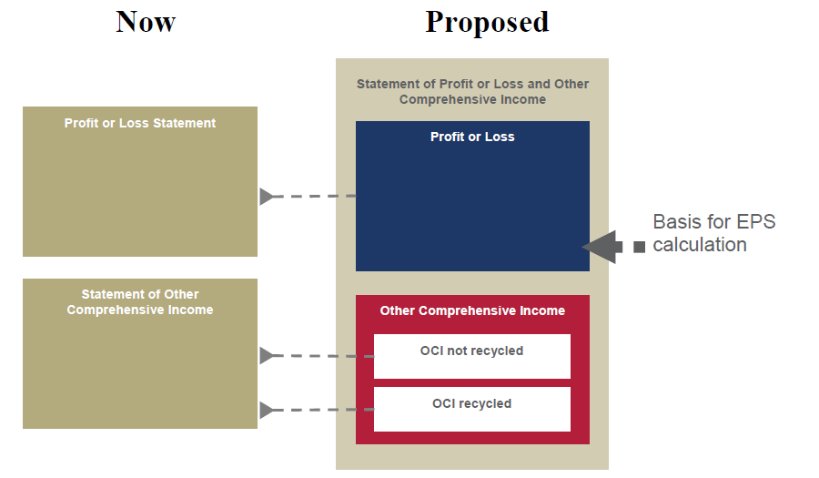
Statement of Comprehensive Income IFRS new proposal on change

Slide 190
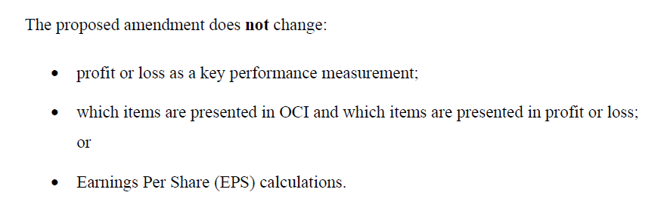
Statement of Comprehensive Income IFRS new proposal on change

Slide 191
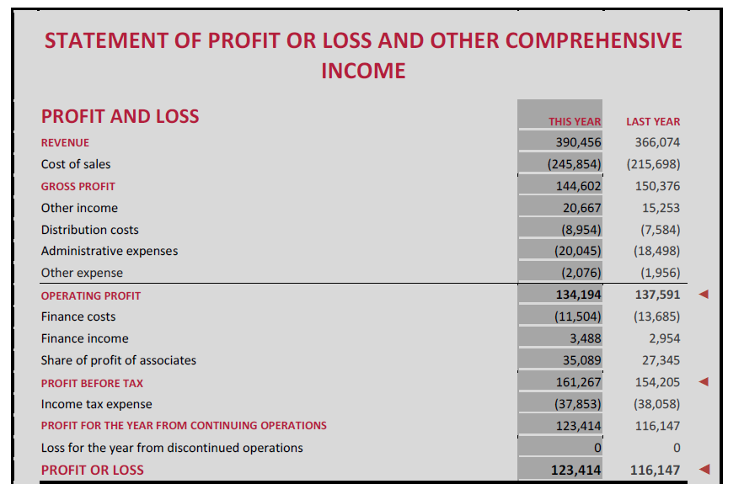
Statement of Comprehensive Income 2 statements- One single

Slide 192
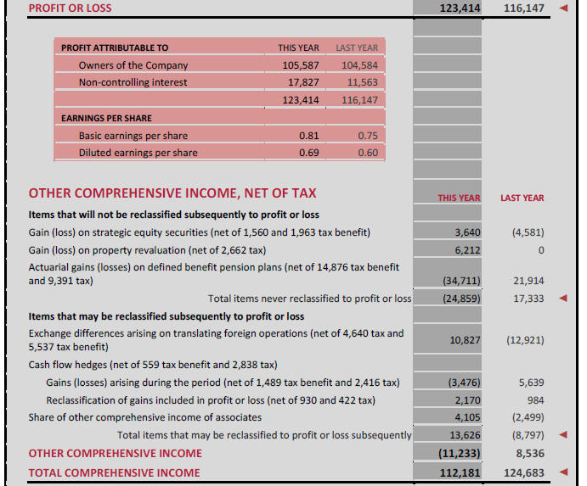
Statement of Comprehensive Income 2 statements- One single

Slide 193
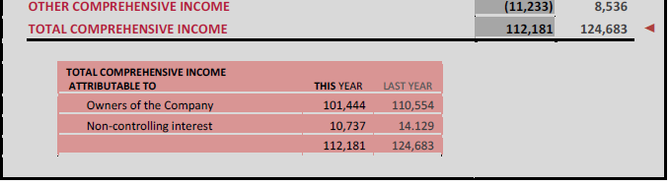
Statement of Comprehensive Income 2 statements- One single

Slide 194
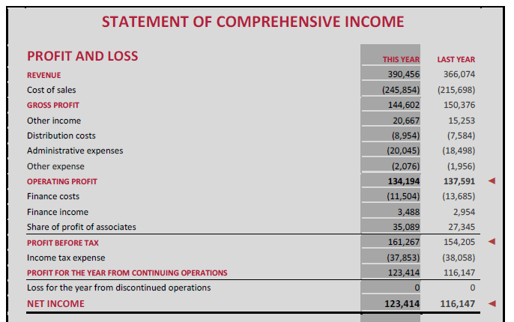
Statement of Comprehensive Income 2 statements- Two Separate Statements

Slide 195
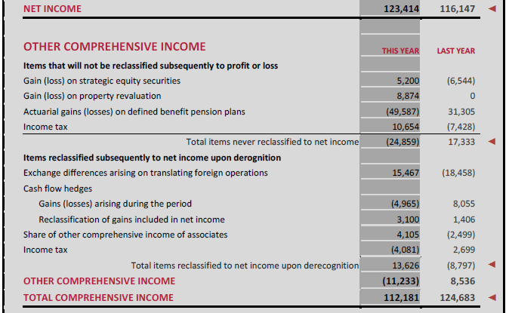
Statement of Comprehensive Income 2 statements- Two Separate Statements

Slide 196
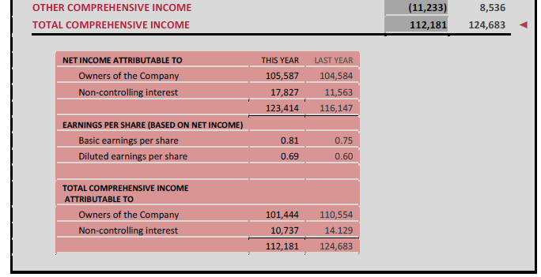
Statement of Comprehensive Income 2 statements- Two Separate Statements

Slide 197
IFRS 1– First Time Adoption
There are 15 Optional exemption’s to ease the burden of retrospective application
There are also 4 mandatory exemption’s where retrospective application is not permitted

Slide 198
IFRS 1– First Time Adoption
Optional Exemption from Retrospective application
1. Business combinations.
2. Fair value or revaluation as deemed cost for property, plant and equipment and other assets.
3. Employee benefits.
4. Cumulative translation differences.
5. Compound financial instruments.
6. Assets and liabilities of subsidiaries.
7. Associates and joint ventures.
8. Designation of previously recognized financial instruments.
9. Share-based payment transactions.
10. Insurance contracts.
11. Decommissioning liabilities.
12. Arrangements containing leases.
13. Fair value measurement of no-active market financial instruments at initial recognition.
14. Service concession arrangements.
15. Borrowing costs.

Slide 199
Optional exemptions
IFRS 1 Optional Exemptions - 15
Business combinations
Compound instruments
Property, plant and equipment,
investment properties, intangibles
Fair value measurement of financial
Instruments on initial recognition
Employee benefits
Standards
in force at
reporting date
Designation of financial assets and
Financial liabilities
Cumulative translation differences
Share-based payments
Transition date for subsidiaries,
associates and joint ventures
Decommissioning liabilities
Leases
Insurance contracts*
Borrowing cost
Service concessions arrangements
Investments in subsidiaries, associates and joint control entities.

Slide 200
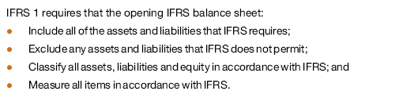
IFRS 1– First Time Adoption
Mandatory Exemption from Retrospective application
1. De-recognition of financial assets and financial liabilities.
2. Hedge accounting.
3. Estimates.
4. Non-current assets classified as held for sale and discontinued operations.
Requirement- IFRS-1

Slide 201
IFRS 1– First Time Adoption
Examples-
Mandatory Exemption from retrospective Application

Slide 202
Mandatory Exemption from Retrospective application
Estimates
Estimate
required by
previous GAAP?
YES
Evidence of error?
NO
Calculation consistent
with IFRS?
NO
YES
YES
NO
Make estimate
reflecting conditions
at relevant date
Use previous estimate
Use previous
estimate and adjust
to reflect IFRS

Slide 203
IFRS 1– First Time Adoption
Step # 1
Mandatory Exemption from retrospective Application
Estimates- Due to uncertainty in business activities
Prospective application
Comparative Information is not required to be restated
Examples:
Bad debts
Inventory obsolescence
Useful life of depreciable assets

Slide 204
IFRS 1– First Time Adoption
Step # 2
Mandatory Exemption from retrospective Application
Derecognizing of financial assets and liabilities-
An entity recognizes all financial assets and financials liabilities, including derivatives, that qualifies for recognition as per IAS 39.
IFRS1.B2- It exempts the retrospective derecognizing for the assets and liabilities recognized before 1st January, 2004. However if the entity has all the available information for the application of derecognizing of financial assets and financial liability, an Entity can choose the period.
Example – An entity which does not apply IFRS1.B3, does not recognized assets transferred in a securitization arrangement that occurred before 1st January, 2004
Reason - It could be costly and complex affair to gather all the previous year’s detail and the effect this transaction will be diminishing with the passage of time.

Slide 205
IFRS 1– First Time Adoption
Step # 3
Mandatory Exemption from retrospective Application
Hedge Accounting – In accordance with IAS 39, as entity shall
Measure all derivatives at fair value; and
Eliminate all deferred losses and gains arising on derivatives that were reported in accordance with previous GAAP as if they are assets and liabilities
However IFRS 1 permits to adopt hedge accounting for relationship
That have been designated as hedges under previous GAAP; and
Which also qualify for hedge accounting under IAS 39
Hedge accounting is than applied from the date, the hedging relationship is fully designated and fully documented as per IAS 39 and not from the date of transition. Also if any transaction is recognized as Hedge under pervious GAAP but not following the definition as Hedge transaction as per IAS 39, has to be designated as per IAS 39.
This designated has to be applied on the date of transition.

Slide 206
IFRS 1– First Time Adoption
Step # 4
Mandatory Exemption from retrospective Application
Non-Controlling Interests – The provision of prospective application of NCI comes in effect due to the changes made in IAS 27 which is applicable effective 30th June, 2010 annual period. The proposed changes suggest:-
To attribute the total comprehensive income between Owner and NCI even though NCI have deficit balance;
Requirement for accounting for changes in the parents’ ownership interest that do not result in a loss of control; and
Requirement for accounting for a loss of control of subsidiary.
The above requirements as mandated by IAS 27 is supposed to be applied prospectively. The basic assumption made herein is the early adoption of IAS27 amendments.
However if an entity elects to apply IFRS 3 retrospectively to past business combinations, it shall also need to apply amended IAS 27 and this exemption is not applicable in that case.

Slide 207
IFRS implementation-
World Scenario

Slide 208
Challenges in IFRS in India
Information content
Protective confidentiality vs. complete
transparency
Completeness vs. Invasion by analysts, who till
recently knew IGAAP
More volatility in Income Statement
Relevance for stakeholders
Recognition and transaction processing with flexibility for
Corporate reporting – Substance over Form,
Tax Accounts and Return – Historical Cost vs. Fair Valuation

Slide 209
Challenges in IFRS in India
Lowest importance to the Regulatory framework of accounting
Test of ‘Functional Currency’
Unlearning and relearning – Research, Reading, Benchmarking
Guidance of EAC of ICAI, RBI – Replaced by IFRIC, SIC and IND AS
Schedule VI and Regulatory Provisions – Revised
Revenue recognition – Retail, Automobile,Construction, Airlines, etc.

Slide 210
Challenges in IFRS in India… 2
Mandatory tests and measurements
Covenant compliance
Classification of Current liabilities
Test of Going concern
Debt and Interest - in Preference Shares and Quasi Equity Instruments
Modeling and valuation of Options and other Derivative contracts
ERP System under new standards
Automated process vs. Worksheets in excel with associated risks
Handling of GAAP differences for conversion

Slide 211
Challenges in IFRS in India… 2
Annual Business Plan preparation under converged IFRS Standards
Emerging needs of Direct Tax Code and Goods and Service Tax
“To be effective, governance standards need to be implemented in a way that fits the culture and organisation structure of the individual company”
CFO, Tata Steel
Source: Indian Management, August 2011

Slide 212
For IFRS implementation
Study IFRS-1/ Ind AS 101 – First time implementation
Study other IFRS & Ind-AS and also the carve out’s
Study the differences between IFRS and Ind- GAAP
Study the IFRIC’s & SIC

Slide 213
Key Industry Impact
Banking Insurance Mutual Funds Real Estate Telecom Technology Pharmaceuticals | Others Media and Entertainment Power Retail Automobile Oil and Gas

Slide 214
Key Industry Impact
Real Estate

Slide 215
Real Estate and Construction
Revenue Recognition
BOT (Built – Operate – Transfer) Contracts
In Indian GAAP- | In IFRS -
No such guidance on treating the Right as Intangible Asset and also no treatment advised on its amortization | If the Company has got rights to collect toll, it is recognised as intangible asset and amortised over term of contract

Slide 216
Real Estate and Construction
Revenue Recognition- Flat’s Sale
Sale v/s Service
Note- IFRIC 15 is not considered in the Ind-AS (carve out)
In Indian GAAP- | In IFRS -
Revenue is recognised on percentage of completion, hence revenue is recognised based on stage of completion of construction | Contracts need to be evaluated as either service contract or sale contract. In case of sale, revenue can be recognised only on transfer of significant risk and rewards to buyer. In case of real estate contract buyer has no effective control over the property till he gets its possession as he has no rights over structural changes of the property.

Slide 217
Real Estate and Construction
Consolidation of SPVs/Subsidiaries
In Indian GAAP- | In IFRS -
SPV’s where holding is less than fifty per cent and subsidiary where control is temporary are not mandated to be consolidated | Entity needs to be consolidated even if the parent–subsidiary relationship exists in substance either by virtue of control exercised over activities of SPV or if SPV is formed to accomplish pre determined objectives of the parent entity

Slide 218
Real Estate and Construction
Other’s
Investment Property :
Investment property is defined as property held to earn rentals or for capital appreciation or both.
In Indian GAAP- | In IFRS -
As per AS–13, Investment Properties is valued at cost less diminution in value other than temporary. Other property are classified as fixed assets and depreciated over life of assets | There is option to carry investment property either at cost or fair value. In case of fair value option, MTM gain/losses is recognised in profit and loss account. Fair value to be disclosed, if cost model is followed

Slide 219
Real Estate and Construction Key Impact:
In case of BOT contracts, increase in balance sheet size by recognition of financial assets or intangible assets
In case of sale contracts, revenue recognition will be concentrated in the year of project completion and balance sheet size will expand as inventory and advances will be carried at gross value
All SPV/Subsidiary need’s to be consolidated. All inter–company transactions and profit will get eliminated.
PL of developer opting for fair value option will become volatile and in case of increasing value of real estate, MTM gain may get accounted for same

Slide 220
Telecom- Revenue Recognition
Content Revenue Agreement
Operator collects content revenue from subscriber, retains the percentage as commission and remits net amount to supplier
In Indian GAAP- | In IFRS -
Gross amount is recognised as revenue and amount paid to supplier is recognised as cost | Amount received ‘on behalf’ can not be recognised as revenue. Hence if operator is acting as agent, only net amount is recognised as commission

Slide 221
Telecom- Revenue Recognition
Multiple element contracts (MEC)- Hand set with plan
In Indian GAAP- | In IFRS -
There is no guidance for revenue recognition of multiple element contract. | As per IAS18, recognition criteria needs to be applied to separately identifiable component of the transaction in order to reflect the substance of the transaction. Revenue recognition criteria applied to two elements together when commercial effect can not be understood without reference of transaction as whole

Slide 222
Telecom- Tower’s
Fixed Assets
Assets Retirement Obligation (ARO)
In Indian GAAP- | In IFRS -
As per AS29, provision need’s to be created at undiscounted amount of ARO at the time of setting up of the asset | The obligation is accounted at present value of estimated cost of dismantling and removing the asset as part of cost of asset and setting up provision for equivalent amount. Discounting is unwound over period and accounted as interest expense.

Slide 223
Telecom- Main Aspects
Key Impact:
Multiple element contract like handset with plan etc. need’s to be segregated, which will have impact on revenue recognition
Revenue from Content revenue agreement having agency contracts- need’s to be recognised on net basis
Dismantling cost need’s to be recognised at present value.

Slide 224
Technology- IT & ITES companies
Revenue Recognition
Multiple Element Contracts
In Indian GAAP- | In IFRS -
There is no specific guidance for segregation of multiple elements like sale of license, implementation fees and maintenance charges. Revenue is recognised based on value specified in the contract without identifying value for each element | As per IAS18, such contracts needs to be split and revenue is recognised separately at fair value of each component to reflect the substance of the transaction

Slide 225
Technology- IT & ITES companies
Revenue Recognition
Sale with Free Services
In Indian GAAP- | In IFRS -
There is no specific guidance for recognition of revenue for free services separately from sale of the software. Hence total revenue is recognised at the time of sale of software | Total revenue collected need’s to be broken as value for goods and value for services. Revenue from sale of software is recognised upfront and sale of services is deferred over period of rendering of services

Slide 226
Technology- IT & ITES companies
Outsourcing Contract
In Indian GAAP- | In IFRS -
These contracts are recorded as service contract and expenses are booked accordingly | Contract needs to be analyzed vis a vis principle of IFRIC 4 to identify whether transaction contains lease arrangement. If yes, accounting needs to be done as lease transaction. In case of finance lease assets and liability needs to be recognised in books of the Company.

Slide 227
Technology- IT & ITES companies
Share based payment
ESOP
In Indian GAAP- | In IFRS -
There is an option to value ESOP either at Intrinsic value or fair value. | The Company need to value ESOP at fair value. This may lead to higher employee cost for the Company

Slide 228
Technology- IT & ITES companies
Share based payment- ESOP
2 Methods used:
Intrinsic Value :
In case the enterprise use Intrinsic value method, they have to disclose :
Net impact on Net results
Net impact on EPS (Basic & Diluted)
Difference with had the fair value method been used.
Fair Value :
Based on fair Value of the option at the date of Grant.
Fair Value is estimated using Market Price or various models e.g Black-Scholes Model
The pricing model takes into consideration as of the grant date :
Cost of Underlying Share = | Market Price at Grant Date Less | Exercise Price of the Option
Exercise price Expected Life of the option Current Price in the market | Expected volatility Expected Dividends Risk Free rate for expected rate of return

Slide 229
Key Industry Impact
Banking/Investment Portfolio

Slide 230
Banking Impact
Revenue Recognition
Interest Income
In Indian GAAP- | In IFRS -
a) Interest income on Loans is recognized on accrual basis, except in the case of NPAs. b) Any associated fees, such as loan processing fees are recognized upfront when those are received. | a) IAS39 requires that income on loans be recorded on an effective interest–rate basis. b) Any associated fees or the interest is spread over the life of the loan

Slide 231
Banking Impact
Revenue Recognition
Discount on acquisition
In Indian GAAP- | In IFRS -
For HTM assets acquired at a discount, banks recognize interest income based on the coupon without considering the amortization of the discount. Discount gets recognised on maturity on actual realisation. | IAS39 requires carrying value to be measured after initial recognition at amortized cost. This results in discount/premium being recognized-effective interest rate basis.

Slide 232
Banking-Loan and Impairment
NPA’s
In Indian GAAP- | In IFRS -
Terminology used is NPA Assets (Assets whose value is impaired) An asset is a NPA in respect of which interest/installment has remained unpaid for more than ninety days. | No such terminology is used in IFRS The impairment losses are incurred if, and only if, there is objective evidence of impairment as a result of one or more events that occurred after the initial recognition of the asset (a ‘loss event’)and that loss event (or events)has an impact on the estimated future cash flows of the financial asset that can be reliably estimated

Slide 233
Banking-Loan and Impairment
NPA’s- Provision for NPA
In Indian GAAP- | In IFRS -
The impaired assets(NPAs) are classified into three categories: 1. Sub–standard assets, 2. Doubtful assets, and 3. Loss assets The impairment provision is made at the prescribed minimum percentage of the asset value | If there is objective evidence that an impairment loss on L&R or HTM investments (carried at amortized cost ) has occurred, the amount of the loss is measured as the difference between Asset’s carrying amount and the discounted present value of estimated future cash flows at the financial asset’s original effective interest rate

Slide 234
Financial Assets
Recognition and Measurement
In Indian GAAP- | In IFRS -
Investments are initially recognised at cost. MTM gain on HFT(Held For Trading) Investment and derivatives is ignored and only MTM loss is charged to profit and loss account. | As per IAS 39, Financial assets are initially recognised at fair value plus direct cost(FVPL). Financial assets classified as FVPL and AFS is subsequently measured at fair value and resultant gain/loss for: FVPL is charged/credited to profit and loss account and AFS is charged/credited to Equity

Slide 235
Financial Assets
Embedded derivatives- Example -A convertible debt instrument in equity:
IAS 39 requires the embedded derivative to be separated from the host contract if certain conditions are met (broadly, when its economic characteristics are not 'closely related' to those of the non-derivative host contract).
Once separated, an embedded derivative is accounted for as at fair value though profit or loss. Separation involves identifying the stated or implied terms of the embedded derivative and can itself be a complex task.
IFRS 1 does not provide any exemption in this area, even though retrospective application can be difficult and costly. Therefore, first-time adopters need to consider separation of embedded derivatives.
In Indian GAAP- | In IFRS -
No guidance is given for their accounting treatment | As per IAS 39, needs to be segregated and derivatives needs to be measured at fair value

Slide 236
Financial Assets
Recognition and Measurement
Interest on NPA
In Indian GAAP- | In IFRS -
Banks recognize interest on NPAs only when interest is actually received. | Interest income on impaired asset is recognized using the rate of interest used to discount the future cash flows for the purpose of measuring the impairment loss

Slide 237
Financial Assets
Recognition and Measurement
Held Till Maturity
In Indian GAAP- | In IFRS -
Intention to hold till maturity is sufficient to classify investment as HTM. Transfer/Sell from HTM category is permissible. | As per IAS39, Bank’s need to have intention and ability to hold investment till maturity. Any transfer/sell from HTM category attracts tainting provisions and Bank needs to reclassify entire HTM portfolio to AFS. Bank’s can not classify investment in HTM category for next two years

Slide 238
Hedge Accounting
Classification
Documentation
In Indian GAAP- | In IFRS -
No need to classify hedge in different categories like fair value hedge, cash flow hedge and hedge for net investment in foreign operations | Hedge needs to be classified in above categories
In Indian GAAP- | In IFRS -
There is no specific requirement for documentation for hedge transactions | IAS39, prescribes specific mandatory documentation and procedural requirement for hedge transactions. Unless, such documentation is followed, banks are not allowed to follow hedge accounting

Slide 239
Hedge Accounting
Measurement
What is effective portion –
In between 80% and 125% is effective and below 80% or above 125% is considered ineffective
In Indian GAAP- | In IFRS -
Accounting for hedge instrument depends on accounting for hedge item (i.e. either accrual or MTM) | a) For a fair value hedge, both the hedging instrument and the hedged item are accounted at fair value in the profit and loss, resulting in, the net ineffective portion in profit or loss. b) For a cash flow or hedge of net investments in foreign operations, only the hedging instrument is held at fair value, with Effective portion being accounted in equity Ineffective portion being accounted in the profit and loss account.

Slide 240
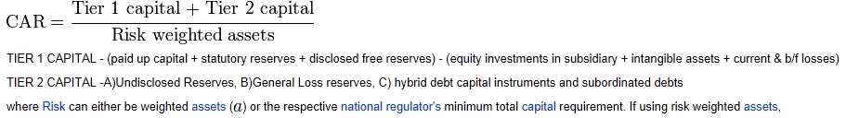
Others
Securitization
In Indian GAAP- | In IFRS -
On Securitization, assets are transferred to SPV and securitised by way of issue of PTC’s (Pass through Certificates) Assets are derecognised from bank’s book | De-recognition of financial asset is more stringent as the slightest control retained over asset securitized leads to assets being retained in the bank’s book. Amount received on securitization is accounted as liability This will lead to increase in RWA (Risk weighted Assets)and have impact on CAR (Capital Adequacy Ratio) of the Banks

Slide 241
What are PTC’s!
‘Pass Through Certificates’ or PTC are issued by banks as another option.
Let me try and help you understand what ‘Pass Through Certificates’ are…

Slide 242
Understanding Pass Through Certificates
Pass Through Certificates (PTCs) are issued by banks as a safeguard against risks.
Simply put, the banks, through PTCs, transfer some of their long term mortgaged assets (receivables) on to other investors like NBFCs and Mutual Funds.

Slide 243
Why do they do this?
They do this because they want to share some of their risks with other players.
They also do this to release capital & book profits.
Investors get interested because they stand to earn more for sharing the risk.

Slide 244
Now…
The transfer is done by means of a Special Purpose Vehicle or SPV which mediates between the investor and borrower.
The PTC ensures that the loan re-payment is made to the investor instead of the bank.
Thus the borrower is accountable to the investor instead of the bank.

Slide 245
What happens when the borrower starts to default? …
If the borrower starts defaulting, the SPV sells off the mortgaged asset and recovers the money.

Slide 246
How PTC’s work!!
Borrower Repays NBFCs & MFs
Borrower Approaches Bank
SPECIAL PURPOSE VEHICLE CREATED
NBFCs & MFs Lend Money
Bank Issues PTCs

Slide 247
PTCs are also used to ensure that banks maintain their liquidity as per the statutory guidelines of the Reserve Bank and at the same time continue lending.

Slide 248
To Sum Up
What: Pass Through Certificates (PTCs) are instruments of investment issued by banks.
Why: It provides the bank a tool for hedging risks.
When: They are issued when the bank feels it has too many risky assets to hold on to or when it needs additional capital for lending.
How: The transfer is done by means of a Special Purpose Vehicle or SPV which mediates between the investor and borrower.

Slide 249
Key Impact: Banking
Upfront fee income will get amortised on effective interest rate vs. earlier was Booked in year of receipt.
MTM gain will get recognised either in PL or Equity
NPA provisioning will become subjective as compared to rule based
Securitized portfolio will retain in banks books will have impact on CAR of the BANK

Slide 250
Insurance
Revenue Recognition
Premium
In Indian GAAP- | In IFRS -
Entire premium and originating expenses are recognised in the first year and provision is made towards endowment component. | Provides an option to split the premium received into two parts as deposit portion and insurance charges. Deposit is recognised as financial liability and measured at fair value or amortised cost. Insurance charges are recognised as income, first year front fee can be amortised over the term of the policy

Slide 251
Insurance
Revenue Recognition
Policy Originating Expenses
In Indian GAAP- | In IFRS -
Charged to income statement in the initial year of issuing of the policy. | IFRS prescribes expenses recognition to be amortised over the term of the policy

Slide 252
Insurance
Key Impact:
Amortisation of expenses may lead to higher profit in earlier year and early break–even as well

Slide 253
Mutual Fund’s
Investment
Investments by Mutual Fund
In Indian GAAP- | In IFRS -
The accounting policy is governed by SEBI. All investment to be carried at MTM in the balance sheet. MTM losses are to be accounted in revenue account and MTM gain is recognised directly in reserves on balance–sheet date and reversed on next day | The Company has option to designate financial assets as FVPL and account for changes in FV in PL account

Slide 254
Mutual Fund’s
Investment
Investments by Asset Management Companies
In Indian GAAP- | In IFRS -
Investments are classified as Current or Long Term. Current is measured at Cost or Market Value whichever is lower and resultant losses are recognised in PL account. Long Term investment is carried at cost and provision is made for diminution in value other than temporary | As per IAS39, Financial Assets can be classified in FVPL, AFS, HTM, L&R. First two categories require measurement at fair value and later two at amortised cost. Movement in fair value of AFS are recognised in Equity

Slide 255
Mutual Fund’s
Key Impact:
MF Investment gain will get accounted in Profit and Loss Account
Classification and measurement of financial assets for Assets Management Companies will change which will result in either higher or lower valuation of investments

Slide 256
Pharmaceuticals
Collaborative Arrangement
Pharma companies entities often enter into R&D arrangement that include multiple elements like intellectual property licenses, R&D services, manufacturing services etc. Product and services delivered under these arrangement is unique.
In Indian GAAP- | In IFRS -
There is no specific guidance on applying revenue recognition criteria on each component | It is necessary to apply revenue recognition criteria to the separately identifiable component’s of a single transaction in order to reflect the substance of the transaction

Slide 257
Pharmaceuticals
Collaborative Arrangement
Acquisition
Acquiring new business for new brand’s is a common practice in the industry.
In Indian GAAP- | In IFRS -
It is not mandatory to follow fair value accounting i.e. purchase method, Hence the true worth of intangible assets acquired may not be captured | UnderIFRS3–R, Only purchase method is allowed, hence identifiable assets, liabilities and contingent liabilities acquired to be accounted at fair value

Slide 258
Pharmaceuticals
Intangible Asset
In Indian GAAP- | In IFRS -
Amortised over estimated useful lives and need persuasive evidence to justify useful life above 10 years (AS-26) | Need to determine whether intangible asset has finite or indefinite useful life. In case of finite life, need to amortised over estimated life. In case of indefinite life, intangible asset is not amortised but tested annually for impairment.

Slide 259
Pharmaceuticals
Key Impact:
Revenue recognition will get impacted for Collaborative Arrangement
Intangibles will be recognised at fair value on acquisition will result in reduction in goodwill component
Intangibles will get amortised over its actual life and will get tested for impairment

Slide 260
Other Sectors including
Media and Entertainment
Power
Retail
Automobile
Oil and Gas

Slide 261
Media and Entertainment
Revenue Recognition
Revenue from Services
Barter–Advertising
In Indian GAAP- | In IFRS -
There is an option to recognise revenue either on percentage of completion method or completed contract method. | Revenue from services can be recognised only on percentage of completion method
In Indian GAAP- | In IFRS -
There is no specific guidance for accounting for barter advertising transaction | As per SIC31, subject to certain conditions, revenue to be recognised at fair value of advertising services provided by the Company

Slide 262
Media and Entertainment
Free/discounted Slots
In Indian GAAP- | In IFRS -
There is no specific guidance on split of contract/revenue for initial slot and free slots | The total revenue is to be split between initial slot and free/discounted slot. Revenue for free/discounted slot is recognised when same is broadcasted

Slide 263
Media and Entertainment
Key Impact:
Revenue and profit will preponed for companies following completed contract method for revenue recognition
Revenue from barter advertising contract to be recognised at fair value of services provided
Revenue for free/discounted slot will deferred

Slide 264
Power
Power Purchase Agreement (PPA)
Power generating and power purchasing companies generally entered into Long term PPA, covering substantial life of the power generating unit.
In Indian GAAP- | In IFRS -
PPA’s are treated as sale/service agreement’s and revenue is recognised accordingly. | PPA’s needs to be analyzed vis a vis principle of IFRIC-4 to identify whether transaction contains lease arrangement. If yes, accounting need’s to be done as lease transaction

Slide 265
Power
Decommissioning and Site Restoration
In Indian GAAP- | In IFRS -
Contractual liability for site restoration needs to be recognised and capitalised at current price. | Need to recognise contractual as well as constructive obligation at discounted present value and similar amount is recognised as provision. Impact of discounting is accounted as interest expense over the period.

Slide 266
Power
Fixed Assets
Most of the power companies are capital intensive and have high value of fixed assets.
In Indian GAAP- | In IFRS -
There is no specific requirement to identify, capitalise or depreciate each separate component of fixed asset. | Each component of fixed assets having different useful life need’s to be identified, capitalised and depreciated separately.

Slide 267
Power
Key Impact:
In case of PPA’s - Profit will increase in earlier year on de–recognition of asset and lower in subsequent year to the extent recognised in initial year
Constructive obligation of decommissioning and site restoration liability needs to be recognised at discounted present value. Interest expense will recognise over period.
Componentisation of fixed assets will impact depreciation amount over year on year

Slide 268
Retail
Customer Loyalty
In Indian GAAP- | In IFRS -
There is no specific guidance for accounting of customer loyalty. Hence some companies recognise full revenue and corresponding expense/liability for customer loyalty points is also recognised. | As per IFRIC 13, fair value of customer loyalty points needs to be reduced from total revenue for the period and revenue for customer loyalty points is recognised when such points are redeemed or lapsed.

Slide 269
Retail
Agency/Ownership Transaction
In Indian GAAP- | In IFRS -
In Indian GAAP, there is no guidance for revenue recognition for agency relationship transaction i.e. i) Gross amount can be recognised as revenue and ii) Amount paid is recognised as Expense | Under IFRS, as per IAS–18, amount resulting increase in equity only be considered as revenue, hence amount received ‘on behalf’ can not be recognised as revenue

Slide 270
Retail
Contract Manufacturing
Retail company gives on–job contracts to other Company providing services only to that Company.
In Indian GAAP- | In IFRS -
In Indian GAAP, this contracts are recorded as service contract and expenses are booked accordingly | Under IFRS, Contract needs to be analyzed vis a vis principle of IFRIC 4 to identify whether transaction contains lease arrangement. If yes, accounting needs to be done as lease transaction. In case of finance lease assets and liability needs to be recognised in books of the Company.

Slide 271
Automobile
Revenue
Sale with Free Services
In Indian GAAP- | In IFRS -
There is no specific guidance for recognition of revenue for free services separately from sale of the vehicle. Hence total revenue is recognised at the time of sale of vehicle. | Under IFRS, total revenue collected need’s to be broken as value for good’s and value for services. Revenue from sale of vehicle is recognised up front and sale of services is deferred over period of rendering of services.

Slide 272
Automobile
Fair Value
In Indian GAAP- | In IFRS -
Revenue is recognised at actual value of sale irrespective of payment terms of the transaction | Revenue is recognised at fair value, hence transaction involving deferred payment(financing), discounted (fair) value is recognised up front and balance amount is recognised as interest over term of deferred payment.

Slide 273
Automobile
Assets – used by Ancillary
In Indian GAAP- | In IFRS -
Vehicle manufacturer transfer’s assets (moulds) to auto component manufacturers, in turn components are sold at discounted rate. In Indian GAAP, no accounting done for asset transferred and asset remains in the books of the Vehicle manufacturer. | If Vehicle manufacturer transfer’s control over the asset in exchange in dissimilar goods/services at a concessional rate, The transfer of asset is treated as deemed sale and Components to be received is to be recorded at fair value.

Slide 274
Automobile
Asset owned by Ancillary
Ancillary units, based on the agreement with the vehicle manufacturer, build/procure plant, machinery and tools to exclusively manufacture goods for the later for the substantial life of the asset
In Indian GAAP- | In IFRS -
Asset’s so procured/ owned by the ancillary are capitalised in its books and depreciated over the useful life. | Arrangement having intent of devoting asset of the ancillary for the exclusive use of a particular vehicle manufacturer, may lead to recognition of transaction as deemed lease ( IFRIC 4 conditions) and will have to be accounted accordingly

Slide 275
Automobile Key Impact:
Revenue for free services needs to be split and recognised over period of service will lead to reduction in initial revenue recognition
Fair valuation revenue recognition and interest recognition of deferral payment will lead to postponement of revenue recognition
Assets given to component manufacturer will be lead to reduction in fixed assets and depreciation and increase in cost of component for vehicle manufacturer
Assets specifically purchased and used for a particular vehicle manufacturer and conditions of IFRIC 4 satisfies, transaction needs to be accounted as finance lease, which will result in capitalisation of asset and recognition of liability in vehicle manufacturer’s books

Slide 276
Oil and Gas:
Exploration and Development Cost
In Indian GAAP- | In IFRS -
There are two different alternative- i) successful effort method and ii) full cost method. Under successful effort method, cost is capitalised as intangible asset till drilling is complete and results are awaited. In case of success, its capitalised as PPE else written off in PL account. Under full cost method, all cost is capitalised in cost centre, hence all cost capitalised and depreciated using unit of production method | Only successful effort method of accounting is allowed. Hence if any cost is accumulated for unsuccessful projects cannot be capitalised and needs to be charged to PL account.

Slide 277
Oil and Gas:
Decommissioning and Site Restoration
In Indian GAAP- | In IFRS -
Contractual liability for site restoration needs to be recognised and capitalised at current price | Need to recognise contractual as well as constructive obligation at discounted present value and similar amount is recognised as provision. Impact of discounting is accounted as interest expense over the period.

Slide 278
Oil and Gas:
Key Impact:
Change in method of recognition of exploration and development cost will lead to an immediate recognition of expenses and reduction in networth
Future obligation of decommissioning and site restoration liability needs to be recognised at discounted present value. Interest expense will recognise over period.

Slide 279
Functional Currency
How to determine?
®
279

Slide 280
Functional Currency
Example
P&L rate
1 USD = Rs. 50.3
P&L rate
1 USD = EUR .79
B/sheet rate 1USD=Rs.50.5
B/sheet rate 1USD=EUR 0.80
Original Currency
Functional Currency
Reporting Currency
(Amount in INR)
(Amount in USD)
(Amount in EUR)
Sales
5000
99.40
78.53
Expense
3000
59.64
47.12
Equity
2000
39.60
31.68
Fixed Assets (PP&E)
3000
59.41
47.52
Current Assets
1000
19.80
15.84
7000
7000
138.85
139.01
111.08
110.21
Difference
0
(0.16)
0.87
Transaction
Translation
Moves to P&L
Moves to B/sheet

Slide 281
The Effects of Changes in Foreign Exchange Rates (IAS 21)
FUNCTIONAL CURRENCY
The functional currency should be determined by looking at several factors.
This currency should be the one in which the entity normally generates and spends cash and in which transactions are normally denominated.
All transactions in currencies other than the functional currency are treated as transactions in foreign currencies.
5 factors can be taken into account in making this decision: the currency ( Primary -3 & Secondary-2 )

Slide 282
The Effects of Changes in Foreign Exchange Rates (IAS 21)
FUNCTIONAL CURRENCY
Primary Factors
(1) That mainly influences the price at which goods and services are sold
(2) Of the country whose competitive forces and regulations mainly influence the entity’s pricing structure
(3) That influences the costs of the entity

Slide 283
The Effects of Changes in Foreign Exchange Rates (IAS 21)
FUNCTIONAL CURRENCY
Secondary Factors
(4) In which funds are generated
(5) In which receipts from operating activities are retained
The Primary factors are generally considered to be the most influential in deciding the functional currency.

Slide 284
The Effects of Changes in Foreign Exchange Rates (IAS 21)
Functional Currency determination-
An entity will have to determine the functional currency of a foreign operation, such as a foreign subsidiary, and whether it is the same currency as that of the reporting entity. Such factors as whether the foreign entity is an extension of the reporting entity business, what proportion of its transactions are with the reporting entity, and the nature of the cash flows will help determine the functional currency of the foreign operation.

Slide 285
The Effects of Changes in Foreign Exchange Rates (IAS 21)
Periodicity of Functional Currency-
The entity’s functional currency reflects the transactions, events, and conditions under which the entity conducts its business. Once decided on, the functional currency does not change unless there is a change in the underlying nature of the transactions and relevant conditions and events.

Slide 286
Meaning of Effective Interest rate Used for Bond Amortization

Slide 287
What are Bonds?
Bonds are interest-bearing notes issued by corporations, universities and governmental entities.
Usually sold to many investors.
Are traded, like stocks, on open markets where the price is determined by the market interest rate. Interest is the cost incurred by the bond issuer for the use of the investor’s money.
The face value is the amount of principal the bond issuer must pay at the maturity date.

Slide 288
Interest Rates: Stated vs. Market
Each bond has a contractual, or stated rate of interest (ex: 5% per year). This rate may be higher or lower than the prevailing interest rate, determined on the open market.
If the market interest rate is less than the stated rate, investors will equalize the difference by purchasing the bond at a higher price. The difference between the higher market price and the face value of the bond is called a premium.
If the market interest rate is greater than the stated rate, investors will equalize the difference by purchasing the bond at a lower price. The difference between the lower market price and the face value of the bond is called a discount.
For accounting purposes, we must calculate and journalize (record) both the interest expense and the discount or premium. Amortization is the process of allocating the discount or premium over the term of the bond.

Slide 289
Amortization of Premium or Discount
Two types of amortization include:
Effective-Interest: the periodic interest expense equals a constant percentage the carrying value of the bond.
Straight-line: The same amount of interest expense of interest expense is allocated in each period.
Let’s illustrate the Effective-Interest method.

Slide 290
Effective-Interest Method
First, assume a bond with a face value of $100,000, a stated interest rate of 10% and a 5-year term. Interest is paid semi-annually (twice a year).
Next, assume that the market interest rate is 12%. Using a present value table, the investor compensates for the lower stated interest rate by paying $92,639 (the carrying value). Thus, the total discount to amortize is:
$100,000 - $92,639 = $7,361

Slide 291
Effective-Interest Method - Discount
There are three computations to make:
Compute the bond interest expense: carrying value X effective-interest rate
Compute the bond interest paid:
face value X stated (contractual) rate
3. Compute the amortization:
difference between two steps above
Then, ADD the amortization from the current carrying value to get the carrying value for the next period
Repeat the process for each interest period

Slide 292
5%
6%

Slide 293
Effective-Interest Method - Discount
The journal entry on the first interest date is:
Bond Interest Expense 5,558
Discount on Bonds Payable 558
Cash 5,000
What is the entry on the second interest date?

Slide 294
Effective-Interest Method - Discount
The journal entry on the second interest date is:
Bond Interest Expense 5,592
Discount on Bonds Payable 592 Cash 5,000
Now, let’s do the computations for a premium!

Slide 295
Effective-Interest Method
First, assume a bond with a face value of $100,000, a stated interest rate of 10% and a 5-year term. Interest is paid semi-annually (twice a year).
Next, assume that the market interest rate is now 8%. Using a present value table, the investor compensates for the higher stated interest rate by paying $108,111 (the carrying value). Thus, the total premium to amortize is:
$108,111 - $100,000 = $8,111

Slide 296
Effective-Interest Method - Premium
There are three computations to make:
Compute the bond interest expense: carrying value X effective-interest rate
Compute the bond interest paid:
face value X stated (contractual) rate
Compute the amortization:
difference between two steps above
Then, SUBTRACT the amortization from the current carrying value to get the carrying value for the next period
Repeat the process for each interest period

Slide 297
5%
4%

Slide 298
Effective-Interest Method - Premium
The journal entry on the first interest date is:
Bond Interest Expense 4,324
Premium on Bonds Payable 676
Cash 5,000
What is the entry on the second interest date?

Slide 299
Effective-Interest Method - Discount
The journal entry on the second interest date is:
Bond Interest Expense 4,297
Premium on Bonds Payable 703
Cash 5,000
The effective-interest and straight-line methods produce different results. If the difference is material, the effective-interest method must be used.

Slide 300
Capital Market-Awareness

Slide 301
Cash & Derivative Market
Cash & Derivative Market
Impact on Indian System
Safe structure of the Indian System
Complexities in the Financial securities market
Notes:
301

Slide 302
Size of the Game
Daily Average Turnover
Cash : Rs 30,000 Crores
Derivatives : Rs 1,70,000 Crores
Notes:
302

Slide 303
Risk Management
Job is only Risk Management
Return is a by-product

Slide 304


First Big Mistake by US Banks –
Unacceptable leverage levels
33 : 1
28 : 1

Slide 305





Wealth destruction in US!!
Balance sheet sizes of some of the biggies
US$ 1.00 Tn
US$ 675 Bn
Balance sheet total of top 10–15 financial institutions in US:
US$ 20 Tn
Vs.
US GDP:
US$ 14 Tn!
US$ 1.80 Tn
US$ 1.02 Tn
US$ 1.08 Tn
US$ 2.00 Tn

Slide 306
New Complex Products
Derivatives & High Yielding Complex securities
Warren Buffet said “Derivatives are weapons of mass destruction”
Credit Default Swaps
US$ 65 Tn
Collateral Debt Obligations
US$ 40 Tn

Slide 307
United States : The falling empire?
Can the largest borrower of the world remain the largest power?
US$ 14.29 Trillion
Notes:
307

Slide 308

Euro: Can it survive?

Slide 309
Euro: Can it survive?
Spain Jobless rate: 24%
Notes:
309

Slide 310

IFRS Brings in Lots of Worries !!!!!!!!!!!!!!!
New Concepts
Derivatives
New Worries

Slide 311
What Is A Derivative?
Forward Contracts
Financial Futures
Swaps
A financial instrument or contract,
whose value is based on, or DERIVED from an UNDERLYING
asset,
interest rate, or
index,
ultimately settled in a net cash payment from one party to another.
Securitization Tranches
Options

Slide 312
What Is A Derivative?
Forward Contracts
Financial Futures
 | Forwards | Futures
a | Private Agreements | Traded on Exchanges
b | Chances of defaults exists | Standardized/ Governing Body
c | None to gurantee | Have Clearing Houses which guarantee the transaction
d | Settlement happens at the end (Normally). | MTM (Mark to market) daily since they are traded

Slide 313
The natures of derivative investments are diverse… ranging from traditional to exotic
Forward Contracts
Financial Futures
Swaps
Some derivatives have multiple underlying values.
Some derivatives are more standardized and are issued through clearing corporations
Some derivatives may be traded on national securities exchanges or they may be private agreements held between corporations.
Companies use derivatives either to manage risk or as a speculative investment to yield higher returns.
Securitization Tranches
Options

Slide 314
When the value of the underlying asset, liability or index changes…
Forward Contracts
Forward Contracts
Financial Futures
Financial Futures
Swaps
Swaps
the fair value of the derivative and the amount of cash expected to be exchanged between the parties changes.
Securitization Tranches
Securitization Tranches
Options
Options
Changes in Underlying

Slide 315
Companies use derivatives either to manage risk or as a speculative investment to yield higher returns
Assets Liabilities
Loans: Long-term debt:
Var. Int. Rate Mortgages $250,000 10 year 8% note $ 245,000
Interest Income
Interest Expense
Net Interest Income
What happens to Net Interest Income when interest rates are 10%?
What happens to Net Interest Income when interest rates are 6%?
Interest Rate Management Strategy:
To protect stability in Net Interest Income

Slide 316
Examples of Derivatives
Forward Contracts and Financial Futures
delivery of specific assets
at a set price (determined at the time of contract)
on a specific future date.
Example: Foreign Currency Future Contract
Used when a financial services company’s customer anticipates the future need for foreign currency, or expects to receive foreign currency.
The financial institution negotiates a contract with another party on behalf of its customer, fixing the price at which the currency will be exchanged and the date on which the currency will be delivered.

Slide 317

What is a Hedge?
A Risk Management Technique
To protect the company from unfavorable changes in
prices,
interest rates, and/or
foreign currency exchange rates.
A hedging strategy can be for a specific asset or transaction, or it can be more general. Management must determine the purpose of the hedge.
Effective Hedge vs. Ineffective Hedge
The change in the fair value of the hedge contract must offset the change in the fair value of the hedged item.
For Effective – at least 80% & not more than 125%

Slide 318
IAS-39 accounting- bases
Question
How can an auditor tell whether a financial asset is at Fair value through
“Profit or Loss “ Or “Available for Sale”
Answer
It is impossible to tell by looking at a Financial Asset (which is merely a paper) whether
It is, for example a-
“Available for sale” or “ Fair value through Profit or Loss”
This depends upon the intention of management which are not auditable ……
Consequently the IAS-39 requires the management to designate the assets into the
Appropriate category on the date of Purchase itself

Slide 319
IAS-39 (type of Hedges)Examples
Derivatives Held as Speculative Investments
Cash Flow Hedges
Fair Value Hedges
Foreign Currency Hedges

Slide 320
Quiz Questions
A 90 day T-bill futures contract used by management as a hedging strategy against increasing interest rates would be classified as ____________ under ASC-815 /FAS 133.
Derivative held for speculative investment
Fair value hedge
Cash flow hedge
Foreign currency hedge
Who determines how the derivatives will be reported on the financial statements?
The auditors
The SEC
The regulators
Management
Under ASC-815/ FAS 133, only effective hedges must be reported on the financial statements.
(True or False)

Slide 321
Quiz Answers
A 90 day T-bill futures contract used by management as a hedging strategy against increasing interest rates would be classified as ____________ under FAS 133.
Derivative held for speculative investment
Fair value hedge
Cash flow hedge
Foreign currency hedge
Who determines how the derivatives will be reported on the financial statements?
The auditors
The SEC
The regulators
Management
Under FAS 133, only effective hedges must be reported on the financial statements.
True or False

Slide 322
Financial Liability and Equity
Substance of Contractual Agreement- For “Equity” or “Liability”
On Issue the Financial Instrument should be classified as Liability or Equity
in accordance with the Substance of the Contractual arrangement on initial
recognition
Example
Redeemable preference share - Not classified as Equity since there is a contractual obligation to transfer the financial assets to the holder of shares. However if they are redeemable at the option of issuer, they would not meet the condition of Liability.
Compound Instruments - Contains both a “Liability” and “Equity” are classified into separate components parts as hereunder :-
Equity portion- the option to convert in equity
Liability Portion- the obligation to repay the Bonds

Slide 323
End of Day -1

Slide 324
Day -2

Slide 325
IFRS in India – Thoughts to Ponder……….
Changes required in legislations
Accounting Standards
standards on new subjects
Conceptual changes
Disclosure changes
Language changes
Training and accreditation
Enabling infrastructure
Regulatory oversight

Slide 326
IFRS Hierarchy
International Accounting Standards Committee Foundation.
The body which oversees the International Accounting Standards Board.
International Accounting Standards Board (IASB).
The body which sets International Financial Reporting Standards (IFRS) and approve interpretations
International Financial Reporting Interpretations Committee (IFRIC).
Responsible for interpretation of standards and issue guidance on issues that have not yet been addressed by standards.
The Standards Advisory Council (SAC).
Forum to provide broad strategic advice on IASB’s agenda priorities and insight into costs and benefits of projects.
Notes:
326

Slide 327
IFRS Hierarchy Statements
International Financial Reporting Standards (IFRS)
International Accounting Standards (IAS)
International Financial Reporting Interpretations (IFRIC)
Standard Interpretations (SIC)
Notes:
327

Slide 328
IFRS - Standards
Starts with……………….
Preface to International Financial Reporting Standards
Framework for the Preparation and Presentation of Financial Statements

Slide 329
IFRS – Standards Contd.
IFRS 1 First-time Adoption of International Financial Reporting Standards
IFRS 2 Share-based Payment
IFRS 3(2008) Business Combinations
IFRS 4 Insurance Contracts

Slide 330
IFRS – Standards Contd.
IFRS 5 Non-current Assets Held for Sale and Discontinued Operations
IFRS 6 Exploration for and Evaluation of Mineral Resources
IFRS 7 Financial Instruments: Disclosures
IFRS 8 Operating Segments

Slide 331
IFRS – Standards Contd.
IFRS 9 - Financial Instruments – Assets (effective date Jan-2015)
IFRS 10 -Consolidated Financial Statements (effective date Jan-2013)
IFRS 11 -Joint Arrangements - revised 28 June 2012
(effective date Jan-2013)
IFRS 12- Disclosure of Interests in Other Entities (effective date Jan-2013)
IFRS 13- Fair Value Measurement (effective date Jan-2013)

Slide 332
IFRS – Standards Contd.
IAS 1(2007) Presentation of Financial Statements
IAS 2 Inventories
IAS 7 Statement of Cash Flows
IAS 8 Accounting Policies, Changes in Accounting Estimates and Errors

Slide 333
IFRS – Standards Contd.
IAS 10 Events after the Reporting Period
IAS 11 Construction Contracts
IAS 12 Income Taxes
IAS 16 Property, Plant and Equipment

Slide 334
IFRS – Standards Contd.
IAS 17 Leases
IAS 18 Revenue
IAS 19 Employee Benefits
IAS 20 Accounting for Government Grants and Disclosure of Government Assistance

Slide 335
IFRS – Standards Contd.
IAS 21 The Effects of Changes in Foreign Exchange Rates
IAS 23 Borrowing Costs
IAS 24 Related Party Disclosures
IAS 26 Accounting and Reporting by Retirement Benefit Plans

Slide 336
IFRS – Standards Contd.
IAS 27(2008) Consolidated and Separate Financial Statements
IAS 28 Investments in Associates
IAS 29 Financial Reporting in Hyperinflationary Economies
IAS 31 Interests in Joint Ventures (move towards IFRS 11)

Slide 337
IFRS – Standards Contd.
IAS 32 Financial Instruments: Presentation
IAS 33 Earnings per Share
IAS 34 Interim Financial Reporting
IAS 36 Impairment of Assets
IAS 37 Provisions, Contingent Liabilities and Contingent Assets

Slide 338
IFRS – Standards Contd.
IAS 38 Intangible Assets
IAS 39 Financial Instruments: Recognition and Measurement
IAS 40 Investment Property
IAS 41 Agriculture

Slide 339

Ind AS ( Issues for Implementation)
India – Its not IFRS , it is Ind-AS
Are we ready ?????
8 IFRS standards issued ( Ind-AS 101 to Ind-AS 108) vs. 13 IFRS Total
40 IAS standards issued ( Ind-AS 1 to Ind-AS 40) vs. 41 IAS Total
IFRIC’s and SIC – Not issued in India (merged in standards)
IFRS for SME not issued in India
Some basic Issues …….

Slide 340
Ind AS ( Road for Implementation)
Some basic adoption techniques (path to IFRS) …….
Revised Schedule VI of the Companies Act is already issued effective 2011 which uses concepts from IFRS like
Current and Non Current classifications
AS will prevail over the law
Terminologies coming from IFRS like Inventories,
Impairment, PP & E etc.
b) XBRL already in place – Concept already implemented in countries following IFRS

Slide 341
Ind AS ( Road for Implementation)
Pending Issues for effective working …….
a) Computation of “Distributable Profits” as per section 205 of the Companies Act which are following the Ind AS (needs revision).
b) How the Income Taxes (including the MAT) will be computed for companies following the Ind AS.
How to deal with the various types of :-
Unrealized gain/loss on derivatives
Notional Non cash accounting adjustments ( low Interest)
Other laws / courts / acts etc…………..
Carve-out’s impact

Slide 342
Ind AS ( Issues for Implementation)
While finalizing the Indian IFRS ( Ind AS), the Indian Standard setters have examined the Indivdual IFRS’s and modified the requirements, wherever necessary to suit Indian conditions.
These modifications are routinely termed as ‘Carve Outs’.
Carve outs are generally perceived as non-desirable, since they dilute the key purpose of :-
Converging with IFRS (to have a common set of accounting standards across countries;
Enable Indian companies to raise capital in overseas markets in a seamless manner;
Provide higher level of comfort to overseas investors).

Slide 343
6 MYTHS:-
ABOUT THE IFRS INDIA
TRANSITION

Slide 344
“We all have our perceptions of what IFRS means for our companies. These are surprisingly consistent across sectors within India.
Not too long ago, our member CFOs and controllers in Australia and the European Union had their own views on IFRS, very similar to ours. When they finally transitioned, most of them realized how off mark their initial perceptions were. That’s why we call them myths.
Treat this as a peek into the ground realities of IFRS transition—what it really looked like for the hundreds of companies we worked with and learned from.“
Source-
IFRS Research Team
Corporate Executive Board

Slide 345
Six Myths About the IFRS India Transition
1 We have a comfortable transition deadline
2 IFRS is limited to changes in accounting procedures
3 We can rely solely on auditors and consultants
4 Transition won’t be very expensive
5 Accountants are the only constituency for training
6 We’ll get it right the first time.

Slide 346
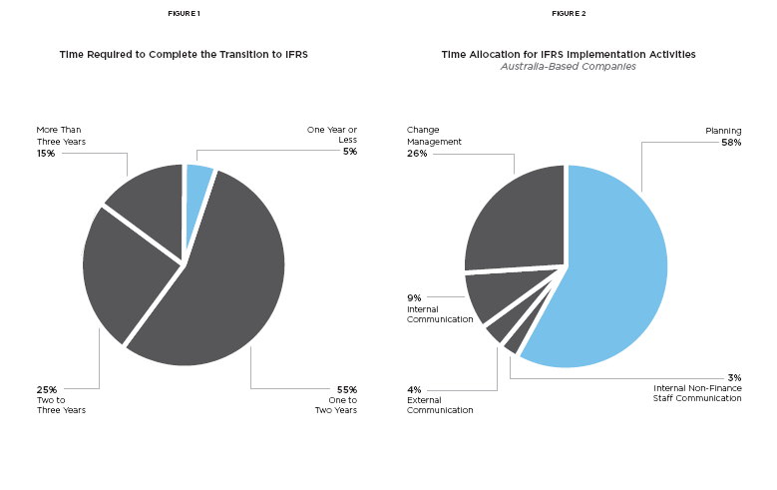
Time Allocation- Planning is the key
Average Time- Between 1 to 3 years

Slide 347
MYTH 1
WE HAVE A COMFORTABLE TRANSITION DEADLINE
Ninety-five percent of companies in Australia and in the European Union took more than a year to the complete IFRS transition, with 40% taking more than two years.
Average time- Minimum 2 years
In other countries, regulators released final interpretations two to three years in advance of IFRS deadline and provided step-by-step transition road maps for companies.
India- IFRS implementation is in stages. Ground work needs fast pace.
Indian companies must begin assessing the impact of IFRS and start planning immediately, dedicating full-time resources to the project. Companies that delay the effort expose themselves to
Several risks including restatement, cost overrun, reputation damage, and market risk.

Slide 348
MYTH 2
IFRS IS LIMITED TO CHANGES IN ACCOUNTING PROCEDURES
Senior management at many companies view IFRS as a Finance priority because of the required changes in accounting practices. However, the impact of IFRS is truly cross-functional, spanning divisions and business units.
HR, Sales, Procurement, Legal, IT, and individual business unit (BU) owners often need to redesign key processes to accommodate IFRS. Critical third-party contracts, debt covenants, and key leadership metrics will change with the change in accounting policies.
Finance must convince stakeholders of cross-functional impact and enlist transition support. Companies that actively involved impacted functions and BUs early had 55% greater transition effectiveness than companies that did not, with Finance spending 90% less time on transition.

Slide 349
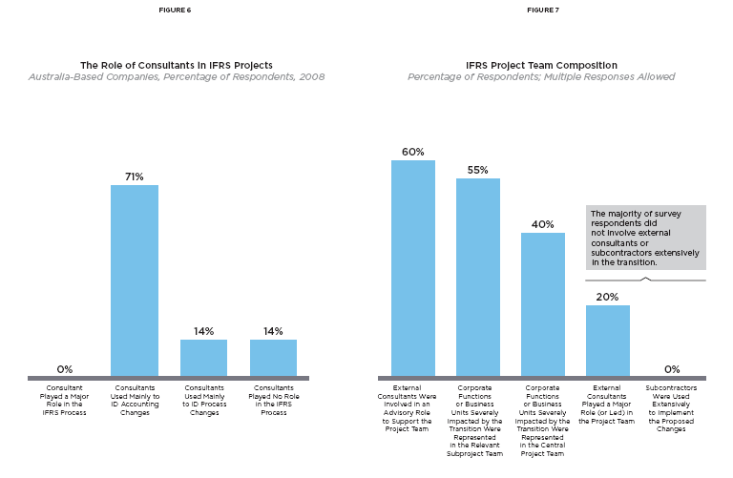
Role Of Consultant in IFRS Project implementation

Slide 350
MYTH 3
WE CAN RELY SOLELY ON AUDITORS AND CONSULTANTS
While many companies believe that auditors and consultants can take on much of the transition load, a vast majority of adopters used consultants in only a minor way during the transition—mainly to identify accounting changes. The nature of transition activities requires most work to be done in house by the internal Finance team.
Given the need to have internal staff lead the transition team and efforts, companies need to invest in training the IFRS project team very early in the process.
At a very early stage, companies must determine the level of external support needed in different transition stages and auditor intervention/sign-off points. Not doing so can result in unnecessary consulting spend and mid-cycle corrections to the project plan.

Slide 351
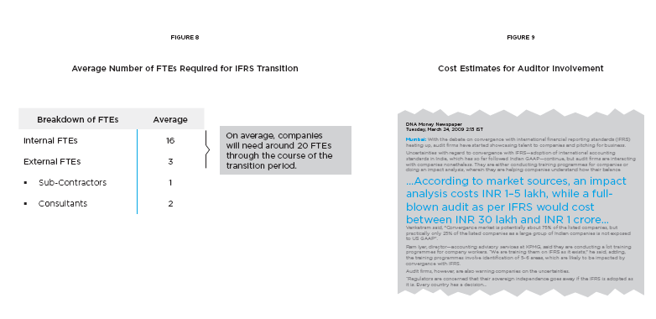
Money/Manpower in IFRS Project implementation

Slide 352
MYTH 4
TRANSITION WON’T BE VERY EXPENSIVE
The IFRS transition is expected to cost Indian firms between Rs. 30 lakh and 1 crore*, with an average of 16 internal and three external full-time staff dedicated to the transition.
Fifty percent of adopters had to implement entirely new IT systems to accommodate IFRS; only 20% of companies did not implement systems changes
Costs such as auditor fees, systems changes, and reporting costs tend to overrun at the last minute. Companies can avoid this through robust planning, auditor sign-off on every accounting change, systems testing, and reporting dry runs.
* Khyati Dharamsi, “Auditors start gearing up firms on IFRS,” DNA Money, 24 March 2009.

Slide 353
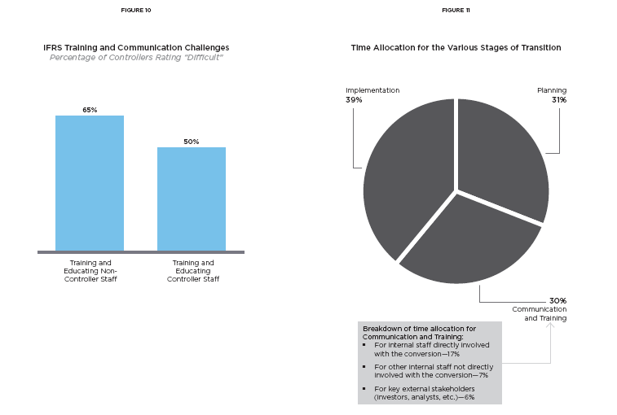
Training and Time Allocation – IFRS implementation

Slide 354
MYTH 5
ACCOUNTANTS ARE THE ONLY CONSTITUENCY WE NEED TO TRAIN
Once companies realize the impact of IFRS on non-accounting functions, coordinating firm wide training for functional and BU staff becomes a daunting, costly task.
Sixty-five percent of controllers found it more difficult to train non-accounting staff and spent a quarter of IFRS training time on functions outside Finance.
Companies cannot save time and resources by using the same training modules for all constituencies, or learning’s will be inapplicable and easily forgotten. The level and scope of training needs to be tailored to meet different segments’ needs.

Slide 355
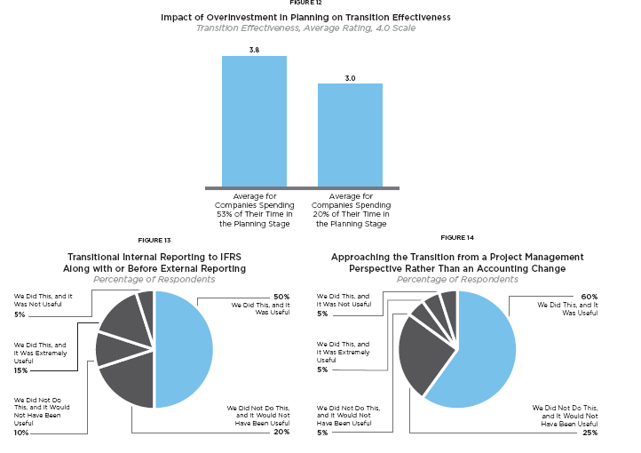
Impact Analysis – IFRS implementation

Slide 356
MYTH 6
WE’LL GET IT RIGHT THE FIRST TIME
Companies that undertake the transition without extensive project planning have 25% less effective transitions. These companies are also much more likely to face auditor sign-off conflicts, restatements, and stock price falls as they come closer to the deadline.
Not conducting internal and external reporting test runs has often caused companies to discover system bugs, process failures, and accounting errors too close to deadline to be fixed in time.
Given the scale of its impact across functions, companies must approach adoption from a project management perspective to increase the likelihood of having a successful transition.`

Slide 357
Key GAAP Differences
RECAP

Slide 358
Key GAAP Differences
Investment/ Financial Instruments
Fixed Assets
Revenue
Business Combination
Consolidation
Others
PL Impact
BS Impact
Disclosure
RECAP

Slide 359
Investment/Financial Instruments
Indian GAAP | IFRS
Investment is classified as Current and Long term. | Financial Instruments is classified in four different categories HTM, FVPL, L&R and AFS.
Current investment is measured at lower of cost or fair value. Long term investment is measured at cost less provision for diminution in value other than temporary. L&R is measured at cost. | Measurement of HTM and L&R at amortised cost and FVPL and AFS at fair value.
Measurement loss always charged to profit and loss account and gain is ignored. | Measurement gain or loss on AFS category to be accounted in equity account.
No guidelines for hedge accounting and documentation. | Hedge transaction to be classified as fair value hedge or cash flow hedge. Specific guidance for hedge accounting, documentation

Slide 360
Investment/Financial Instruments
Impact
Unrealised measurement gain on FVPL will get recognised in PL Account. Measurement gain/loss of AFS will not affect PL Account. On derecognition, It will get transferred from equity to PL Account. Standardisation and documentation for hedge accounting since specific guidance available. Strict provisions for classification of asset in HTM category, hence most of the investment will be classified as FVPL/AFS and measured at fair value. All derivatives classified as FVPL and measured at fair value.

Slide 361
Fixed Assets
Indian GAAP | IFRS
Fixed assets are not required to be componentized and depreciated separately. | Fixed assets are required to be componentized and depreciated separately.
Change in depreciation method is considered as change in accounting policy and requires retrospective re-computation of depreciation. | Change in useful life and depreciation method is considered as change in accounting estimates and applied prospectively.
Fixed assets are measured at cost less accumulated depreciation | Option to carry at cost less accumulated depreciation or to adopt revaluation model. To carry revaluation at regular interval
Impact
Each component will get identified, capitalisedand depreciated separately. This will amount of depreciation. If fair value/revaluation model adopted, value of fixed assets will change on year on year basis.

Slide 362
Revenue
Indian GAAP | IFRS
Interest income to be recognized on a time proportion basis. | Interest income to be recognized at effective interest rate.
Income from service contract is recognised as completed service contract or proportionate completion method. | Income from services to be recognized only on percentage of completion method.
Amount received ‘on behalf’ can be grouped with revenue. | Amount resulting in increase in equity only to be recognised as revenue.
Contract is not segregated or combined for revenue recognition. | Contracts needs to be either segregated or grouped for revenue recognition.

Slide 363
Revenue
Impact
Income in financing transaction will spread over period of transaction and restrict ballooning either at inception or end of transanction. Income from services will get recognised as per stage of completion i.e. matching with expenses incurred instead of recognizing it at completion of project. Multiple element transactions will either get combined or segregated as per substance or commercial sense of the transaction.

Slide 364
Business Combination
Indian GAAP | IFRS
Pooling of Interest or Purchase Method. | Purchase method. All assets and liabilities are recorded at fair market value.
Goodwill normally amortised over five years. | Goodwill is not amortised and tested for impairment.
Excess of net assets acquired over consideration is considered as capital reserve | Consideration is lower than value of assets acquired, same is recognised in profit and loss account
Impact
Business Combination will represent true value of assets and liability acquired. This may lead to reduction in good will recognition also. In Bargained deals, Profit will get recognised in year of business combination.

Slide 365
Consolidation
Indian GAAP | IFRS
Potential voting rights are not considered for determination of control. | Potential voting rights currently exercisable or convertible are considered .
Option to exclude from consolidation if control is temporary or operated under severe long term restriction. | All subsidiaries needs to be consolidated. No such exclusion permitted.
SPVs are not consolidated considering parent does not have more than one half of the voting power or control over composition of BOD. | When in substance control is establish and benefit from SPV flows to parent, consolidation is mandatory.
Minority Interest can not be negative. | Losses in excess of investment allocated.

Slide 366
Consolidation
Indian GAAP | IFRS
Associates: Goodwill is recognised based on carrying value. Losses in excess of carrying value is not recognised. | Goodwill is recognised based on fair value. Losses in excess of carrying value is recognised as long term loans.
In case of a JV – Proportionate Consolidation allowed | Equity or Proportionate Consolidation are allowed.

Slide 367
Equity Investments: Common Shares
Percentage
Ownership
0%
20%
50%
100%
Level of
Influence Little or None Significant Control
Type of
Investment No Significant Significant Subsidiary
Influence Influence
Accounting
Method HFT or AFS Equity Consolidation;
Treatment Method Cost or equity method

Slide 368
Other –P& L Impact
Indian GAAP | IFRS
Employee Benefit Actuarial Gain/Losses on employee benefit is recognised immediately. | Option to amortise using corridor approach.
Discount rate used is determined with reference to market yield of government bonds. | Discount rate is determined with reference to market yield on high quality corporate bonds.
Lease Initial direct cost of lessor can be charged to PL or amortised over period of lease. Lease of land is treated as sale of land. | Initial direct cost has to be amortised over period of lease. Lease of land can be classified as finance lease or operating lease.
Government Grant May be recognised under shareholder’s fund or income in P&L over period | Can not be recognised under shareholder’s fund and to be recognised in P&L over period

Slide 369
Other –BS Impact
Indian GAAP | IFRS
Inventory Valuation of inventory is not applicable to WIP of service provider. | Valuation of inventory is applicable to WIP of service provider also.
Provisions and Liability Amount of provision should not be discounted. Liability is recognised only on contractual obligation. | Discounting is required. Liability is recognised for constructive obligation also.
Liability/Equity Compulsorily convertible debentures are accounted as liability and measured either at fair value or amortised cost. | This are treated as equity if fixed to fixed condition is satisfied.
Redeemable preference shares are accounted as equity. | Redeemable preference shares to be treated as liability .

Slide 370
Other –Disclosure Impact
Indian GAAP | IFRS
No separate standard for disclosure. Specific formats have been specified by regulators like Companies Act, Banking Regulation Act. | IAS 1 prescribes minimum structure of financial statements and contains guidance on disclosures.
No requirements for disclosure of critical judgments. | IAS 1 requires disclosure of critical judgments made by management in applying accounting policies.
Effect for prior period errors is given in current year with disclosures. | IAS 8 requires retrospective restatement of prior period figures by restatement of opening balances of assets, liabilities and equity for the earliest period practicable.
Contingent Asset is not required to be disclosed. | Contingent Asset is required to be disclosed.

Slide 371
Overview of Ind AS and IFRS/IAS (Basic Comparison)

Slide 372

Comparison of IFRS AND Accounting standards
Ind AS | Ind AS Name | Corresponding IFRS
Ind AS 101 | First-time Adoption of Indian Accounting Standards | IFRS 1 | - | -
Ind AS 102 | Share based Payment | IFRS 2
Ind AS 103 | Business Combinations | IFRS 3 | - | -
Ind AS 104 | Insurance Contracts | IFRS 4 | - | -
Ind AS 105 | Non-Current Assets Held for Sale and Discontinued Operations | IFRS 5 | - | -
Ind AS 106 | Exploration for and Evaluation of Mineral Resources | IFRS 6 | - | -
Ind AS 107 | Financial Instruments: Disclosures | IFRS 7 | - | -
Ind AS 108 | Operating Segments | IFRS 8 | - | -
IAS/IFRS
IFRIC
SIC

Slide 373
Ind AS | Ind AS Name | Corresponding IFRS
Ind AS 1 | Presentation of Financial Statements | IAS 1 | - | -
Ind AS 2 | Inventories | IAS 2 | - | -
Ind AS 7 | Statement of Cash Flows | IAS 7 | - | -
Ind AS 8 | Accounting Policies, Changes in Accounting Estimates and Errors | IAS 8 | - | -
Ind AS 10 | Events after the Reporting Period | IAS 10 | IFRIC 17 | -
 |  |  | IFRIC 12 | SIC 29
Ind AS 11 | Construction Contracts | IAS 11 | - | -
Ind AS 12 | Income Taxes | IAS 12 |  | SIC 21, 25
Ind AS 16 | Property, Plant and Equipment | IAS 16 | IFRIC 1 | -
Ind AS 17 | Leases | IAS 17 | IFRIC 4 | SIC 15, 27
IAS/IFRS
IFRIC
SIC

Slide 374
Ind AS | Ind AS Name | Corresponding IFRS
Ind AS 18 | Revenue | IAS 18 | IFRIC 13, 15*, 18 | SIC 31
Ind AS 19 | Employee Benefits | IAS 19 | IFRIC 14 | -
Ind AS 20 | Accounting for Government Grants and Disclosure of Government Assistance | IAS 20 | - | SIC 10
Ind AS 21 | The Effects of Changes in Foreign Exchange Rates | IAS 21 | - | -
Ind AS 23 | Borrowing Costs | IAS 23 | - | -
Ind AS 24 | Related Party Disclosures | IAS 24 | - | -
Ind AS 27 | Consolidated and Separate Financial Statements | IAS 27 | - | SIC 12
Ind AS 28 | Investments in Associates | IAS 28 | - | -
Ind AS 29 | Financial Reporting in Hyperinflationary Economies | IAS 29 | IFRIC 7 | -
IAS/IFRS
IFRIC
SIC

Slide 375
Ind AS | Ind AS Name | Corresponding IFRS
Ind AS 31 | Interests in Joint Ventures | IAS 31 |  | SIC 13
Ind AS 32 | Financial Instruments: Presentation | IAS 32 | IFRIC 2*
Ind AS 33 | Earnings per Share | IAS 33
Ind AS 34 | Interim Financial Reporting | IAS 34 | IFRIC 10
Ind AS 36 | Interim Financial Reporting | IAS 36
Ind AS 37 | Provisions, Contingent Liabilities and Contingent Assets | IAS 37 | IFRIC 5,6
Ind AS 38 | Intangible Assets | IAS 38 |  | SIC 32
Ind AS 39 | Financial Instruments: Recognition and Measurement | IAS 39 | IFRIC 9, 16, 19
Ind AS 40 | Investment Property | IAS 40
IAS/IFRS
IFRIC
SIC

Slide 376

Comparison between Ind AS & IFRS/IAS having no significant difference
Ind AS | Ind AS Name | IFRS / IAS
Ind AS 102 | Share based Payment | IFRS 2
Ind AS 104 | Insurance contracts | IFRS 4
Ind AS 106 | Exploration for and Evaluation of Mineral Resources | IFRS 6
Ind AS 108 | Operating segments | IFRS 8
Ind AS 10 | Events after the reporting period | IAS 10
Ind AS 36 | Impairment of Assets | IAS 36
Ind AS 37 | Provisions, Contingent Liabilities and Contingent Assets | IAS37

Slide 377
Comparison between Ind AS 101 & IFRS 1
Ind AS & Corresponding IFRS | Ind AS Name | Ind AS 101 | IFRS 1
Ind AS101 & IFRS 1 | First-time Adoption of Indian Accounting Standards | An entity’s first Ind AS financial statements are the first annual financial statements in which it adopts Ind- AS in accordance with companies act 1956 . The date of transition is the beginning of the current period and also provides an option to present comparitive financial statements in accordance with Ind AS on memorandum basis. | It provides various examples of first IFRS financial statement. Transitional date is beginning of the earliest period for which an entity presents full comparitive information under IFRS.

Slide 378
Comparison between Ind AS 103 & IFRS 3
Ind AS & Corresponding IFRS | Ind AS Name | IND AS 103 | IFRS 3
Ind AS103 & IFRS 3 | Business combinations | It gives guidance regarding entity’s under common control. It requires the bargain purchase again in other comprehensive income and accumulated in equity as capital reserve, unless there is no clear evidence for underlying reason for classification of the business combination as bargain purchase. | It excludes the scope of business combinations of entities under common control. It requires bargain purchase gain arising on business combination to be recognised in profit or loss.

Slide 379
Comparison between Ind AS 105 & IFRS 5
Ind AS & IFRS | Ind AS Name | IND AS 105 | IFRS 5
Ind AS 105 & IFRS 5 | Non-Current Assets Held for Sale and Discontinued Operations | Components of profit or loss and other comprehensive income shall be presented as a part of the statement of profit and loss. .It does not deals with non current assets as this paragraph is deleted and Ind AS 40 prohibits the use of fair value model. | Requirements regarding presentation of discontinued operations where separate income statement is presented under paragraph 33A of IFRS 5 have been deleted. It deals with non-current assets that are accounted for in accordance with the fair value model in IAS 40 Investment property.

Slide 380
Comparison between Ind AS 107 & IFRS 7
IND AS & Corresponding IFRS | Ind AS Name | IND AS 107 | IFRS 7
Ind AS 107 & IFRS 7 | Financial Instruments: Disclosures | Components of profit or loss and other comprehensive income shall be presented as a part of the statement of profit and loss. | Requirements regarding disclosures of description of gains and losses where separate income statements is presented have been deleted.

Slide 381
Comparison between Ind AS 1 & IAS 1
Ind AS & Corresponding IAS | Ind AS Name | IND AS 1 | IAS 1
Ind AS 1 & IAS 1 | Presentation of financial statements | It allows only single statement approach It requires the statement of changes in equity to be shown as the part of balance sheet Only one terminology is to be used by all entities | It provides an option either to follow single statement approach or to follow two statement approach It requires prepartion of changes in equity as a seperate statement It gives option to follow different terminology for different titles of financial statements

Slide 382
Comparison between Ind AS 2& IAS 2
Ind AS & Corresponding IAS | Ind AS Name | Ind AS 2 | IAS 2
Ind AS 2 & IAS 2 | Inventories | It requires only nature wise classification of expenses. | Recognition of inventories as an expense based on function-wise classification, has been deleted .

Slide 383
Comparison between Ind AS 7& IAS 7
Ind AS & Corresponding IAS | Ind AS Name | Ind AS 7 | IAS 7
Ind AS 7 & IAS 7 | Statement of cash flows | It does not provide such an option and classify the interest paid and interest and dividend received as item of financing activity and investing activity It requires the dividend paid to be classified as a part of financing activity only. | It gives an option to classify the interest paid and interest and dividends received as item of operating cash flows. It gives an option to classify the dividend paid as an item of operating activity.

Slide 384
Comparison between Ind AS11& IAS 11
IndAS & Corresponding IAS | Ind AS Name | IND AS 11 | IAS 11
Ind AS 11 & IAS 11 | Construction contracts | It deal with accounting for construction contracts in respect of real estate developers, since it has been kept out of the scope of Ind AS 18, Revenue. | It does not deal with accounting for construction contracts in respect of real estate developers.

Slide 385
Comparison between Ind AS12& IAS 12
Ind AS & Corresponding IAS | Ind AS Name | IND AS 12 | IAS 12
Ind AS 12 & IAS 12 | Income taxes | Ind AS 1 requires that the components of profit or loss and other comprehensive income shall be presented as a part of the statement of profit and loss. | Requirements regarding presentation of tax expense (income) , where separate income statement is presented, have been deleted.

Slide 386
Comparison between Ind AS16 & IAS 16
Ind AS & Corresponding IAS | Ind AS Name | IND AS 16 | IAS 16
Ind AS 16 & IAS 16 | Property , Plant & equipment | Reduction in carrying amount of an item of property, plant and equipment by the amount of government grant received in respect of such an item is not permitted in Ind AS 20 | Reduction in carrying amount of an item of property, plant and equipment by the amount of government grant received in respect of such an item is permitted in Ind AS 20

Slide 387
Comparison between Ind AS17& IAS 17
Ind AS & Corresponding IAS | Ind AS Name | IND AS 17 | IAS 17
Ind AS 17 & IAS 17 | Leases | When the lessee’s interest in both land and buildings is classified as an investment property then according to Ind AS 40 Investment Property use of the fair value model is prohibited. | When the lessee’s interest in both land and buildings is classified as an investment property , the fair value model is adopted.

Slide 388
Comparison between Ind AS18 & IAS 18
Ind AS & Corresponding IAS | Ind AS Name | IND AS 18 | IAS 18
Ind AS 18 & IAS 18 | Revenue | IFRIC 15 has not been included in Ind AS 18 to scope out such agreements and to include the same in Ind AS 11, Construction Contracts. | IFRIC 15 on Agreement for Construction of Real Estate prescribes that construction of real estate should be treated as sale of goods and revenue should be recognized when the entity has transferred significant risks and rewards of ownership and retained neither continuing managerial involvement nor effective control.

Slide 389
Comparison between Ind AS19 & IAS 19
Ind AS & Corresponding IAS | Ind AS Name | IND AS 19 | IAS 19
Ind AS 19 & IAS 19 | Employee benefits | It requires recognition of the same in other comprehensive income, both for post-employment defined benefit plans and other long-term employment benefit plans. It gives guidance that detailed actuarial valuation of defined benefit obligations may be made at intervals not exceeding three years. The rate to be used to discount post-employment benefit obligation shall be determined by reference to the market yields on government bonds | It permits various options for treatment of actuarial gains and losses for post-employment defined benefit plans. It does not gives guidance that detailed actuarial valuation of defined benefit obligations may be made at intervals not exceeding three years. The rate to be used to discount post employment benefit obligation shall be determined by reference to market yield on government bonds only where there is no deep market of high quality corporate bonds.

Slide 390
Comparison between Ind AS20& IAS 20
Ind AS & Corresponding IAS | Ind AS Name | IND AS 20 | IAS 20
Ind AS 20 & IAS 20 | Accounting for government grants & Disclosure of government assistance | It requires measurement of such grants only at their fair value. It requires presentation of such grants in balance sheet only by setting up the grant as deferred income. | It gives an option to measure non-monetary government grants either at their fair value or at nominal value.. It gives an option to present the grants related to assets, including non-monetary grants at fair value in the balance sheet either by setting up the grant as deferred income or by deducting the grant in arriving at the carrying amount of the asset .

Slide 391
Comparison between Ind AS21& IAS 21
Ind AS & Corresponding IAS | Ind AS Name | IND AS 21 | IAS 21
Ind AS 21 & IAS 21 | The effects of change in foreign exchange rates | Ind AS 21 permits an option to recognise exchange differences arising on translation of certain long-term monetary items from foreign currency to functional currency directly in equity. It also requires the accumulated exchange differences to be transferred to profit or loss in an appropriate manner. It requires an additional disclosure of the date of change in functional currency. | It does not permit such a treatment. When there is a change in functional currency of either the reporting currency or a significant foreign operation, IAS 21 requires disclosure of that fact and the reason for the change in functional currency.

Slide 392
Comparison between Ind AS23& IAS 23
Ind AS & Corresponding IAS | Ind AS Name | IND AS 23 | IAS 23
Ind AS 23 & IAS 23 | Borrowing cost | Paragraph 6A is added in Ind AS 23 to provide the guidance | IAS 23 provides no guidance as to how the adjustment prescribed in paragraph 6(e) is to be determined..

Slide 393
Comparison between Ind AS24& IAS 24
IND AS & Corresponding IAS | Ind AS Name | IND AS 24 | IAS 24
Ind AS 24 & IAS 24 | Related party disclosures | In the Ind AS 24, disclosures which conflict with confidentiality requirements of statute/regulations are not required to be made since Accounting Standards cannot override legal/regulatory requirements. | The disclosures of related party over rule the regulatory requirements.

Slide 394
Comparison between Ind AS27& IAS 27
IND AS & Corresponding IAS | Ind AS Name | IND AS 27 | IAS 27
Ind AS 27 & IAS 27 | Consolidated and separate financial statements | No exemption is provided in Ind AS , however exemption provided under companies act would prevail. | Exemption is provided to a parent company to not present consolidated financial statements if the conditions of para 10 are satisfied.

Slide 395
Comparison between Ind AS28& IAS 28
IND AS & Corresponding IAS | Ind AS Name | IND AS 28 | IAS 28
Ind AS 28 & IAS 28 | Investments in associates | It provides that this difference should not be more than three months, unless impracticable. Paragraph 1(b) of IAS 28 has been deleted in Ind AS 28 as the Companies Act, 1956, is not applicable to mutual funds, unit trusts and similar entities including investment linked insurance funds . | Where the financial statements of an associate used in applying equity method are prepared as of a date different from that of the investor, IAS 28 requires that this difference should not be more than three months. It is applicable to mutual fund , unit trust and similar entities.

Slide 396
Comparison between Ind AS29& IAS 29
IND AS & Corresponding IFRS | Ind AS Name | IND AS 29 | IAS 29
Ind AS 29 & IAS 29 | Financial Reporting in Hyperinflationary Economies | It requires an additional disclosure regarding the duration of the hyperinflationary situation existing in the economy . | It does not requires an additional disclosure regarding the duration of the hyperinflationary situation existing in the economy .

Slide 397
Comparison between Ind AS31& IAS 31
IND AS & Corresponding IAS | Ind AS Name | IND AS 31 | IAS 31
Ind AS 31 & IAS 31 | Interests in Joint Ventures | Paragraph 1(b) of IAS 31 has been deleted in Ind AS 31 as the Companies Act, 1956, is not applicable to mutual funds, unit trusts and similar entities including investment linked insurance funds and, thus, this standard would not be applicable to such entities. . | It is applicable to mutual funds , unit trusts and similar entities including linked insurance funds

Slide 398
Comparison between Ind AS32& IAS 32
IND AS & Corresponding IAS | Ind AS Name | IND AS 32 | IAS 32
Ind AS 32 & IAS 32 | Financial Instruments: Presentation | As an exception to the definition of financial liability’ in paragraph 11 (b) (ii), Ind AS 32 considers the equity conversion option embedded in a convertible bond denominated in foreign currency to acquire a fixed number of entity’s own equity instruments is considered an equity instrument if the exercise price is fixed in any currency. | This exception is not provided in IAS 32.

Slide 399
Comparison between Ind AS33& IAS 33
IND AS & Corresponding IAS | Ind AS Name | IND AS 33 | IAS 33
Ind AS 33 & IAS 33 | Earnings per Share | EPS related information is to be disclosed both in consolidated financial statement and separate financial statement. | Where an entity presents both consolidated financial statements and separate financial statements it may give EPS related information for consolidated financial statements only.

Slide 400
Comparison between Ind AS34& IAS 34
IND AS & Corresponding IAS | Ind AS Name | IND AS 34 | IAS 34
Ind AS 34 & IAS 34 | Interim Financial Reporting | It allows only single statement approach on the lines of Ind AS 1. It requires the statement of changes in equity to be shown as a part of the balance sheet. As per Ind AS 34 the requirement to present interim financial report should be governed by the relevant law or regulation and not by way of an encouragement through an Accounting Standard. | With regard to preparation of statement of profit and loss, (IAS) 34, Interim Financial Reporting, provides option either to follow single statement approach or to follow two statement approaches. It requires preparation of a Statement of Changes in Equity as a separate statement Interim financial reporting should be governed by the way of an encouragement through an Accounting Standard.

Slide 401
Comparison between Ind AS38& IAS 38
IND AS & Corresponding IAS | Ind AS Name | IND AS 38 | IAS 38
Ind AS 38 | Intangible Assets | It allows only fair value for recognising the intangible asset and grant in accordance with Ind AS 20. | Acquisition of an intangible asset by way of a government grant, IAS 38, Intangible Assets, provides the option to an entity to recognise both asset and grant initially at fair value or at a nominal amount plus any expenditure that is directly attributable to preparing the asset for its intended use. I

Slide 402
Comparison between Ind AS39& IAS 39
IND AS & Corresponding IAS | Ind AS Name | IND AS 39 | IAS 39
Ind AS 39 & IAS 39 | Financial Instruments: Recognition and Measurement | Ind AS 39 determines the fair value of the financial liabilities which upon initial recognition are designated at fair value through profit or loss, any change in fair value consequent to changes in the entity’s own credit risk shall be ignored. Ind AS 39 does not mention so as IAS 26 is not relevant for companies. | IAS 39 requires all changes in fair values in such liabilities to be recognised in profit or loss. IAS 39 does not change the requirements relating to employee benefit plans that comply with IAS 26, Accounting and Reporting by Retirement Benefit Plans

Slide 403
Comparison between Ind AS 40& IAS 40
IND AS & Corresponding IAS | Ind AS Name | IND AS 40 | IAS 40
Ind AS 40 & IAS 40 | Investment Property | It permits only the cost model | IAS 40 permits both cost model and fair value model (except in some situations) for measurement of investment properties after initial recognition.

Slide 404
First time adoption - IFRS 1 Key Highlights: a) 15 Optional Exemptions b) 4 mandatory exemptions c) One time use only d) Very important to understand – 1st year is always difficult

Slide 405
Overview
First-time adoption of IFRS – First time adoption is a critical issue for clients making the transition to IFRS.

Slide 406

IFRS 1– First Time Adoption
Objective
An entity’s first IFRS Financial Statement:-
Is transparent and comparable over all period
Provides a suitable starting point for accounting
The cost does not exceed benefits
The aim is to strike a balance between full retrospective application providing transparency and global comparability with the cost of application

Slide 407
IFRS-1 First Time Adoption

Slide 408
IFRS 1– First Time Adoption
Application
An entity shall apply this IFRS in:-
Its first IFRS Financial statements
Interim Finance report in accordance with IAS 34
These entities are known as “First Time Adaptors of IFRS”.
IFRS 1 can be applied “Once in a lifetime of the company” and that is with the First time adoption in Full IFRS Financial statements and in Interim statements in the transition year.
Thus IFRS 1 with its’ list of exemptions and exceptions gives benefit to adapt it on or before the transition date.

Slide 409
IFRS 1– First Time Adoption
6 step process
in “1st time” adoption

Slide 410
IFRS 1– First Time Adoption
Step # 1
Identification of “First Time Adaptors”
Prepared most recent F/S as per National GAAP
Which are not consistence with IFRS; or
Which are in consistence with IFRS only where National GAAP is silent; or
Which are reconciling some amount as per IFRS;
OR
Prepared most recent F/S as per IFRSs
But no compliance statement has been made in F/S; or
But containing compliance statement with some IFRS;
OR
Prepared F/S as per IFRS for internal use only; or
Prepared reporting package as per IFRS for consolidation purpose but not all the financial statements are prepared; or
Did not prepare any financial statements in previous period
All the above companies can apply the provisions of IFRS 1.

Slide 411
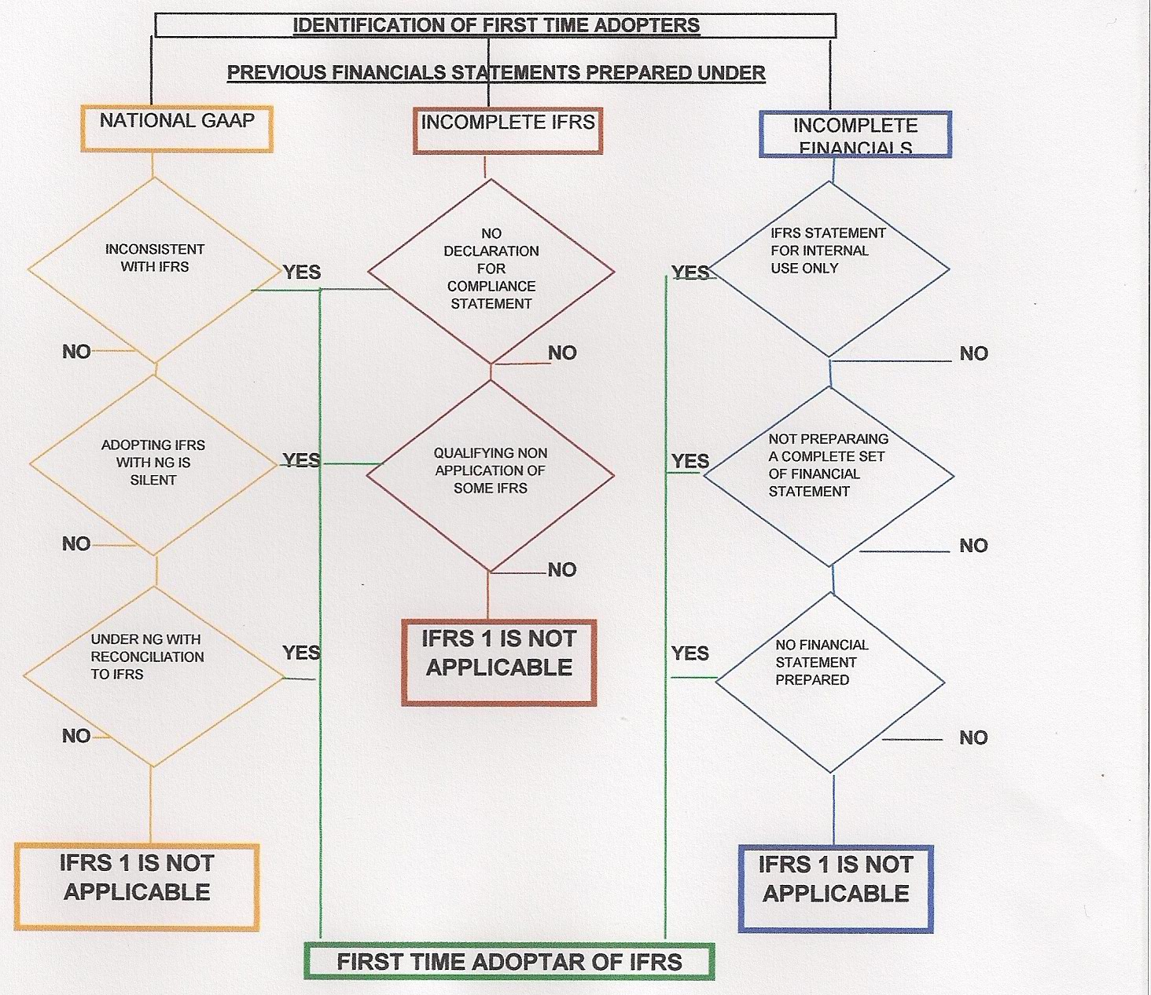
IFRS 1– First Time Adoption
–Step # 1
NG-National GAAP

Slide 412
IFRS 1– First Time Adoption
Examples of First Time Adaptors:
Q) Entity “A” had prepared F/S for previous year as per National GAAP and those F/S contained Compliance Statement with IFRS, Does IFRS1 applies to Entity A in the Current Year?

Slide 413
IFRS 1– First Time Adoption
Ans.) The Answer is “No”. IFRS 1 does not apply to Entity “A” as para.3 is very specific on the statement of Compliance in F/S. Even if the auditor qualifies that previous year audit report in the year but since entity gives compliance statement, IFRS 1 can not be applied in “current year” on Entity “A”.

Slide 414
IFRS 1– First Time Adoption
Examples of First Time Adaptors:
Q) Entity “B” has prepared previous F/S in accordance with some IFRS but not all. During the current year’s F/S, Entity “B” has given unreserved compliance statement. Are the current year’s F/S first time IFRS F/S as per IFRS 1?
Ans) “Yes”. IFRS 1 clearly mentions that F/S which carries unreserved compliance statement are the first IFRS F/S.

Slide 415
IFRS 1– First Time Adoption
Major points in Step # 1:
Making an “unreserved compliance statement” is a key factor
F/S carrying this statement first time will be considered first IFRS under IFRS1
To be the first F/S under IFRS 1, F/S shall comply with all IFRS

Slide 416
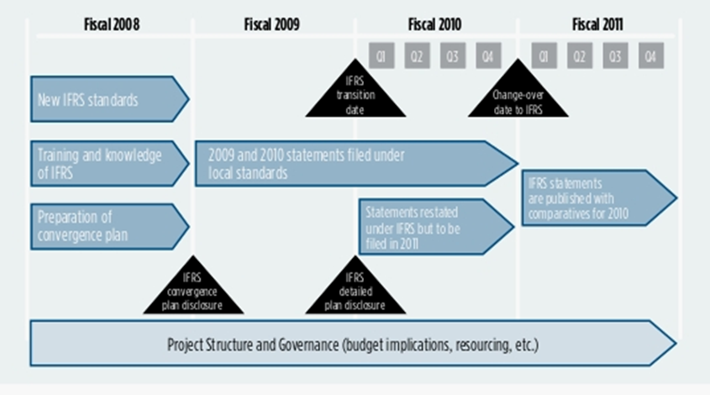
IFRS 1– First Time Adoption
Step # 2- Plan for Implementation

Slide 417
IFRS 1– First Time Adoption
Step # 2
Starting Point
Conversion to IFRS involves “Robust change” in the way an entity’s financial being read. It will have impact on -ratio analysis, Foreign exchange and hedging activities, Corporate income taxes, management reporting and so on
The Methodology for the conversion should be treating the conversion as a project. It should have a project leader, team members not only from accounts and finance but from other sphere within the Organization as well.
The project team should inform the board and audit committee on regular basis on its plan and progress.
The project should began with
Impact Assessment
Diagnostic activity; and
Scoping exercise.

Slide 418
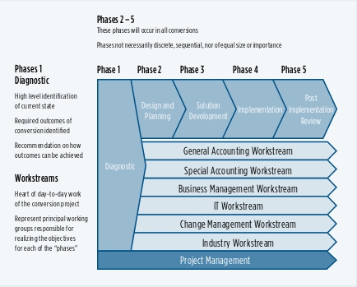
IFRS 1– First Time Adoption
Step # 2

Slide 419
IFRS 1– First Time Adoption
Step # 3
Accounting Policies
The general rule of IFRS 1 is, to develop first F/S that conforms with the IFRSs effective as on 1st IFRS statement, and throughout all the periods presented.
The impact of the general rule is, transition from Local GAAP to IFRS requires a complete, retrospective restatement of assets, liabilities and equity in conformity with IFRSs (subject to exemptions covered later)
Adjustments required during transition
Recognize all assets and liabilities whose recognition is required by IFRSs
Some possible adjustments may include
IAS 37 requires recognition of provision as liabilities
IAS 19 requires an employer to recognize its liabilities under defined benefit plan

Slide 420
IFRS 1– First Time Adoption
Step # 3
Adjustments required during transition- Reclassify the recognition of Assets, Liabilities and equity between National GAAP to IFRSs
Not recognize items as assets or liabilities if IFRSs do not permit such recognition
Some possible adjustment may include
IAS 38 does not recognize expenditure on certain items as an intangible assets e.g. research, training, advertising and promotion etc.
Deferred tax assets, when recovery is not probable is derecognized
Treasury stock if allowed as asset in National GAAP, it should be reclassify as part of Equity under IFRS’s

Slide 421
IFRS 1– First Time Adoption
Step # 3
Apply IFRSs in measuring all recognized assets and liabilities
Financial instruments are valued at Fair value or amortized cost under IAS 39
Provisions are calculated using the best estimates as per IAS 37
In other words, in the absence of specific exception and exemptions, First time Opening statement of Financial Position is prepared as if it had always been applying IFRSs.

Slide 422
IFRS 1– First Time Adoption
Step # 4
There are 15 Optional exemption’s to ease the burden of retrospective application
There are also 4 mandatory exemption’s where retrospective application is not permitted

Slide 423
IFRS 1– First Time Adoption
Optional Exemption from Retrospective application
1. Business combinations.
2. Fair value or revaluation as deemed cost for property, plant and equipment and other assets.
3. Employee benefits.
4. Cumulative translation differences.
5. Compound financial instruments.
6. Assets and liabilities of subsidiaries.
7. Associates and joint ventures.
8. Designation of previously recognized financial instruments.
9. Share-based payment transactions.
10. Insurance contracts.
11. Decommissioning liabilities.
12. Arrangements containing leases.
13. Fair value measurement of no-active market financial instruments at initial recognition.
14. Service concession arrangements.
15. Borrowing costs.

Slide 424
Optional exemptions
IFRS 1 Optional Exemptions - 15
Business combinations
Compound instruments
Property, plant and equipment,
investment properties, intangibles
Fair value measurement of financial
Instruments on initial recognition
Employee benefits
Standards
in force at
reporting date
Designation of financial assets and
Financial liabilities
Cumulative translation differences
Share-based payments
Transition date for subsidiaries,
associates and joint ventures
Decommissioning liabilities
Leases
Insurance contracts*
Borrowing cost
Service concessions arrangements
Investments in subsidiaries, associates and joint control entities.

Slide 425
IFRS 1– First Time Adoption
Mandatory Exemption from Retrospective application
1. De-recognition of financial assets and financial liabilities.
2. Hedge accounting.
3. Estimates.
4. Non-current assets classified as held for sale and discontinued operations.
Requirement- IFRS-1

Slide 426
IFRS 1– First Time Adoption
Examples-
Mandatory Exemption from retrospective Application

Slide 427
Mandatory Exemption from Retrospective application
Estimates
Estimate
required by
previous GAAP?
YES
Evidence of error?
NO
Calculation consistent
with IFRS?
NO
YES
YES
NO
Make estimate
reflecting conditions
at relevant date
Use previous estimate
Use previous
estimate and adjust
to reflect IFRS

Slide 428
IFRS 1– First Time Adoption
Step # 4
Mandatory Exemption from retrospective Application
Estimates- Due to uncertainty in business activities
Prospective application
Comparative Information is not required to be restated
Examples:
Bad debts
Inventory obsolescence
Useful life of depreciable assets

Slide 429
IFRS 1– First Time Adoption
Step # 4
Mandatory Exemption from retrospective Application
Derecognizing of financial assets and liabilities-
An entity recognizes all financial assets and financials liabilities, including derivatives, that qualifies for recognition as per IAS 39.
IFRS1.B2- It exempts the retrospective derecognizing for the assets and liabilities recognized before 1st January, 2004. However if the entity has all the available information for the application of derecognizing of financial assets and financial liability, an Entity can choose the period.
Example – An entity which does not apply IFRS1.B3, does not recognized assets transferred in a securitization arrangement that occurred before 1st January, 2004
Reason - It could be costly and complex affair to gather all the previous year’s detail and the effect this transaction will be diminishing with the passage of time.

Slide 430
IFRS 1– First Time Adoption
Step # 4
Mandatory Exemption from retrospective Application
Hedge Accounting – In accordance with IAS 39, as entity shall
Measure all derivatives at fair value; and
Eliminate all deferred losses and gains arising on derivatives that were reported in accordance with previous GAAP as if they are assets and liabilities
However IFRS 1 permits to adopt hedge accounting for relationship
That have been designated as hedges under previous GAAP; and
Which also qualify for hedge accounting under IAS 39
Hedge accounting is than applied from the date, the hedging relationship is fully designated and fully documented as per IAS 39 and not from the date of transition. Also if any transaction is recognized as Hedge under pervious GAAP but not following the definition as Hedge transaction as per IAS 39, has to be designated as per IAS 39.
This designated has to be applied on the date of transition.

Slide 431
IFRS 1– First Time Adoption
Step # 4
Mandatory Exemption from retrospective Application
Non-Controlling Interests – The provision of prospective application of NCI comes in effect due to the changes made in IAS 27 which is applicable effective 30th June, 2010 annual period. The proposed changes suggest:-
To attribute the total comprehensive income between Owner and NCI even though NCI have deficit balance;
Requirement for accounting for changes in the parents’ ownership interest that do not result in a loss of control; and
Requirement for accounting for a loss of control of subsidiary.
The above requirements as mandated by IAS 27 is supposed to be applied prospectively. The basic assumption made herein is the early adoption of IAS27 amendments.
However if an entity elects to apply IFRS 3 retrospectively to past business combinations, it shall also need to apply amended IAS 27 and this exemption is not applicable in that case.

Slide 432
IFRS 1– First Time Adoption
Examples-
Optional Exemption from retrospective Application

Slide 433
IFRS 1– First Time Adoption
Step # 5
Optional Exemptions from Other IFRSs
Past Business Combination– Broadly this exemption allows entity to either opt IFRS3 restatement or Follow the statement as made under previous GAAP but with some adjustment.
The inclusion of this exemption is having a major impact on transition as in most cases it is very difficult to have all the necessary information related to past business combination.
There are 2 types of business combination that do not fall under IFRS 3R, thus taking out from the virtue of this exemption:-
The formation of a joint venture
Combination of entities and business under common control
In principal Entities have following option under this exemption:-
Apply IFRS 3 retrospectively
Apply IFRS 3 from a particular business combination and there after on all
Not to apply IFRS 3 for the application of IFRS 1
However any business combination after IFRS 1 adoption need to be account as per
IFRS 3 and 3R.

Slide 434
IFRS 1– First Time Adoption
Step # 5
Optional Exemptions from Other IFRSs
Past Business Combination (Cont..)– In case of an entity availing this exemption, following will be the impact on that Business Combination:-
The classification will remain same as per Indian GAAP
An entity shall recognize al assets and liability as per Indian GAAP, other than:-
Some financial assets and financial liabilities derecognized in Indian GAAP
Assets including goodwill and liability which does not qualify to be recognize as per Indian GAAP and as per current IFRS also can not be qualify
Any resulting change shall effect in the retained earning unless the change result in the recognition of intangible asset subsumed in Goodwill previously
The carrying amount of the assets and liability shall become the deemed cost and for later year will be used in the same manner under cost based approach.
The goodwill as assumed under Indian GAAP will be adjusted only by:-
Any adjustment in the recognition of intangible asset subsumed in Goodwill previously; and
Under IAS 36 under the impairment loss on the date of transition and recognizing any impairment loss in retained earnings

Slide 435
IFRS 1– First Time Adoption
Step # 5
Optional Exemptions from Other IFRSs
Past Business Combination (Cont..)– EXAMPLE
An entity has acquired 75% of subsidiary S. In complying with Indian GAAP entity has recognized an intangible asset of CU1000 that would not have qualified for recognition in accordance with IAS 38, Intangible Assets. The tax base of this intangible asset was NIL thus giving rise to deferred tax liability of CU300 (Assumed rate of 30%). On the date of transition the carrying amount of the intangible asset in accordance with Indian GAAP was CU 800 and the carrying amount of deferred tax liability of CU 240.
APPLICATION:- Because the intangible asset do not qualify for recognition as separate asset, entity has to transfer the asset to goodwill along with deferred tax liability and Non controlling interest. Thus increasing the goodwill by CU 360 (CU 800 – 25% NCI – Deferred tax liability CU 240).

Slide 436
IFRS 1– First Time Adoption
Step # 5
Optional Exemptions from Other IFRSs
IFRS 2 – Share based Payments
IFRS 2 applies to the transaction where in entity uses equity to purchase goods and services.
This exemption provide option to the application for IFRS 2;
Grant Date | Vested Date | Application
On or before 7th November, 2002 | On or before 7th November, 2002 | It is not required though encouraged to apply the provisions of IFRS 2.
After 7th November, 2002 | before 1st Jan. 2005 | It is not required though encouraged to apply the provisions of IFRS 2. Though if an entity wish to apply IFRS 2 it can do so only if the fair value of these equity instrument has been publicly disclosed
After 7th November, 2002 | After 1st Jan. 2005 | It is mandatory to apply the provisions of IFRS2.

Slide 437
IFRS 1– First Time Adoption
Step # 5
Optional Exemptions from Other IFRSs
Insurance Contracts – IFRS 4 deals in Insurance contracts. This exemption allows Para 9 which restrict the transitional provisions of other IFRS shall not be applicable. Like IFRS 1, IFRS 4 also restrict the application of transitional provisions of other IFRS including IFRS 1.
Fair value or revaluation as Deemed cost – This exemption is available for Property, plant and equipment, Investment property (if carried on under cost model) and intangible assets that meet the recognition and revaluation criteria in IAS 38.
Under cost model, an item of PPE is carried forward on cost less accu. Depreciation less impairment loss. Under revaluation model an item is revalued every year.
Under this exemption an entity may elect to use previous Indian GAAP value or specific event value e.g. IPO, as revaluation if the revaluation is broadly compared with either the cost model OR fair value.
Even if an entity declares higher value under this exemption the same will be nullified under the impairment provision vide IAS 36.

Slide 438
IFRS 1– First Time Adoption
Step # 5
Optional Exemptions from Other IFRSs
Leases – IFRIC 4, Determining whether an arrangement contains a lease, applies at the inception of the agreement but vide this exemption IFRS 1 allows the application of IFRIC 4 at the date of transition to determine whether an arrangement falls under the definition of lease based on the circumstances on the date of transition.
Employee Benefits – IAS 19, Employees Benefit, allows the use of a corridor approach that leaves some actuarial gains or losses unrecognized.
Under IFRS 1 an entity is allows to recognize all gains or losses as at the date of transition even if corridor approach is used for subsequent gains and losses.
If this election is applied, it should be applied to all plans.

Slide 439
IFRS 1– First Time Adoption
Step # 5
Optional Exemptions from Other IFRSs
Cumulative translation differences – IAS 21, The effects of changes in Foreign exchange rates, requires
the translation difference to be shown separately as a component of equity for each foreign operation.
On disposal, to reclassify the cumulative translation difference from equity to profit and loss as part of gain or loss from disposal.
IFRS 1 exempts entities to comply with these requirement that exist at the date of transition. However if the entity adopts this exemption:-
The cumulative translation difference are deemed to be ZERO; and
The gain or loss on a subsequent disposal shall exclude difference that arose before the transition date but include the later differences. provided the liability does not exist at the date of transition.
Where the liability does exist at the date of transition, an entity need to separate equity and liability retrospectively as if the same was always been followed under IFRS.
Compound Financial Instrument – As per IAS 32, Compound financial instrument needs to be bifurcated between equity and liability.
IFRS 1 provides exemption from such requirement

Slide 440
IFRS 1– First Time Adoption
Step # 5
Optional Exemptions from Other IFRSs
Investments in subsidiaries, jointly controlled entities and associates–This exemption is relevant for 1st time adopter that is
A parent or investor; and
Present separate financial statements
In accordance with IAS 27, the carrying cost of such investment should be either Cost or value as derived by IAS 39.
IFRS 1 gives exemption in determining carrying cost.
Cost of investments
At Cost
In accordance with IAS 39
Deemed Cost
Fair Value
Indian GAAP carrying amount

Slide 441
IFRS 1– First Time Adoption
Step # 5
Optional Exemptions from Other IFRSs
Assets / Liabilities of subsidiaries, associates and joint venture – Entities in the same group may adopt IFRS at different date based on the country conditions they are working in, regional conditions or early adoption. They can 2 scenarios:-
A subsidiary adopts IFRS1 later than its parent
A parent adopts IFRS 1 later its subsidiary
Accounting for the assets / liability under scenario # 1
The carrying would remain same as included in parent F/S based on transition; OR
The carrying amount as per IFRS 1 based on subsidiaries adoption. It requires independent adoption of IFRS 1 by subsidiary.
Considerations for option # 1:-
It implies using all the options adopted by parent;
It needs adjustment due to the fact of difference in accounting policies; and
Option is useful as it suggests single set of policies if basic assumptions are same

Slide 442
IFRS 1– First Time Adoption
Step # 5
Optional Exemptions from Other IFRSs
Assets / Liabilities of subsidiaries, associates and joint venture (Cont..)–-
A parent adopts IFRS 1 later than its subsidiary –
The group shall measure the assets / Liabilities of the subsidiary at the same carrying amount of Subsidiary after making necessary adjustment for consolidation and equity accounting.
The principle is once a part of the group moved to IFRS and comply with the IFRS the parent can not elect to change amount. The amounts are based on subsidiaries date of transition.
This rule are not in fact optional exemption. The parent must use the subsidiaries amount however the parent still need to apply the retrospective exception as mentioned in Step # 4.

Slide 443
IFRS 1– First Time Adoption
Step # 5
Optional Exemptions from Other IFRSs
Designation of previously recognized financial instruments–- The fundamental of IFRS 1 is, an entity shall recognize its assets and liabilities as if IFRS had always been applied. However IAS 39 allows that financial assets and financial liabilities can be designated at the time of initial recognition as fair value through profit and loss.
IAS 32 states that such designation is irrevocable. IFRS 1 allows such designation to be made at the date of transition.
An entity shall disclose the fair value of financial assets and financial liability designated into each category and their carrying amount. Any adjustment in the carrying amount shall be treated as transition adjustment.
Fair value measurement of Financial assets and financial liabilities at initial recognition can either be at
Prospectively to transactions entered into after 25th October, 2002; OR
Prospectively to transactions entered into after 1st January, 2004

Slide 444
IFRS 1– First Time Adoption
Step # 5
Optional Exemptions from Other IFRSs
Decommissioning liabilities included in the cost of PPE– IFRIC 1 requires that any specified changes in decommissioning, restoration or similar liability has to be added to or deducted from the cost of assets.
IFRS 1 provides exemption from IFRIC 1. However if this exemption is being availed, the entity shall:-
Measure the liability at the date of transition;
If the liability is within the scope of IFRIC1, back into the amount by discounting the liability over the intervening period; and
Calculate the depreciation on that amount as at the transition date
IFRS 1 allows the exemption from Para. 9 to adopt the transitional provision of IFRIC 12
IFRS 1 allows the exemption from Para. 9 to adopt the transition provision of IAS 23, Borrowing cost. In applying this exemption, entity may
Capitalize borrowing cost for all qualifying assets for which the commencement date for capitalization is or after 1st July, 2009 Or date of transition whichever is later OR
Designate an earlier date as effective date

Slide 445
IFRS 1– First Time Adoption
Step # 6
Presentation and Disclosure
To comply with IAS 1R, an entity should present minimum below statement as part of its first IFRS F/S:-
3 Statement of Financial Position- 3 statement of Financial position means, 1st statement of comparatives at the date of transition, 2nd statement at the date of transition and 3rd statement at the date of adoption of IFRS
2 Statement of other IFRS primary statement- This means that 2 statements each of Comprehensive income, Other comprehensive income, cash flow and changes in equity
Related notes - Notes related to the explicit and unreserved statement of compliance, accounting policies adopted out of the options provided with in IFRS, disclosure requirements as provided in other IFRS. Also the terms specifically been used as “Related notes”, which may be interpreted to include notes on the 3rd additional statement of financial position which is the comparative at the date of transition.

Slide 446
IFRS 1– First Time Adoption
Step # 6
Presentation and Disclosure (Cont…)
A first time adopter shall explain the transition and shall include some reconciliation statements
Reconciliation of its equity in accordance with Indian GAAP as
compare to IFRS.
This reconciliation needs to be presented for
(i) the date of transition to IFRS; and
(ii) The end of latest period presented in accordance with Indian GAAP;

Slide 447
IFRS 1– First Time Adoption
Step # 6
Presentation and Disclosure (Cont…)
Reconciliation of total comprehensive income in accordance with IFRS as compare to Indian GAAP
The starting point for such reconciliation shall be total comprehensive income in accordance with Indian GAAP if the F/S would have been prepared under Indian GAAP
Reconciliation of Cash flow in accordance with IFRS as compare to Indian GAAP if the F/S would have been prepared under Indian GAAP
Also if entity discover some error made under Indian GAAP, it shall be disclosed separately other than change in A/c policies
Though there is no format prescribed for such reconciliation but IFRS 1IG contain an example which can be used to decide the format. However such reconciliation shall provide sufficient detail for users to understand the material adjustment during transition.

Slide 448
IFRS 1– First Time Adoption
Step # 6
Presentation and Disclosure (Cont…)
Other Consideration in Presentation and Disclosure
IFRS 1 does not provide exemption from the disclosure requirement of other IFRSs
If entity is also presenting non IFRS comparatives and historical summaries
These summaries are outside the purview of IFRS
These summaries shall be labeled as previous Indian GAAP information prominently
Disclose the nature of main adjustment to make it comply with IFRS
IAS 8, changes in Accounting policies does not apply for first time adopter hence the disclosure requirements of IAS 8 are not applicable.

Slide 449
IFRS 1– First Time Adoption
Step # 6
Presentation and Disclosure (Cont…)
Interim Financial Reports –
Besides the disclosure requirements of IAS 34, an entity shall include reconciliations to explain the material adjustments from Indian GAAP to IFRSs
An entity can disclose some of the adjustment information in other documents but in that case, it need to specifically disclose and cross referred such document in Interim Financial reports.
This is based on the assumption that the users have access to other documents as mentioned in Interim Financial reports.

Slide 450
ROBUST PROJECT METHODOLOGY
SOURCE – KPMG LLP, Canada

Slide 451
IFRS 1– First Time Adoption
ALTERNATES AND OPTIONS
IFRS by its very nature provide necessary provisions in respect of:-
Accounting treatments;
Measurement; and
Disclosures
Through out the IFRS there are areas where in some options being provided. These options are provided as some country position in terms of Legal, Economy, Political and/ or business practice may differ from other and IFRS may not be apply with equal force globally.
The attached word file provides a outline of the different options available in IFRS.

Slide 452
IFRS 1– First Time Adoption
DIFFERENCES
January 2010 and April 2010 is the transition line for 2 major economies in G 20 Group namely Canada and India as well as for Japan to crease out the differences between NGAAP and IFRS by 2011.
The attached file explain the differences in the NGAAP (India & Canada) and IFRS
India GAAP – IFRS comparison has been taken from the project carried out by PWC comparing IFRS, US GAAP and Indian GAAP.

Slide 453
IFRS CONVERSION ISSUES

Slide 454
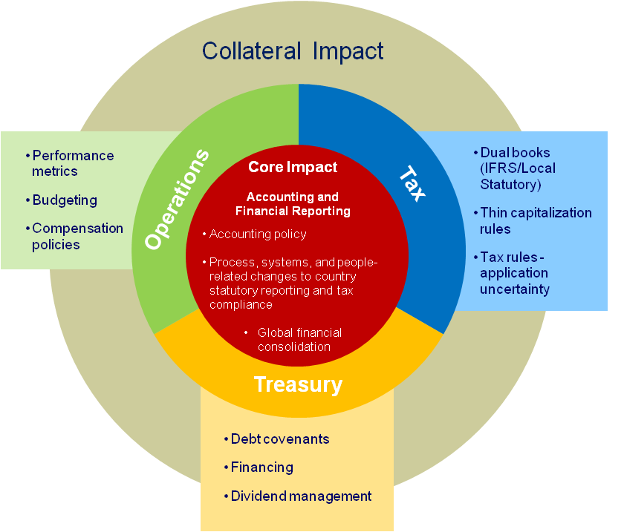
Business and organisational considerations IFRS impact beyond financial statements
Most aspects of the business can be affected:
Processes and systems
Operations
Tax
Treasury
Examples include impact on:
Debt covenants
Compensation plans
Revenue contracts
Joint ventures and alliances
Investor communication
The adoption of IFRS affects more than a company’s accounting policies, processes, and people.
Ultimately, most aspects of a company’s business and operations are affected potentially.

Slide 455
IFRS Implementation Issues
Treasury Management
Hedge Accounting
Investments
Valuation
Fair valuation approach
Fair valuation methodologies
Distribution
2010-11 profit will change
Dividend policy
Investor relations
Changes in EPS
EU experience
Debt Covenants
IAS 1 requirements
ORGANISATION
Mergers & Acquisitions
Control
Goodwill
Capital reserve
IFRS 1 option
IT Systems
Disclosures (IFRS 7)
Hedge accounting
Data collection
Management Compensation
ESOP fair value
Targets not achievable
Director remuneration
Investors
HR
Training
Revised CTC
MIS
Increased volatility
Fluctuations outside control
Fair value adjustment
Tax Implication
Fair value adjustment
Most item will flow through P & L

Slide 456
Potential business issues
Some of the key business issues that will need to be addressed for successful implementation:
Treasury management
Distributions
Debt covenants & financing
Mergers & acquisitions
Management compensation
Potential tax implications
Management information
Human resources & training
IT systems
Investor relations

Slide 457
Potential business issues
Treasury management
Certain financing and hedging policies will no longer achieve the desired accounting effect, will instead create volatility in reported profits
Challenge
have to find good economic strategies that will produce right accounting treatment
Distributions
Equity will change – current dividend policy may no longer be sustainable
Altered dividend patterns may directly impact the share price

Slide 458
Potential business Issues
Debt covenants & financing
Where debt covenants do not provide for changes in accounting standards, changes to financial position may cause these covenants to be breached
Impact company’s ability to ensure continuity of financing arrangements
When seeking to raise finance, comparative figures may need to apply IFRS as well
Mergers & acquisitions
Accounting for potential acquisitions will be altered by the adoption of IFRS
Goodwill => become non-amortised
Past mergers/acquisitions may contain clauses including price revisions based on accounting data Example- Company X acquisition of Jaguar (if having any clause of price revision based on adoption of IFRS (liability or Recoverable)

Slide 459
Potential business issues
Management compensation
Fair value of share options and other incentive plans shall be recognised
Additional cost to company
Any adjustment to a directors’ remunerations scheme is a sensitive issue
Careful management of investor relations is essential
Various Models used to value shares are- Fair market, Black –scholes pricing Model.

Slide 460
Potential business issues
Share Based payments (IFRS-2)
Grant Date (date on which conditions for giving are met)
Vesting period (needs to complete certain period say 3 years before the shares can be given to the person)
Example
Company X grants 120 share Options to about 460 employees . Each grant is conditional on the employee working for Company X for next 3 years. Company X has estimated that fair value of each share option is $12. Company X estimate that 25% of employees will leave during the 3 year period and shall forfeit their rights to the share options.
Question- Find the amounts to be recognised for services as consideration for the share option during the vesting period.

Slide 461
Potential business issues
Share Based payments (IFRS-2)
Working
step 1 | 120*460 | 55,200.00
Step 2 |  | Years | working | Remuneration expense | Cumm Remuneration expense
 |  | 1 | 55200 options X 75% X $12 X 1/3 years | 165,600.00 | 165,600.00
 |  | 2 | 55200 options X 75% X $12 X 2/3 years | 165,600.00 | 331,200.00
 |  | 3 | 55200 options X 75% X $12 X 3/3 years | 165,600.00 | 496,800.00
 |  |  | Total | 496,800.00

Slide 462
Activity
Situation2
Year 1- 25 employees leave. Company X revises the estimates from 25% to 20%.
Year 2- Another 22 employees leave. Company X further revises the estimates from 20% to 15% .
Year 3- Another 13 employees leave.

Slide 463
Activity
Situation2
Solution
Working
step 1 | 120*460 | 55,200.00
 | 460
Step 2 | employee left | Years | working | Remuneration expense | Cumm Remuneration expense
 | 25 | 1 | 55200 options X 80% X $12 X 1/3 years | 176,640.00 | 176,640.00
 | 22 | 2 | 55200 options X 85% X $12 X 2/3 years | 198,720.00 | 375,360.00
 | 13 | 3 | 48000 options X $12 less 3,75,360 | (174,720.00) | 200,640.00
 |  |  | (460-60= 400 *120 =48,000 options)
 | 60 |  | Total | 200,640.00

Slide 464
Potential business issues
Potential tax implications
Definition of “taxable profits”, follow accounting rules?
Major accounting principles adopted:
Mark-to-market basis for valuation
Flow through P&L accounts for most items
Both unrealized gains and loss will appear in profit and loss account
Items may cause material impact:
Financial instruments
Share-based payments
Investment properties
Income taxes
Revenue recognition

Slide 465
Potential business issues
Management information
Forecasts and internal performance measurements may no longer be comparable with results reported in FS (eg fair value change)
Making forecast more difficult
Human resources & training
Training will be required throughout the organization, but not just for finance dept
Existing skills may not be adequate to tackle IFRS related issues ➔ need to be supplemented externally or by recruitment or by training .

Slide 466
Potential business issues
IT systems
Systems that will be affected:
internal and external reporting systems, accounting systems and operating systems
E.g. new accounting treatments for financial instruments may require treasury systems to be integrated with financial reporting system

Slide 467
Potential business issues
Investor relations
May challenge the changes in profits and EPS
Investors will form their own expectation on new accounting policies and expect certain accounting outcomes
Nobody likes surprises
Comparison becomes difficult because of IFRS in phases amongst Companies.

Slide 468
IFRS- HR issues
Recruitment of Employees – Knowledge of IFRS
Retention of Employees with Knowledge
Increase of Burden on Existing Employees
HR Policies- Retirals Benefits and Funded Scheme –Unrealized gains
movement in OCI
Director Incentives- Impact on IFRS
ESOP- Working & Valuations

Slide 469
IFRS- Legal & Commercial
Legal Contracts – Futures impacts
Derivatives & Hedge Accounting- Impact’s
Payment terms – defer or non defer- Present Value Booking
Supplier Contract’s & Customer Contract’s- Validate with IFRIC-4
Contracts- Supply only/ Bundle of Supply & Services
Company X Team is aware- How about other’s – Need Total
education
Continuous awareness – Change in process – Dynamic Environment

Slide 470
Planning for IFRS
Technical Accounting
Tax
Internal Processes and Statutory Reporting
Technology Infrastructure
Organizational Issues
Implementation strategy and timeline

Slide 471
IFRS Conversion Approach
Determine business case & future state vision for IFRS adoption
Perform comprehensive IFRS conversion
Enable continued IFRS reporting and perform knowledge transfer

Slide 472
IFRS Conversion Approach
An IFRS assessment and conversion utilizes a three-phase approach
Phase 1
Phase 2
Phase 3
Assess
Convert
Sustain
Objective
Determine business case & future state vision for IFRS adoption
Perform comprehensive IFRS conversion
Enable continued IFRS reporting and perform knowledge transfer
Key Tasks
Analyze impact of IFRS statutory and regulatory requirements
Determine tax reporting & method implications of IFRS adoption
Analyze impact to accounting, reporting, close consolidation, and reconciliation processes and controls
Evaluate the impact upon financial systems and architecture
Assess magnitude of change upon stakeholders and operating model
Technical Accounting Country Assessment
High Level Tax Impact Assessment
Current State Process and Controls Assessment
Current State Systems Assessment
Business Case and Roadmap
Convert to IFRS at the consolidated and/or statutory reporting level
Perform tax conversion
Design future state accounting, reporting, close consolidation, and reconciliation processes and controls
Design future state IT systems to incorporate IFRS reporting
Develop change management strategy and revised operating model
IFRS Accounting Policies and Procedures
IFRS Compliant Reports
Future State Process Flows and Narratives
Change and Risk Mitigation Plan
Revised Operating Model
Configure, test, and deliver production environment and monitor system enhancements
Execute change management activities and implement revised operating model
Deploy future state accounting, reporting, close consolidation, and reconciliation processes & controls
Continue monitoring and application of the changing standards environment
Facilitate knowledge transfer for ongoing IFRS reporting
Finalized IFRS Policies
Revised processes
Training Workshops
Detailed Transition Plan
IFRS Conversion Summary
Key Deliverables
Notes:
472

Slide 473
Steps
Parallel run and test systems
Implement business decisions
Train staff
Design and implement systems
Plan the implementation
Think of business issues
Scope the impact

Slide 474
Experience Learned
Be Strategic. Accounting choices and a principles based approach provides opportunity.
The business will be impacted. Taxes. Systems. Debt Covenants. Dividends. Earnings. MIS. The reach of IFRS can be widespread.
Execution counts. Understanding concepts is only the beginning. Striking the numbers and documenting your position requires a very large effort.
Communication is critical. Internal communication across your business is needed. External communication with all stakeholders is important. Don’t forget the analysts!
Disclosures require a lot of effort. Don’t leave this until it’s too late. The information requirements are extensive.

Slide 475
Key considerations for Industries
Summary
Impact on P&L and Net worth
Market valuation
Global image
More business
True picture
IFRS is much more than an accounting matter.

Slide 476
Questions?

Slide 477
Thank you

