Slide 1
VALUATION

Slide 2
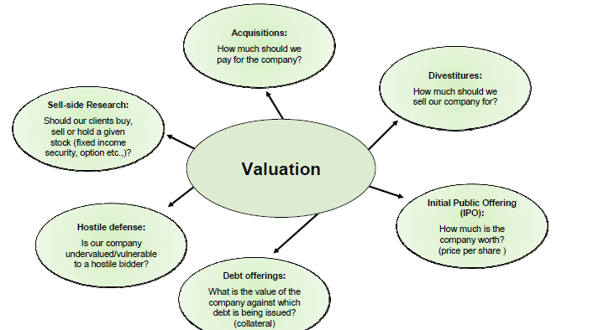
Why valuation is Important

Slide 3
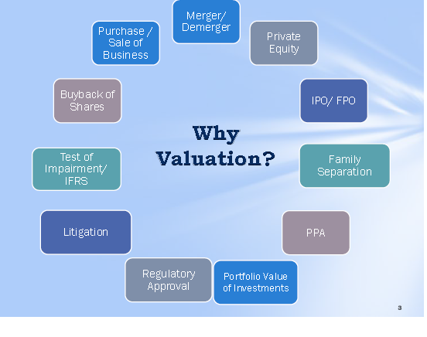
Importance of Valuation in Merger and acquisition

Slide 4
INTRINSIC VALUE
Basic premise is Market generally doesn't value stocks fairly (mismatch between intrinsic value and market price)
• Objective of Valuation is to estimate the real or intrinsic value of the company’s stock

Slide 5
SEARCH FOR INTRINSIC VALUE
DISCOUNTING CASH FLOWS
• PRESENT VALUE OF DIVIDENDS
• PRESENT VALUE OF FREE CASHFLOW TO
EQUITY
• PRESENT VALUE OF FREE OPERATING CASH FLOW OF THE FIRM

Slide 6
IV & MARKET PRICE
• Market Price
– Consensus value of all potential traders
• Trading Signal
– IV > MP Buy
– IV < MP Sell or Short Sell
– IV = MP Hold or Fairly Priced

Slide 7
Importance of valuation(contd.)
Aim
Buyer
Seller
Value the company as high as possible
In M&A
Value the company as low as possible

Slide 8
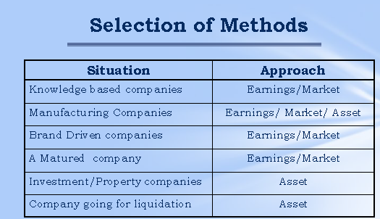

Slide 9
VALUATION MODELS
• ASSET BASED
• DISCOUNTED CASH FLOW BASED
• RELATIVE VALUATION
• NEWER APPROACHES

Slide 10
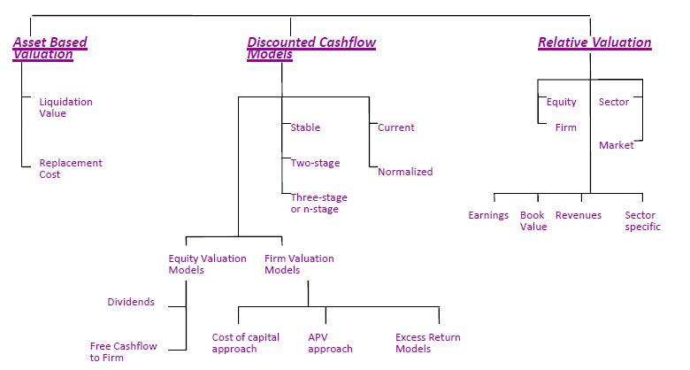
VARIOUS MODELS

Slide 11
Understand Various Types of Equity Valuation Models
Fundamental Stock Analysis: Models of Equity Valuation
    Basic Types of Models
      1. Balance Sheet Models
        Book Value
        Liquidation Value
        Replacement Value
      2. Discounting Models
        Free Cash Flow to the Firm (FCFF)
        Free Cash Flow to Equity (FCFE)
      3. Dividend Discount Models
      4. Price/Earning Ratios

Slide 12
Balance Sheet Models
Balance sheet models assume that the intrinsic value of the firm is the value of its assets.
  What is the value of the firms assets?
    Is it the value on the books?
    Is it the value we could really get for the assets (liquidation value)?
    Is it the value we could get to replace the assets?

Slide 13
Balance Sheet Models (continued)
Book Value (per share)
  Look at the book value: Equity / shares outstanding
  Example: Ford
    Assets 243,283 million
    Liabilities 219,736 “
    Owners Equity 23,547 “
    Shares Outstanding 1,169 “
  What is the Book Value per share?
    Rs23,547/1,169 = Book value of Rs20.14 per share
  Logic: the value of the assets should be equal to their value on the books.
  Be careful as book value does not tell you depreciation methods or the true value of the assets (they may be worthless)

Slide 14
LIQUIDATION VALUE
Liquidation value (per share)
  The amount of money realized by breaking up the firm, selling assets and repaying its debt
  Company A has a market value of Rs 250 million (mn) with Rs50 mn in debt, cash of Rs150 mn and other assets likely worth Rs200 mn if sold today.
  What is the liquidation value?
    Liquidation value is the cash on hand and what they could liquidate the other assets for, I.e. 150+200-50 = Rs300 mn
  Logic: if market price falls below liquidation value, the firm becomes a takeover target as investors buy the company and sell it in pieces

Slide 15
ASSET BASED : LIMITATIONS
• Book Value is an application of arbitrary
accounting rules
• Not concerned with the Market Price
• Better approach is either Replacement cost or
Liquidation Value

Slide 16
Discounting Models
(FCFF,FCFE)
Discounting models assume the intrinsic value of the company is the present value of the firms’ expected future cash flows. It is useful when:
  The company does not pay dividends
  Dividends paid differs from what the firm could pay
  Free cash flows align with profitability within a specific forecast period
  The investor takes a control perspective

Slide 17
CASH FLOW
• The statement of cash flows reports on cash inflows and outflows to the firm during the period of analysis.
• Intrinsic value can be estimated by discounting future cash flows using appropriate discount rate.
• Accuracy of the model depends on the visibility of future cash flows , correct assessment of the risk free rate , risk premium and the period for which the projections will be made.

Slide 18
VALUATION
• Process of determining the fair market value of a financial asset on the basis of present value of the
expected cash flows
• Three step process:
– Estimate the expected cash flows
– Determine the appropriate interest rate or interest rates to discount the cash flows
– Compute the present value of the expected cash flows in step 1 by discounted them with interest rate(s) in step 2

Slide 19
VALUATION
• In an efficient market, the market price is the best estimate of value. The purpose of any valuation model is then the justification of this value.
• A good valuation provides a precise estimate of value.
Equity valuation v/s firm valuation

Slide 20
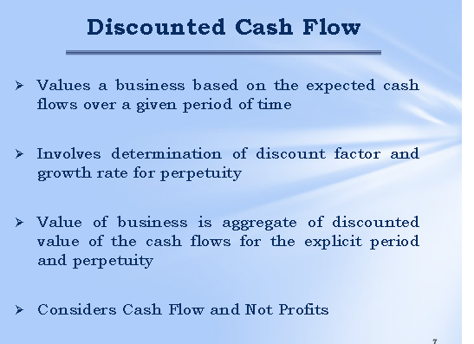
Importance of valuation continued

Slide 21
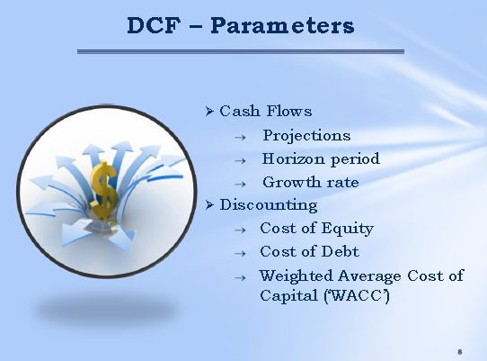

Slide 22
Free Cash Flow
Free Cash Flow to the Firm
Free Cash Flow to Equity
= Cash flow available to
Common stockholders
= Cash flow available to
Debtholders
Preferred stockholders
Common stockholders
Notes:
LOS: Define and interpret free cash flow to the firm (FCFF) and free cash flow to equity (FCFE).
Page 147
Free cash flow to the firm (FCFF) is the cash flow available to all the firm’s suppliers of capital once the firm pays all operating expenses (including taxes) and expenditures needed to sustain the firm’s productive capacity. The expenditures include what is needed to purchase fixed assets and working capital, such as inventory. The firm’s suppliers of capital include common stockholders, bondholders, and preferred stockholders (if the firm has preferred stock outstanding).
Free cash flow to equity (FCFE) is the cash flow available to the firm’s common stockholders once operating expenses (including taxes), expenditures needed to sustain the firm’s productive capacity, and payments to (and receipts from) debtholders are accounted for.
Note that the cash flow from operations as reported in the firm’s financial statements is not the same as free cash flow. Later, however, we will adjust the firm’s financial statement figures to derive free cash flow. Unadjusted financial income measures—such as earnings before interest, taxes, depreciation, and amortization (EBITDA)—do not provide an accurate description of the free cash flow available to the firm’s capital providers. For example, EBITDA and net income do not account for the investment in assets needed to sustain the firm’s productive capacity.

Slide 23
FCFF vs. FCFE Approaches to
Equity Valuation
FCFF Discounted at WACC – Debt Value
FCFE Discounted at Required Equity Return
Equity Value
Notes:
LOS: Describe, compare, and contrast the FCFF and FCFE approaches to valuation.
LOS: Describe the characteristics of companies for which the FCFF model is preferred to the FCFE model.
Pages 147 – 148
There are two ways to estimate the equity value using free cash flows.
An entire firm and all its cash flows (FCFF) are discounted, with the relevant discount rate being the weighted average cost of capital (WACC) because it reflects all the firm’s sources of capital. The value of the firm’s debt is then subtracted to calculate the equity value.
Only the free cash flows to equity (FCFE) are discounted, with the relevant discount rate being the required return on equity. This provides a more direct way of estimating equity value.
In theory, both approaches should yield the same equity value if the inputs are consistent. However, the FCFF approach would be favored in two cases.
The firm’s FCFE is negative.
The firm’s capital structure (mix of debt and equity financing) is unstable. The FCFF approach is favored here because a) the required return on equity used in the FCFE approach will be more volatile when the firm’s financial leverage (use of debt) is unstable and b) when using historical data to estimate free cash flow growth, FCFF growth might reflect the firm’s fundamentals better than FCFE growth, which would fluctuate as debt fluctuates.
Text Integration Note: The estimation of the WACC (weighted average cost of capital) was covered in Chapter 2 of the Equity Asset Valuation text.

Slide 24
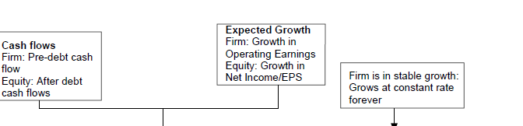
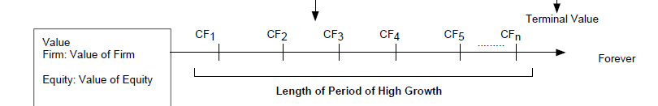

GENERIC DCF MODEL

Slide 25
PRESENT VALUE OF DIVIDENDS
• Value of a share of common stock is the present value of all future dividends
• To value a stock, you first find the present discounted value of the expected cash flows.
• P0 = Div1/(1 + ke) + P1/(1 + ke) where
– P0 = the current price of the stock
– Div = the dividend paid at the end of year 1
– ke = required return on equity investments
– P1 = the price at the end of period one

Slide 26
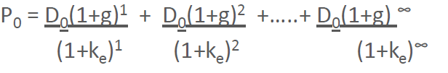
GORDON GROWTH MODEL
Some firms try to increase their dividends at a constant rate
Where,
D0 = the most recent dividend paid
• g = the expected growth rate in dividends
• ke = the required return on equity investments

Slide 27
GORDON GROWTH MODEL
The model can be simplified algebraically
to read:
• P0 = D0/(1 + g) = D1/(ke - g)
Where g is the constant perpetual growth rate .

Slide 28
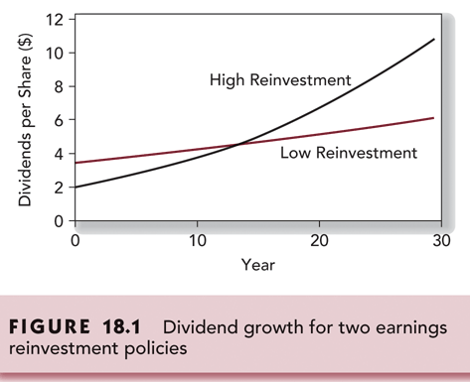
REINVESTMENT & DIVIDEND
GROWTH

Slide 29
FCFF
Free Cash Flow to the Firm (FCFF)
  FCFF is the cash flow available to the company’s suppliers of capital after all operating expenses (including taxes) are paid and working and fixed capital investments are made.
    FCFF = cash prior to the payment of interest to the debt holders
      FCFF = EBIT - taxes + depreciation (non-cash costs) – capital spending – increase in net working capital – change in other assets + terminal value
  Discount this at the firm’s WACC
  Firm Value = Operating free cash flow
  WACC – growth _{OFCF}

Slide 30
NUMERICAL EXAMPLE
EBITDA | Rs1000
DEPRECIATION EXPENSE | Rs 400
INTEREST EXPENSE | Rs 150
TAX RATE | 30%
PURCHASE OF FIXED RATE | Rs 500
CHANGE IN WORKING CAPITAL | Rs 50
NET BORROWING | Rs 80
DEBT | Rs 1500
Ke | 12%
Kd | 10%
cash | Rs 450
We | 80%
Wd | 20%
WACC | 11%
GROWTH | 5%

Slide 31
Example: Calculating FCFF from
EBIT and EBITDA
EBIT=EBITDA-DEPRECIATION=1000-400=600
FCFF=EBIT(1-TAX RATE)+DEPRECIATION-FC-WC
FCFF=600(1-.30)+400-500-50=Rs270

Slide 32
Calculation(FCFF)
Enterprise value=
270*(1.05)/11%-5%
=4725(Using FCFF)

Slide 33
FCFE
Free Cash Flows to Equity (FCFE)
  FCFE is the cash flow available to the company’s equity shareholders after all operating expenses, interest, and principle repayments have been made and necessary investments in working capital and fixed capital have been made
    FCFE = Adjusts cash flows for debt repayments
    FCFE = EBIT – interest - taxes + depreciation (non-cash costs) – capital expenditures – increase in net working capital – principal debt repayments + new debt issues + terminal value. Discount at k = required return on equity
    Equity Value =Free Cash Flows to Equity/(ke – growth _{FCFE})

Slide 34
Firm Value and Equity Value
How to get equity value, from firm value?
Subtract the value of all non-equity claims in the firm, that are included in the cost of capital calculation.
Subtract out the value of all debt
Add new Borrowings
Doing so, will give you a value for the equity

Slide 35
Calculating FCFE from FCFF
FCFE=FCFF-INT(1-TAX RATE)+NET BORROWING
FCFE=Rs270-Rs150(1-.30)+Rs80=Rs245

Slide 36
CALCULATION(FCFE)
Equity value
=245*(1.05)/12%-5%
=3675(using FCFE)
EV+CASH-DEBT=EQUITY
4725+450-150O =3675

Slide 37
Relative Valuation

Slide 38
What is relative valuation
In relative valuation, the value of an asset is compared to the values assessed by the market for similar or comparable assets To do relative valuation then,
Finding comparable assets
  We need to identify comparable assets and obtain market values for these assets
  Scaling the market prices to a common variable
  Convert these market values into standardized values, since the absolute prices cannot be compared This process of standardizing creates price multiples.

Slide 39
Relative valuation is pervasive
Most valuations are relative valuations.
  Almost 85% of equity research reports are based upon a multiple and comparables.
  More than 50% of all acquisition valuations are based upon multiples
  While there are more discounted cash flow valuations in consulting and corporate finance, they are often relative valuations disguised as discounted cash flow valuations

Slide 40
Comparable multiples
Comparable multiples are regularly used to value businesses.
They are quick and easy method to come up with a value for a company.
There are two basic steps in using comparable multiple analysis :
Selecting the correct multiple and then
Applying it to the relevant earning base

Slide 41
Reasons for popularity
Use of comparable is less time and resource intensive
It is easier to sell
It is easier to defend
Market imperative : Measures relative and not intrinsic value

Slide 42
Comparable multiples/Relative valuation
Common multiples that are used are either equity multiples or enterprise multiples.:
PE Ratios
Enterprise value / EBITDA
EV/EBIT
EV/Sales
Equity Value/ Book value
Peer Comparison
Sum of Parts

Slide 43
P/ERatio
It is the ratio of a company stock price divided by its earning per share.
PE Ratio = MPS
EPS
MPS : Market value per Share
EPS : Earning price per Share

Slide 44
P/E RATIO
• Best interpretation of P/E ratio is to see it as a reflection of market’s perception of companies worth
• P/E = [ D/E]/ k-g
• P/E is indirectly proxy for DDM

Slide 45
P/E RATIO
• Usually calculated using EPS from the last 4 quarters. This is Trailing P/E
• Forward P/E is calculated using estimated earnings over the next 4 quarters
• P/E also takes into account market expectations for a company’s growth (For same EPS growth companies will command higher P/E)
• Normalizing PE over the full business cycle

Slide 46
P/E RATIO
Rationale for using P/E
• EPS is primary determinant of investment value
• Most widely used and popular in investment community
• More practical from practitioners perspective
• Quick to perform

Slide 47
When we multiply the a derived P/E ratio by a target company ‘s EPS , we get an estimated stock price.
For example let us say that we have analyzed 10 comparable companies have found that the average P/E ratio is 17
We then multiply this value by the target company’s EPS , which we assume in this example is Rs 3/- : 17 X3= Rs 51

Slide 48
P/E RATIO:LIMITATIONS
• Earnings is an accounting number which is influenced by non-cash items like Depreciation and accounting rules (GAAP) which can vary form country to country
• During times of inflation P/E ratio tends to be lower as earnings are artificially propped up due to understatement of inventory and depreciation

Slide 49
EBITDA multiples
Also called as cash flow multiples because EBIDTA is sometimes used as a proxy for cash flows .
Enterprise value multiple : EVM =
Enterprise Value
EBIDTA
This is calculated for group or comparable companies to derive average value.

Slide 50
Reasons for Increased Use of Value/EBITDA
1. The multiple can be computed even for firms that are reporting net losses, since earnings before interest, taxes and depreciation are usually positive.
2. For firms in certain industries, such as cellular, which require a substantial investment in infrastructure and long gestation periods, this multiple seems to be more appropriate than the price/earnings ratio.

Slide 51
3. In leveraged buyouts, where the key factor is cash generated by the firm prior to all discretionary expenditures, the EBITDA is the measure of cash flows from operations that can be used to support debt payment at least in the short term.
4. By looking at the value of the firm and cash flows to the firm it allows for comparisons across firms with different financial leverage.

Slide 52
PRICE TO BOOK VALUE
• P/B Ratio = Market Price per Share/Book Value per Share
• P/B is useful where assets are liquid and can be easily computed
• P/B is useful to find out liquidation price of the business
• Book value is generally positive and hence P/B can be used even where P/E doesn’t work
• Book value is more stable than EPS

Slide 53
P/BV
• Second only to PE
• Incase of PE , Price is related to Income statement while in case of P/BV price relates to balance sheet

Slide 54
P/BV:LIMITATIONS
• Book value is generally on historical basis and does not reflect current market price
• Book values can be influenced by accounting rules
• Book value does not recognize intangible assets like brand value and human capital
• In growing economies with higher inflation book values could be substantially lower than market value of assets

Slide 55
PRICE TO SALES
• P/S Ratio = Market Price per Share/Sales per Share
• Only valuation method possible when company has no earnings or cash flows( like distressed firms)
• Sales revenue is less likely to be
manipulated/distorted

Slide 56
P/S : LIMITATIONS
• Poor valuation method as a given amount of
sales not always translate into earnings and cash flows
• P/S does not capture difference in cost structures
• Useful for mature and cyclical companies

Slide 57
PEG
• PEG incorporates impact of earnings growth
• It calculates P/E per unit of expected earnings growth
• Limitations : assumes linear relationship between growth and P/E , PEG does not factor differences in risk

Slide 58
EV/EBIDTA
• Refers to overall company than only equity
• More appropriate comparison as takes care of differences in leverage
• Being pre Depreciation / Amortization takes care of capital intensive nature of certain businesses
• EBIDTA is generally positive even when earnings(EPS) may be negative

Slide 59
SUM OF THE PARTS
• Based on valuation of each division or line of business individually
• Usually in case of conglomerates which different/ diversified businesses
• Need for this type of valuation since different businesses have different risk/return profile

Slide 60
ECONOMIC VALUE ADDED
• Conceptualized by Stern Stewart & Co.
• To assess if company earned excess over its cost of capital
• EVA = NOPAT – ( C% x TC )
• EVA/Capital ratio can help compare companies of different sizes

Slide 61
MVA
• Company must generate positive EVA over time .
• If it does so its MVA would rise ( MVA =Market value of company – total capital )

Slide 62
SAMPLE BENCHMARKS
Strong Balance Sheets with positive cash flow
• Debt to Equity < 50 %
• Solid Dividend Yield > 3%+
• Dividend Payout Ratio < 60%
• P/E Ratio < Industry average
• History of Paying Dividends consistently
• Focused on Emerging Markets

Slide 63
REAL LIFE GUIDELINES
• In real life analysts focus only on the critical factors which impact the valuation of the company / sector
• More than the model it is the insight in the critical factors which will lead to better valuation
• Look for factors which can cause EPS / ROE to change during the review period .
• Objective is to look for major change in trend

Slide 64
COMPARISON OF DCF AND RELATIVE
VALUATION
In real life professionals prefer relative valuation but many times use DCF as a reality check
• With DCF method there could be times when there are no overvalued/undervalued securities

Slide 65
PROS
Closer to market perception than DCF
Fund manager’s performance is judged relative to market
Requires far less information and assumptions than DCF
Much faster and simpler

Slide 66
CONS
No two businesses are strictly comparables
Undervalued stock on relative basis may still be overvalued.

Slide 67
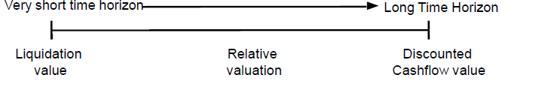
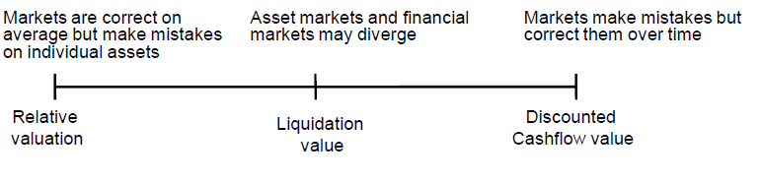
WHICH MODEL TO USE

Slide 68
THANKS

