Slide 1
Inventory Valuation u/s 142(2A) of Income Tax Act &
Form 6C
Tax Research Department (ICMAI)
Inventory Valuation under Income Tax Act
Mission Towards Transparency with CMAs
CMA NAVNEET KUMAR JAIN
FCMA. MBA, LL.B., M.COM., PGDTL, PGDFM, PGDIM, DISA(CMA), AIIISLA, LIII
INSOLVENCY PROFESSIONAL
Ex-Consultant-World Bank, Ex Consultant WHO
Central Council Member
ICMAI

Slide 2
Agenda: Discussion on Emerging Role of CMAs in Income Tax Act
1
Amendment of Section 142(2A) of Income Tax Act : Benefit to Exchequer and to all other stakeholders
2
Draft Inventory Valuation Format
3
Suggestions on Draft Inventory Valuation formats

Slide 3
Discussions
Purpose of this session???
Few Questions to start with
Amendment In Budget 2023: Inclusion of Cost Accountants under Income Tax Act
Notification of amended Section 142(2A) in Mar 23
Pros & Cons of Such Amendment
Release of Form 6C(Format of Inventory Valuation Report for public Comments)
Steps to be taken by CMA Fraternity and the Industry/other stakeholders
Way forward??
Big Question: CAN WE EXPECT ANY BEHAVIOURAL CHANGE AMONG CORPORATES/OTHER ASSESSEES

Slide 4
Few Questions
What Section 142(2A) amendment under Income Tax Act (Referred here as ITA) is all about?
Can the amended section 142(2A) create a sense of product level costing among the organisations leading to efficient & effective utilization of resources
Whether Recognition of CMA under Income Tax Act (Referred here as ITA) will create more opportunities?
Whether Inventory Valuation under ITA can be done by any professional other than CMA?
Who will assign the work of inventory valuation under Section 142(2A) of IT Act?
Can Companies directly assign the work of inventory Valuation?
When Will the work of Inventory Valuation under ITA be assigned?
What type of report is to be given
Whether any such report on Inventory Valuation is available till now?
Whether banks can ask for such type of reports from borrowers in future.

Slide 5
Few Questions
Whether the amendment u/s 142(2A) of ITA is applicable to companies only
What needs to be taken care of by cost auditors while finalizing cost audit reports

Slide 6
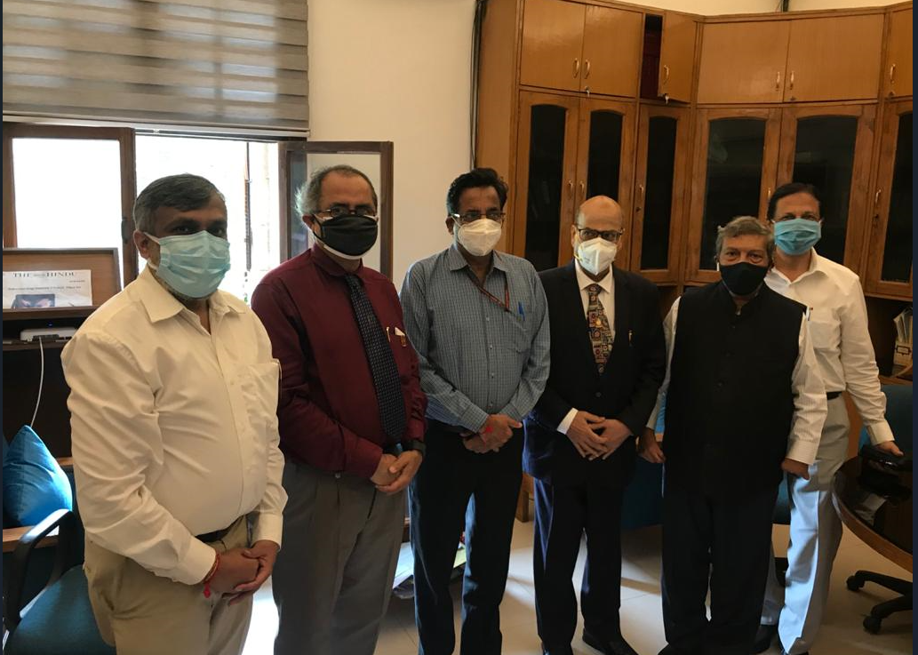
Inventory valuation-beginning of cma’s journey

Slide 7

FEBRUARY 2023
Ist FEB 23 THE GOLDEN BUDGET DAY for CMAs

Slide 8
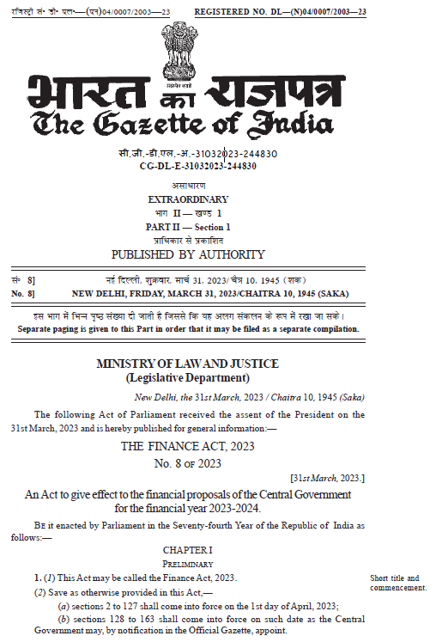
Another Golden Day
31st Mar 2023
Finance Act 2023 Notified
Cost Accountants finally got recognition under Income Tax Act for Inventory Valuation

Slide 9
Discussions
To plug the loophole, for the first time in India, the concept of inventory valuation by Cost Accountants has been introduced though in specific cases, but yes, now assessing officers have been given the powers to get the inventory valuation done under Section 142(2A) of Income Tax Act and it will be in addition to any of the audit under section 142(2A) of Income Tax Act.
The amendment in section 142(2A) of the Income Tax Act segregated the inventory valuation and audit into two parts.
It means that only Inventory Valuation can be asked to be done by a Cost Accountant even when audit under section 142(2A) has not been asked for.
It needs mention that in the back up explanations to amendment of section 142(2A) of Income Tax Act a reference to the Section 148 of the Companies Act 2013 with regard to maintenance of cost records has also been made.

Slide 10
Section 142 sub-section (2A) has been amended so as to enable the Assessing Officer to get the inventory of the assesaee also valued by a cost accountant.
Inserted an Explanation in the said section to define “cost accountant” to mean a cost accountant as defined in clause (b) of sub-section (1) of section 2 of the Cost and Works Accountants Act, 1959 and who holds a valid certificate of practice under subsection (1) of section 6 of the said Act.”
These amendments will take effect from 1st April, 2023.
For the purpose of simplification and as a step towards way forward, we would like to segregate the persons in two categories
a) Companies where section 148 of the Companies Act 2013 is applicable and maintenance of cost records is required
b) Persons other than mentioned in (a) above

Slide 11
What about companies covered under section 148 of the Companies Act 2013
The companies which fall in (a) category above must prepare the cost records first, value the inventory as per cost records and consider the same in the financials being finalized for the year.
Though the amendment is applicable for the year 2023-24 but as a pilot project the companies which are covered under section 148 of the Companies Act should get the costing prepared first before finalization of the financials for the year 2023 so as to identify the teething troubles.
The persons mentioned in (b) above may start the process of having an exhaustive costing system so that at the end of any year the cost data is available to be used for inventory valuation.
Once the specific process of inventory valuation through costing/cost records is adopted, the chances of variances in inventory valuation in case of any special assignment undertaken under section 142(2A) of Income Tax Act will be minimized.

Slide 12
Specific Provision- Inventory Valuation
. In section 142 of the Income-tax Act,––
(a) for sub-section (2A), the following sub-section shall
be substituted, namely:––
“(2A) If, at any stage of the proceedings before him, the Assessing Officer,
having regard to the nature and complexity of the accounts,
volume of the accounts,
doubts about the correctness of the accounts,
multiplicity of transactions in the accounts or
specialised nature of business activity of the assessee, and
the interests of the revenue,
is of the opinion that it is necessary so to do, he may, with the previous
approval of the Principal Chief Commissioner or Chief Commissioner or Principal Commissioner or Commissioner,
direct the assessee

Slide 13
Specific Provision- Inventory Valuation
to get either or both of the following, namely:––
(i) to get the accounts audited by an accountant, as defined in the Explanation below sub-section (2) of section 288, nominated by the Principal Chief Commissioner or Chief Commissioner or Principal Commissioner or Commissioner in this behalf and to furnish a report of such audit in the prescribed form duly signed and verified by such accountant and setting forth such particulars, as may be prescribed, and such other particulars as the Assessing Officer may require; ………………………………………..
ii) to get the inventory valued by a cost accountant,
nominated by the Principal Chief Commissioner or Chief Commissioner or Principal Commissioner or Commissioner in this behalf and
to furnish a report of such inventory valuation
in the prescribed form
duly signed and verified
by such cost accountant and
setting forth such particulars, as may be prescribed, and such other particulars as the Assessing Officer may require:
Provided that the Assessing Officer shall not direct the assessee to get the accounts so audited or inventory so valued
unless the assessee has been given a reasonable opportunity of being heard.”;

Slide 14
Opportunity of being heard
The authorities should keep in mind that opportunity of being heard has to be given to the assessee before issuing directions for Inventory Valuation by a Cost Accountant.
So the assessees must have proper and detailed item level backups (RMC and conversion Costs) of Inventory Valuation so as to justify the inventory figures as are shown in the Income Tax Returns or Tax Audit Reports.

Slide 15
SWOT Analysis of CMAs with respect to New Provisions
S
W
Strengths
Weaknesses
Expertise of CMAs in analysis of financials and costing of Products
Exhaustive Training required with regard to reporting considering the mandate by the Income Tax Authorities.
Opportunities
Threats
Showcase expertise in costing and inventory valuation.
Failure to live upto the expectations may close the doors of regulators.
Need to work Hard
O
T

Slide 16
 | Fees for Inventory Valuations
 | (2D) The expenses of, and incidental to, any audit under sub-section (2A) (including the remuneration of the accountant) shall be determined by the Principal Chief Commissioner or Chief Commissioner or Principal Commissioner or Commissioner] (which determination shall be final) and paid by the assessee and in default of such payment shall be recoverable from the assessee in the manner provided in Chapter XVII-D for the recovery of arrears of tax : Provided that where any direction for audit under sub-section (2A) is issued by the Assessing Officer on or after the 1st day of June, 2007, the expenses of, and incidental to, such audit (including the remuneration of the Accountant) shall be determined by the Principal Chief Commissioner or Chief Commissioner or Principal Commissioner or Commissioner in accordance with such guidelines as may be prescribed and the expenses so determined shall be paid by the Central Government. | (b) in sub-section (2D),–– “audit or inventory valuation under sub-section (2A) (including the remuneration of the accountant or the cost accountant, as the case may be)” (ii) in the proviso,–– (I) “audit or inventory valuation under” (II) “such audit or inventory valuation (including the remuneration of the accountant or the cost accountant, as the case may be)”

Slide 17
 | (3) The assessee shall, except where the assessment is made under section 144, be given an opportunity of being heard in respect of any material gathered on the basis of any inquiry under sub-section (2) or any audit under sub - section (2A) and proposed to be utilised for the purposes of the assessment. | “audit or inventory valuation”

Slide 18
Cost Records Applicability and Inventory Valuation
The companies where cost records maintenance has been mandated must take the cost from Cost Records being maintained at item level for the purposes of comparison of Cost or NRV.
The simple step of considering the product level cost from costing data being maintained under section 148 of the Companies Act for inventory valuation may help the companies to avoid any complex problem in case any such order under Section 142(2A) is issued by Income Tax department.

Slide 19
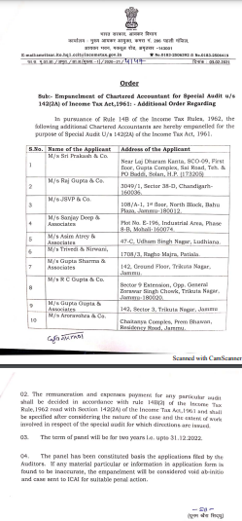

Slide 20
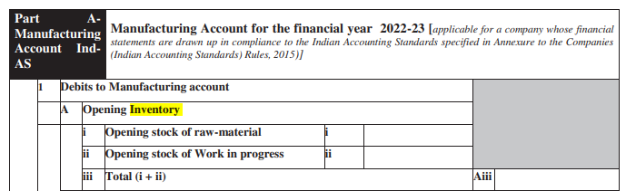
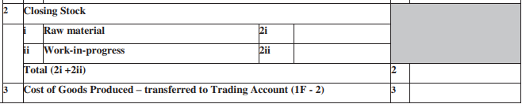
ITR-6: Indian Income Tax Return [For Companies other than companies claiming exemption under section 11]– Inventory Valuation reporting-Extracts

Slide 21
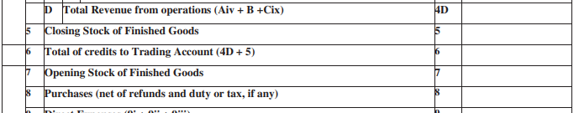
ITR-6: Indian Income Tax Return [For Companies other than companies claiming exemption under section 11]– Inventory Valuation reporting-Extracts
.

Slide 22
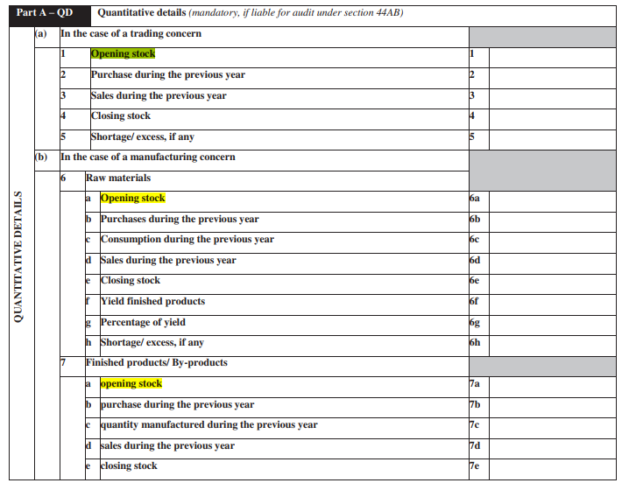
ITR-6: Indian Income Tax Return [For Companies other than companies claiming exemption under section 11]– Inventory Valuation reporting-Extracts
.

Slide 23
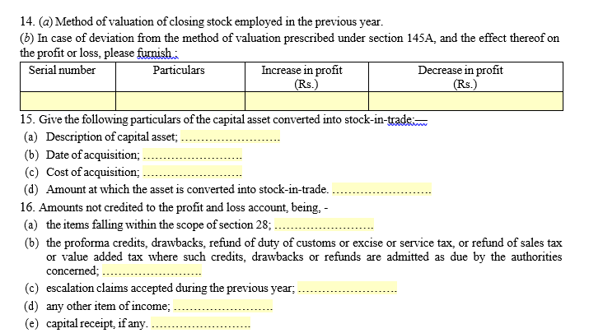
TAR

Slide 24
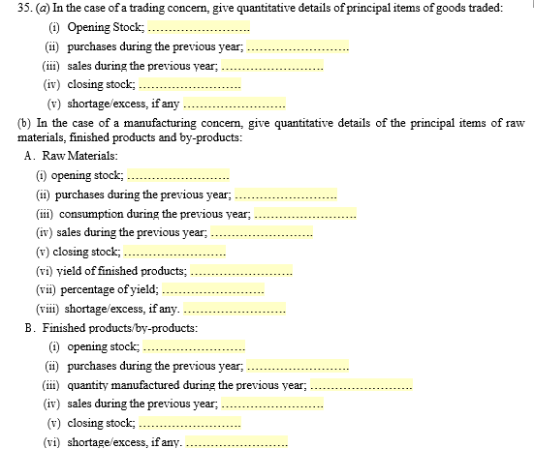
TAR-Quantities only

Slide 25
Cost Audit Reference in TAR

Slide 26
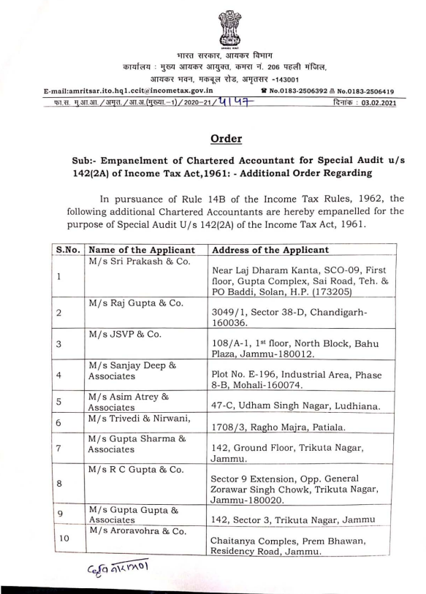
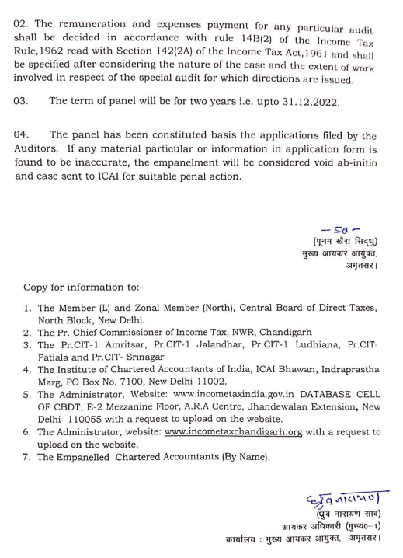

Slide 27
Form 6C
Report
Annexures

Slide 28
Form 6C
Report
  Inventory Valuation report under clause (ii) of section 142(2A) of the Income-tax Act, 1961
  Declarations/certifications
    Examined the inventory
    Conducted Inventory Valuation
    Proper Books of Accounts
      Comments to be added
    Whether Inventory Value is appropriate
    Prescribed Particulars
    And other particulars as asked by AO
    Variations in the Inventory Valuation Report (disclosures in 3CD wherever applicable otherwise in Audited accounts) adequately explained with reasons and justifications thereof

Slide 29
Form 6C
Report
Notes :
This report has to be given by the Cost Accountant nominated by the Pr. Chief Commissioner or Chief Commissioner or Pr. Commissioner or Commissioner of Income-tax under clause (ii) of section 142(2A) of the Income-tax Act, 1961.
Where any of the matters stated in this report is answered in the negative or with a qualification, the report shall state the reasons therefor.

Slide 30
Annexures 6C-13 Main points/items
Information of the Assessee
1 Address (Head Office and branches)
2. Date of incorporation
3. Nature of business
4. Details of principal products
5. Details of books of accounts maintained with respect to inventory
6. Method of accounting employed with respect to inventory maintained. Indicate whether there is any change from the method of valuation employed with respect to inventory maintained in the immediately two preceding previous years
7 Method of valuation of opening and closing stock
8 Summarized Details of Financial Results

Slide 31
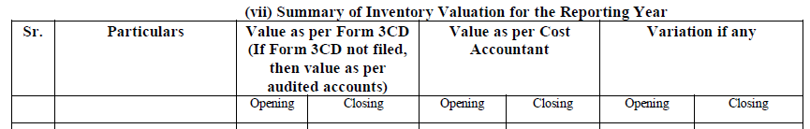
SUGGESTIONS e.g.
 | Items no in Form 6C | In Draft for Public Comments | Suggestions | Reasons
 | 12 (vii) Summary of Inventory Valuation for the Reporting Year (Header) | Value as per Form 3CD (If Form 3CD not filed, then value as per audited accounts) | Value as per relevant Income Tax returns/Audited Financials considered for working out profits for Income Tax computation | In Form 3CD valuation of Inventory is not shown rather only quantities are shown in Para 35, so modification will give direct relationship with the audited financials

Slide 32
Method of valuation of opening and closing stock
7. (i) Method of valuation of opening and closing stock of following inventory items used by the Assessee:
a) Finished Goods / Stock-in-trade
b) Work-in-progress (WIP)
c) Raw materials
d) By-products
e) Intermediate Product
f) Jigs, Tools, and Dies
g) Stores, Spares & Consumables
h) Scrap
What about GIT?????

Slide 33
Method of valuation of opening and closing stock
(ii) State whether there is any change in the method of valuation of
any of the aforesaid items as compared to the method employed in
the immediately two preceding previous years
(iii) If the answer to (ii) above is in the affirmative, specify the
amount by which the profit or loss for the year has been affected
by such change

Slide 34
Annexures 6C-13 Main points/items
9 In respect of items manufactured, full quantitative details of raw materials and finished products
  (i) Details of Raw Material for the year under reporting
  (ii)(a) Quantitative details in respect of items manufactured / traded by the Assessee
  *(ii)(b) Quantitative adjustments -
10. (i) Has the assessee conducted physical verification of raw materials, stores and finished products, etc. or the goods dealt in mentioned above?
  (ii) Details of discrepancies, if any
11. (i) Whether valuation is in conformity with the Income Computation and Disclosure Standards notified under sub-section (2) of Section 145 of the Income Tax Act, 1961 (“the Act”)?
(ii) Details of discrepancies, if any

Slide 35
Annexures 6C-13 Main points/items
12. Details of inventory valuation for the year under reporting by the Cost Accountant (wherever ICDS II is applicable) –
  (i) Valuation of Finished Goods/ Stock-in-trade
  (ii) Valuation of Work-in-Progress (WIP)
  (iii) Valuation of Raw Materials
  (iv) Valuation of By-Products
  (v) Valuation of Intermediate Products (IMP)
  (vi) Valuation of Other Stores
  (vii) Summary of Inventory Valuation for the Reporting Year
Notes
  Method of valuation adopted by cost accountant
  the amount by which profit or loss for the year would be affected by the changed valuation computed by the Cost Accountant.
  State reasons for year-to-year variation in operational efficiency (output / input ratio) for various products, if any.
  Any other relevant observation of the Cost Accountant.

Slide 36
13. Details of inventory valuation for the year under reporting by the Cost Accountant (wherever ICDS II is not applicable) –
A. Inventory valuation for Assessees engaged in the Construction Contracts which are dealt with by the Income Computation and Disclosure Standard III
(i) Valuation of Completed Units Ready for Sale
(ii) Valuation of Construction Work-in-progress
(iii) Valuation of Construction Materials
(iv) Valuation of Construction Fittings
(v) Summary of Inventory Valuation for the Reporting Year for Construction Contracts

Slide 37
13. Details of inventory valuation for the year under reporting by the Cost Accountant (wherever ICDS II is not applicable) –
B. Inventory valuation for Assessees engaged in the trading of Securities which are dealt with by the Income Computation and Disclosure Standard VIII.
(i) Valuation of Shares held as Stock-in-trade
(ii) Valuation of Debt Securities held as Stock-in-trade
(iii) Valuation of Convertible Securities held as Stock-in-trade
(iv) Valuation of Any other security held as Stock-in-trade
(v) Summary of Inventory Valuation for the Reporting Year for Shares, Debentures and other Financial Instruments held as stock-in-trade

Slide 38
13. Details of inventory valuation for the year under reporting by the Cost Accountant (wherever ICDS II is not applicable) –
C. Inventory valuation of livestock, agriculture and forest products, mineral oils, ores and gases, except those held by the trader of such inventories
i. Valuation of Inventory of Livestock
ii. Valuation of Inventory of Agriculture & Forest Produce
iii. Valuation of Inventory of Mineral Oils, Ores and Gases
iv. Summary of Comparison -

Slide 39
Inventory Valuation
by Cost Accountants
Background

Slide 40
ICDS & Section 148 of the Companies Act-Reference in Budget
[clauses 68, 72 & 122]
Preventing Permanent Deferral Of Taxes Through Undervaluation Of Inventory
Assessees are required to maintain books of account for the purposes of the Act. The Central Government has notified the Income Computation and Disclosure Standards (ICDS) for the computation of income. ICDS-II relates to valuation of inventory. Section 148 of the Companies Act 2013 also mandates maintenance of cost records and its audit by cost accountant in some cases.

Slide 41
BIBLIOGRAPHY
Type of
source - The Finance Bill 2023
pictures - www.taxguru.in and
www.taxscan.in

