Slide 1

E-Invoice
GST - 2.0
by
Prasanna Kumar K C
29th Dec 2020

Slide 2

eInvoicing
Overview
eInvoice means :-
Notified Registered Person
Reporting details of specified GST documents (i.e., Invoice, Debit / Credit note) to a Government-notified portal (IRP) in a particular form GST INV-01
Obtaining an Invoice Reference Number (IRN) & digitally signed digital stream of QR code
Issue Tax Invoice / DN / CN with QR code⁺ on Tax Invoice
Notes:
+ Notification No. 72/2020 [rule 46(r)]

Slide 3
eInvoicing
Applicability
Applicability :-
  Notified Registered Person [Sec. 2(94) Reg. u/s 25 but not include a person having UIN]
  Whose Turnover [any preceding financial year from 2017-18 onwards]
    > INR 500 Crores ➔ 1st Oct 2020⁺ [for Oct20 invoice shall be uploaded within 30 days – No Penalty⁺⁺⁺]
    > INR 100 Crores ➔ 1st Jan 2021⁺⁺
  Require to report all B2B + export / deemed export transactions
  B2C transactions [only RP who's TO > 500 Crores, mandatory from 1st Dec 2020]
Sec. 2(6) - “aggregate turnover” means the aggregate value of all taxable supplies (excluding the value of inward supplies on which tax is payable by a person on reverse charge basis), exempt supplies, exports of goods or services or both and inter-State supplies of persons having the same PAN, to be computed on all India basis but excl. CGST/SGST/IGST & cess
Notes:
+Notification 61/2020 30.07.2020
++ Notification 88/2020 10.11.2020
+++ Notification 73/2020 01.10.2020

Slide 4

e-Invoicing
Process Flow
Registered Person
Invoice Registration Portal (IRP) (Govt. Portal)
GSTN System (Govt. Portal)
1
Generation of Invoice at ERP / SAP / Accounting System / Bulk generation utility tool
Convert invoice details in to JSON format
Upload the JSON to IRP
2
Duplication check with GSTN
Generate & Validate Hash no. for IRN
Add digital signature
Add Digital stream of QR Code
2a
Hash stored in GST system
De-duplication checked
Data updated at e-way Bill System [PART-A]
Updation of GST return data
  GSTR1 updated for seller
  GSTR2A / 2B updated for buyer
4
3
Has to store IRN (in HASH form)
Convert digital stream of QR Code into QR Code
Print IRN & QR Code in the invoice
Return digitally signed JSON to RP with IRN (in Hash)
QR Code included in JSON (in digital stream)
Notes:
JSON format is ➔ that stores simple data structures and objects in JavaScript Object Notation (JSON) format, which is a standard data interchange format
IRN ➔ Invoice Reference Number (GSTIN+financial year+Invoice No.+document Type)

Slide 5
e-Invoicing
IRN & QR Code
4 Parameters to generate IRN
1.Supplier GSTIN
2.Supplier’s invoice number
3.Document Type (INV/CRN/DBN)
4.Financial year (YYYY-YY)
8 Parameters to generate a QR Code
1.GSTIN of Supplier
2.GSTIN of Recipient
3.Invoice number as given by Supplier
4.Date of generation of invoice
5.Invoice value (taxable value and gross tax)
6.Number of line items
7.HSN Code of main item (the line item having highest taxable value)
8.Unique Invoice Reference Number (hash)
64-digit hash number :-
d2334e4d936218e1cbb5f99768b4268af4aeb9ba109d2ab12c2e2bb32f64eff0
Verification of IRN or QR Code ➔ through portal / QR Code App

Slide 6
e-Invoicing
Mandatory / Optional Fields
Basic Details | Document Period / Preceding Doc. Ref. / Receipt Ref. | Buyer Details | Dispatch Details | Export Details | Item Details |  |  |  | Document Total Details | Payee Details | Seller Details | Ship to Details | e-way Bill
eInvoice schema Version | Document Period Start Date | Customer Name | Dispatcher GSTIN | Invoice Currency Code | Sr. No. of Item | IGST Amount | Item Description | Batch Number | Taxable Value Total | Payee Name | Supplier Name | Ship to GSTIN | Transporter ID
IRN | Document Period End Date | Customer Trade Name | Dispatcher Name | Country Code | Service | CGST Amount | Barcode | Batch Expiry Date | IGST Amount Total | Bank Account No. | Supplier Trade Name | Ship to Legal Name | Trans Mode
Supply Type | Preceding Document Number | Customer GSTIN | Dispatcher Address 1 | Invoice Value FC | HSN Code | SGST/UT Amount | Free Quantity | Warranty Date | CGST Amount Total | Mode of Payment | Supplier GSTIN | Ship to Trade Name | Trans Distance
Document Type | Preceding Document Date | Place of Supply | Dispatcher Address 2 | Port Code | Barcode | Item Discount | Cess Rate | Atrribute Name | SGST/UT Amount Total | Branch Code | Supplier Address1 | Ship to Address 1 | Trans Name
Document Number | Other Reference | Customer Address 1 | Dispatcher Place | Shipping Bill No. | Quantity | Other Charges | Cess Advalorem | Atrribute Value | Comp. Cess Amount Total | Payment Terms | Supplier Address2 | Ship to Address 2 | Trans Doc No.
Document Date | Receipt Advice Ref & Date | Customer Address 2 | Dispatcher State Code | Shipping Bill Date | UoM | Item Total Amount | Cess Non- Advalorem |  | State Cess Amount Total | Payment Instruction | Supplier Place | Ship to Place | Trans Doc Date
Additional Currency Code | Tender / Lot Ref. | Customer Place | Dispatcher from Pincode | Remarks | Item Price | Gross Amount | Cess specific Value |  | Discount Amount Invioce Level | Credit Transfer | Supplier State | Ship to Pin code | Vehicle No.
Reverse Charge | Contract Ref. | Customer State Code | Dispatcher State | Export Duty Amount | Pre-tax Value | Unique Serial Number | State Cess Rate |  | Other Charges Invioce Level | Direct Debit | Supplier Pin code | Ship to State Code | Vehicle Type
IGST Applicability [supply within state / UT] | External Ref. | Customer Pincode |  | Supplier can opt refund | Taxable Value | Purchase Order Line Reference | State Cess Amount Advalorem |  | Round off Amount | Credit Days | Supplier Phone
eComGSTIN | Project Ref. | Customer Phone |  |  | GST Rate |  | State Cess Amount Non-Advalorem |  | Total Invoice Value in INR |  | Supplier-Email
 | PO Ref. No & Date | Customer-Email |  |  |  |  |  |  | Total Invoice Value in FCNR
 |  |  |  |  |  |  |  |  | Paid Amount
 |  |  |  |  |  |  |  |  | Amount Due
Mandatory |  |  | Conditional Mandatory |  | Optional

Slide 7

e-Invoicing
Exemption at the Entity Level
Exemptions⁺
  B2C supplies (if the Supplier’s TO INR <500 Crores)
  Special Economic Zone Units [Not SEZ Developer] [Incl. Free Trade & Warehousing Zones FTWZ]
  Insurer or a banking company or a financial institution, including a non-banking financial company
  Goods Transport Agency supplying services in relation to transportation of goods by road in a goods carriage
  Suppliers of passenger transportation service
  Suppliers of services by way of admission to exhibition of cinematograph films in multiplex screens
Notes:
+ Notification 13/2020 ➔ Other than RP specified under Rule 54 (2) (3) (4) & (4A)

Slide 8
e-Invoicing
Documents Included / Excluded
Documents to be reported
Tax Invoice
  B2B
  Export Invoices
  Supplies to SEZ
  Deemed Exports
Debit Note
Credit Note
Documents not required to be reported
Debit Note
Credit Note
Delivery Challan
Bill of Supply
Bill of Entry
Payment Voucher
Refund /Receipt Voucher
Self invoice generated w.r.t RCM Supplies [u/s 9(3) & 9(4)]
ISD Invoices

Slide 9
e-Invoicing
Transactions Incl. / Excl.
  All B2B / Export⁺ or SEZ with or w/o GST and deemed exports
  Stock Transfer / Service Transfer Invoices / Corporate Cross Charges Service Invoices
  Exhibition Sales / Sale on approval
  Supplies to Government – with GSTN or GSTN for the purpose of deducting TDS
  Legal Entity has SEZ unit & DTA, DTA require to issue e-Invoice?
  Invoice issued towards interest received for the delayed payment from the customer
  Supplier who supplies notified goods or services w/o payment of GST in terms of Sec9(3) [RCM]
  Sale of alcoholic liquor for human consumption & petroleum products
  Supply of exempted goods or services [where Bill of Supply being issued]
  High Sea Sales / Bonded warehouse Sales / Merchandised Exports [Schedule III supplies]
Notes:
+ Bill to outside Indian Customer but Hotel services provided within India [URD], POS India

Slide 10
e-Invoicing
Consequences: -
  If supplier not complied with eInvoice compliance, then such invoice will not be treated as valid invoice as per Rule 48(5)
  Penalties as prescribed u/s 122 - Certain Scenarios: -
    Supplies are made w/o issue of invoice
    Fails to issue invoice in accordance with the provision
    Penalty would be INR 10,000 OR tax amount W.E.H
  No need to issue invoices in Original / Duplicate / Triplicate – Rule 48(6)
  Printed invoice is not necessary be carried, IRN / QR code in electronic mode form shall be produced to the proper officer – Rule 138A(2) [shall be valid for 30 days]

Slide 11
e-Invoicing
Invoice Registration Portal [IRP]
  10 common GST electronic portal are notified⁺, effective from 01.01.2020 :-
  https://einvoice1.gst.gov.in
  https://einvoice2.gst.gov.in
  https://einvoice3.gst.gov.in
  https://einvoice4.gst.gov.in
  https://einvoice5.gst.gov.in
  https://einvoice6.gst.gov.in
  https://einvoice7.gst.gov.in
  https://einvoice8.gst.gov.in
  https://einvoice9.gst.gov.in
  https://einvoice10.gst.gov.in
e-Way Bill
  e-Way Bill required in addition to e-Invoice?
Notes:
+Notification No. 69/2019 dated 13.12.2019

Slide 12
e-Invoicing
Other aspects
When to report Invoice details to IRP ➔ should be in line with Sec.31
Invoice require signature as it is already singed by the IRP ➔ it is governed by Rule 46
Transportation of goods without valid eInvoice ➔ lead to detention of goods / vehicle and penalty
Any time limit to report at IRP ➔ no such validation built in at present
Discloser of TCS ➔ under other charges invoice level
Incase of DN / CN reporting of original invoice number is not necessary for eInvoice
e-Invoice can be issued with more than 1 QR Code issued by IRP
No restriction to use company logo in the invoice
Maximum 1000 line items can be reported in an invoice
Freight, insurance, packing & forwarding chgs may be added as one more line item in the invoice
Blocking of direct generation of e-way bill for e-Invoice has been deferred to 31.12.2020

Slide 13
e-Invoicing
Cancel / Amend of e-Invoice
Cancellation
IRN shall be cancelled within 24 hours of generation
No Partial Cancellation
If connected e-way bill is active, IRN can’t be cancelled
e-way bill once verified by the officer during transit IRN can’t be cancelled
No invoice number can be used of a cancelled IRN again
Amendment
No Amendment
Any amendments shall only while filing GSTR1 return [except 4 fields which used to generate IRN]

Slide 14
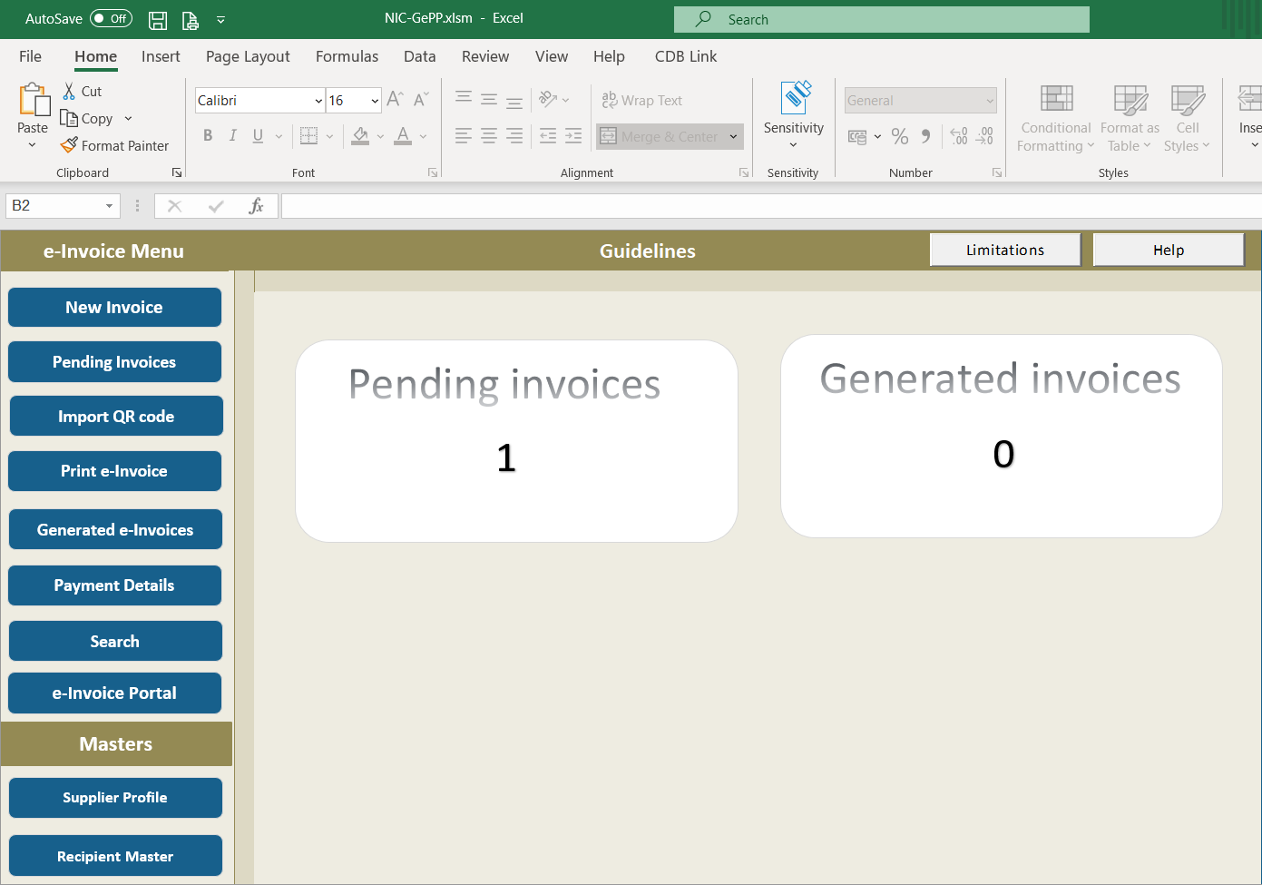
e-Invoicing
Modes of generation of e-Invoice
API based [directly from TP’s system to IRP, available for TP who’s TO > INR 500 Crores]
API Based through GSP / ASP
Bulk Generation Offline Utility Tool or GST eInvoice Preparing & Printing Tool [GePP]

Slide 15
e-Invoicing
Dynamic QR Code for B2C Invoices
  RP who’s TO > INR 500 Crores
  Mandatory from 1st Dec 2020⁺
  Relaxation from the payment of penalty for the period of 1st Dec2020 to 31st Mar2021 if complied from 1st April 2021⁺⁺
  Not required to uploaded to IRP & Shall be self generated by the TP
  Moto to promote digital payments
  Dynamic QR Code shall consist of
      GSTIN of the supplier
      Name of the recipient
      Invoice number, given by the supplier
      Date of invoice
      Invoice value
      The number of line items
      HSN Code of the main item
      Unique IRN
      Cross reference of the payment
Notes:
+ Notification 14/2020 as amended by Notification 71/2020
++ Notification 89/2020

Slide 16
e-Invoicing
Implementation Challenges
  Do an impact Analysis study
  Choose the right mode to handle e-Invoice
  Customization of ERP / Accounting system
  Check & update Masters like, Customer / Supplier, Material Master, GST Rate,
  Validate the mandatory Fields and format in which IRP accepts the data in line with e-Invoice Schema INV-01
  Train the staff, create an awareness [accuracy is important]
  Ensure supplier’s compliance else will lead to loss of ITC, take declaration, incorporate in Contract / PO / WO
  Store IRN / Acknowledgement No. / Acknowledgement Date for audit trails
  Continuity of the Transactions on cut off date [Goods sent on approval, Service provided not billed, goods not returned from Jobwork for more than 1-year, continuous supply of goods / services]

Slide 17
e-Invoicing
Common Errors
  2150 - Duplicate IRN
  2172 - For intra state transaction IGST amounts is not applicable [GST_on_IntraState_Supply]
  2176 - Invalid HSN code
  2182 - Taxable value of all items must be equal to total taxable value
  2189 - Invalid total Invoice Value [total of all line items + other charges – discount] +/- One]
  2193 - AssAmt value should be equal to (TotAmt - Discount) for HSN - {0} and Sl. No {1}
  2194 - Invalid total item value for HSN - {0} and Sl. No {1}
  2211 - Supplier and recipient GSTIN should not be the same
  2212 - The recipient GSTIN cannot be URP for supply type {0}
Notes:
Standard tax Rates are 0, 0.5, 1, 2, 3, 5, 12, 18, 28

Slide 18
e-Invoicing
Common Errors
  2227 - SGST and CGST Amounts should be equal for HSN - {0} and and Sl. No {1}
  2233 - Duplicate Serial number are not allowed in items level
  2234 - Invalid SGST and CGST Amounts for HSN - {0} and Sl. No {1}
  2235 - IGST amount given with HSN -{0} and Sl. No {1} is Invalid
  2240 - Invalid GST rate for HSN -{0} and Sl. No {1}
  2244 - Recipient pincode is mandatory for transaction -{0}
  2265 - Recipient GSTIN state code should be same as the sate code passed in recipient details
  2275 - Recipient PIN code should be 999999 for direct export
  3028 - GSTIN is not present in invoice system
  3029 - GSTIN is not active
Notes:
Standard tax Rates are 0, 0.5, 1, 2, 3, 5, 12, 18, 28

Slide 19
THANKS!!
Behind Every Successful Business Decision, There Is Always A CMA

