Slide 1
INCOME TAX RETURN (ITR) - 2

Slide 2
Coverage
Introduction
Heads of Income Tax
Exemptions
Deductions
ITR Forms
Introduction to Income Tax website
Filing of Income Tax Return (ITR)– 2
Important Links

Slide 3
Introduction
Why should we pay Taxes to the Government?
Types of Taxes
Direct Taxes
Indirect Tax

Slide 4
Who should file Income Tax Return?
Every Individual who has an Income exceeding the taxable limit has to file Income Tax return. The taxable limit for the Financial Year 2019-20 is
₹ 3 lakh for senior citizens (aged 60 years or more but less than 80 years),
₹ 5 lakh for super senior citizens (aged 80 years or more) and
₹ 2.5 lakh for others.
Other Conditions
Deposit of an aggregate of ₹1 Crore or more during the Previous Year in one or more current accounts.
Incurred an aggregate expenditure of ₹ 2 Lakh or more for travel to foreign country for self or others.
Incurred an aggregate of more amount exceeding ₹ 1 Lakh on electricity during the previous year.
Based on information received in Annual Information Return (AIR), Income Tax Department can ask individuals to file Income Tax return though they do not fall under the above.

Slide 5
Transactions tracked by Income Tax - AIR
Sl. No. | Nature and Value of transaction | Person responsible
1 | Cash deposits aggregating to 10 lakh rupees or more in a year in any savings account of a person maintained in that bank | Bank / Post Office
2 | Payments made by any person against bills raised in respect of a credit card issued to that person, aggregating to 2 lakh rupees or more in the year. | Bank / other company issuing Credit Card
3 | Receipt from any person of an amount of two lakh rupees or more for acquiring units of that fund (Mutual Fund). | A trustee of a Mutual Fund
4 | Receipt from any person of an amount of five lakh rupees or more for acquiring bonds or debentures issued by the Company or institution. | A Company or institution issuing bonds or debentures.
5 | Receipt from any person of an amount of one lakh rupees or more for acquiring shares issued by the Company through IPO. | A Company issuing shares through IPO
6 | Purchase or sale by any person of immoveable property valued at thirty lakh rupees or more. | Registrar / Sub Registrar
7 | Receipt from any person of an amount or amounts aggregating to five lakh rupees or more in a year for bonds issued by the Reserve Bank of India. | Reserve Bank of India

Slide 6
Advantages of filing Income Tax Return
Saves yourself from Penalty and Prosecution.
Proof for claiming compensation from certain authorities.
Used as a part of documentation for
Home / Personal / Vehicle Loans
Credit Cards
Insurance Policies
Visa processing
Option to Amend if needed (in future).
Carry forward Losses (if any).
Refund of excess paid Tax (if any).
To apply for certain Government tenders.

Slide 7
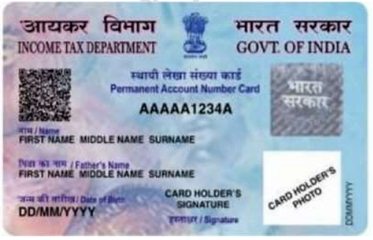
PAN Number
Unique Identification Number given to every tax payer.
Used as Identify proof in many places
Used as Login in Income Tax website
Declaration in Form 60 is to be done for doing major transactions if PAN is not available.
Applying for New PAN Card / Changes to PAN
Can be applied using form 49A
Can also be applied using Aadhaar Number and receive PAN within 10 mins. https://www.incometaxindiaefiling.gov.in/e-PAN/index.html?lang=eng
Existing PAN Card can be downloaded through NSDL / UTIITSL websites if existing PAN card is lost or destroyed by paying a nominal fees.
Changes to PAN card can be applied through online or offline modes
Online – NSDL / UTIITSL websites
TIN (Tax Information Network) Center

Slide 8
PAN Number
10 character length with alpha-numeric
Example AAAAA1234A
The first three characters of the code are three letters forming a sequence of alphabets letters from AAA to ZZZ
The fourth character identifies the type of holder of the card. Each holder type is uniquely defined by a letter from the list below:
A — Association of persons (AOP)
B — Body of individuals (BOI)
C — Company
F — Firm
G — Government
H — HUF [Hindu joint family | Hindu undivided family]
L — Local authority
J — Artificial juridical person
P — Individual or Person
T — Trust (AOP)
Fifth character of PAN represents the first character of the PAN holder's last name/surname in case of an individual. In case of non-individual PAN holders fifth character represents the first character of PAN holder's name.
Next four characters are sequential numbers running from 0001 to 9999.
Last character, i.e., the tenth character is an alphabetic check digit.
Individuals have a choice of select display name in PAN Card. Hence to fetch the Name of PAN Number using the below link
https://onlineservices.tin.egov-nsdl.com/etaxnew/tdsnontds.jsp

Slide 9
Heads of Income
Income from Salary (Above 50 lakhs)
Income from House Property (More than 2 Houses)
Income from Capital Gains – Short Term & Long Term
Profits or Gains from Business or Profession
Income from Other Sources

Slide 10
Income from Salary
Salary includes- Salary, Perquisite & Profit in lieu of Salary
Salary:
(i) wages;
(ii) any annuity or pension;
(iii) any gratuity;
(iv) any fees, commissions, perquisites or profits in lieu of or in addition to any salary or wages;
(v) any advance of salary;
(va) any payment received by an employee in respect of any period of leave not availed of by him;
(vi) the annual accretion to the balance at the credit of an employee participating in a recognised provident fund, to the extent to which it is chargeable to tax under rule 6 of Part A of the Fourth Schedule;
(vii) the aggregate of all sums that are comprised in the transferred balance as referred to in sub-rule (2) of rule 11 of Part A of the Fourth Schedule of an employee participating in a recognised provident fund, to the extent to which it is chargeable to tax under sub-rule (4) thereof; and
(viii) the contribution made by the Central Government or any other employer in the previous year, to the account of an employee under a pension scheme referred to in section 80CCD;

Slide 11
Income from Salary contd.
"perquisite" includes —(i) the value of rent-free accommodation provided to the assessee by his employer;
(ii) the value of any concession in the matter of rent respecting any accommodation provided to the assessee by his employer;
(iii) the value of any benefit or amenity granted or provided free of cost or at concessional rate in any of the following cases—
(a) by a company to an employee who is a director thereof;
(b) by a company to an employee being a person who has a substantial interest in the company;
(c) by any employer (including a company) to an employee to whom the provisions of paragraphs (a) and (b) of this sub-clause do not apply and whose income under the head "Salaries"
(iv) any sum paid by the employer in respect of any obligation which, but for such payment, would have been payable by the assessee;

Slide 12
Income from Salary
(v) any sum payable by the employer, whether directly or through a fund, other than a recognised provident fund or an approved superannuation fund or a Deposit-linked Insurance Fund established under section 3G of the Coal Mines Provident Fund and Miscellaneous Provisions Act, 1948 (46 of 1948), or, as the case may be, section 6C of the Employees' Provident Funds and Miscellaneous Provisions Act, 1952 (19 of 1952), to effect an assurance on the life of the assessee or to effect a contract for an annuity;
(vi) the value of any specified security or sweat equity shares allotted or transferred, directly or indirectly, by the employer, or former employer, free of cost or at concessional rate to the assessee.
(vii) any contribution to an approved superannuation fund by the employer in respect of the assessee, to the extent it exceeds one lakh and fifty thousand rupees; and
(viii) the value of any other fringe benefit or amenity as may be prescribed:]
In case income exceeds 50 lakhs and above Assessee should declare Assets and Liabilities in Balance sheet.

Slide 13
Allowances in Salary
House Rent Allowance:
Least of the below is exempt from Tax.
Actual HRA received
40% of Salary (50% in house is located in 4 Metros - New Delhi, Mumbai, Chennai or Kolkata)
Actual Rent paid
Excess of Rent paid over 10% of salary (Rent paid – 10% of salary)
(Salary= Basic + DA (if part of retirement benefit) + Turnover based Commission)
Rental receipt is required if the rent paid is more than Rs. 3,000 per month; and PAN Number of Land Lord is mandatory if Rent paid is more than 1 Lakh per annum (8,333 per month).
Rent receipt with revenue stamp (Except for Karnataka state ) is compulsory.
No exemption is allowed for any amount paid towards house / apartment maintenance expenses paid either to the landlord or to house / apartment associations.

Slide 14
Leave Travel Allowance
Can be claimed twice in a block of 4 years.
The current block is 2018 to 2021.
If journey by Air –Economy class fare of the national carrier (Air India) by shortest route or the amount spent whichever is less.
If journey by Rail – AC First class fare by shortest route or the amount spent whichever is less
Where places of origin of Journey and destination are connected by rail & journey is performed by any other mode of transport- AC First class fare by shortest route or the amount spent whichever is less.
Where places of origin of Journey and destination are not connected by rail,
a) Recognized public transport exists- First class or deluxe class fare by the shortest route or the amount spent, whichever is less.
b) No recognized public transport exists - AC First class rail fare by Shortest route or the amount spent whichever is less

Slide 15
LTA Rules
Employers need to collect and scrutinize the proof of travel (ticket etc.)
limited to the actual expenses incurred
Any Leave encashed for the purpose of Leave travel or home travel concession is taxable.
Foreign Travel – The exemption is not available in case of Foreign Travel
The Exemption is not available to more than 2 surviving children of an individual born after 1.10.1998. However, this restriction is not there in respect of children born before 1.10.1998.

Slide 16
List of benefits available to Salaried Persons
https://www.incometaxindia.gov.in/_layouts/15/dit/mobile/viewer.aspx?path=https://www.incometaxindia.gov.in/charts%20%20tables/list_of_benefits_available_to_a_salaried_person_final.htm&k=&IsDlg=0

Slide 17
Income from Salary
Calculation of Income from Salary
Basic Salary | XXXX
Add
Bonus, Commission, etc | XXXX
Allowances | XXXX
Perquisites | XXXX
Retirement Benefits | XXXX
Gross Salary | XXXX
Less
Allowances to the extent Exempt | XXXX
Net Salary | XXXX
Less
Standard Deduction | XXXX
Professional Tax | XXXX
Income Chargeable under the head Salary | XXXX

Slide 18
Salary – Other Points to be considered
Company Changed during the year
If the individual works in multiple companies during the year and receives multiple Form 16s.
Income of all the Form 16s should be aggregated while filing Income Tax return.
Deductions like Standard Deduction are to be applied only once.
Employee Vs Consultant
In case TDS is deducted as per section 194C or 194J, it should not be considered as Salary Income, but to be considered as Business Income.

Slide 19
Income from House Property
Income received from renting of House is taxable under ‘Income from House Property’.
House should be in the name of the asseessee.
If asseessee has multiple own houses, ITR 1 is not allowed. ITR2 or other ITRs have to be used.
As per the recent amendment, an assessee can use 2 houses as Self Occupied. One for his family (spouse and children and other for parents. Similarly, one for him, and others for his children living in a different city).
If house is jointly owned, share of the house property is taxable.

Slide 20
House Property contd…
Calculation of Income from House Property
 | Self Occupied | Let out
Gross Rent received / Receivable during the year |  | XXXX
Less: Municipal / Property Tax / Tax paid to Local authority |  | XXXX
Annual Value |  | XXXX
Less: 30% of Annual Value towards repairs |  | XXXX
Less: Interest on borrowed Capital | XXXX | XXXX
Add: Arrears of PY received in current Year less 30% |  | XXXX
Income Chargeable under the hear Income from House Property | XXXX | XXXX
Refer the below Deductions
80C,80EE,80EEA.
*Loan taken for purchase of plot / site not eligible.
*Maximum house property loss can be claimed Rs 2,00,000

Slide 21

Income from Capital Gains
Capital Gains constitute
Gain / Loss on Sale of Shares, Mutual Funds, Bonds, and other securities
Gain / Loss on Sale of Land, Buildings, etc.,
Classification of Capital Gains
Short Term Capital Gains
Long Term Capital Gains

Slide 22
Capital Gains contd…
Capital gains are generally included in taxable income, but in most cases, are taxed at a lower rate. ... Short-term capital gains are taxed as ordinary income at rates up to 37 percent; long-term gains are taxed at lower rates, up to 20 percent.
Capital gains tax is only paid on realized gains after the asset is sold
Capital gains treatment only applies to “capital assets” such as stocks, bonds, jewelry, coin collections, and real estate property
There are two types of capital gains Short term capital gains and Long term capital gains
The IRS taxes all capital gains but has different tax approaches for long-term gains vs. short-term gains
Taxpayers can use strategies to offset capital gains with capital losses in order to lower their capital gains taxes
Taxable capital gains for the year are reduced by the amount of capital losses incurred in that year. A capital loss is when you sell an investment for less than you purchased it for. The total of long-term capital gains minus any capital losses is known as the "net capital gain," which is the amount capital gains taxes are assessed on

Slide 23
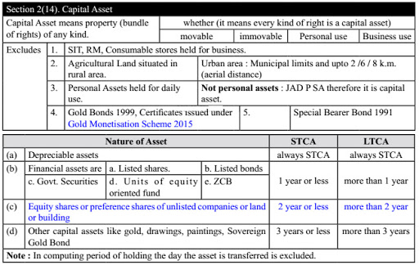
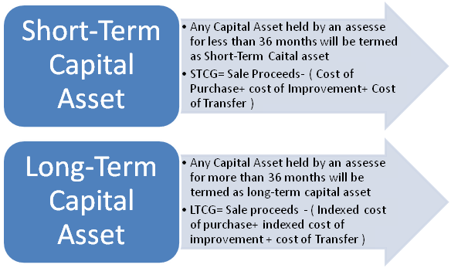
Capital Gains contd…

Slide 24
Capital Gains contd…
Short Term Capital Gains
Short-term capital gains can be explained as the profits that have been generated through the sale of capital assets that were held for less than 36 months.
If the gains generated by shares is short-term capital gain or not is decided by its holding period.
Assets like shares that are listed on a recognised stock exchange and has been held for less than 12 months, are treated as short-term capitals. The proceeds earned through them are treated as short-term capital gains(Such shares include Government securities, debentures, equity-oriented Mutual Funds, UTI units and Zero-Coupon Bonds).
To determine the STCG tax rate on shares easily, the gains generated through them are divided into two categories –
Short-term capital gains that fall under Section 111A.
Short-term capital gains that fall do not fall under Section 111A.
A rate of 15% will be charged as income tax on short-term capital gain on shares that fall under this category. They would further attract surcharge and cess where ever applicable.
Taxable capital gains for the year are reduced by the amount of capital losses incurred in that year. A capital loss is when you sell an investment for less than you purchased it for. The total of long-term capital gains minus any capital losses is known as the "net capital gain," which is the amount capital gains taxes are assessed on

Slide 25
Capital Gains contd…
Long Term capital Gains
If any asset held for more than 36 months is known as long term Capital Asset.
If any Security or units or Zero coupon bond is held for more than 1year.
Cost of indexation is only applicable for Long term Capital Gains.
In case of Long Term Capital Gains are taxable at 20% under section 112.
This is an exception to the above section (i.e) section 112. Under section 112A tax on LTCG on transfer of equity shares or equity oriented units or units of business trust in excess of 1lakh shall be taxable @ 10% (If certain conditions are satisified).
Deduction under chapter VI A are not allowed against LTCG u/s 112A.
Rebate u/s 87A and also indexation benefit is not available against LTCG u/s 112A.

Slide 26
Income from Other Sources
Any income which is not taxable under salary, house property, PGBP, Capital gains that income shall be taxable under income from Other sources.
Rent from letting out of Plant, Machinery and furniture.
Dividend on shares.
Director’s sitting fees.
Agricultural income from land located outside India.
Salary of MLA/MP/MLC.
Interest on income tax department refund.
Winning from lotteries, puzzels ,card games and Horse races,etc.
Income from Royality.
Income on any investment.

Slide 27
Other Sources contd…
Interest from Savings Account*
Interest from Deposits (Bank / Post Office /Cooperative Society)*
Interest from Income Tax Refund
Family Pension
Others – Depends upon Main / ancillary activity
*Applicable Deductions
80TTA Deduction on Savings Account Interest
80TTB Interest on deposits in case of Resident senior citizens

Slide 28
Set off and Carry forward of Losses
Types of Losses | Intra Head Adjustment | Inter Head Adjustment/ Set off | Carry Forwarded | Brought Forward Losses to be Set Off against | Time Limit to carry forward | Mandatory filing of return of income
Loss from House Property | Allowed | Allowed, upto Maximum of Rs. 2,00,000 from AY 2018-19 | Allowed | Income from House Property | 8 Years | No
Loss from Speculative Business | Only against Speculative business income | Not Allowed | Allowed | Income from Speculative Business | 4 Years | Yes
Loss from Specified Business | Only against Specified business income | Not Allowed | Allowed | Income from Specified Business | Unlimited | Yes
Other Business Losses | Allowed | Allowed, except from Salary Income | Allowed | Income from Normal Business |  | Yes
Short Term Capital Loss | Only against STCG & LTCG | Not Allowed | Allowed | STCG & LTCG | 8 Years | Yes
Long Term Capital Loss | Only against LTCG | Not Allowed | Allowed | LTCG | 8 Years | Yes
Loss from Owing & Maintaining Race Horses | Only against income from Owing & Maintaining Race Horses | Not Allowed | Allowed | Income from Owing & Maintaining Race Horses | 4 Years | Yes
Other Loss under ‘Other Sources’ | Allowed | Allowed | Not Allowed | N/A | N/A | N/A
Loss from Salary | Loss from Salary Not Possible

Slide 29
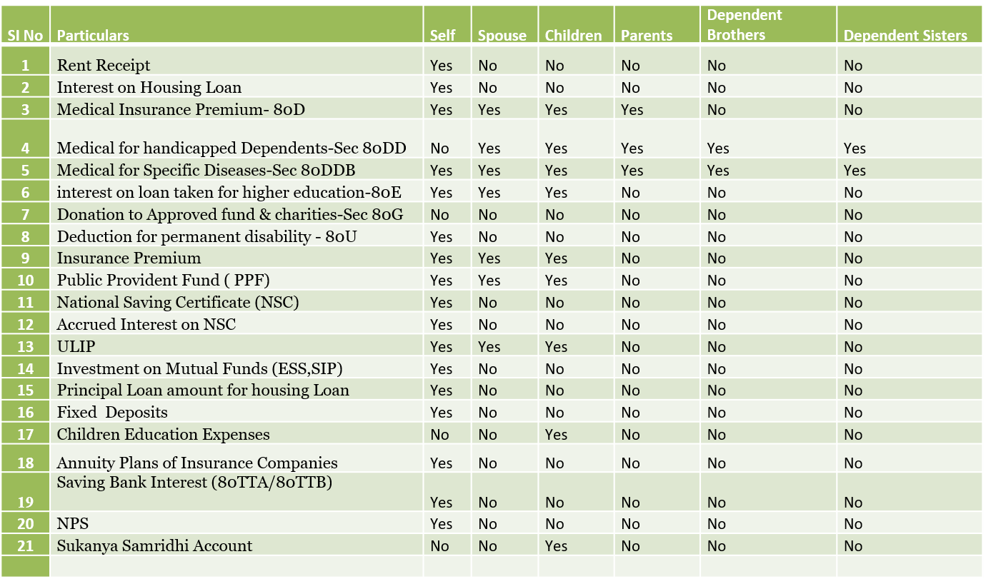
Definition of Family in various deductions

Slide 30

Deductions under Chapter VI-A
Section 80C
Maximum Limit- Rs.1,50,000/-
Different Investment in this section includes
Life Insurance premium
EPF-Employee contribution can be claimed for deduction.
Public Provident Fund
National Savings Certificate (NSC).
Sukanya Samriddhi Account
ELSS or Tax Saving Mutual Funds
Senior Citizen Savings Scheme
5-Years Post Office or Bank Deposits.
Tuition fee of kids.
Principal payment towards home loan.
Stamp duty and registration cost of the house.

Slide 31
Deductions under Chapter VI-A
Section 80CCC
Deduction under Sec.80CCC is available only for individuals. Contribution to an annuity plan of the LIC of India or any other insurer for receiving the pension. Do remember that the amount should be paid or deposited out of income chargeable to tax.
Note:- this is also the part of the combined limit of Rs.1.5 lakh available under Sec.80C Sec.80CCC, and Sec.80CCD(1)

Slide 32
Deductions under Chapter VI-A
NPS Tax Benefit-Section 80CCD1
An individual’s maximum 20% of annual income (Earlier it was 10% but after Budget 2017, it increased to 20%) or an employees (10% of Basic+DA) contribution will be eligible for deduction.
Note:- this is also the part of the combined limit of Rs.1.5 lakh available under Sec.80C Sec.80CCC, and Sec.80CCD(1)
NPS Tax Benefit-Section 80CCD2
There is a misconception among many that there is no upper limit for this section. However, the limit is least of 3 conditions.
1) Amount contributed by an employer,
2) 10% of Basic+DA and
3) Gross Total Income.
This is additional deduction which will not form the part of Sec.80C limit.
The deduction under this section will not be eligible for self-employed.

Slide 33
Deductions under Chapter VI-A
NPS Tax Benefit-Section 80CCD(1B)
This is the additional tax benefit of up to Rs.50,000 eligible for income tax deduction and was introduced in the Budget 2015, One can avail the benefit of this Sect.80CCD (1B) from FY 2015-16.
Both self-employed and employees are eligible for availing this deduction.
This is over and above Sec.80CCD (1).

Slide 34
Deductions under Chapter VI-A
Section 80D – Deduction in respect of Health insurance Premium
Deduction under this section is available if you satisfy the following conditions.
The taxpayer should be an individual (resident, NRI or Foreign Citizen) or HUF.
Payment should be made out of income chargeable to tax.
Changes from Budget 2018-
In Budget 2018, the maximum tax deduction limit for senior citizens under Sec.80D is raised to Rs.50,000. The earlier limit was Rs.30,000.
In case of single premium health insurance policies having a cover of more than one year, it is proposed that the deduction shall be allowed on a proportionate basis for the number of years for which health insurance cover is provided, subject to the specified monetary limit.

Slide 35
Deductions under Chapter VI-A
Section 80DD – Maintenance including Medical Treatment of Dependant who is a person with disability
A resident individual or HUF is allowed to claim the deduction
If incurred an expenditure for medical treatment, training, and rehabilitation of dependent relative (being a person with a disability).
Can be claimed only when deposited or paid for any approved scheme of LIC (or any other insurance) or UTI for the maintenance of such dependent relative.
Fixed deduction of Rs.75,000
Higher deduction of Rs.1,25,000 is available if such dependent relative is suffering from severe disability
NOTE:-Refer to section 80U if the person himself is with Disability

Slide 36
Deductions under Chapter VI-A
Section 80DDB – Medical Treatment of specified Disease
An Individual’s of HUFs expenses actually paid for medical treatment of specified diseases and ailments subject to certain conditions can be claimed under this section.
The maximum deduction is Rs. 40,000. This can also be claimed on behalf of the dependents. The tax deduction limit under this section for Senior Citizens and very Senior Citizens (above 80 years) is now revised to Rs 1,00,000.
With effect from the assessment year 2016-17, the taxpayer shall be required to obtain a prescription from a specialist doctor (not necessarily from a doctor working in a Government hospital) for availing this deduction.
Can claim the deduction for the medical treatment of self, spouse, children, parents brothers, and sisters of the individual.

Slide 37
Deductions under Chapter VI-A
The ailments covered under this section are as below:
Section 80DDB
# Neurological Diseases where the disability level has been certified to be of 40% and above;
(a) Dementia (b) Dystonia Musculorum Deformans (c) Motor Neuron Disease (d) Ataxia (e) Chorea (f) Hemiballismus (g) Aphasia (h) Parkinson’s Disease
# Malignant Cancers
# Full Blown Acquired Immuno-Deficiency Syndrome (AIDS) ;
# Chronic Renal Failure
# Hematological disorders
a) Hemophilia
b) Thalassaemia

Slide 38
Deductions under Chapter VI-A
Section 80E – Interest on Loan taken for higher Education
If the loan is taken by an individual for any study in India or outside India, then they can claim the deduction.
The interest part of the loan on such education loan can be claimed for deduction for pursuing individual’s own education or for the education of his relatives (Spouse, children or any student for whom the individual is legal guardian).
The entire interest is deductible in the year in which the individual starts to pay interest on the loan and subsequent 7 years or until interest is paid in full (i.e for total 8 years).
NOTE:-Interest should be paid out of the income of chargeable to tax.

Slide 39
Deductions under Chapter VI-A
Section 80EEA - Deduction in respect of interest on loan taken for certain House Property
INDIVIDUAL SHOULD NOT BE ELIGIBLE TO CLAIM DEDUCTION UNDER SECTION 80E.
THE DEDUCTION SHALL NOT EXCED RS 1,50,000.
THE DEDUCTION SHALL BE ALLOWED IN COMPUTING THE TOTAL INCOME OF THE INDIVIDUALFOR THE ASSESSMENT YEAR
BEGINNING ON THE 1ST DAY OF APRIL 2020 AND SUBSEQUENT ASSESSMENT YEARS.
Section 80EEB – Deduction in respect of purchase of Electric Vehicle
DEDUCTION SHALL BE CLAIMED ON LOAN TAKEN FROM THE FINANCIAL INSTITUTIONS FOR THE PURCHASE OF ELECTRIC
VEHICLE.
THE DEDUCTION SHALL NOT EXCED RS 1,50,000.
THE DEDUCTION SHALL BE SUBJECT TO THE CONDITION THAT THE LOAN SANCTIONED BY THE FINANCIAL INSTITUTION
SHALL BE DURING FROM APRIL 1ST 2019 TO MARCH 31ST 2023.

Slide 40
Deductions under Chapter VI-A
Section 80G – Donations to funds, Certain charitable Institutions etc.,
Donations to certain approved funds, trusts, charitable institutions/donations for renovation or repairs of notified temples, etc can be claimed as a deduction under this section.
This deduction can only be claimed when the contribution made by cheque or draft or in cash. In-kind contributions like food material, clothes, medicines etc. do not qualify for deduction under this section.
The donations made to any Political party can be claimed under section 80GGC.
From FY 2017-18, the limit of deduction under section 80G / 80GGC for donations made in cash is reduced from current Rs 10,000 to Rs 2,000 only.

Slide 41
Deductions under Chapter VI-A
Section 80GG – Rent Paid
DEDUCTION IS TO BE CLAIMED ON THE RENT PAID BY THE ASSESSEE.
ASSESSEE SHALL NOT RECEIVE ANY INCOME UNDER CLAUSE(13A) OF SECTION 10 i.e HOSE RENT ALLOWANCE.
AMOUNT OF DEDUCTION SHALL BE THE LEAST OF THE FOLLOWING
RENT PAID - 10% OF TOTAL INCOME
RS. 5000 PER MONTH
25%OF THE TOTAL INCOME

Slide 42
Deductions under Chapter VI-A
Section 80GGA – Donation to scientific Research and Rural Development
DEDUCTION SHALL BE AVAILED BY THE ASSESSEE UNDER THIS SECTION IN RESPECT OF CERTAIN DONATIONS
FOR SCIENTIFIC RESEARCH OR RURAL DEVELOPMENT.
THE AMOUNT PAID BY THE ASSESSEE TO A RESEARCH ASSOCIATION,UNIVERSITY,COLLEGE,INSTITUTION SHALL
BE APPROVED FOR THE PURPOSR OF SUB SECTION (1) OD SECTION 35.
Section 80GGC – Donation to Political Party
DEDUCTION UNDER THIS SECTION SHALL BE AVAILED BY THE ASSESSEE FOR THE CONTRIBUTION
MADE BY HIN TO ANY POLITICAL PARTY.
NO DEDUCTION SHALL BE ALLOWED IN THIS SECTION FOR ANY SUM CONTRIBUTED BY WAY OF CASH.

Slide 43
Deductions under Chapter VI-A
Section 80TTA – Interest on Savings Account in case of other than Senior Citizens
DEDUCTION IN RESPECT OF INTEREST EARNED ON DEPOSITS IN SAVINGS ACCOUNT WITH
BANK or COOPERATIVE SOCIETY or POST OFFICE.
ASSESSEE SHALL BE INDIVIDUAL(NOT BEING A SENIOR CITIZEN) or HINDU UNDIVIDED FAMILY.
THE AMOUNT OF DEDUCTION SHALL NOT EXCEED RS.10,000.
Section 80TTB – Interest on deposits in case of Resident senior Citizens
ASSESSEE CLAIMING DEDUCTION UNDER THIS SECTION MUST BE A SENIOR CITIZEN.
DEDUCTION SHALL BE ALLOWED ON THE INTEREST EARNED ON DEPOSITS WITH BANK or
COOPERATIVE SOCIETY or POST OFFICE.
THE AMOUNT OF DEDUCTION SHALL NOT EXCEED RS.50,000.

Slide 44
Deductions under Chapter VI-A
Section 80U – In Case of person with Disability
To claim tax benefits under Sec.80U, the taxpayer should be an individual and resident of India.
If he is suffering from 40% or more than 40% of any disability, then he can claim a tax deduction.
You can claim the fixed deduction of Rs.75,000 . a higher deduction of Rs.1,25,000 is allowed in respect of a person with a severe disability (i.e. having a disability of 80% or above).
The assessee claiming deduction under this section shall furnish a copy of certificate issued by the medical authority in such form as may be prescribed.

Slide 45
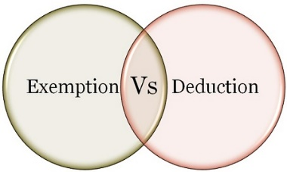
What is the difference between Exemption and deduction?
If an income is exempt from tax, then it is not included in the computation of income. However, the deduction is given from income chargeable to tax.
Exempt income will never exceed the amount of income. However, the deduct may be less than or equal to or more than the amount of income.
Exemption : Section 10 deals with exemptions
Deduction: Section 80 C to 80 U deals with deduction

Slide 46
Documentation mostly asked by Companies from employees
Documents to be maintained / Submitted to the Employer
Exemptions & Deductions | Documentation
Exemptions under section 10 & 17
HRA Exemption (Sec 10 (13A)) | Original House rent payment receipt with land lord's PAN
Sec 24
House/property income or loss (enter loss as negative)
Interest on housing loan (for tax exemption) | Loan payment schedule and receipt
Deductions under Chapter VI-A
Medical Insurance Premium / health check (sec 80D) | Premium Receipt
Medical Insurance Premium for parents (sec 80D) | Premium Receipt
Medical for handicapped dependents (Sec 80DD) | Certificate of disability -Form 10-IA format
Medical for specified diseases (Sec 80DDB) | Premium Receipt & medical expenses incurred for treatment can be submitted to claim exemptions U/Sec.80DDB
Higher Education Loan Interest Repayment (Sec 80E) | Copy of loan repayment schedule and receipt
Deduction for permanent disability (80U) | Certificate of disability -Form 10-IA format
Interest on Saving Bank Account 80TTA/80TTB | Interest Certificate from Bank
Deductions under Chapter VI (sec 80C)
Pension scheme (sec 80C) | Premium Receipt
NSC (sec 80C) | Copy of NSC
Public Provident Fund & Sukanya Samridhi Account | Photocopy of respective documents
Employees Provident Fund & Voluntary PF (sec 80C) | Will be exempted based on the deducted amount in pay slips.
Children's Education Tuition Fees (sec 80C) | Receipt of fees payment
New Pension Scheme | The print out of the Transaction Statement as document for claiming Tax benefit.
Housing loan principal repayment, registration/stamp duty (sec 80C) | Copy of loan repayment schedule and receipt
Insurance premium & others (MF, ULIP, FD, etc.) (sec 80C) | Receipt of payment and copy of investment documentation

Slide 47
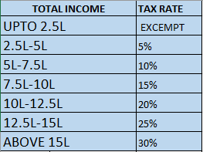
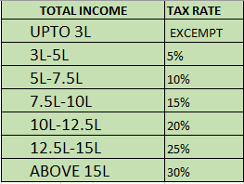
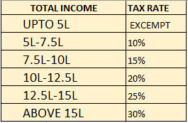
Income Tax Slabs
INDIVIDUAL
UPTO 60 YRS
60-80 YRS
MORE THAN 80 YRS

Slide 48
OTHER POINTS RELATING TO SLAB RATES
Health And Education Cess 4%
Surcharge of 10% on Rs. 50 Lakhs to Rs. 1 crore Income earners
Surcharge of 15% on Rs. 1 Cr. Plus income earners
Tax credit of Rs.12,500/- for income upto Rs. 5 Lakhs u/s 87A
Standard deduction of Rs. 50,000/-for Salaried and Pensioners
There are no separate slab for male & Female

Slide 49
Rebate under Section 87A
The tax rebate of Rs.12,500 for individuals with income of up to Rs 5 Lakh has been proposed in Budget AY- 2020-21.
To avail this benefit, there are certain conditions and they are as below.
The taxpayer must be a resident individual.

Slide 50
Tax Deducted at Source (TDS)
Introduction to TDS

Slide 51
Tax Deducted at Source (TDS) Rates
Particulars | TDS Rate (%) | TDS Rates from 01.04.2020 to 13.05.2020 | TDS Rates from 14.05.2020 to 31.03.2021
Section 192: Payment of salary | Normal Slab Rate | Normal Slab Rate | Normal Slab Rate
Section 192A: Premature withdrawal from EPF | 10 | 10 | 10
Section 193: Interest on securities. a) any debentures or securities for money issued by or on behalf of any local authority or a corporation established by a Central, State or Provincial Act; b) any debentures issued by a company where such debentures are listed on a recognized stock exchange in accordance with the Securities Contracts (Regulation) Act, 1956 (42 of 1956) and any rules made thereunder; c) any security of the Central or State Government; d) interest on any other security | 10 | 10 | 7.5
Section 194: Dividend other than the dividend as referred to in Section 115-O | 10 | 10 | 7.5
Section 194A: Income by way of interest other than “Interest on securities” | 10 | 10 | 7.5
w.e.f 1st April 2018, interest up to Rs. 50,000 earned by senior citizens on:
– deposit with banks
– deposit with post offices
– fixed deposits schemes
– recurring deposit schemes
will be exempt from TDS
w.e.f 1st April 2019, TDS on the interest income from post offices and bank deposits have increased up to Rs. 40,000 from the present limit of Rs. 10,000.

Slide 52
Tax Deducted at Source (TDS) Rates
Particulars | TDS Rate (%) | TDS Rates from 01.04.2020 to 13.05.2020 | TDS Rates from 14.05.2020 to 31.03.2021
Section 194B: Income by way of winnings from lotteries, crossword puzzles, card games and other games of any sort | 30 | 30 | 30
Section 194BB: Income by way of winnings from horse races | 30 | 30 | 30
Section 194C: Payment to contractor/sub-contractors.
a) HUF/Individuals | 1 | 1 | 0.75
b) Others | 2 | 2 | 1.5
Section 194D: Insurance commission | 5 | 5 | 3.75
 | ( w.e.f 01.06.2016) (10% from 01.04.2015 to 31.05.2016
Section 194DA: Payment in respect of a life insurance policy | 5 | 5 | 3.75
 | (w.e.f 01.09.2015)
 | 1
 | ( w.e.f 01.06.2016)
 | (2% from 01.04.2015 to 31.05.2016)
Section 194EE: Payment in respect of deposit under National Savings scheme | 10 | 10 | 7.5
 | (w.e.f 01.06.2016)
 | (20% from 01.04.2015 to 31.05.2016)
Section 194F: Payment on account of repurchase of a unit by Mutual Fund or Unit Trust of India | 20 | 20 | 15
Section 194G: Commission, etc., on the sale of lottery tickets | 5 | 5 | 3.75
 | (w.e.f 01.06.2016)
 | (10 % from 01.04.2015 to 31.05.2016)

Slide 53
Tax Deducted at Source (TDS) Rates
Particulars | TDS Rate (%) | TDS Rates from 01.04.2020 to 13.05.2020 | TDS Rates from 14.05.2020 to 31.03.2021
Section 194H: Commission or brokerage | 5 | 5 | 3.75
 | (w.e.f 01.06.2016)
 | (10 % from 01.04.2015 to 31.05.2016)
Section 194-I: Rent on a) Plant & Machinery | (a) 2 | 2 | 1.5
b) Land or building or furniture or fitting | (b) 10 | 10 | 7.5
W.e.f 1st April 2019, TDS limit for deduction of tax on rent is increased to Rs. 2,40,000 p.a from Rs.1,80,000 p.a.
Section 194-IA: Payment on transfer of certain immovable property other than agricultural land | 1 | 1 | 0.75
Section 194 – IB: Rent payable by an individual or HUF not covered u/s. 194I (w.e.f from 01.06.2017) |  | 5 | 3.75
Section 194 – IC: Payment under Joint Development Agreements to Individual/HUF | 5 | 10 | 7.5
(w.e.f. 01.04.2017) | (w.e.f from 01.06.2017)
 | (If payment of Rent exceeds Rs. 50,000/- per month. )
 | 10

Slide 54
Tax Deducted at Source (TDS) Rates
Particulars | TDS Rate (%) | TDS Rates from 01.04.2020 to 13.05.2020 | TDS Rates from 14.05.2020 to 31.03.2021
Section 194J: Any sum paid by way of: a. Fee for professional services (b) Remuneration/fee/commission to a director ore) (c) For not carrying out any activity in relation to any business. (d) For not sharing any know-how, patent, copyright etc. | 10 | 10 | 7.5
(e) Fee for technical services and (f) Royalty towards the sale or distribution or exhibition of cinematographic films. | 2 | 2 | 1.5
Section 194 K:Payment of any income in respect of | 10 | 10 | 7.5
(a) units of a mutual fund as per section 10(23D); or
(b) the units from the administrator; or
(c) units from specified company
(w.e.f. 01.04.2020)
Section 194LA: Payment of compensation on acquisition of certain immovable property | 10 | 10 | 7.5
Section 194LBA: Certain income distributed by a business trust to its unit holder | 10 | 10 | 7.5
Section 194LBB: Certain income paid by an investment fund to its investors | 10 | 10 | 7.5

Slide 55
Tax Deducted at Source (TDS) Rates
Particulars | TDS Rate (%) | TDS Rates from 01.04.2020 to 13.05.2020 | TDS Rates from 14.05.2020 to 31.03.2021
Section 194 LBC:Income in respect of investment in securitization fund | 25 | 25 | 18.75
1. Individual and HUF | 30 | 30 | 22.5
2. Others
Section 194M: Certain payments by Individual/HUF (Limit – 50 Lakhs) | 5 | 5 | 3.75
Section 194N:Payment of certain amount in cash (Limit 1 Crore) | 2 | 2 | 2
Section 194N:Payment of certain amount in cash (first proviso of section 194N)if- | – | 2 | 2
– The amount is more than Rs.20 lakh but up to Rs. 1 crore |  | 5 | 5
– The amount exceeds Rs. 1 crore (Applicable from 01.07.2020)
Section 194O:Applicable for e-commerce operator for the sale of goods or provision of services facilitated by it through its digital or electronic facility or platform (Applicable from 01.10.2020) | 1 | – | 0.75
Any Other Income | 10 | 10 | 10

Slide 56
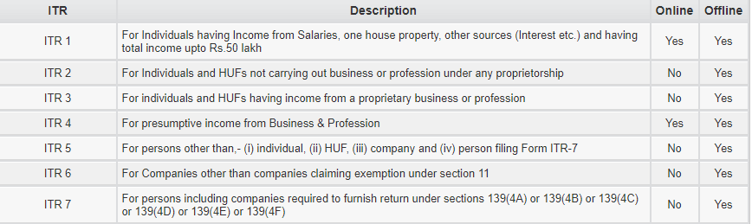
ITR Forms

Slide 57
ITR 1 (Sahaj) vs ITR2
Income | ITR1 | ITR2
Income more than 50 Lakhs | X | ü
More than 1 House | X | ü
Capital Gains Example Shares, Mutual Funds, Sale of Property | X | ü
Exempt income greater than 5K | X | ü
For HUF | X | ü
Director in a Company | X | ü
Having foreign Assets / Income | X | ü
Winnings from Lottery and Income from Race Horses | X | ü

Slide 58
Ways to file Income Tax return
Income Tax website
Online
Offline through xml
Softwares – Genius, Host books, eztax, Winman etc.,
Websites filing ITRs – Clear Tax, myITreturn, Taxspanner, Taxsmile.com, H&R Block, Filing Mantra, etc.,

Slide 59
Types of Returns & Last Dates
Mandatory and Voluntary Return u/s 139(1)
Filing Income Tax return in case of Loss u/s 139(3)
Filing of Income Tax return after due date u/s 139(4)
Revised Income Tax return u/s 139(5)
Defective Return u/s 139(9)

Slide 60
ITR Filing Procedures- Sec 139
Section 139 consists of various subsections which deals with different types of Income tax returns. These subsections are as follows:
Section 139(1) – Mandatory and Voluntary Returns
Section 139(1) deals with the mandatory and voluntary filing of income tax returns by the taxpayer:
Mandatory Return
The following taxpayers are required to file a mandatory income tax return are listed below:
Any private, public, foreign, domestic company.
Any Limited Liability Partnership (LLP) and unlimited liability partnership.
Any total individual income is exceeding the exemption limit.

Slide 61
ITR Filing- Sec 139
Section 139(3) – Filing Income Tax Return in Case of Loss
Section 139(3) deal with tax returns in case of loss incurred in a company or firm.
If losses are incurred in any income under the head “Profits and Gains of Business and Profession” or the head “Capital Gains”, then income tax return must be filed before the due date mentioned under section 139(1).
The following heads mentioned below will not be affected by the delayed filing of income tax return:
Any loss occurred under the heads of “House and residential property”.
Any loss occurred by the unabsorbed property as mentioned under section 139(3).

Slide 62
ITR Filing- Sec 139
Section 139(4) – Late Filing Income Tax Return
Section 139(4) deals with late filing of income tax return. Its provisions have been described below:
The taxpayer can file late income tax returns before end of the Assessment year or completion of Assessment u/s144.
The tax payer with late filing of income tax returns may incur a fee of Rs 5,000 as specified under Section 234F upto Dec and Rs10000 after Dec’19 ( maximum Rs.1000 for total Income below Rs.5.00 lakh).
However, no penalty shall be levied on returns that were not required to be mandatorily filed as per Section 139(1).

Slide 63
ITR Filing- Sec 139
Section 139(5) – Revised Return
Section 139(5) deals with revised income tax return in case of any mistakes while filing the original income tax returns. The following are its provisions:
If the original or initial income tax return was filed by the assessee or entity as per Section 139(1) , he/she can file a revised income tax return before end of the Assessment year of relevance or prior to the completion or conclusion of assessment, depending on which takes place sooner.
A late income tax return cannot be revised. However, any loss return that was filed within the prescribed due date as mentioned in Section 139(1) can be revised.

Slide 64
ITR Filing- Sec 139
Section 139(9) – Defective Returns
As per the provisions under section 139(9), income tax return is defective when specific documents are not attached with the income tax return. In case the return is considered defective by the tax officer, then the concerned tax payer will be informed by him and be allowed to rectify the defect within 15 days starting from the day of intimation.
In the request from tax payer through an application, the allowable period could be extended. The assessing officer intimates the tax payer about the defect through a simple letter.

Slide 65
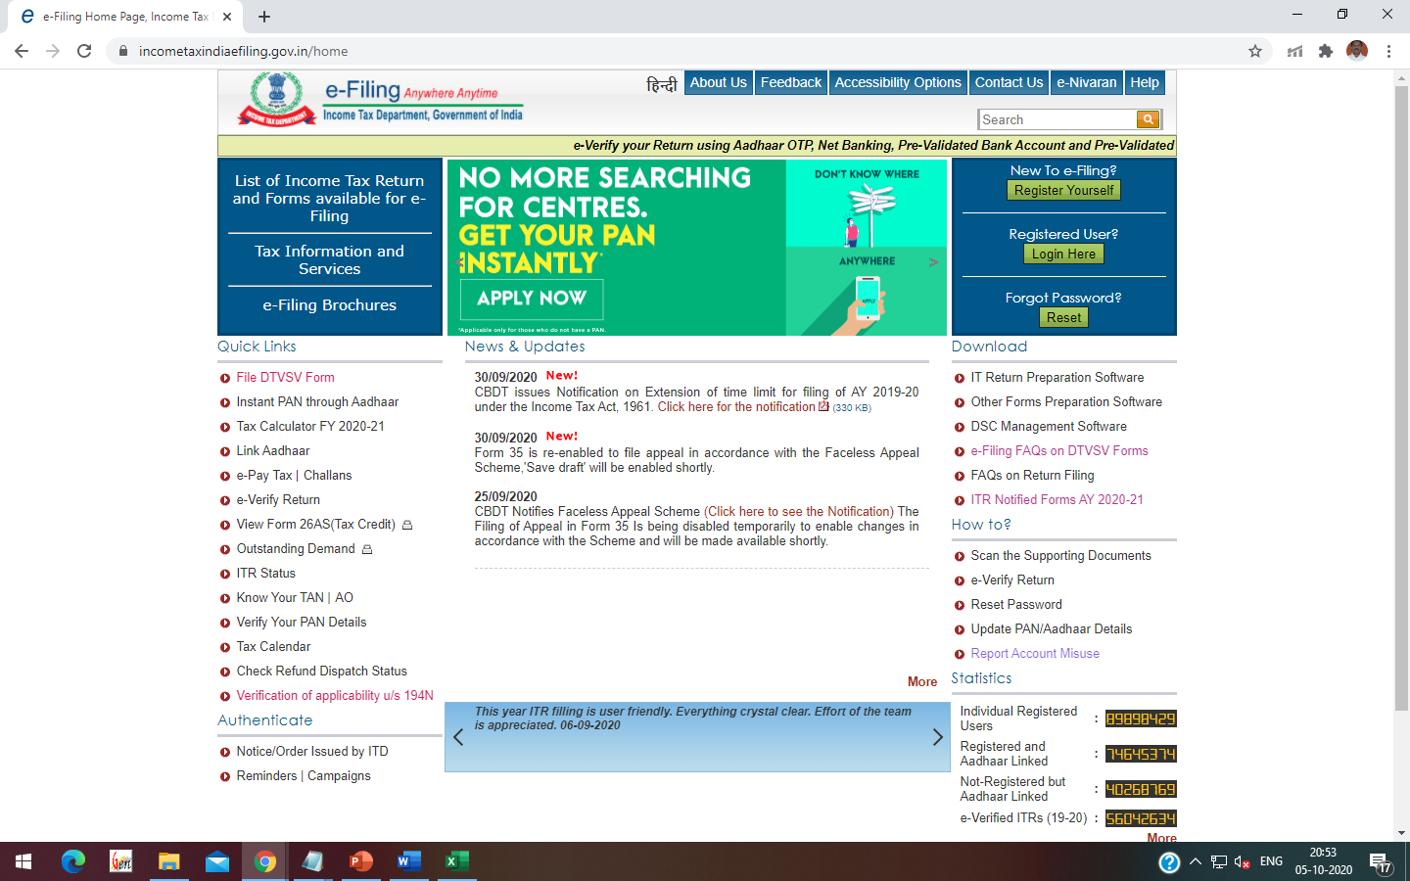
Introduction to Income Tax e-filing Website

Slide 66
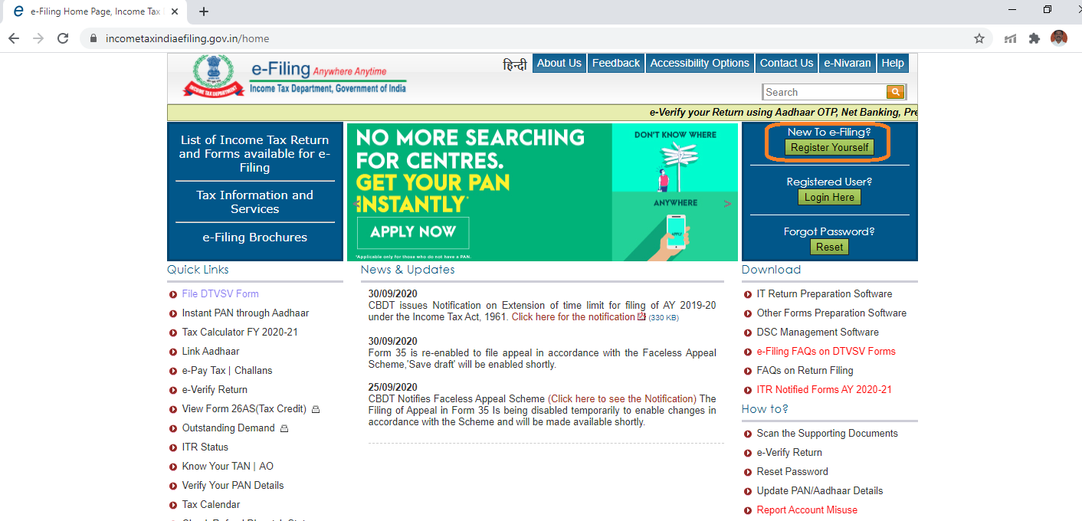
First time Registration in Income Tax website

Slide 67
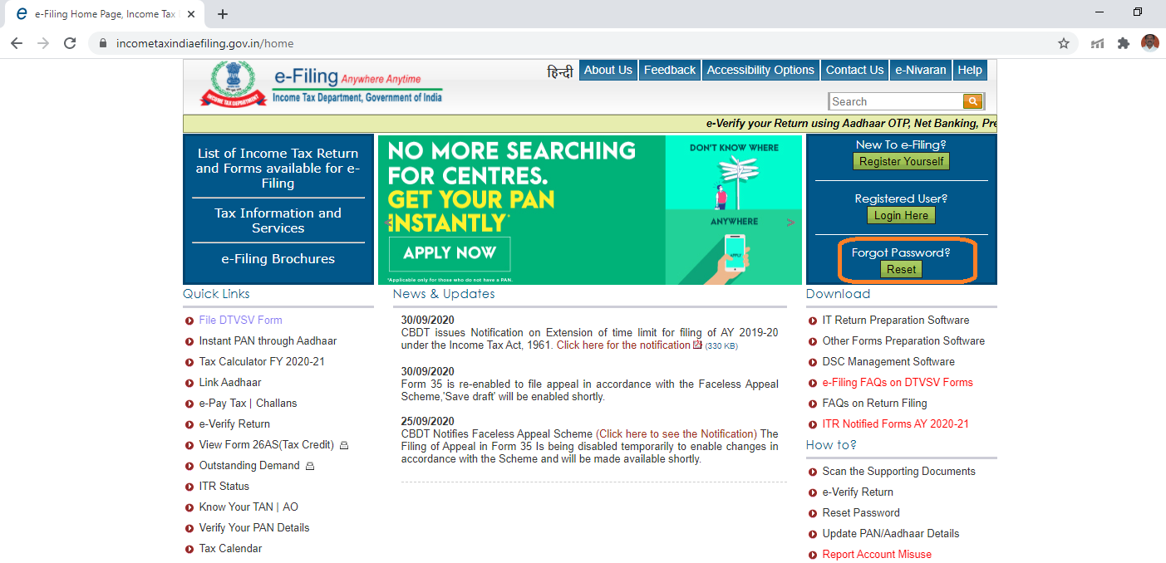
Forgot Password

Slide 68
Documents to be reviewed before filing ITR
Form 26AS
Status of Previous ITR
E-verification status of previous ITRs
‘Compliance Portal’ in Income Tax website
‘For your Actions’ in Income Tax website
Form 16 (if applicable)

Slide 69
Filing of Income Tax Return

Slide 70
e-verification
Ways to e-verify Income Tax Return
Via Aadhaar-based OTP
Generating EVC via Net-banking
Generating EVC via bank account
Verifying tax-returns through demat account
Generating EVC through your bank ATM
Sending signed ITR-V/Acknowledgement receipt
Signing through Digital signature Certificate (DSC).

Slide 71
Important Links
Income Tax e-filing website
https://www.incometaxindiaefiling.gov.in/home
Link to Pay Income Tax / Income Tax TDS
https://onlineservices.tin.egov-nsdl.com/etaxnew/tdsnontds.jsp
Link to check name of PAN / TAN (to check name details without making online payment)
https://onlineservices.tin.egov-nsdl.com/etaxnew/tdsnontds.jsp
Link to check Refund status (without logging into Income Tax website)
https://tin.tin.nsdl.com/oltas/refund-status-pan.html
Link to check (year wise) Income Tax Act and Rules
https://www.incometaxindia.gov.in/Pages/acts/income-tax-act.aspx

Slide 72

Contact Details of Faculty
+ 91 9490747591
SurendraKumarAmara@yahoo.co.in
https://www.linkedin.com/in/surendra-amara-39975a30/

