Slide 1
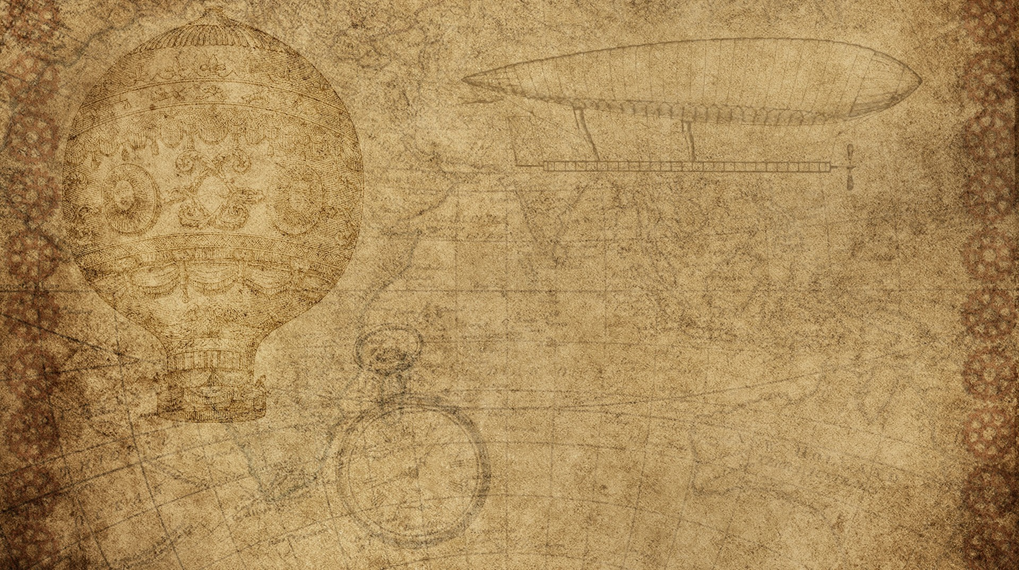

Registration
Under goods and services tax

Slide 2

Multiple choice questions
1. Who is required to obtain compulsory registration under GST, regardless of turnover?
A. Agriculturist
B. Person making only exempt supply
C. Person making inter-state taxable supply
D. Small trader making intra-state supply below ₹20 lakhs
Correct Answer: C
Explanation: Inter-state taxable suppliers must register under GST, regardless of turnover.
2. What is the threshold limit of aggregate turnover for GST registration for a person supplying goods in most states (Normal Category States)?
A. ₹10 lakhs
B. ₹20 lakhs
C. ₹40 lakhs
D. ₹50 lakhs
Correct Answer: C
Explanation: For suppliers of goods in most states, the threshold is ₹40 lakhs. It is lower for services and special category states.

Slide 3
3. What is the time limit for applying for GST registration from the date on which the person becomes liable for registration?
A. 15 days
B. 30 days
C. 60 days
D. 90 days
Correct Answer: B
Explanation: Application must be submitted within 30 days of becoming liable.
4. Which of the following is NOT included in the aggregate turnover for GST registration?
A. Exempt supplies
B. Interstate supplies
C. Inward supplies on which tax is paid under reverse charge
D. Export of goods or services
Correct Answer: C
Explanation: Inward supplies under reverse charge are not part of aggregate turnover.

Slide 4
5. What is the effective date of registration if the application is submitted within the prescribed time?
A. Date of grant of registration
B. Date of submission of application
C. Date on which liability arises
D. Date of verification of documents
Correct Answer: C
Explanation: If applied within 30 days, registration is effective from the date on which liability to register arose.
6. Which of the following persons is required to obtain GST registration compulsorily, even if the turnover is below the threshold?
A. Casual taxable person
B. Non-resident taxable person
C. E-commerce operator
D. All of the above
Correct Answer: D
Explanation: All listed persons must register under GST regardless of turnover.

Slide 5
7. Which of the following is true for a casual taxable person under GST?
A. They must register only if turnover exceeds ₹40 lakhs
B. They can operate without registration
C. They must obtain registration before commencing business
D. Registration is not required for casual supply of exempted goods
Correct Answer: C
Explanation: Casual taxable persons must register before starting business.
8. A person who is required to deduct tax at source (TDS) under GST must register if:
A. Turnover exceeds ₹20 lakhs
B. Turnover exceeds ₹10 lakhs
C. They are deducting TDS under GST, regardless of turnover
D. They make inter-state supply
Correct Answer: C
Explanation: Persons liable to deduct TDS under GST must register, regardless of turnover.

Slide 6
9. Which form is used to apply for GST registration?
A. GST REG-01
B. GST REG-03
C. GST REG-06
D. GST REG-08
Correct Answer: A
Explanation: GST REG-01 is used for new registration.
10. If a registered person is no longer liable to be registered under GST, he may apply for cancellation of registration in:
A. GST REG-03
B. GST REG-06
C. GST REG-16
D. GST REG-30
Correct Answer: C
Explanation: GST REG-16 is the application form for cancellation of registration.

