Slide 1


Slide 2

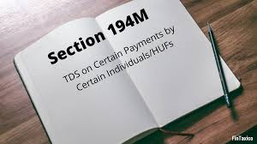
SECTION 194M
TDS ON PAYMENT TO RESIDENT CONTRACTORS AND PROFESSIONALS

Slide 3
194M. Payment of certain sums by certain individuals or Hindu undivided family
(1) Any person, being an individual or a Hindu undivided family (other than those who are required to deduct income-tax as per the provisions of section 194C, section 194H or section 194J) responsible for paying any sum to any resident for carrying out any work (including supply of labour for carrying out any work) in pursuance of a contract, by way of commission (not being insurance commission referred to in section 194D) or brokerage or by way of fees for professional services during the financial year, shall, at the time of credit of such sum or at the time of payment of such sum in cash or by issue of a cheque or draft or by any other mode, whichever is earlier, deduct an amount equal to five per cent. of such sum as income-tax thereon:
Provided that no such deduction under this section shall be made if such sum or, as the case may be, aggregate of such sums, credited or paid to a resident during a financial year does not exceed fifty lakh rupees.
(2) The provisions of section 203A shall not apply to a person required to deduct tax in accordance with the provisions of this section.
Explanation.--For the purposes of this section, --
(a) contract shall have the meaning assigned to it in clause (iii) of the Explanation to section 194C;
(b) "commission or brokerage" shall have the meaning assigned to it in clause (i) of the Explanation to section 194H;
(c) "professional services" shall have the meaning assigned to it in clause (a) of the Explanation to section 194J;
(d) "work" shall have the meaning assigned to it in clause (iv) of the Explanation to section 194C.

Slide 4

APPLICABILITY
An individual and/or Hindu undivided family (HUF) has to deduct tax at source under Section 194M. Such individuals and HUF must not be required to get their books of accounts audited. Books of Accounts are required to be audited if total turnover or receipts of a business exceed Rs. 1 crore or where receipts of a profession exceed Rs. 50 lakh.
IT SHOULD BE NOTED THAT NO TDS UNDER SECTION 194M IS APPLICABLE TO THE ASSESSEE IF THEY WERE CODUCTING AUDIT REFERRED UNDER SECTION 44AD.
Payments to non-residents are not covered under this section.

Slide 5
RATE AT WHICH TDS UNDER SECTION 194M IS TO BE DEDUCTED
@ 5%
THE TOTAL SUM PAID EXCEEDS RS.50,00,000.00 IN A YEAR.
IF
If the recipient does not furnish his PAN to the deductor, tax will be deducted
MAXIMUM MARGINAL RATE
@20%

Slide 6

TIME LIMIT FOR DEPOSITING IN TDS
If the amount is deducted in March – on or before April 30 of the next financial year.
FOR EXAMPLE:
if the amount has been deducted in March 2020, then the TDS will be deposited to the department by 30 April 2021.
In any other month – within seven days from the end of the month in which the tax deduction is made.
FOR EXAMPLE:
if the amount has been deducted paid in the month of September 2020, then the TDS will be deposited to the department by 7 October 2020.

Slide 7
CERTIFICATE OF TAX DEDUDCTED UNDER SECTION 194M
THE PERSON WHO DEDUCTS TAX UNDER SECTION 194M SHALL FURNISH A CERTIFICATE :
UNDER
FORM NO.16D
WITHIN
15 DAYS OF THE DUE DATE OF FURNISHING THE CHALLAN CUM STATEMENT
IN
FORM 26QD

Slide 8
SPECIAL POINTS TO BE NOTED:
If the Assesse required to get Books of Accounts audited, TDS deduction is applicable as per Section 194C and 194J. The individual and/or HUF who have to deduct TDS under Section 194C (TDS on payment to a contractor) and 194J (TDS on payment on professional fees) do not have to deduct tax at source under Section 194M.
The individual or HUFs who has to deduct tax can pay the tax to the government by quoting his or her PAN only. Not required to get a tax deduction account number (TAN) for TDS deduction.
TDS amount will be deducted on the earlier of the following dates:
At the time of credit of the amount.
At the time of payment by cash or by the issue of a cheque or draft.

Slide 9
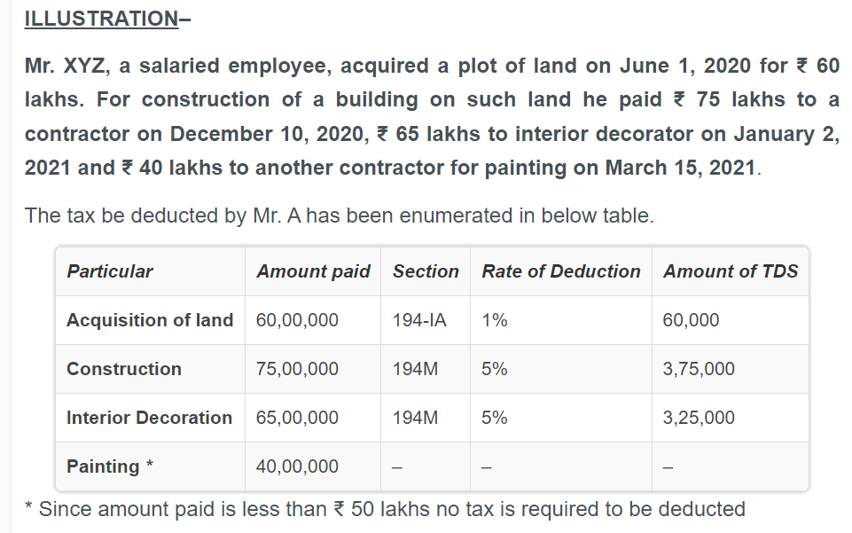

Slide 10
194 N - Payment of certain amounts in cash
Every person, being,-
(i) a banking company to which the Banking Regulation Act, 1949 (10 of 1949.) applies (including any bank or banking institution referred to in section 51 of that Act);
(ii) a co-operative society engaged in carrying on the business of banking;
or
(iii) a post office,
who is responsible for paying any sum, being the amount or the aggregate of amounts, as the case may be, in cash exceeding one crore rupees during the previous year, to any person (herein referred to as the recipient) from one or more accounts maintained by the recipient with it shall, at the time of payment of such sum, deduct an amount equal to two per cent. of such sum, as income-tax:

Slide 11
Provided that in case of a recepient who has not filed the returns of income for all of the three assessment years relevant to the three previous years, for which the time limit of file return of income under sub-section (1) of section 139 has expired, immediately preceding the previous year in which the payment of the sum is made to him, the provision of this section shall apply with the modification that-
(i) the sum shall be the amount or the aggregate of amounts, as the case may be, in cash exceeding twenty lakh rupees during the previous year; and
(ii) the deduction shall be-
(a) an amount equal to two per cent. of the sum where the amount or aggregate of amounts, as the case may be, being paid in cash exceeds twenty lakh rupees during the previous year but does not exceed one crore rupees; or
(b) an amount equal to five per cent. of the sum where the amount or aggregate of amounts, as the case may be, being paid in cash exceeds one crore rupees during the previous year:
Provided further that the Central Government may specify in consultation with the Reserve Bank of India, by notification in the Official Gazette, the recipient in whose case the first proviso shall not apply or apply at reduced rate, if such recipient satisfies the conditions specified in such notification:
3[Provided also that where the recipient is a co-operative society, the provisions of this section shall have effect, as if for the words "one crore rupees", the words "three crore rupees" had been substituted.]

Slide 12
Provided also that nothing contained in this section shall apply to any payment made to-
(i) the Government;
(ii) any banking company or co-operative society engaged in carrying on the business of banking or a post office;
(iii) any business correspondent of a banking company or co-operative society engaged in carrying on the business of banking, in accordance with the guidelines issued in this regard by the Reserve Bank of India under the Reserve Bank of India Act, 1934; (2 of 1934.)
(iv) any white label automated teller machine operator of a banking company or co-operative society engaged in carrying on the business of banking, in accordance with the authorisation issued by the Reserve Bank of India under the Payment and Setllement Systems Act, 2007 (51 of 2007.):
Provided also that the Central Government may specify in consultation with the Reserve Bank of India, by notification in the Official Gazette, the recipient in whose case the provision of this section shall not apply or apply at reduced rate, if such recipient satisfies the conditions specified in such notification.]

Slide 13
194 - O
(1) Notwithstanding anything to the contrary contained in any of the provisions of Part B of this Chapter, where sale of goods or provision of services of an e-commerce participant is facilitated by an e-commerce operator through its digital or electronic facility or platform (by whatever name called), such e-commerce operator shall, at the time of credit of amount of sale or services or both to the account of an e-commerce participant or at the time of payment thereof to such e-commerce participant by any mode, whichever is earlier, deduct income-tax at the rate of one per cent of the gross amount of such sales or services or both.
Explanation.—For the purposes of this sub-section, any payment made by a purchaser of goods or recipient of services directly to an e-commerce participant for the sale of goods or provision of services or both, facilitated by an e-commerce operator, shall be deemed to be the amount credited or paid by the e-commerce operator to the e-commerce participant and shall be included in the gross amount of such sale or services for the purpose of deduction of income-tax under this sub-section.
(2) No deduction under sub-section (1) shall be made from any sum credited or paid or likely to be credited or paid during the previous year to the account of an e-commerce participant, being an individual or Hindu undivided family, where the gross amount of such sale or services or both during the previous year does not exceed five lakh rupees and such e-commerce participant has furnished his Permanent Account Number or Aadhaar number to the e-commerce operator.

Slide 14
(3) Notwithstanding anything contained in Part B of this Chapter, a transaction in respect of which tax has been deducted by the e-commerce operator under sub-section (1), or which is not liable to deduction under sub-section (2), shall not be liable to tax deduction at source under any other provision of this Chapter:
Provided that the provisions of this sub-section shall not apply to any amount or aggregate of amounts received or receivable by an e-commerce operator for hosting advertisements or providing any other services which are not in connection with the sale or services referred to in sub-section (1).
(4) If any difficulty arises in giving effect to the provisions of this section, the Board may, with the approval of the Central Government, issue guidelines for the purpose of removing the difficulty.
(5) Every guideline issued by the Board under sub-section (4) shall be laid before each House of Parliament, and shall be binding on the income-tax authorities and on the e-commerce operator.
(6) For the purposes of this section, e-commerce operator shall be deemed to be the person responsible for paying to e-commerce participant.

Slide 15
194 P - Deduction of tax in case of specified senior citizen
(1) Notwithstanding anything contained in the provisions of Chapter XVII-B, in case of a specified senior citizen, the specified bank shall, after giving effect to the deduction allowable under Chapter VI-A and rebate allowable under section 87A, compute the total income of such specified senior citizen for the relevant assessment year and deduct income-tax on such total income on the basis of the rates in force.
(2) The provisions of section 139 shall not apply to a specified senior citizen for the assessment year relevant to the previous year in which the tax has been deducted under sub-section (1).

Slide 16
(a) |  | "specified bank" means a banking company as the Central Government may, by notification in Official Gazette, specify;
(b) |  | "specified senior citizen" means an individual, being a resident in India -
(i) |  | who is of the age of seventy-five years or more at any time during the previous year;
(ii) |  | who is having income of the nature of pension and no other income except the income of the nature of interest received or receivable from any account maintained by such individual in the same specified bank in which he is receiving his pension income; and
(iii) |  | has furnished a declaration to the specified bank containing such particulars, in such form and verified in such manner, as may be prescribed

Slide 17
194 Q
(1) Any person, being a buyer who is responsible for paying any sum to any resident (hereafter in this section referred to as the seller) for purchase of any goods of the value or aggregate of such value exceeding fifty lakh rupees in any previous year, shall, at the time of credit of such sum to the account of the seller or at the time of payment thereof by any mode, whichever is earlier, deduct an amount equal to 0.1 per cent of such sum exceeding fifty lakh rupees as income-tax.
Explanation.—For the purposes of this sub-section, "buyer" means a person whose total sales, gross receipts or turnover from the business carried on by him exceed ten crore rupees during the financial year immediately preceding the financial year in which the purchase of goods is carried out, not being a person, as the Central Government may, by notification in the Official Gazette, specify for this purpose, subject to such conditions as may be specified therein.
(2) Where any sum referred to in sub-section (1) is credited to any account, whether called "suspense account" or by any other name, in the books of account of the person liable to pay such income, such credit of income shall be deemed to be the credit of such income to the account of the payee and the provisions of this section shall apply accordingly.
(3) If any difficulty arises in giving effect to the provisions of this section, the Board may, with the previous approval of the Central Government, issue guidelines for the purpose of removing the difficulty.
(4) Every guideline issued by the Board under sub-section (3) shall, as soon as may be after it is issued, be laid before each House of Parliament, and shall be binding on the income-tax authorities and the person liable to deduct tax.

Slide 18
(5) The provisions of this section shall not apply to a transaction on which—
(a) | tax is deductible under any of the provisions of this Act; and
(b) | tax is collectible under the provisions of section 206C other than a transaction to which sub-section (1H) of section 206C applies.

Slide 19
Section 194 Q – Deduction of tax at source on Purchase of Goods
This section is applicable from 01.07.2021 and provides for deduction of tax at source on the payment made by the assessee towards the purchase of goods. It is similar to section 206C(1H) which is applicable for collection of tax at source.
It is applicable to a resident buyer for purchase of goods of the value or aggregate value exceeding Rs.50 lakhs in any previous year.
The assessee at the time of credit of such sum to the account of the seller or at the time of payment whichever is earlier shall deduct an amount equal to 0.1% of such sum exceeding Rs.50 lakhs by way of income-tax.
The buyer would mean a person whose total sales, gross receipts or turnover from the business carried on by him exceeded Rs.10 crores during the financial year preceding the financial year in which the purchase of goods is carried out.

Slide 20
This provision shall not apply where
tax is deductible at source under any other provision of this Act; and
tax is collectible under the provisions of section 206C other than a transaction to which section 206C(1H) applies.
In other words, the seller covered by section 206C(1H) would collect 0.1% (w.e.f. 01.04.2021) and the buyer would deduct 0.1% w.e.f. 01.07.2021.
In the Memorandum explaining the provisions in the Finance Bill, 2021 it is clarified that if on a transaction TCS is required under section 206C(1H) as well as TDS under section 194Q, then in respect of that transaction only TDS under section 194Q shall only be carried out.

Slide 21
Reduced rate of TDS under section 194Q when PAN not furnished. [further proviso to section 206AA(1)]
When the person entitled to receive any sum or income on which tax is deductible under Chapter XVII-B does not furnish Permanent Account Number to the person responsible for deducting tax at source, the person making payment must deduct tax at source at the higher of the following rates viz.
rate as specified in the relevant provision of this Act; or
at the rate or rates in force; or
at the rate of 20%.
The Finance Bill, 2021 proposes to insert section 194Q for deduction of tax at source w.e.f. 01.07.2021. If the supplier of goods referred to in section 194Q does not furnish his PAN then the buyer must deduct tax at source @ 5% instead of 20% given above. This is enabled by inserting a further proviso to section 206AA to be effective from 1st July, 2021.

Slide 22
Sub-Section (1H) as has been inserted in Sec.206C :
The tax shall be collected by the seller from buyer, if following conditions are satisfied:
There is a sale of goods to such buyer.
The seller receives any amount as consideration for the sale of any goods of the value or aggregate of such value exceeding INR 50 lakhs in any previous year from such buyer.
It is pertinent to note that the threshold limit of INR 50 lakhs is per buyer per year. Additionally, the threshold limit of INR 10 crore in the preceding financial year shall be considered to determine the applicability of the provisions upon seller. This means that entities having turnover/ gross receipts/ sales of less than INR 10 crore are kept outside the ambit of the above section.
Further, the government has made certain exclusions of buyers from the purview of the said section:
The Central Government, a State Government, an Embassy, a High Commission, legation, commission, consulate and the trade representation of a foreign state; or
A local Authority defined in the Explanation to section 10(20); or
Importer of goods or any other person notified by the Central Government. Till date no notification covering any exclusion of parties from the above said provision has been introduced by the government.

Slide 23
Threshold limit of turnover: Including supply of service or not?
The issue for consideration is that whether the sale of service shall also be included in computing the threshold limit of turnover for seller or should the same be excluded from the ambit of this section. It shall be noted that the definition of the term "seller" provides that total sales, gross receipts or turnover from the business carried on by such seller shall be considered. In view that the sales/turnover from the business is considered, the same should include both sale of goods and services.
Turnover of 10 Crores: With GST or without?
The government has elucidated vide circular mentioned above that no adjustment on account of GST is required to be made to calculate sales consideration of INR 50 Lakhs, since the collection of tax is made with reference to receipt of amount of sale consideration.
Therefore, one is not required to bifurcate the amount of sale consideration received between that to sale price and GST component. The moment composite amount of sale consideration received exceeds INR 50 lakhs, the seller will be required to apply the provisions of section 206C(1H).
However, there is an uncertainty on the computation of threshold limit for seller's turnover i.e. whether the turnover shall be inclusive or exclusive of GST. This is especially in view that the circular clarifies the position with regards to sales consideration and not turnover.

Slide 24
First year of incorporation/formation: TCS applicable or not?
The definition of the term 'seller' provides as follows, mean a person whose total sales from the business carried on by him exceed ten crore rupees during the financial year immediately preceding the financial year in which the sale of goods is carried out.
Therefore, TCS provisions should not apply in the year of incorporation/formation as there were no sales, gross receipts or turnover in the preceding financial year.

Slide 25
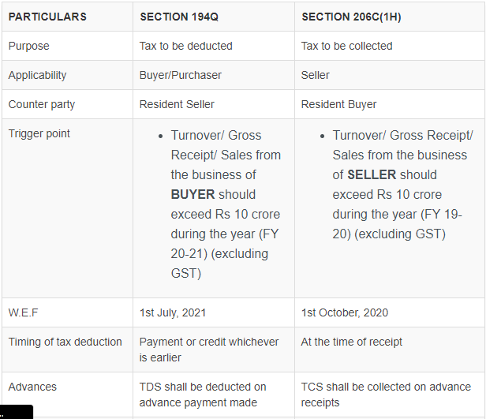

Slide 26
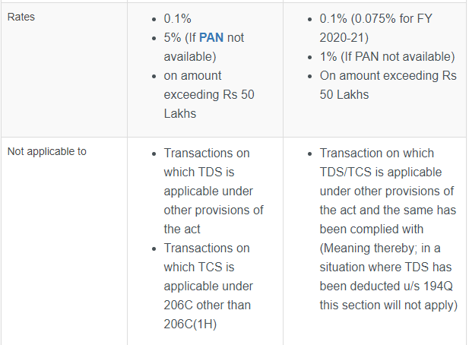

Slide 27
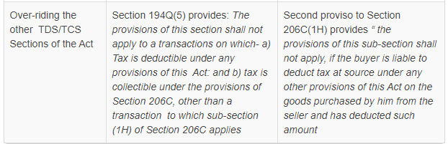

Slide 28
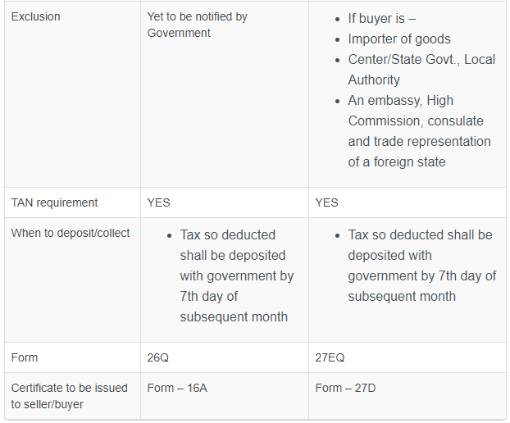

Slide 29
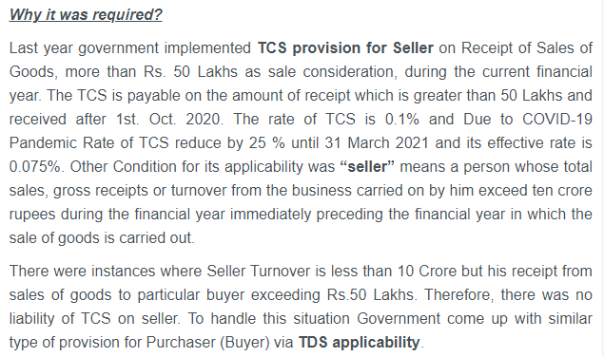

Slide 30
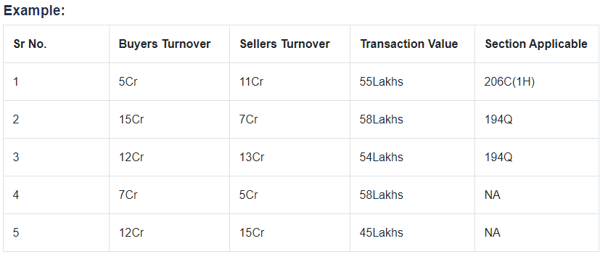
ILLUSTRATION

Slide 31
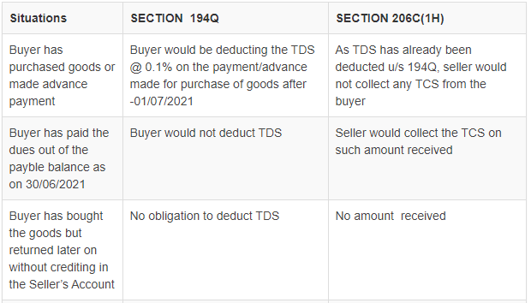
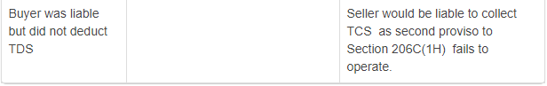
TRICKY SITUATIONS

Slide 32

THANK YOU!

