Slide 2
IMPORTS
Prof Vijayan Ramakrishnan
rvijayan99@gmail.com

Slide 3
Topics to be covered
Background of Customs Law
Important Acts in Customs
Meaning and scope of Imports
Definitions
Landmark judgement defining import
High sea sales
Bonded Warehouse
Valuation of Imported Goods
SVB and related Party transactions
Import of Services
Imports and GST
Advance Rulings
Important Case studies

Slide 4
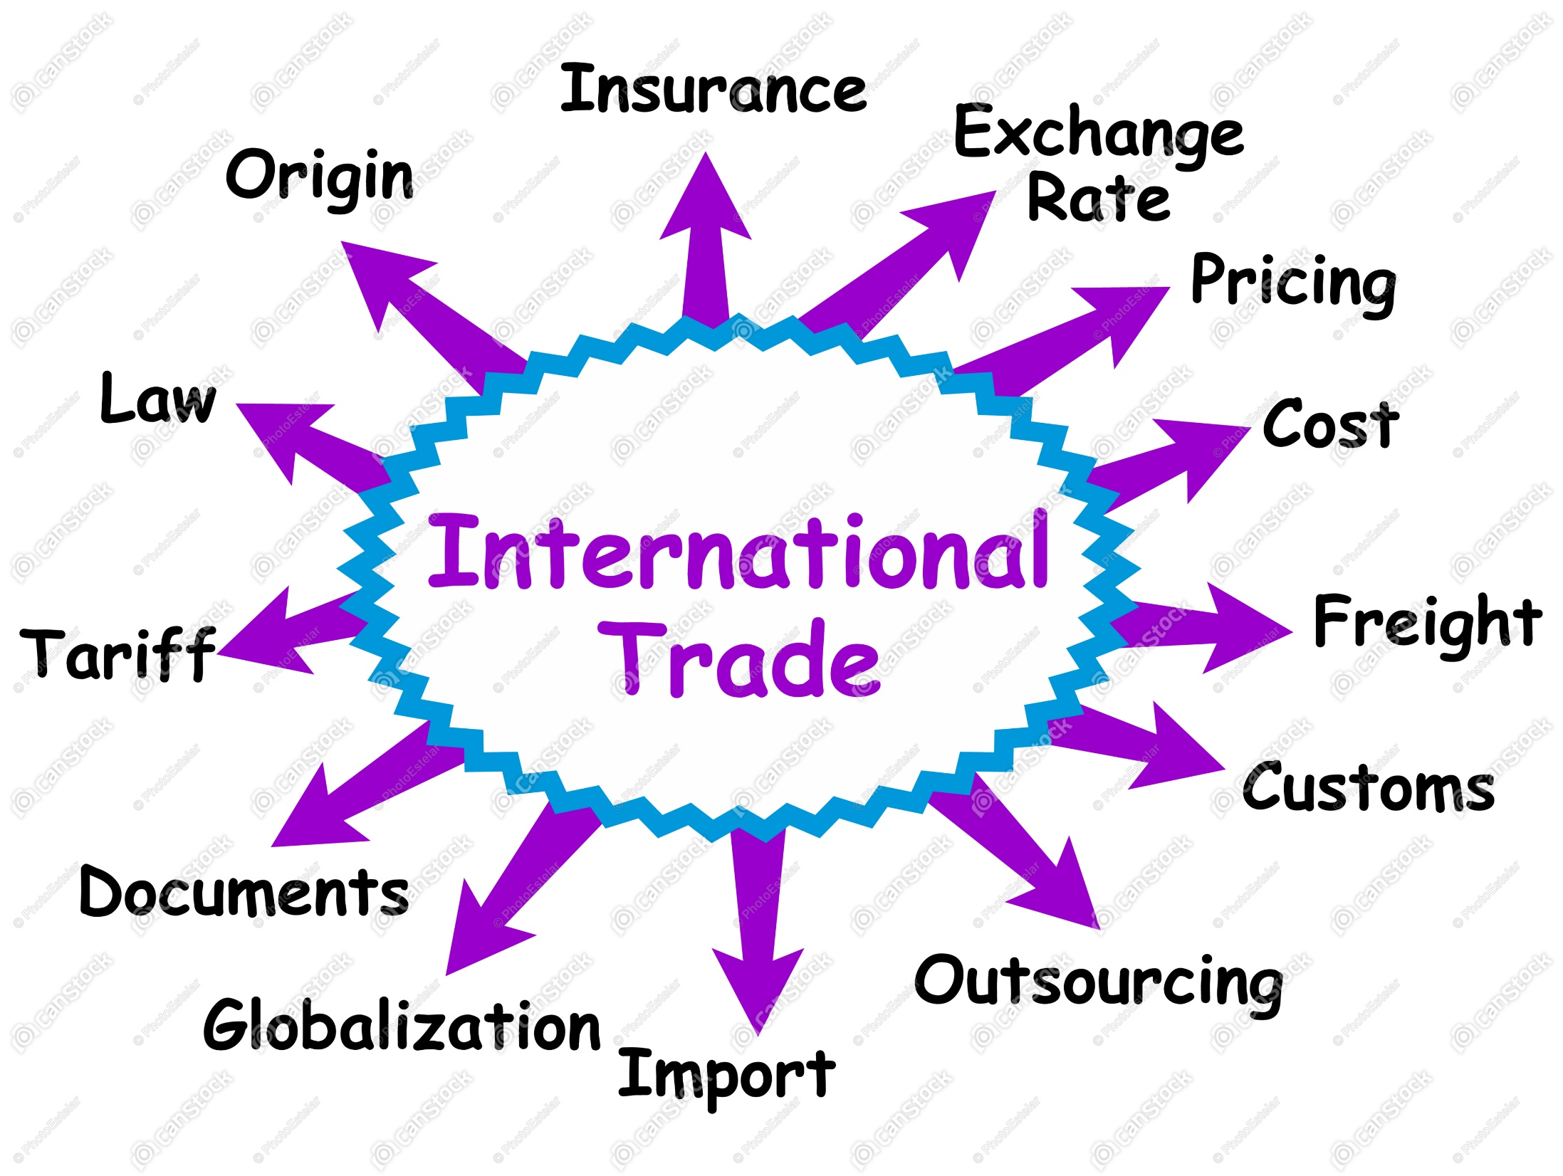

Slide 5
Territorial waters
The territorial jurisdiction extends to territorial water up to 12 nautical miles from the nearest point of the baseline;
beyond territorial waters is the Contiguous Zone extending up to 24 nautical miles;
and beyond that up to 200 nautical miles is the Exclusive Economic Zone of India.
Exclusive Economic Zone is an area of coastal water and seabed within a certain distance of a country's coastline, to which the country claims exclusive rights for fishing, drilling, and other economic activities.
Indian Customs Waters' means the water extending into the sea up to the limit of the contiguous zone of India.
In this manner, Indian Customs waters reach out up to 12 nautical miles past territorial waters.

Slide 6
Introduction to Customs Law
Background of Customs Law
Customs duty is on import into India and export out of India.
As per ancient custom, a merchant entering a kingdom with his goods had to make a suitable gift to the King.
Also it was a custom for a king to bring some gifts when he visits other king .
Britishers found this a novel way to collect money and they introduced Customs Duty

Slide 7
The main objectives of levying a customs duty are to:
Ensure that nothing goes out of a country against the laws of the land and rules and regulations are followed as enforced by customs authorities.
Check the authenticity of the value of goods as per customs valuation rules to prevent over and under invoicing.
Assess export duty as per the Customs Tariff Act.
Check that all the set provisions are being followed by export and import authorities.
Maintain all import and export data.
Prevent the import of drugs (like opium) for illegal use in the country.

Slide 8
CBIC
Central Board of Indirect Taxes and Customs (erstwhile Central Board of Excise & Customs) is a part of the Department of Revenue under the Ministry of Finance, Government of India.
It deals with the tasks of formulation of policy concerning levy and collection of Customs, Central Excise duties, Central Goods & Services Tax and IGST, prevention of smuggling and administration of matters relating to Customs, Central Excise, Central Goods & Services Tax, IGST and Narcotics to the extent under CBIC's purview

Slide 9
Evolution of Customs
Year | Progress
1788 | Customs duty collection was abolished by Lord Cornwallis
1801 | Reintroduced
1878 | Sea Customs Act enacted
1924 | Land Customs Act enacted
1934 | Air customs was controlled by Indian Aircraft Act 1934 , earlier it was 1911
1962 | Customs Act, 1962, repealed all the earlier enactments and consolidated Air , Sea and Land customs

Slide 10
Customs in India
India is a part of various international customs agreements set by global institutions. Some of these institutions are as follows:
World Trade Organisation (WTO): WTO, headquartered at Geneva, Switzerland, consists of 153 members and represents more than 97% of the world trade.
World Customs Organisation (WCO): WCO is an independent inter-governmental body established in 1952.

Slide 11
World Trade Organisation
The World Trade Organization is an intergovernmental organization that regulates international trade.
Headquarters Geneva, Switzerland
Purpose: Regulate international trade
Founded: 1 January 1995
Membership: 164 member states
Formation: 1 January 1995; 23 years ago

Slide 12
Administering WTO trade agreements
Forum for trade negotiations
Handling trade disputes
Monitoring national trade policies
Technical assistance and training for developing countries
Cooperation with other international organizations

Slide 13
World Customs Organisation
The World Customs Organization is an intergovernmental organization headquartered in Brussels, Belgium.
Headquarters: Brussels, Belgium
Founded: 26 January 1952
Secretary General: Kunio Mikuriya (January 2009 - present)
Membership: 180 customs administrations
Formerly called: Customs Co-operation Council (CCC)
Type of business: Intergovernmental organization

Slide 14
The WCO is noted for its work in areas covering the development of international conventions, instruments, and tools on topics such as
  commodity classification, & Valuation
  rules of origin, & collection of customs revenue,
  supply chain security, & international trade facilitation,
  customs enforcement activities,
  combating counterfeiting in support of Intellectual Property Rights (IPR),
  drugs enforcement, illegal weapons trading, integrity promotion, and
  delivering sustainable capacity building to assist with customs reforms and modernization.
The WCO maintains the international Harmonized System (HS) goods nomenclature, and administers the technical aspects of the World Trade Organization (WTO) Agreements on Customs Valuation and Rules of Origin.

Slide 15
Categories of imports
Most of the goods are free for exports and imports without obtaining any license, while a few are banned and some others are canalized requiring license, for import and export.
So, exporter /importer has to check up whether any license is required before accepting and executing export order or plan to import any goods.
Imports have been classified in 3 categories i.e
Restricted goods
Canalised goods
Prohibited goods

Slide 16
Prohibited Items: These items cannot be exported or imported. These items include wild life exotic birds, wood and wood products in the form of logs, timber, pulp and charcoal.
Restricted Items: These are the goods that can be exported/imported only with a license, in accordance with regulations governing in this behalf.
Canalized Items: Goods, which are canalized, can be imported or exported through the canalizing agency, specified in the Negative List. The Director General of Foreign Trade, may, issue license to any other person to import or export items
Goods in this category can be imported only through canalizing agencies. The main canalized items are currently petroleum products, bulk agricultural products, such as grains and vegetable oils, and some pharmaceutical products..
Visit DGFT website www.dgft.gov.in to get all further details

Slide 17
Various Customs related Acts
There are various acts enacted in India related to customs.
These acts regulate international trade in a transparent manner by controlling illegal trade like drugs and narcotics.
These acts prevent the dumping of goods from other countries.
The most important customs related acts are
  Customs Act, 1962
  Customs Tariff Act, 1975
  Foreign Trade (Development and Regulation) Act, 1992.
  Foreign Trade Policy
Apart from the above, following Acts are also very important
  Central Excise Tariff Act 1985 – Most of them have come under GST
  Foreign Exchange Management Act 1999
  Legal Metrology Act 2009

Slide 18
The Customs Act 1962
XVII Chapters (17)
Total sections : 161
Customs Tariff:
Total 21 Sections
Chapter 98
Chapter 77 is Blank
Foreign Trade (Development & Regulation) Act 1992
6 Chapter
20 Sections
Foreign Trade Policy
11 Chapters

Slide 19
Important Definitions as per The Customs Act 1962
Chapter 1 –Section 2 of The Customs Act 1962 gives all definitions of Customs
As per section 2(23) of Customs Act, 'import' with its grammatical variations and cognate expressions, means bringing into India from a place outside India.
Section 2(27) of Customs Act defines 'India' as inclusive of territorial waters.
What are the territorial waters in customs law?
Section 3 of the 'Territorial Waters, Continental Shelf, Exclusive Economic Zone and other Maritime Zone Act, 1976' specifies that territorial water extend upto 12 nautical miles from the base line on the coast of India and include any bay, gulf, harbour, creek or tidal river.
Indian customs waters extend upto contiguous( adjoining, adjacent) zone of India which twenty four nautical miles from the nearest point of base line. Thus Indian customs waters extend upto twelve nautical miles beyond territorial waters.
One nautical mile is equal to 1.852 km

Slide 20
[(2) "assessment" means determination of the dutiability of any goods and the amount of duty, tax, cess or any other sum so payable, if any, under this Act or under the Customs Tariff Act, 1975 (51 of 1975) (hereinafter referred to as the Customs Tariff Act) or under any other law for the time being in force, with reference to-
(a) the tariff classification of such goods as determined in accordance with the provisions of the Customs Tariff Act;
(b) the value of such goods as determined in accordance with the provisions of this Act and the Customs Tariff Act;
(c) exemption or concession of duty, tax, cess or any other sum, consequent upon any notification issued therefor under this Act or under the Customs Tariff Act or under any other law for the time being in force;

Slide 21
(d) the quantity, weight, volume, measurement or other specifics where such duty, tax, cess or any other sum is leviable on the basis of the quantity, weight, volume, measurement or other specifics of such goods;
(e) the origin of such goods determined in accordance with the provisions of the Customs Tariff Act or the rules made thereunder, if the amount of duty, tax, cess or any other sum is affected by the origin of such goods;
(f) any other specific factor which affects the duty, tax, cess or any other sum payable on such goods, and includes provisional assessment, self-assessment, re-assessment and any assessment in which the duty assessed is nil ;]

Slide 22
(3) "baggage" includes unaccompanied baggage but does not include motor vehicles;
⁵ [(3A) "beneficial owner" means any person on whose behalf the goods are being imported or exported or who exercises effective control over the goods being imported or exported;]
(4) "bill of entry" means a bill of entry referred to in section 46;
(5) "bill of export" means a bill of export referred to in section 50;
(9) "conveyance" includes a vessel, an aircraft and a vehicle;

Slide 23
(11) "customs area" means the area of a customs station ¹³ [or a warehouse] and includes any area in which imported goods or export goods are ordinarily kept before clearance by Customs Authorities;
(12) "customs port" means any port appointed under clause (a) of section 7 to be a customs port ¹⁴ [and includes a place appointed under clause (aa) of that section to be an inland container depot];
(13) "customs station" means any customs port, customs airport ¹⁵ [, international courier terminal, foreign post office] or land customs station;
(14) "dutiable goods" means any goods which are chargeable to duty and on which duty has not been paid;

Slide 24
(15) "duty" means a duty of customs leviable under this Act;
(16) "entry" in relation to goods means an entry made in a bill of entry, shipping bill or bill of export and includes ¹⁶ [* * *] the entry made under the regulations made under section 84;
(17) "examination", in relation to any goods, includes measurement and weighment thereof;
(18) "export", with its grammatical variations and cognate expressions, means taking out of India to a place outside India;
(19) "export goods" means any goods which are to be taken out of India to a place outside India;
(20) "exporter", in relation to any goods at any time between their entry for export and the time when they are exported, includes ¹⁷ [any owner, beneficial owner] or any person holding himself out to be the exporter;

Slide 25
(22) "goods" includes -
(a) vessels, aircrafts and vehicles;
(b) stores;
(c) baggage;
(d) currency and negotiable instruments; and
(e) any other kind of movable property;

Slide 26
(23) "import", with its grammatical variations and cognate expressions, means bringing into India from a place outside India;
(24) ²¹ ["arrival manifest or import manifest"] or"import report" means the manifest or report required to be delivered under section 30;
(25) "imported goods" means any goods brought into India from a place outside India but does not include goods which have been cleared for home consumption;
(26) "importer", in relation to any goods at any time between their importation and the time when they are cleared for home consumption, includes ²² [any owner, beneficial owner] or any person holding himself out to be the importer;

Slide 27
(30) "market price", in relation to any goods, means the wholesale price of the goods in the ordinary course of trade in India;
(33) "prohibited goods" means any goods the import or export of which is subject to any prohibition under this Act or any other law for the time being in force but does not include any such goods in respect of which the conditions subject to which the goods are permitted to be imported or exported have been complied with;
(37) "shipping bill" means a shipping bill referred to in section 50;
(41) "value", in relation to any goods, means the value thereof determined in accordance with the provisions of ³¹ [sub-section (1) or sub-section (2) of Section 14];
³² [(43) "warehouse" means a public warehouse licensed under section 57 or a private warehouse licensed under section 58 or a special warehouse licensed under section 58A;]
(44) "warehoused goods" means goods deposited in a warehouse;

Slide 28
Meaning and Scope of Imports
What Is an Import?
An import is a good or service bought in one country that was produced in another. Imports and exports are the components of international trade.
If the value of a country's imports exceeds the value of its exports, the country has a negative balance of trade, also known as a trade deficit.
To avoid negative balance of trade more exports and less imports should be effected.
Make in India should be one of the best option.
Replacing imports by domestic products.

Slide 29
Scope of Imports
Economic Significance: Imports and exports are vital components of a nation’s economy.
They contribute to the Gross Domestic Product (GDP) and can influence a country’s balance of trade and balance of payments
.Diversification: Imports allow a country to access a wider variety of products and resources, often at competitive prices. Exports enable a nation to capitalize on its strengths, whether in manufacturing, agriculture, or services, by selling to international markets
.Global Trade: Imports and exports are the foundation of international trade, facilitating the exchange of goods and services between countries. International trade promotes economic growth and fosters cooperation between nations
.

Slide 30
Job Creation: Both imports and exports can generate employment opportunities.
Exports create jobs in industries that produce goods or services for foreign markets, while imports can create jobs in distribution, retail, and related sectors.
Technology Transfer: Exports can lead to the transfer of technology and know-how to foreign markets, fostering innovation and economic development globally.
Imports can provide access to advanced technologies and expertise.

Slide 31
Trade Balances: A country’s trade balance is the difference between its exports and imports.
A trade surplus occurs when exports exceed imports, while a trade deficit occurs when imports surpass exports.
These balances can have economic and political implication
Government Policies: Governments often regulate imports and exports through trade policies, tariffs, and quotas to protect domestic industries, ensure national security, or promote certain sectors of the economy

Slide 32
Global Supply Chains: Imports and exports are integral to global supply chains.
Products often pass through multiple countries before reaching consumers, emphasizing the interconnectedness of the global economy.
The scope of imports and exports is vast, encompassing economic, political, social, and environmental aspects.
They play a pivotal role in shaping a country’s economic development and its interactions with the rest of the world

Slide 33
Reason for international trade
Cheap Resources
Advantage of New technology
Non availability in domestic market
Government regulations
Comparative advantage
Faster expansion in the market

Slide 34
Trade Barriers on imports
1. To protect home industries from foreign competition: In most of the developing countries, a major part of basic and heavy industries are still in the initial stage.
They have high cost of production and low quality of output. Therefore, such industries need protection from outside competitors.
2. To promote new industries and R&D: Developed countries are enriched with technologies that developing countries are still researching and innovating.
Thus, it becomes really important to protect these potential developments from any kind of foreign competition.

Slide 35
3. To conserve foreign exchange reserves: When a country indulges in surplus import then it impacts the foreign currency of the nation, hence government uses certain measures, such as quotas and tariffs for ensuring the proper balance of foreign exchange reserve.
4. To maintain favourable balance of payments: As the name suggests the Balance of Payment (BOP) denotes the gap between inflow and outflow of foreign currency in the economy.
When a country has favourable amount of BOP, then it attracts goodwill and more foreign investment for its economic development.
Trade barriers imposed by the government plays an important role in import reduction and improving BOP of the nation.

Slide 36
5. To protect national economy from dumping: When an MNC sells its products at price, which is lower than its production cost then it is known as dumping.
As an outcome, the domestic manufacturers fail to beat the competition and they withdraw their products and presence from the market.
For controlling such situations government may increase tariffs on the dumped goods.
6. To make economy self-reliant: During the beginning stage, budding industries need protection from government.
Slowly these protected industries gain strength and stands against the foreign competitors by continuously improving their quality.

