Slide 1
ITR 2
CMA AJITH SIVADAS

Slide 2
Who is Eligible to file ITR-2 for AY 2025-26?
ITR-2 form is for individuals and HUF receiving income other than income from ‘Profits and Gains from Business or Profession’. Thus, individuals with income from the following sources are eligible to file Form ITR-2:
Income from salary/pension
Income from house property (income can be from more than one house property)
Income from capital gains/loss on sale of investments/property (both short-term and long-term)
Income from other sources (including winning from lottery, bets on racehorses and other legal means of gambling)
Agricultural income of more than Rs 5,000
Resident not ordinarily resident and a non-resident
The total income from the above sources may exceed Rs 50 lakh.
Further, if you are a Director of any company and an individual who has invested in unlisted equity shares of a company, you must file returns in ITR-2.

Slide 3
Who Cannot file ITR-2 for AY 2025-26?
Any individual or HUF having income from business or profession.
Note - Taxpayers eligible to file ITR-1 can also file ITR-2. However, it is advisable to file using ITR-1 as long as they meet the eligibility criteria.

Slide 4
Capital Gains Split
Capital gains must be split based on transfer date: before or after 23rd July 2024.

Slide 5
Buyback Loss Reporting
From 1st October 2024, capital losses on share buybacks are allowed if the related dividend income is reported under "Income from Other Sources."
A new field has been added to the Capital Gains Schedule in ITR forms to report such buy-back losses, ensuring compliance with the amended provisions.

Slide 6
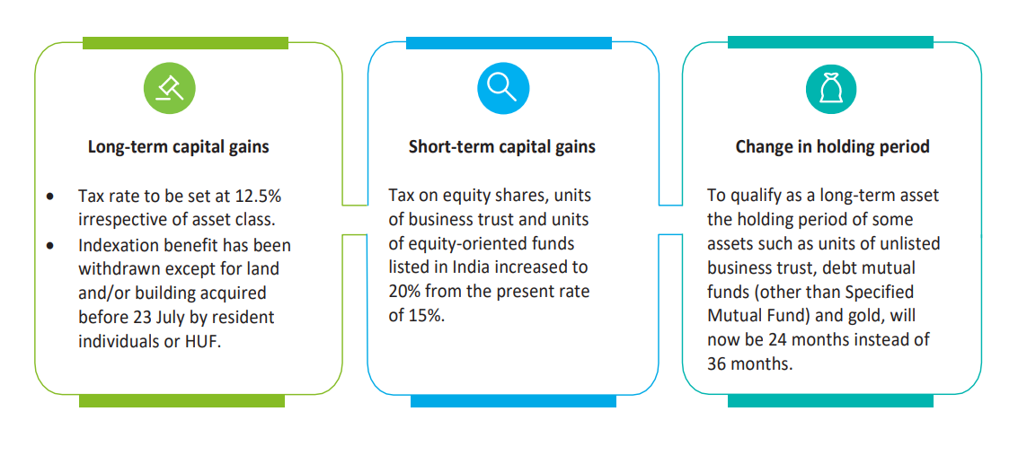
CAPITAL GAINS

Slide 7
87 A – REBATE – DEFAULT REGIME - INDIVIDUAL
AY 24-25
RS. 25,000
112,111A,
112A etc.
AY 25-26
RS.20,000 OR 25,000
112,111A,
112A etc
AY 26-27
RS.60,000
Proviso to 87A
ITB 2025
RS.60,000
BUDGET MEMORANDUM
CLAUSE
156 - Relief
156 (2) (b) – Marginal relief

Slide 8
Assets & Liabilities Threshold
Reporting required only if total income exceeds ₹1 crore (raised from previous limit).

Slide 9
What Documents do I Need to File ITR-2?
If you have a salary income, you need Form 16 issued by your employer.
If you have earned interest on fixed deposits or saving bank account and TDS has been deducted on the same, you need TDS certificates i.e., Form 16A issued by Deductors.
You will need Form 26AS to verify TDS on salary as well as TDS other than salary. Form 26AS could be downloaded from the e-filing portal.
If you are living in rented premises, you need rent paid receipts for the calculation of HRA (in case you have not submitted the same to your employer).
If you have any capital gains transactions in shares, you will need a summary or profit / loss statement of capital gain transactions of shares or securities during a year, if any, for computation of capital gain.
You will need your bank passbook, Fixed Deposit Receipts (FDRs) to calculate amount of interest income.
If you have received rent from your rented house property, then you will need your tenant / local tax payment/interest on borrowed capital details (if any) to calculate income from house property.
In case you want to claim any loss incurred during the current year, then you will need the relevant documents exhibiting the loss.
In case you wish to claim the previous year’s loss, you will need a copy of ITR-V pertaining to the previous year, disclosing the said loss.
You will also need documents or proofs for claiming tax saving deductions u/s 80C, 80D, 80G, and 80GG such as life and health insurance receipts, donation receipts, rent receipts, receipts for tuition fees etc., if the same were not considered in your Form 16.

