Slide 1
CHARITABLE INSTITUTIONS AND ITR 7
CMA AJITH SIVADAS
1

Slide 2
Coverage
OVERVIEW
FIRST REGIME TAXATION
SECOND REGIME TAXATION
STATUTORY PROVISIONS
2

Slide 3
OVER VIEW

Slide 4
SEC - 10 (23 C)
Hospitals or Educational Institution
Hospitals or Educational institutions
Government Support
Annual Receipts
If wholly or substantially (more than 50% of total receipts) financed by government
If not supported by Govt. but aggregate annual receipts is below 5 Crores.

Slide 5
SEC 10 (23 C)
Any University or Educational Institution existing solely for educational purposes and not for the purpose of profit Wholly or Substantially financed by Government
Any Hospital or Medical Institution existing solely for medical relief wholly or substantially financed by Government
Any University or Educational Institution having the Gross Receipts less than the prescribed limit which is 5Cr now
Any Hospital or Medical Institution having the Gross Receipts less than the prescribed limit which is 5Cr now

Slide 6
5. Any other fund having regard to the objects of the fund or institution and its importance throughout India or throughout any state or states. Approval to be obtained from the prescribed authority
6. Any trust or institution wholly for public religious purposes or wholly for Public religious and charitable purposes. Approval to be obtained from the prescribed authority
Any university or other educational institution solely for the educational purposes (Not financed by government) and which maybe approved by the Principal Commissioner
(via) Any Hospital or other medical institution solely for the Medical purposes (Not financed by government) and which maybe approved by the Principal Commissioner.

Slide 7
An educational institution having annual receipts of ` 3.80 crore during the P.Y. 2023-24, has availed exemption under section 10(23C)(iiiad). The Assessing Officer has denied the exemption on the grounds that the educational institution has not made any application to the prescribed authority for approval under the said section 10(23C)(iiiad). Examine the action of the Assessing Officer in denying the exemption.
As per section 10(23C)(iiiad), income of any university or other educational institution existing solely for educational purposes and not for purposes of profit would be exempt if the aggregate annual receipts of such university or educational institution do not exceed ` 5 crore. Therefore, the exemption available under this section can be availed without making any application to the prescribed authority. Therefore, the action of the Assessing Officer in denying the exemption to the educational institution is not correct.

Slide 8
A not for profit trust undertakes philanthropic activities through an educational institution and a hospital. During the P.Y. 2023-24, the trust had annual receipts of ` 3 crore from its educational institution and ` 4 crore from the hospital. During the P.Y. 2023-24, it desires to avail exemption under section 10(23C)(iiiad) and 10(23C)(iiiae), as the individual threshold under each of the subclauses, is less than ` 5 crore. Can it do so? Examine.
As per Explanation below to section 10(23C)(iiiae), it has been clarified that the limit of annual receipts of ` 5 crore is qua ‘taxpayer’ and not qua ‘activity’. Therefore, if the aggregate annual receipts from educational activity and medical activity exceeds ` 5 crores, then, exemption under sub-clause (iiiad) and (iiiae) cannot be availed by the trust.
Since, in the present case, the aggregate annual receipt of ` 7 crores (` 3 crores of educational institution and ` 4 crores from hospital) exceeds the threshold of ` 5 crores, exemption under section 10(23C)(iiiad) and (iiiae) cannot be availed, even though the individual receipts from educational institution and hospital have not exceeded ` 5 crores.

Slide 9
TYPES OF CHARITABLE INSTITUTIONS
TRUST
SOCIETIES
SECTION 8 COMPANIES
HINDU MATH
WAKF BOARD

Slide 10
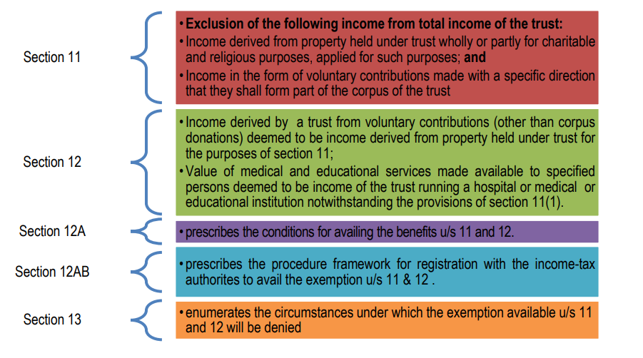

Slide 11
SEC 12 AB REGISTERED ENTITIES
01
Register under Income Tax:
To have a control over the trust by income tax department.
03
Need not apply balance 15%,
as it can be reserved without time limit.
05
If income not received or due to other reasons not applied,
Inform this in Form 9A before 139(1)- 2 months prior
Registration
Balance 15%
Deemed apply
Apply 85%
If 85% not applied
02
04
Invest the amount in modes of 11(5);
Inform % not applied to IT using Form 10 before 139(1), 2 months prior, Purpose & period upto 5 yrs.
Spent at least 85% of Income:
Wholly and exclusively for the purpose in India in the same year.

Slide 12

Charitable Purpose - Sec 2(15)
RELIEF OF POOR
MEDICAL RELIEF
PRESERVATION OF
ENVIRONMENT
Any other object of General Public Utility
Add a photo
EDUCATION
YOGA
PRESERVATION OF
MONUMENTS
Any other object of general public utility
It may include any activity in the nature of trade, commerce or business, but:
$) The activity carried out in the course of the charitable purpose other than GPU
$) Receipts from such activity shall not exceed 20% of total receipts.

Slide 13
Overview - Object of general public utility not to comprise receipts from trade, commerce, business etc.
There is no total embargo on commercial receipts. Receipts from these activities up to the following limits are acceptable
  AY 2009-10 to 2011-12: up to Rs. 10 lakhs/year
  AY 2012-13 to 2015-16: up to Rs. 25 lakhs/year
  From AY 2016-17: up to 20% of the total receipts
This embargo does not apply to
  Public religious trusts
  Charitable trusts carrying on the first five limbs of charity as defined in S. 2(15) – Circular 11/2008 dt 19.12.2008
Trade associations carrying out commercial activities will be hit – ACIT vs. Ahmedabad Urban Development Authority (SC) (2022) 143 taxmann.com 278 (SC) 19.10.2022
5

Slide 14
An institution having its main object as “advancement of general public utility” received ` 30 lakhs in aggregate during the P.Y.2023-24 from an activity in the nature of trade. The total receipts of the institution, including donations, was ` 140 lakhs. It applied 85% of its total receipts from such activity during the same year for its main object i.e., advancement of object of general public utility.
(i) What would be the tax consequence of such receipt and application thereof by the institution?
(ii) Would your answer be different if the institution’s total receipts had been ` 150 lakhs (instead of ` 140 lakhs) in aggregate during the P.Y.2023-24?
(iii) What would be your answer if the main object of the institution is “relief of the poor” and the institution receives` 30 lakhs from a trading activity, when its total receipts are ` 140 lakhs and applies 85% of the said receipts for its main object?

Slide 15
(i) As the main object of the institution is “advancement of object of general public utility”, the institution will lose its “charitable” status for the P.Y.2023-24, since it has received ` 30 lakhs from an activity in the nature of trade, which exceeds ` 28 lakhs, being 20% of the total receipts of the institution undertaking that activity for the previous year. The application of 85% of such receipt for its main object during the year would not help in retaining its “charitable” status for that year. The institution will lose its charitable status and consequently, the benefit of exemption of income for the P.Y.2023-24, irrespective of the fact that its approval is not withdrawn or its registration is not cancelled.

Slide 16
(ii) If the total receipt of the institution is ` 150 lakhs, and the institution receives ` 30 lakhs in aggregate from an activity in the nature of trade during the P.Y.2023-24, then it will not lose its “charitable” status since receipt of upto 20% of the total receipts of the institution in a year from such activity is permissible. The institution can claim exemption subject to fulfilment of other conditions under sections 11 to 13. Further, such activity should also be undertaken in the course of actual carrying out of such advancement of any other object of general public utility

Slide 17
(iii) The restriction regarding carrying on a trading activity for a cess, fee or other consideration will not apply if the main object of the institution is “relief of the poor”.
Therefore, receipt of ` 30 lakhs from a trading activity by such an institution will not affect its “charitable” status, even if it exceeds 20% of the total receipts of the institution. The institution can claim exemption subject to fulfilment of other conditions under sections 11 to 13.

Slide 18
Charitable trust engaged in business activity
- Section 11(4A) provides that the exemption under the respective regime, would be available in respect of income, being profits and gains from business activity if –– (a) such business is incidental to the attainment of the objects of the trust/institution; and (b) separate books of account are maintained by such trust/institution in respect of such business

Slide 19
Cases where trust property consists of a business undertaking
Section 11(4) clarifies that for the purposes of section 11, property held under trust may consist of a business undertaking so held. If that be so, the trustees may claim that the income of such undertaking enjoys exemption under section 11. Section 11(4) provides that –
(a) The Assessing Officer shall have the power to determine the income of the undertaking in accordance with the provisions of the Act relating to assessment, and
(b) Where the income determined by the Assessing Officer is in excess of that shown in the books of the undertaking, such excess shall be deemed to be applied to purposes other than charitable or religious purposes.

Slide 20
NSN, a charitable educational trust approved under section 10(23C)(vi), is running a school. It operates a stationery shop outside the school campus. A sum of ` 75 lakhs has been derived as net income from such business activity, which has been applied towards the objectives of the trust in providing education. The trust maintains separate books of accounts for the business activity. Examine the taxability of application of the income, if the income so derived relates to the previous year 2023-24.

Slide 21
The trust objective of providing education is a charitable purpose as per section 2(15). The trust in the given case runs a stationery shop business, whose income is applied towards the objectives of the trust. In this case, the business income from the stationery shop will be eligible to avail exemption in respect of profits and gains of business, if such business is incidental to the attainment of the objectives of the trust and separate books of account are maintained in respect of such business.
Therefore, in the given case, the profit from the business shall be eligible for exemption under section 11, assuming that the said business is incidental to the attainment of the objects of the trust (i.e., education) and books of account for such business activity is maintained separately.

Slide 22
Income from property held for charitable or religious purposes in India [Section 11(1)]
(a) Income derived from property held under trust wholly for charitable or religious purposes to the extent such income is applied in India for such purpose. Further, a minimum 85% of the income derived to be applied for charitable or religious purpose.
(b) Income derived from property held under trust in part only for such purpose, to the extent such income is applied in India for such purposes.
(c) Income derived from property held under trust,
- created on or after 1.4.1952 for charitable purpose which tends to promote international welfare in which India is interested to the extent to which such income is applied to such purpose outside India. This does not cover religious trusts.
- trust for charitable or religious purposes, created before 1.4.1952, to the extent to which such income is applied for such purposes outside India.
In both the cases, the CBDT should have, by general or special order, directed that such income shall not be included in the total income of the person in receipt of such income.
(d) Income in the form of voluntary contributions made with a specific direction that they shall form part of the corpus of the trust or institution.
Such voluntary contributions received as corpus must be invested or deposited in one or more of the forms or modes specified in section 11(5) maintained specifically for such corpus, for claim of exemption.

Slide 23
Voluntary Contributions [Section 12]
Any voluntary contribution received by a trust created wholly for charitable or religious purposes or by an institution established wholly for such purposes shall, for the purposes of section 11, be deemed to be income derived from property held under trust wholly for charitable or religious purposes. However, corpus donations (i.e., contributions made with a specific direction that they shall from part of the corpus of the trust or institution) shall not be treated as income, provided they are invested in the modes specified under section 11(5) [Section 12(1)].
The value of any services, being medical or educational services, made available by any charitable or religious trust running a hospital or medical institution or an educational institution, to any person referred under section 13(3), would be deemed to be income of such trust or institution derived from property held under trust wholly for charitable or religious purposes during the previous year in which such services are so provided and shall be chargeable to income-tax.

Slide 24
Conditions for availing exemption under First Regime and Second Regime
1. Approval/Registration for claiming exemption.
2. Mandatory filing of return
3. Maintenance of Books of account & Other Documents and Audit of accounts

Slide 25
Mandatory filing of return
In order to avail of exemption under any of these regimes, the entities approved under first regime and entities registered under second regime are required to file the return of income under section 139(4C) or under 139(4A), respectively within the time allowed under section 139(1) [i.e., on or before the due date of filing return of income] or section 139(4) [upto 31st December of the relevant assessment year], if the total income without giving effect to the provisions of
− section 10, in case of first regime approved entities or
− section 11 and 12 in case of second regime approved entities, exceeds the maximum amount which is not chargeable to income-tax.

Slide 26
Maintenance of Books of account & Other Documents and Audit of accounts
With effect from A.Y. 2023-24, where the total income of the trust or institution or fund referred under these two regimes without giving effect to the provisions of section 10(23C)(iv)/(v)(vi)(via) or section 11 and 12, as the case may be exceeds the maximum amount which is not chargeable to income-tax in any previous year, such entities shall
− keep and maintain books of account and other documents in such form and manner and at such place,
− get the accounts audited by a chartered accountant and the report of such audit in the prescribed form duly signed and verified by such accountant and setting forth such prescribed particulars, should be furnished on or before the specified date i.e., one month prior to the due date for filing return of income.

Slide 27
FORM 9A AND FORM 10
Where due to reason that whole or any part of the income has not been received during the year, the amount can be applied in the year of receipt or in the following year. However, intimation in writing must be sent to Assessing Officer (AO) in Form 9A before the expiry of time allowed u/s. 139(1) for furnishing the return of income. In case the amount is not applied, it will be deemed to be the income of previous year immediately following year of receipt [Explanation 1 to Section 11(1) & section 11(1B)].
Setting apart of funds with the specific purpose u/s.11(2) – for a period of 5 years:A charitable trust may opt for accumulating its income for a specific purpose to be spent in a period of 5 years. Trust should pass appropriate resolution for accumulation. The purpose of accumulation is to be specified to the Assessing Officer in Form No. 10 along with copy of resolution passed. If accumulated amount could not be applied due to order/ injunction of the court, such period will be excluded.

Slide 28
Examples of Condition - B
Scenario – 1 Income : 1,00,000/- Applied : 85,000/- Deemed apply : Nil |  | Scenario – 2 Income : 1,00,000/- Applied : 65,000/- Deemed apply : Nil |  | Scenario – 3 Income : 1,00,000/- Applied : 60,000/- Deemed apply : 12,000/- |  | Scenario – 4 Income : 1,00,000/- Applied : 60,000/- Deemed apply : 12,000/-
Particulars | Amount | Particulars | Amount | Particulars | Amount | Particulars | Amount
Income | 1,00,000/- | Income | 1,00,000/- | Income | 1,00,000/- | Income | 1,00,000/-
Application | 85,000/- | Application | 65,000/- | Application | 60,000/- | Application | 60,000/-
% applied | 85% | % applied | 65% | % applied | 60% | % applied | 60%
Reserve Accu. | 15,000/- | Reserve Accu. | 15,000/- | Reserve Accu. | 15,000/- | Reserve Accu. | 15,000/-
5 Year Accu. | Nil | 5 Year Accu. | 20,000/- | 5 Year Accu. | 13,000/- | 5 Year Accu. | 13,000/-
Form – 10 | Nil to filed | Form – 10 | Yes, 20,000/- | Form – 10 | Yes, 13,000/- | Form – 10 | Not submitted
Form – 9A | Nil to filed | Form – 9A | Nil to be filed | Form – 9A | Yes, 12,000/- | Form – 9A | Not submitted
Total Income | NIL | Total Income | NIL | Total Income | NIL | Total Income | 25,000/-

Slide 29
Amounts not treated as application of income or not allowable as deduction
Amount credited or paid out of income of any trust by way of corpus donation not to be considered as application [Explanation 2 to section 11(1)]
Only 85% of the amount credited or paid by way of donation (other than corpus donations) to another trust or institution out of current year income would be considered as application [Explanation 4(iii) to section 11(1)]
Amount credited or paid, out of accumulated income of any trust, to any trust or institution registered under section 12AA/12AB or referred to in section 10(23C)(iv)/(v)/(vi)/ (via), not considered as application of income [Explanation to section 11(2)]
Provisions of sections 40(a)(ia), 40A(3) and 40A(3A) apply in case of application of income by trust [Explanation 3 to section 11(1)]

Slide 30
Corpus donations utilised by fund/trust/institution towards its objects shall not be treated as application of income.
Application out of loan/borrowings not to be treated as application of income.
No set off or deduction allowable of any excess application of earlier previous year [Explanation 5 to section 11(1)]
No deduction for depreciation where cost of asset has been claimed as application of income
Expenditure allowed only on actual payment basis

Slide 31
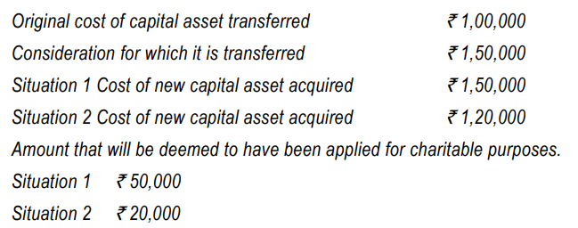
Transfer of a capital asset held under trust wholly for charitable or religious purposes [Section 11(1A)(a)]

Slide 32
Manner of computation of income of a trust violating certain conditions [Sections 13(10) & (11)]

Slide 33
Consequences of failure to comply with stipulated conditions:
With effect from A.Y.2023- 24, if a trust or an institution violates certain stipulated conditions, the income shall be chargeable to tax after allowing deduction for expenditure (other than capital expenditure) incurred in India for the objects of the trust/ institution.
The following are the violations:
- It has receipts from trade, commerce etc. while advancing the object of general public utility, in excess of 20% of total receipt; - It fails to maintain prescribed books of account;
- It fails to get its books of account audited and furnish audit report on or before the specified date;
- It fails to file return of income under section 139(4A) (or 139(4C), as the case may be, for the first regime trust) within the time stipulated under section 139(1) or 139(4).

Slide 34
Conditions to be fulfilled for claim of deduction of revenue expenditure
(a) such expenditure is not from the corpus standing to the credit of the trust or institution as on the end of the financial year immediately preceding the previous year relevant to the assessment year for which income is being computed;
(b) such expenditure is not from any loan or borrowing;
(c) there is no claim of depreciation on those assets, whose acquisition cost has been claimed as application of income in any previous year; and
(d) such expenditure is not in form of any contribution or donation to any person.

Slide 35
Disallowances:
(a) Capital expenditure is not allowed as a deduction.
(b) Disallowance under sections 40(a)(ia), on account of non-deduction of tax or nonpayment of tax deducted at source on or before the due date of filing of return, would be attracted
(c) Disallowance of expenditure in respect of cash payment in excess of `. 10,000 under section 40A(3) and 40A(3A) would be attracted .
(d) no deduction in respect of any expenditure or allowance or set-off of any loss shall be allowed to the assessee under any other provision of this Act.

Slide 36
Taxation of specified income of NPOs chargeable to tax by charitable trusts/institutions [Section 115BBI]
As per section 115BBI specified income of a trust/institution availing exemption under the first regime [section 10(23C)(iv)/(v)/(vi)/(via))] or second regime [Section 11], would be chargeable at the rate of 30%.

Slide 37
“Specified income” means:
(a) income accumulated or set apart in excess of 15% of the income, where such accumulation is not allowed under any specific provision of the Income-tax Act, 1961.
(b) deemed income on account of violation of certain conditions stipulated for accumulation of income under section 11(3) and corresponding provision in section 10(23C).
(c) deemed income on account of violation of deemed application provisions specified under 11(1B) read with Explanation 1 below to section 11(1).
(d) any income which is not exempt under section 10(23C) or section 11 on account of funds of the trust or institution invested otherwise in the forms and modes specified under section 11(5)
(e) any income which is applied for the benefit of any specified prohibited person referred to in section 13(3).
(f) any income derived from a property held under trust for a charitable purpose which tends to promote international welfare in which India is interested to the extent to which such income is not applied towards charitable purposes outside India.

Slide 38
Circumstances where levy of tax on accreted income is attracted – 115TD
The accreted income of a specified person shall be taxable at the maximum marginal rate(@34.944%) on
– (1) conversion into a form not eligible for grant of registration under section 12AA or section 12AB or approval under section 10(23C) (iv) /(v)/ (vi)/ (via); or
(2) merger with an entity not having similar objects and registered under section 12AA or section 12AB or approved under section 10(23C) (iv) /(v)/ (vi)/ (via); or
(3) non-distribution of assets on dissolution to any other specified person within a period of 12 months from the end of the month in which the dissolution takes place. This levy of exit tax shall be in addition to income chargeable in the hands of the entity.

Slide 39
Deemed conversion into non-eligible form - Circumstances:
(i) the registration granted to it under section 12AA or section 12AB or approval under section 10(23C) (iv) /(v)/ (vi)/ (via) has been cancelled; or
(ii) it has adopted or undertaken modification of its objects which do not conform to the conditions of registration and,— (a) it has not applied for fresh registration under section 12AA or section 12AB or approval under section 10(23C)(iv) /(v)/ (vi)/ (via) in the said previous year; or (b) it has filed application for fresh registration u/s 12AA or 12AB or approval under section 10(23C) (iv)/(v)/(vi)/(via) but the said application has been rejected; or
(iii) it has failed to make an application for – (a) reapproval/re-registration; or (b) renewal of approval/registration where the period of approval/registration is due to expire; or (c) final approval/registration within the period specified under clause (i)/(ii)/(iii) of the first proviso to section 10(23C) or clause (i)/(ii)/(iii) of section 12A(1)(ac), as the case may be, which expires in the said previous year.

Slide 40
Meaning of Accreted Income:
Aggregate FMV of total assets of the specified person as on the specified date
Less
Total liability of the specified person computed in accordance with the prescribed method of valuation [See Method of Valuation prescribed by CBDT given in pages 10.77 to 10.81]

Slide 41
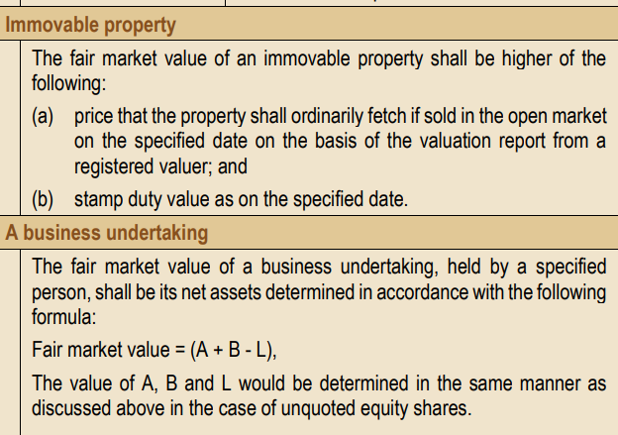

Slide 42
Overview - Pitfalls
Religious trust can do charity but a charitable trust cannot pursue religious objects – Charitable trust having mixed objects – very dangerous scenario
Problem situations – Charitable trust with religious objects, public religious trusts with private religious objects, benefits given to specified persons, trust property misused, amounts not invested in specified mode, problems in accounts, audit, Violation of other allied laws, ITR / TAR non filing etc. – Can lead to cancellation of registration and accreted tax.
Denial of exemption vs. cancellation of regn
42

Slide 43
Overview – source of income and application of income
Sources of income
  Voluntary Contributions (domestic / foreign)
  Income from property held under trust
  Corpus Donation (Donor direction, Investment u/s 11(5))
  Other income
  Income exempt under other sections (Agrl Inc, S 10(23C))
Application of income (Revenue or capital permissible)
  Not less than 85% of CY income to be applied in India for charitable or religious purposes (on cash basis).
  Spending from earlier year’s surplus, corpus donation, loans etc not treated as application of income
  Depreciation not deductible if cost of asset is claimed as application of income
43

Slide 44
Overview Accumulations of income
Section 11(1) – 15% of Income of CY
Explanation to S 11(1) – Accumulate till the year of receipt or next year, as the case may be. Option (Form 9 A) to be exercised within 2 months before the ITR due date. (income not recd or any other reason) – Delay upto 3 years (earlier 365 days) – Condonation – CIT – Cir 17/2022
Section 11(2) – Can be accumulated for a period up to 5 years. Option (Form 10) to be exercised within 2 months before the ITR due date. Invest as per S 11(5) – Delay upto 3 years (earlier 365 days)
– Condonation – CIT – Cir17/2022
8

Slide 45
Overview – other conditions
Trusts having business income – business should be incidental to objects, books to be maintained & income to be used for objects
Registration of trusts now compulsory u/s 12AB (10(23C) and 80G also as the case may be) – Earlier Sections 12A/12AA
Maintain books (Rule 17AA)
Audit and file audit report by due date (Form 10B / Form 10BB)
10 (23C) – 5 crore income institiutions – audit not required – ITR must
File ITR – 139(4A) (139(1) or 139(4) – circular 173/193/2019-ITA-I-23.04.2019 – File F 10, 10B and then ITR
9

Slide 46
Overview – Anonymous Donations (S. 115 BBC)
Donation where donor’s identity is unknown (be careful with UPI and imps fund transfers)
Not taxable in the case of religious trusts and religious and charitable trusts receiving anonymous donations for religious purposes.
For others anonymous donations are taxable at 30% + SC + Cess
Threshold limit – Rs. 1,00,000 or 5% of total donations, whichever is higher
10

Slide 47
Overview – Tax at special situations
When assessment of a year is completed without giving exemption – Assessed income of that year is taxable at MMR. This is a year to year affair. Note – AO cannot cancel regn.
Exit tax on conversion to non charitable trust or trust cease to exist – E.g. cancellation of registration, modification of objects without taking fresh registration etc. – Exit tax = Accreted income x MMR, where Accreted income is the value of net assets on the specified date.

Slide 48
RECENT AMENDMENTS
FINANCE ACT 2020
FINANCE ACT 2021
FINANCE ACT 2022
FINANCE ACT 2023

Slide 49
Finance Act 2020
Provisions regarding re-registration, provisional registration, regularisation of provisional registration etc. introduced in Sections 10(23C), 12AB & 80G. Cut off date got extended up to 31.03.2022 – Discussed elsewhere. Re registration time further extended to 25.11.2022. Again extended to 30.09.2023.
Audit reports – Form 10B or Form 10BB – now required to be e-filed 1 month prior to the ITR due date u/s 139(1) – earlier they need be filed only along with ITR (wef AY 2020- 21) – Refer circular 15/2022 & 16/2022 for CIT’s power to condone delay. – Forms have undergone change
Corpus donation given to other registered entities shall not be regarded as application of income u.s. 11 & 10(23C) – (wef AY 2020 – 21)
Section 80G – Filing of statement in respect of donors – Forms 10BD & 10BE – Cut off date got extended up to 30.06.2023 from 31.05.2023.

Slide 50
Finance Act 2021
Section 10(23C) – (iiiad) & (iiiae) – Small income institutions – Ceiling enhanced from Rs. 1 crore to Rs. 5 Crores (wef AY: 2022 – 23)
Amendment common to S 11 and S 10(23C) – wef AY: 2022 – 23
  Corpus donations must be invested in S 11(5) modes
  Amounts spent from the following sources will not be allowed as application of income
    Corpus donation
    Income accumulated to the extent of 15% year to year
    Loans.
However when the funds are replenished or loan is repaid, application disallowed can be claimed as deduction
  Excess application of earlier years cannot be set off

Slide 51
FA: 2022 – Amendments to bring consistency
A trust/institution is required to apply at least 85 percent of its income towards charitable activities in a particular year. However, in the event this threshold is not met, the law allows for accumulation of funds to be applied for charitable purposes in the future years (not exceeding 5 years). Such accumulation is subject to certain conditions (S 11(2) / 11(5) etc). Now, such conditions are made applicable to 10(23C) cases also. (AY 2023-24)
Currently, under the 12A regime, income diverted/excessive benefits provided to trustees/other specified persons result in such amount becoming taxable for the trust/institution. Now, such conditions are made applicable to 10(23C) cases also. (AY: 2023 – 24)
Currently, under the 12A regime, there is a requirement to file a Return of Income for claiming exemption. Now, such a condition is made applicable to 10(23C) cases also. (AY 2023 – 24)
Currenly, re-organisation (i.e., conversion, merger or transfer of assets on dissolution) of trusts/institutions governed by 12A regime with any non- qualifying entity (i.e., an entity that is not governed by either of the regimes) triggers a taxation under the accreted income provisions. Now, the accreted
income provisions are made applicable to 10(23C) regime as well. AY 2023-24
15

Slide 52
FA 2022 - Period of utilisation of accumulation
A trust/institution is required to apply at least 85 percent of its income towards charitable activities in a particular year. However, in the event this threshold is not met, the law allows for the accumulation of funds to be applied for charitable purposes in the future years (not exceeding 5 years), subject to certain conditions.
Before Amendment , such accumulated funds can be applied even in the year subsequent to the previous year upto which accumulation is done—if it is not used in such subsequent year as well, then the funds not applied become taxable in such subsequent year.
Now, the option of allowing application in such subsequent year is done away with — therefore, if the accumulated funds are not entirely applied up to the previous year of accumulation, then the funds not applied become taxable in such last year.

Slide 53
FA 2022 – Application of income to be reckoned only on ‘payment’ basis
Currently, there is no explicit provision determining the manner of reckoning the application of income (i.e., either accrual basis or cash basis could be followed).
Now, it is proposed that the application of income shall be reckoned only on ‘payment’ basis.
This change is proposed to be effective from FY 2021−22 itself. (AY: 2022 – 23)
Closing balances of creditors and accounts payable must be reduced from application of income. In the first year we cannot add thereto opening balance of creditors and accounts payable. Whether advances paid could be deducted is a debatable point.

Slide 54
FA: 2022 – Computation of taxable income resulting on account of certain prescribed non-compliances
AY 2023 – 24 onwards
Currently, there is no explicit provision determining the manner of computation of taxable income resulting on account of non-compliances. Presently officers tax the gross receipts without allowing application of income.
Now, it is provided that the taxable income resulting on account of prescribed non- compliances (such as (a) not maintaining prescribed books of accounts, (b) not filing the Return of Income, and (c)carrying on commercial activities for consideration beyond the prescribed threshold of 20%) shall be computed after
allowing deduction of
following conditions:
revenue expenditure incurred in India, but subject to the
Expenditure should not be a donation or contribution to any person.
Expenditure incurred without withholding appropriate tax or expenditure incurred in cash beyond the prescribed threshold shall not be allowed.
Expenditure incurred from the corpus or any loan or borrowing shall not be
allowed.
Depreciation on an asset, the cost of which is claimed as application of income in any year, shall not be allowed.

Slide 55
FA: 2022 – New tax rate prescribed for certain specified income – 115BBI
Currently, there is an ambiguity on the tax rate that applies, where certain specified incomes of the trust/ institution become taxable.
Now, it is provided that specified income (resulting from violations such as (i) accumulation of funds for prohibited
purposes, (ii) partial application of accumulated funds, (iii) deployment of (iv)
to
funds in prohibited investments, and
diversion of income/provision
of excessive benefits
trustees/other specified persons) would be taxable at a flat rate of 30 percent (plus applicable surcharge if any and cess) without reduction of any expenditure or allowances or set off of losses.
Other incomes (if any) of the trust/institution will be taxable per the currently applicable provisions.

Slide 56
FA: 2022 – Proportionate income (instead of entire income) now made taxable on account of prescribed non- compliance
It is provided that if trust/institution diverts income/ provides excessive benefits to trustees/other specified persons or deploys its funds in prohibited investments only that part of income that is diverted/regarded as excessive benefit/deployed in prohibited investments would be taxable. (items iii & iv) in the previous slide
This position has been upheld in certain rulings even
before the amendment. As discussed
above, 30
such percent
income will be taxable at a flat rate of without any deductions.
20

Slide 57
FA 2022: – Penalty for
of excessive
specified persons - Section 271 AAE
A trust/institution will be liable to penalty for diversion of income/provision of excessive benefits to trustees/ other specified persons.
The penalty will be equal to 100 percent of the amount diverted in case of the first instance and will go up to 200 percent of the amount diverted in case of violations in subsequent years.
This penalty will be in addition to any other penalties that may be levied under the existing law.

Slide 58
FA: 2022 – Streamlining of the administrative/procedural framework
Maintenance of the prescribed books of accounts
– Where the total income of the trust/institution exceeds the basic exemption limit, it is required to get its books of accounts audited.
– Currently, there
are no specificbooks of accounts that
the trust/institution is required to maintain.
– Now, it is proposed that such a trust/institution would be required to maintain the prescribed books of accounts.
Reference is made in Form 10B and 10BB Forms
Rule 17AA notified on 10.08.2022 – Refer notification GSR
622(E) dated 10.08.2022

Slide 59
Summary of Rule 17AA
Every charitable institution is required to keep and maintain the following books of accounts and other documents:
  Books of account including the cash book, ledger, journal, copies of bills, original bills, and any other books.
  Books of account for a business undertaking and business carried on by assessee
  Other documents for maintaining a record of:
    All projects and Institutions run by the person containing details of the name address and objectives
    Income in respect of voluntary contribution containing details of donor
    income from property held under trust along with the list of such property and other income of institution or trust, etc
    The application of income in and outside India, deemed application of income, income accumulated or set apart, money invested in the specified mode etc
    Voluntary contribution received and its application
    Loans and borrowings
    Properties held by trust
    The specified person

Slide 60
Summary of Rule 17AA contd…
Mode in which documents may be kept
The books of account and other documents may be kept in written form, electronic form, digital form or as printouts of data stored digitally
Place where to be kept
The books of account and other documents shall be kept and maintained by the entities at their registered office. However books may be kept in another place if management decides to do so by passing a resolution.
Period for which books to be maintained
The books of account and other documents shall be kept and maintained for 10 years from the end of the relevant assessment year

Slide 61
FA : 2022 – Withdrawal of registration/approval provisions revamped
The provisions dealing with withdrawal of the registration/approval of a trust/institution have been revamped.
Notably, the new provisions enumerate certain ‘specified
violations’ that will lead to a withdrawal
of the registration/approval—amongst
them is the
having a business that is not incidental to
material
attainment of its objectives,
non-
compliances in other legislations, etc.

Slide 62
Finance Act 2023
For the discussions below
Regime 1 | Entities referred to in section 10(23C)(iv) – Approved charitable trust 10(23C)(v) – Public religious or religious / charitable trust 10(23C)(vi) – University / Educational Institutions 10(23C)(via) – Hospital / Medical institutions
Regime 2 | 12AA / 12AB registered entities

Slide 63
FA 2023 – Allowability vis-a- vis depositing back of amount spent from corpus
Section: Regimes 1 & 2 | Clause of FB: 5 | Effective date: AY 2023 – 24
Discussion Amount spent from corpus donation is not allowed as deduction. But if amount spent from corpus donation is replenished from income it can be claimed as application subject to conditions
Proposal

Slide 64
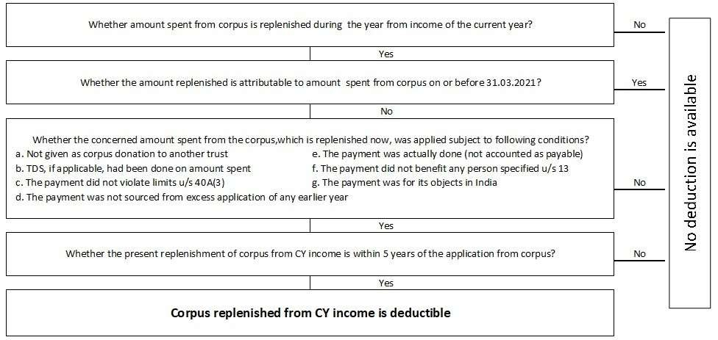

Slide 65
FA 2023 – Allowability vis-a- vis repayment of loan
Section: Regimes 1 & 2 | Clause of FB: 7 | Effective date: AY 2023 – 24
Discussion Amount spent from loan is not allowed as deduction. But if the loan is repaid from income it can be claimed as application subject to conditions
Proposal

Slide 66
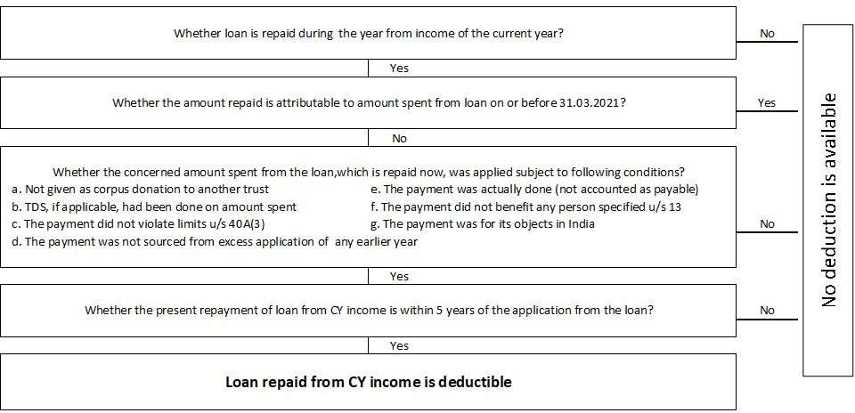
30

Slide 67
FA – 2023 Treatment of donation to other trusts
Section: Regimes 1 & 2 | Clause of FB: 5 & 7 | Effective date: AY 2024 – 25
Discussion Certain trusts falling within a group roll funds from one trust to another by way of donation so that each trust in the loop gets the benefit of accumulating 15% of the respective donation E.g. Trusts A to E are under same group. Trust A’s income of Rs. 1,00,000 is donated to Trust B. Trust B donates Rs. 85,000 (85% of Rs. 1,00,000) to Trust C. Trust C donates Rs. 72,250 (85% of Rs. 85,000) to Trust D. Trust D donates Rs. 61,413 (i.e. 85% of Rs. 72,250) to Trust E. Now Trust E has to apply Rs. 52,201 (i.e. 85% of Rs. 61,413). However, this effectively is only 52% of A’s income of Rs. 1,00,000.
Proposal It is proposed that only 85% of eligible donations made by a trust or institution in the first regime or second regime to another trust or institution in the first regime or second regime shall be treated as application in the hands of the donor.
31

Slide 68
FA 2023 - Omission of certain provisions relating to dating back of exemption
Section: Regimes 1 & 2 | Clause of FB: 8 | Effective date: 01.04.2023
Discussion Section 12A(2): Once registered under section 12AA or 12AB, exemption shall be available to the trust from the assessment year relevant to the financial year in which application for registration was made. Section 12A(2) 2nd proviso – Once registration is granted u/s 12AA or 12AB, that status quo should be applied in all pending assessments of earlier years. Section 12A(2) 3rd proviso - Once registration is granted u/s 12AA or 12AB, earlier year’s assessments should not be reopened just because the trust was not registered in those years Section 12A(2) 4th proviso – Trust will not get any immunity if registration is cancelled or application for registration is rejected
32

Slide 69
Proposal
Second and third provisos are taken away – i.e. henceforth there is no immunity vis- à-vis earlier years for an already existing trust that applies for registration for the first time.
Fourth proviso is also omitted.
33

Slide 70
FA 2023 - Regarding provisional / regular registration / approval
Section: Regimes 1 & 2 & 80G | Clause of FB: 5,8,9,40 | Effective date: 01.10.2023
Discussion Situation 1 : Trusts or institutions formed or incorporated during the previous year are not able to get exemption in the year of formation because they are required to apply for registration or approval at least one month before the previous year for which exemption is sought. Situation 2 Trusts / Institutions, where activities have already commenced, are required to apply for two registrations / approvals (i.e. provisional and regular) simultaneously.
34

Slide 71
Proposal
In Situation 1
Henceforth, the trusts / institutions shall be allowed to make application for provisional registration / approval before the commencement of activities.
In Situation 2
The trusts / institutions that have already commenced their activities, shall make application for regular approval / registration (i.e. provisional can be skipped). IT authorities’ powers are also spelt out.
35

Slide 72
FA 2023 - Violations vis-à-vis the new registration / approval regime
Section: Regimes 1 & 2 & 80G | Clause of FB: 5 & 9 | Effective date: 01.04.2023
Discussion The process of granting provisional approval / registration for new trust and the reregistration / re approval of already registered / approved trusts / institutions are automated. Application is filed in the portal and provisional approval / registration or re approval /re registration in such cases is granted in an automated manner without verification.
Proposal In many cases it is found that applications are defective, not complete and contain incorrect particulars Therefore, proposal is made to empower CIT / PCIT to cancel the registration / approval when application referred to above is incomplete or it contains false or incorrect information.
36

Slide 73
FA 2023 - Trusts / Institutions not filing application in certain cases
Section: Regimes 1 & 2 | Clause of FB: 57 | Effective date: AY 2023-24
Discussion Certain existing registered / approved trusts have not made application for re- registration or re approval Certain provisionally registered / approved trusts have not made application for regular registration Likely scenario in future – A trust registered / approved for 5 years may not apply for re registration or re approval Section 115TD provides for levy of exit tax on accreted income when a charitable trust gets converted to a non charitable trust in the manner laid down in the Act. By not applying for regular registration / approval or re registration or re approval the trust gets and easy route to exit without payment of exit tax.
37

Slide 74
Proposal
Amendment is proposed in Section 115TD
If the trust fails to make application for re registration or re approval or regular registration or regular approval within the stipulated time, it shall be deemed to have been converted into any form that is not eligible for registration or approval. It will attract exit tax.
Procedural part and definition part are also amended.
38

Slide 75
FA 2023 - Alignment of ITR, Accumulation and Audit report due dates
Section: Regimes 1 & 2 | Clause of FB: 5 and 7 | Effective date: AY 2023-24
Discussion (Also see Circular dated 24.05.2023) Presently
Due date for | Due date | Remarks
ITR | 31st July | where there is no audit
 | 31st October | where there is audit
Accumulation | same as ITR due date | Form 10 (section 11) / Form 9 A (section 10 (23C))
Audit report | 1 month prior to ITR due date i.e. 30th September | Form 10 B (section 11) / Form 10 BB (section 10 (23C))
39

Slide 76
Proposal
Due date for filing Form No 10 / 9 A is made 2 month prior to
ITR due date ( 31st August in audit cases and 31st May in non- audit cases) – Also see Circular 6 / 2023 dated 24.05.2023
Reason as per Memorandum explaining the provisions – “The
auditors are required to report the details of form 10/9A in the
audit report. Since the due date for furnishing form 9A/10 (It should have been Form 10 B / 10 BB) is one month before the due date of furnishing the ITR, auditors find it difficult to report”
40

Slide 77
FA 2023 No exemption if return is not filed
Section: Regimes 1 & 2 | Clause of FB: 5 & 8 | Effective date: AY 2023- 24
Discussion With the introduction of the scheme of filing updated return under section 139 (8A), there arose an unintended situation wherein trusts filing updated returns became eligible for exemption.
Proposal It is clarified that exemption will be available only if the return of income is filed under section 139 (1) or 139 (4)

Slide 78
FA 2023 - Section 80 G
Section: 80 G | Clause of FB: 40 | Effective date: AY 2024-25
Discussion Section 80G gives a list of certain specified donees.
Proposal Following 3 institutions are removed from the list of eligible donees 80 G (2) (a) (ii) – Jawaharlal Nehru Memorial Fund 80 G (2) (a) (iii c) – Indira Gandhi Memorial Trust 80 G (2) (a) (iii d) – Rajiv Gandhi Foundation

Slide 79
DUE DATES FOR AY 23 -24
Types of Person | Due Date for ITR Filing 2023-24 | Types of ITR/ FORM
Charitable Trust | 31st May 2024 | Form 10BD-10BE - Statement of Donations
Charitable Trust | 31st July 2024 | ITR 7
Charitable Trust | 31st August 2024 | Form 9A - Application of income of previous year in the next year or in future
Charitable Trust | 31st August 2024 | Form 10 - Accumulation of income for future application for 5 years
Charitable Trust | 30th September 2024 | Audit Report with Charity Commissioner.
Charitable Trust | 31st October 2024 | ITR 7 in case Trust is applicable to 10B/10BB
Charitable Trust | 30th September 2024 | Audit under Income Tax - Form 10B/10BB

Slide 80
CHANGES IN ITR 2024-25.

Slide 81
THANK YOU

