Slide 1
ASSESSMENT UNDER SECTION 143(3)
OF THE INCOME TAX ACT, 1961
BY CMA AJITH SIVADAS

Slide 2

Every taxpayer has to furnish the details of his income to the Income-tax Department. These details are to be furnished by filing up his return of income.
Once the return of income is filed up by the taxpayer, the next step is the processing of the return of income by the Income Tax Department.
WHAT IS ASSESSMENT UNDER INCOME TAX ACT?
The process of examining the return of income by the Income- Tax department is called as “Assessment”.
Assessment also includes re-assessment and best judgment assessment under section 144.

Slide 3



What is Assessment Procedure ?
Assessment simply means determination of Tax
It is Procedure for determining of Tax Liability and Recovery of Tax
This is determined as per Taxation law existing in that particular Assessment Year
How Much did you earn ?
File your ROI
Checking your ITR by Dept

Slide 4
TYPES OF ASSESMENTS
Self Assessment
Summary Assessment(sec 143(1))
Scrutiny assessment.(Sec -143(3))
Best Judgement Assessment(Sec-144)
Income Escaping Assessment(Sec 147)

Slide 5
This is a detailed assessment and is referred to as scrutiny assessment
At this stage a detailed scrutiny of the return of income will be carried out is to confirm the correctness and genuineness of various claims, deductions, etc., made by the taxpayer in the return of income.
Scrutiny assessment
U/s 143(3)

Slide 6
An income tax return has been filed under Section 139 or in response to an income tax notice under Section 142(1).
.
The Assessing Officer or Income Tax Authority deems it necessary or expedient to ensure that the taxpayer has not understated the income or has not computed excessive loss or has not under-paid income tax in any manner
Applicability of Scrutiny Assessment

Slide 7
Purpose of Scrutiny Assessment
To ensure that there is no Understated income, or
To ensure that there is no Computation of excessive loss, or
To ensure that there is no Underpaid tax in any manner.

Slide 8
Computer Aided Scrutiny Selection (CASS):.
Cases are also being selected under CASS on the basis of broad based selection filters. List of such cases shall be separately intimated in due course by the DGIT(Systerns) to the jurisdictional authorities concerned. The cases for this purpose are mostly selected through the process of computer assisted scrutiny selection (CASS) and there is no element of subjectivity in this process

Slide 9


Limited Scrutiny U/s 143(3)
CASS- Computer Assisted Scrutiny Selection
The Central Board of Direct Taxes (‘CBDT’),Vide Instruction No.7/2014 Dated 26-9-2014 had clarified the Extent of enquiry in certain category of cases Specified there in, Which are selected for Scrutiny through CASS.
Reasons for selection of case under CASS are – mismatch of ITR Data with AIR information/CIB/26AS
Recent Circulars and Notifications – Instruction No. 20/2015 Dated 29/12/2015
AO Should communicate the Reasons/issues for which the file has been selected in CASS
The Questionnaire under section 142(1)(ii) of the act in ‘Limited Scrutiny’ Cases shall remain confined only
To the specific reasons/ issues for which case has been picked up for scrutiny. Further, the scope of enquiry, Shall be restricted to the ‘Limited Scrutiny’ issues.
Notes:
9

Slide 10
Limited Scrutiny
CONVERT
Complete Scrutiny
During the course assessment proceedings in ‘limited Scrutiny’ cases, if:
It comes to the notice of the Assessing officer that there is potential escapement of income exceeding Rs.5 Lac/10 Lac ( for metro cities ) requiring substantial verification on any other issue (S), then, the case may be taken up for ‘Complete Scrutiny ‘ with the approval of the Pr. CIT/CIT Concerned.
The AO has to take approval of Pr. CIT/CIT in writing after being satisfied about merits of the issue [ S ] necessitating ‘complete Scrutiny ‘ in that particular case.
‘Metro cities ‘ would mean Delhi, Mumbai, Chennai, Kolkata, Bengaluru, Hyderabad and Ahmedabad.

Slide 11
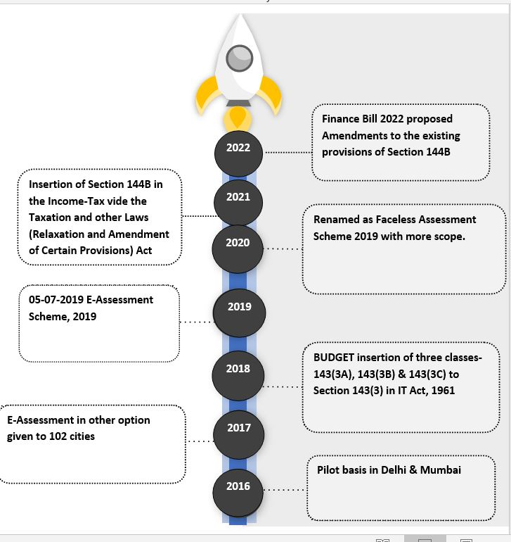

Slide 12

Time-limit
As per Section 153, the time limit for making assessment under section 143(3) is:-
18 months from the end of the assessment year in which the income was first [for assessment year 2018-19
12 months from the end of the assessment year in which the income was first assessable [Applicable for assessment year 2019-20 and assessment year 2020- 21]
Within 9 months from end of the assessment year in which income was first [Applicable for assessment year 2021-22 and onwards]

Slide 13
AMENDMENDS in section 143 w.e.f 1st April 2021
Where a return has been furnished under section 139, or in response to a notice under sub-section (1) of section 142, the Assessing Officer or the prescribed income-tax authority, as the case may be, if, considers it necessary or expedient to ensure that the assessee has not understated the income or has not computed excessive loss or has not under-paid the tax in any manner, shall serve on the assessee a notice requiring him, on a date to be specified therein, either to attend the office of the Assessing Officer or to produce, or cause to be produced before the Assessing Officer any evidence on which the assessee may rely in support of the return
Provided that no notice under this sub-section shall be served on the assessee after the expiry of [three] months from the end of the financial year in which the return is furnished.(Inserted w.e.f 01-04-2021 by the finance bill 2021)

Slide 14
SECTION 144B
FACELESS ASSESSMENT
Faceless Assessment is a part of e-governance initiative of the Government of India.
To do scrutiny proceeding under section 143(3) / 147.
To be conducted in a faceless and jurisdiction-less manner.
Through the electronic means of communication via e-proceedings functionality.
No physical/personal interface between the assesee and the assessing authority.

Slide 15
FEATURES
The case selection will be through the system using data analytics & Artificial Intelligence
Automated random allocation of cases
Abolition of Territorial jurisdiction
Central issuance of notices with Document Identification Number (DIN)
Team-based assessment & reviews
No physical interface, meaning no need to visit Income Tax office
FEATURES

Slide 16
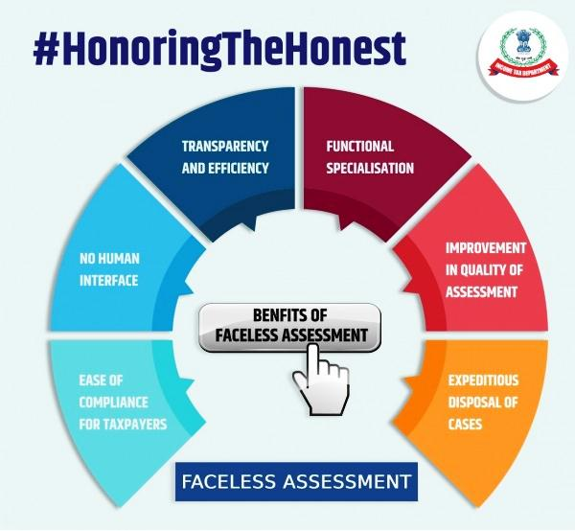
BENEFITS

Slide 17
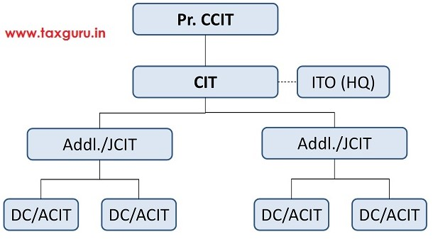
National E-Assessment Centre

Slide 18
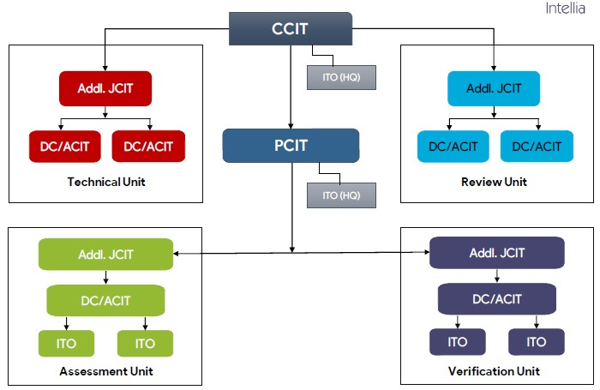
Regional E-Assessment Centres

Slide 19
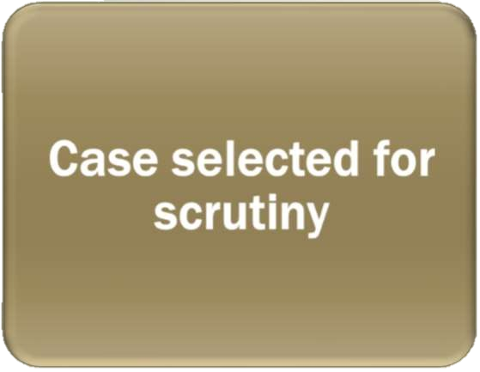

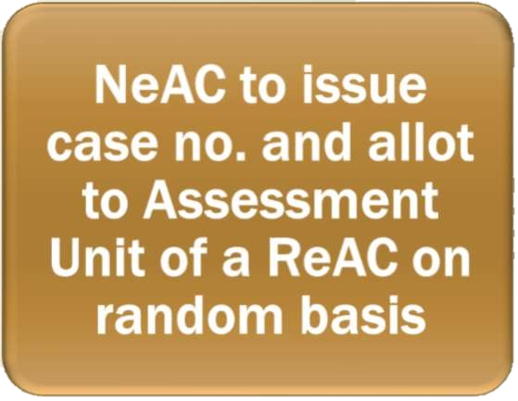



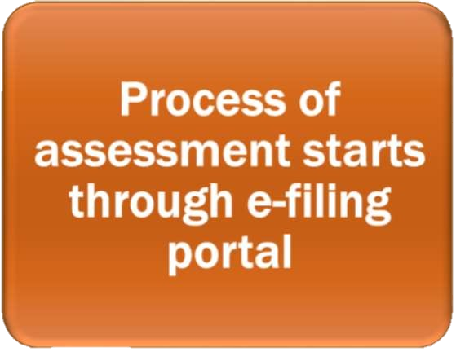
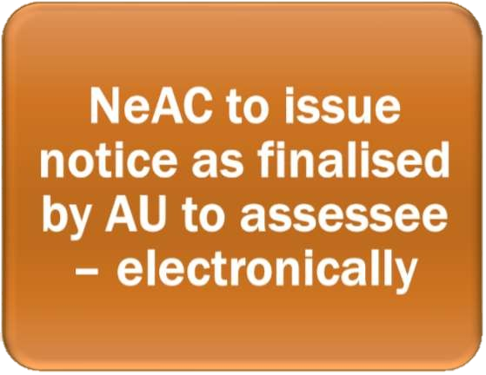
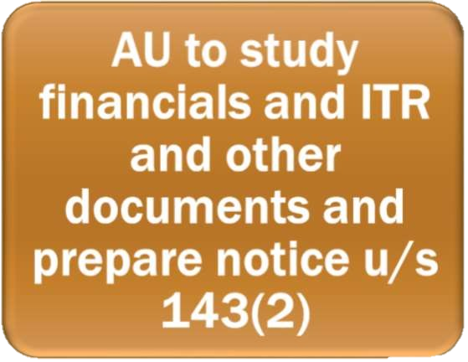


INITIAL PROCESS IN FACELESS ENVIRONMENT

Slide 20
Notice and Response
National e Assessment Centre shall serve a notice on the assessee under section 143(2).
Such Notice shall specify the issues selected for assessment.
ACIT (e Verification), having headquarter at Delhi, to act as prescribed Income tax Authority for the purpose of section 143(2).
Assessee may, within fifteen days from the date of receipt of notice, file his response to the NeAC.

Slide 21
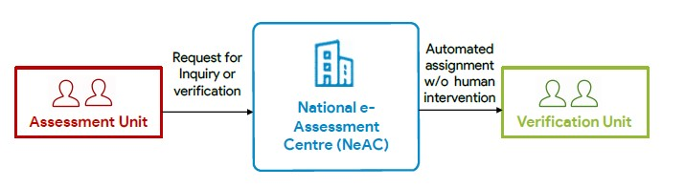
Enquiry or Verification
Request for conducting of certain enquiry or verification by the verification unit can be made by the assessment unit.
Such requests shall be assigned by the NeAC to a verification unit through an automated allocation system.

Slide 22
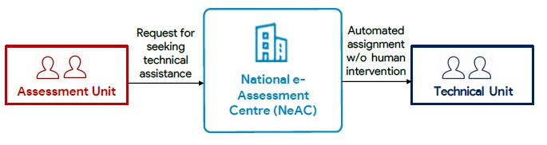
Technical assistance to Assessment Units
Assessment units may place a request for technical assistance from the technical unit to NeAC.
Such request shall be assigned by the NeAC to a technical unit in any one ReAC through an automated allocation system.

Slide 23
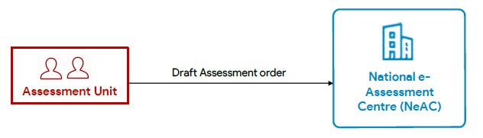
Assessment Orders
Assessment unit shall, after taking into account all the relevant material available on the record, make in writing, a draft assessment order either accepting the returned income of the assessee or modifying the returned income of the assesse, as the case may be, and send a copy of such order to the NeAC.
The assessment unit shall, while making draft assessment order, provide details of the penalty proceedings to be initiated therein, if any;

Slide 24
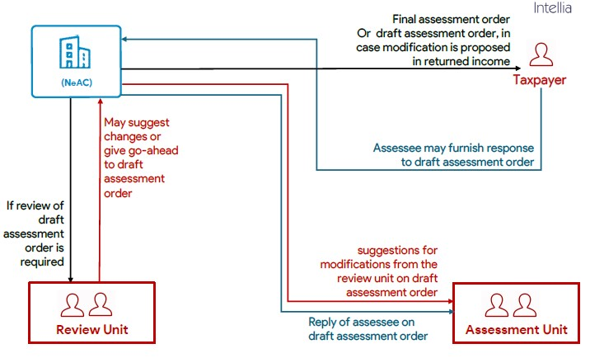
Assessment Orders

Slide 25
PROCEDURE IN FACELESS ENVIRONMENT
National E-assessment Centre (NeAC)
Issue of Notice u/s 143(2)
Assessee
Submit e-Response within 15 days to
National E-assessment Centre (NeAC)
Assigns the case randomly to
Assessment Unit at Regional E-assessment Centre
Asks NEC to Connect with Assessee or Verification Unit or Technical Unit
National E-assessment Centre (NeAC)
Connects with
Assessee
(For obtaining information)
Verification Unit
(For verifying information)
Technical Unit
(For technical inputs)
National E-assessment Centre (NeAC)

Slide 26
National E-assessment Centre (NeAC)
New Assessment Unit at ReAC
Assessment Unit at ReAC
On the basis of inputs prepare draft assessment order & send to
National E-assessment Centre (NeAC)
Review Unit
If Prejudicial to Assessee?
Yes
Suggest any Modifications?
No
Yes
No
On Request of assessee may provide Opportunity of
Personal Hearing via Video Telephony
Yes
Response by Assessee?
No
Finalise the Assessment Order
& Sends to
Jurisdictional Assessing Officer
Assessee

Slide 27
ISSUES - DEPARTMENT
Robust & secure data servers for storage of data gathered at level of NeAC & ReACs
Requisite Internet band width & secured communication channels for implementation
Availability/Development of facilities to support video conferencing and/or video telephony
Capability of handling bulk submission online and resolving real time technical glitches
Development of systems for Automated allocation of cases to ReACs.
Adequate training

Slide 28
ISSUES - ASSESSEES
Necessity to keep address, email-id & mobile number updated in the Income tax database
Lot of time & cost may be consumed in digitizing physical data.
Hardships faced on account of Technical glitches due to lack of appropriate IT infrastructure.
Ability to differentiate between genuine communication received from department vis-a vis fake communication
Basic understanding of operation of this scheme

Slide 29
PROS/ CONS
Saving of Time and Money of AR
Not to face mood swings of AOs
Assessment records available
Change of Satisfaction Mode !!
Whose Satisfaction now – NeAC or AU or Officer of AU !!!!
AO did not remain AO in many cases – Instructions based assessments !!!!

Slide 30


