Slide 1
REASSESSMENT U/S 147
INRELATION TO NOTICE U/S 148
UNDER THE INCOME TAX ACT,1961
AND
REPLY THEREOF

Slide 2
By virtue of the Constitutional right under Article 265 of the Constitution of India ‘No tax shall be levied or collected except by authority of law’.
An assessee of any civilized country is bound to pay the tax to the government for which he is liable under the law. The Government on the other hand is obliged to collect only that amount of tax which is lawfully payable by an assessee.
The entire object of administration of tax is to secure the revenue for the development of the Country and not charge assessee more tax than that which is due and payable by the assessee.

Slide 3
Under the new regime, it is obligatory for the AO to Issue Notice U/s 148A(b) to the assesse, containing the information along with adverse material purporting escapement of income, which can be countered by the assesse by way material and evidences available with him. This is a major change qua the old provisions in which this information (reasons for re-opening and satisfaction recorded) was made available to the assesse after issuance of notice U/s 148 of the erstwhile regime and filing of return of the Income by the assesse.
Section: 148A,148A(a),148A(b),148A(c ) and lastly 148A(d) GKN Drive Shafts India Ltd.Vs. ITO [2003] 259,ITR 19

Slide 4
To curb the black money the Income-tax Act, 1961 has provided rigorous powers to the revenue department to recover the tax demand including the power to arrest and detain is provided under the Act. Hence it's highly important to understand the provisions for due maintenance of the Accounts and assessment thereof under the Income Tax Act.
The legislatures amended the provisions of section 148 w.e.f. 1 April 2021 making it mandatory to follow the procedures as stipulated U/s 148A, prior to issue of notice U/s 148. Under the new regime, an opportunity is provided by the revenue to the assesse by issuing a notice u/s 148A, which requires the assesse to explain his case and to get the proceedings dropped with the satisfaction of the AO.

Slide 5
Relevant Provisions
Article 265 Constitution of India as mother law
Section 135 Director of Inspection,Commissioner
Section 148A Notice and Order prior to Section 148
Section 148 – Assessment/Reassessment
Section 149 - Time Limit
Section 151 – Approval of the Appropriate authority
Issue: Reason to believe and not any Reason to Suspect

Slide 6
148A. The Assessing Officer shall, before issuing any notice under section 148, —
conduct any enquiry, if required, with the prior approval of specified authority, with respect to the information which suggests that the income chargeable to tax has escaped assessment;
provide an opportunity of being heard to the assesse, by serving upon him a notice to show cause within such time, as may be specified in the notice, being not less than seven days and but not exceeding thirty days from the date on which such notice is issued, or such time, as may be extended by him on the basis of an application in this behalf, as to why a notice under section 148 should not be issued on the basis of information which suggests that income chargeable to tax has escaped assessment in his case for the relevant assessment year and results of enquiry conducted, if any, as per clause (a);
(b) Issuance of Show cause notice
consider the reply of assesse furnished, if any, in response to the show-cause notice referred to in clause (b);

Slide 7
(c ) decide, on the basis of material available on record including reply of the assesse, whether or not it is a fit case to issue a notice under section 148, by passing an order, with the prior approval of specified authority, within one month from the end of the month in which the reply referred to in clause (c) is received by him, or where no such reply is furnished, within one month from the end of the month in which time or extended time allowed to furnish a reply as per clause (b) expires:
Provided that the provisions of this section shall not apply in a case where, —
the Assessing Officer is satisfied, with the prior approval of the Principal Commissioner or Commissioner that any money, bullion, Jewellery or other valuable article or thing, seized in a search under section 132 or requisitioned under section 132A, in the case of any other person on or after the 1st day of April, 2021, belongs to the assesse; or
the Assessing Officer is satisfied, with the prior approval of the Principal Commissioner or Commissioner that any books of account or documents, seized in a search under section 132 or requisitioned under section 132A, in case of any other person on or after the 1st day of April, 2021, pertains or pertain to, or any information contained therein, relate to, the assesse; or
the Assessing Officer has received any information under the scheme notified under section 135A pertaining to income chargeable to tax escaping assessment for any assessment year in the case of the assesse.

Slide 8
The Assessing Officer before issuing notice conduct an enquiry , if required, with the prior approval of the specified authority, with respect to the information in his possession, which suggests that the income chargeable to tax has escaped assessment.
Explanation – 1 to section 148 clarifies the nature of information as follows:
any information in the case of the assesse for the relevant assessment year in accordance with the risk management strategy formulated by the Board from time to time;
any audit objection to the effect that the assessment in the case of the assesse for the relevant assessment year has not been made in accordance with the provisions of this Act; or
any information received under an agreement referred to DTAA in section 90 or section 90A of the Act; or
any information made available to the Assessing Officer under the scheme notified under section 135A; or
any information which requires action in consequence of the order of a Tribunal or a Court.]

Slide 9
Risk Management Strategy
Risk Management Strategy is neither defined in the section 148 nor notified by the CBDT Except CBDT INSTRUCTION F. NO. 225/135/2021/ITA-II, DATED 10-12-2021
In the above CBDT Instruction, the criteria for implementation of Risk Management Strategy has been defined for AYs 2015-16 and 2018-19 and the Assessing Officers were directed to identify the following categories of information pertaining to Assessment Year 2015-16 and Assessment Year 2018-19, which may require action under section 148 of the Act, for uploading on the Verification Report Upload (VRU) functionality on Insight portal:
Information from any other Government Agency/Law Enforcement AgencyInformation arising out of Internal Audit objection, which requires action u/s 148 of the Act
Information received from any Income-tax Authority including the assessing officer himself or herself
Information arising out of search or survey action
Information arising out of FT&TR references
Information arising out of any order of court, appellate order, order of NCLT and/or order u/s 263/264 of the Act, having impact on income in the assessee's case or in the case of any other assessee

Slide 10
Iv Cases involving addition in any assessment year on a recurring issue of law or fact:
exceeding Rs. 25 lakhs in eight metro charges at Ahmedabad, Bengaluru, Chennai, Delhi, Hyderabad, Kolkata, Mumbai and Pune while at other charges, quantum of addition should exceed Rs. 10 lakhs;
exceeding Rs. 10 crore in transfer pricing cases.
and where such an addition:
has become final as no further appeal has been filed against the assessment order; or
has been confirmed at any stage of appellate process in favor of revenue and assessee has not filed further appeal; or
has been confirmed at the 1st stage of appeal in favor of revenue or subsequently; even if further appeal of assessee is pending, against such order.
No further CBDT Circular has been issued explaining the criteria for implementation of Risk Management Strategy for reopening other AYs.
Whether same criteria of Risk Management Strategy shall be applied for other AYs in absence of any clarification?

Slide 11
Deemed Information – Explanation 2 to Section 148- In the cases of search u/s 132 or requisition u/s 132A or Survey u/s 133A (except TDS survey u/s 133A(2A) and Other than searched person cases (153C)- -AO shall be deemed to have information which suggests that the income chargeable to tax has escaped assessment

Slide 12
Procedure u/s 148A to be followed before issuance of notice u/s 148
Prior to issuance of notice under section 148, AO is required to follow the procedure prescribed under clauses (a) to (d) of the Section 148A and pass an order under section 148A(d).
The AO, under section 148A, is obliged to:
Conduct enquiry, with the prior approval of the specified authority, with respect to information which suggests that income of the assessee has escaped assessment [section 148A(a)];
Issue a notice upon the assessee to show-cause why notice under section 148 should not be issued and provide an opportunity of being heard to the assessee [section 148A(b)]. Time period of at least 7 days but not exceeding 30 days to be provided to respond to show cause notice. Extended time may be allowed on application in this behalf.
Consider the reply of the assessee [section 148A(c)];
“Decide” on the basis of material available on record and the reply furnished by the assessee, by passing “an order” within one month of receipt of assessee's reply whether or not it is a fit case for issuance of notice under section 148, with prior approval of specified authority [section 148A(d)].
Procedure provided in section 148A is not applicable in cases of search, survey or requisition initiated or made on or after 01.04.2021 [First Proviso to Section 148A]

Slide 13
Legal parameters/tests which were used to determine the valid reasons to believe under old law will still be applicable under new reassessment scheme:
Tangible Material and Information showing live link with the allegation of escapement of income;
Whether external source or reconsideration of material on record;
Whether the judicial concept of ‘change of opinion’ developed under the erstwhile re-assessment law is still applicable to the new re-assessment scheme?
Non-Existing Transactions or Defective and Incorrect Information and facts showing lack of application of mind;
Whether allegation mentioned in the show cause notice u/s 148A(b) be subsequently modified/changed in the order passed u/s 148A(d)
Show cause Notice u/s 148A(b) in the form of questionnaire seeking details/Roving and Fishing Enquiry
Whether Information and material can be furnished after passing of order u/s 148A(d)

Slide 14
Section 149-Time Limits for issuance of notice u/s 148
In terms of the amended section 149(1), notice under section 148 can be issued:
within 3 years from the end of the relevant assessment year, unless the case falls under clause b);
within 10 years from the end of the relevant assessment year, where, the AO has in his possession ‘books of accounts’ or ‘other documents’ or ‘evidence’ which reveal that income chargeable to tax, which has escaped assessment amounts to or is likely to amount to Rs.50 lakhs or more for the said year, and is represented in the form of:
an asset;
expenditure in respect of a transaction or in relation to an event or occasion; or
an entry or entries in the books of account. W.e.f 01.04.2025 10 years are replaced by five years
For the purpose of clause (b), “Asset" shall include immovable property, being land or building or both, shares and securities, loans and advances, deposits in bank account.
8) Section 149 (1A) provides that, if income escaping assessment in the form of an asset or expenditure in relation to an event or occasion of Rs.50 lakhs or more is in relation to more than one assessment year within the extended period of 10 years, then, notice under section 148 can be issued for every such assessment year-If asset or expenditure is more than Rs. 50 lakh but spread over 2 or more years – can reopen all the years

Slide 15
Amended time limit after FA 2024
For section 149 of the Income-tax Act, the following section shall be substituted with effect from the 1st day of September, 2024, namely 149.
(1) No notice under section 148 shall be issued for the relevant assessment year,-
(a) if three years and three months have elapsed from the end of the relevant assessment year, unless the case falls under clause (b);
(b) if three years and three months, but not more than five years and three months, have elapsed from the end of the relevant assessment year unless the Assessing Officer has in his possession books of accounts or other documents or evidence related to any asset or expenditure or transaction or entries which show that the income chargeable to tax, which has escaped assessment, amounts to or is likely to amount to fifty lakh rupees or more.
(2) No notice to show cause under section 148A shall be issued for the relevant assessment year,—
(a) if three years have elapsed from the end of the relevant assessment year, unless the case falls under clause (b);
(b) if three years, but not more than five years, have elapsed from the end of the relevant assessment year unless the income chargeable to tax which has escaped assessment, as per the information with the Assessing Officer, amounts to or is likely to amount to fifty lakh rupees or more.

Slide 16
Note: The table is not factoring possibility of notices which could have been issued u/s. 153A or 153C as per law prior to Finance Act, 2021. It may be noted that as per the provisions of section 153A or 153C which stood prior to Finance Act, 2021, 10 years could have been reopened subject to the condition that there is some evidence which reveal that income represented in the form of asset has escaped assessment.
Another View on the interpretation of the First Proviso to Section 149(1): Assessment for assessment year 2021-22 and years prior thereto can, even under the new regime, be reopened only up to 6 years (and not 10 years). If time-limit for issuance of notice under section 148 has expired on 31.03.2021, in terms of the pre-amended provisions, then notice cannot be issued under the new reassessment scheme.
As per this Interpretation, Only AYs 2013-14 and 2014-15 could not be reopened after 31.03.2021 since limitation was expiring on 310.3.2021 only for these 2 AYs under clause (b) of un-amended section 149(1)

Slide 17
Case cannot be reopened under new reassessment scheme if search u/s 132 or requisition u/s 132A is prior to 1.4.2021-Assessment shall be made u/s 153A or 153C in cases of search or requisition prior to 01.04.2021-2nd Proviso to Section 149
11) Time limit prescribed under section 149 of the Act shall exclude:
the time or extended time allowed to the assessee to respond to show cause notice under section 148A(b); or
any period during which the proceedings under section 148A are stayed by an order of any Court.
If after excluding the aforesaid period, time available for passing order under section 148A(d) does not exceed 7 days, the remaining time shall be deemed to be extended to 7 days and the period of limitation under section 149(1) shall be deemed to extended accordingly. [5th and 6th Proviso to Section 149(1)-These were 3rd and 4th Proviso before the F.A 2023 ]

Slide 18
Approvals for reopening –specified authority u/s 151, u/s 148B and in other cases
Approval of Specified Authority [section 151]: For the purposes of section 148 and 148A, “specified authority” shall be:
Where 3 years or less have elapsed from the end of the relevant assessment year, Pr. CIT, Pr. DIT, CIT or DIT;
Where more than 3 years have elapsed from the end of the relevant assessment year, Pr. CCIT, Pr. DGIT, CCIT or DGIT, as applicable.
13) In cases where re-assessment is initiated on the basis of ‘deemed information’ (i.e., search, requisition and survey cases), no reassessment order shall be passed by an AO below the rank of Jt. CIT except with prior approval of the Addl. CIT/ Addl. DIT or Jt. CIT/ DIT. [Section 148B]

Slide 19
14) Reassessment based on search in case of other person(153C-for understanding)-
AO of the other person shall have to record satisfaction with prior approval of Principal Commissioner or Commissioner;
Then approval has to be obtained from specified authority u/s 151 to issue notice u/s 148 as per the first proviso. Thus, 2 approvals are to be taken in 153C cases.
No need of procedure u/s 148A.

Slide 20
Section 148A(b) Show Cause Notice to Assessee
The Assessing Officer has to provide an opportunity to the assesse, with the prior approval of specified authority
The time to be specified in the notice shall not be less than 7 days but not exceeding 30 days from the date on which such notice is issued.
SCN requiring assesse to explain, as to why a notice u/s 148 should not be issued on the basis of information, which suggest that income chargeable to tax has escaped assessment in the case for the relevant assessment year and as results of enquiry conducted if any, as per Clause (a) of Section 148A.
Reply furnished by the assesse in response to notice referred in Clause (b) of section 148A, i.e., Show Cause Notice.

Slide 21
In case the assessee has made a request for personal hearing or cross examination of third party or statement or third party, then the Assessing Officer is bound to provide the same with the approval of specified or Specified authority.
AO to decide whether or not it is a fit case to issue a notice u/s 148, by passing a speaking order U/s 148A(d), with the prior approval of specified authority.
The decision of the Assessing Officer U/s 148A(d), either, the purposed re-opening of assessment shall be dropped or

Slide 22
re-opening of assessment u/s 147 shall be made by way of issuing a notice u/s 148 of the Income Tax Act.
Time Limit : one month from the end of month in which the reply referred in Clause(c) is received by the Assessing Officer or
where no such reply is furnished, within one month from the end of month in which time or extended time was allowed to furnish a reply as per Clause (b) expires

Slide 23
If the Assessing Officer is dis-satisfied with the submissions filed by the assesse, then he shall pass an order under clause (d) of section 148A and thereafter issue a notice u/s 148 for the relevant assessment year, directing assesse to file return of income for the relevant assessment year.
After receiving the aforesaid order and notice u/s 148 the assessee needs to file the return of income for the relevant assessment year within time prescribed in the notice u/s 148 and proceedings for reassessments shall start.
And as per amended provisions the power of the A.O. have been widened and he can make full scrutiny of the case under reference while making assessment u/s 148.

Slide 24
In case the AO has not provided the information relied upon, i.e., adverse material available against the assesse, the assesse must ask for providing adverse material to him.
The assesse should co-relate the entire charges mentioned by the Assessing Officer in the notice/SCN issued u/s 148A and should file a detailed reply rebutting the charges / accusation made by the AO and submit entire material and evidences available with the assesse to counter the allegation / charges levied against him for escapement of income in the said notice issued u/s 148A.
The assesse should ask for providing statement of third party relied upon by the Assessing Officer along with enquiry made if any as well as prior approval of specified authority in this respect.

Slide 25
the assesse should ask for providing cross examination of the third party based on whose statements, the notice u/s 148A has been issued.
the assesse should deny all the allegations made against him for which he has counter replies and material available with him.
the assesse should ask for his personal hearing to the Assessing Officer.

Slide 26
the assesse must find out if minimum seven days’ time has been provided to him to make the compliance of notice u/s 148A served upon him.
In case the assesse has sought an adjournment on e-portal or by email or by sending adjournment application through Speed Post, well in advance then whether that adjournment has been granted to him or not.
In case the application for adjournment has not been considered by the Assessing Officer and he has passed the order u/s 148A(d) before the time sought by the assesse through adjournment application then the such order is bad in Law, ought to be quashed.

Slide 27
In case after examination and making thorough analysis of order passed u/s 148A(d) and finds that the proper procedure as envisaged u/s 148A has not been followed or the order is out of jurisdiction and time bared, then the assesse can file a Writ Petition against such order passed u/s 148A(d), since this is not only violative of principles of natural justice but it also violates the procedure as envisaged u/s 148A

Slide 28
If the assessing officer is satisfied with the reply, he shall drop the proceedings.
Otherwise he shall issue the speaking Assessment Order u/s 147 stating :
the brief facts of the case,
the details of opportunities given,
Grounds for disallowing the matters specified in the replies,
Final computation of taxable income,…
The closure order shall also contain a demand notice, stating the amount payable by the assessee and a computation sheet.

Slide 29
Mobis India Ltd. v. Dy. CIT [2022] 145 taxmann.com 131/[2023] 450 ITR 60 (Mad.)
Where Assessing Officer had no subjective satisfaction while issuing notice of reopening and reopening was essentially on audit party opinion and not on basis of his own conviction, reopening of assessment was not justified [Assessment year 2017-18] [In favour of assessee]
Hon’ble Delhi High Court set asides order u/s 148A(d) and Notice u/s 148 of Income Tax Act, 1961 dated 31-03-2022. (Writ Petition (C) 8238-2022)
Annexure enclosed with the order u/s 148A(d) clearly recoded that assessee’s case was not fit for issuance of notice u/s 148 of the Act. AO personally appeared before the court and said that Annexure was wrongly attached.
Assessment of the party from whom accommodation entry was alleged was accepted by the department in scrutiny assessment.
S. R.Ashok Associates Private Limited versus ACIT, Circle 22(2), Delhi (Delhi High Court) ( W.P.(C) 8238/2022)
Similar views were expressed in Allahabad High court and Calcutta High court in the case of
Dharmendra Kumar Singh, Union of India and 2 Others, Allahabad High Court (WRIT TAX No. – 641 of 2022

Slide 30
M/s RN Fashion Vs Union of India and ORS, (Calcutta High Court) (APOT/85/2022
Where the A.O. has not passed order even without consideration of the submission of the assesse U/s148A(d) and all evidences were even attached but not perused thereon
Or Jasmine Bonny Agitok Sangma v. Union of India & Ors. Meghalaya High Court WP (C) No. 179/2022
Aten Capital Private Limited Vs ACIT, Circle 1(1) Delhi, (Delhi High Court) (W.P.(C) 7415/2022)

Slide 31
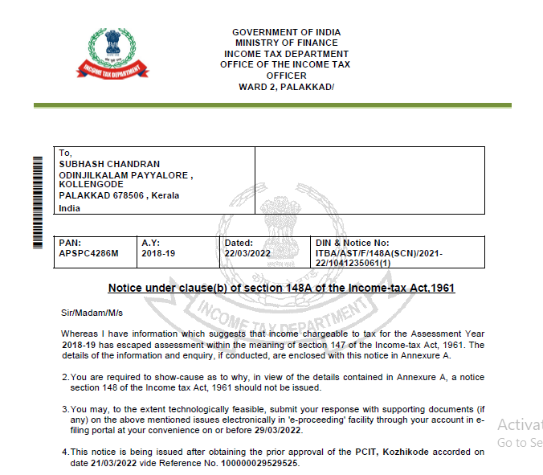
Notice u/s 148A(b)

Slide 32
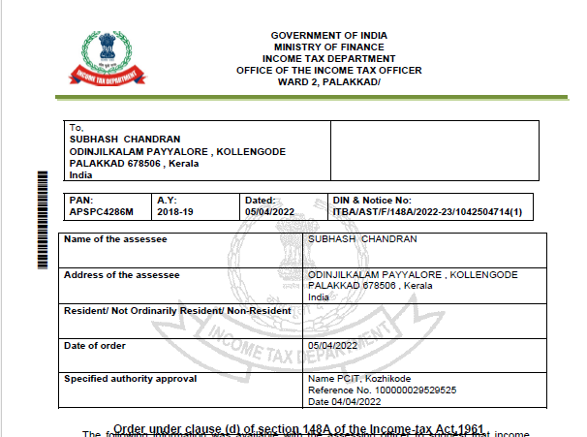
Order u/s 148A(d)

Slide 33
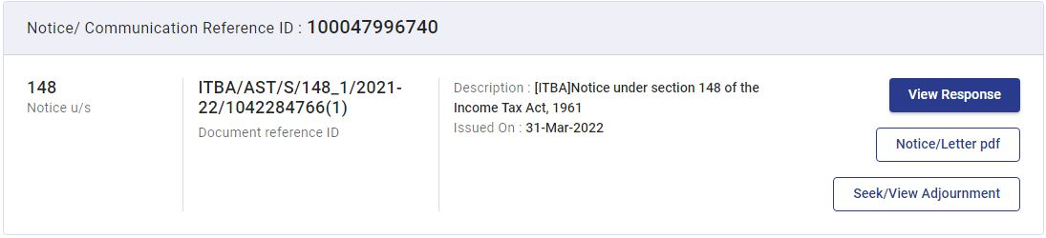
Notice u/s 148 can be issued whether or not the assessee have furnished return.
The assessee can seek adjournment of the time limit for furnishing return as specified in Section 148 through the option available in the portal :
Option to seek adjournment

Slide 34
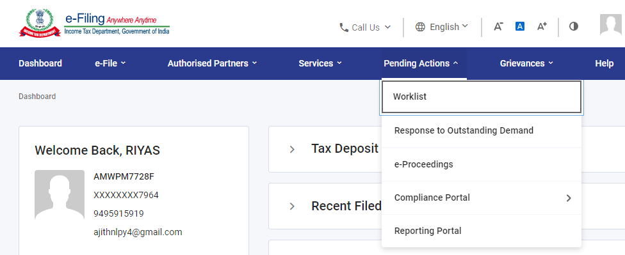
The proceeding notices/orders can be seen in the e-proceedings facility in the e-filing portal. It can be accessed by the following steps :
1.Login to Income Tax Website
2.Pending actions e proceedings.

Slide 35
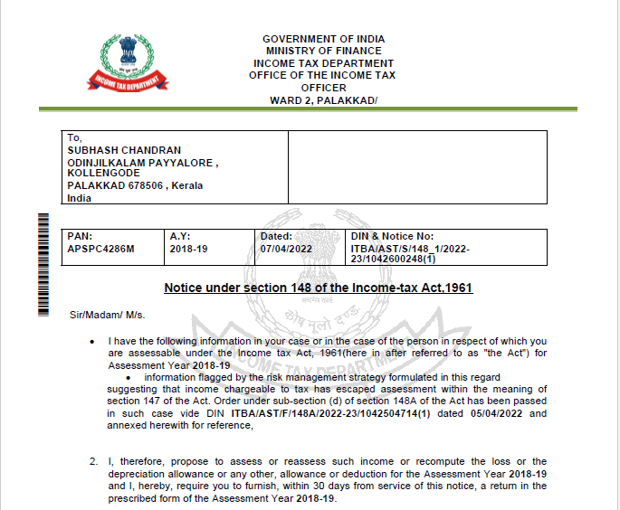
Notice u/s 148

Slide 36
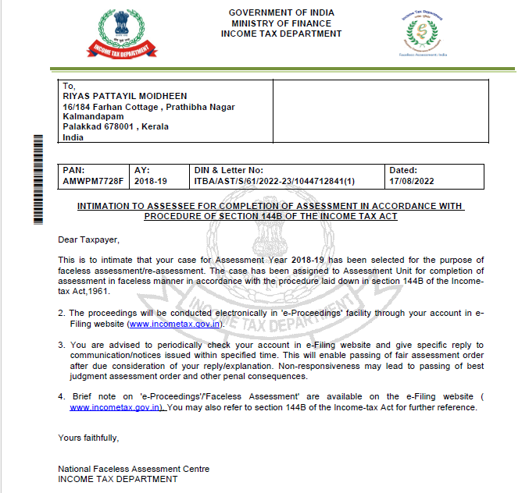
Intimation under section 144B (Faceless Assessment)

Slide 37
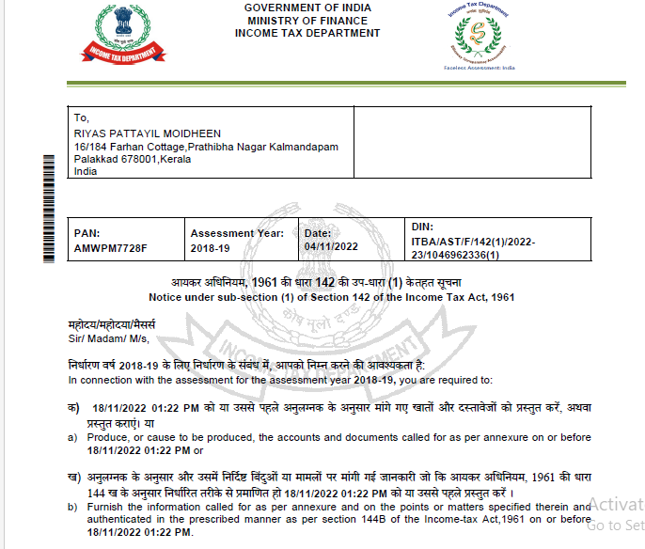
Notice u/s 142(1) requiring production of documents

Slide 38
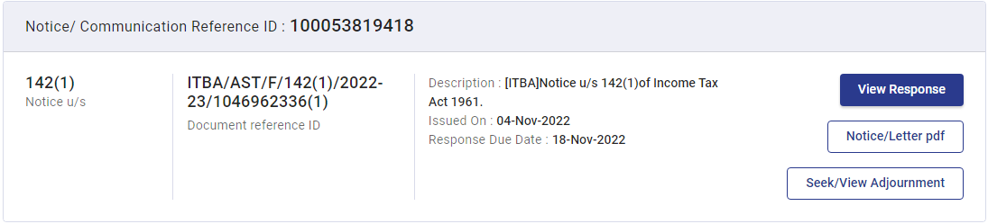
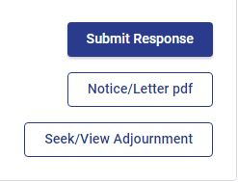
The assessee shall reply to such notice within the time limit mentioned in the notice, in the manner specified in section 144B.
The response shall be made by clicking the following option available under the e-proceedings facility.

Slide 39
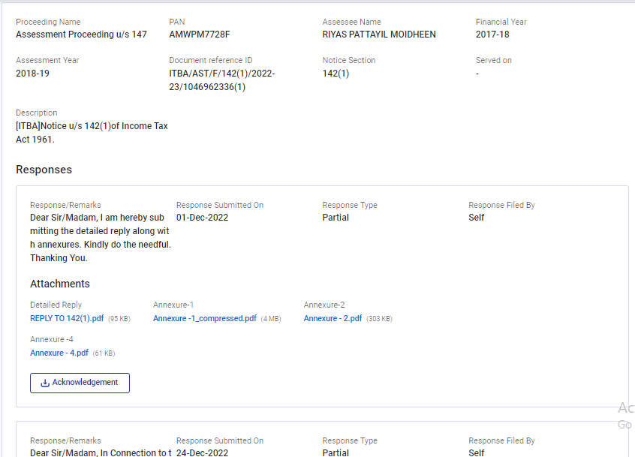
Snap of submitted response

Slide 40
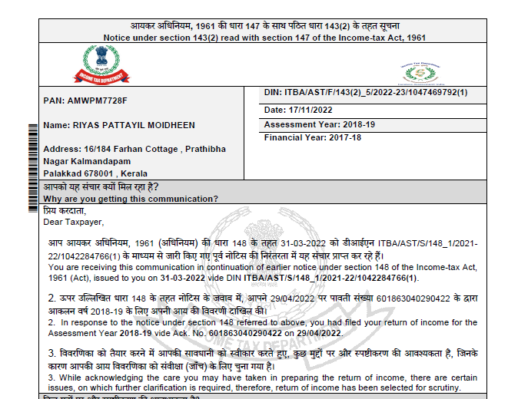
Notice u/s 143(2) (For scrutiny)

Slide 41
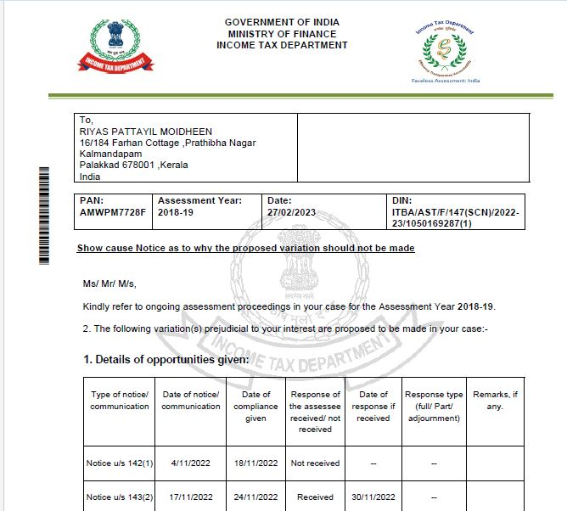
Show cause notice u/s 147

Slide 42
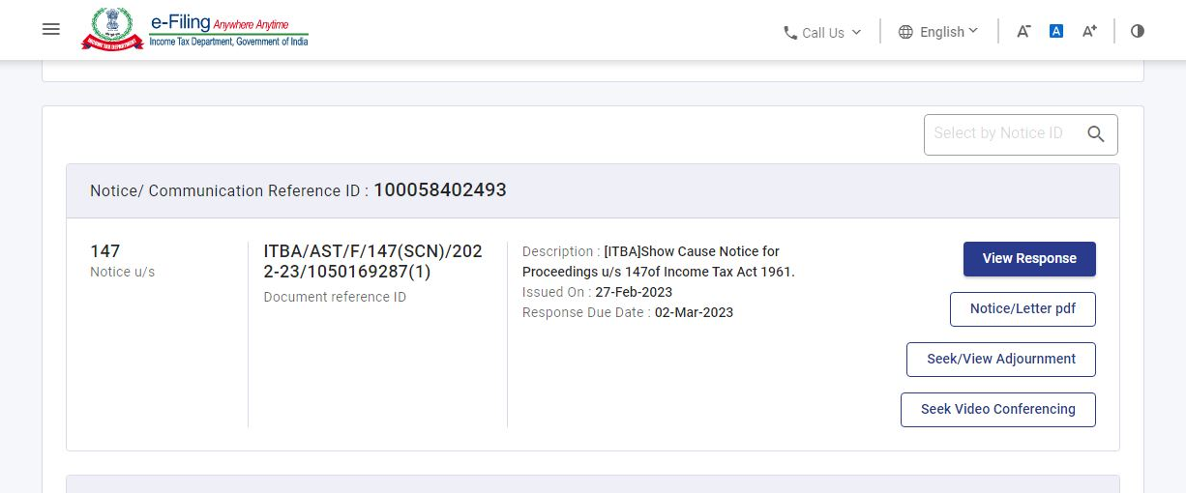
The assessee can seek time extension for furnishing reply to the show cause notice.
He may also seek video conferencing through the option available in the portal.

Slide 43
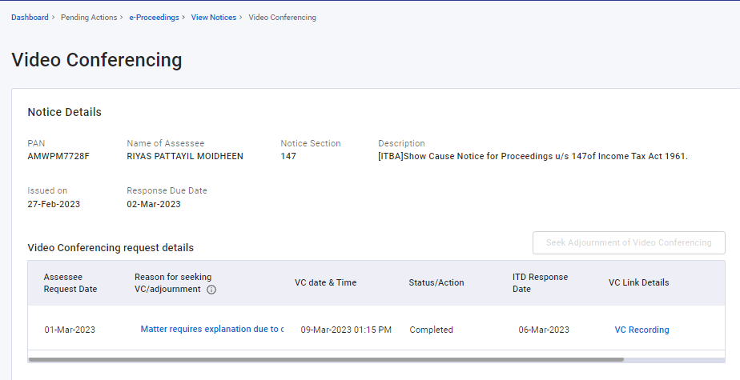
Request for Video conferencing

Slide 44
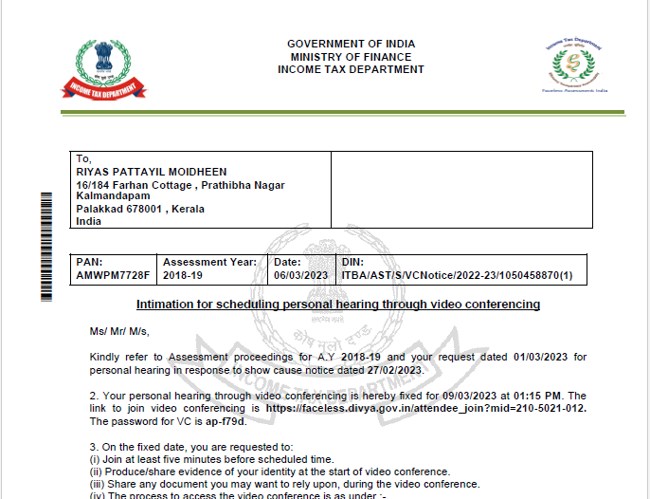
The assessing officer shall as requested by the assessee, provide an opportunity for video conferencing.

Slide 45
Thanks for listening the whole slides

