Slide 1
DEDUCTIONS NOT CLAIMED IN RETURN
An assessee can revise its return of income under section 139(5) on discovery of any omission or wrong statement therein. The revised return replaces and substitutes the original return. Since revised returns takes place of original return, the A.O is bound to take cognizance of the revised return.

Slide 2
The return can be revised at any time before the end of the relevant assessment year or before the completion of the assessment, whichever is earlier. As such, if the omission or wrong statement is discovered before the time to revise return is over, assessee can definitely be benefitted by this provision. However, where it is discovered after the expiry of the time to revise the return, there is no provision in the act to set the omission or error right.

Slide 3
During scrutiny assessment, when assessee comes across such omission or wrong statement, they generally claim the expenditure or the benefit right at the stage of assessment proceedings. However, there is no provision in the act, which authorizes the assessing officer to entertain additional claim which were not claimed in the return. Therefore, the claim is rejected by the assessing officer.

Slide 4
Goetze (India) Ltd. v. Commissioner of Income-tax [2006] 157 Taxman 1 (SC)
In this case, the return was filed on 30-11-1995 by the company. On 12-1-1998, company sought to claim a deduction by way of a letter before the Assessing Officer. The deduction was disallowed by the Assessing Officer on the ground that there was no provision under the Income-tax Act to make amendment in the return of income by moving an application at the assessment stage without revising the return. Commissioner (Appeals) decided in favour of the assessee, whereas ITAT decided in favour of the revenue.

Slide 5
JUTE CORPORATION OF INDIA LTD.
the question raised was “whether the Tribunal has jurisdiction to examine an issue raised before it for the first time”. The decision was affirmative.

Slide 6
CIT v. Jai Parabolic Springs Ltd. [2008] 306 ITR 42
The court, held that the Supreme Court dismissed the appeal in Goetze India Limited, making it clear that the decision was limited to the power of the assessing authority to entertain a claim for deduction otherwise than by a revised return and did not impinge on the powers of the Tribunal. It was also held that there was no prohibition on the powers of the Tribunal to entertain an additional ground which, according to the Tribunal, arises in the matter and for the just decision of the case.

Slide 7

Additional Evidence
&
Revised Grounds of Appeal Before CIT(A)

Slide 8








Additional Evidence
Revision / Amendment of Grounds
Grounds of Appeal
Facts of the Case

Slide 9


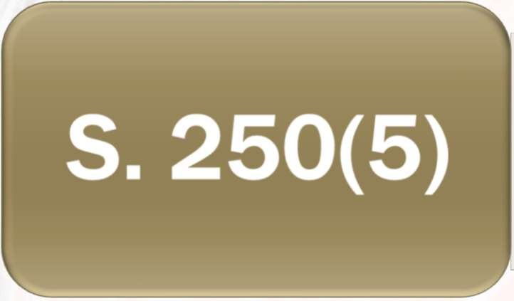

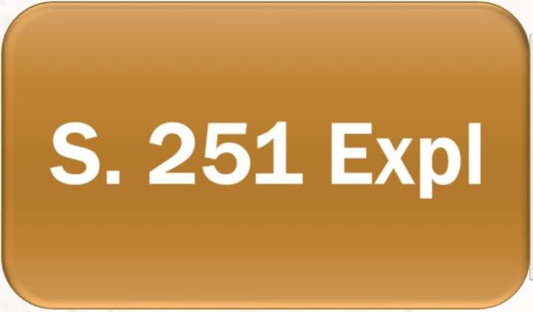

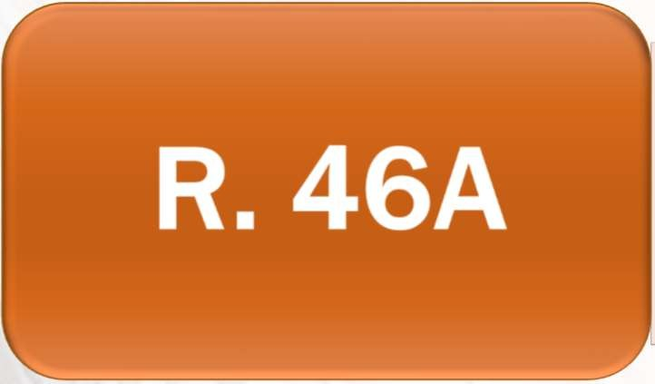

RELATED PROVISIONS
Ground of Appeal Revision
Powers of CIT(A)
Additional Evidence

Slide 10
AMENDMENT / REVISION OF GROUNDS
 Can it be done?
 Is it a New Ground or Amendment of Existing Ground?
 S. 250(5) - CIT (A) may, at hearing of an appeal, allow appellant to go into any ground of appeal not specified in grounds of appeal, if he is satisfied that omission of that ground from Form of appeal was not:
 wilful or
 unreasonable.

Slide 11
Explanation to S. 251 - In disposing of an appeal, the CIT (A) may consider and decide any matter arising out of the proceedings in which the order appealed against was passed, notwithstanding that such matter was not raised before the CIT (A) by the appellant

Slide 12
JUDICIAL PRONOUNCEMENTS
 Madras High Court in M/s Ramco Cements Ltd. vs.
DCIT Tax case Appeal No. 916/2014 - It is to be noted herein that the Act does not contain any express provision preventing the assessee from raising new grounds in appeal and there is no provision in the act restricting the Appellate Authority to entertain such new ground in the appeal. In the absence of statutory bar, the appellate authority is vested with the power, which is co-terminus with that of original authority, to allow the assessee to raise new ground, if same is bonafide and not willful or unreasonable

Slide 13
JUDICIAL PRONOUNCEMENTS
 S. 250(5) empowers CIT(A) to allow appellant to raise additional grounds of appeal if satisfied that, omission thereof was not willful or unreasonable. It is a discretionary power which is exercised based on the facts and circumstances of each case - Jute Corporation of India Ltd. vs. CIT: 187 ITR 688 (SC)
 Where a claim is not made in ROI, including revised ROI, although the AO is not empowered to allow such claim, the same can be raised before CIT(A) as additional grounds of appeal -
- Goetze India Ltd. v. CIT 284 ITR 323 (SC)
- CIT v. Jai Parabolic Springs Ltd. 306 ITR 42 (Del.)

Slide 14
JUDICIAL PRONOUNCEMENTS
 If facts not on record, additional Grounds of appeal can be admitted, and matter may be set aside for verification by AO –
 DCM Benetton India Ltd. v. CIT: 173 Taxman 283 (Del. HC);
 ONGC v. Addl. CIT: ITA No. 357 & 358/Del./2005 (Del. ITAT)
 By when can we file the additional grounds?
 There is no time limit to file additional grounds of appeal –
 K.C. Khajanchi v. ITAT in C.W. No. 2164/99;
 Zakir Hussain v. CIT (2006) 202 CTR (Raj.) 40;
 Jindal Polyester & Steel Ltd. v. DCIT (ITA No.2521/Del/1997) (Del.Tri.)

Slide 15
JUDICIAL PRONOUNCEMENTS
 CIT vs. Jindal Saw Pipes Ltd. (2010) 78 CCH 0717 Del HC - Authority of the CIT is co- extensive with that of the AO. Moreover, s.
250(5) allows the assessee to raise an issue not even forming part of the grounds of appeal. CIT
(A) was therefore justified in allowing revised claim of the assessee company for deduction.
 Ramgopal Ganpatrai & Sons Ltd. vs. CIT (1953) 21 CCH 031 Mum HC - Assessee is entitled to raise new ground which was not raised before AO, nor stated in grounds of appeal.

Slide 16

WHEN TO REVISE
When it can be / should be done?
Error
New points
Summarise, if earlier was detailed
New AR and wants additional grounds
Ground: “That the appellant carves leave to add, alter, modify or delete any of the ground of appeal.”

Slide 17

ADDITIONAL EVIDENCE

Slide 18
ADDITIONAL EVIDENCE
 CIT(A)can admit additional evidence or documents only after applying rule 46A
 Additional evidences cannot be accepted without giving a reasonable opportunity to AO to examine and rebut the said evidences
 If AO objects to admission of additional evidence, then CIT (A) should give categorical finding in terms of rule 46A for admission thereof
 Proper reasons must be given for non-acceptance of additional evidence under rule 46A
 To render justice, CIT (A) can admit new evidence
 Additional evidence must be allowed for reasonable cause

Slide 19
WHEN AO REFUSE TO ADMIT AE
 It is mandatory that AO should receive the additional evidences while disposing off the remand report.
 The AO may refuse to admit the additional evidences in his remand report
 In such cases, the CIT (A) can admit the additional evidences by his own to render the justice.
 In case, AO refused or decline, It’s the power of the CIT ( A) to receive and consider the same.

Slide 20
ADDITIONAL EVIDENCE
Application to be made:
  in writing
  in duplicate
  with prayer for acceptance of additional document
  along with justification
  specifically mention the sub rule of Rule 46 A in which these paper are being filed.

Slide 21
ADDITIONAL EVIDENCE
CIT (A) shall not take into account any additional evidence unless the AO has been allowed a reasonable opportunity:
  to examine the evidence or document or to cross-examine witness produced by appellant
  to produce any evidence or document or any witness in rebuttal of the additional evidence produced by the appellant

Slide 22
SUO-MOTO POWER
○ R. 46A(4) - Nothing contained in this rule shall affect the power of CIT (A) to direct the production of any document, or examination of any witness, to enable him to dispose of the appeal, or for any other substantial cause including the enhancement of the assessment or penalty whether on his own motion or on the request of the AO u/s 251(1)(a) or the imposition of penalty u/s 271.

Slide 23
RELEVANT SUB-RULE 46A(1)
Where AO refused to admit the said evidence which ought to have been admitted
Where appellant was prevented by sufficient cause from producing evidence called upon by AO or relevant to any ground in appeal
Where appellant was prevented by sufficient cause from producing the AO any evidence which is relevant to any ground of appeal
Where AO made the impugned order without giving sufficient opportunity to appellant

Slide 24
R. 46A(1)(A)
 Where AO refused to admit the said evidence which ought to have been admitted
 Faceless assessment !!!
 Manually
Bulk
Any other reason
 Evidence of refusal
E-mail
Speed post / courier

Slide 25
R. 46A(1)(B) / (C)
 Where appellant was prevented by sufficient cause from producing evidence called upon by AO or relevant to any ground in appeal
 Where appellant was prevented by sufficient cause from producing the AO any evidence which is relevant to any ground of appeal
 Not giving sufficient time
 Evidence not with appellant – ED / GST, etc
 Fire or another calamity
 Third party refusing

Slide 26
R. 46A(1)(D)
 Where AO made the impugned order without giving sufficient opportunity to appellant
 Suo-moto additions
 Assessment u/s 144
 Addition without show cause

Slide 27
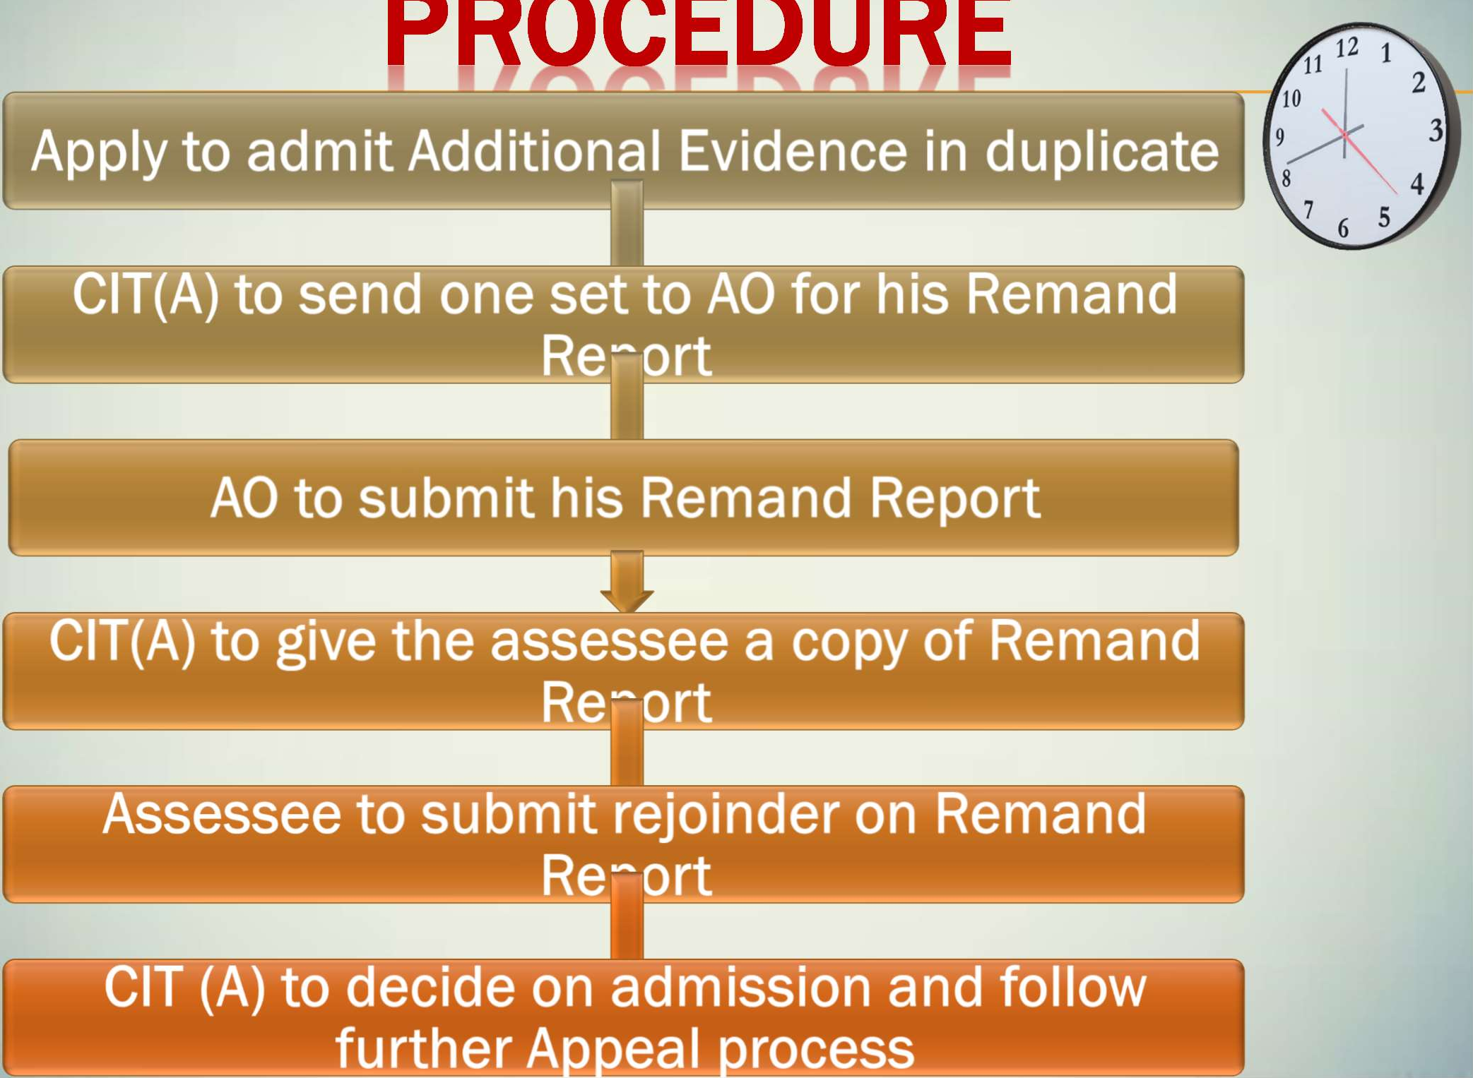
PROCEDURE

Slide 28
JUDICIAL PRONOUNCEMENTS
 Bombay High Court in Smt. Prabhavati S. Shah vs. CIT [1998] 231 ITR 1 - AAC should have admitted additional evidence in exercise of power u/s 250(5) as well as under Rule 46A(1)(c) considering the fact that AO had considered loan as income only on ground that summons issued to lenders were returned unserved and didn’t provide opportunity to assessee during assessment proceedings

Slide 29
JUDICIAL PRONOUNCEMENTS
 CIT v. Virgin Securities and Credits P.
Ltd (2011) 332 ITR 396 (Del) - CIT(A) should
admit the additional evidence if he finds that the same is crucial for the disposal of the appeal.
 Delhi High Court in Chandrakant Chanu Bhai Patel 202 Taxman 262 - if additional evidence is without any blemish and in order to advance the cause of justice, the same ought to be admitted.

Slide 30
JUDICIAL PRONOUNCEMENTS
 High Court of Delhi in CIT vs. Manish Build Well (P) Ltd. in ITA No.928/2011 dt. 15.11.2011
(2011) 63 DTR 369 - after admission of additional evidence, it is mandatory to follow Rule 46A(3) of the Rule. It was found that the AO only objected the admissibility of additional evidence and restricted himself to comment on the merits of the evidence. Therefore, the Hon’ble court observes that the ld. CIT (A) did not follow the mandatory procedure for consideration of additional evidence at the first appellate stage.

Slide 31
JUDICIAL PRONOUNCEMENTS
 ITAT Delhi in ITO Vs. Kuber Chand Sharma- ITA No.
3982/Del/2009 – CIT (A) has admitted the additional evidence without fulfilling the categorical conditions laid down in Rule 46A, as explained by Hon’ble Delhi High Court in the case of Manish Build Well Pvt. Ltd. Consequently, his order on this issue is not tenable; however, the issue of merits remains.
Besides, from the record it emerges that assessee wanted to file only government records & revenue record about crops - Matter set aside, restored back to AO to decide the same afresh after affording the assessee sufficient opportunity of being heard.

Slide 32
REASONABLE OPP. TO AO
 CIT (A) cannot proceed with additional evidences by its own without giving an opportunity to assessing officer to verify additional evidences. It is mandatory for CIT (A) to remand additional evidences to AO.
 ITAT Delhi ITO Vs Mrs. Anvita Abbi ITA No. 3707 / Del/2011 Ld. CIT (A) admitted fresh evidences but did not allow any opportunity to AO for examining those evidences or furnishing any evidence in rebuttal as required by Rule 46A(3). Therefore, order of ld CIT (A) is in violation of Rule 46A. Matter set aside to AO.

Slide 33
FINDING OF CIT(A) ON AO OBJECTION
 If AO objects to admission of additional evidence, then CIT (a) should give categorical finding in terms of rule 46A for admission thereof - ITAT Delhi , ITO Vs. Kuber Chand Sharma (ITA No.
3982/Del/2009)
 Reasons must be given for non-acceptance of additional evidence under rule 46A
 Abhay Kumar Shroff V/s. ITO 63 ITD 144(Pat)
 Smt. Prabhavati S. Shah V/s. CIT, 231 ITR 278
 Collector Land Katji 167 ITR 471 (SC)

Slide 34
OPPORTUNITY TO AO
 ITAT Chandigarh, ITO Vs Bhagwan Dass, Contractor IT Appeal No. 383 (Chd.) of 2011.
On plain reading of Rule 46A, it is clear that it is introduced to place fetters on the right of the appellant, to produce before 1st Appellate Authority, any evidence, whether oral or documentary, other than the evidence produced by him, during the course of proceedings before the AO, except in the circumstances set out therein. It does not deal with the power of the 1st appellate authority, to make further enquiry.

Slide 35
OPPORTUNITY TO AO
 In present case, assessee has already filed requisite details before AO & further detail was to be filed before AO & he refused to accept the same. Therefore, assessee was compelled to file details by way of Speed Post. Further, new evidence filed by assessee from govt. agency & the same are essential for disposal of appeal. AO was given due opportunities & he submitted remand report hence, CIT(A) has given due opportunity to AO, within Rule 46A.

Slide 36
SUO MOTO CALL OF CIT(A)
 Where CIT (A) has called for production of any document on his own during the course of appellate proceedings, then he is not obliged to call for a remand report from AO on the said evidences. In such circumstances the revenue cannot raise the issue of violation of Rule 46A
 CIT v Surtech Hospital & Research Centre Ltd 293 ITR 53 (Bom),
 CIT v Sagar Construction Pvt Ltd [2015] 56 taxmann.com 434 (Patna)
 Contrary view by the Kerala High Court in CIT v E. D. Benny 283 CTR (Ker) 212

Slide 37
SUO MOTO CALL OF CIT(A)
 Assessee filed reply before AO in which several details as per query of AO were furnished at assessment stage including copy of cash book.
 Even if CIT(A) called for books of account, details and vouchers at appellate stage for examination, there was nothing wrong in his power to examine books of account as per Rule 46A(4)
 ITO & Anrs v Jaidka Woolen & Hosiery Mills P. Ltd & Anrs (2018) 68 ITR (Trib) 0216 (Delhi)

Slide 38
FAVORABLE REMAND REPORT
 Where CIT(A) has admitted additional evidences and called for remand report from AO & if AO gives the report in favour of assessee i.e. where AO accepts evidences filed by assessee & opines that additions are not warranted considering evidences, then CIT(A) considering remand report may allow appeal in favour of assessee. Revenue cannot be aggrieved by order of CIT(A) & file appeal before ITAT for which favourable remand report was given by AO.
 B.Jayalakshmi v ACIT [2018] 407 ITR 0212 (Mad)
 Ramanlal Kamdar v CIT [1977] 108 ITR 0073 (Mad)
 Jivatlal Purtapshi v CIT [1967] 65 ITR 0261 (Bom)
 M.M. Annaiah v CIT [1970] 76 ITR 0582 (Mys)

