Slide 1
Assessment in Response to Notice u/s 143(2)
– Section 143(3) including E-Assessment

Slide 2
Session Overview
- Introduction to Scrutiny Assessment
- Legal Framework: Sec 143(2) and 143(3)
- E-Assessment under Faceless Regime
- Practical Tips: Preparing Point-wise Replies
- Sample AO Reply Format

Slide 3
Section 143(2) – Notice for Scrutiny
- Purpose: Ensure no understatement of income or excessive deductions
- Timeline: Issued within 3 months from end of FY of ITR filing
- Trigger points: High-value transactions, TDS mismatches, random selection

Slide 4
Section 143(3) – Scrutiny Assessment
- Full-fledged examination of return
- AO can call for evidence, books of account
- Outcome: Additions/disallowances, revised tax liability

Slide 5
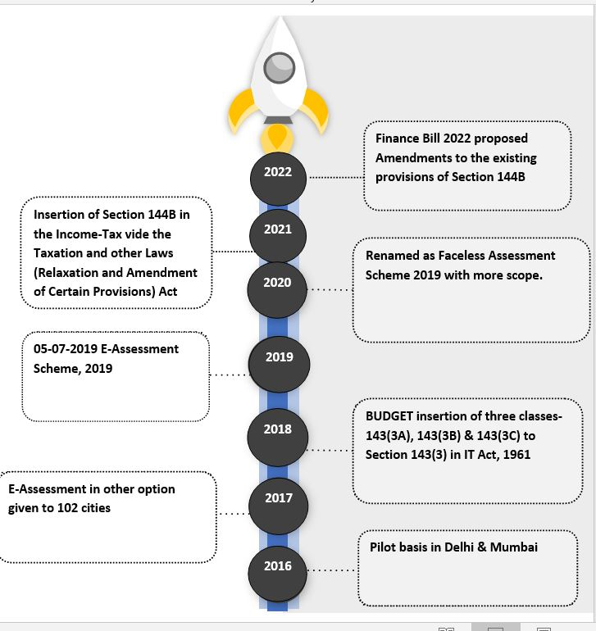

Slide 6
FACELESS ASSESSMENT
Faceless Assessment is a part of e-governance initiative of the Government of India.
To do scrutiny proceeding under section 143(3) / 147.
To be conducted in a faceless and jurisdiction-less manner.
Through the electronic means of communication via e-proceedings functionality.
No physical/personal interface between the assesee and the assessing authority.

Slide 7

FEATURES
The case selection will be through the system using data analytics & Artificial Intelligence
Automated random allocation of cases
Abolition of Territorial jurisdiction
Central issuance of notices with Document Identification Number (DIN)
Team-based assessment & reviews
No physical interface, meaning no need to visit Income Tax office
FEATURES

Slide 8
E-Assessment Framework
- Introduced under Sec 144B
- Faceless assessment procedure
- Entities: Assessment, Verification, Review, Technical Units
- All communication through Income Tax Portal

Slide 9
E-Assessment: Process Flow
1. Notice u/s 143(2) issued
2. Questionnaire issued
3. Submit replies with documents
4. Draft order issued
5. Final order with demand/refund

Slide 10
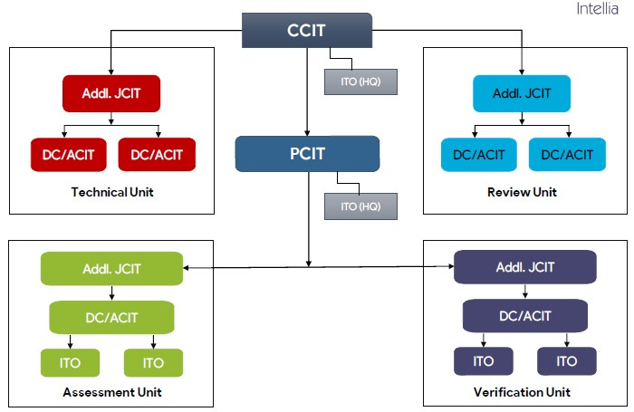
Regional E-Assessment Centres

Slide 11
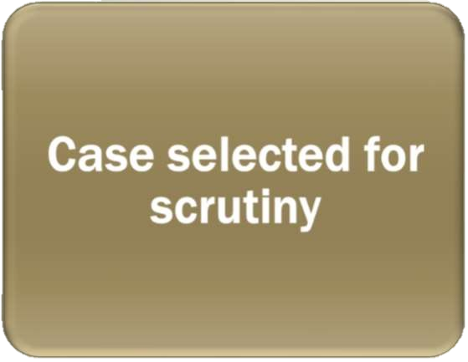

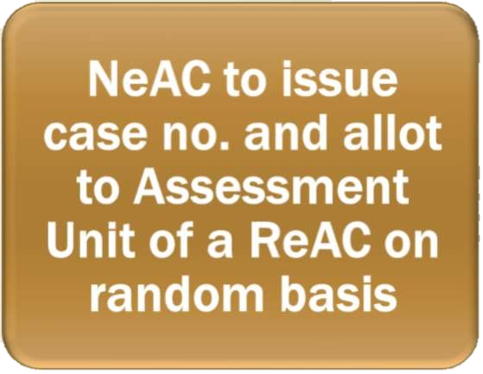



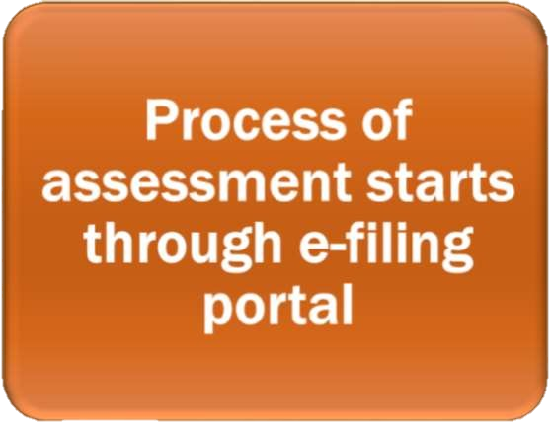
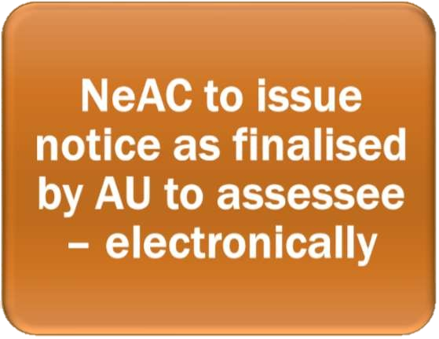
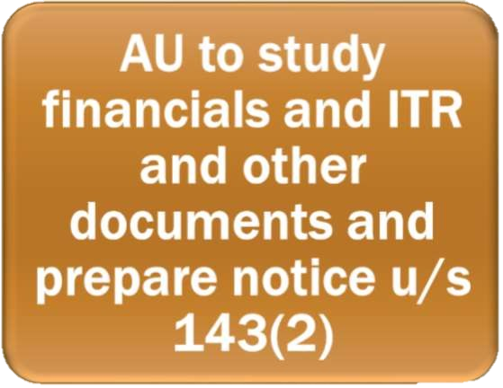


INITIAL PROCESS IN FACELESS ENVIRONMENT

Slide 12
Notice and Response
National e Assessment Centre shall serve a notice on the assessee under section 143(2).
Such Notice shall specify the issues selected for assessment.
ACIT (e Verification), having headquarter at Delhi, to act as prescribed Income tax Authority for the purpose of section 143(2).
Assessee may, within fifteen days from the date of receipt of notice, file his response to the NeAC.

Slide 13
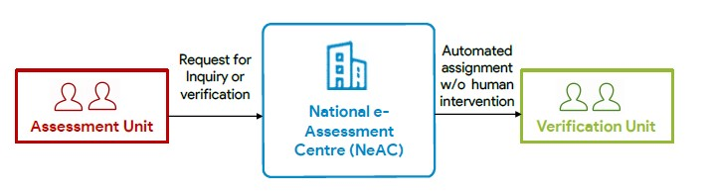
Enquiry or Verification
Request for conducting of certain enquiry or verification by the verification unit can be made by the assessment unit.
Such requests shall be assigned by the NeAC to a verification unit through an automated allocation system.

Slide 14
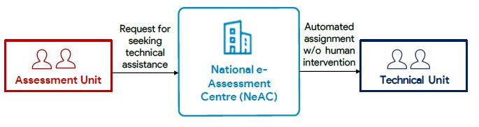
Technical assistance to Assessment Units
Assessment units may place a request for technical assistance from the technical unit to NeAC.
Such request shall be assigned by the NeAC to a technical unit in any one ReAC through an automated allocation system.

Slide 15
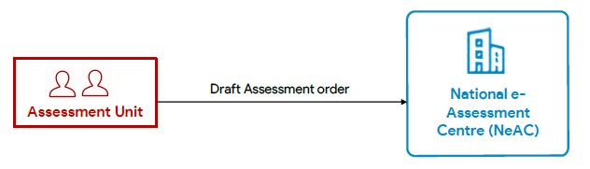
Assessment Orders
Assessment unit shall, after taking into account all the relevant material available on the record, make in writing, a draft assessment order either accepting the returned income of the assessee or modifying the returned income of the assesse, as the case may be, and send a copy of such order to the NeAC.
The assessment unit shall, while making draft assessment order, provide details of the penalty proceedings to be initiated therein, if any;

Slide 16
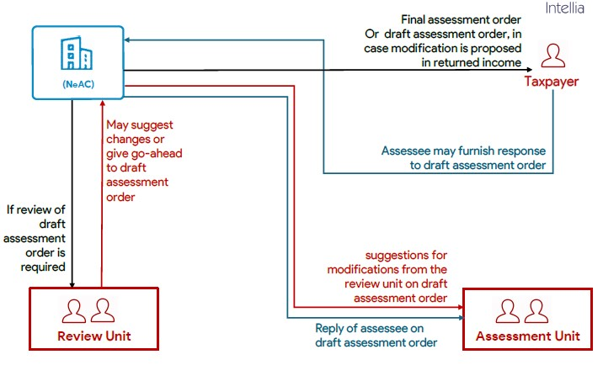
Assessment Orders

Slide 17
PROCEDURE IN FACELESS ENVIRONMENT
National E-assessment Centre (NeAC)
Issue of Notice u/s 143(2)
Assessee
Submit e-Response within 15 days to
National E-assessment Centre (NeAC)
Assigns the case randomly to
Assessment Unit at Regional E-assessment Centre
Asks NEC to Connect with Assessee or Verification Unit or Technical Unit
National E-assessment Centre (NeAC)
Connects with
Assessee
(For obtaining information)
Verification Unit
(For verifying information)
Technical Unit
(For technical inputs)
National E-assessment Centre (NeAC)

Slide 18
National E-assessment Centre (NeAC)
New Assessment Unit at ReAC
Assessment Unit at ReAC
On the basis of inputs prepare draft assessment order & send to
National E-assessment Centre (NeAC)
Review Unit
If Prejudicial to Assessee?
Yes
Suggest any Modifications?
No
Yes
No
On Request of assessee may provide Opportunity of
Personal Hearing via Video Telephony
Yes
Response by Assessee?
No
Finalise the Assessment Order
& Sends to
Jurisdictional Assessing Officer
Assessee

Slide 19
Practical Aspects: Preparation Strategy
- Read notice and annexures
- Identify queries
- Gather evidence: invoices, statements
- Match data with ITR, 26AS, AIS/TIS

Slide 20
Point-wise Reply: Best Practices
- Serial numbers per queries
- Clear headings, bullets
- Refer annexures
- Be precise

Slide 21
Sample Assessments

Slide 22
Uploading Reply on Portal
- Log in to e-filing portal
- Go to e-Proceedings
- Click "Submit Response"
- Attach PDFs (max 5MB)
- Use DSC/e-verify

Slide 23
Tips for Effective Submissions
- Submit on time
- Name files clearly
- Check acknowledgement log
- Keep backup copies

Slide 24
Common Pitfalls to Avoid
- Incomplete replies
- Unreadable scans
- AIS/TIS mismatches
- Missing annexures

Slide 25
Final Outcome & Follow-up
- Respond to draft order
- Final 143(3) order
- Appeal if needed
- Comply with demand/refund

Slide 26
Q&A Session
- Open floor for participant questions

Slide 27
Thank You

