Slide 1
INVENTORY VALUATION
DRAFT FORM 6C – SEC 142(2A)

Slide 2
Index
Sec 142(2A)
Sec 145A
Form 6C
ICDS II and comparison
Illustration
Points to be considered.

Slide 3
142 (2A)
If, at any stage of the proceedings before him, the Assessing Officer, having regard to the nature and complexity of the accounts, volume of the accounts, doubts about the correctness of the accounts, multiplicity of transactions in the accounts or specialised nature of business activity of the assessee, and the interests of the revenue, is of the opinion that it is necessary so to do, he may, with the previous approval of the Principal Chief Commissioner or Chief Commissioner or Principal Commissioner or Commissioner, direct the assessee to get either or both of the following, namely:—
(i) to get the accounts audited by an accountant, as defined in the Explanation below sub-section (2) of section 288, nominated by the Principal Chief Commissioner or Chief Commissioner or Principal Commissioner or Commissioner in this behalf and to furnish a report of such audit in the prescribed form duly signed and verified by such accountant and setting forth such particulars, as may be prescribed, and such other particulars as the Assessing Officer may require;
(ii) to get the inventory valued by a cost accountant, nominated by the Principal Chief Commissioner or Chief Commissioner or Principal Commissioner or Commissioner in this behalf and to furnish a report of such inventory valuation in the prescribed form duly signed and verified by such cost accountant and setting forth such particulars, as may be prescribed, and such other particulars as the Assessing Officer may require:

Slide 4
SEC 145. Method of accounting.
(1) Income chargeable under the head Profits and gains of business or profession or Income from other sources shall, subject to the provisions of sub-section (2), be computed in accordance with either cash or mercantile system of accounting regularly employed by the assessee.
(2) The Central Government may notify in the Official Gazette[2] from time to time [3][income computation and disclosure standards] to be followed by any class of assessees or in respect of any class of income.
(3) Where the Assessing Officer is not satisfied about the correctness or completeness of the accounts of the assessee, or where the method of accounting provided in sub-section (1) [4][has not been regularly followed by the assessee, or income has not been computed in accordance with the standards notified under sub-section (2)], the Assessing Officer may make an assessment in the manner provided in section 144.

Slide 5
Amendment in Income-tax Act (Finance Act, 2018)
Section 145A
For the purpose of determining the income chargeable under the head “Profits and gains of business or profession”,––
(i) the valuation of inventory shall be made at lower of actual cost or net realizable value computed in accordance with the income computation and disclosure standards notified under sub-section (2) of section 145;
(ii) the valuation of purchase and sale of goods or services and of inventory shall be adjusted to include the amount of any tax, duty, cess or fee (by whatever name called) actually paid or incurred by the assessee to bring the goods or services to the place of its location and condition as on the date of valuation;
(iii) the inventory being securities not listed on a recognized stock exchange, or listed but not quoted on a recognized stock exchange with regularity from time to time, shall be valued at actual cost initially recognized in accordance with the income computation and disclosure standards notified under sub-section (2) of section 145;
(iv) the inventory being securities other than those referred to in clause (iii), shall be valued at lower of actual cost or net realizable value in accordance with the income computation and disclosure standards notified under sub-section (2) of section 145:
Provided that the comparison of actual cost and net realizable value of securities shall be made category-wise.

Slide 6
ICDS II: VALUATION OF INVENTORIES

Slide 7
PREAMBLE
This Income Computation and Disclosure Standard is applicable for computation of income chargeable under the head “Profits and gains of Business or profession” or “Income from other sources” and not for the purpose of maintenance of books of accounts.
In the case of conflict between the provisions of Income Tax Act, 1961 (‘the Act)’ and this Income Computation and Disclosure Standard, the provisions of the Act shall prevail to that extent”.

Slide 8
Scope :
This Income Computation and Disclosure Standard shall be applied for valuation of inventories, except:
Work in Progress under Construction contracts.
Work in Progress under other Standards
Shares, Debentures and other financial instruments.
Live Stock, agriculture and forest produce, mineral oil, ores and natural gas.
Machinery spares used in connection with tangible fixed assets.

Slide 9
AS/Ind Comparison
Scope of the Standard
AS – 2 :
Inventories do not include spare parts, servicing equipment and standby equipment which meet the definition of ppe as per AS10
Ind AS – 2:
  It doest not apply to commodity broker-traders who measure heir inventories at fair value less costs to sell.
  scopes out the biological assets related to agricultural activity and agricultural produce at the time of harvest
  no mention of machinery spares

Slide 10
DEFINITIONS
Inventories :are assets
(a) held for sale in the ordinary course of business.
(b)in the process of production for such sale.
(c)In the form of materials or supplies to be consumed in the production process or in the rendering of services .
Net realisable value : is the estimated selling price in the ordinary course of business less the estimated cost of completion and the estimated costs necessary to make the sale

Slide 11
MEASUREMENT
“Inventories shall be valued at cost, or net realisable value, whichever is lower.”

Slide 12
MEASUREMENT
Cost of inventories include
Cost of services
All costs of purchase
Other cost incurred in bringing the inventories to their present location& condition
Cost of conversion

Slide 13
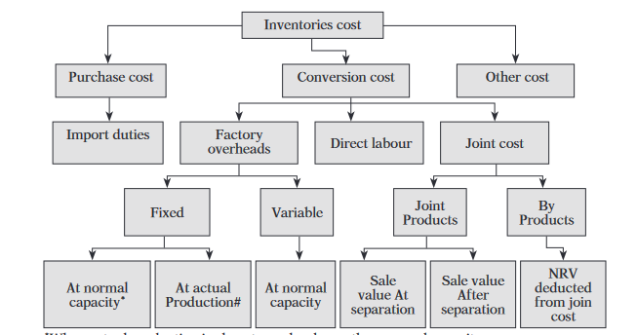

Slide 14
Purchase price include
Purchase price including duties & taxes
Freight inward
Other expenditure directly related to purchase
Trade discount
Rebate and other similar items
Purchase price exclude
AS 2 | Ind AS 2
Purchase price including duties & taxes(other than those subsequently recoverable by the enterprise from the taxing authorities), freight inwards & other expenditure related to acquisition. Trade discount ,rebate, duty drawbacks and other similar items are deducted in determining the cost purchase | Purchase price comprise of purchase price, import duties and other taxes(other than those subsequently recoverable by the entity from the taxing authorities) and transport ,handling and other cost directly attributable to the acquisition of finished goods ,materials and service. Trade discount ,rebate, duty drawbacks and other similar items are deducted in determining the cost purchase

Slide 15
AS – EXCLUSIVE METHOD – IN BOOKS
ICDS – INCLUSIVE METHOD – FOR TAX COMPUTATION
MEMORANDUM STATEMENT SHOWING REVENUE NEUTRALITY WOULD SERVE IN CASE FOLLOWING EXCLUSIVE METHOD.

Slide 16
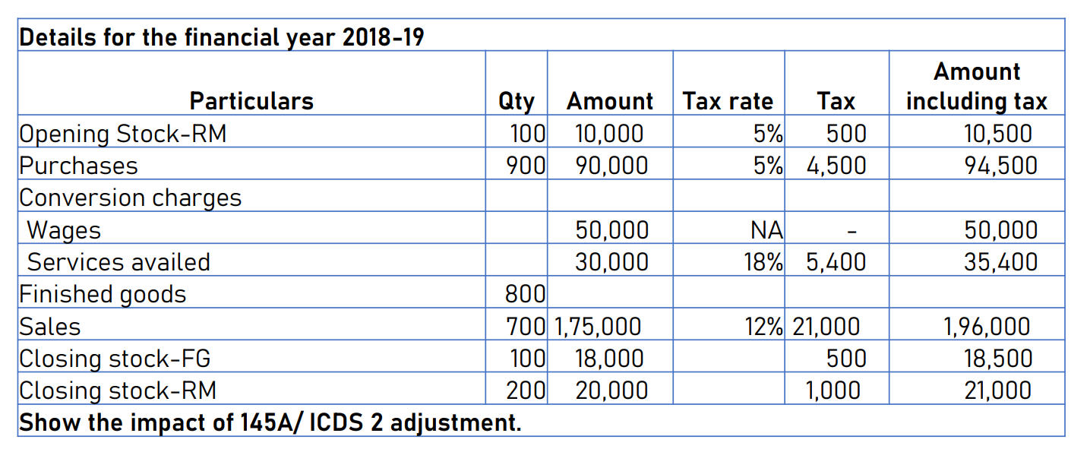

Slide 17
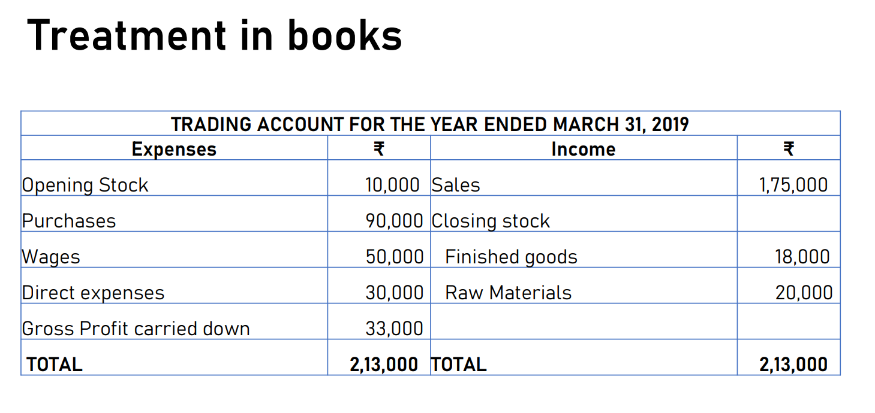

Slide 18
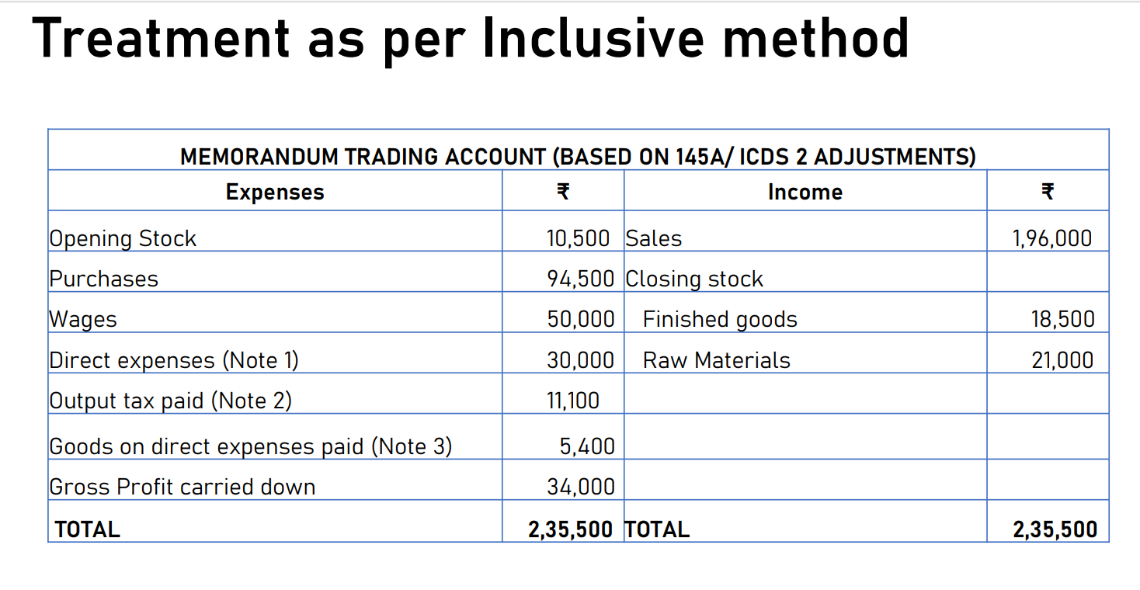

Slide 19
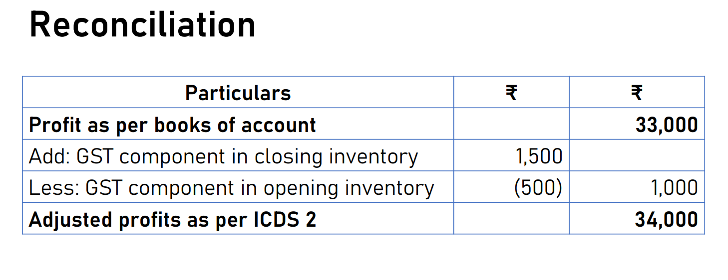

Slide 20
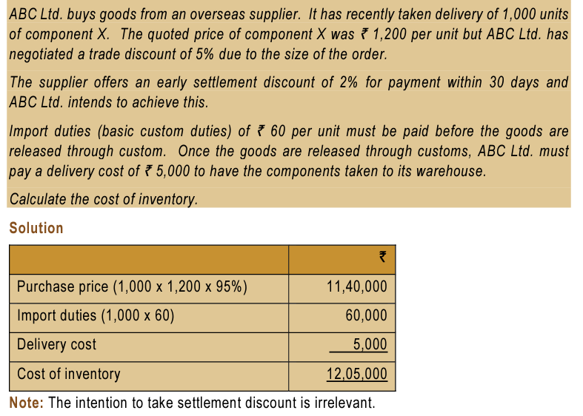

Slide 21
Cost of Conversion
(a) Costs directly related to the units of production and
(b) Systematic allocation of fixed and variable production overheads that are incurred in converting materials into finished goods.

Slide 22
OVERHEADS
Fixed production overheads shall be those indirect costs of production that remain relatively constant regardless of the volume of production.
Variable production overheads shall be those indirect cost of production that vary directly or nearly directly, with the volume of production.
The allocation of fixed production overheads for the purpose of their inclusion in the costs of conversion shall be based on the normal capacity of the production facilities.

Slide 23
Normal capacity shall be the production expected to be achieved on an average over a number of periods or seasons under normal circumstances, taking into account the loss of capacity resulting from planned maintenance. The actual level of production shall be used when it approximates to normal capacity.
The amount of fixed production overheads allocated to each unit of production shall not be increased as a consequence of low production or idle plant.
Unallocated overheads shall be recognised as an expense in the period in which they are incurred. In periods of abnormally high production, the amount of fixed production overheads allocated to each unit of production is decreased so that inventories are not measured above the cost. Variable production overheads shall be assigned to each unit of production on the basis of the actual use of the production facilities

Slide 24
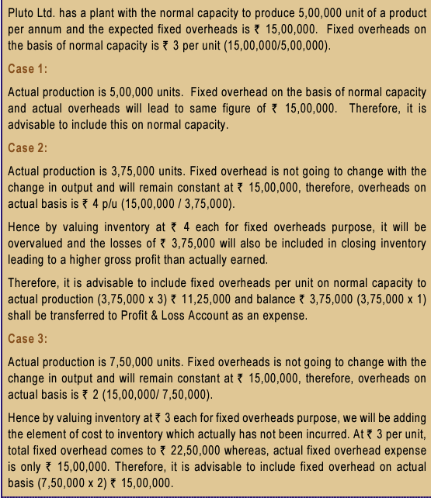

Slide 25

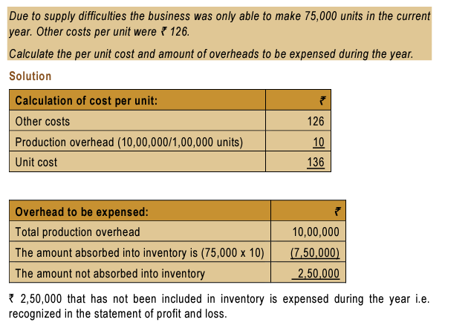

Slide 26
Joint products
Where a production process results in more than one product being produced simultaneously and the costs of conversion of each product are not separately identifiable, the costs shall be allocated between the products on a rational and consistent basis.

Slide 27
By Products
Where by products, scrap or waste materials are immaterial, they shall be measured at net realisable value and this value shall be deducted from the cost of the main product.

Slide 28
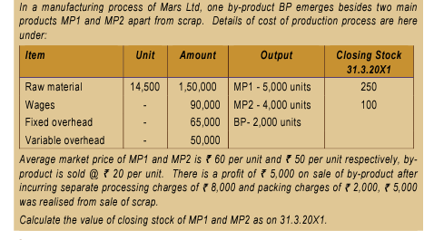

Slide 29
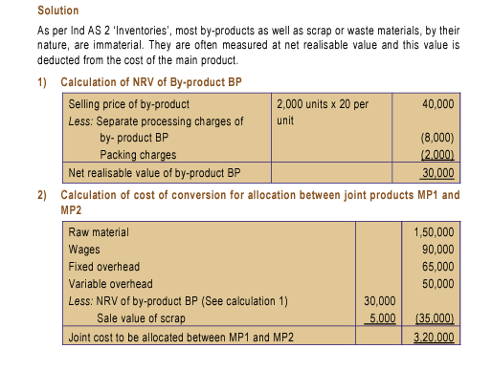

Slide 30
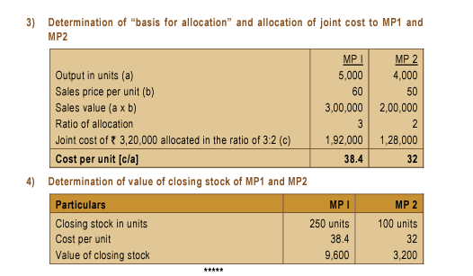

Slide 31
Other Costs
Other costs shall be included in the cost of inventories only to the extent that they are incurred in bringing the inventories to their present location and condition.
Interest and other borrowing costs shall not be included in the costs of inventories, unless they meet the criteria for recognition of interest as a component of the cost as specified in the Income Computation and Disclosure Standard on borrowing costs.

Slide 32
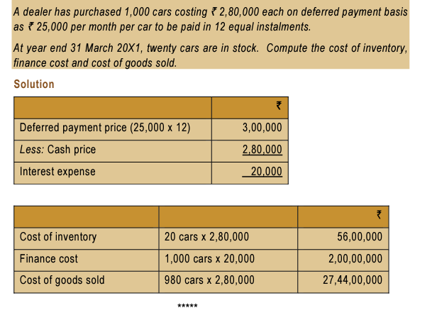

Slide 33
Practical Example :
Q. Closing Inventory at cost of a company amounted to Rs. 9,56,700. The following items were included at cost in the total-
350 Shirts, which had cost Rs.380 each and normally sold for Rs. 750 each. Owing to a defect in manufacture, they were all sold after the Balance Sheet date at 50% of their normal price. Selling expenses amounted to 5% of the proceeds.
700 Trousers, which had cost Rs. 520 each. These too were found to be defective. Selling Expenses for the batch totaled Rs. 3800. They were sold for Rs. 950 each.
Calculate the Inventory Value considering the above items.

Slide 34
Solution:
Valuation of Shirts:
(i) Value of Stock at Cost (Rs. 380 x 350 units ) Rs. 1,33,000
(ii) NRV of Shirts ( Rs. 750 x 50% x 350 units) less 5% thereon Rs. (1,24,688)
(iii) Write-down required for Shirts (i-ii) Rs. 8,312
(b) Valuation of Trousers:
Cost of Trousers as given = Rs 520 x 700 Trousers = Rs. 3,64,000
Net Realizable Value of Trousers=
Value= Lower of (i) Cost Rs. 520 & (ii) NRV Rs 944.57. Therefore, Rs.520 per unit or Rs. 3,64,000 should be the Carrying Amount of this Inventory. Since, Inventory is already carried at cost, no further adjustment is required.
Estimated Sale Price per unit Rs. 950.00
Less: Selling Expenses per unit (Rs.3,800 / 700 Trousers) Rs. (5.43)
Net Realizable Value per Unit Rs. 944.57

Slide 35
c) Valuation of Inventory
Value of Inventory as given 9,56,700
Less: Write down of Value of Shirts (8,312)
Revised Inventory Value 9,48,388

Slide 36
Costs of services :
Cost of service shall consist of labour and other cost of personnel directly engaged in providing the service including supervisory personal and attributable overheads

Slide 37
Cost of conversion comparsion
AS - 2 Ind AS - 2 | The actual level of production may be used, if it approximates normal capacity

Slide 38
Exclusions from the Cost of Inventories
In determining the cost of inventories, the following costs shall be excluded and recognised as expenses of the period in which they are incurred, namely:- | (a) Abnormal amounts of wasted materials, labour, or other production costs; (b) Storage costs, unless those costs are necessary in the production process prior to a further production stage; (c) Administrative overheads that do not contribute to bringing the inventories to their present location and condition; (d) Selling costs.

Slide 39
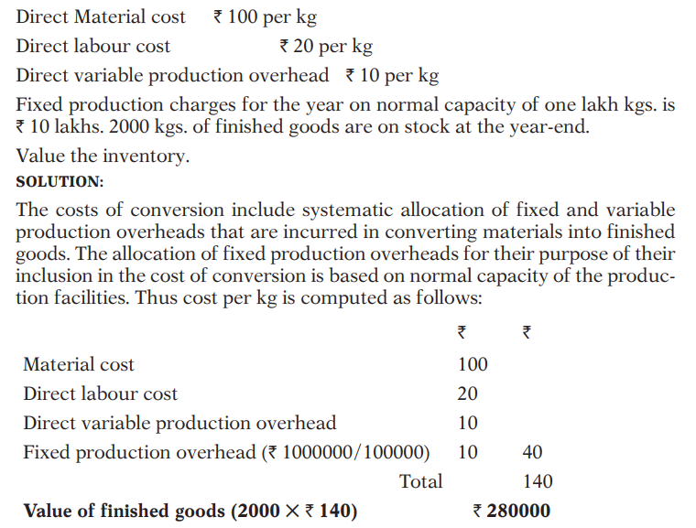

Slide 40
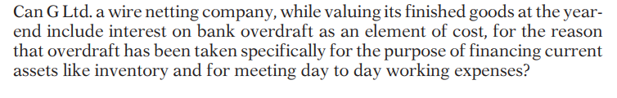
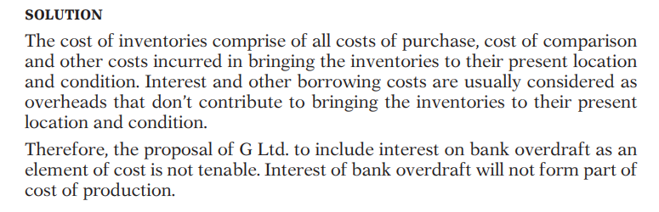

Slide 41
Cost Formulae
The Cost of inventories of items
(i) that are not ordinarily interchangeable; and
(ii) goods or services produced and segregated for specific projects
shall be assigned by specific identification of their individual costs.
‘Specific identification of cost’ means specific costs are attributed to identified items of inventory.
Where there are a large numbers of items of inventory which are ordinarily interchangeable, specific identification of costs shall not be made.

Slide 42
AS - 2 | Ind AS - 2
It is not expressly mandated to use the same cost formula consistently for all inventories that have a similar nature and use to the entity. The formula used should reflect the fairest possible approximation to the cost incurred in bringing the items of inventory to their present location and condition. - Techniques such as standard cost or retail method may be used for convenience, if the results approximate the actual cost. | Requires an entity to use the same cost formula for all inventories having a similar nature and use to the entity. - For inventories with a different nature or use, different cost formulas may be justified.

Slide 43
First-in First-out and Weighted Average Cost Formula
Cost of inventories, other than the inventory dealt under specific identification, shall be assigned by using the First-in First-out (FIFO), or weighted average cost formula. The formula used shall reflect the fairest possible approximation to the cost incurred in bringing the items of inventory to their present location and condition:
(a) The FIFO formula assumes that the items of inventory which were purchased or produced first are consumed or sold first, and consequently the items remaining in inventory at the end of the period are those most recently purchased or produced.
(b) Under the weighted average cost formula, the cost of each item is determined from the weighted average of the cost of similar items at the beginning of a period and the cost of similar items purchased or produced during the period. The average shall be calculated on a periodic basis, or as each additional shipment is received, depending upon the circumstance.

Slide 44
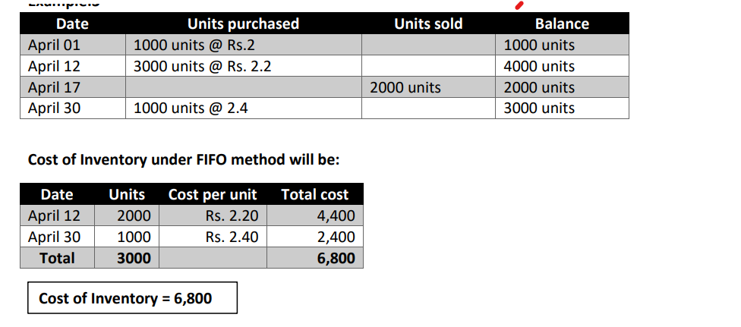
FIFO

Slide 45
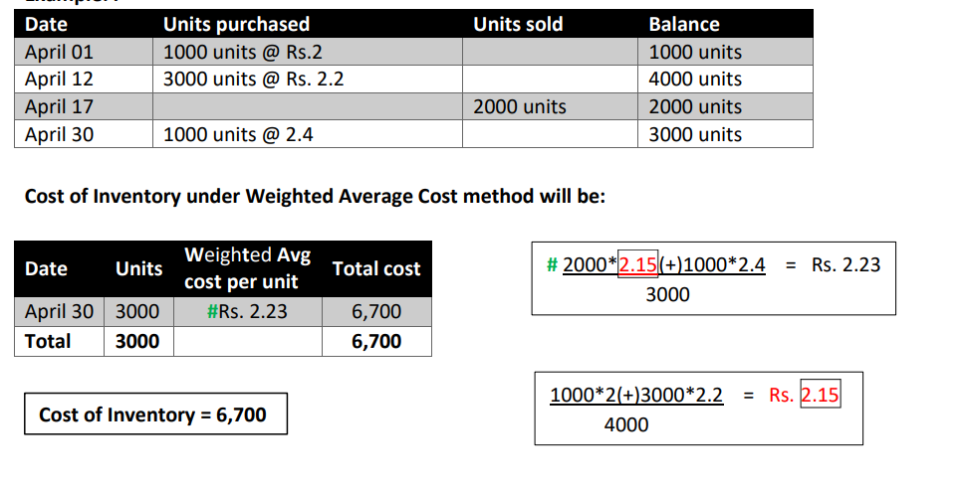
WEIGHTED AVERAGE

Slide 46
Techniques for the Measurement of Cost
Techniques for the measurement of the cost of inventories, such as the standard cost method or the retail method, may be used for convenience if the results approximate the actual cost. Standard costs take into account normal levels of consumption of materials and supplies, labour, efficiency and capacity utilisation. They are regularly reviewed and, if necessary, revised in the light of the current conditions

Slide 47
Retail Method
Where it is impracticable to use the costing methods referred to in FIFO and WA, the retail method can be used in the retail trade for measuring inventories of large number of rapidly changing items that have similar margins.
The cost of the inventory is determined by reducing from the sales value of the inventory, the appropriate percentage gross margin. The percentage used takes into consideration inventory, which has been marked down to below its original selling price

Slide 48
Retail Method
AS - 2 Ind AS - 2 | Adjusting sale value by appropriate percentage gross margin is the general approach permitted. An average percentage for each retail department is often used.

Slide 49
Example of the Retail Inventory Method
the iPhone costs RS. 30000 to manufacture and it sells for RS. 50000. The cost-to-retail ratio is 60% (30000/50000 * 100). Let's say that the iPhone had total sales of 18,00,00,000 for the period.
Beginning inventory: 10,00,00,000
New Purchases: 5,00,00,000
Total goods available for sale: 15,00,00,000
Sales: 10,80,00,000 (Sales of 18,00,00,000 x 60% cost-to-retail ratio)
Ending inventory: 4,20,00,000 (15,00,00,000 - 10,80,00,000)

Slide 50
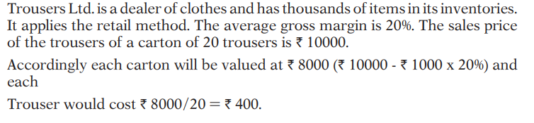

Slide 51
Net Realisable Value
Inventories shall be written down to net realisable value on an item-by-item basis.
Where ‘items of inventory’ relating to the same product line having similar purposes or end uses and are produced and marketed in the same geographical area and cannot be practicably evaluated separately from other items in that product line, such inventories shall be grouped together and written down to net realisable value on an aggregate basis.

Slide 52
NRV ……
Net realisable value shall be based on the most reliable evidence available at the time of valuation. The estimates of net realisable value shall also take into consideration the purpose for which the inventory is held. The estimates shall take into consideration fluctuations of price or cost directly relating to events occurring after the end of previous year to the extent that such events confirm the conditions existing on the last day of the previous year.

Slide 53
NRV ….
Materials and other supplies held for use in the production of inventories shall not be written down below the cost, where the finished products in which they shall be incorporated are expected to be sold at or above the cost.
Where there has been a decline in the price of materials and it is estimated that the cost of finished products will exceed the net realisable value, the value of materials shall be written down to net realisable value which shall be the replacement cost of such materials.

Slide 54
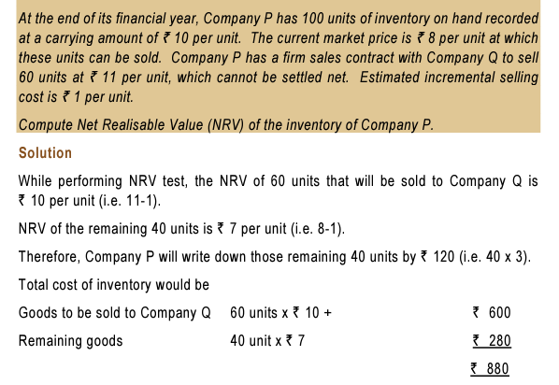

Slide 55
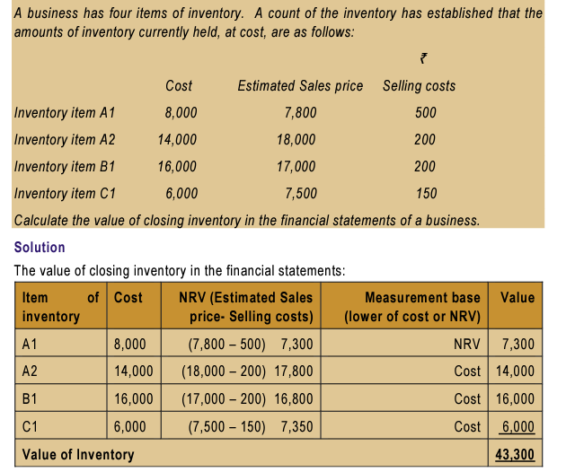

Slide 56
VALUE OF OPENING INVENTORY
The value of the inventory as on the beginning of the previous year shall be
(i) the cost of inventory available, if any, on the day of the commencement of the business when the business has commenced during the previous year; and
(ii) the value of the inventory as on the close of the immediately preceeding previous year in any other case.

Slide 57
CHANGE OF METHOD OF VALUATION OF INVENTORY
The method of valuation of inventories once adopted by a person in any previous year shall not be changed without reasonable cause. However, ‘reasonable cause’ is not defined. The guidance for the same will need to be taken from judicial precedents

Slide 58
Query: | Is the change of method of valuation of inventory justified?
 | Snow White Food Products Co. Ltd. v. CIT [1982] 10 Taxman 37 (Cal.)
 | FACTS: Assessee had been following the mercantile system of accounting hitherto and had done so even in the relevant year except for the interest income and that there was no resolution by the board of directors or the shareholders of the assessee supporting the change, except for a statement in the annual report to the effect that the management had decided to account for interest on cash basis, from which it was not established that the assessee had decided to change its regular method.
 | HELD: In the instant case the Tribunal had held specifically that on the evidence on record it could not be said the assessee had decided to change its existing regular method of accounting by another regular method. Hence, the Tribunal was right in holding that the assessee-company was not entitled to change its method of accounting from the mercantile to the cash system insofar as the credits in the interest account were concerned and thus, the interest accrued during the relevant year but not received was liable to be included in that assessment year.
Conclusion | The method of valuation of inventory shall not be changed without a reasonable cause and shall be followed consistently in subsequent year.

Slide 59
Change in Method of Valuation
AS - 2 | Change from one cost formula to another constitutes a change in an accounting policy. As such, pursuant to AS 5, a change in method of valuation of inventories should be made only if it is required by statute or for compliance with an AS or if it is considered that the change would result in a more appropriate presentation of the financial statements of the enterpri
Ind AS - 2 | Change from one cost formula to another constitutes a change in an accounting policy. A change in an accounting policy can only be made if the change is required by an Ind AS, or results in the financial statements providing reliable and more relevant information

Slide 60
VALUATION OF INVENTORY IN CASE OF CERTAIN DISSOLUTIONS
In case of dissolution of a partnership firm or association of person or body of individuals, notwithstanding whether business is discontinued or not, the inventory on the date of dissolution shall be valued at the net realisable value.
ICDS II now prescribes valuation of inventory at NRV in all cases where there is dissolution of a firm, AOP or BOI, irrespective of the fact whether on dissolution the business has been discontinued or not.
AS - 2 Ind AS - 2 | Because of going concern assumption, these situations are not dealt with in AS 2 and Ind AS 2

Slide 61
FORM 6D

Slide 62
ILLUSTRATION

Slide 63
STEPS TO BE FOLLOWED
1. Verification Of Financial Records.
2. Understanding The Industry.
3. Knowing About Accounting Policies Adopted.
4. Comparing Inventory In Books As Per As/Ind As With ICDS.
5. Calculating Cost And NRV – Element Wise
6. Raw Material Constituting 80% Should Be Classified And Reported.
7. Valuation Separately For RM, WIP, FG, TG, Consumables, Biological Assets, Financial Instruments.
8. Reconciliation Between ICDS And AS Valuation.

