Slide 1
INCOME ESCAPEMENT ASSESMENT U/S 147

Slide 2
New Reassessment Scheme introduced by the Finance Act, 2021 w.e.f 01.04.2021 and amended by the Finance Act 2022 and 2023

Slide 3
Intention and purpose of substituting the erstwhile reassessment provisions with the new provisions
Intention and purpose of the Enactment is clear from the paras 153 and 154 of the Budget Speech of the Hon’ble Finance Minister for the year 2021-22.
“Reduction in Time for Income Tax Proceedings
153. Honourable Speaker, presently, an assessment can be re-opened up to 6 years and in serious tax fraud cases for up to 10 years. As a result, taxpayers have to remain under uncertainty for a long time.
154. I therefore propose to reduce this time-limit for re-opening of assessment to 3 years from the present 6 years. In serious tax evasion cases too, only where there is evidence of concealment of income of `50 lakh or more in a year, can the assessment be re-opened up to 10 years. Even this reopening can be done only after the approval of the Principal Chief Commissioner, the highest level of the Income Tax Department.”
Also Memorandum explaining the provisions of Finance Bill 2021 proposes that the new system would result in less litigation and would provide ease of doing business to the taxpayers as there is a reduction in time limit by which a notice for assessment or reassessment or re-computation can be issued.

Slide 4
Introduction of new Re-assessment scheme
New re-assessment scheme came into effect from 01.04.2021.
The legislature vide the Finance Act, 2021 completely revamped the scheme of reassessment by substituting the provisions of sections 147, 148,149 & 151 and brought in safeguards in new scheme in accordance with the judgment of the Hon’ble Supreme Court in GKN Driveshafts (India) Ltd. [2003] 259 ITR 19 by inserting section 148A.
The term or phrase “reasons to believe” has been substituted with the term “information which suggests that income chargeable to tax has escaped assessment ”.
Change in time limits and specified authority.
No separate provision or time limit for reassessment in case of undisclosed foreign asset(including financial interest in any entity) and foreign income.

Slide 5
Key aspects , salient features and recent controversies in the amended Sections 148, 148A, 149 and 151

Slide 6
Key aspects and salient features –Reassessment scheme w.ef. 01.04.2021
Prior to 01.04.2021, the requirement to reopen the case u/s 147 was “reasons to believe” which has now been substituted with the requirement of “information which suggests that income chargeable to tax has escaped assessment ” under amended section 148 of the Act.
Section 148 has been completely substituted and it provides that the notice u/s 148 shall be served on the assessee along the order passed u/s 148A(d), if required. However, in many cases, AOs are passing the orders u/s 148A(d) before the date of issuance of notice u/s 148-Is this action valid? Can 148A(d) order be passed and served to the assessee before issuance of notice u/s 148?
First Proviso to section 148 provides that no notice u/s 148 shall be issued unless:
there is “information which suggests that income chargeable to tax has escaped assessment”; and
Prior approval of the specified authority under section 151
No approval to issue notice u/s 148 is required when the order u/s 148A(d) is passed with the prior approval of the specified authority (Second Proviso to Section 148)

Slide 7
4) “Information which suggests that income chargeable to tax has escaped assessment” for the purpose of section 148 and 148A has been specifically defined in the Explanation 1 of Section 148:
any information in accordance with risk management strategy formulated by the Board
any audit objection that assessment has not been made in accordance with the provisions of the Act;
any information received under DTAA ( Section 90 or 90A);
any information made available to the Assessing Officer under the scheme notified under section 135A;-
any information which requires action in consequence of the order of a Tribunal or a Court-

Slide 8
Risk Management Strategy
Risk Management Strategy is neither defined in the section 148 nor notified by the CBDT Except CBDT INSTRUCTION F. NO. 225/135/2021/ITA-II, DATED 10-12-2021
In the above CBDT Instruction, the criteria for implementation of Risk Management Strategy has been defined for AYs 2015-16 and 2018-19 and the Assessing Officers were directed to identify the following categories of information pertaining to Assessment Year 2015-16 and Assessment Year 2018-19, which may require action under section 148 of the Act, for uploading on the Verification Report Upload (VRU) functionality on Insight portal:
Information from any other Government Agency/Law Enforcement AgencyInformation arising out of Internal Audit objection, which requires action u/s 148 of the Act
Information received from any Income-tax Authority including the assessing officer himself or herself
Information arising out of search or survey action
Information arising out of FT&TR references
Information arising out of any order of court, appellate order, order of NCLT and/or order u/s 263/264 of the Act, having impact on income in the assessee's case or in the case of any other assessee

Slide 9
vi. Cases involving addition in any assessment year on a recurring issue of law or fact:
exceeding Rs. 25 lakhs in eight metro charges at Ahmedabad, Bengaluru, Chennai, Delhi, Hyderabad, Kolkata, Mumbai and Pune while at other charges, quantum of addition should exceed Rs. 10 lakhs;
exceeding Rs. 10 crore in transfer pricing cases.
and where such an addition:
has become final as no further appeal has been filed against the assessment order; or
has been confirmed at any stage of appellate process in favor of revenue and assessee has not filed further appeal; or
has been confirmed at the 1st stage of appeal in favor of revenue or subsequently; even if further appeal of assessee is pending, against such order.
No further CBDT Circular has been issued explaining the criteria for implementation of Risk Management Strategy for reopening other AYs.
Whether same criteria of Risk Management Strategy shall be applied for other AYs in absence of any clarification?

Slide 10
5) Deemed Information – Explanation 2 to Section 148- In the cases of search u/s 132 or requisition u/s 132A or Survey u/s 133A (except TDS survey u/s 133A(2A) and Other than searched person cases (153C)- -AO shall be deemed to have information which suggests that the income chargeable to tax has escaped assessment

Slide 11
Procedure u/s 148A to be followed before issuance of notice u/s 148
Prior to issuance of notice under section 148, AO is required to follow the procedure prescribed under clauses (a) to (d) of the Section 148A and pass an order under section 148A(d).
The AO, under section 148A, is obliged to:
Conduct enquiry, with the prior approval of the specified authority, with respect to information which suggests that income of the assessee has escaped assessment [section 148A(a)];
Issue a notice upon the assessee to show-cause why notice under section 148 should not be issued and provide an opportunity of being heard to the assessee [section 148A(b)]. Time period of at least 7 days but not exceeding 30 days to be provided to respond to show cause notice. Extended time may be allowed on application in this behalf.
Consider the reply of the assessee [section 148A(c)];
“Decide” on the basis of material available on record and the reply furnished by the assessee, by passing “an order” within one month of receipt of assessee's reply whether or not it is a fit case for issuance of notice under section 148, with prior approval of specified authority [section 148A(d)].
Procedure provided in section 148A is not applicable in cases of search, survey or requisition initiated or made on or after 01.04.2021 [First Proviso to Section 148A]

Slide 12
Section 149-Time Limits for issuance of notice u/s 148
7) In terms of the amended section 149(1), notice under section 148 can be issued:
within 3 years from the end of the relevant assessment year, unless the case falls under clause b);
within 10 years from the end of the relevant assessment year, where, the AO has in his possession ‘books of accounts’ or ‘other documents’ or ‘evidence’ which reveal that income chargeable to tax, which has escaped assessment amounts to or is likely to amount to Rs.50 lakhs or more for the said year, and is represented in the form of:
an asset;
expenditure in respect of a transaction or in relation to an event or occasion; or
an entry or entries in the books of account.
For the purpose of clause (b), “Asset" shall include immovable property, being land or building or both, shares and securities, loans and advances, deposits in bank account.
8) Section 149 (1A) provides that, if income escaping assessment in the form of an asset or expenditure in relation to an event or occasion of Rs.50 lakhs or more is in relation to more than one assessment year within the extended period of 10 years, then, notice under section 148 can be issued for every such assessment year-If asset or expenditure is more than Rs. 50 lakh but spread over 2 or more years – can reopen all the years

Slide 13
Amended time limit after FA 2024
For section 149 of the Income-tax Act, the following section shall be substituted with effect from the 1st day of September, 2024, namely 149.
(1) No notice under section 148 shall be issued for the relevant assessment year,-
(a) if three years and three months have elapsed from the end of the relevant assessment year, unless the case falls under clause (b);
(b) if three years and three months, but not more than five years and three months, have elapsed from the end of the relevant assessment year unless the Assessing Officer has in his possession books of accounts or other documents or evidence related to any asset or expenditure or transaction or entries which show that the income chargeable to tax, which has escaped assessment, amounts to or is likely to amount to fifty lakh rupees or more.
(2) No notice to show cause under section 148A shall be issued for the relevant assessment year,—
(a) if three years have elapsed from the end of the relevant assessment year, unless the case falls under clause (b);
(b) if three years, but not more than five years, have elapsed from the end of the relevant assessment year unless the income chargeable to tax which has escaped assessment, as per the information with the Assessing Officer, amounts to or is likely to amount to fifty lakh rupees or more.

Slide 14
First Proviso to Section 149(1) containing grandfathering clause: As per the first proviso to section 149(1) of the Act, applicable w.e.f. 1.4.2021, no notice under section 148 of the Act can be issued at any time in a case for the relevant assessment year beginning on or before 01.04.2021, if the time limit for issuing notice u/s 148 or section 153A, or section 153C as specified under clause (b) of the un-amended section 149(1) or section 153A or 153C Act, as the case may be, had expired at that time. [Refer the table attached below for more understanding]
A.Y. | 2021-22 | 2020-21 | 2019-20 | 2018-19 | 2017-18 | 2016-17 | 2015-16 | 2014-15 | 2013-14 | 2012-13
Issue of Notice by: | Yes | Yes | Yes | Yes | Yes | Yes | Yes | No | No | No
31.03.2022 | Yes | Yes | Yes | Yes | Yes | Yes | No | No | No | No
31.03.2023 | Yes | Yes | Yes | Yes | Yes | No | No | No | No | No
31.03.2024 | Yes | Yes | Yes | Yes | No | No | No | No | No | No
31.03.2025 | Yes | Yes | Yes | No | No | No | No | No | No | No
31.03.2026 | Yes | Yes | No | No | No | No | No | No | No | No
31.03.2027 | Yes | Yes | No | No | No | No | No | No | No | No
31.03.208 | Yes | No | No | No | No | No | No | No | No | No

Slide 15
Note: The table is not factoring possibility of notices which could have been issued u/s. 153A or 153C as per law prior to Finance Act, 2021. It may be noted that as per the provisions of section 153A or 153C which stood prior to Finance Act, 2021, 10 years could have been reopened subject to the condition that there is some evidence which reveal that income represented in the form of asset has escaped assessment.
Another View on the interpretation of the First Proviso to Section 149(1): Assessment for assessment year 2021-22 and years prior thereto can, even under the new regime, be reopened only up to 6 years (and not 10 years). If time-limit for issuance of notice under section 148 has expired on 31.03.2021, in terms of the pre-amended provisions, then notice cannot be issued under the new reassessment scheme.
As per this Interpretation, Only AYs 2013-14 and 2014-15 could not be reopened after 31.03.2021 since limitation was expiring on 310.3.2021 only for these 2 AYs under clause (b) of un-amended section 149(1)

Slide 16
10) Case cannot be reopened under new reassessment scheme if search u/s 132 or requisition u/s 132A is prior to 1.4.2021-Assessment shall be made u/s 153A or 153C in cases of search or requisition prior to 01.04.2021-2nd Proviso to Section 149
11) Time limit prescribed under section 149 of the Act shall exclude:
the time or extended time allowed to the assessee to respond to show cause notice under section 148A(b); or
any period during which the proceedings under section 148A are stayed by an order of any Court.
If after excluding the aforesaid period, time available for passing order under section 148A(d) does not exceed 7 days, the remaining time shall be deemed to be extended to 7 days and the period of limitation under section 149(1) shall be deemed to extended accordingly. [5th and 6th Proviso to Section 149(1)-These were 3rd and 4th Proviso before the F.A 2023 ]

Slide 17
Approvals for reopening –specified authority u/s 151, u/s 148B and in other cases
12) Approval of Specified Authority [section 151]: For the purposes of section 148 and 148A, “specified authority” shall be:
Where 3 years or less have elapsed from the end of the relevant assessment year, Pr. CIT, Pr. DIT, CIT or DIT;
Where more than 3 years have elapsed from the end of the relevant assessment year, Pr. CCIT, Pr. DGIT, CCIT or DGIT, as applicable.
13) In cases where re-assessment is initiated on the basis of ‘deemed information’ (i.e., search, requisition and survey cases), no reassessment order shall be passed by an AO below the rank of Jt. CIT except with prior approval of the Addl. CIT/ Addl. DIT or Jt. CIT/ DIT. [Section 148B]
14) Reassessment based on search in case of other person(153C-for understanding)-
AO of the other person shall have to record satisfaction with prior approval of Principal Commissioner or Commissioner;
Then approval has to be obtained from specified authority u/s 151 to issue notice u/s 148 as per the first proviso. Thus, 2 approvals are to be taken in 153C cases.
No need of procedure u/s 148A.

Slide 18
“Information which suggests that income chargeable to tax has escaped assessment”-Applicability of Jurisprudence established under old reassessment scheme
Amended section 148 provides that no notice can be issued unless there is information which suggests that income chargeable to tax has escaped assessment. In the erstwhile section 148, AO was only required to record the reasons for reopening before issuance of notice.
Courts have interpreted the phrase ‘reason to believe’, to lay down several judicial principles to prevent abuse of powers by the AO. [Ref: Kelvinator India (Supra)]
In absence of the phrase ‘reason to believe’ under the new scheme, whether the jurisprudence developed under the old regime will still be applicable?

Slide 19
5) Whether the following legal parameters/tests which were used to determine the valid reasons to believe under old law will still be applicable under new reassessment scheme:
Tangible Material and Information showing live link with the allegation of escapement of income;
Whether external source or reconsideration of material on record;
Whether the judicial concept of ‘change of opinion’ developed under the erstwhile re-assessment law is still applicable to the new re-assessment scheme?
Non-Existing Transactions or Defective and Incorrect Information and facts showing lack of application of mind;
Whether allegation mentioned in the show cause notice u/s 148A(b) be subsequently modified/changed in the order passed u/s 148A(d)
Show cause Notice u/s 148A(b) in the form of questionnaire seeking details/Roving and Fishing Enquiry
Whether Information and material can be furnished after passing of order u/s 148A(d)

Slide 20
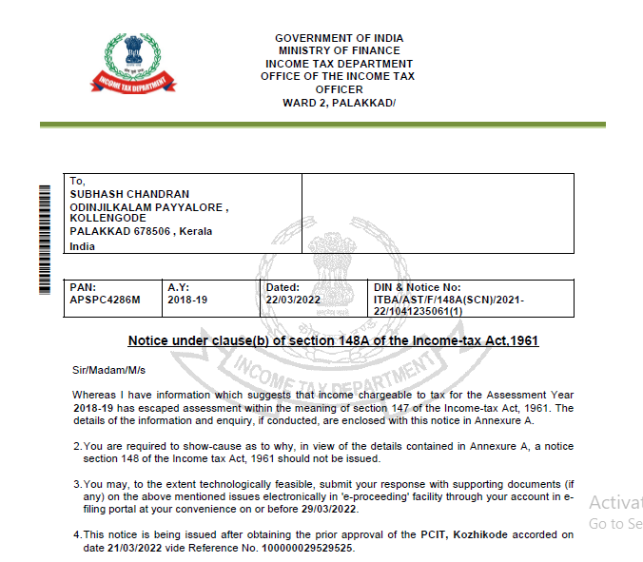
Notice u/s 148A(b)

Slide 21
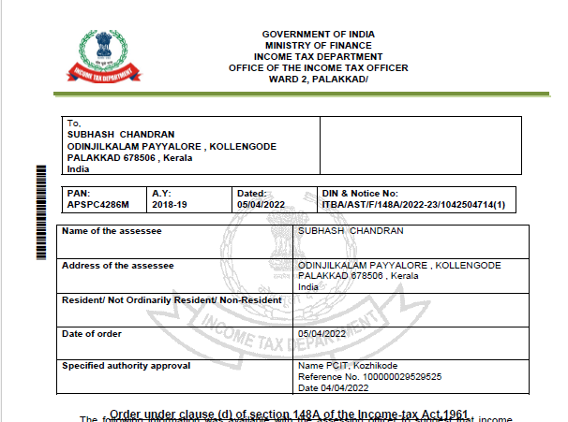
Order u/s 148A(d)

Slide 22
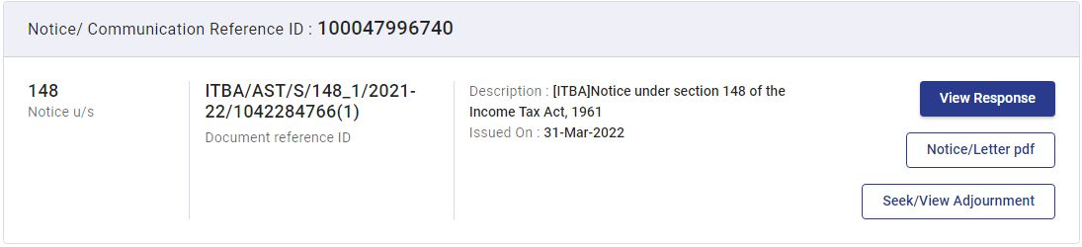
Notice u/s 148 can be issued whether or not the assessee have furnished return.
The assessee can seek adjournment of the time limit for furnishing return as specified in Section 148 through the option available in the portal :
Option to seek adjournment

Slide 23
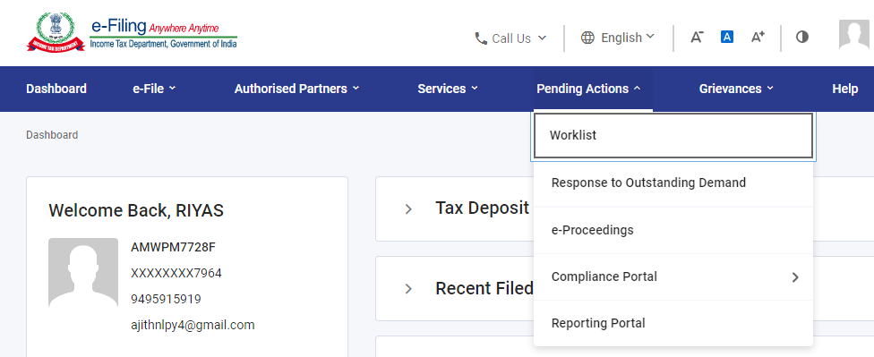
The proceeding notices/orders can be seen in the e-proceedings facility in the e-filing portal. It can be accessed by the following steps :
1.Login to Income Tax Website
2.Pending actions e proceedings.

Slide 24
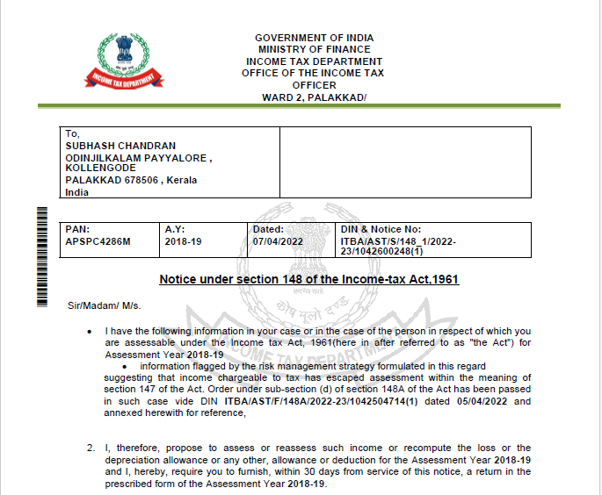
Notice u/s 148

Slide 25
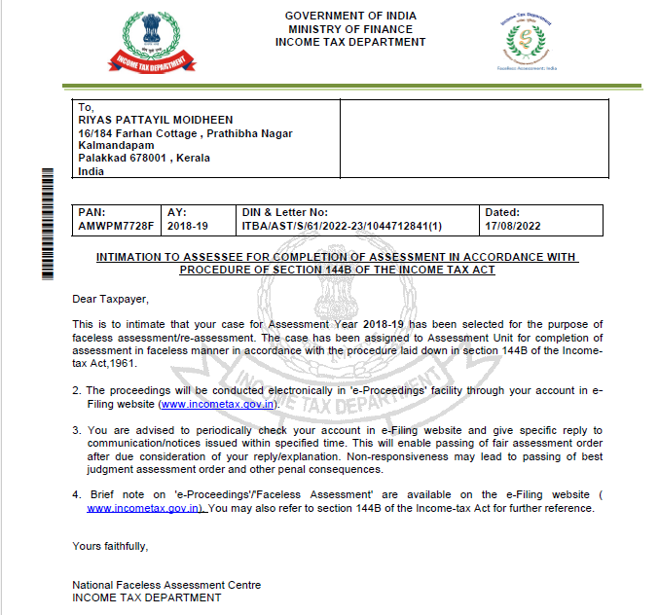
Intimation under section 144B (Faceless Assessment)

Slide 26
Conducting inquiry, providing opportunity before issuance of notice u/s 148 (Sec.148A)
The assessing officer, before issuance of notice u/s 148, provide an opportunity of being heard to the assessee, by serving upon him a notice to show cause within such time, as may be specified in the notice, as to why a notice under section 148 should not be issued. [Sec 148A(b)]
Time limit for reply : 7 days – 30 days (as specified in notice)

Slide 27
After considering the reply of the assessee furnished, if any, in response to the show-cause notice referred to in clause (b), the assessing officer will decide on the basis of material available on record including reply of the assessee, whether or not it is a fit case to issue a notice under section 148, by passing an order, with the prior approval of specified authority. [148A(d)]
Time limit for order :
If assessee furnished reply to show cause notice u/s 148A(b) – within 30 days of reply
If no reply to the show cause notice - within one month from the end of the month in which time or extended time allowed to furnish a reply as per clause (b) expires.

Slide 28
Option u/s 148A (inquiry/opportunity for being heard) shall not be available in the following situations:
a search is initiated u/s 132 or books of account, other documents or any assets are requisitioned u/s 132A in the case of the assessee on or after 01-04-2021; or
The Assessing Officer is satisfied, with the prior approval of the Principal Commissioner or Commissioner that any money, bullion, jewellery or other valuable article or thing, seized in a search u/s 132 or requisitioned u/s 132A, in the case of any other person on or after 01-04-2021, belongs to the assessee; or

Slide 29
The Assessing Officer is satisfied, with the prior approval of the Principal Commissioner or Commissioner that any books of account or documents, seized in a search u/s 132 or requisitioned u/s 132A, in case of any other person on or after 01-04-2021, pertains or pertain to, or any information contained therein, relate to, the assessee; or
The Assessing Officer has received any information under the scheme notified u/s 135A pertaining to income chargeable to tax escaping assessment for any assessment year in the case of the assessee.

Slide 30
After furnishing the return, the Assessing Officer shall intimate the assessee that the case has been selected for the purpose of faceless assessment/re-assessment
Faceless Assessment [Sec 144B]
Notwithstanding anything to the contrary contained in any other provision of this Act, the assessment, reassessment or recomputation under sub-section (3) of section 143 or under section 144 or under section 147, as the case may be, with respect to the cases referred to in sub-section (2), shall be made in a faceless manner.
The proceedings will be conducted electronically in 'e-Proceedings' facility through the assessee’s e-filing website.

Slide 31
Inquiry before assessment [Sec. 142]
Issue of notice to the assessee [Sec. 142(1)] –
to submit a return [Sec. 142(1)(i)]
Assessing Officer may require him to submit a return in the prescribed form on or before the date specified in the notice.
In case assessee has not furnished the return of income, it is not mandatory for the Assessing Officer to issue notice u/s 142(1)(i) if he wishes to make best judgment assessment.
to produce accounts, documents etc. [Sec. 142(1)(ii) & (iii)]
The Assessing Officer may ask the assessee to produce such documents or accounts as he may require.
The prior approval of the Joint Commissioner shall be obtained for this.
The Assessing Officer shall not require the production of any accounts relating to a period more than three years prior to the previous year.

Slide 32
2. Inquiry
For the purpose of obtaining full information in respect of the income (or loss) of any person, the Assessing Officer may make such inquiry, as he considers necessary.
3. Giving direction to get books of account audited [Sec. 142(2A) to (2D)]
The Assessing Officer (after giving reasonable opportunity to the assessee) may direct the assessee to get his accounts audited if he is of the opinion that it is necessary to do.
Such direction can be issued even if the accounts of the assessee have already been audited u/s 44AB or any other law for the time being in force

Slide 33
4. Opportunity of being heard [Sec. 142(3)]
The assessee must be given an opportunity of being heard in respect of any material gathered on the basis of any inquiry u/s 142(2) or any audit u/s 142(2A) and is proposed to be utilised for the purpose of the assessment.
The assessing Officer may issue notice u/s 142(1) multiple times as and when he required to collect details for the completion of asssessment within the time specified in the notice.
Time limit for reply for notice u/s 142(1) - as specified in the notice
An option for personal hearing may be provided by the assessing officer to the assessee at his request.

Slide 34
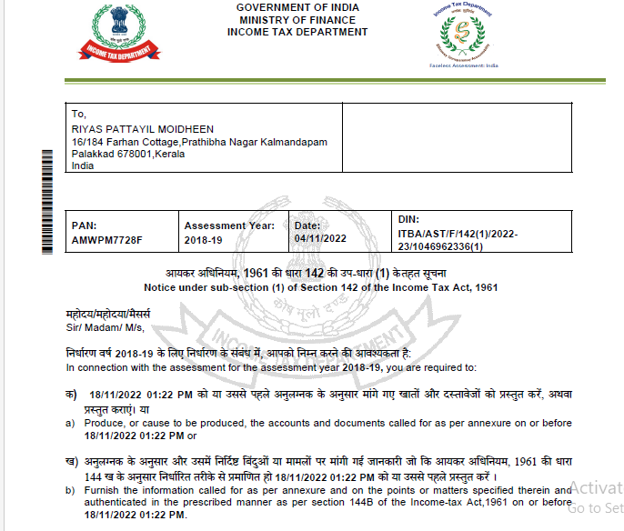
Notice u/s 142(1) requiring production of documents

Slide 35
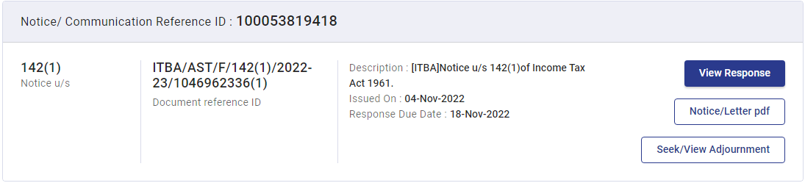
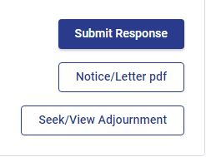
The assessee shall reply to such notice within the time limit mentioned in the notice, in the manner specified in section 144B.
The response shall be made by clicking the following option available under the e-proceedings facility.

Slide 36
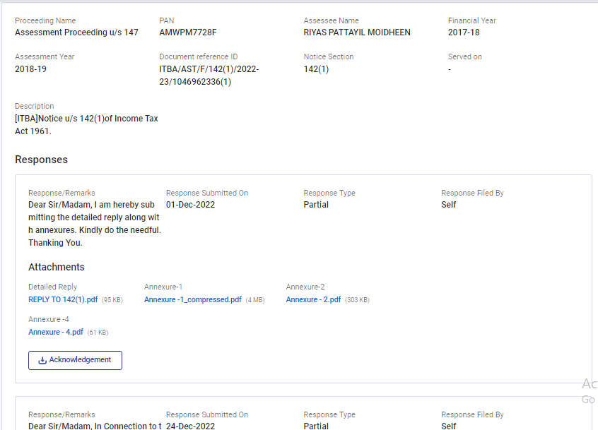
Snap of submitted response

Slide 37
Notice for scrutiny [Sec. 143(2)]
Where a return has been furnished under section 139, or in response to a notice under sub-section (1) of section 142, the Assessing Officer or the prescribed income-tax authority, as the case may be, if, considers it necessary or expedient to ensure that the assessee has not understated the income or has not computed excessive loss or has not under-paid the tax in any manner, shall serve on the assessee a notice requiring him to produce, or cause to be produced before the Assessing Officer any evidence on which the assessee may rely in support of the return:
Time limit for reply – as specified in the notice

Slide 38
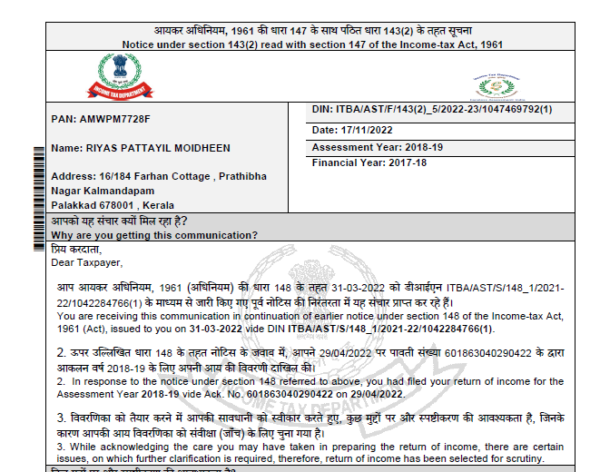
Notice u/s 143(2) (For scrutiny)

Slide 39
During the proceeding, the assessing officer may seek for additional information by issuing a notice u/s 142(1) .
After considering the reply(ies) furnished by the assessee, the assessing officer may drop the proceedings if he is satisfied.
If he is not satisfied he shall proceed to issue a show cause notice u/s 147 before concluding the proceedings.
Time limit for reply to show cause notice – as specified in the notice

Slide 40
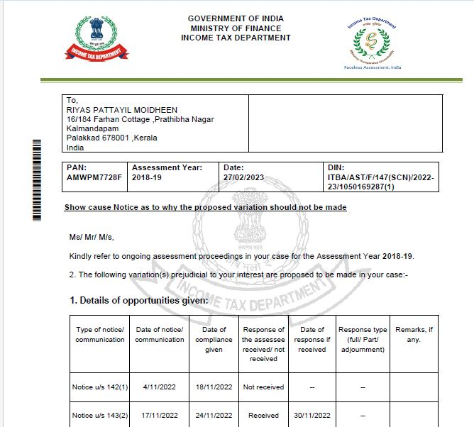
Show cause notice u/s 147

Slide 41
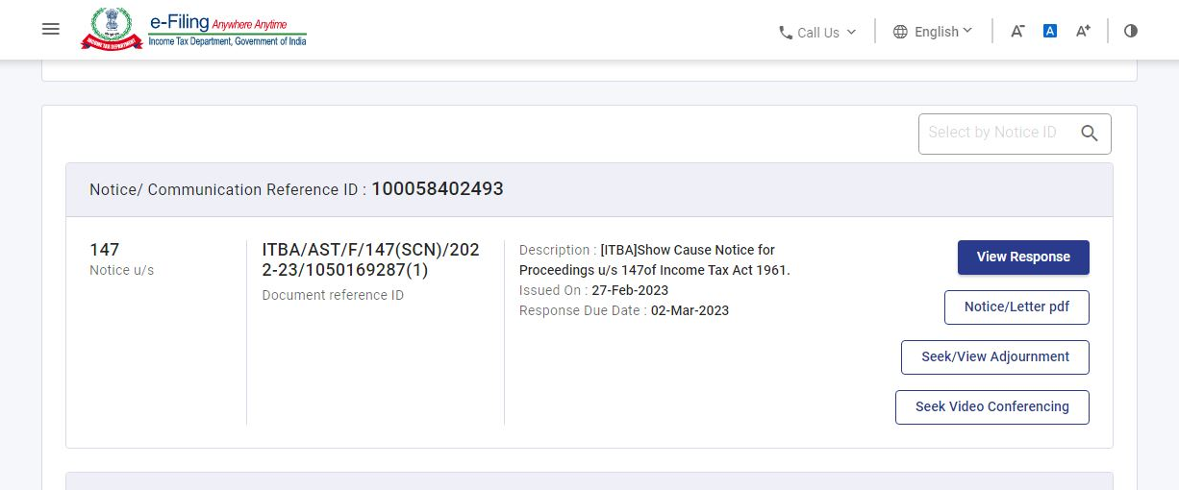
The assessee can seek time extension for furnishing reply to the show cause notice.
He may also seek video conferencing through the option available in the portal.

Slide 42
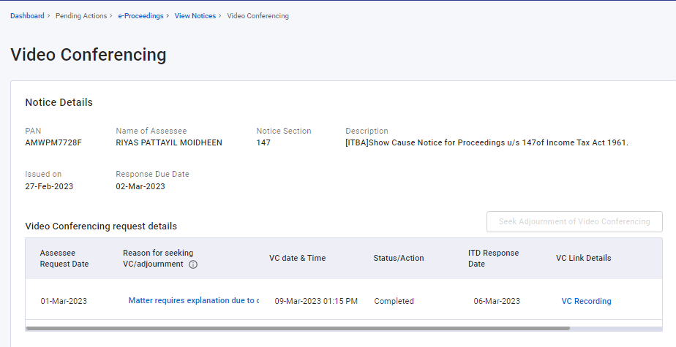
Request for Video conferencing

Slide 43
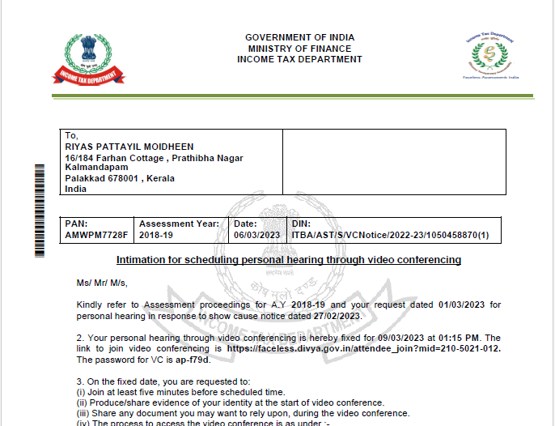
The assessing officer shall as requested by the assessee, provide an opportunity for video conferencing.

Slide 44
If the assessing officer is satisfied with the reply, he shall drop the proceedings.
Otherwise he shall issue the speaking Assessment Order u/s 147 stating :
the brief facts of the case,
the details of opportunities given,
Grounds for disallowing the matters specified in the replies,
Final computation of taxable income,…
The closure order shall also contain a demand notice, stating the amount payable by the assessee and a computation sheet.

Slide 45
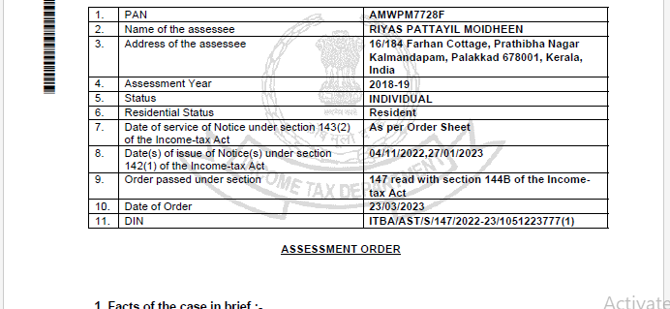
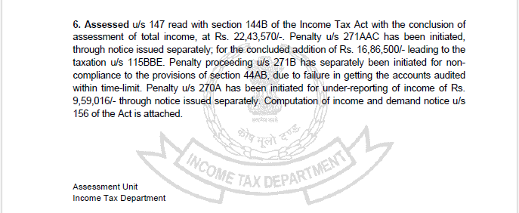
Assessment order

Slide 46
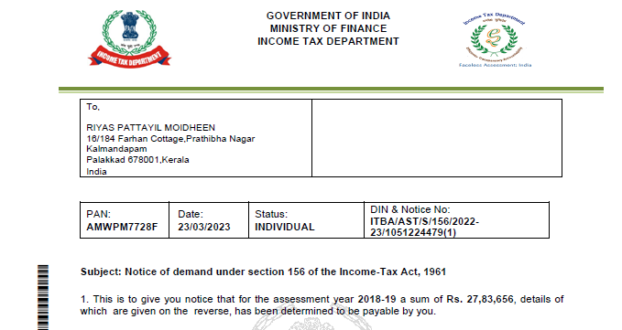
Demand Notice

Slide 47
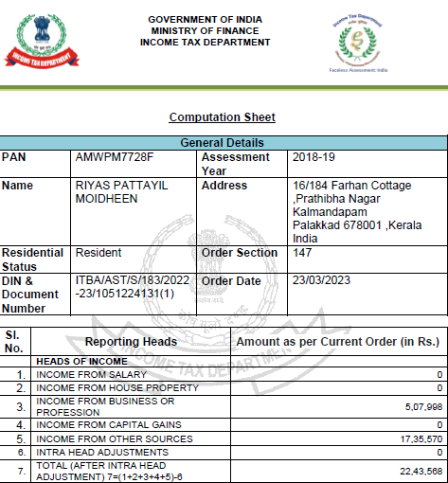
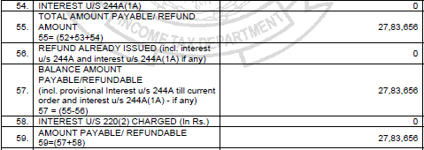

Slide 48
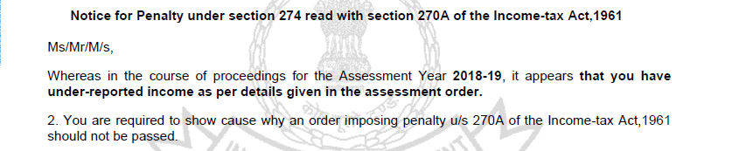
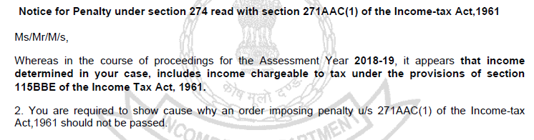
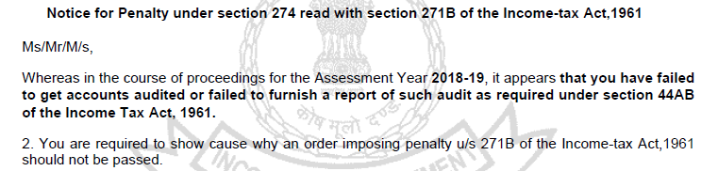
Simultaneously, he may also initiate penalty proceedings, if any by issuing Show cause notices, depending upon the case
.
.
.
Time Limit to reply - as specified in notice

Slide 49
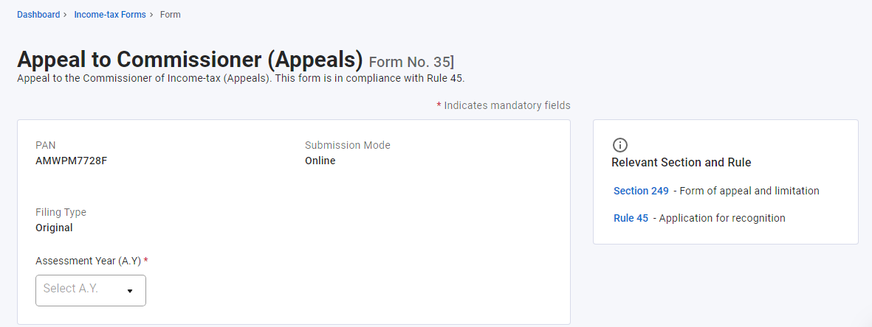
If the assessee is aggrieved by the order of the Assessing Officer (AO), he can file an appeal against the same before the Commissioner of Income Tax (Appeals) by submitting duly filled Form 35 online on the e-Filing portal.
Every appeal is accompanied by an appeal fee, quantum of which depends on the total income as computed/assessed by the assessing officer.
Time limit – within 30 days of order u/s 147

