Slide 1
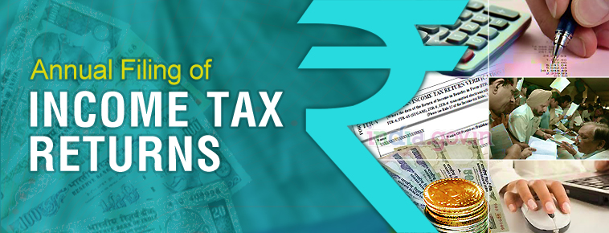
B.Com, ACMA, ACA, Ad Dip MA CIMA(UK)

Slide 2
COMPULSORY FILING OF RETURN
Companies and Firms are mandatorily required to file the return.
Any other person, being resident other than not ordinarily resident, shall furnish, a return, within due date, in respect of his income or loss for the previous year irrespective of the fact that his total income does not exceed basic exemption limit or does not have any taxable income, if he:
a) holds, as a beneficial owner or otherwise, any asset (including any financial interest in any entity) located outside India or has signing authority in any account located outside India; or
b) is a beneficiary of any asset (including any financial interest in any entity) located outside India.
Exception: An individual, being a beneficiary of any asset (including any financial interest in any entity) located outside India where, income, if any, arising from such asset is includible in the income of the person referred above in accordance with the provisions of this Act.

Slide 3
MANDATORY FURNISHING OF RETURN IN CASE OF HIGH VALUE TRANSACTIONS
A person (other than firm and company), who is not required to furnish a return as per aforesaid provision, and who during the previous year
1
Has deposited an aggregate amount exceeding Rs.1 crore in one or more current accounts maintained with a banking company or a co-operative bank : or
2
3
4
Has incurred expenditure of an aggregate amounts exceeding Rs.2 lakh for himself or any other person for foreign travel to a foreign country: or
Has incurred expenditure of an aggregate amount exceeding Rs. 1 lakh towards consumption of electricity; or
Fulfills such other conditions as may be prescribed,
shall furnish a return of his income on or before the due date in such form and verified in such manner and setting forth such other particulars, as may be prescribed.

Slide 4
INCOME TAX RETURNS
ITR 1 (SAHAJ)
For Individuals having Income from Salaries, one house property (does not have any brought forward loss), other sources [Interest (does not have any loss under the head) etc. but except winnings from lottery or income from race horses] and having total income upto` 50 lakh. However, the form is not to be used for an individual who is either Director in a company or has invested in unlisted equity shares or has any brought forward / carry forward loss under the head ‘Income from House Property’ or has to furnish return under seventh proviso to section 139(1) of the Income Tax Act
ITR 2
ITR 3
For Individuals and HUFs not carrying out business or profession under any proprietorship
ITR 4 (Sugam)
For Individuals and HUFs having income from a proprietary business or profession
For presumptive income from Business & Profession However, the form is not to be used for an individual who is either Director in a company or has invested in unlisted equity shares or has any brought forward / carry forward loss under the head ‘Income from House Property’

Slide 5
ITR 5
For person other than (i) Individual; (ii) HUF; (iii) Company; & (iv) Person filing Form ITR-7
ITR 6
For Companies other than companies claiming exemption u/s 11
ITR 7
For persons including companies required to furnish return u/s 139(4A) or 139(4B) or 139(4C) or139(4D) or 139(4F)
ITR- V
Income Tax Return Verification Form [Where the data of the aforesaid Return of Income has transmitted electronically without digital signature]

Slide 6

A SESSION ON FILING OF ITR 5

Slide 7
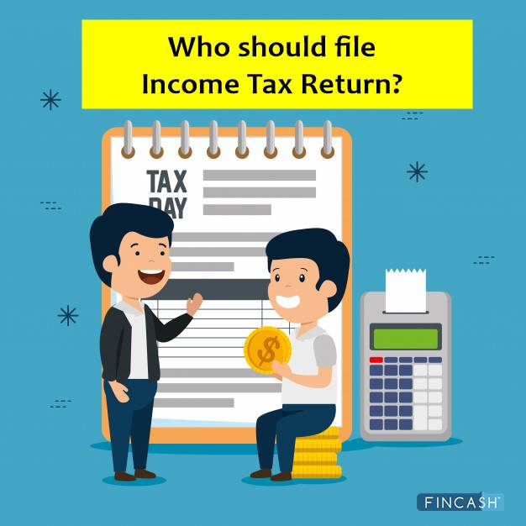
ITR – 5?

Slide 8
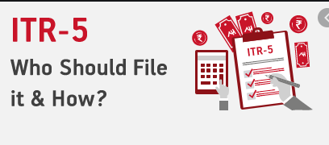
Who should file ITR – 5?
Following are the persons eligible to file ITR-5:
A Firm
Limited Liability Partnership (LLP)
Association of Persons (AOP)
Body of Individuals (BOI)
Artificial Juridical Person (AJP) referred to in clause (vii) of section 2(31)
Local Authority referred to in clause (vi) of section 2(31)
Representative Assessee referred to in section 160(1)(iii) or (iv)
Co operative society registered under Societies Registration Act, 1860 or under any other law of any State,
estate of deceased person, estate of an insolvent,
business trust referred to in section 139(4E)
investments fund referred to in section 139(4F).
?
However, a person who is required to file the return of income under section 139(4A) or 139(4B) or 139(4D)shall not use this form.

Slide 9

Key Changes
(as compared to ITR for AY 2020-21)
Option to avail benefit u/s 115BAD is provided in ITRs, after filing Form 10IF, for Cooperative societies being:
Primary Agricultural Credit Society
Primary Co‐operative Agricultural and Rural Development bank
Co‐operative Bank other than “a primary agricultural credit society” or “a primary co‐operative agricultural and rural development bank”
Other Cooperative Society

Slide 10
For co‐operative societies opting under 115BAD, tax will be charged at 22% and surcharge will be charged at 10% from Rs.1/‐ onwards. Also, such assessee’ s are not eligible for certain deductions and allowances as mentioned below :
o Exemption u/s 10AA
o Additional depreciation under clause (iia) of sub‐section (1) of section 32
o Deduction u/s 32AD / 33AB / 33ABA
o Deduction under sub‐clause (ii) or sub‐clause (iia) or sub‐clause (iii) of subsection (1) or sub‐section (2AA) of section 35
o Deduction under section 35AD
o Deduction under section 35CCC or
o Deduction under Chapter VIA except 80JJAA and 80LA(1A) incase of IFS unit.
o Any amount in brought forward losses to the extent of above deductions
will not be allowed to set off and carry forward and
o Any brought forward loss to the extent of unabsorbed depreciation will be
added back to the asset.

Slide 11
Option of Filing ITR in response to notice u/s 153A and 153C is removed from ITR as requirement to file ITR under these sections is omitted.
In AY 2020‐21 , the threshold limit for a person carrying on business was increased from one crore rupees to five crore rupees in cases where the cash receipts or payments by a business don’t exceed 5% of the such receipts or such payments, however in AY 2021‐22 , the limit of five crore rupees is increased to ten crore rupees
The existing restriction of 17 codes in Nature of business/profession schedule is removed.
Loss (negative value) under “No books of account” at sl.no.65 in Sch P&L is restricted.
In schedule BP, Income/ receipts credited to profit and loss account considered under head “other sources” has been bifurcated into 2 parts as
  “Dividend income” and
  “Other than dividend income”

Slide 12
All the fields related to 115B – Income Life insurance Business i.e.,
  sl.no.4b, Sl.no.Table E "Computation of income from life insurance business referred to in section 115B " of Schedule BP,
  Sl.no.iv of Sch CYLA, Sl.no.iii of Schedule BFLA,
  Col 8 of Schedule CFL and
  sl.no.12 of Schedule SI
have been removed. And corresponding mapping has been updated in Part B‐TI
Section 44BBB is removed from Sl.no.4a and sl.no.36 of Schedule BP
In Schedule DPM, the column "3a.Amount as adjusted on account of opting for taxation section 115BAD" and "3b. Adjusted Written down value on the first day of previous year (3) + (3a)" has been added . Hence corresponding mapping changes are made in schedule DPM
CBDT vide notification dated 20th September 2019 increased depreciation to 45% on motor cars, motor buses etc wrt assets purchased on or after the 23rd day of August, 2019 but before the 1st day of April, 2020 and is put to use before the 1st day of April, 2020. Therefore, no additions will be allowed in 45% block from the AY 2021‐22 w.r.t to such assets.

Slide 13
In Schedule CG, the allowable difference between full value of consideration u/s. 50 C and value of property as per stamp authority has been increased from 1.05 times to 1.10 times
In schedule OS,
  The existing drop related to “Dividend income” is bifurcated into 2 parts i.e “Dividend income [other than (ii)]” and “Dividend income u/s 2(22)(e)” and respective changes are done in sl.no.2e _DTAA field and in sl.no.10(i)_Quarterly breakup of Dividend income.
  Dividend will now be taxable from Rs.1/‐ as the section 115BBDA is omitted. Accordingly Interest expenditure u/s 57(1) to earn Dividend can be claimed at sl.no.3.
  The existing drop down at Sl. No. 2d “115AD(1)(i)‐ Income received by an FII in respect of securities (other than units referred to in section115AB)“ bifurcated into 2 drop downs as under:‐
      115AD(1)(i)‐Income being Dividend received by an FII in respect of securities (other than units referred to in section115AB) @20%
      115AD(1)(i)‐Income being other than dividend income received by an FII in respect of securities (other than units referred to in section115AB) @20%
    Further new drop downs are inserted in sl. No. 2d and Sl. No. 2e wrt “Interest referred to in section 194LC(1)” and Distributed income being Dividend referred to in section 194LBA

Slide 14

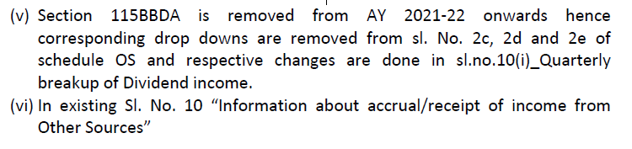
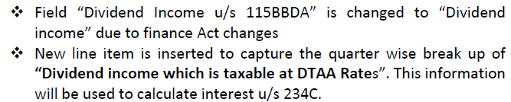
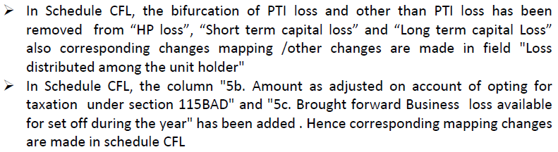


Slide 15
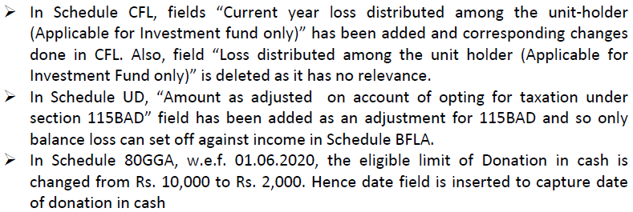
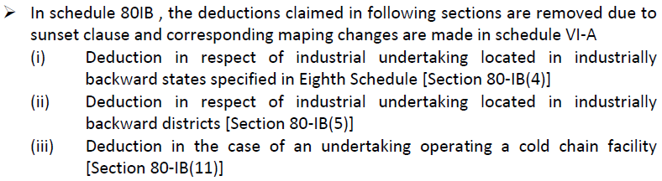

Slide 16
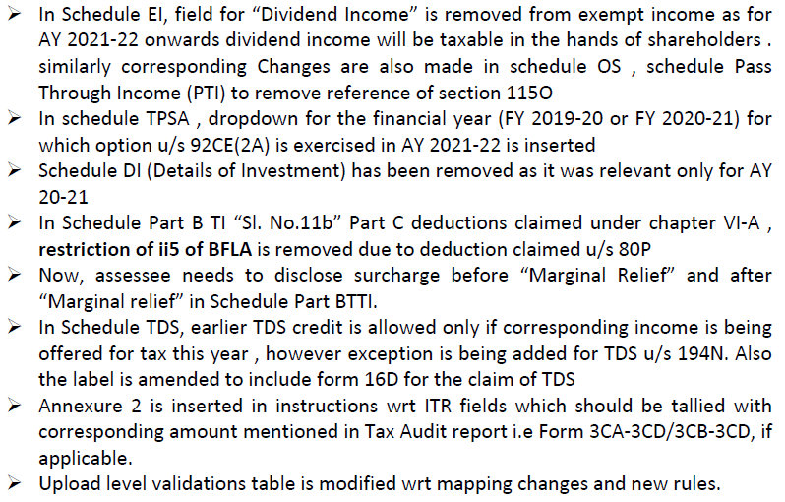

Slide 17
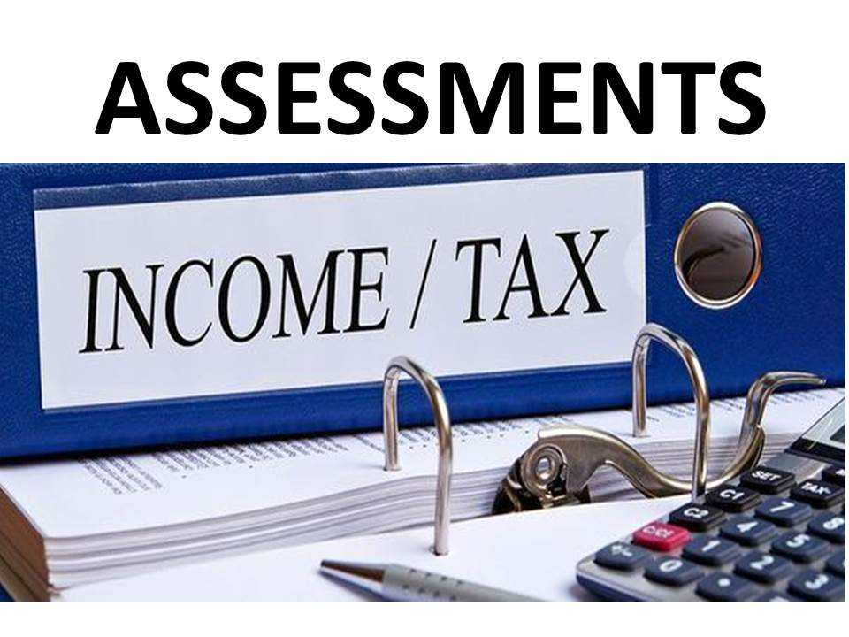

Slide 18
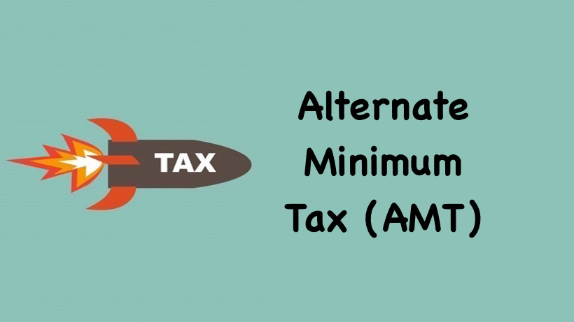

Slide 19

ALTERNATE MINIMUM TAX (AMT)
Background :
The Finance Act, 2011 had introduced the concept of AMT initially in relation to LLPs and accordingly the LLPs were subject to AMT @18.5% of adjusted total income.
Though the concept of Alternate Minimum Tax (AMT) is similar to MAT in case of corporates, however, the tax base in the case of LLPs is the adjusted total income computed as per the Income-tax Act, 1961 and not the book profit computed after making the specified adjustments to the profit as per the profit and loss account prepared in accordance with Schedule VI to the Companies Act, 1956.
The Finance Act, 2012 extended the levy of AMT to certain persons other than companies, in order to widen the tax base vis-à-vis profit-linked deductions. Accordingly, any person other than a company, who has claimed deduction under any section (other than section 80P) included in Chapter VI-A under the heading “C – Deductions in respect of certain incomes” or under section 10AA or under section 35AD would be subject to AMT with effect from A.Y. 2013-14.

Slide 20

The provisions of AMT would, however, not be applicable to an individual, HUF, AOPs, BOIs, whether incorporated or not, or artificial juridical person, if the adjusted total income of such person does not exceed Rs. 20 lakh
Levy of AMT @ 18.5% on Adjusted Total Income:
Accordingly, where the regular income-tax payable by a person, other than a company, for a previous year computed as per the provisions of the Income-tax Act, 1961 (other than Chapter XII-BA) is less than the AMT payable for such previous year, the adjusted total income shall be deemed to be the total income of the person. Such person shall be liable to pay income-tax on the adjusted total income @ 18.5% [Section 115JC].
Meaning of Adjusted Total Income:
“Adjusted total income” would mean the total income before giving effect to Chapter XII-BA i.e. AMT provisions as increased by the deductions claimed, if any, under –
any section (other than section 80P) included in Chapter VI-A under the heading “C – Deductions in respect of certain incomes” (Section 80-IA to 80RRB);
section 10AA (SEZ); and
section 35AD, as reduced by the depreciation allowable under section 32, as if no deduction under section 35AD was allowed in respect of the asset for which such deduction is claimed.

Slide 21

Furnishing Report by Chartered Accountant:
Such persons to whom this section applies should obtain a report in the prescribed form from a Chartered Accountant certifying that the adjusted total income and the AMT have been computed in accordance with the provisions of this Chapter. The report has to be furnished on or before the specified date referred to in section 44AB (i.e., one month prior to the due date for filing return of income), in such form as may be prescribed, from an accountant referred to in the Explanation below section 288(2), certifying that the adjusted total income and the alternate minimum tax have been computed in accordance with the provisions of this Chapter and furnish such report by that date.
Levy of AMT @9% of Adjusted Total Income in case of a unit located in IFSC:
Where the person subject to AMT is a unit located in an International Financial Services Centre (IFSC) deriving its income solely in convertible foreign exchange, AMT would be leviable @9% of Adjusted Total Income, instead of 18.5%.

Slide 22
Applicability of Interest and Penal provisions:
Section 115JE specifically provides that “save as otherwise provided in this Chapter, all other provisions of this Act shall apply to a person referred to in this Chapter”. Hence, all other provisions relating to self-assessment under section 140A, advance tax, interest under sections 234A, 234B and 234C, penalty etc. would also apply to a person who is subject to AMT.
Non-applicability of AMT provisions:
The provisions of this section shall not apply to a person who has exercised the option under section 115BAC or section 115BAD [Section 115JC(4)].

Slide 23

FIRMS/LLPs
and their PARTNERS

Slide 24


FIRMS/LLPs and their Partners
A firm is to be assessed as a unit and the share income from the firm in the hands of the partners is exempt. There is no need for registration.
Partnership Firm Assessed as Such (PFAS) [Section 184]
Conditions:
The firm should be evidenced by an “instrument’
Individual shares of partners must be specified in the instrument.
A certified copy of the instrument should accompany the first return of income of a firm.
If there is any change in the constitution of the firm or profit-sharing ratio during any previous year, a certified copy of the revised instrument of partnership should be filed along with the return of income of the relevant assessment year.

Slide 25

Computation of Income of Partnership Firm:
Remuneration is to be allowed
Interest is to be allowed
Unabsorbed depreciation and other losses should be provided for.
Remuneration paid to Partners:
Conditions:
Such remuneration should be paid only to the working partner.
It should be authorised by the partnership deed.
It should not pertain to a period prior to partnership deed.
It should not exceed the permissible limit.

Slide 26
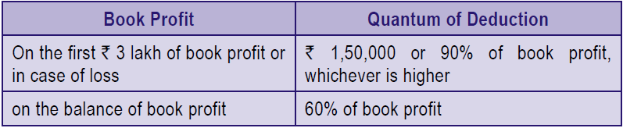
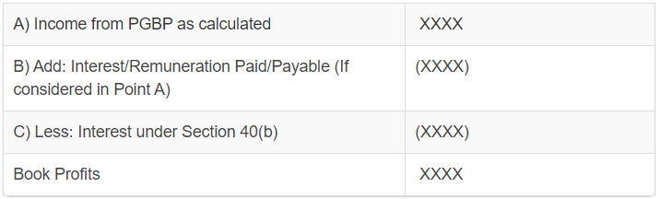
Permissible Limit:
Calculation of Book Profit:

Slide 27

Interest payable to partners:
Conditions:
Authorised by and in accordance with the partnership deed.
Interest should not be for a period falling prior to the date of such partnership deed authorizing the payment of such interest.
Rate of Interest shall not exceed 12% simple interest per annum.
The interest paid by a firm to its partners on the credit balance standing in all the accounts/whether in capital account, loan account or current account, shall be allowed as deduction to the firm under section 40(b).

Slide 28

Computation of income of partner of a firm (PFAS):
Share income exempt under section 10(2A):
The partner’s share in the total income of firm (PFAS) will be exempt in his hands and will not be included in his total income.
Partner’s share in the Total Income of the firm:
By virtue of this exemption, a partner of PFAS will not be taxed in respect of his share in the firm’s income since the firm itself will be taxed as a separate entity @ 30%. There will be no allocation of income among the partners. On account of this exemption, he will not be entitled to set-off his share in the firm’s loss against his other personal income.

Slide 29


Chargeability of Remuneration and Interest:
If the firm is given the benefit of deduction of remuneration and interest paid to a partner then the liability to tax in respect of such amount will be that of a partner. If the firm is not given the benefit of deduction because of the non-compliance with the provisions of section 40(b) then the firm itself will be liable in respect of the amount and the partner will not be taxed in respect of it in his personal assessment.

Slide 30
Assessment of firms –
Some of the important issues to be considered by the Assessing Officer
[Circular 12/2019, dated 19.6.2019]
Partnership deed should form the basis for determination of remuneration payable to the working partners. Furthermore, in situations where the remuneration either so specified in the partnership deed or computed as per the method indicated therein falls short of the amount allowable under section 40(b)(v), it would be restricted to the figure computed on the basis of the partnership deed.
While computing remuneration payable to the working partners under section 40(b)(v) of the Act, the remuneration should not exceed a particular aggregate amount which is based upon the figure of 'book profit'.
Under section 185, any non-compliance by the firm or its partners with provisions of section 184 may result in denial of expenses such as remuneration, interest etc. payable to the partners which are otherwise allowable under the provisions of the Act.

Slide 31
Where firms try to inflate the profits eligible for deduction undersection 80-IA by not claiming expenditure towards remuneration, salary, interest etc. which are payable to the partners, the Assessing Officers may examine these transactions in light of provisions of section 80-IA(10) which empower Assessing Officer tore-compute profit of the eligible business after excluding the profits of the related activity/business which produced the excessive profit.
While framing assessments in case of firms claiming carry forward and set off of losses, Assessing Officers have to verify such claims taking into consideration provisions of section78 which disallow such a carry forward and set off in case of change in constitution of the firm or on succession.

Slide 32

Rate of Tax:
A PFAS will be chargeable in respect of its total income at the rate of 30% plus surcharge @12% if its total income exceeds Rs. 1 crore, plus health and education cess @ 4% thereon.
Treatment of Losses:
If PFAS incurs any loss, the firm alone can set off and forward such losses to be set off against income of the subsequent years. The firm will not be allowed to apportion its unabsorbed losses among its partners.

Slide 33
Set off of carry forward loss in case of change in the constitution of the firm [Section 78]:
If there is a change in the constitution of the firm, the loss of a retired/deceased partner can be carried forward by the firm only to the extent that it does not exceed such partner’s share in the profits of the firm of the relevant previous year. It is applicable only in case of change in constitution of the firm, as a result of retirement or death of a partner in the previous year.
Liability of partner of LLP in liquidation [Section 167C]:
In case of liquidation of an LLP, where tax due from the LLP cannot be recovered, every person who was a partner of the LLP at any time during the relevant previous year will be jointly and severally liable for payment of such tax unless he proves that non-recovery cannot be attributed to any gross neglect, misfeasance or breach of duty on his part in relation to the affairs of the LLP.

Slide 34
Assessment in case of change in constitution, succession and dissolution of a firm [Section 187 to 189A]:
Change in constitution of a firm:
Where at the time of making an assessment under section 143 or 144 it is found that a change has occurred in the constitution of a firm, assessment shall be made on the firm as constituted at the time of making the assessment.
Meaning of change in constitution of the firm:
Admission or Retriment of one or more Partners
Change in Profit-sharing ratio.
Succession of one firm by another:
In a case where a firm carrying on a business or profession is succeeded by another firm; separate assessment will be made on the predecessor firm and the successor firm in accordance with the provisions of section 170.

Slide 35
3. Dissolution of firm or discontinuance of business:
Where a firm is dissolved or business or profession is discounted by the firm, the assessing officer shall make an assessment of the total income of the firm as if no discontinuance or dissolution has taken place and all the provisions of the Act relating to levy of a penalty or any other sum chargeable under this Act, shall be applicable accordingly.
Every person who was at the time of dissolution or discontinuance a partner of a firm and the legal representative of deceased partner shall be jointly and severally liable for the amount of tax, penalty or other sum payable by the firm and all the provisions of the Act shall apply accordingly. If any proceedings have commenced in respect of any assessment year before dissolution or discontinuance, the proceeding may be continued against such persons from that stage. The liability of legal representative is limited to the extent to which the estate is capable of meeting the liability.

Slide 36

Conversion of company into an LLP
Under section 56 and section 57 of the Limited Liability Partnership Act, 2008, conversion of a private company or an unlisted public company into an LLP is permitted. Consequently, section 47(xiiib) has been inserted under the Income-tax Act, to provide that –
any transfer of a capital asset or intangible asset by a private company or unlisted public company to an LLP; or
any transfer of a share or shares held in a company by a shareholder
on conversion of a company into a LLP in accordance with section 56 and section 57 of the Limited Liability Partnership Act, 2008, shall not be regarded as a transfer for the purposes of levy of capital gains tax under section 45, subject to fulfillment of certain conditions.

Slide 37

These conditions are as follows:
the total sales, turnover or gross receipts in business of the company should not exceed Rs. 60 lakh in any of the three preceding previous years;
all the shareholders of the company immediately before conversion become partners of the LLP in the same proportion as their shareholding in the company;
no consideration other than share in profit and capital contribution in the LLP arises to the shareholders;
the erstwhile shareholders of the company continue to be entitled to receive at least 50% of the profits of the LLP for a period of 5 years from the date of conversion;
The total value of assets as appearing in the books of account of the company in any of the three previous years preceding the previous year in which the conversion takes place, should not exceed Rs. 5 crore;
all assets and liabilities of the company become the assets and liabilities of the LLP; and
no amount is paid, either directly or indirectly, to any partner out of the accumulated profit of the company for a period of 3 years from the date of conversion.

Slide 38

However, if subsequent to the transfer, any of the above conditions are not complied with, the capital gains not charged under section 45 would be deemed to be chargeable to tax in the previous year in which the conditions are not complied with, in the hands of the LLP or the shareholder of the predecessor company, as the case may be [Section 47A(4)].
However, if the entity fails to fulfill any of the conditions mentioned above, the benefit of set-off of business loss/unabsorbed depreciation availed by the LLP would be deemed to be the profits and gains of the LLP chargeable to tax in the previous year in which the LLP fails to fulfill any of the conditions listed above.

Slide 39

Assessment of AOPs/ BOIs
and their members

Slide 40

Computation of Total Income of AOPs/BOIs
Computation of total income in the case of an association of persons or body of individuals will be done in the same manner as in the case of any other assessee.
In computing the total income, interest, salary, bonus, commission, remuneration, by whatever name called, paid to members will not be allowed [Section 40(ba)]

Slide 41
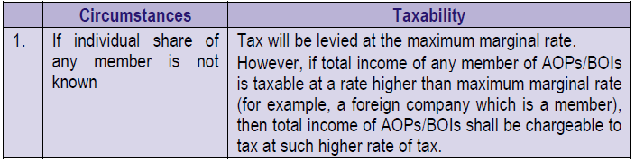
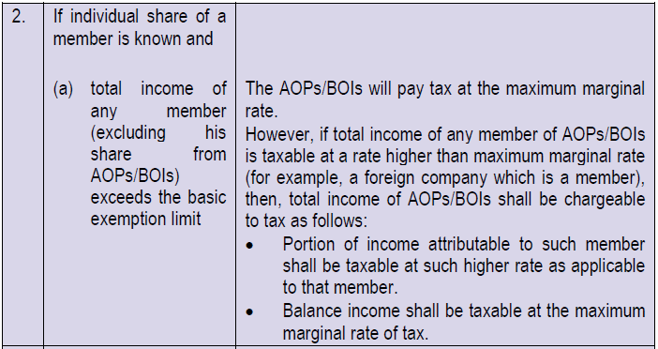
Computation of Tax where shares of members in AOPs/BOIs are unknown [Section 167B]:

Slide 42
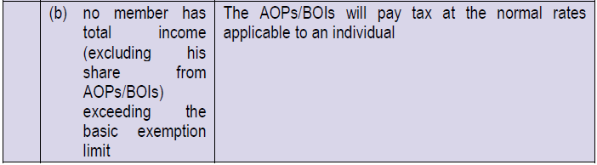


Slide 43
Rate of Surcharge applicable to AOP /BOI whether incorporated or not, having income under section 115AD of the Income-tax Act
The Finance (No.2) Act, 2019 has levied an enhanced surcharge of 25% and 37%, where the total income of individuals/HUF/AOPs/BOIs exceeds Rs. 2 crores and Rs. 5 crores, respectively. However, the enhanced surcharge has been withdrawn on tax payable at special rates under section 115AD on short-term capital gains and long-term capital gains arising from the transfer of securities referred to in 115AD(1)(b)

Slide 44

Assessment of share in the hands of member [Section 86]:
If an AOPs/BOIs has paid tax at the maximum marginal rate, or a higher rate, the member’s share in the total income of the firm will not be included in his total income.
If the AOPs/BOIs has paid tax at regular rates applicable to an individual, the member’s share in the income of the AOPs/BOIs computed under section 67A shall form part of his total income. However, the member will be allowed rebate under section 110 at the average rate in respect of such share.
If the AOPs/BOIs has not paid tax on its total income, the member’s share in the total income of the AOPs/BOIs will be included in his total income and taxed at regular rates.

Slide 45

Computation of member’s share in the total income of AOPs/BOIs [Section 67A]:
Any interest, salary, bonus, commission, remuneration, etc. paid to a member during the previous year will be deducted from the total income of the association or body, and the balance will be apportioned among the members in proportion to their respective shares.
If the amount apportioned to a member as per (a) is a profit, any interest, salary, etc. paid to him by the association or body during the previous year will be added to that amount and the aggregate sum will be such member’s share in the income of the AOPs/BOIs.
If the amount apportioned to a member as per (a) is a loss, any interest, salary, etc., paid to him by the association or body will be deducted from the amount of loss and the balance sum will be such member’s share in the income of the AOPs/BOIs.
The share of a member in the income/loss of the AOPs/BOIs will, for the purposes of assessment, be apportioned under the various heads of income in the same manner in which income/loss of the association has been determined under each head. Any interest paid by a member on capital borrowed by him for the purpose of investment in the AOPs/BOIs will be allowed as deduction while computing his share of income under the head “Profits and gains of business or profession.”

Slide 46

Share of member of an AOPs/BOIs in the income of the AOPs/BOIs to be reduced from net profit for computing book profit for levy of MAT [Section 115JB]
Under section 115JB, in the case of a company, if the tax payable on the total income computed as per the normal provisions of the Income-tax Act, 1961 is less than 15% of its book profit, such book profit shall be deemed to be the total income of the company and the tax payable for the relevant previous year shall be 15% of its book profit.
Under section 86, no income-tax is payable on the share of a member of an AOPs/BOIs in the income of the AOPs/BOIs in certain circumstances. A company which is a member of an AOPs is also not required to pay tax in respect of its share in the income of the AOPs in such cases.

Slide 47

Assessment
of

Slide 48


Slide 49

General Provisions
The expression “co-operative society” means a society registered under the Cooperative Societies Act, 1912 or under any other law for the time being in force in any State for the registration of co-operative societies [Section 2(19)].
For purposes of taxation, it is treated as a separate assessable entity.
Apart from this, the computation of income in the case of a co-operative society should also be made in the same way under each head of income as in the case of any other assessee.

Slide 50

Exemptions:
Section 80P provides certain exemptions to co-operative societies. However, the exemption is not available to co-operative banks, other than primary agricultural credit societies and primary co-operative agricultural and rural development banks.
It may also be noted that the provisions of section 194A which require deduction of income-tax at source from interest other than interest on securities, credited or paid, do not apply to such income credited or paid –
by a co-operative society (other than a co-operative bank) to a member thereof or to any other co-operative society;
in respect of deposits with a primary agricultural credit society or a primary credit society or a co-operative land mortgage bank or a co-operative land development bank;
in respect of deposits (other than time deposits) with a co-operative society, other than a co-operative society or bank engaged in carrying on the business of banking.

Slide 51
Option to exercise concessional rates of tax under section 115BAD:
Section 115BAA has been inserted by the Taxation Laws (Amendment) Act, 2019 to provide an option to an existing domestic company to pay tax at concessional rate of 22%, if it does not claim any incentive/exemption and deduction as provided in said section.
Option to pay tax at concessional rate
On similar lines, section 115BAD has been inserted by the Finance Act, 2020 to provide an option to resident co-operative society from the assessment year 2021-22 onwards to pay tax @22% plus surcharge @10% plus Health and education cess @4% (effective tax rate is 25.168%) on the total income

Slide 52
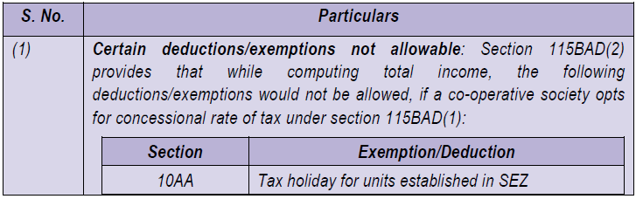
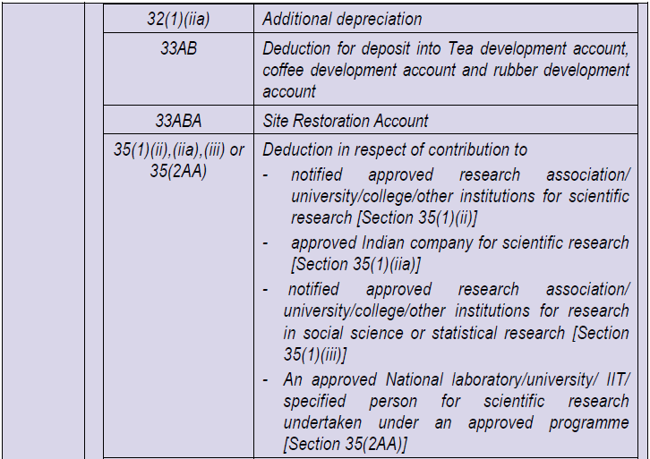
Conditions to be satisfied for availing concessional rate of tax:

Slide 53
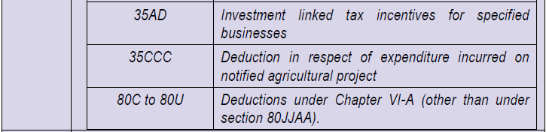
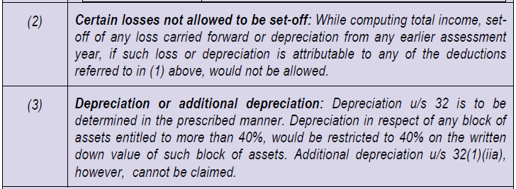
In case of a co-operative society opting for section 115BAD, total income should be computed without set-off of any loss brought forward or depreciation from any earlier assessment year, where such loss or depreciation is attributable to any of the deductions listed in (1) above [Such loss and depreciation would be deemed to have been already given effect to and no further deduction for such loss or depreciation shall be allowed for any subsequent year]
Where there is a depreciation allowance in respect of a block of asset from an earlier assessment year attributable to additional depreciation u/s 32(1)(iia), which has not been given full effect to prior to A.Y. 2021-22 and which is not allowed to be set-off in the A.Y.2021-22 due to exercise of option u/s 115BAD from that year, corresponding adjustment shall be made to the WDV of such block of assets as on 1.4.2020 in the prescribed manner i.e., the WDV as on 1.4.2020 will be increased by the unabsorbed additional depreciation not allowed to be set-off.

Slide 54

Deduction under section 80LA(1A) allowable:
In case of a person, having a Unit in the International Financial Services Centre, as referred to in section 80LA(1A), which has exercised option under this section, the deduction under the said section shall be available to such Unit subject to fulfilment of the conditions contained in that section.
Time limit for exercise of option:
The concessional rate would be applicable only if option is exercised in the prescribed manner on or before the due date of filing return of income specified under section 139(1) for any previous year relevant to the assessment year commencing on or after A.Y. 2021-22. Once such option is exercised, it would apply to subsequent assessment years and cannot be subsequently withdrawn for the same or any other previous year.
AMT liability not attracted:
Co-operative societies exercising option u/s 115BAD are not liable to alternate minimum tax u/s 115JC.

Slide 55

Assessment of Mutual Concerns

Slide 56

General principles of mutuality –
The first principle of mutuality is that no person can trade with himself or make income out of himself. There must be complete identity between the contributors and the participators.
The participation in the surplus need not be immediate but it may assume the shape of a reduction in the future contribution or a division of the surplus on dissolution.
It does not make any difference whether the persons joining together form an association or incorporate a company because the fact of incorporation does not destroy the identity of the contributors and participators.
Where there is mutuality, the fact that some members alone take advantage of the mutual enterprise would not affect the mutual character of the association.
There is nothing in law which prohibits a mutual association from carrying on a trade so long as it is confined to its own members.
It is not necessary that the surplus should be returned to every member of the association pro rata. The identification between the contributors and the participators should be regarded as one whole and not in relation to each individual.
It is not necessary that all the activities of such an association should be mutual in character. There may be activities of a non-mutual character but the exemption from tax will apply to the surplus arising out of the mutual enterprise.

Slide 57
Insurance business:
Under section 2(24)(vii) any surplus accruing to life as well as general mutual insurance concerns will fall within the definition of the word “income” and as such would be taxable as income from business. Section 44 expressly provides the profits and gains of any business of insurance including that carried on by a mutual insurance company or a cooperative society shall be computed not according to the provisions of the Act for computation of income under the various heads but according to the method prescribed in the Rules contained in the First Schedule to the Act.
Trade and professional associations:
A trade, professional or similar association may be a mutual concern. Section 28(iii) enacts that “income derived by a trade, professional or similar association from specific services performed for its members” shall be taxable as business profits. Under section 2(24)(v) any sum chargeable under section 28(iii) is deemed to be income. The object of these provisions seems to be to tax as profit the surplus arising from specific services rendered to members by a mutual trade, professional or similar association which otherwise may not be liable to tax in view of the general principles applicable to mutual concerns.

Slide 58

Clubs:
The consensus of judicial opinion is that any surplus accruing to a members’ club from the subscriptions and charges for various conveniences paid by members is not income or profit at all, nor can a social club be deemed to trade as far as its dealings with its own members are concerned. The position would be the same even though the club may be incorporated as a company or registered as a society. But a club is taxable on the profit derived from subscriptions and charges paid by non-members and on the income derived from its capital assets. Where a club is an incorporated company carrying on business it may be taxable on the money received from its members as well as non-members in the course of its business.
However, if the club is not a member’s club but is a proprietary club i.e. if the club is owned by an outsider and not by the members themselves, the proprietor would be taxable on the profits earned by running the club. The position would not in any way be affected by the fact that the proprietor is a limited company and some of the shareholders are members of the club.

Slide 59
HOW TO FILE ITR 5 FORM USING OFFLINE UTILITY?
ITR Form can be filed with the Income-tax Department electronically on the e-filing web portal of Income-tax Department
Below are the steps to follow for downloading ITR 5 :-
STEP 1: Visit--https://www.incometaxindiaefiling.gov.in/home

Slide 60
STEP 2:From the menu bar select “Downloads”; then go to “Offline Utilities” and select “Income Tax Return Preparation Utilities”.
STEP 3: Select your Assessment Year, i.e. 2020-21.
STEP 4: Depending on your income type, choose the right ITR form for IT returns filing. You will find ITR forms in both Java and Excel formats. Depending on your choice, select the right file type. Click on “Download Link” found under the Java or Excel formats.

Slide 61
STEP 5: The ITR return file will get downloaded in the ZIP file format. Extract the file at a relevant location in your computer.
For Excel File - Click ‘Import Personal / Tax Details from XML’, located at right side of the ‘Income Details’ tab. The side buttons (like validate, Next, Calculate Tax, etc.) of the excel file will work only if ‘Macros’ and ‘ActiveX’ function of the Excel workbook is enabled
STEP 6 : Attach the ‘Pre-filled XML’ file which has been downloaded

Slide 62
Login to ‘e-Filing’ Portal
Go to the ‘My Account’ menu located at upper-left side of the page -> Click ‘Download Pre-filled XML’
Select the ‘Assessment Year’ and ‘ITR Form Name’ from the dropdown list
Click ‘Continue’ ` Choose the type of details ` Click ‘Confirm’ ` Click ‘Download XML’
STEP 7: Attach the downloaded ‘Pre-fill XML’ file to populate the relevant details.

Slide 63
STEP 8: Enter all the Mandatory Fields ` Validate all the sheets`
STEP 9 : Calculate all the taxes and confirm all the pages.
STEP 10 : Then, click on “Generate XML”.

Slide 64
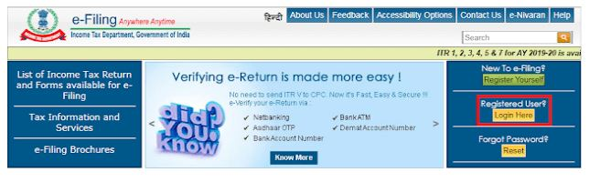
STEP 11 : Then, click on “Save XML” and save the file at the desired drive.
STEP 12 : Once you have calculated and filled in all the information correctly, log on to “www.incometaxindiaefiling.gov.in” once again.

Slide 65
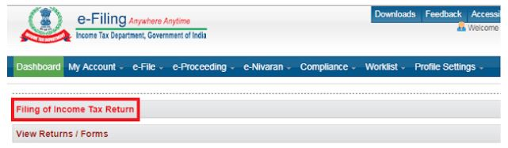
STEP 13 : Go to “E-file” select “Income Tax Return” or select the option “Filing of Income Tax Return” for income tax return filing online.
STEP 14 : Select “Assessment Year”.

Slide 66
STEP 15 : Select “ITR Form Name”.
STEP 16 : Then in “Submission Mode”, select “Upload XML”.
STEP 17 : Under the drop-down, select any one of the options and verify the returns.

Slide 67
Choose any one of the following option to verify the Income Tax Return:
• Digital Signature Certificate (DSC).
If you do not have DSC
• Aadhaar OTP
• EVC using Prevalidate Bank Account Details
• EVC using Prevalidate Demat Account Details
• Already generated EVC through My Account ` Generate EVC Option or Bank ATM. Validity of such EVC is 72 hours from the time of generation
• Don’t Want to e-verify this Income Tax Return and would like to send signed ITR-V to Bengaluru

Slide 68
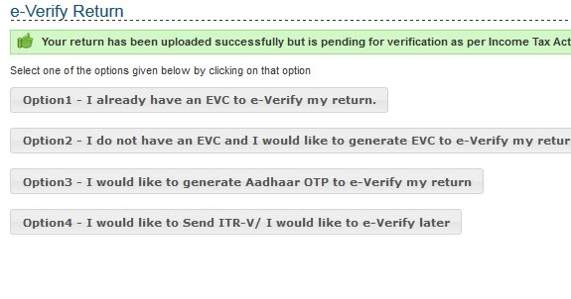
STEP 18 : Click on “Continue”
STEP 19 : Then attach the duly filled XML file

Slide 69
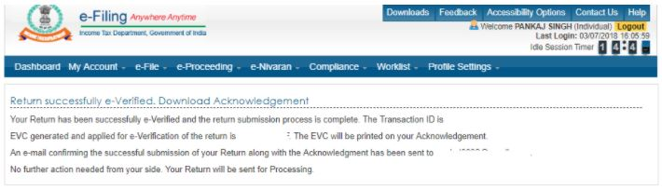
STEP 20 :Taxpayer will get an option to enter OTP for e-verifying the ITR, if an EVC or Aadhaar OTP option is chosen. Or To attach DSC, if DSC option is chosen to e-verify the ITR
STEP 21 :After successful submission, ITD will process your ITR and send an email confirmation stating the same

Slide 70


