Slide 1
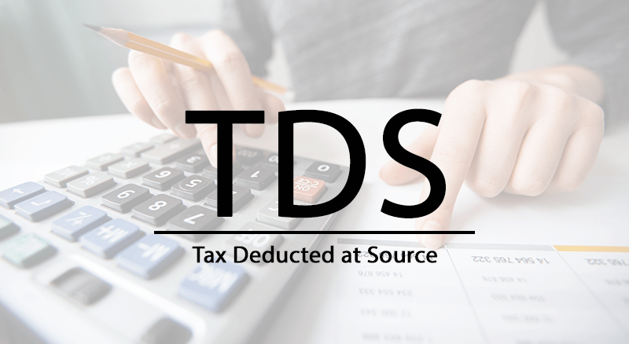

Slide 2

SESSION ON TDS SECTIONS 194E, 194EE, 194F, 194G,194H,194M

Slide 3
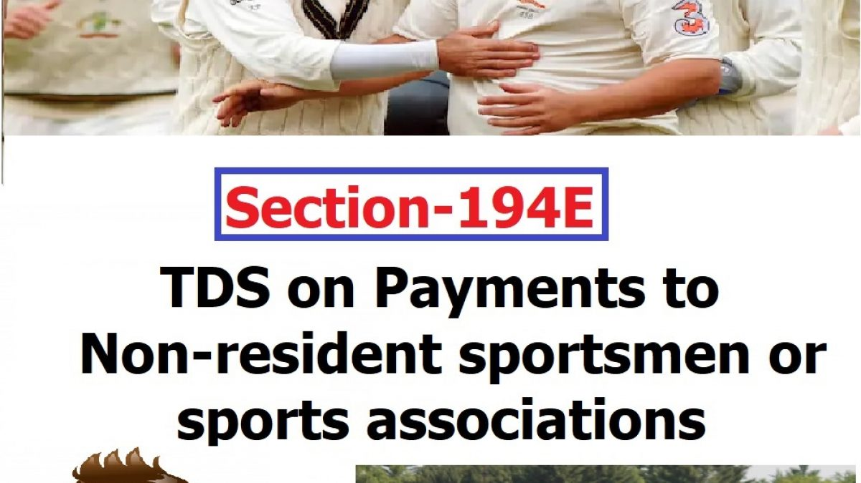

Slide 4
SECTION 194 E
TDS ON PAYMENT TO NON- RESIDENT SPORTSMEN/ SPORTS ASSOCIATION
PERSONS LIABLE TO DEDUCT TDS U/S 194E
Any person making payment of income referred to in section 115BBA of Income Tax Act, 1961 to the following persons shall be liable to deduct TDS:-
A Non resident sportsman(including an athlete)
An Entertainer
who is not a citizen of India.
A non- resident sports association / institution.

Slide 5
PAYMENTS REFFERED TO IN SECTION 115BBA
Where the total income of an assessee,-
a)
being a sportsman (including an athlete),
who is not a citizen of India and is a non-resident
includes any income received or receivable by way of --
(i) participation in India in any game (other than a game the winnings wherefrom are taxable under section 115BB) or sport
(iii) contribution of articles relating to any game or sport in India in newspapers, magazines or journals; or
(ii) advertisement; or

Slide 6
b)
being a non-resident sports association or institution
includes any amount guaranteed to be paid or payable to such association or institution in relation to any game (other than a game the winnings wherefrom are taxable under section 115BB) or sport played in India,
c)
being an entertainer
who is not a citizen of India and is a non-resident
includes any income received or receivable from his performance in India

Slide 7
TIME OF DEDUCTION OF TDS UNDER SECTION 194E
When this section gets attracted in a given transaction, deductor is required to deduct TDS within earlier of the following dates –
At the time of payment in cheque, draft, cash or any other mode
At the time of credit of the income to the account of the recipient
OR

Slide 8
RATE AT WHICH TDS UNDER SECTION 194E IS TO BE DEDUCTED
Deductor liable to deduct TDS under section 194E is required to deduct TDS
@ 20%

Slide 9
TDS RETURN FILING U/S 194E
The Deductor, under section 194E of the Income Tax Act, 1961, is required to furnish TDS return in Form 27Q
FORM 27Q IS TO BE FILED QUARTERLY
Provisions of section 203 of the Income Tax Act, 1961 makes it mandatory for the Deductor to issue the TDS certificate to the payee. The Deductor deducting TDS under section 194E is required to furnish TDS certificate in Form 16A

Slide 10
RELEVANT RULES AND FORMS FOR THE PURPOSE OF THIS SECTION
RULES
RULE 31AB
RULE 31
RULE 30
RULE 31A
RULE 37 A
FORMS
FORM No.16A
FORM 26 AS
FORM 27 Q

Slide 11

CASE LAWS
Pilcom Vs. CIT West Bengal(SUPREME COURT)
Payments made to the Non-Resident Sports Association represented their income which accrued or arose or deemed to have accrued or arisen in India, shall required to deduct tax under section 194E.

Slide 12
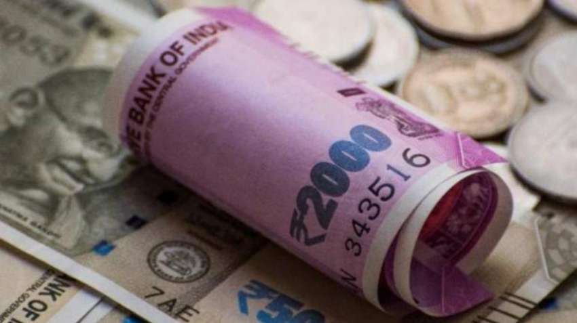
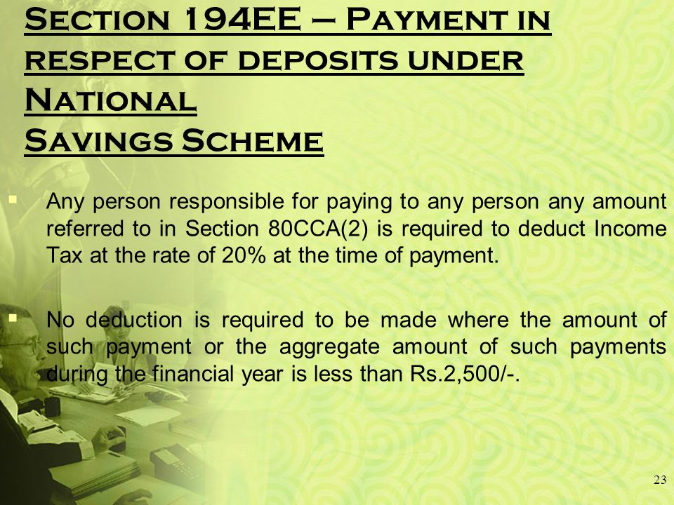

Slide 13
SECTION 194EE
PAYMENTS IN RESPECT OF DEPOSITS UNDER NATIONAL SAVINGS SCHEME, ETC.
PERSON LIABLE TO DEDUCT TDS U/S 194EE
PAYMENT TO ANY PERSON ANY AMOUNT REFERRED TO IN Clause (a) Of Sub-section (2) Of Section 80CCA

Slide 14
CLAUSE (a) of Sub section (2) of Section 80CCA
Where any amount-
STANDING TO THE CREDIT OF THE ASSESSEE
UNDER THE NATIONAL SAVINGS SCHEME IN RESPECT OF WHICH A DEDUCTION HAS BEEN ALLOWED UNDER SUB SECTION (1)
TOGETHER WITH THE INTEREST ACCRUED ON SUCH AMOUNT
IS WITHDRAWN IN WHOLE OR PART IN ANY PREVIOUS YEAR.

Slide 15
TIME OF DEDUCTION OF TDS UNDER SECTION 194EE
AT THE TIME OF PAYMENT

Slide 16
RATE AT WHICH TDS UNDER SECTION 194EE IS TO BE DEDUCTED
@ 10%
The rate is7.5% for transactions from 14 May 2020 until 31 March 2021.(COVID PERIOD)
If the recipient does not furnish his PAN to the deductor, tax will be deducted
@ 20%

Slide 17
WHEN NO TDS IS DEDUCTIBLE UNDER SECTION 194EE
PAYMENT UP TO RS. 2,500
PAYMENT TO LEGAL HEIRS
DECLARATION TO THE PAYER IN FORM NO. 15G OR 15H [Section 197A]

Slide 18
TDS RETURN FILING U/S 194EE
The Deductor, under section 194EE of the Income Tax Act, 1961, is required to furnish TDS return in Form 26Q

Slide 19
RELEVANT RULES AND FORMS FOR THE PURPOSE OF THIS SECTION
RULES
RULE 30
RULE 31A
RULE 37
RULE 31
RULE 31 AB
RULE 29C
FORMS
FORM 15
FORM 15H
FORM 16A
FORM 26
FORM 26AS
FORM 26Q

Slide 20

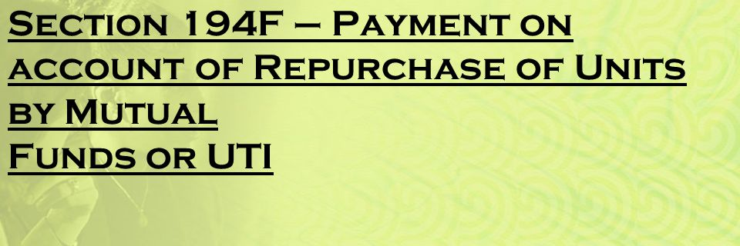


Slide 21
SECTION 194F
PAYMENTS ON ACCOUNT OF REPURCHASE OF UNITS BY MUTUAL FUND OR UTI
PERSON LIABLE TO DEDUCT TDS U/S 194F
MUTUAL FUNDS or UTI IS LIABLE TO DEDUCT TDS ON
PAYMENT TO ANY PERSON ANY AMOUNT REFERRED TO IN Subsection (2) of section 80CCB

Slide 22
SECTION 80 CCB (2)
Amount which is invested by the assessee in the units being issued under a plan formulated under the
Equity Linked Savings Scheme.
The amount so invested has been allowed as a deduction, however, the amount invested (whole or part) is returned back to the assessee by the Fund / Trust either by way of repurchase of the units or on the termination of the plan

Slide 23
TIME OF DEDUCTION OF TDS UNDER SECTION 194F
AT THE TIME OF MAKING PAYMENT OF THE REQUISITE AMOUNT
TIME OF DEPOSIT OF TDS WITH THE GOVERNMENT
within a period of 7 days from the end of the month in which TDS is deducted. However, the TDS deducted in the month of March is to be deposited on or before 30th April.

Slide 24
RATE AT WHICH TDS UNDER SECTION 194F IS TO BE DEDUCTED
The rate is 15% for transactions from 14 May 2020 until 31 March 2021.(COVID PERIOD)
@ 20 %
There is no exemption limit provided under section 194F
CATEGORY OF PAYEE
Individuals And HUF

Slide 25
RELEVANT RULES AND FORMS FOR THE PURPOSE OF THIS SECTION
RULES
RULE 31
RULE 31AB
RULE 30
RULE 31A
RULE 27
FORMS
FORM 16A
FORM 26AS
FORM 26
FORM 26Q

Slide 26

SECTION 194 G

Slide 27
SECTION 194G
COMMISSION ON SALE OF LOTTERY TICKETS
PERSON LIABLE TO DEDUCT TDS U/S 194G
person, who is paying any income by way of
commission
prize on lottery tickets to the person who has been stocking / distributing / purchasing / selling the lottery tickets
remuneration

Slide 28
TIME OF DEDUCTION OF TDS UNDER SECTION 194G
the Deductor is required to deduct TDS within earlier of the following prescribed dates –
At the time of payment in cash / cheque / draft / any other mode
At the time of credit of income to the account of the payee
OR

Slide 29
RATE AT WHICH TDS UNDER SECTION 194G IS TO BE DEDUCTED
@ 5%
The rate is 3.75% for transactions from 14 May 2020 until 31 March 2021.(COVID PERIOD)
It should be noted that no surcharge, education cess or SHE cess shall be levied on the said rate of 5%.
If the recipient does not furnish his PAN to the deductor, tax will be deducted
@ 20%
MAXIMUM MARGINAL RATE

Slide 30
EXEMPTION LIMIT U/S 194 G
Liable to deduct TDS under section 194G only if the income amount exceeds INR 15,000
Provision of lower / NIL TDS deduction
The payee can, by filing an application in Form no. 13, request the assessing officer for lower TDS deduction or NIL / no TDS deduction. If the payee receives the appropriate certificate from the Assessing Officer, the Deductor would deduct TDS at a lower rate or NIL rate, as directed
However, section 206AA(4) states that no certificate for lower / NIL deduction shall be granted unless the application contains the
Permanent Account Number (PAN) of the applicant

Slide 31
RELEVANT RULES AND FORMS FOR THE PURPOSE OF THIS SECTION
RULES
RULE 28
RULE 31AB
RULE 28 AA
RULE 28 AB
RULE 30
RULE 37
RULE 31
RULE 31A
FORMS
FORM 16A
FORM 26AS
FORM 13
FORM 26Q
FORM 26

Slide 32
CONSEQUENCES A DEDUCTOR WOULD FACE IF HE FAILS TO DEDUCT TDS OR AFTER DEDUCTING THE SAME FAILS TO DEPOSIT IT TO THE GOVERNMENT’S ACCOUNT
Disallowance of expenditure
section 40(a)(i)
section 40(a)(ia)
Levy of interest
section 201
Levy of Penalty
section 271C
Section 58(1A)
Prosecution
Section 276 B

Slide 33

SECTION 194H
TDS ON COMMISSION AND BROKERAGE

Slide 34
APPLICABILITY
Individuals and Hindu Undivided Family who were covered under section 44AB are also required to deduct TDS. However, From FY 2020-21, individual and HUF whose turnover from business is above Rs. 1 crore or gross receipts from profession are above Rs. 50 lakh are also required to deduct TDS.

Slide 35
RATE AT WHICH TDS UNDER SECTION 194G IS TO BE DEDUCTED
@5%
The rate is 3.75% for transactions from 14 May 2020 until 31 March 2021.(COVID PERIOD)
It should be noted that no surcharge, education cess or SHE cess shall be levied on the said rate of 5%.
If the recipient does not furnish his PAN to the deductor, tax will be deducted
MAXIMUM MARGINAL RATE
@20%

Slide 36
NON-APPLICABILITY
No deduction shall be made under this section in a case where the amount or the aggregate amounts of such income to be credited or paid during the financial year does not exceed INR 15,000.
The Person can make an application to the assessing officer under section 197 for deduction of tax at NIL rate or at a lower rate.

Slide 37

TIME LIMIT FOR DEPOSITING IN TDS
Tax Deducted during the month of April to February is to be deposited on or before the 7th of next month. Tax Deducted in the month of March is to be deposited on or before 30th April.
FOR EXAMPLE:
Tax deducted on 25 April is to be deposited on or before 7th May and tax deducted on 15 march is to be deposited on or before 30 April.

Slide 38


CASE LAWS
Kotak Securities Limited Vs. Dy. Commissioner of Income Tax TDS Circle 2(1) (ITAT Mumbai)
When bank issues bank guarantee on behalf of assessee, there is no principal-agent relationship between bank and assesse. So, assessee is not required to deduct TDS.
CIT vs. Mother Dairy India Ltd.
Commission paid by Mother Dairy to concessionaires who sell milk of assessee from booths owned by assessee not liable to TDS under section 194H as principle-agent relationship is missing.

Slide 39

CIT vs. Singapore Airlines Ltd.
Assessee-airlines issued tickets to its travel agents at a concessional price, transaction between assessee and travel agents was that of principal-to-principal and difference in price was discount and therefore, such transaction would not fall with ambit of section 194H.
Tube Investments of India Ltd. v. ACIT[2009] 223 CTR 99 (MAD).
Where assessee, a manufacturer of bicycles, was giving trade incentive to dealers, if dealers were selling goods at price for which they were purchasing from company, such trade incentive would amount to commission for purpose of section 194H.

Slide 40

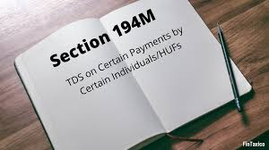
SECTION 194M
TDS ON PAYMENT TO RESIDENT CONTRACTORS AND PROFESSIONALS

Slide 41

APPLICABILITY
An individual and/or Hindu undivided family (HUF) has to deduct tax at source under Section 194M. Such individuals and HUF must not be required to get their books of accounts audited. Books of Accounts are required to be audited if total turnover or receipts of a business exceed Rs. 1 crore or where receipts of a profession exceed Rs. 50 lakh.
IT SHOULD BE NOTED THAT NO TDS UNDER SECTION 194M IS APPLICABLE TO THE ASSESSEE IF THEY WERE CODUCTING AUDIT REFERRED UNDER SECTION 44AD.
Payments to non-residents are not covered under this section.

Slide 42
RATE AT WHICH TDS UNDER SECTION 194M IS TO BE DEDUCTED
@ 5%
THE TOTAL SUM PAID EXCEEDS RS.50,00,000.00 IN A YEAR.
IF
The rate is 3.75% for transactions from 14 May 2020 until 31 March 2021.(COVID PERIOD)
If the recipient does not furnish his PAN to the deductor, tax will be deducted
MAXIMUM MARGINAL RATE
@20%

Slide 43

TIME LIMIT FOR DEPOSITING IN TDS
If the amount is deducted in March – on or before April 30 of the next financial year.
FOR EXAMPLE:
if the amount has been deducted in March 2020, then the TDS will be deposited to the department by 30 April 2021.
In any other month – within seven days from the end of the month in which the tax deduction is made.
FOR EXAMPLE:
if the amount has been deducted paid in the month of September 2020, then the TDS will be deposited to the department by 7 October 2020.

Slide 44
CERTIFICATE OF TAX DEDUDCTED UNDER SECTION 194M
THE PERSON WHO DEDUCTS TAX UNDER SECTION 194M SHALL FURNISH A CERTIFICATE :
UNDER
FORM NO.16D
WITHIN
15 DAYS OF THE DUE DATE OF FURNISHING THE CHALLAN CUM STATEMENT
IN
FORM 26QD

Slide 45
SPECIAL POINTS TO BE NOTED:
If the Assesse required to get Books of Accounts audited, TDS deduction is applicable as per Section 194C and 194J. The individual and/or HUF who have to deduct TDS under Section 194C (TDS on payment to a contractor) and 194J (TDS on payment on professional fees) do not have to deduct tax at source under Section 194M.
The individual or HUFs who has to deduct tax can pay the tax to the government by quoting his or her PAN only. Not required to get a tax deduction account number (TAN) for TDS deduction.
TDS amount will be deducted on the earlier of the following dates:
At the time of credit of the amount.
At the time of payment by cash or by the issue of a cheque or draft.

Slide 46

THANK YOU!

