Slide 1


B.Com, ACMA, ACA, Ad Dip MA CIMA(UK)

Slide 2


Slide 3


Section 194-IA
Payment on transfer of certain immovable property other than agricultural land

Slide 4

Payment on transfer of certain immovable property other than agricultural land.
(1) Any person, being a transferee, responsible for paying (other than the person referred to in section 194LA) to a resident transferor any sum by way of consideration for transfer of any immovable property (other than agricultural land), shall, at the time of credit of such sum to the account of the transferor or at the time of payment of such sum in cash or by issue of a cheque or draft or by any other mode, whichever is earlier, deduct an amount equal to one per cent of such sum as income-tax thereon.
(2) No deduction under sub-section (1) shall be made where the consideration for the transfer of an immovable property is less than fifty lakh rupees.
(3) The provisions of section 203A shall not apply to a person required to deduct tax in accordance with the provisions of this section.

Slide 5

SECTION | NATURE OF PAYMENT | PAYER | PAYEE | RATE | LIMIT
194-IA | Payment on transfer of certain immovable property other than agricultural land. | Any person, being a transferee (other than a person referred to in section 194LA) | Any Resident Transferor | 1 % (0.75 %*) * Rates for period from 14.5.2020 to 31.3.2021 | Rs. 50,00,000 (Consideration for transfer)

Slide 6

Why TDS on transfer of Immovable Property?
Former Finance Minister P. Chidambaram while introducing TDS on Property said that the transactions of Immovable Property are usually undervalued and under‐reported.
The parties don’t even mention the PAN No. in the agreement or while entering into the transaction.
With a view to improving the reporting of such transactions, the Section 194‐IA was introduced in the Finance Bill of 2013

Slide 7


Non-Applicability of Section 194-IA
If Person acquires Agricultural Land in India.
If Transferor is Non-Resident.

Slide 8
Practical aspects of Section 194 IA and Section 195
Particulars | Section 194 IA | Section 195
Category of Payee/Seller | Resident | Non-Resident
Nature of Payment | any sum by way of consideration for transfer of any immovable property (other than agricultural land) | any interest or any other sum chargeable under the provisions of the Act
Rate of TDS | 1 % on entire sale consideration | LTCG – 20% , STCG – Slab Rate (Only on the Capital Gain, not on the entire sale consideration)
Remittance of TDS | The buyer shall remit the TDS amount through a challan cum statement in Form 26QB and a TDS certificate shall be issued to the Payee / Seller in Form 16B. | The person who is liable to deduct TDS (Buyer of the immovable property) must mandatorily apply for a TAN (There is no option for him to remit the TDS amount through Form 26QB)

Slide 9

DETAILS REQUIRED FOR PAYMENT OF THE TDS
TDS ON IMMOVABLE PROPERTY
Go to the Income Tax Dept. official site. Or use the following link:
http://www.incometaxindia.gov.in/Pages/tds-sale-of-immovable-property.aspx
Provide details like name, address, PAN, mobile number and email id of the seller as well as buyer, in Form 26QB
Also, provide the complete address of the property, along with the date of agreement, total value of consideration, date of payment, etc.
The buyer should ensure that the PAN of the seller is correct. Otherwise, the seller will not be able to get the credit for tax deducted by the buyer, as the credit shall flow on the basis of PAN card details furnished in Form 26QB.
The TDS can be paid online or deposited offline, by tendering the physical challan to an authorised bank. The bank will then update the details on the income tax department’s website
Once the TDS has been deposited, the buyer has to download the TDS certificate in Form No 16B, from the website of the Income Tax Department and furnish it to the seller within 15 days.

Slide 10
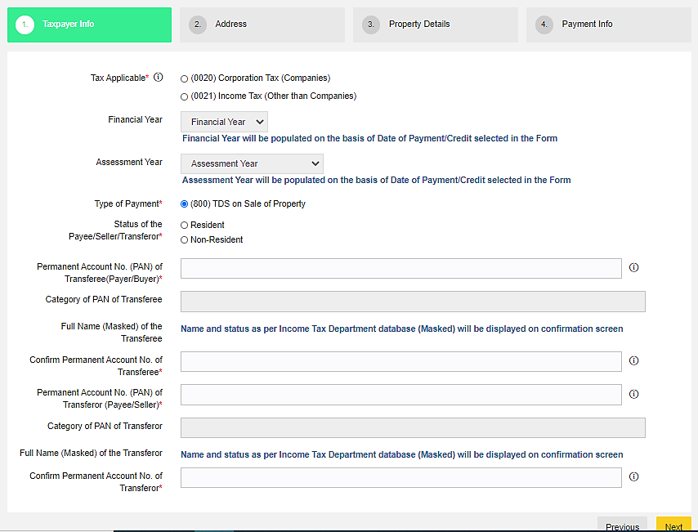
E-Payment Procedure of TDS on Property (Form 26 QB)

Slide 11
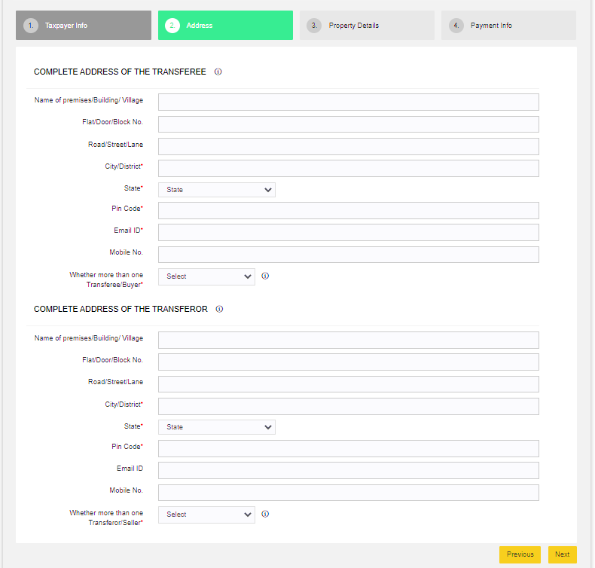

Slide 12
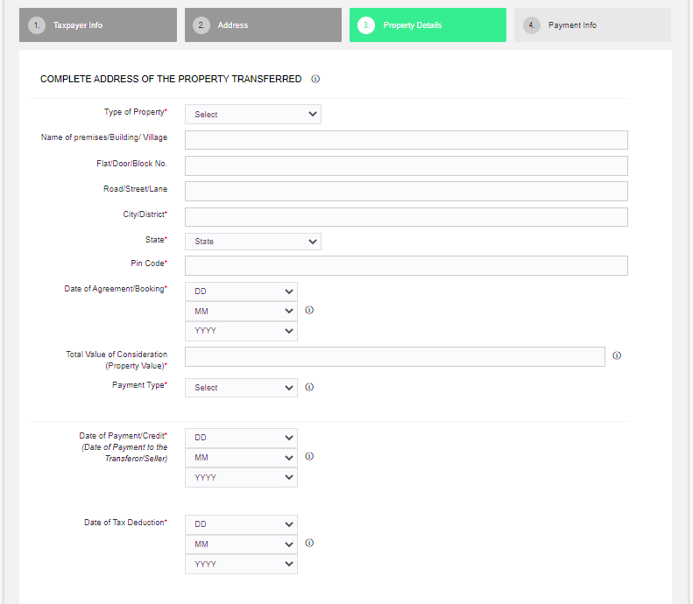

Slide 13
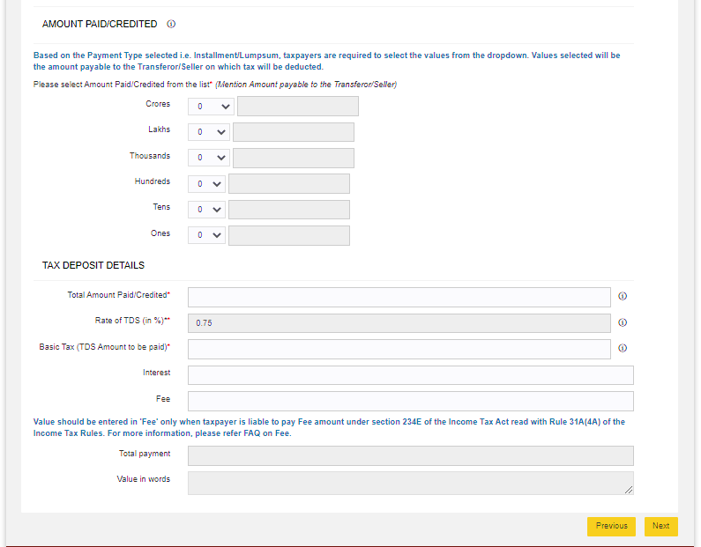

Slide 14
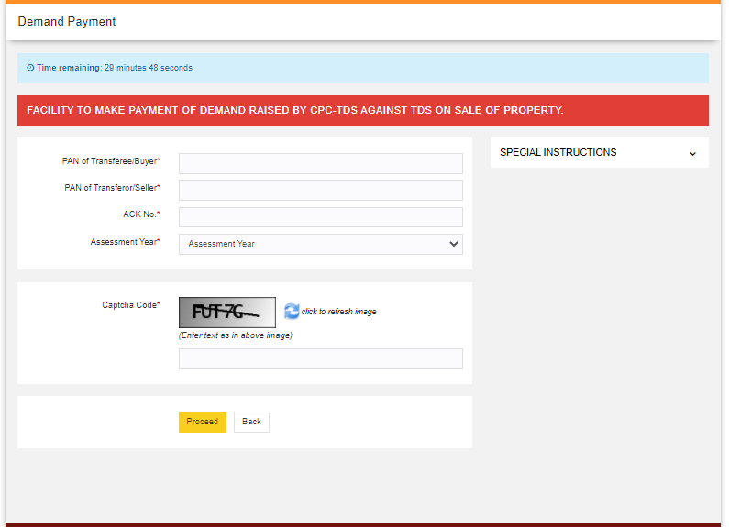
Demand Payment for TDS on Property (Form 26 QB)

Slide 15
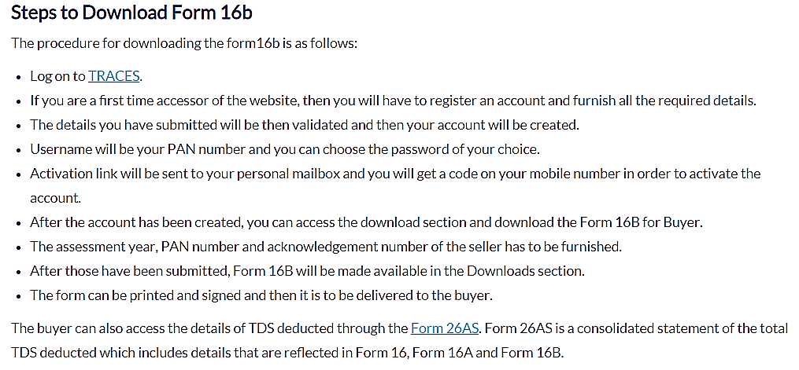
Form 16B – TDS Certificate for Sale of Property
Form 16B which is a TDS certificate reflects the amount that has been deducted as TDS on property that has been deposited by the buyer with the Income Tax Department. Form 16B can be downloaded from TRACES website. Once the buyer furnishes the details in Form 26QB and deposits the TDS, he or she can download Form 16B online. This form is to be given to the buyer.

Slide 16


Section 194-IB
Payment of rent by certain Individuals or Hindu Undivided family.

Slide 17
Payment of rent by certain individuals or Hindu undivided family.
Any person, being an individual or a Hindu undivided family (other than those referred to in the second proviso to section 194-I), responsible for paying to a resident any income by way of rent exceeding fifty thousand rupees for a month or part of a month during the previous year, shall deduct an amount equal to five per cent of such income as income-tax thereon.
(2) The income-tax referred to in sub-section (1) shall be deducted on such income at the time of credit of rent, for the last month of the previous year or the last month of tenancy, if the property is vacated during the year, as the case may be, to the account of the payee or at the time of payment thereof in cash or by issue of a cheque or draft or by any other mode, whichever is earlier.
(3) The provisions of section 203A shall not apply to a person required to deduct tax in accordance with the provisions of this section.
(4) In a case where the tax is required to be deducted as per the provisions of section 206AA, such deduction shall not exceed the amount of rent payable for the last month of the previous year or the last month of the tenancy, as the case may be.

Slide 18

SECTION | NATURE OF PAYMENT | PAYER | PAYEE | RATE | LIMIT
194-IB | Payment on rent by certain individuals or HUF | Individual/HUF (other than Individual/HUF whose total sales, gross receipts or turnover from business or profession carried on by him exceeds Rs. 1 Crore or Rs. 50 Lakhs respectively. | Any Resident | 5 % (3.75 %*) * Rates for period from 14.5.2020 to 31.3.2021 | Rs. 50,000 for a month or part of a month

Slide 19
Practical aspects of Section 194 I and Section 194IB
Particulars | Section 194 I | Section 194 IB
Category of Payer | Any person, other than an individual or a HUF or Individuals and HUF covered under section 44AB(a) and (b) | Individual/HUF (other than Individual/HUF whose total sales, gross receipts or turnover from business or profession carried on by him exceeds Rs. 1 Crore or Rs. 50 Lakhs respectively.
Limit | Aggregate more than Rs. 2,40,000/- | Rs. 50,000 for a month or part of a month
TDS Rate | 2 %* (plant, machinery or equipment) 10 %* (other cases) * Reduced to 1.5 % and 7.5 % respectively for the period from 14th May, 2020 to 31st March, 2021 | 5 % (3.75 %*) * Rates for period from 14.5.2020 to 31.3.2021

Slide 20
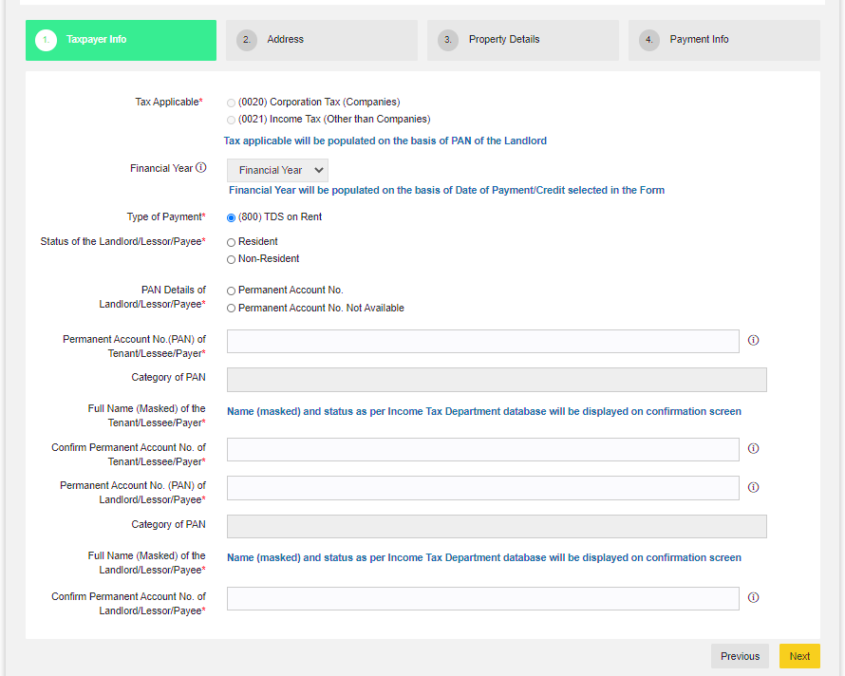
E-Payment for TDS on Rent of Property (Form 26 QC)

Slide 21
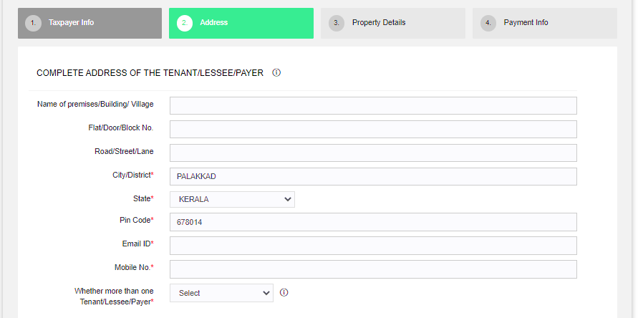
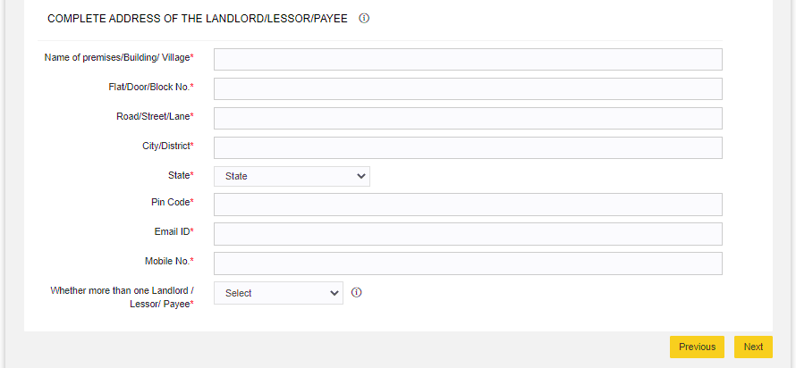

Slide 22
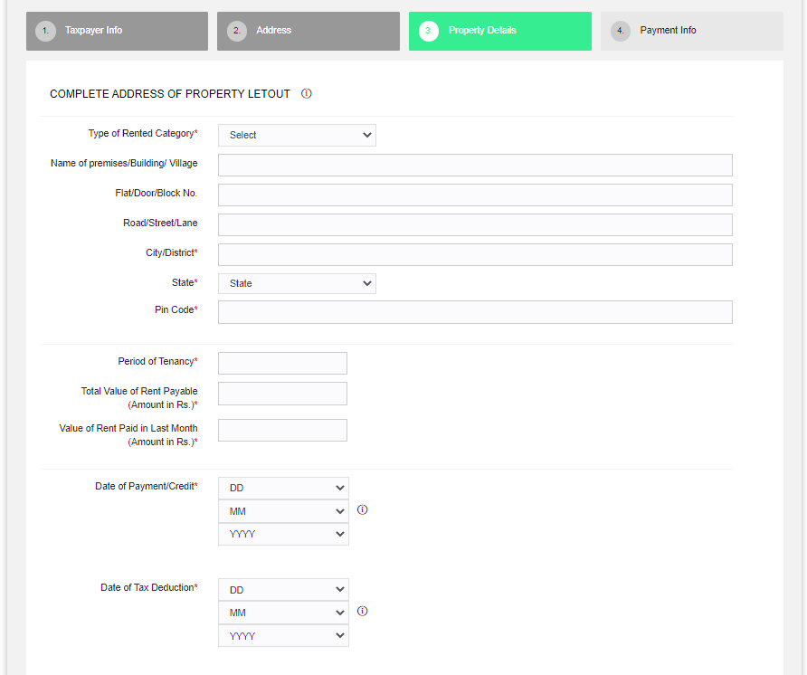

Slide 23
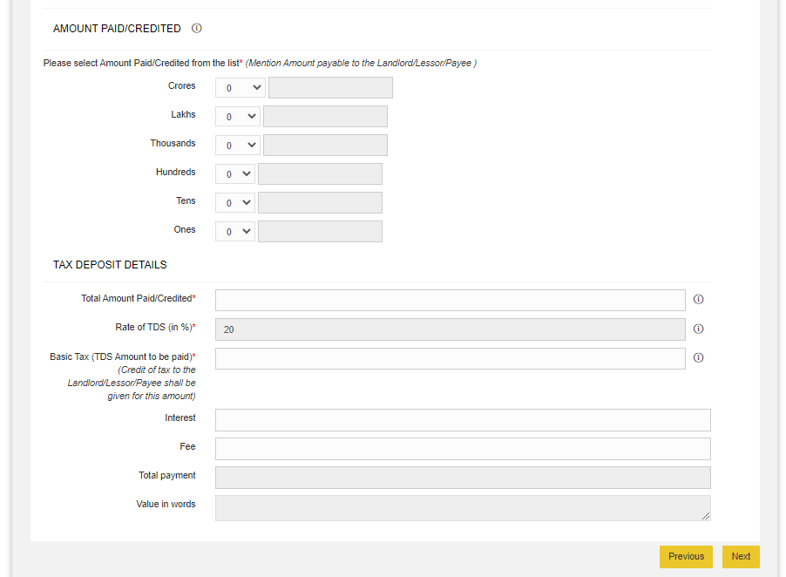

Slide 24
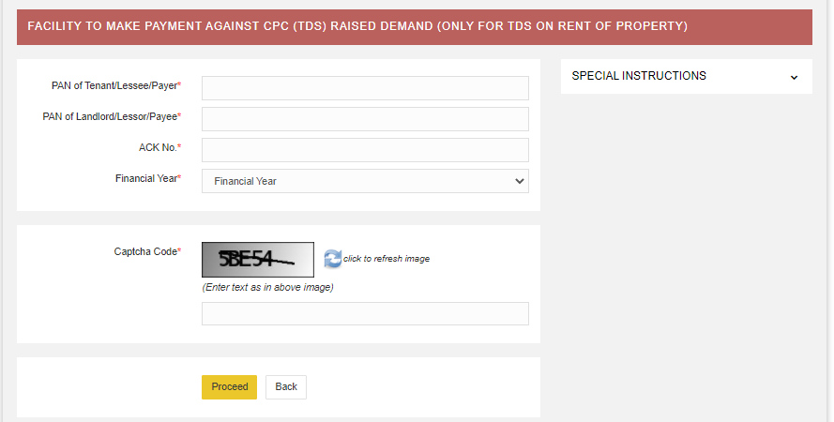
Demand Payment for TDS on Rent of Property (Form 26 QC)

Slide 25


Section 194-IC
Payment under specified agreement

Slide 26
Payment under specified agreement.
Notwithstanding anything contained in section 194-IA, any person responsible for paying to a resident any sum by way of consideration, not being consideration in kind, under the agreement referred to in sub-section (5A) of section 45, shall at the time of credit of such sum to the account of the payee or at the time of payment thereof in cash or by issue of a cheque or draft or by any other mode, whichever is earlier, deduct an amount equal to ten per cent of such sum as income-tax thereon.

Slide 27
SECTION | NATURE OF PAYMENT | PAYER | PAYEE | RATE | LIMIT
194-IC | Payment under specified agreement referred to in section 45(5A) | Any Person responsible for paying any sum by way of consideration, not being consideration in kind. | Any Resident | 10 % (7.50 %*) * Rates for period from 14.5.2020 to 31.3.2021 | No threshold specified.

Slide 28


What is Joint Development Agreement?
This is an agreement between the owner of an asset (being land or building or both) who agrees to allows another person to build a real estate project on such asset, in return for share and/or payment in cash.

Slide 29

Section 194-J
Fees for Professional or Technical Services

Slide 30
Fees for professional or technical services.
(1) Any person, not being an individual or a Hindu undivided family, who is responsible for paying to a resident any sum by way of—
(a) fees for professional services, or
(b) fees for technical services, or
(ba) any remuneration or fees or commission by whatever name called, other than those on which tax is deductible under section 192, to a director of a company, or
(c) royalty, or
(d) any sum referred to in clause (va) of section 28,
shall, at the time of credit of such sum to the account of the payee or at the time of payment thereof in cash or by issue of a cheque or draft or by any other mode, whichever is earlier, deduct an amount equal to [two per cent of such sum in case of fees for technical services (not being a professional services) or royalty where such royalty is in the nature of consideration for sale, distribution or exhibition of cinematographic films and ten per cent of such sum in other cases,] as income-tax on income comprised therein :

Slide 31
Provided that no deduction shall be made under this section—
(A) from any sums as aforesaid credited or paid before the 1st day of July, 1995; or
(B) where the amount of such sum or, as the case may be, the aggregate of the amounts of such sums credited or paid or likely to be credited or paid during the financial year by the aforesaid person to the account of, or to, the payee, does not exceed—
(i) thirty thousand rupees, in the case of fees for professional services referred to in clause (a), or
(ii) thirty thousand rupees, in the case of fees for technical services referred to in clause (b), or
(iii) thirty thousand rupees, in the case of royalty referred to in clause (c), or
(iv) thirty thousand rupees, in the case of sum referred to in clause (d) :
Provided further that an individual or a Hindu undivided family, whose total sales, gross receipts or turnover from the business or profession carried on by him exceed [one crore rupees in case of business or fifty lakh rupees in case of profession] during the financial year immediately preceding the financial year in which such sum by way of fees for professional services or technical services is credited or paid, shall be liable to deduct income-tax under this section :
Provided also that no individual or a Hindu undivided family referred to in the second proviso shall be liable to deduct income-tax on the sum by way of fees for professional services in case such sum is credited or paid exclusively for personal purposes of such individual or any member of Hindu undivided family:
Provided also that the provisions of this section shall have effect, as if for the words "ten per cent", the words
"two per cent" had been substituted in the case of a payee, engaged only in the business of operation of call centre.

Slide 32
Who is Liable to Deduct TDS Under Section 194J?
Everyone except an individual/HUF who is liable to make the following payments to any resident is liable to deduct TDS Under Section 194J:
1.Fees for professional services and for technical services or
2. Any remuneration/ fees/ commission whatever name called to a director of a company other than the payment on which tax is deductible u/s 192 or
3.Royalty or
4. Non-compete fees u/s 28(VA)
Note: It includes Individual/HUF falling under the scope of section 44AB.

Slide 33

Meaning of Professional Services Under Section 194J
Professional Services are defined under Section 194J includes:
  Medical
  Legal
  Engineering
  Architectural profession
  Accountancy
  Technical consultancy, or
  Interior decoration
  Professional services notified in section 44AA includes:
  The profession of film artist
  The profession of the authorized representative
  The profession of Company Secretary
  Professional Services related to sports activities engraved by CBDT for Section 194J Under TDS
  Anchors
  Commentators
  Event Managers
  Physiotherapists
  Referees and Umpires
  Sports Persons
  Sports Columnists
  Trainers and Coaches

Slide 34
Meaning of Fees for Technical Services Under Section 194J:
Technical services
Managerial services
Consultancy Services
Provision of services of technical or other personnel

Slide 35
RATE OF TDS
Category | Rate
If Payee is engaged only in the business of the operation of the call centre and the payment of fees for technical service (not being a professional royalty where such royalty is in the nature of consideration for sale, distribution or exhibition of cinematographic film) | 2%
Payee involved in any other business operation or profession comes under the scope of194J and not being a professional royalty where such royalty is in the nature of consideration for sale, distribution or exhibition of cinematographic film. | 10%
If PAN not furnished by the payee | 20%

Slide 36
A CASE STUDY
Ram & Krishna enterprises is a grocery company. This is a fast growing company so seeing the market need and opportunity, management decided to expand the business. Management has decided below action plans for FY 20-21.
1. Construct infrastructure to manufacture & store the products
2. Implementation of customized software / ERP
3. Feasibility study of owned vs hired logistics
Management has appointed M/s PMC & associates to design the construction layout to construct the building. They also appointed M/s F&S associates to design and implement an ERP solution for their all activities including procurement, manufacturing, sales, accounts payable and receivables etc., Purchase order has been raised for both the above services and the same is submitted to the finance team to release the advance payment as per the PO terms. Since both the activities are falling under section 194 J hence Finance manager has to deduct the TDS as per the prevailing rates. Now here question comes that whether both the services are covered under the professional services. Whether TDS will be deducted @ 10% or 2%

Slide 37
Prima facie, it is appearing that both the services are falling under the definition of professional services and TDS has to be deducted @10%. These confusions we face in our regular services during consultancy or Job.
In case of design service, vendor has to give the design layout, which can be finished with his professional knowledge hence finance manager has to deduct TDS @10%. Whereas customized software/ERP design & implementation is a technical service as the same involve following step :
gathering of the requirement from end users,
2) Solution design,
3) Development or customization of ERP software,
4) Implementation of the software throughout all the branches of PMC & associates. Hence the same will be covered under the technical service and as per our opinion TDS can be deducted @ 2% under section 194J.
More examples of Professional and technical services:
Professional services – Services of doctors, chartered accountants, tax consultancy services, project monitoring services etc.
Technical services – Computer development software, Bio technical services, geological and scientific services etc.

Slide 38
Time of TDS Deduction Under Section 194J
The credit of the amount to payee’s account
Payment of such amount to the payee in cash/ cheque/ draft or any other medium,
whichever is earlier

Slide 39
The Threshold Section 194J Under TDS
Category | Threshold Limit
Fees for professional services | 30000
Fees for technical services | 30000
Royalty | 30000
Non-compete fees | 30000
Remuneration/ commission/fees payable to a director of a company | No such limit

Slide 40
Conditions for Non-Applicability of TDS Section 194J
If the payment is made by an individual or HUF. But if the individual/ HUF falls under *44AB(a)/ 44AB(b)then the payment is liable to deduct TDS following Section 194J
Further, an individual/HUF is not liable to pay TDS under section 194J if the payment is made or credited exclusively for personal purposes.

Slide 41

Gross amount including / excluding GST.
Circular No. 23/2017 – dated 19/07/2017.
The Board hereby clarifies that wherever in terms of the agreement or contract between the payer and the payee, the component of ‘GST on services’ comprised in the amount payable to a resident is indicated separately, tax shall be deducted at source under Chapter XVII-B of the Act on the amount paid or payable without including such ‘GST on services’ component.

Slide 42

Doctor's remuneration ? 192 / 194 J
Manipal Health Systems V. CIT
The Karnataka High Court observed that contract between the assesse and doctors was not a “Contract of Service” but “Contract for service”. Thus the payment made to doctors by the hospital are covered under section 194J of the Income tax act, also as per the agreement made by the doctors and the assesse the doctors were not in employment and PF, ESI etc of the doctors was not done.

Slide 43

DIRECTORS REMUNERATION
GST not applicable on Director’s remuneration if subjected to TDS u/s 192 of Income Tax Act 1961.
CBIC Clarification Circular No: 140/10/2020 – GST.
There by 194 J deduction fees/remuneration GST shall be applicable.

Slide 44

REIMBURSEMENT OF EXPENSES
Reimbursement of Expenses should not be taken into consideration while calculating the gross amount liable to deduct TDS u/s 194J
i.e, If the gross amount of professional fees is Rs.100000/- which, includes Rs. 10000/- as Reimbursement of Expenses, TDS u/s 194J is to be deducted on Rs.90000/- only.

Slide 45

TDS TO BE DEDUCTED NOT UNDER 194J
Services like, Maintennance of
Lift
Air conditioner
Electrical fittings
Fire Hindrance
Pest control
Do not cover under Technical works and hence, covered under 194C and not under 194J

Slide 46

CIT VS PVS MEMORIAL HOSPITAL LTD
(KERALA HIGH COURT)
Where Tax is required under 194J but deducted at a lesser rate under 194C then the application of 194J cannot be avoided.

Slide 47

Consequences of Not Remitting TDS with Income Tax Department:
Disallowance of expenditure under section 40(a)(i) of and section 40(a)(ia)
Any sum payable to a resident, which is subject to deduction of tax at source, would attract 30% disallowance if it is paid without deduction of tax at source or if tax is deducted but is not deposited with the Central Government till the due date of filing of return.
However, where in respect of any such sum, tax is deducted or deposited in subsequent year, as the case may be, the expenditure so disallowed shall be allowed as deduction in that year.

Slide 48
Levy of Interest under Section 221
Person in default shall be liable to action in accordance with the provisions of section 201 and shall be deemed to be an assessee-in-default in respect of such tax and liable for penal action u/s 221 of the Act.
Further Section 201(1A) lays down that such person shall be liable to pay simple interest
at 1% for every month or part of the month on the amount of such tax from the date on which such tax was deductible to the date on which such tax is deducted; and
at one and one-half percent for every month or part of a month on the amount of such tax from the date on which such tax was deducted to the date on which such tax is actually paid.
Such interest, if chargeable, is mandatory in nature and has to be paid before furnishing of quarterly statement of TDS for respective quarter.

Slide 49
Penalty for Delay in filing TDS Returns:
All Person must bear a penalty of Rs.200/day, under section 234E, for the delay in filing TDS or TCS returns after the specified due date. However, such a penalty will not exceed the amount of TDS for which the statement was required to be filed.
Penalty under section 271H:
A penalty from Rs.10,000 to Rs.1 Lakh is leviable under Section 271H if a company provides incorrect information or fails to submit the returns within the specified due date. This penalty will be charged in addition to the penalty under Section 234E.
No penalty under Section 271H will be charged in case of delay in filing the TDS/TCS return if the following conditions are satisfied:
The tax deducted/collected at source is paid to the credit of the government.
Late filing fees and interest (if any) is paid to the credit of the government.
The TDS/TCS return is filed before the expiry of a period of one year from the due date specified in this behalf.

Slide 50


