Slide 1
DEDUCTION OF TAX AT SOURCE FROM INTEREST ON SECURITIES
Scope and application of section 193
Section 193 provides that where any person pays any income by way of interest on securities to payee, the tax will have to be deducted at source. Payments to non- residents will be a subjected to deduction of tax at source under section 195.

Slide 2
Sec 193 : Deduction of tax on securities.
What payments are covered by section 193
Payments which fulfil following conditions are covered by section 193;
Payment is in the nature of ‘interest on securities’
Such interest on securities is not exempt from tax by virtue of proviso to section 193.

Slide 3
What is ‘Interest on securities’-
The term ‘security’ has reference to written instrument, and such instruments are usually for the payment of money or to evidence a debt; they are more than a mere promise of the debtor to pay liability and have as collateral to such instruments pledges of property or some additional obligation.
EXEMPT SECURITIES –No tax will be deducted at source from interest on securities specified below:

Slide 4
Any Interest payable on 4.25 per cent National Defence Bond,1972, where the bonds are held by a resident individual.
Any interest payable to an individual on 4.25 per cent National Defence Loan 1968,or 4.75 per cent National defence Loan 1972.
Any interest payable on National Development Bonds.

Slide 5
Interest on securities
Any Interest payable on 5- year National Saving Certificate.
Any interest payable to a resident individual or resident HUF on any debenture issued by a company in which the public are substantially interested, if the following conditions are satisfied:
the amount of interest or as the case may be the aggregate amount of such interest paid or likely to be paid on such debenture by the company to

Slide 6
Such individual or HUF does not exceed Rs.5000;
And
such interest is paid by the company by an account payee cheque.
Any interest payable to LIC/GIC/4 companies formed under GIC Act/ any other insurer in respect of any securities owned by it or in which it has beneficial interest.

Slide 7
Note the following points:
The expression ‘owner of the securities’ in occurring section 199 would include a beneficial owner name but in the name of a collecting bank is entitled to apply for the grant of an abatement or exemption certificate under section 197(1).
Where Government securities are registered in the name of a banking company, tax will be

Slide 8
deducted at source from the interest at the ‘rate in force’ applicable to the banking company without regard to the status of the beneficial owner of the securities. The tax deduction certificate under section 203 will also be furnished to the banking company.
INTEREST ON 8 PER CENT SAVINGS (TAXBLE) BONDS-

Slide 9
Interest on securities
Section 193 has been amended to provide that the person responsible for paying to a resident any interest on 8 percent Saving Bonds shall deduct at source.
GENERAL EXMPTION- The CBDT have granted exemption from tax deduction/ collection at source on the receipts of corporarion which are established by a Central,State or Provincial Act for the welfare and economic upliftment

Slide 10
of ex- servicemen and whose income qualifies for a period.
WHO IS RESPONSIBLE TO DEDUCT TAX AT SOURCE
In the case of interest on securities payable by the Central or a State Government, the appropriate disbursing officers is the person responsible for paying interest on securities.

Slide 11
In the case of interest on securities payable by any other person, the person responsible for paying interest is the local authority, corporation or company itself including the principal officer.
When payment is made to Government ,etc
- Where the recipient of payment is any of the following persons, no tax shall be deducted at source:

Slide 12
No tax deduction for following persons
Central Government
State Government
R B I
U T I
LIC,GIC and its subsidiaries, and other insurer,in respect of any securities owned by them or in which they have full beneficial interest

Slide 13
Corporation established under Central Acts, whose income is exempt from tax
Mutual Funds as specified in section 10(23D).
WHEN TAX TO BE DEDUCTED
Tax has to be deducted either at the time of payment of interest or at the time of credit of such income to the account of the payee ,which

Slide 14
Is earlier. Any sum credited to Interest Suspense Account’ will be treated as interest credited to account of payee.
When no tax need to be deducted or tax may be deducted at lower rate
The payee has to make an application to the Assessing Officer in the prescribed form well in advance.If the Assessing Officer is satisfied that the existing and estimated tax liability of the payee

Slide 15
Justifies deduction at a lower rate or no deduction of tax, he shall issue an appropriate certificate to that effect
Form of Application – The application by the payee must be in Form No.13.
Quoting of Pan Mandatory – No certificate will be isssued if the application does not contain the PAN of the Payee.

Slide 16
Interest on securities
How Lower Rate/ Nil Rate is determined-
The assessing Officer is first required to determine the existing and estimated liability after taking into consideration the following:
Tax payable on estimated income of the previous year relevant to the assessment year;
Tax payable on the assessed or returned income, as the case may be, of the last three

Slide 17
Tax deduction on interest
Previous years;
(3) Existing liability under the Income-Tax Act and Wealth – tax Act;
(4) Advance tax payment for the assessment year relevant to the previous year till the date of making the application;
(5) Tax collected at source at source for the assessment year relavant to the previous year till the date of making the application.

Slide 18
Interest on securities
Form of quarterly statement
The statement must be prepared in Form No.26Q.
Points to be noted
The deductor shall quote his tax deduction and collection account number (TAN) in the statement.
The deductor shall quote the PAN of Deductees.

Slide 19
DEDUCTION OF TAX AT SOURCE FROM INTEREST OTHER THAN INTEREST ON SECURITIES
          Scope and effect of section 194A
Under section 194A,any of the specified person is liable to deduct tax at source if such person makes payment of income by way of interest other than interest on securities to any resident person.

Slide 20
Interest other than on securities
What is interest
Interest means return for the use by one person of a sum belonging to another person. Where payment of interest is in kind, tax will be deducted at source.

Slide 21
‘Interest’ means interest payable in any manner in respect of any moneys borrowed or debt incurred and includes any service fee or other charge in respect of the moneys borrowed or debt incurred or in respect of any credit facility which has not been utilised.
Hence, interest includes the following:
Interest on loan, debt, claim, ect.,

Slide 22
Following persons are responsible to deduct tax at source on interest other than interest on securities to a resident person –
Any person, other than Individual or HUF;
or An individual or a HUF, whose total sales, gross receipts or turnover from the business or profession carried on by him exceed Rs. 1 crore in case of business or Rs. 50 lakh in case of profession during the financial year immediately preceding the financial year in which such interest is credited or paid.
Note: No tax shall be deducted at source if during the financial year, if interest payable by the payer to payee does not exceed ₹ 5,000. Therefore if any partnership firm, LLP, Company, AOP, society pays interest exceeding the threshold limit, it is required to deduct TDS.

Slide 23
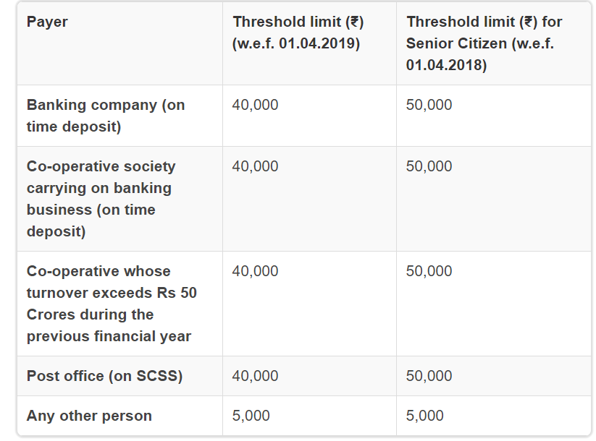
THRESHOLD LIMITS

Slide 24
When tax is to deducted
Tax is to be deducted either at the time of credit of such income to the account of payee or at the time of payment thereof in cash or bank issue of a cheque or draft or by any other mode, whichever is ealier
Which Challan to be used
TDS is required to be deposited in Challan No.281.

Slide 25
15 G / 15 H
If a declaration is submitted u/s 197A by the recipient to the payer along with his/her PAN, then no tax is deductible.

Slide 26
FORM 13 – SEC 197
As per provisions of section 197, the recipient can apply in form no.13 to the Assessing Officer to get a certificate authorizing the payer to deduct tax at lower rate (or deduct no tax, if certain conditions are satisfied). There is no time limit for application and it can be filed at any time before actual deduction of tax. If the recipient does not have PAN, he cannot apply for the certificate.
The certificate shall be issued, directly to the person responsible for paying income, on a plain paper, under an advice to the applicant. The certificate cannot be issued with retrospective effect. The recipient may furnish copy of such certificate to the person responsible for paying the income for lower/no deduction of tax at source.

Slide 27
Whether Tax is required to be deducted where interest is paid for delayed payments of trade liability?
Interest paid for delayed payments of trade liability is out of ambit of section 2(28A).
2(28A) “interest” means interest payable in any manner in respect of any moneys borrowed or debt incurred (including a deposit, claim or other similar right or obligation) and includes any service fee or other charge in respect of the moneys borrowed or debt incurred or in respect of any credit facility which has not been utilised ;
From the aforesaid provisions of section 2(28A) of the Act, it may be seen that ‘Interest’ contemplated thereunder, is payable in respect of ‘Moneys borrowed’ or ‘Debt incurred’.

Slide 28
Whether a partnership firm is liable to deduct Tax on a sum paid as interest on loan borrowed from Indian branch of a foreign bank?
Section 194A provides that tax is not required to be deducted at source from interest credited or paid to any banking company to which the Banking Regulations Act, 1949 applies. A foreign bank operating in India is governed by the Banking Regulations Act, 1949. Therefore, a partnership firm is not required to deduct tax at source from interest on loan payable to Indian Branch of the Foreign Bank.

Slide 29
SEC 206 AB AND SEC 206 CCA

