Slide 1

CMA AJITH SIVADAS
B.Com, ACMA, ACA, Ad Dip MA CIMA(UK)

Slide 2

Every seller shall collect tax from the buyer of any specified goods at the time of receiving the payment or debiting the buyer account whichever is earlier
Section 206C of the Income Tax Act governs the goods on which the seller has to collect tax from the purchaser.

Slide 3
WHO IS A BUYER ?
A person who obtains in any sale by way of auction tender or any other mode, specified goods or right to receive any such goods.
EXCLUDES
PUBLIC SECTOR COMPANY
CENTRAL GOVERNMENT
STATE GOVERNMENT
EMBASSY / HIGH COMMISSION
CLUBS ( Sports / Social)
A BUYER who purchases goods for PERSONAL CONSUMPTION

Slide 4
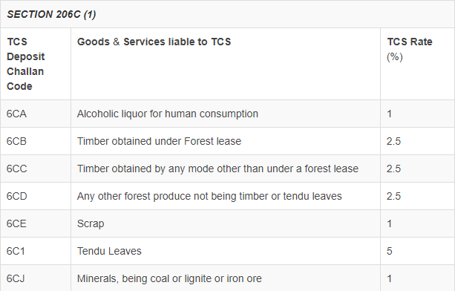
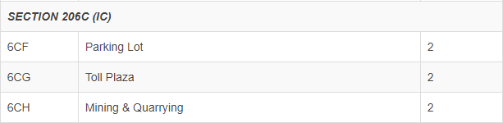

Slide 5
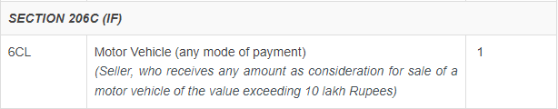
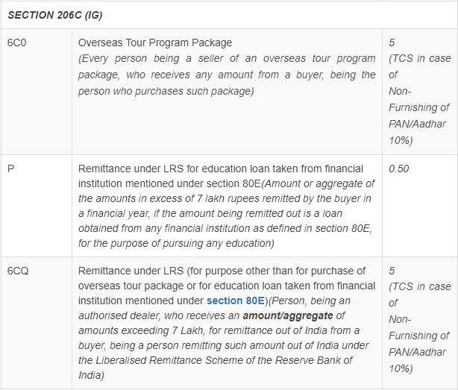

Slide 6
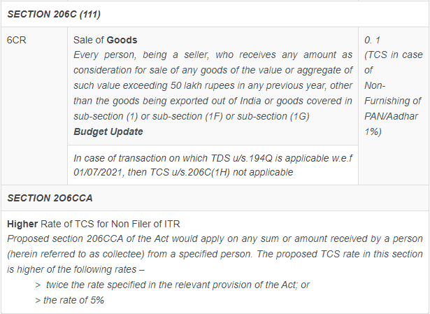

Slide 7

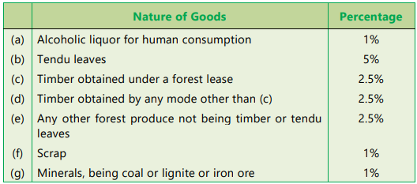
Sale of Certain Goods
Under Section 206C(1), sellers of certain goods are required to collect tax from the buyers at the specified rates.

Slide 8

SCRAP – Definition
The two important conditions for an item to be considered as SCRAP are:
The scrap should arise from manufacture or mechanical working of materials, and
It should not be usable as such
If any of the above 2 conditions is not satisfied, then the item will not be treated as Scrap, and thus No TCS u/s. 206C.

Slide 9

The definition of Scrap does not suggests that the scrap should be generated by the seller himself. Thus, the provisions of section 206C of the Act are applicable to a trader dealing in the scrap.
Chandmal Sancheti vs ITO (Jaipur ITAT)
The scrap sold should arise out of manufacturing or mechanical working of material. In absence of which, no requirement to collect tax at source.
Navine Fluorine International Ltd. vs. ACIT (Ahmedabad ITAT)
Provisions of TCS not applicable to dealer of scrap.
Lala Bharat Lal & Sons vs. ITO (Lucknow ITAT)
The Tribunal in this case held, that trading in the scrap cannot be deemed to have any nexus with manufacturing and hence a trader cannot be subjected to collection of TCS on the ground that he has dealt in scrap which has been manufactured by another assessee.

Slide 10

Where products obtained in course of ship breaking activity are usable as such, they do not fall within definition of scrap. Hence, not liable for TCS.
CIT vs. Priya Blue Industries Pvt. Ltd. (Gujarat HC)
Sale of railway scrap by dealer being certainly not usable due to its breakage or wear and tear, same would be subjected to TCS during resale.
Pramod Kumar Jain vs. ITO
Whether Sale of Scrap where Form 27C has been submitted by buyer is liable to TCS u/s.206C(1H)?
Since sale of scrap is covered u/s. 206C(1), the provisions of Section 206C (1H) shall not apply.

Slide 11

Where the assessee has received declaration in Form No. 27C from the buyer that the goods shall be used in manufacturing, processing or producing articles or things or for the purposes of generation of power and not for trading purposes, TCS shall not be required to be collected. [Neither u/s. 206C(1) nor u/s. 206C(1H)]

Slide 12

Lease or a License of Parking Lot, Toll Plaza or Mine or a Quarry
Section 206(1C) provides for collection of tax by every person who grants a lease, license or enters into a contract or rights in any
Parking lot
Toll plaza
A mine or quarry
To another person for the purpose of business.
RATE : 2%

Slide 13

The provisions of this section shall not apply to mining and quarrying of mineral oil, petroleum and natural gas.
The provisions of this section shall not apply if the licensee or lessee is a public sector company.
Individual / HUF even if his turnover does not exceed Rs.1 Crore or Rs. 50 Lakhs, as the case may be are also liable to collect tax u/s. 206C(1C).

Slide 14

Sale of Motor Vehicle of Value exceeding ₹ 10 Lakhs
Section 206C(1F) provides that every person, being a seller, who receives any amount as consideration for sale of a motor vehicle of the value exceeding ₹ 10 Lakhs, shall collect tax from buyer @ 1% of the sale consideration.
RATE : 1%

Slide 15

TCS on motor vehicle to be collected at the time of (receipt of) Retail Sale and not on sale of motor vehicle by manufacturers to dealers / distributors
– CBDT Circular No. 22/2016 dtd. 08.06.2016
Receipt of Sale consideration from a dealer would be subjected to TCS under sub-section (1H) of the Act, if such sales are not subjected to TCS under sub-section (1F) of section 206C of the Act.
-- CBDT circular 17/2020
Receipt of sale consideration by a dealer is liable for TCS u/s. 206C(1H).
Thus, earlier exemption given on sale of motor vehicles by manufacturers to dealers/distributors vide CBDT Circular No. 22/2016 dtd. 08.06.2016 is not relevant now since the same have been specifically included vide above Guidelines vide CBDT circular 17/2020.

Slide 16
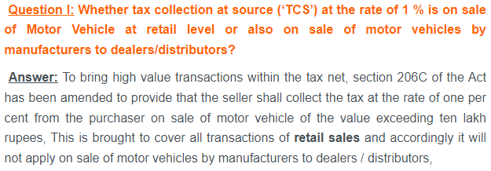
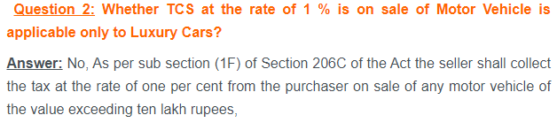
FAQ on Section 206(1F)

Slide 17
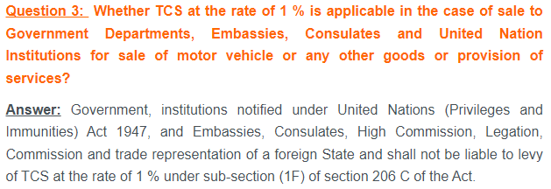
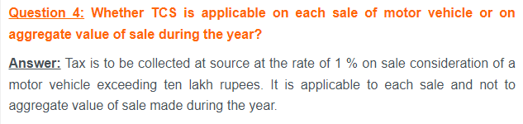
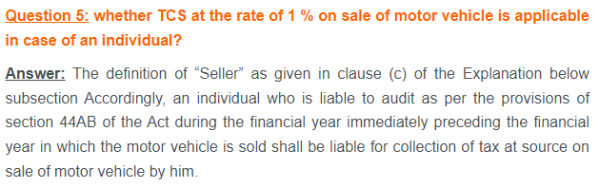

Slide 18
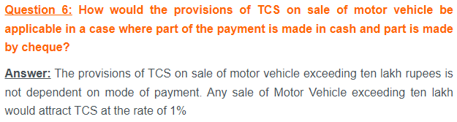

Slide 19

Overseas remittance or an overseas tour package
Section 206C(1G) provides for collection of tax by every person,
being an authorized dealer - who receives amount, under the Liberalised Remittance Scheme of the RBI
being a seller of an overseas tour programme package - who receives any amount from the buyer who purchases the package
RATE : 5%

Slide 20
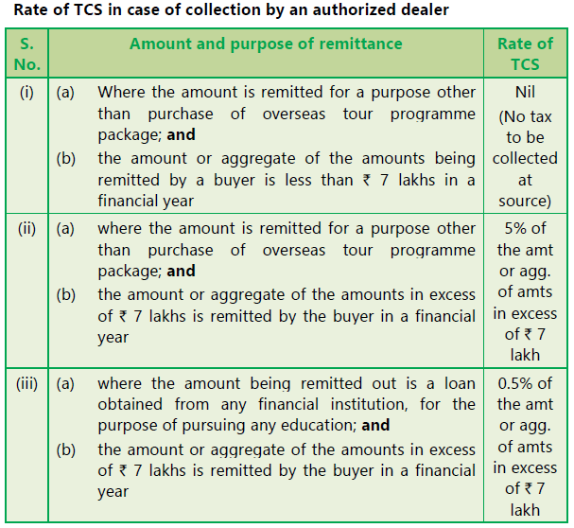

Slide 21
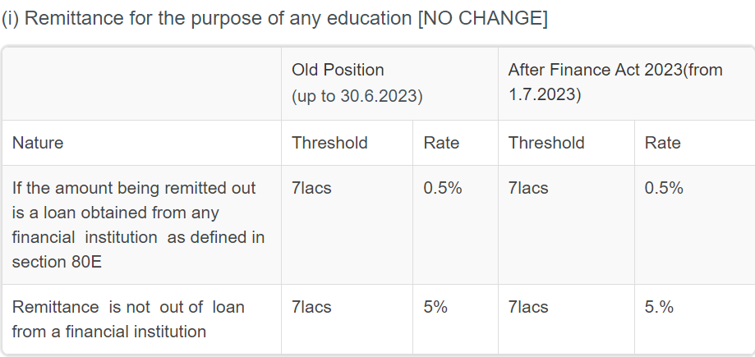

Slide 22
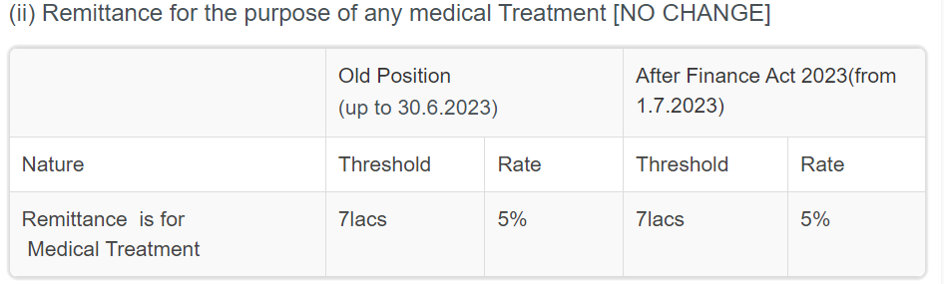

Slide 23
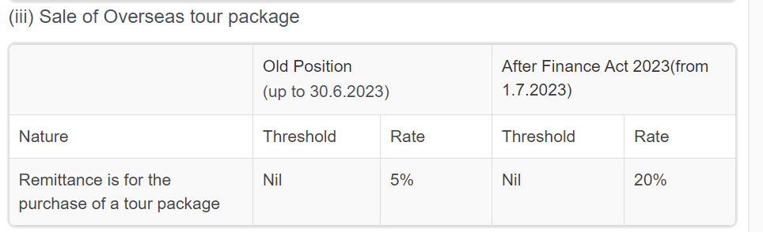

Slide 24
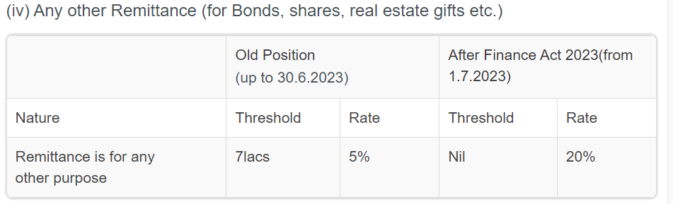

Slide 25

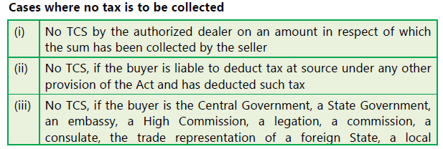

Slide 26
Consequences of failure to collect tax at source
If any person fails to deduct the TCS in full or in part or deducted the TCS and not deposited or not filed during specified time interval, as in the case may be, not prejudicing to any consequences against him, he shall be deemed to be “Assessee in Default”
Provided further that no penalty shall be charged under section 221 from such person unless the Assessing Officer is satisfied that the person has without good and sufficient reasons failed to collect and pay the tax.

Slide 27

Section 206CCA – Special provision for collection of tax at source for non-filers of ITR
The person from whom tax is required to be collected has not filed ITRs for the assessment year relevant to the previous year immediately prior to the previous year in which tax is required to be collected for which the time limit for filing the return under section 139(1) has expired and the aggregate amount of TDS and TCS in his case exceeds Rs.50,000 or more in each of these two previous years.
The person liable to collect tax at source shall collect at the higher of the following two rates viz.
  at twice the rate specified in the relevant provisions of the Act; or
  at the rate of 5 percent.
If the provisions of section 206CC is applicable to such person in addition to this provision, TCS shall be at higher of the two rates provided in this section and section 206CC.
This provision will not apply to a non-resident who does not have a PE in India.

Slide 28
206CC – Mandatory Requirement of Furnishing PAN
Section 206CC of Income Tax Act, 1961 has been inserted to provide that any person whose payments are subject to tax collection at source
i.e. the collectee, shall mandatorily furnish his PAN to the collector failing which the collector shall collect tax at source at higher of the following rates –
a. At twice the applicable rate of TCS or
b. At the rate of 5

Slide 29
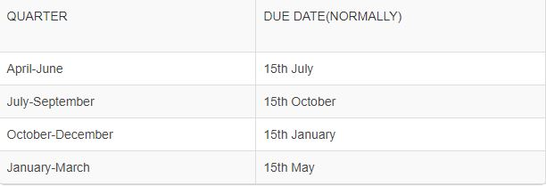
TCS RETURN
Seller has to file return in Form 27EQ on quarterly basis
DUE DATES FOR TCS RETURN FILING

Slide 30
Steps of Filing at Glance
Registration
Preparation
Submission

Slide 31
Filing of TDS/ e filing of TCS
1. Registration:
The deductor /collector should hold valid TAN and is required to be registered in the e-filing website (https://www.incometaxindiaefiling.gov.in/) as “Tax Deductor & Collector” to file the “e-TDS/e-TCS Return”.
Registration in case of Government agencies?
In case of an office of the government, the Treasury Officer can register as an external agency user.
2.Preparation:
The Return Preparation Utility (RPU) to prepare the TDS/TCS Statement and File Validation Utility (FVU) to validate the Statements can be downloaded from the tin-nsdl website (httos://wvvw.tin-nsdi.corni).
The statement is required to be uploaded as a zip file and submitted using either Digital Signature Certificate (DSC) or Electronic Verification Code (EVC). For DSC mode, the signature for the zip file can be generated using the DSC Management Utility available under Downloads in the e-Filing website

Slide 32

Can I use EVC for Verification?
Alternatively, deduetor /collector can e-Verify using EVC.
3. Submission:
The deductor/collector is required to login to the e-filing website using TAN and go to TDS Upload TDS. The deductor/collector is required to upload the “Zip” file along with either the signature file (generated as explained in para (b) above) or EVC.
In case of External agency user, TDS/TCS return can be filed for the deductors/collectors under their jurisdiction using Digital Signature Certificate.

Slide 33
Modes of Generating EVC
Net Banking
Principal contact person’s net banking login (linked to the registered PAN) can be used to generate the EVC for the TAN
Aadhaar OTP
The principal contact person’s PAN can be linked with AADHAAR to use this option.
Bank Account Number – The principal contact person can use his pre validated bank account details to avail this option.
Demat Account Number – The principal contact person can use his pre validated demat account details to avail this option.

Slide 34
Once uploaded, the status of the statement shall be shown as “Uploaded”. The uploaded file shall be processed and validated.
Upon validation, the status shall be shown as either “Accepted” or “Rejected which will reflect within 24 hours from the time of upload.
The status of uploaded file is visible at TDS View Filed TDS. In case the submitted file is “Rejected”, the rejection reason shall be displayed.

