Slide 1
SEC 194 IA,194 IC,194 J
TAX DEDUCTED AT SOURCE

Slide 2
SEC 194 IA - Payment on transfer of certain immovable property other than agricultural land.
(1) Any person, being a transferee, responsible for paying (other than the person referred to in section 194LA) to a resident transferor any sum by way of consideration for transfer of any immovable property (other than agricultural land), shall, at the time of credit of such sum to the account of the transferor or at the time of payment of such sum in cash or by issue of a cheque or draft or by any other mode, whichever is earlier, deduct an amount equal to one per cent of such sum ⁹¹[or the stamp duty value of such property, whichever is higher,] as income-tax thereon.
(2) No deduction under sub-section (1) shall be made where the consideration for the transfer of an ⁹²[immovable property and the stamp duty value of such property, are both,] less than fifty lakh rupees.
(3) The provisions of section 203A shall not apply to a person required to deduct tax in accordance with the provisions of this section.

Slide 3
Explanation.—For the purposes of this section,—
(a) "agricultural land" means agricultural land in India, not being a land situate in any area referred to in items (a) and (b) of sub-clause (iii) of clause (14) of section 2;
(aa) "consideration for transfer of any immovable property" shall include all charges of the nature of club membership fee, car parking fee, electricity or water facility fee, maintenance fee, advance fee or any other charges of similar nature, which are incidental to transfer of the immovable property;
(b) "immovable property" means any land (other than agricultural land) or any building or part of a building;
[(c) "stamp duty value" shall have the same meaning as assigned to it in clause (f) of the Explanation to clause (vii) of sub-section (2) of section 56.]

Slide 4

Section 194-IA
Payment on transfer of certain immovable property other than agricultural land

Slide 5

SECTION | NATURE OF PAYMENT | PAYER | PAYEE | RATE | LIMIT
194-IA | Payment on transfer of certain immovable property other than agricultural land. | Any person, being a transferee (other than a person referred to in section 194LA) | Any Resident Transferor | 1 % Non PAN – 20% 206 AB applicable up to 31.03.2022. | Rs. 50,00,000 (Consideration or SDV for transfer which ever is higher from 01.04.22) 110% Principle Dilemma.

Slide 6

Why TDS on transfer of Immovable Property?
Former Finance Minister P. Chidambaram while introducing TDS on Property said that the transactions of Immovable Property are usually undervalued and under‐reported.
The parties don’t even mention the PAN No. in the agreement or while entering into the transaction.
With a view to improving the reporting of such transactions, the Section 194‐IA was introduced in the Finance Bill of 2013

Slide 7


Non-Applicability of Section 194-IA
If Person acquires Rural Agricultural Land in India.
If Transferor is Non-Resident.

Slide 8
Case Law : Section 194-IA
Pushkar Prabhat Chandra Jain vs. UOI [2019] 262 Taxman 118 (Bom)
If payer, after deducting tax, fails to deposit it in Government revenue, measures can always be initiated against such payers once seller of property suffers TDS at hands of payer purchaser; seller could not again be asked to pay same again.

Slide 9
Vinod Soni V/s ITO
Purchased by 4 persons – Total amount 1.50 Crores
TDS not applicable

Slide 10
Time of Deduction
Date of Payment or
Date of Credit
Which ever is earlier
With in 30 days payment to exchequer.

Slide 11
NIL / Lower Deduction
197 not applicable
15 G/ 15 H not applicable

Slide 12
Oxica enterprises (P) Ltd. Vs Dy CIT
Purchased from two Joint Owners – 60.12 Lakhs Total
No TDS

Slide 13
Practical aspects of Section 194 IA and Section 195
Particulars | Section 194 IA | Section 195
Category of Payee/Seller | Resident | Non-Resident
Nature of Payment | any sum by way of consideration for transfer of any immovable property (other than agricultural land) | any interest or any other sum chargeable under the provisions of the Act
Rate of TDS | 1 % on entire sale consideration | LTCG – 20% , STCG – Slab Rate (Only on the Capital Gain, not on the entire sale consideration)
Remittance of TDS | The buyer shall remit the TDS amount through a challan cum statement in Form 26QB and a TDS certificate shall be issued to the Payee / Seller in Form 16B. | The person who is liable to deduct TDS (Buyer of the immovable property) must mandatorily apply for a TAN (There is no option for him to remit the TDS amount through Form 26QB)

Slide 14
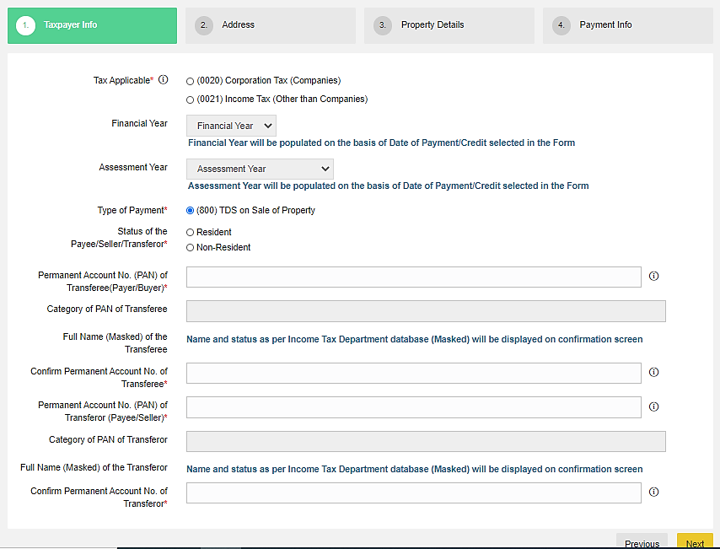
E-Payment Procedure of TDS on Property (Form 26 QB)

Slide 15
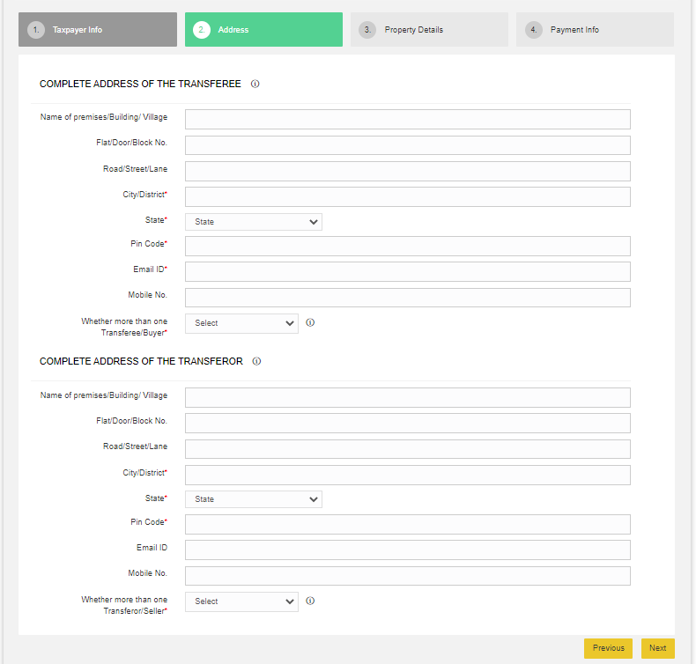

Slide 16
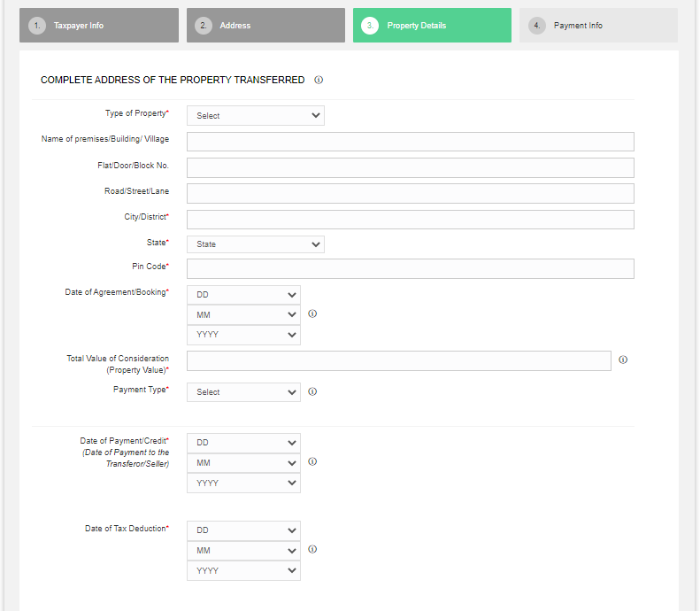

Slide 17
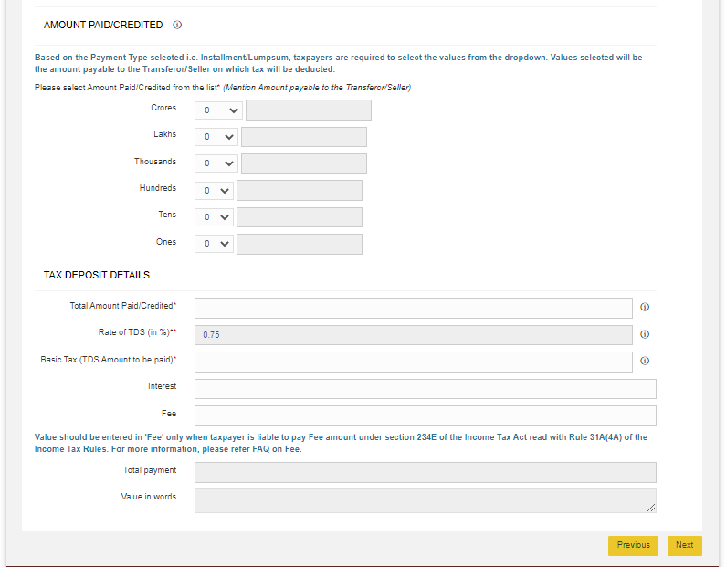

Slide 18
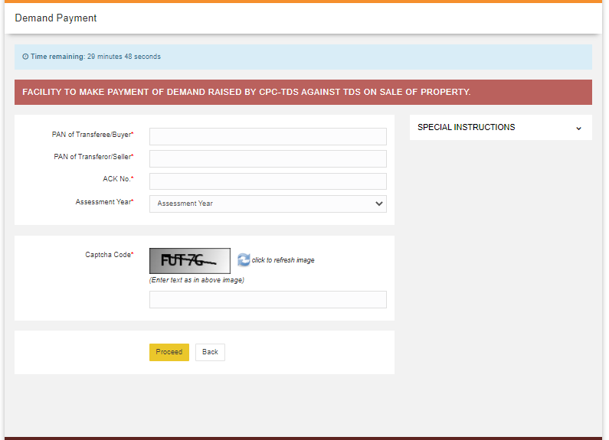
Demand Payment for TDS on Property (Form 26 QB)

Slide 19
SEC 194 IC - Payment under specified agreement.
Notwithstanding anything contained in section 194-IA, any person responsible for paying to a resident any sum by way of consideration, not being consideration in kind, under the agreement referred to in sub-section (5A) of section 45, shall at the time of credit of such sum to the account of the payee or at the time of payment thereof in cash or by issue of a cheque or draft or by any other mode, whichever is earlier, deduct an amount equal to ten per cent of such sum as income-tax thereon.

Slide 20
Rate – 10%
Payment or credit which ever is earlier.
Payee must be resident
No threshold limits
197 / 15 G,H not applicable

Slide 21
194 J -
(1) Any person, not being an individual or a Hindu undivided family, who is responsible for paying to a resident any sum by way of—
(a) fees for professional services, or
(b) fees for technical services, or
(ba) any remuneration or fees or commission by whatever name called, other than those on which tax is deductible under section 192, to a director of a company, or
(c) royalty, or
(d) any sum referred to in clause (va) of section 28,

Slide 22
shall, at the time of credit of such sum to the account of the payee or at the time of payment thereof in cash or by issue of a cheque or draft or by any other mode, whichever is earlier, deduct an amount equal to ⁹⁸[two per cent of such sum in case of fees for technical services (not being a professional services), or royalty where such royalty is in the nature of consideration for sale, distribution or exhibition of cinematographic films and ten per cent of such sum in other cases,] as income-tax on income comprised therein :

Slide 23
Provided that no deduction shall be made under this section—
(A) from any sums as aforesaid credited or paid before the 1st day of July, 1995; or
(B) where the amount of such sum or, as the case may be, the aggregate of the amounts of such sums credited or paid or likely to be credited or paid during the financial year by the aforesaid person to the account of, or to, the payee, does not exceed—
(i) thirty thousand rupees, in the case of fees for professional services referred to in clause (a), or
(ii) thirty thousand rupees, in the case of fees for technical services referred to in clause (b), or
(iii) thirty thousand rupees, in the case of royalty referred to in clause (c), or
(iv) thirty thousand rupees, in the case of sum referred to in clause (d):

Slide 24
Provided further that an individual or a Hindu undivided family, whose total sales, gross receipts or turnover from the business or profession carried on by him exceed ⁹⁹[one crore rupees in case of business or fifty lakh rupees in case of profession] during the financial year immediately preceding the financial year in which such sum by way of fees for professional services or technical services is credited or paid, shall be liable to deduct income-tax under this section :
Provided also that no individual or a Hindu undivided family referred to in the second proviso shall be liable to deduct income-tax on the sum by way of fees for professional services in case such sum is credited or paid exclusively for personal purposes of such individual or any member of Hindu undivided family:
Provided also that the provisions of this section shall have effect, as if for the words "ten per cent", the words "two per cent" had been substituted in the case of a payee, engaged only in the business of operation of call centre.

Slide 25
Who is Liable to Deduct TDS Under Section 194J?
Everyone except an individual/HUF who is liable to make the following payments to any resident is liable to deduct TDS Under Section 194J:
1.Fees for professional services and for technical services or
2. Any remuneration/ fees/ commission whatever name called to a director of a company other than the payment on which tax is deductible u/s 192 or
3.Royalty or
4. Non-compete fees u/s 28(VA)
Note: It includes Individual/HUF falling under the scope of section 44AB.

Slide 26
Meaning of Professional Services Under Section 194J
Professional Services are defined under Section 194J includes:
  Medical
  Legal
  Engineering
  Architectural profession
  Accountancy
  Technical consultancy, or
  Interior decoration
  Professional services notified in section 44AA includes:
  The profession of film artist
  The profession of the authorized representative
  The profession of Company Secretary
  Professional Services related to sports activities engraved by CBDT for Section 194J Under TDS
  Anchors
  Commentators
  Event Managers
  Physiotherapists
  Referees and Umpires
  Sports Persons
  Sports Columnists
  Trainers and Coaches

Slide 27
Meaning of Fees for Technical Services Under Section 194J:
Technical services
Managerial services
Consultancy Services
Provision of services of technical or other personnel

Slide 28
RATE OF TDS
Category | Rate
If Payee is engaged only in the business of the operation of the call centre and the payment of fees for technical service (not being a professional royalty where such royalty is in the nature of consideration for sale, distribution or exhibition of cinematographic film) and Technical services other than professional | 2%
Payee involved in any other business operation or profession comes under the scope of194J and not being a professional royalty where such royalty is in the nature of consideration for sale, distribution or exhibition of cinematographic film. | 10%
If PAN not furnished by the payee | 20%

Slide 29
A CASE STUDY
Ram & Krishna enterprises is a grocery company. This is a fast growing company so seeing the market need and opportunity, management decided to expand the business. Management has decided below action plans for FY 20-21.
1. Construct infrastructure to manufacture & store the products
2. Implementation of customized software / ERP
3. Feasibility study of owned vs hired logistics
Management has appointed M/s PMC & associates to design the construction layout to construct the building. They also appointed M/s F&S associates to design and implement an ERP solution for their all activities including procurement, manufacturing, sales, accounts payable and receivables etc., Purchase order has been raised for both the above services and the same is submitted to the finance team to release the advance payment as per the PO terms. Since both the activities are falling under section 194 J hence Finance manager has to deduct the TDS as per the prevailing rates. Now here question comes that whether both the services are covered under the professional services. Whether TDS will be deducted @ 10% or 2%

Slide 30
Prima facie, it is appearing that both the services are falling under the definition of professional services and TDS has to be deducted @10%. These confusions we face in our regular services during consultancy or Job.
In case of design service, vendor has to give the design layout, which can be finished with his professional knowledge hence finance manager has to deduct TDS @10%. Whereas customized software/ERP design & implementation is a technical service as the same involve following step :
gathering of the requirement from end users,
2) Solution design,
3) Development or customization of ERP software,
4) Implementation of the software throughout all the branches of PMC & associates. Hence the same will be covered under the technical service and as per our opinion TDS can be deducted @ 2% under section 194J.
More examples of Professional and technical services:
Professional services – Services of doctors, chartered accountants, tax consultancy services, project monitoring services etc.
Technical services – Computer development software, Bio technical services, geological and scientific services etc.

Slide 31
Time of TDS Deduction Under Section 194J
The credit of the amount to payee’s account
Payment of such amount to the payee in cash/ cheque/ draft or any other medium,
whichever is earlier

Slide 32
The Threshold Section 194J Under TDS
Category | Threshold Limit
Fees for professional services | 30000
Fees for technical services | 30000
Royalty | 30000
Non-compete fees | 30000
Remuneration/ commission/fees payable to a director of a company | No such limit

Slide 33
Conditions for Non-Applicability of TDS Section 194J
If the payment is made by an individual or HUF. But if the individual/ HUF falls under *44AB(a)/ 44AB(b)then the payment is liable to deduct TDS following Section 194J
Further, an individual/HUF is not liable to pay TDS under section 194J if the payment is made or credited exclusively for personal purposes.

Slide 34

Gross amount including / excluding GST.
Circular No. 23/2017 – dated 19/07/2017.
The Board hereby clarifies that wherever in terms of the agreement or contract between the payer and the payee, the component of ‘GST on services’ comprised in the amount payable to a resident is indicated separately, tax shall be deducted at source under Chapter XVII-B of the Act on the amount paid or payable without including such ‘GST on services’ component.

Slide 35

Doctor's remuneration ? 192 / 194 J
Manipal Health Systems V. CIT
The Karnataka High Court observed that contract between the assesse and doctors was not a “Contract of Service” but “Contract for service”. Thus the payment made to doctors by the hospital are covered under section 194J of the Income tax act, also as per the agreement made by the doctors and the assesse the doctors were not in employment and PF, ESI etc of the doctors was not done.

Slide 36
Circular no. 715 dated 8.8.1995 - Payment made to Hospitals
Payment made to Hospitals - 194 J applicable.
Commission recvd by ad. Agency from media – 194J
Payment to electrician – 194C
Maintanence Contract – 194C
Re-imbursements – No TDS

Slide 37

DIRECTORS REMUNERATION
GST not applicable on Director’s remuneration if subjected to TDS u/s 192 of Income Tax Act 1961.
CBIC Clarification Circular No: 140/10/2020 – GST.
There by 194 J deduction fees/remuneration GST shall be applicable.

Slide 38
REIMBURSEMENT OF EXPENSES
Reimbursement of Expenses should not be taken into consideration while calculating the gross amount liable to deduct TDS u/s 194J
i.e, If the gross amount of professional fees is Rs.100000/- which, includes Rs. 10000/- as Reimbursement of Expenses, TDS u/s 194J is to be deducted on Rs.90000/- only.

Slide 39
TDS TO BE DEDUCTED NOT UNDER 194J
Services like, Maintennance of
Lift
Air conditioner
Electrical fittings
Fire Hindrance
Pest control
Do not cover under Technical works and hence, covered under 194C and not under 194J

Slide 40
CIT VS PVS MEMORIAL HOSPITAL LTD
(KERALA HIGH COURT)
Where Tax is required under 194J but deducted at a lesser rate under 194C then the application of 194J cannot be avoided.

