Slide 1


Slide 2

SESSION ON TDS SECTIONS 194E, 194EE, 194F, 194G,194H,194M

Slide 3
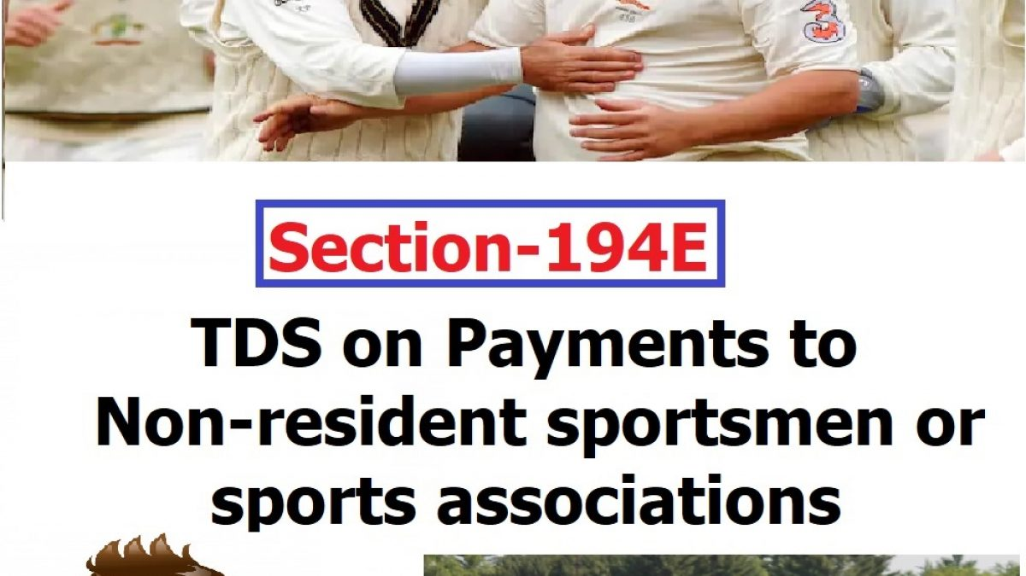

Slide 4
SECTION 194 E
TDS ON PAYMENT TO NON- RESIDENT SPORTSMEN/ SPORTS ASSOCIATION
PERSONS LIABLE TO DEDUCT TDS U/S 194E
Any person making payment of income referred to in section 115BBA of Income Tax Act, 1961 to the following persons shall be liable to deduct TDS:-
A Non resident sportsman(including an athlete)
An Entertainer
who is not a citizen of India.
A non- resident sports association / institution.

Slide 5
PAYMENTS REFFERED TO IN SECTION 115BBA
Where the total income of an assessee,-
a)
being a sportsman (including an athlete),
who is not a citizen of India and is a non-resident
includes any income received or receivable by way of --
(i) participation in India in any game (other than a game the winnings wherefrom are taxable under section 115BB) or sport
(iii) contribution of articles relating to any game or sport in India in newspapers, magazines or journals; or
(ii) advertisement; or

Slide 6
b)
being a non-resident sports association or institution
includes any amount guaranteed to be paid or payable to such association or institution in relation to any game (other than a game the winnings wherefrom are taxable under section 115BB) or sport played in India,
c)
being an entertainer
who is not a citizen of India and is a non-resident
includes any income received or receivable from his performance in India

Slide 7
TIME OF DEDUCTION OF TDS UNDER SECTION 194E
When this section gets attracted in a given transaction, deductor is required to deduct TDS within earlier of the following dates –
At the time of payment in cheque, draft, cash or any other mode
At the time of credit of the income to the account of the recipient
OR

Slide 8
RATE AT WHICH TDS UNDER SECTION 194E IS TO BE DEDUCTED
Deductor liable to deduct TDS under section 194E is required to deduct TDS
@ 20%

Slide 9
TDS RETURN FILING U/S 194E
The Deductor, under section 194E of the Income Tax Act, 1961, is required to furnish TDS return in Form 27Q
FORM 27Q IS TO BE FILED QUARTERLY
Provisions of section 203 of the Income Tax Act, 1961 makes it mandatory for the Deductor to issue the TDS certificate to the payee. The Deductor deducting TDS under section 194E is required to furnish TDS certificate in Form 16A

Slide 10
RELEVANT RULES AND FORMS FOR THE PURPOSE OF THIS SECTION
RULES
RULE 31AB
RULE 31
RULE 30
RULE 31A
RULE 37 A
FORMS
FORM No.16A
FORM 26 AS
FORM 27 Q

Slide 11

CASE LAWS
Pilcom Vs. CIT West Bengal(SUPREME COURT)
Payments made to the Non-Resident Sports Association represented their income which accrued or arose or deemed to have accrued or arisen in India, shall required to deduct tax under section 194E.

Slide 12
CASE LAWS
International Merchandising Corporations-Indian Branch Office V/s. ADIT (2015) 42 Tribunal
Sanction Fees paid to a non-resident association of a tennis professional requires tax to be deducted at source under section 194E

Slide 13
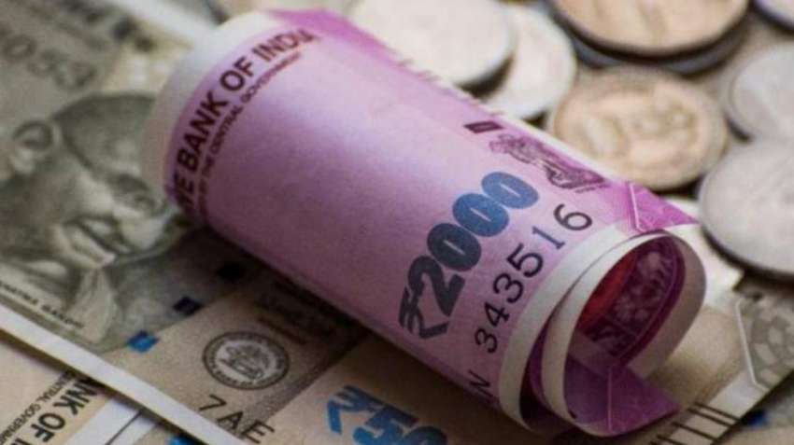
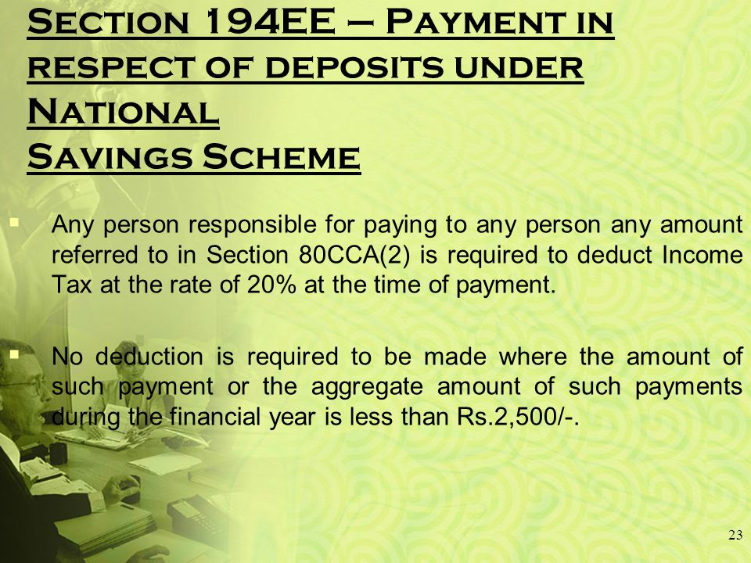

Slide 14
SECTION 194EE
PAYMENTS IN RESPECT OF DEPOSITS UNDER NATIONAL SAVINGS SCHEME, ETC.
PERSON LIABLE TO DEDUCT TDS U/S 194EE
PAYMENT TO ANY PERSON ANY AMOUNT REFERRED TO IN Clause (a) Of Sub-section (2) Of Section 80CCA

Slide 15
CLAUSE (a) of Sub section (2) of Section 80CCA
Where any amount-
STANDING TO THE CREDIT OF THE ASSESSEE
UNDER THE NATIONAL SAVINGS SCHEME IN RESPECT OF WHICH A DEDUCTION HAS BEEN ALLOWED UNDER SUB SECTION (1)
TOGETHER WITH THE INTEREST ACCRUED ON SUCH AMOUNT
IS WITHDRAWN IN WHOLE OR PART IN ANY PREVIOUS YEAR.

Slide 16
TIME OF DEDUCTION OF TDS UNDER SECTION 194EE
AT THE TIME OF PAYMENT

Slide 17
RATE AT WHICH TDS UNDER SECTION 194EE IS TO BE DEDUCTED
@ 10%
If the recipient does not furnish his PAN to the deductor, tax will be deducted
@ 20%

Slide 18
WHEN NO TDS IS DEDUCTIBLE UNDER SECTION 194EE
PAYMENT UP TO RS. 2,500
PAYMENT TO LEGAL HEIRS
DECLARATION TO THE PAYER IN FORM NO. 15G OR 15H [Section 197A]

Slide 19
TDS RETURN FILING U/S 194EE
The Deductor, under section 194EE of the Income Tax Act, 1961, is required to furnish TDS return in Form 26Q

Slide 20
RELEVANT RULES AND FORMS FOR THE PURPOSE OF THIS SECTION
RULES
RULE 30
RULE 31A
RULE 37
RULE 31
RULE 31 AB
RULE 29C
FORMS
FORM 15
FORM 15H
FORM 16A
FORM 26
FORM 26AS
FORM 26Q

Slide 21

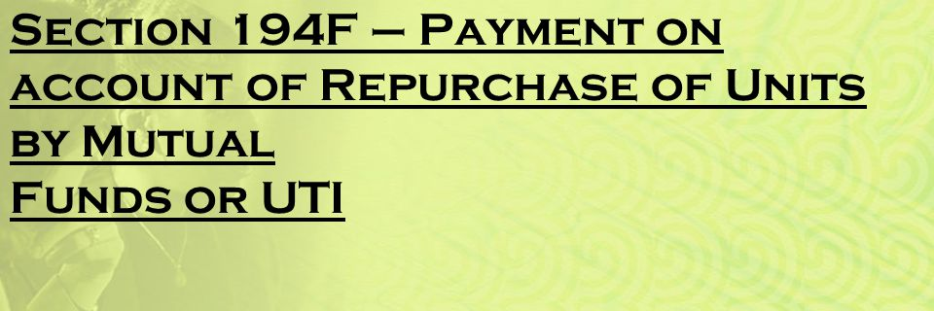


Slide 22
SECTION 194F
PAYMENTS ON ACCOUNT OF REPURCHASE OF UNITS BY MUTUAL FUND OR UTI
PERSON LIABLE TO DEDUCT TDS U/S 194F
MUTUAL FUNDS or UTI IS LIABLE TO DEDUCT TDS ON
PAYMENT TO ANY PERSON ANY AMOUNT REFERRED TO IN Subsection (2) of section 80CCB

Slide 23
SECTION 80 CCB (2)
Amount which is invested by the assessee in the units being issued under a plan formulated under the
Equity Linked Savings Scheme.
The amount so invested has been allowed as a deduction, however, the amount invested (whole or part) is returned back to the assessee by the Fund / Trust either by way of repurchase of the units or on the termination of the plan

Slide 24
TIME OF DEDUCTION OF TDS UNDER SECTION 194F
AT THE TIME OF MAKING PAYMENT OF THE REQUISITE AMOUNT
TIME OF DEPOSIT OF TDS WITH THE GOVERNMENT
within a period of 7 days from the end of the month in which TDS is deducted. However, the TDS deducted in the month of March is to be deposited on or before 30th April.

Slide 25
RATE AT WHICH TDS UNDER SECTION 194F IS TO BE DEDUCTED
@ 20 %
There is no exemption limit provided under section 194F
CATEGORY OF PAYEE
Individuals And HUF

Slide 26
RELEVANT RULES AND FORMS FOR THE PURPOSE OF THIS SECTION
RULES
RULE 31
RULE 31AB
RULE 30
RULE 31A
RULE 27
FORMS
FORM 16A
FORM 26AS
FORM 26
FORM 26Q

Slide 27

SECTION 194 G

Slide 28
SECTION 194G
COMMISSION ON SALE OF LOTTERY TICKETS
PERSON LIABLE TO DEDUCT TDS U/S 194G
person, who is paying any income by way of
commission
prize on lottery tickets to the person who has been stocking / distributing / purchasing / selling the lottery tickets
remuneration

Slide 29
TIME OF DEDUCTION OF TDS UNDER SECTION 194G
the Deductor is required to deduct TDS within earlier of the following prescribed dates –
At the time of payment in cash / cheque / draft / any other mode
At the time of credit of income to the account of the payee
OR

Slide 30
RATE AT WHICH TDS UNDER SECTION 194G IS TO BE DEDUCTED
@ 5%
It should be noted that no surcharge, education cess or SHE cess shall be levied on the said rate of 5%.
If the recipient does not furnish his PAN to the deductor, tax will be deducted
@ 20%
MAXIMUM MARGINAL RATE

Slide 31
EXEMPTION LIMIT U/S 194 G
Liable to deduct TDS under section 194G only if the income amount exceeds INR 15,000
Provision of lower / NIL TDS deduction
The payee can, by filing an application in Form no. 13, request the assessing officer for lower TDS deduction or NIL / no TDS deduction. If the payee receives the appropriate certificate from the Assessing Officer, the Deductor would deduct TDS at a lower rate or NIL rate, as directed
However, section 206AA(4) states that no certificate for lower / NIL deduction shall be granted unless the application contains the
Permanent Account Number (PAN) of the applicant

Slide 32
RELEVANT RULES AND FORMS FOR THE PURPOSE OF THIS SECTION
RULES
RULE 28
RULE 31AB
RULE 28 AA
RULE 28 AB
RULE 30
RULE 37
RULE 31
RULE 31A
FORMS
FORM 16A
FORM 26AS
FORM 13
FORM 26Q
FORM 26

Slide 33
CONSEQUENCES A DEDUCTOR WOULD FACE IF HE FAILS TO DEDUCT TDS OR AFTER DEDUCTING THE SAME FAILS TO DEPOSIT IT TO THE GOVERNMENT’S ACCOUNT
Disallowance of expenditure
section 40(a)(i)
section 40(a)(ia)
Levy of interest
section 201
Levy of Penalty
section 271C
Section 58(1A)
Prosecution
Section 276 B

Slide 34

SECTION 194H
TDS ON COMMISSION AND BROKERAGE

Slide 35
APPLICABILITY
Individuals and Hindu Undivided Family who were covered under section 44AB are also required to deduct TDS. However, From FY 2020-21, individual and HUF whose turnover from business is above Rs. 1 crore or gross receipts from profession are above Rs. 50 lakh are also required to deduct TDS.

Slide 36
RATE AT WHICH TDS UNDER SECTION 194G IS TO BE DEDUCTED
@5%
It should be noted that no surcharge, education cess or SHE cess shall be levied on the said rate of 5%.
If the recipient does not furnish his PAN to the deductor, tax will be deducted
MAXIMUM MARGINAL RATE
@20%

Slide 37
NON-APPLICABILITY
No deduction shall be made under this section in a case where the amount or the aggregate amounts of such income to be credited or paid during the financial year does not exceed INR 15,000.
The Person can make an application to the assessing officer under section 197 for deduction of tax at NIL rate or at a lower rate.

Slide 38

TIME LIMIT FOR DEPOSITING IN TDS
Tax Deducted during the month of April to February is to be deposited on or before the 7th of next month. Tax Deducted in the month of March is to be deposited on or before 30th April.
FOR EXAMPLE:
Tax deducted on 25 April is to be deposited on or before 7th May and tax deducted on 15 march is to be deposited on or before 30 April.

Slide 39
Points To Be Noted
Is Discounts are considered as “Commission”?
The High Court accepted that the discount is the price rebate and hence the same is not a commission.
Meaning of Commission
Commission or brokerage includes any payment
received or receivable,
directly or indirectly, OR
by a person acting on behalf of another person
TDS on commission or brokerage includes,
for services rendered (not being professional services), or
for any services in the course of buying or selling of goods, or
in relation to any transaction relating to any asset, valuable article or thing, except securities

Slide 40
When Brokerage Is Exempted Under Section 194H?
An employer is paying salary or commission to the employee (comes under Section 192 and not 194H).
Commission on insurance income and loan underwriting.
An individual with a lower or nil TDS certificate from an authorized body will enjoy TDS exemption for all services.
Paying financial corporations under the range of central finance.
Charges imposed for warehouse services.
Interest from the NRI account.
Payments done by the Reserve Bank of India to any bank.
Income by interest from any savings with bank and post office.
Brokerage for providing security to the public.
Commission imposed on the transaction by using debit or credit card in between an acquirer bank and merchant organization.

Slide 41
Circular No.5/2016, dated 29/02/2016
Section 194H, read with section 194C of the Income Tax Act,1961- Deduction of tax at source- Commission or Brokerage etc
The issue of applicability of TDS provisions on payments made by television channels or media houses publishing newspaper or magazines to advertising agencies for procuring and canvassing for advertisements has been examined by the board view of representations received in this regard.
There are two types of payments related with advertising :-
Payment by client to the advertising agencies,
and
Payment by advertising agencies to the television channel/Newspaper Company

Slide 42
The applicability of TDS on these payments has already ben deal with in Circular No.715, dated 8-8-1999, where it has been clarified in Question Nos. 1&2 ha while TDS under section 194C (as work contract) will be applicable on the first type of payment, there ill be no TDS under section 194C on the second type of payment eg. payment by advertising agency to the media company.
However, another issue has been raised in various cases as to whether the fees or charges taken or retained by advertising companies from media companies for canvasing/booking advertisements (typically 15% of the billing) is commission or discount. It has been argued by the asssessee that since the relationship between the media company and the advertising company is on a principal-10-principal basis such payments are in the nature of trade discount and not commission and, therefore, outside the purview of TDS under section 194H. The Department, on the other hand has taken the stand in some cases that since the advertising agencies act on behalf of the media companies for procuring advertisements, the margin retained by the former amounts of constructive payment of commission and, accordingly, TDS under section 194H is attracted.

Slide 43
The issue has been examined by the Alahabad High Court in the case of Jagan Prakashan Ltd and Delhi High Court in the mater of Living Media Limited and it was held in both the cases that the relationship between the media company and the advertising agency is that of a principle-to-principal' and, therefore, not liable for TDS under section 194H. The SLPs filed by the Department in the matter of Living Media Ltd and Jagran Prakashan Ltd have been dismissed by the Supreme Court vide order dated 11-12-2009 and order dated S-5-2014,rspectively, Though these decisions are in respect of print media, the ratio is also applicable to electronic medial television advertising as the broad nature of the activities involved is similar.
In view of the above, it is hereby clarified that no TDS is attracted on payments made by television channels newspaper companies to the advertising agency for booking Or procuring of or canvasing for advertisements.
It is also further clarified that
Commission referred to in Question No.27 of the Board's Circular No. 715, dated 8-1995 does not refer to payments by media companies to advertising companies or booking of advertisements but to payments for engagement of models, artists photographers, sportspersons, etc, and, therefore, is not relevant to the issue of TDS referred to in this Circular.

Slide 44
Special Points to be Noted
Amount received by stamp vendors is discount and not a commission- Held in the case Ahamedabad stamp vendors Association V/s Union of India(2002)
Airlines pay their agents for services rendered by them for sale of tickets. This is allowed to the agent from the list price. It was held that this can be treated as brokerage and tax should be deducted at source under section 194H.
Followed in the case:-
Around the World Travel and Tour Pvt Limited V/s Union Of India, Madras HC, ITR 473 AND 477, 2004
Payments for services relating to transactions in securities in marketing units of various mutual fund schemes to the potential investors, section 194H is attracted.
Held in CIT V/s. Tandon and Mahendra, 2014

Slide 45
Where an hospital had made Arrangement with two sisters for procurement of drugs and medicines making credit available to them for purchases, the amount paid for their services cannot be treated as commission, so as to require tax deduction at source. (CIT V/s. Jaslok Hospital and Research Centre, 2015)
Where the bank provides to retailers swiping machines for processing its credit cards issued to the customers, the payment by the customers to the bank does not require tax deduction at source as the bank is either buying nor selling goods nor does it render any service in the nature of an agency. It is a case, where the principle of doubtful penalization has to be strictly applied in favor of non-deduction of tax at source.(CIT V/s. J D S Apparels P Ltd., 2015)
Where a payment was made to the stockiest/dealers under a sales promotion scheme by way of incentives on the basis of their performance, there can be no inference if The brokerage or commission in respect of such payments, where the relationship that of principal to principal.
(CIT V/s. Intervet India Pvt Limited, 2014, Bombay HC)

Slide 46
Amount received for undertaking procurement and marketing milk and milk products through concessionaires is a case of purchases of milk outright and not agency sales. The amount paid for the purchases and the amount charged a maximum retail price does not constitute brokerage or commission, so as to require tax deduction at source. (CIT V/s. Mother Diary India Private Limited, Delhi HC, 2013)
Payments to non-executive directors for services rendered cannot be fall within the scope of section 194H.(DCIT V/s. Kirloskar Oil Engine Limited, 2016)
Payments for service rendered by del credere agents, who were only acting as liaison with no direct service, the payment of special discount through del credere agents depending upon the quantity of the off take does not require tax deduction at source.( United Breweries Limited V/s. ITO, 2015, Vishakpatanam Tribunal)

Slide 47


CASE LAWS
Kotak Securities Limited Vs. Dy. Commissioner of Income Tax TDS Circle 2(1) (ITAT Mumbai)
When bank issues bank guarantee on behalf of assessee, there is no principal-agent relationship between bank and assesse. So, assessee is not required to deduct TDS.
CIT vs. Mother Dairy India Ltd.
Commission paid by Mother Dairy to concessionaires who sell milk of assessee from booths owned by assessee not liable to TDS under section 194H as principle-agent relationship is missing.

Slide 48

CIT vs. Singapore Airlines Ltd.
Assessee-airlines issued tickets to its travel agents at a concessional price, transaction between assessee and travel agents was that of principal-to-principal and difference in price was discount and therefore, such transaction would not fall with ambit of section 194H.
Tube Investments of India Ltd. v. ACIT[2009] 223 CTR 99 (MAD).
Where assessee, a manufacturer of bicycles, was giving trade incentive to dealers, if dealers were selling goods at price for which they were purchasing from company, such trade incentive would amount to commission for purpose of section 194H.

Slide 49
Vodafone Essar Cellular Limited V/s. ACIT, Cochin Tribunal
The distributors were linking the agents in the chain of delivering services to consumers deriving an income so that it can only be treated as commission under section 194H, so as to require to deduct TDS
CIT V/s Director, Prasar Bharathi, Kerala
In an agreement between Dooradharshan and advertising agencies, the amount retained from the collections made from the agents to be payable to Dhooradharshan was termed as discount. The amount withheld was in nature of commission and liable to deduct TDS under section 194H

Slide 50

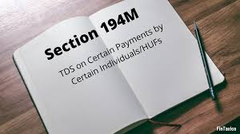
SECTION 194M
TDS ON PAYMENT TO RESIDENT CONTRACTORS AND PROFESSIONALS

Slide 51

APPLICABILITY
An individual and/or Hindu undivided family (HUF) has to deduct tax at source under Section 194M. Such individuals and HUF must not be required to get their books of accounts audited. Books of Accounts are required to be audited if total turnover or receipts of a business exceed Rs. 1 crore or where receipts of a profession exceed Rs. 50 lakh.
IT SHOULD BE NOTED THAT NO TDS UNDER SECTION 194M IS APPLICABLE TO THE ASSESSEE IF THEY WERE CODUCTING AUDIT REFERRED UNDER SECTION 44AD.
Payments to non-residents are not covered under this section.

Slide 52
RATE AT WHICH TDS UNDER SECTION 194M IS TO BE DEDUCTED
@ 5%
THE TOTAL SUM PAID EXCEEDS RS.50,00,000.00 IN A YEAR.
IF
If the recipient does not furnish his PAN to the deductor, tax will be deducted
MAXIMUM MARGINAL RATE
@20%

Slide 53

TIME LIMIT FOR DEPOSITING IN TDS
If the amount is deducted in March – on or before April 30 of the next financial year.
FOR EXAMPLE:
if the amount has been deducted in March 2020, then the TDS will be deposited to the department by 30 April 2021.
In any other month – within seven days from the end of the month in which the tax deduction is made.
FOR EXAMPLE:
if the amount has been deducted paid in the month of September 2020, then the TDS will be deposited to the department by 7 October 2020.

Slide 54
CERTIFICATE OF TAX DEDUDCTED UNDER SECTION 194M
THE PERSON WHO DEDUCTS TAX UNDER SECTION 194M SHALL FURNISH A CERTIFICATE :
UNDER
FORM NO.16D
WITHIN
15 DAYS OF THE DUE DATE OF FURNISHING THE CHALLAN CUM STATEMENT
IN
FORM 26QD

Slide 55
SPECIAL POINTS TO BE NOTED:
If the Assesse required to get Books of Accounts audited, TDS deduction is applicable as per Section 194C and 194J. The individual and/or HUF who have to deduct TDS under Section 194C (TDS on payment to a contractor) and 194J (TDS on payment on professional fees) do not have to deduct tax at source under Section 194M.
The individual or HUFs who has to deduct tax can pay the tax to the government by quoting his or her PAN only. Not required to get a tax deduction account number (TAN) for TDS deduction.
TDS amount will be deducted on the earlier of the following dates:
At the time of credit of the amount.
At the time of payment by cash or by the issue of a cheque or draft.

Slide 56

THANK YOU!

