Slide 1
SEC. 200, 200 A, 201, 201(1A), 234 E, 203

Slide 2
Duty of person deducting tax [Section 200]
The persons responsible for deducting the tax at source should deposit the sum so deducted to the credit of the Central Government or as the Board directs, within the prescribed time.
Further, an employer paying tax on non-monetary perquisites provided to employees in accordance with section 192(1A), should deposit within the prescribed time, the tax to the credit of the Central Government or as the Board directs.

Slide 3
GOVT DEDUCTORS
All sums deducted in accordance with Chapter XVII-B by an office of the Government shall be paid to the credit of the Central Government on
the same day where the tax is paid without production of an income-tax challan and
- on or before seven days from the end of the month in which the deduction is made or income-tax is due under section 192(1A), where tax is paid accompanied by an income-tax challan.

Slide 4
NON GOVT DEDUCTORS
on or before 30th April, where the income or amount is credited or paid in the month of March.
In any other case, the tax deducted should be paid on or before seven days from the end of the month in which the deduction is made or income-tax is due under section 192(1A).
Tax deducted under sections 194-IA, 194-IB and 194M have to be remitted within 30 days from the end of the month of deduction. A challan-cum-statement in Form 26QB/26QC/26QD has to be furnished within 30 days from the end of the month of deduction.

Slide 5
In special cases, the Assessing Officer may, with the prior approval of the Joint Commissioner, permit quarterly payment of the tax deducted under section 192/194A/194D or 194H on or before 7th of the month following the quarter, in respect of first three quarters in the financial year and 30th April in respect of the quarter ending on 31st March. The dates for quarterly payment would, therefore, be 7th July, 7th October, 7th January and 30th April, for the quarters ended 30th June, 30th September, 31st December and 31st March, respectively.

Slide 6
Rule 31A – Submission of quarterly statements
Every person responsible for deduction of tax under Chapter XVII-B shall deliver, or cause to be delivered, the following quarterly statements to the DGIT (Systems) or any person authorized by him, in accordance with section 200(3):
Statement of TDS under section 192 and 194P in Form No.24Q;
Statement of TDS under other sections from section 193 to section 196D in Form No.26Q in respect of all deductees other than a deductee being a non-corporate non-resident or a foreign company or resident but not ordinarily resident in which case the relevant form would be Form No.27Q.

Slide 7
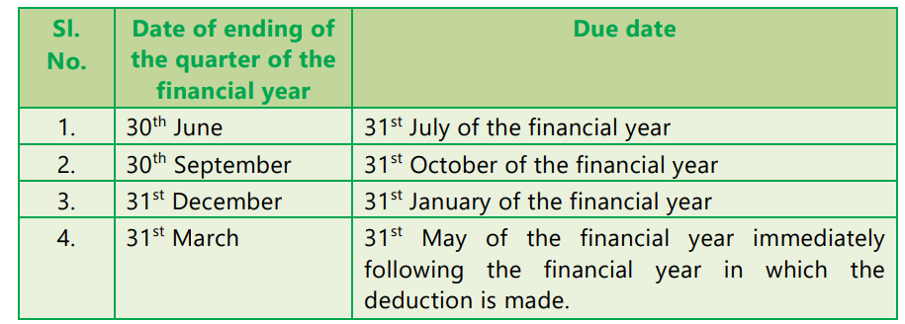
DUE DATES - RETURNS

Slide 8
Correction of arithmetic mistakes and adjustment of incorrect claim during computerized processing of TDS statements [Section 200A]
At present, all statements of tax deducted at source are filed in an electronic mode, thereby facilitating computerised processing of these statements. Therefore, in order to process TDS statements on computer, electronic processing on the same lines as processing of income-tax returns has been provided in section 200A.
The following adjustments can be made during the computerized processing of statement of tax deducted at source or a correction statement – (i) any arithmetical error in the statement; or (ii) an incorrect claim, if such incorrect claim is apparent from any information in the statement.

Slide 9
The sum payable by, or the amount of refund due to, the deductor has to be determined after adjustment of interest and fee against the amount paid under section 200 or section 201 or section 234E and any amount paid otherwise by way of tax or interest or fee.
An intimation will be prepared and generated and sent to the deductor, specifying his tax liability or the refund due, within one year from the end of the financial year in which the statement is filed. The refund due shall be granted to the deductor.
For this purpose, the CBDT is empowered to make a scheme for centralized processing of statements of TDS to determine the tax payable by, or refund due to, the deductor.

Slide 10
SEC 201 - Consequences of failure to deduct or pay
Any person including the principal officer of a company –
who is required to deduct any sum in accordance with the provisions of the Act; or
an employer paying tax on non-monetary perquisites under section 192(1A).
shall be deemed to be an assessee-in-default, if he does not deduct, or does not pay or after deducting, fails to pay, the whole or any part of the tax, as required by or under the provisions of the Income-tax Act, 1961.

Slide 11
Non-applicability of deeming provision
Any person (including the principal officer of the company) who fails to deduct the whole or any part of the tax on the amount credited or paid to a payee shall not be deemed to be an assessee-in-default in respect of such tax if such payee –
has furnished his return of income under section 139;
(ii) has taken into account such sum for computing income in such return of income; and
(iii) has paid the tax due on the income declared by him in such return of income,
and the payer furnishes a certificate to this effect from an accountant in such form as may be prescribed.

Slide 12
SEC 201(A) - INTEREST
A person deemed to be an assessee-in-default under section 201(1), for failure to deduct tax or to pay the tax after deduction, is liable to pay simple interest @ 1% for every month or part of month on the amount of such tax from the date on which tax was deductible to the date on which such tax was actually deducted and simple interest @ 1½% for every month or part of month from the date on which tax was deducted to the date on which such tax is actually paid.

Slide 13
SEC 203 - Certificate for tax deducted
Every person deducting tax at source have to issue a certificate to the effect that tax has been deducted and specify the amount so deducted, the rate at which tax has been deducted and such other particulars as may be prescribed.
Every person, being an employer, referred to in section 192(1A) shall, within such period, as may be prescribed, furnish to the person in respect of whose income such payment of tax has been made, a certificate to the effect that tax has been paid to the Central Government, and specify the amount so paid, the rate at which the tax has been paid and such other particulars as may be prescribed.

Slide 14
The certificate of deduction of tax at source to be furnished under section 203 shall be in Form No.16 in respect of tax deducted or paid under section 192 and in any other case, Form No.16A.
Form No.16 shall be issued to the employee annually by 15th June of the financial year immediately following the financial year in which the income was paid and tax deducted. Form No.16A shall be issued quarterly within 15 days from the due date for furnishing the statement of TDS under Rule 31A.
Form No. 16B, 16C or 16D shall be issued by the every person responsible for deduction of tax under section 194-IA, 194-IB or 194M to the payee within fifteen days from the due date for furnishing the challan-cum-statement in Form No. 26QB, 26QC or 26QD, respectively, under rule 31A.

Slide 15
PICTURE

Slide 16
SEC 234 E – LATE FEES
The fee, if any, has to be computed in accordance with the provision of section 234E. A fee of ` 200 for every day would be levied under section 234E for late furnishing of TDS statement from the due date of furnishing of TDS statement to the date of furnishing of TDS/ statement.
However, the total amount of fee shall not exceed the total amount of tax deductible/collectible and such fee has to be paid before delivering the TDS statement.

Slide 17
234 H - PENALTY
In addition to said fee, a penalty ranging from a minimum of ` 10,000 to a maximum of ` 1,00,000 shall also be levied under section 271H for not furnishing TDS/TCS statement within the prescribed time or furnishing incorrect information in the said statements in respect of tax deducted or collected at source.
Since late furnishing of TDS/TCS statements would attract levy of fees under section 234E, no penalty under section 271H shall be levied for delay in furnishing of TDS/TCS statement, if the TDS/TCS statement is furnished within one year of the prescribed due date after payment of tax deducted or collected along with applicable interest and fee. However, if the delay is beyond the period of one year, both fee under section 234E and penalty under section 271H would be leviable.

