Slide 1
Sec 195-other sums – non resident

Slide 2
^{[1]}[(1) Any person responsible for paying to a non-resident, not being a company, or to a foreign company, ^{[2]}[any interest (not being interest referred to in section 194LB or section 194LC)] ^{[3]}[or section 194LD] ^{[4]}[* * * *] or any other sum chargeable under the provisions of this Act (not being income chargeable under the head Salaries ^{[5]}[* * * *]) shall, at the time of credit of such income to the account of the payee or at the time of payment thereof in cash or by the issue of a cheque or draft or by any other mode, whichever is earlier, deduct income-tax thereon at the rates in force :
^{[6]}[Provided that in the case of interest payable by the Government or a public sector bank within the meaning of clause (23D) of section 10 or a public financial institution within the meaning of that clause, deduction of tax shall be made only at the time of payment thereof in cash or by the issue of a cheque or draft or by any other mode :]
Explanation ^{[9]}[1] : For the purposes of this section, where any interest or other sum as aforesaid is credited to any account, whether called Interest payable account or Suspense account or by any other name, in the books of account of the person liable to pay such income, such crediting shall be deemed to be credit of such income to the account of the payee and the provisions of this section shall apply accordingly.]
^{[10]}[Explanation 2.--For the removal of doubts, it is hereby clarified that the obligation to comply with sub-section (1) and to make deduction thereunder applies and shall be deemed to have always applied and extends and shall be deemed to have always extended to all persons, resident or non-resident, whether or not the non-resident person has --

Slide 3
(i) a residence or place of business or business connection in India; or
(ii) any other presence in any manner whatsoever in India.]
(2) Where the person responsible for paying any such sum chargeable under this Act ^{[11]}[(other than salary)] to a non-resident considers that the whole of such sum would not be income chargeable in the case of the recipient, he may make an application ^{[12]}[in such form and manner to the Assessing Officer, to determine in such manner, as may be prescribed], the appropriate proportion of such sum so chargeable, and upon such determination, tax shall be deducted under sub-section (1) only on that proportion of the sum which is so chargeable :
^{[13]}[* * * *]
^{[14]}[(3) Subject to rules^{[15]} made under sub-section (5), any person entitled to receive any interest or other sum on which income-tax has to be deducted under sub-section (1) may make an application in the prescribed form to the ^{[16]}[Assessing] Officer for the grant of a certificate authorising him to receive such interest or other sum without deduction of tax under that sub-section, and where any such certificate is granted, every person responsible for paying such interest or other sum to the person to whom such certificate is granted shall, so long as the certificate is in force, make payment of such interest or other sum without deducting tax thereon under sub-section (1).

Slide 4
(4) A certificate granted under sub-section (3) shall remain in force till the expiry of period specified therein or, if it is cancelled by the ^{[17]}[Assessing] Officer before the expiry of such period, till such cancellation.
(5) The Board may, having regard to the convenience of assessees and the interests of revenue, by notification in the Official Gazette, make rules specifying the cases in which, and the circumstances under which, an application may be made for the grant of a certificate under sub-section (3) and the conditions subject to which such certificate may be granted and providing for all other matters connected therewith.]
^{[18]}[(6) The person responsible for paying to a non-resident, (not being a company), or to a foreign company, any sum, whether or not chargeable under the provisions of this Act, shall furnish the information relating to payment of such sum, in such form and manner, as may be prescribed.]^{[19]}
^{[20]}[(7) Notwithstanding anything contained in sub-section (1) and sub-section (2), the Board may, by notification in the Official Gazette, specify a class of persons or cases, where the person responsible for paying to a non-resident, not being a company, or to a foreign company, any sum, whether or not chargeable under the provisions of this Act, shall make an application ^{[21]}[in such form and manner to the Assessing Officer, to determine in such manner, as may be prescribed], the appropriate proportion of sum chargeable, and upon such determination, tax shall be deducted under sub-section (1) on that proportion of the sum which is so chargeable.

Slide 5
SEC 195 - NONRESIDENT
Tax deducted at source (TDS) is a tax collection mechanism by the government wherein the payer responsible for making the payment must deduct tax from the amount paid to another person or entity.
In this regard, Section 195 of the Income Tax Act, 1961 specifies the TDS provision in the case of an individual making a payment by way of interest or any other amount other than salary to an NRI or a foreign company.
Non-resident Indians (NRIs) also need to file their tax returns for the income earned in India. Similarly, they also can claim the tax deducted at source (TDS) when filing tax returns.

Slide 6
NON RESIDENT
As per the said provisions, a person is said to be a non-resident in India if not a resident in India, as laid out in section 6 of the Act.
A person will be a resident of India in any financial year if they satisfy the following conditions:
If they stay in India for 182 days or more during the financial year, or
If they stay in India for 60 days or more during the financial year, and 365 days or more during the immediately preceding four financial years.

Slide 7
Exception for point (2)
In the case of an Indian citizen or a person of Indian origin (PIO) whose total income, other than income from foreign sources:
Exceeds Rs 15 lakhs during the relevant financial year – 60 days as mentioned in point (2) above will get substituted with 120 days.
Sec 6(1A) – DEEMED RESIDENT.
An Indian citizen or PIO earning a total income over Rs 15 lakhs (other than from foreign sources) is deemed a NOT ORDINARILY resident in India if they are not taxed in any other country.(DEEMED RESIDENT).

Slide 8
Who should deduct tax under Section 195?
Any person who makes any payment (other than salary or interest referred to in sections 194LB, 194LC and 194LD) taxable in India to a non-resident must deduct tax under this section.
The payer, one who pays the NRI or remits the payment, can be a resident or a non-resident, an individual, Hindu Undivided Families (HUFs), partnership firms, other NRIs, foreign companies, or an artificial juridical person (for example, a corporation, government agency or non-profit organisation).

Slide 9
Is there a threshold limit to deduct TDS u/s 195?
No, there is no threshold limit to deduct TDS under Section 195. However, the payer must deduct tax only when the payment made to a non-resident is taxable in India. Therefore, no tax is to be deducted in case of exempt income or any other income that is not taxable as per the Income Tax Act unless the government notifies explicitly.

Slide 10
At what rate is the tax deducted under section 195?
TDS is deducted at either of the following rates, whichever is more beneficial to the payee:
Rates as per the Finance Act of the given year
Rates contained in the Double Taxation Avoidance Agreement (DTAA) between India and the country of residence of such non-resident
Note that the rates given under the Finance Act are to be increased by the applicable surcharge and education cess of 4%. However, surcharge and cess are not required to be added to the rates given under DTAA.

Slide 11
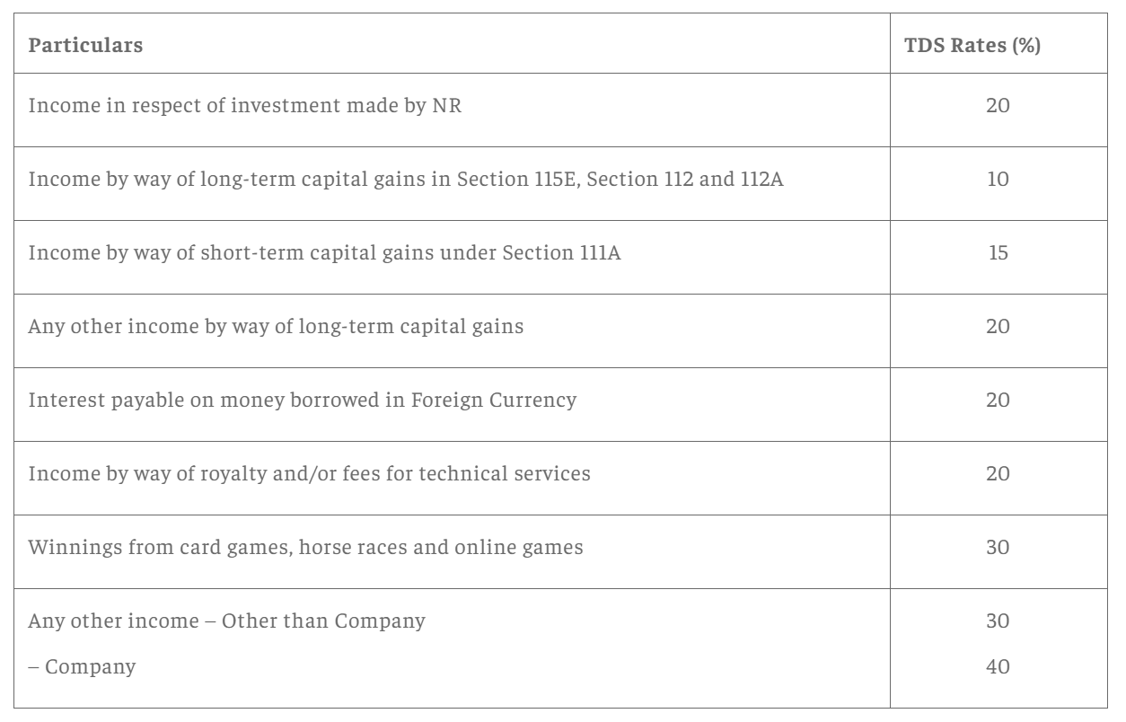

Slide 12
Application for nil or lower TDS deduction certificate by the payer
When the payer believes that no amount or only a partial amount (other than salary) is taxable in the hands of the non-resident in India or that TDS is to be done at a lower rate, then he may make an application under Form 15E to the Assessing Officer (AO) for obtaining a lower or nil deduction certificate.

Slide 13
Declaration of information in relation to foreign payments
The payer responsible for paying any amount to a non-resident or a foreign company is required to furnish complete and accurate information regarding such payment in Form 15CA and Form 15CB with the AO. Note that such information must be furnished even if the amount paid is not taxable under the Act. Failure to do such compliance shall attract a penalty of Rs 1 lakh under Section 271-I.

Slide 14
15 CA
Form 15CA is a Declaration of Remitter and is considered as a tool for collecting information in lieu of payments which are chargeable for tax in the hands of recipient non-resident of India. This is starting of an effective Information Processing System which may be utilized by the Income tax Department to freely track the foreign remittances and their source to determine tax liability.
Financial Institutions are now more vigilant in seeking such Forms before remittance is effected since now as per revised Rule 37BB a duty is implied on them to furnish Form 15CA received from remitter to an income-tax authority for the uses of any proceedings under the Income-tax Act.

Slide 15
Part A –Section A of Form 15CA is filled in by the remitter when the payment or the total sum of the payment extended by the remitter to NRI recipient during a particular Financial Year is Rs. 5 Lakhs or less.
Part B –Section B of Form 15CA is in the role when such payments are more than Rs. 5 Lakhs. Information is entered by the filer in Section B after acquiring a certificate from Assessing Officer (valid under section 197) or the order from Assessing Officer (valid under sub-section (2) or sub-section (3) of section 195).
Part C –If such payments made during a particular FY exceed Rs. 5 Lakhs, the related information has to be entered in Section C of Form 15CA after acquiring the Tax Determination Certificate or Form 15CB from authorized CA (valid under sub-section (2) of section 288).
Part D –Payments made by the remitter during a particular FY which is not referred to in sub-section 37BB or in other words is not taxable under law, the information related to such payments is to be entered in Section D of Form 15CA.

Slide 16
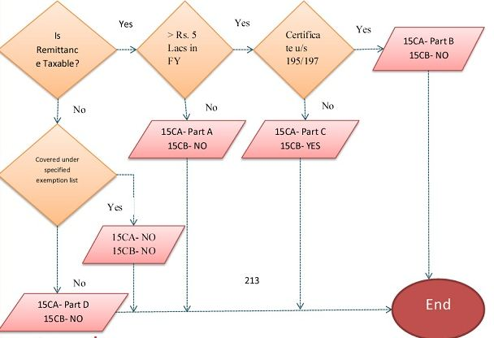

Slide 17
