Slide 1

TDS
CA AJITH SIVADAS
B.Com, ACMA, ACA, Ad Dip MA CIMA(UK)

Slide 2
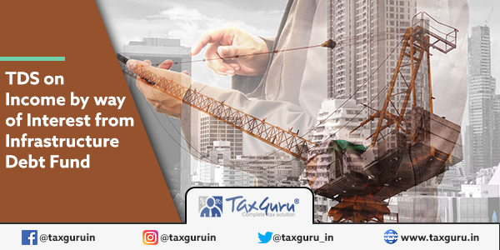
194LB

Slide 3
194LB. Income by way of interest from infrastructure debt fund.
Where any income by way of interest is payable to a non-resident, not being a company or to a foreign company, by an infrastructure debt fund referred to in clause (47) of section 10, the person responsible for making the payment shall, at the time of credit of such income to the account of the payee or at the time of payment thereof in cash or by issue of a cheque or draft or by any other mode, whichever is earlier, deduct income-tax thereon at the rate of five per cent.

Slide 4
amount paid in the nature of interest on infrastructure debt fund to a non-resident (other than a company or foreign company).
NATURE & SCOPE
RATE OF DEDUCTION
5 % on the interest amount
deducted at the time of making payment or credit of the interest income which ever is earlier.
WHEN TO DEDUCT ?

Slide 5
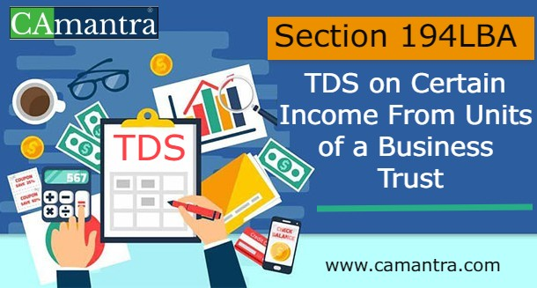

Slide 6
194LBA. Certain income from units of a business trust.
(1) Where any distributed income referred to in section 115UA, being of the nature referred to ^{[2]}[in ^{[3]}[* * *] clause (23FC)] ^{[4]}[or clause (23FCA)] of section 10, is payable by a business trust to its unit holder being a resident, the person responsible for making the payment shall at the time of credit of such payment to the account of the payee or at the time of payment thereof in cash or by the issue of a cheque or draft or by any other mode, whichever is earlier, deduct income-tax thereon at the rate of ten per cent.
(2) Where any distributed income referred to in section 115UA, being of the nature referred to ^{[5]}[in ^{[6]}[* * *] of clause (23FC)] of section 10, is payable by a business trust to its unit holder, ^{[7]}[being a non-resident (not being a company)] or a foreign company, the person responsible for making the payment shall at the time of credit of such payment to the account of the payee or at the time of payment thereof in cash or by the issue of a cheque or draft or by any other mode, whichever is earlier, deduct income-tax thereon at the rate of ^{[8]}[five per cent in case of income of the nature referred to in sub-clause (a) and ten per cent in case of income of the nature referred to in sub-clause (b), of the said clause].]
^{[9]}[(2A) Nothing contained in sub-sections (1) and (2) shall apply in respect of income of the nature referred to in sub-clause (b) of clause (23FC) of section, 10, if the special purpose vehicle referred to in the said clause has not exercised the option under section 115BAA.]
^{[10]}[(3) Where any distributed income referred to in section 115UA, being of the nature referred to in clause (23FCA) of section 10, is payable by a business trust to its unit holder, being a non-resident (not being a company), or a foreign company, the person responsible for making the payment shall at the time of credit of such payment to the account of the payee or at the time of payment thereof in cash or by the issue of a cheque or draft or by any other mode, whichever is earlier, deduct income-tax thereon at the rates in force.

Slide 7
(23FC) any income of a business trust ⁹³[by way of-
(a) interest received or receivable from a special purpose vehicle; or
(b) dividend ¹¹⁰[received or receivable from a special purpose vehicle]]
Explanation.-For the purposes of this clause, the expression “special purpose vehicle” means an Indian company in which the business trust holds controlling interest and any specific percentage of shareholding or interest, as may be required by the regulations under which such trust is granted registration;

Slide 8
(23FCA) any income of a business trust, being a real estate investment trust, by way of renting or leasing or letting out any real estate asset owned directly by such business trust.
Explanation.-For the purposes of this clause, the expression “real estate asset” shall have the same meaning as assigned to it in clause (zj) of sub-regulation (1) of regulation 2 of the Securities and Exchange Board of India (Real Estate Investment Trusts) Regulations, 2014 made under the Securities and Exchange Board of India Act, 1992 (15 of 1992);]

Slide 9
115UA. (1) Notwithstanding anything contained in any other provisions of this Act, any income distributed by a business trust to its unit holders shall be deemed to be of the same nature and in the same proportion in the hands of the unit holder as it had been received by, or accrued to, the business trust.
(2) Subject to the provisions of section 111A and section 112, the total income of a business trust shall be charged to tax at the maximum marginal rate.
(3) If in any previous year, the distributed income or any part thereof, received by a unit holder from the business trust is of the nature as referred to ³[ in ⁴[****] clause (23FC) ] ²[or clause (23FCA)] of section 10, then, such distributed income or part thereof shall be deemed to be income of such unit holder and shall be charged to tax as income of the previous year.
⁵[(3A) The provisions of sub-section (1) shall not apply in respect of any sum referred to in clause (xii) of sub-section (2) of section 56, received by a unit holder from a business trust.]
(4) Any person responsible for making payment of the income distributed on behalf of a business trust to a unit holder shall furnish a statement to the unit holder and the prescribed authority, within such time and in such form and manner as may be prescribed, giving the details of the nature of the income paid during the previous year and such other details as may be prescribed.]

Slide 10
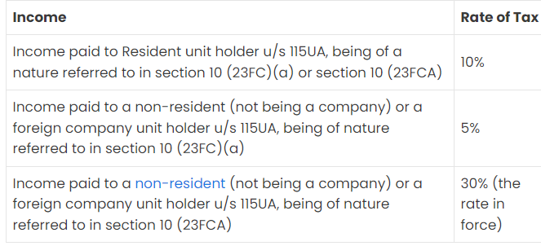
On amount paid as Income under section 115UA by a Business trust to its unit holder.
NATURE & SCOPE
RATE
WHEN TO DEDUCT ?
At the time of making payment of such income.

Slide 11
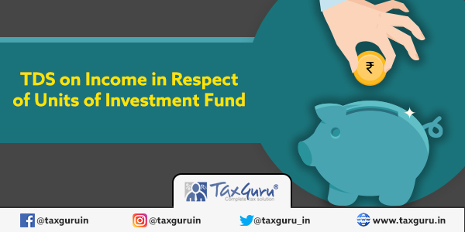
194LBB

Slide 12
194LBB. Income in respect of units of investment fund.
Where any income, other than that proportion of income which is of the same nature as income referred to in clause (23FBB) of section 10, is payable to a unit holder in respect of units of an investment fund specified in clause (a) of the Explanation 1 to section 115UB, the person responsible for making the payment shall, at the time of credit of such income to the account of payee or at the time of payment thereof in cash or by issue of a cheque or draft or by any other mode, whichever is earlier, [2][deduct income-tax thereon,--
(i) at the rate of ten per cent., where the payee is a resident;
(ii) at the rates in force, where the payee is a non-resident (not being a company) or a foreign company.
Provided that where the payee is a non-resident (not being a company) or a foreign company, no deduction shall be made in respect of any income that is not chargeable to tax under the provisions of the Act.]
Explanation.--For the purposes of this section,--
(a) unit shall have the meaning assigned to it in clause (c) of the Explanation 1 to section 115UB;
(b) where any income as aforesaid is credited to any account, whether called suspense account or by any other name, in the books of account of the person liable to pay such income, such crediting shall be deemed to be the credit of such income to the account of the payee, and the provisions of this section shall apply accordingly.

Slide 13
(23FBB) any income referred to in section 115UB, accruing or arising to, or received by, a unit holder of an investment fund, being that proportion of income which is of the same nature as income chargeable under the head “Profits and gains of business or profession”.
Explanation.-For the purposes of clauses (23FBA) and (23FBB), the expression “investment fund” shall have the meaning assigned to it in clause (a) of the Explanation 1 to section 115UB; ]

Slide 14
Explanation 1.-For the purposes of this Chapter,-
(a) “investment fund” means any fund established or incorporated in India in the form of a trust or a company or a limited liability partnership or a body corporate which has been granted a certificate of registration as a Category I or a Category II Alternative Investment Fund and is regulated under the Securities and Exchange Board of India (Alternative Investment Fund) Regulations, 2012, made under the Securities and Exchange Board of India Act, 1992 (15 of 1992) ⁵[regulated under the International Financial Services Centres Authority (Fund Management) Regulations, 2022 made] ⁴[or under the International Financial Services Centres Authority Act, 2019 (50 of 2019.)];
(b) “trust” means a trust established under the Indian Trusts Act, 1882 (2 of 1882) or under any other law for the time being in force;
(c) “unit” means beneficial interest of an investor in the investment fund or a scheme of the investment fund and shall include shares or partnership interests.

Slide 15
Amount paid as income in respect of an Investment Fund specified under section 115UB to a unit holder.
NATURE & SCOPE
RATE
WHEN TO DEDUCT
Resident
10%
Non-Resident/
Foreign Company
(Not being a company).
At The Rate In Force
Amount Credited to the account of the payee
Time of payment in Cash/Cheque/draft
whichever is earlier

Slide 16

194LBC

Slide 17
194LBC. Income in respect of investment in securitisation trust.
(1) Where any income is payable to an investor, being a resident, in respect of an investment in a securitisation trust specified in clause (d) of the Explanation occurring after section 115TCA, the person responsible for making the payment shall, at the time of credit of such income to the account of the payee or at the time of payment thereof in cash or by issue of a cheque or draft or by any other mode, whichever is earlier, deduct income-tax thereon, at the rate of--
(i) twenty-five per cent., if the payee is an individual or a Hindu undivided family;
(ii) thirty per cent., if the payee is any other person.
(2) Where any income is payable to an investor, being a non-resident (not being a company) or a foreign company, in respect of an investment in a securitisation trust specified in clause (d) of the Explanation occurring after section 115TCA, the person responsible for making the payment shall, at the time of credit of such income to the account of the payee or at the time of payment thereof in cash or by issue of a cheque or draft or by any other mode, whichever is earlier, deduct income-tax thereon, at the rates in force.
Explanation.--For the purposes of this section,--
(a) investor shall have the meaning assigned to it in clause (a) of the Explanation occurring after section 115TCA;
(b) where any income as aforesaid is credited to any account, whether called suspense account or by any other name, in the books of account of the person liable to pay such income, such crediting shall be deemed to be the credit of such income to the account of the payee, and the provisions of this section shall apply accordingly.

Slide 18
(a) investor means a person who is holder of any securitised debt instrument or securities [3][or security receipt] issued by the securitisation trust;
(b) securities means debt securities issued by a Special Purpose Vehicle as referred to in the guidelines on securitisation of standard assets issued by the Reserve Bank of India;
(c) securitised debt instrument shall have the same meaning as assigned to it in clause(s) of sub-regulation (1) of regulation 2 of the Securities and Exchange Board of India (Public Offer and Listing of Securitised Debt Instruments) Regulations, 2008 made under the Securities and Exchange Board of India Act, 1992 (15 of 1992) and the Securities Contracts (Regulation) Act, 1956 (42 of 1956);
(d) securitisation trust means a trust, being a --
(i) special purpose distinct entity as defined in clause (u) of sub-regulation (1) of regulation 2 of the Securities and Exchange Board of India (Public Offer and Listing of Securitised Debt Instruments) Regulations, 2008 made under the Securities and Exchange Board of India Act, 1992 (15 of 1992) and the Securities Contracts (Regulation) Act, 1956 (42 of 1956), and regulated under the said regulations; or
(ii) Special Purpose Vehicle as defined in, and regulated by, the guidelines on securitisation of standard assets issued by the Reserve Bank of India [4][; or]

Slide 19
SECTION | NATURE OF PAYMENT | PAYER | PAYEE | RATE | LIMIT
194LBC | Income in Respect of Investment in Securitization Trust | Any person who gives income to an investor with respect to investment in securitization trust | Any Person | 25% (resident Individual & HUF) 30% (other than resident individual & HUF) 40% (foreign company) 30% (Non-resident not being a foreign company) | -

Slide 20

Scope of Section 194LBC
Section 194LBC applies to the amount paid as an income to an investor in respect of an investment in a securitization trust as specified u/s 115TCA.
When to deduct TDS u/s 194LBC
Tax u/s 194LBC shall be deducted at the earlier of, the credit of such income to the account of the payee or at the time of making payment either in cash or by way of issuing cheque or draft or by any other mode.

Slide 21

Who is responsible to Deduct TDS under Section 194LBC?
(a) Where such income is payable to a resident investor [Section 194LBC(1)]
Where any income is payable to an investor, being a resident, in respect of an investment in a securitisation trust specified in clause (d) of the Explanation occurring after section 115TCA, the person responsible for making the payment shall, at the time of credit of such income to the account of the payee or at the time of payment thereof in cash or by issue of a cheque or draft or by any other mode, whichever is earlier, deduct income-tax thereon.
(b) Where such income is payable to a Non-Resident Investor [Section 194LBC(2)]
Where any income is payable to an investor, being a non-resident (not being a company) or a foreign company, in respect of an investment in a securitisation trust specified in clause (d) of the Explanation occurring after section 115TCA, the person responsible for making the payment shall, at the time of credit of such income to the account of the payee or at the time of payment thereof in cash or by issue of a cheque or draft or by any other mode, whichever is earlier, deduct income-tax thereon, at the rates in force.

Slide 22

Securitisation trust means: a trust, being a— (i) "special purpose distinct entity" as defined in clause (u) of sub-regulation (1) of regulation 2 of the Securities and Exchange Board of India (Public Offer and Listing of Securitised Debt Instruments) Regulations, 2008 made under the Securities and Exchange Board of India Act, 1992 (15 of 1992) and the Securities Contracts (Regulation) Act, 1956 (42 of 1956), and regulated under the said regulations; or
(ii) "Special Purpose Vehicle" as defined in, and regulated by, the guidelines on securitisation of standard assets issued by the Reserve Bank of India; or
(iii) trust set-up by a securitisation company or a reconstruction company formed, for the purposes of the Securitisation and Reconstruction of Financial Assets and Enforcement of Security Interest Act, 2002 (54 of 2002), or in pursuance of any guidelines or directions issued for the said purposes by the Reserve Bank of India, which fulfils such conditions, as may be prescribed.

Slide 23
194LC. Income by way of interest from Indian Company.
(1) Where any income by way of interest referred to in sub-section (2) is payable to a non-resident, not being a company or to a foreign company by a specified company ^{[2]}[or a business trust], the person responsible for making the payment, shall at the time of credit of such income to the account of the payee or at the time of payment thereof in cash or by issue of a cheque or draft or by any other mode, whichever is earlier, deduct the income-tax thereon at the rate of five per cent.
^{[3]}[Provided that in case of income by way of interest referred to clause (ib) of sub-section (2), the income-tax shall be deducted at the rate of four per cent.]
^{[3A][}Provided further that in case of income by way of interest referred to in clause (ic) of sub-section (2), the income-tax shall be deducted at the rate of nine per cent.]
(2) The interest referred to in sub-section (1) shall be the income by way of interest payable by the specified company ^{[4]}[or the business trust], --
^{[5]}[(i) in respect of monies borrowed by it in foreign currency from a source outside India,--
(a) under a loan agreement at any time on or after the 1st day of July, 2012 but before the ^{[6]}[1st day of July, ^{[7]}[2023]]; or
(b) by way of issue of long-term infrastructure bonds at any time on or after the 1st day of July, 2012 but before the 1st day of October, 2014; or
(c) by way of issue of any long-term bond including long-term infrastructure bond at any time on or after the 1st day of October, 2014 but before the ^{[8]}[1st day of July, ^{[9]}[2023]],

Slide 24
as approved by the Central Government in this behalf; ^{[10]}[or]]
^{[11]}[(ia) in respect of monies borrowed by it from a source outside India by way of issue of rupee denominated bond before the 1st day of July, ^{[12]}[2023], and]
^{[13]}[(ib) in respect of monies borrowed by it from a source outside India by way of issue of any long-term bond or rupee denominated bond on or after the 1st day of April, 2020 but before the 1st day of July, 2023, which is listed only on a recognised stock exchange located in any International Financial Services Centre, ^{[13A]}[or]]
^{[13B]}[(ic) in respect of money borrowed by it from a source outside India by way of issuance of any long-term bond or rupee denominated bond on or after the 1st day of July, 2023, which is listed only on a recognised stock exchange located in an International Financial Services Centre; and]
(ii) to the extent to which such interest does not exceed the amount of interest calculated at the rate approved by the Central Government in this behalf, having regard to the terms of the loan or the bond and its repayment.
Explanation.--For the purpose of this section --
(a) foreign currency shall have the meaning assigned to it in clause (m) of section 2 of the Foreign Exchange Management Act, 1999 (42 of 1999);
(b) specified company means an Indian company.]
^{[14]}[(c) International Financial Services Centre" shall have the meaning assigned to it in clause (q) of section 2 of the Special Economic Zones Act, 2005 (28 of 2005);
(d) recognised stock exchange shall have the meaning assigned to it in clause (ii) of Explanation 1 to clause (5) of section 43.

Slide 25
Section 194 LC – Income by way of interest from Indian company.
The section deals with TDS deduction on income by way of interest from an Indian Company or a business trust and the provisions relating to the same has been explained in the current article.
Basic Applicability:
The Indian Company or a business trust paying interest income to a non-resident, not being a company, or to a foreign company is liable to deduct TDS.
Interest income payable by the Indian Company or the business trust on the following is covered under section 194LC –
Interest in respect of money borrowed by the Indian Company or the business trust in foreign currency from a source outside India –
Under a loan agreement between 1st July 2012 to 1st July 2023.
By issuing long term infrastructure bonds between 1st July 2012 to 1st October 2014.
By issuing long term bond including long term infrastructure bonds between 1st October 2014 to 1st July 2023.

Slide 26
Interest in respect of money borrowed by the Indian Company or the business trust in foreign currency from a source outside India by way of issue of rupee denominated bond before 1stJuly 2023.
To the extent, the interest income does not exceed the amount of interest calculated at the rate approved by the Central Government.
Time of TDS deduction –
At the time of payment thereof in cheque or cash or draft or any other mode of payment; or
At the time of credit of interest income to the account of the payee.
Rate of deduction of TDS –
The Deductor is liable to deduct TDS @ 5%. In addition to the same, the Education Cess and SHE Cess is to be added to the base rate. Further, if the Surcharge gets applicable the same is also to be added.

Slide 27
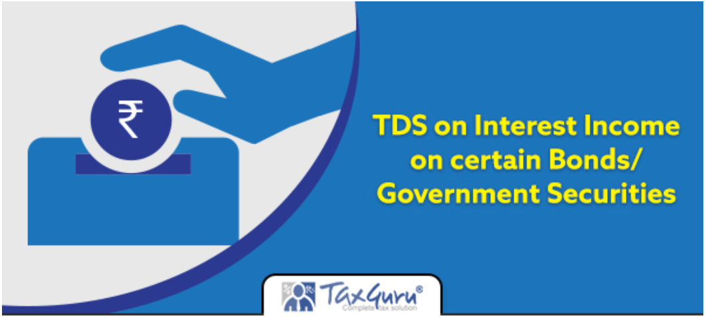
Section 194 LD – Income by way of interest on certain bonds and
Government securities.

Slide 28
194LD. Income by way of interest on certain bonds and Government securities
(1) Any person who is responsible for paying to a person being a Foreign Institutional Investor or a Qualified Foreign Investor any income by way of interest referred to in sub-section (2), shall, at the time of credit of such income to the account of the payee or at the time of payment of such income in cash or by the issue of a cheque or draft or by any other mode, whichever is earlier, deduct income-tax thereon at the rate of five per cent.
^{[2]}[(2) The income by way of interest referred to in sub-section (1) shall be the interest payable,--
(a) on or after the 1st day of June, 2013 but before the 1st day of July, 2023 in respect of the investment made by the payee in --
(i) a rupee denominated bond of an Indian company; or
(ii) a Government security;
(b) on or after the 1st day of April, 2020 but before the 1st day of July, 2023 in respect of the investment made by the payee in municipal debt securities:
Provided that the rate of interest in respect of bond referred to in sub-clause (i) of clause (a) shall not exceed the rate as the Central Government may, by notification in the Official Gazette, specify.]
Explanation.--For the purpose of this section,--
(a) Foreign Institutional Investor shall have the meaning assigned to it in clause (a) of the Explanation to section 115AD;
(b) Government security shall have the meaning assigned to it in clause (b) of section 2 of the Securities Contracts (Regulation) Act, 1956 (42 of 1956);
^{[3]}[(ba) municipal debt securities shall have the meaning assigned to it in clause (m) of sub-regulation (1) of regulation 2 of the Securities and Exchange Board of India (Issue and Listing of Municipal Debt Securities) Regulations, 2015 made under the Securities and Exchange Board of India Act, 1992 (15 of 1992);]
(c) Qualified Foreign Investor shall have the meaning assigned to it in the Circular No. Cir/IMD/DF/14/2011, dated the 9th August, 2011, as amended from time to time, issued by the Securities and Exchange Board of India, under section 11 of the Securities and Exchange Board of India Act, 1992 (15 of 1992)

Slide 29

1) Who is responsible to deduct tax u/s 194LD?
Any person who is responsible for paying to a person being a Foreign Institutional Investor or a Qualified Foreign Investor any income by way of interest.
2) Nature of Payment
Interest payable on or after the 1st day of June, 2013 but before the 1st day of July, 2023 (Amended in Finance Act,2020) in respect of investment made by the payee in —
a rupee denominated bond of an Indian company ; or
a Government security.
on or after the 1st day of April, 2020 but before the 1st day of July, 2023 in respect of the investment made by the payee in municipal debt securities

Slide 30
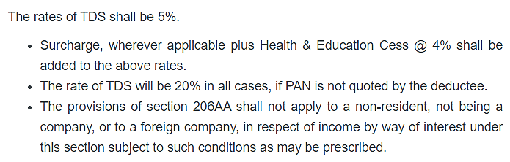

When to Deduct TDS under Section 194LD?
At the time of credit of such income to the account of payee or at the time of payment whichever is earlier.
4) Applicable Rate of TDS

Slide 31
CONSEQUENCES A DEDUCTOR WOULD FACE IF HE FAILS TO DEDUCT TDS OR AFTER DEDUCTING THE SAME FAILS TO DEPOSIT IT TO THE GOVERNMENT’S ACCOUNT
Disallowance of expenditure
section 40(a)(i)
section 40(a)(ia)
Levy of interest
Section 201(1A)
Levy of Penalty
section 271C
Section 58(1A)
Prosecution
Section 276 B
Section 234E
Section 270A
Section 271H
Section 221
section 40(a)(iii)

Slide 32
DISALLOWANCE OF EXPENDITURE
SECTION 40(a)(i)
Notwithstanding anything to the contrary in sections 30 to [2][38], the following amounts shall not be deducted in computing the income chargeable under the head Profits and gains of business or profession in the case of any assessee any interest (not being interest on a loan issued for public subscription before the 1st day of April, 1938), royalty, fees for technical services or other sum chargeable under this Act, which is payable,(A) outside India;
or (B) in India to a non-resident, not being a company or to a foreign company, on which tax is deductible at source under Chapter XVII-B and such tax has not been deducted or, after deduction, has not been paid [4][on or before the due date specified in sub-section (1) of section 139]

Slide 33
SECTION 40(a)(ia)
Thirty per cent of any sum payable to a resident, on which tax is deductible at source under Chapter XVII-B and such tax has not been deducted or, after deduction, has not been paid on or before the due date specified in sub-section (1) of section 139

Slide 34
SECTION 58(1A)
(1A) The provisions of [8][sub-clauses (ia) and (iia)] of clause (a) of section 40 shall, so far as may be, apply in computing the income chargeable under the head Income from other sources as they apply in computing the income chargeable under the head Profits and gains of business or profession .]

Slide 35
LEVY OF INTEREST
SECTION 201 A
Non-deduction of tax at source, either in whole or in part
After deduction of tax, non-payment of tax either in whole or in part
SECTION 221(1)
When an assessee is in default or is deemed to be in default in making a payment of tax, he shall, in addition to the amount of the arrears and the amount of interest payable under sub-section (2) of section 220, be liable, by way of penalty, to pay such amount as the [3][Assessing] Officer may direct, and in the case of a continuing default, such further amount or amounts as the [4][Assessing] Officer may, from time to time, direct, so, however, that the total amount of penalty does not exceed the amount of tax in arrears
Interest 1% Per Month
Period for which interest is to be paid: From the date on which tax-deductible to the date on which tax is actually deducted.
Interest 1.5% Per Month
Period for which interest is to be paid: From the date of deduction to the date of payment

Slide 36
LEVY OF PENALTY
SECTION 271
C
If any person fails to deduct the whole or any part of the tax as required by or under the provisions of Chapter XVII-B; or pay the whole or any part of the tax as required by or under, --sub-section (2) of section 115-O; orsecond proviso to section 194B, then, such person shall be liable to pay, by way of penalty, a sum equal to the amount of tax which such person failed to deduct or pay as aforesaid.
SECTION 271 H
Penalty for failure to furnish statements, etc
The penalty referred to in sub-section (1) shall be a sum which shall not be less than ten thousand rupees but which may extend to one lakh rupees
Any penalty imposable under sub-section (1) shall be imposed by the [4][Joint Commissioner
no penalty shall be levied for the failure referred to in clause (a) of sub-section (1), if the person proves that after paying tax deducted or collected along with the fee and interest, if any, to the credit of the Central Government, he had delivered or cause to be delivered the statement referred to in sub-section (3) of section 200 or the proviso to sub-section (3) of section 206C before the expiry of a period of one year from the time prescribed for delivering or causing to be delivered such statement.

Slide 37
SECTION 234E
Without prejudice to the provisions of the Act, where a person fails to deliver or cause to be delivered a statement within the time prescribed in sub-section (3) of section 200 or the proviso to sub-section (3) of section 206C, he shall be liable to pay, by way of fee, a sum of two hundred rupees for every day during which the failure continues
SECTION
270 A
Penalty for under-reporting and misreporting of income
UNDER REPORTING- The penalty referred to in sub-section (1) shall be a sum equal to fifty per cent of the amount of tax payable on under-reported income
MIS REPORTING- Notwithstanding anything contained in sub-section (6) or sub-section (7), where under-reported income is in consequence of any misreporting thereof by any person, the penalty referred to in sub-section (1) shall be equal to two hundred per cent. of the amount of tax payable on under-reported income

Slide 38
PROSECUTION
SECTION 276 B
If a person fails to pay to the credit of the Central Government-the tax deducted at source by him as required by or under the provisions of Chapter XVII-B; or the tax payable by him, as required by or under, -- sub-section (2) of section 115-O; or the second proviso to section 194B, he shall be punishable with rigorous imprisonment for a term which shall not be less than three months but which may extend to seven years and with fine.

Slide 39
Provided that any person, including the principal officer of a company, who fails to deduct the whole or any part of the tax in accordance with the provisions of this Chapter on the sum paid to a resident or on the sum credited to the account of a resident shall not be deemed to be an assessee in default in respect of such tax if such resident—
(i) has furnished his return of income under section 139;
(ii) has taken into account such sum for computing income in such return of income; and
(iii) has paid the tax due on the income declared by him in such return of income,
and the person furnishes a certificate to this effect from an accountant in such form as may be prescribed⁶⁸:]
FORM 26 A

