Slide 1
194 E, 195, 196C, 196D

Slide 2
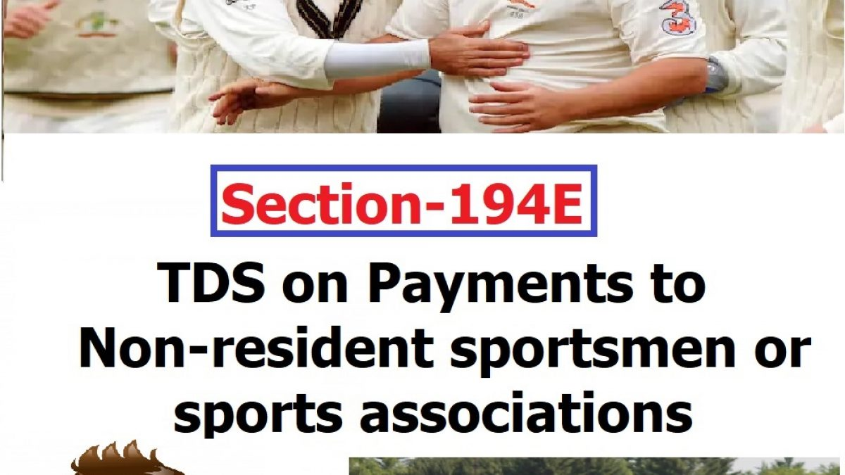

Slide 3
SECTION 194 E
TDS ON PAYMENT TO NON- RESIDENT SPORTSMEN/ SPORTS ASSOCIATION
PERSONS LIABLE TO DEDUCT TDS U/S 194E
Any person making payment of income referred to in section 115BBA of Income Tax Act, 1961 to the following persons shall be liable to deduct TDS:-
A Non resident sportsman(including an athlete)
An Entertainer
who is not a citizen of India.
A non- resident sports association / institution.

Slide 4
PAYMENTS REFFERED TO IN SECTION 115BBA
Where the total income of an assessee,-
a)
being a sportsman (including an athlete),
who is not a citizen of India and is a non-resident
includes any income received or receivable by way of --
(i) participation in India in any game (other than a game the winnings wherefrom are taxable under section 115BB) or sport
(iii) contribution of articles relating to any game or sport in India in newspapers, magazines or journals; or
(ii) advertisement; or

Slide 5
b)
being a non-resident sports association or institution
includes any amount guaranteed to be paid or payable to such association or institution in relation to any game (other than a game the winnings wherefrom are taxable under section 115BB) or sport played in India,
c)
being an entertainer
who is not a citizen of India and is a non-resident
includes any income received or receivable from his performance in India

Slide 6
TIME OF DEDUCTION OF TDS UNDER SECTION 194E
When this section gets attracted in a given transaction, deductor is required to deduct TDS within earlier of the following dates –
At the time of payment in cheque, draft, cash or any other mode
At the time of credit of the income to the account of the recipient
OR

Slide 7
RATE AT WHICH TDS UNDER SECTION 194E IS TO BE DEDUCTED
Deductor liable to deduct TDS under section 194E is required to deduct TDS
@ 20%

Slide 8
TDS RETURN FILING U/S 194E
The Deductor, under section 194E of the Income Tax Act, 1961, is required to furnish TDS return in Form 27Q
FORM 27Q IS TO BE FILED QUARTERLY
Provisions of section 203 of the Income Tax Act, 1961 makes it mandatory for the Deductor to issue the TDS certificate to the payee. The Deductor deducting TDS under section 194E is required to furnish TDS certificate in Form 16A

Slide 9
RELEVANT RULES AND FORMS FOR THE PURPOSE OF THIS SECTION
RULES
RULE 31AB
RULE 31
RULE 30
RULE 31A
RULE 37 A
FORMS
FORM No.16A
FORM 26 AS
FORM 27 Q

Slide 10
CASE LAWS
Pilcom Vs. CIT West Bengal(SUPREME COURT)
Payments made to the Non-Resident Sports Association represented their income which accrued or arose or deemed to have accrued or arisen in India, shall required to deduct tax under section 194E.

Slide 11
CASE LAWS
International Merchandising Corporations-Indian Branch Office V/s. ADIT (2015) 42 Tribunal
Sanction Fees paid to a non-resident association of a tennis professional requires tax to be deducted at source under section 194E

Slide 12
SEC 195 - NONRESIDENT
Tax deducted at source (TDS) is a tax collection mechanism by the government wherein the payer responsible for making the payment must deduct tax from the amount paid to another person or entity.
In this regard, Section 195 of the Income Tax Act, 1961 specifies the TDS provision in the case of an individual making a payment by way of interest or any other amount other than salary to an NRI or a foreign company.
Non-resident Indians (NRIs) also need to file their tax returns for the income earned in India. Similarly, they also can claim the tax deducted at source (TDS) when filing tax returns.

Slide 13
NON RESIDENT
As per the said provisions, a person is said to be a non-resident in India if not a resident in India, as laid out in section 6 of the Act.
A person will be a resident of India in any financial year if they satisfy the following conditions:
If they stay in India for 182 days or more during the financial year, or
If they stay in India for 60 days or more during the financial year, and 365 days or more during the immediately preceding four financial years.

Slide 14
Exception for point (2)
In the case of an Indian citizen or a person of Indian origin (PIO) whose total income, other than income from foreign sources:
Exceeds Rs 15 lakhs during the relevant financial year – 60 days as mentioned in point (2) above will get substituted with 120 days.
An Indian citizen or PIO earning a total income over Rs 15 lakhs (other than from foreign sources) is deemed a NOT ORDINARILY resident in India if they are not taxed in any other country.(DEEMED RESIDENT).

Slide 15
Who should deduct tax under Section 195?
Any person who makes any payment (other than salary or interest referred to in sections 194LB, 194LC and 194LD) taxable in India to a non-resident must deduct tax under this section.
The payer, one who pays the NRI or remits the payment, can be a resident or a non-resident, an individual, Hindu Undivided Families (HUFs), partnership firms, other NRIs, foreign companies, or an artificial juridical person (for example, a corporation, government agency or non-profit organisation).

Slide 16
Is there a threshold limit to deduct TDS u/s 195?
No, there is no threshold limit to deduct TDS under Section 195. However, the payer must deduct tax only when the payment made to a non-resident is taxable in India. Therefore, no tax is to be deducted in case of exempt income or any other income that is not taxable as per the Income Tax Act unless the government notifies explicitly.

Slide 17
At what rate is the tax deducted under section 195?
TDS is deducted at either of the following rates, whichever is more beneficial to the payee:
Rates as per the Finance Act of the given year
Rates contained in the Double Taxation Avoidance Agreement (DTAA) between India and the country of residence of such non-resident
Note that the rates given under the Finance Act are to be increased by the applicable surcharge and education cess of 4%. However, surcharge and cess are not required to be added to the rates given under DTAA.

Slide 18
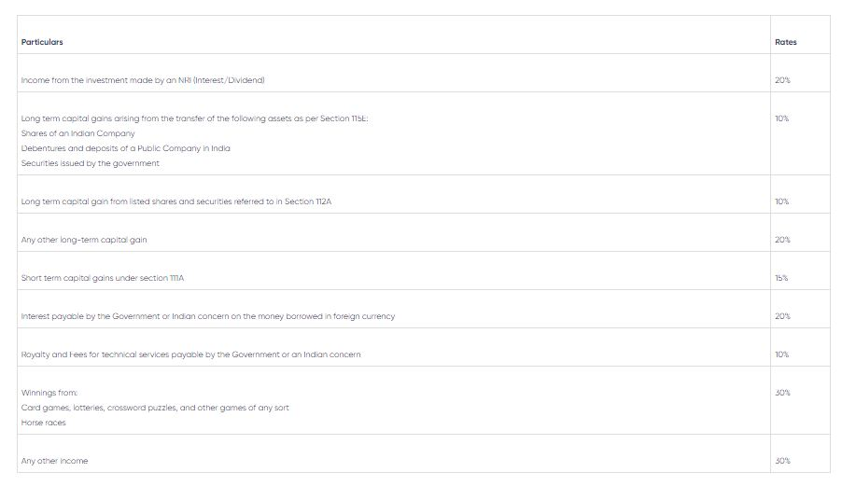

Slide 19
Application for nil or lower TDS deduction certificate by the payer
When the payer believes that no amount or only a partial amount (other than salary) is taxable in the hands of the non-resident in India or that TDS is to be done at a lower rate, then he may make an application under Form 15E to the Assessing Officer (AO) for obtaining a lower or nil deduction certificate.

Slide 20
Declaration of information in relation to foreign payments
The payer responsible for paying any amount to a non-resident or a foreign company is required to furnish complete and accurate information regarding such payment in Form 15CA and Form 15CB with the AO. Note that such information must be furnished even if the amount paid is not taxable under the Act. Failure to do such compliance shall attract a penalty of Rs 1 lakh under Section 271-I.

Slide 21
15 CA
Form 15CA is a Declaration of Remitter and is considered as a tool for collecting information in lieu of payments which are chargeable for tax in the hands of recipient non-resident of India. This is starting of an effective Information Processing System which may be utilized by the Income tax Department to freely track the foreign remittances and their source to determine tax liability.
Financial Institutions are now more vigilant in seeking such Forms before remittance is effected since now as per revised Rule 37BB a duty is implied on them to furnish Form 15CA received from remitter to an income-tax authority for the uses of any proceedings under the Income-tax Act.

Slide 22
Part A –Section A of Form 15CA is filled in by the remitter when the payment or the total sum of the payment extended by the remitter to NRI recipient during a particular Financial Year is Rs. 5 Lakhs or less.
Part B –Section B of Form 15CA is in the role when such payments are more than Rs. 5 Lakhs. Information is entered by the filer in Section B after acquiring a certificate from Assessing Officer (valid under section 197) or the order from Assessing Officer (valid under sub-section (2) or sub-section (3) of section 195).
Part C –If such payments made during a particular FY exceed Rs. 5 Lakhs, the related information has to be entered in Section C of Form 15CA after acquiring the Tax Determination Certificate or Form 15CB from authorized CA (valid under sub-section (2) of section 288).
Part D –Payments made by the remitter during a particular FY which is not referred to in sub-section 37BB or in other words is not taxable under law, the information related to such payments is to be entered in Section D of Form 15CA.

Slide 23
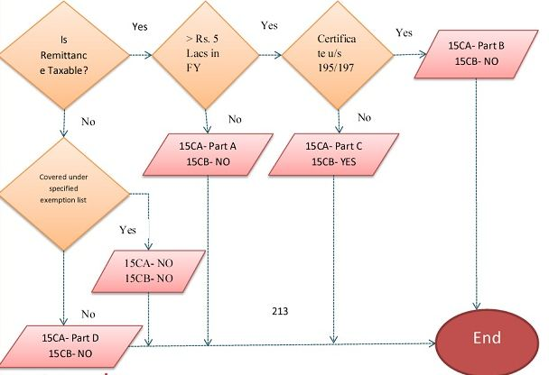

Slide 24
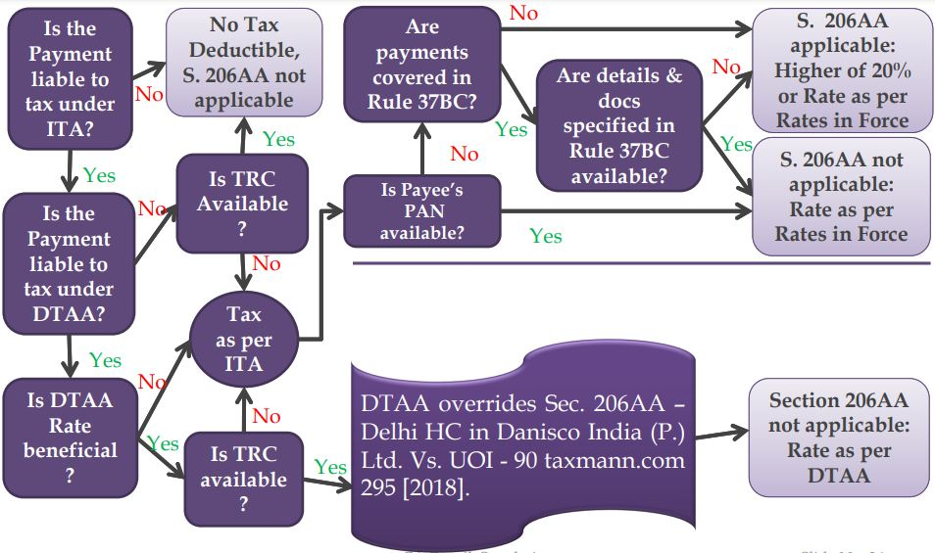

Slide 25
196 C
Nature of Payment
(a) Interest on notified bonds referred to in section 115AC.
(b) Dividends on Global Depository Receipts referred to in section 115AC (c) Long-term capital gain arising from transfer of such bonds or Global Depository Receipts

Slide 26
When to Deduct TDS under Section 196C?
At the time of credit of such income to the account of payee or at the time of payment, whichever is earlier.

Slide 27
Rate of TDS under Section 196C?
The rate of tax deduction u/s 1946C is
10%(+ SC+H&E Cess)

Slide 28
Other key point related to Section 196C
No deduction shall be made in respect of dividend referred to in section 115-O.

Slide 29
Who is responsible to deduct tax under section 196D of Income Tax Act, 1961?
Any person responsible for making payment to Foreign Institutional Investors

Slide 30
Nature of Payment
Income in respect of securities referred to in section 115AD (not being interest referred to in section 194LD)

Slide 31
When to Deduct TDS under Section 196D?
At the time of credit of such income to the account of payee or at the time of payment, whichever is earlier. For this purpose, “payment” can be in cash or by issue of a cheque or draft of by any other mode.

Slide 32
Rate of TDS under Section 196D
The rate of tax deduction u/s 196D is 20% (+ SC+H&E Cess)

Slide 33
Other key point related to Section 196D
No deduction shall be made in respect of capital gains arising from transfer of such securities.

