Slide 1
CCIT
Prof. Vijayan Ramakrishnan

Slide 2
Topics to be covered
Advance Authorisation / DFIA
EPCG
EOU / EHTP / STPI /BTP
Manufacturing under bonded warehouse
Special Economic Zones including FTWZ
Duty Drawback Scheme
RODTEP
Chapter 3 of Foreign Trade Policy & HBOP
Additional benefits for Imports and Exports to MSME

Slide 3
Topics to be covered on Sunday 03.12.23
ADVANCE AUTHORISATION ( DUTY ENTITLEMENT EXEMPTION CERTIFICATE)
DUTY FREE IMPORT AUTHORISATION
EXPORT PROMOTION CAPITAL GOODS SCHEME (EPCG)

Slide 4
Chapter 4 of Foreign Trade Policy covers the Duty Exemption/Remission Schemes.
These schemes have been introduced by the Government understanding that products should be exported and not taxes.

Slide 5
Export Incentives
Exemption
Re-imbursement
Pre – Export Incentives
Post – Export Incentives

Slide 6
4.01 Schemes
The Duty exemption Remission Schemes are covered under the Chapter 4 of Foreign Trade Policy
(a) Duty Exemption Schemes.
The Duty Exemption schemes consist of the following:
  Advance Authorisation (AA) (which will include Advance Authorisation for Annual Requirement) also known as Advance license scheme
  Duty Free Import Authorisation (DFIA).

Slide 7
(b) Duty Remission Scheme.
  Duty Drawback (DBK) Scheme, administered by Department of Revenue.
(c) Scheme for Rebate on State and Central Taxes and Levies (RoSCTL), as notified by the Ministry of Textiles.
(d) Schemes for Remission of Duties and Taxes on Exported Products (RoDTEP) notified by Department of Commerce and administered by Department of Revenue

Slide 8
ADVANCE AUTHORISATION ( DUTY ENTITLEMENT EXEMPTION CERTIFICATE)

Slide 9
Advance authorisation (AAS) and Duty Free Import Authorisation (DFIA)
The Duty Exemption Scheme consists of Advance Authorization (AA) and Duty Free Import Authorization ( DFIA).
One significant difference is that unlike the Advance Licence Scheme where the value addition requirement is only positive value addition, under the new scheme minimum value addition requirement is 20% (except for items in gem & jewellery sector).
Another vital difference is that under the new scheme once the export obligation is fulfilled, the licence or the inputs imported (other than fuel) against it can be transferred / sold. AA is issued for import of inputs at Zero duty (para 4.03 and 4.14 of current FTP 2015-20.
It is granted prior to the completion of export obligation.
The initial export obligation period is 18 months
The minimum value addition (VA) required to be achieved is 15%.
It is subject to actual user condition even after discharge of export obligation.

Slide 10
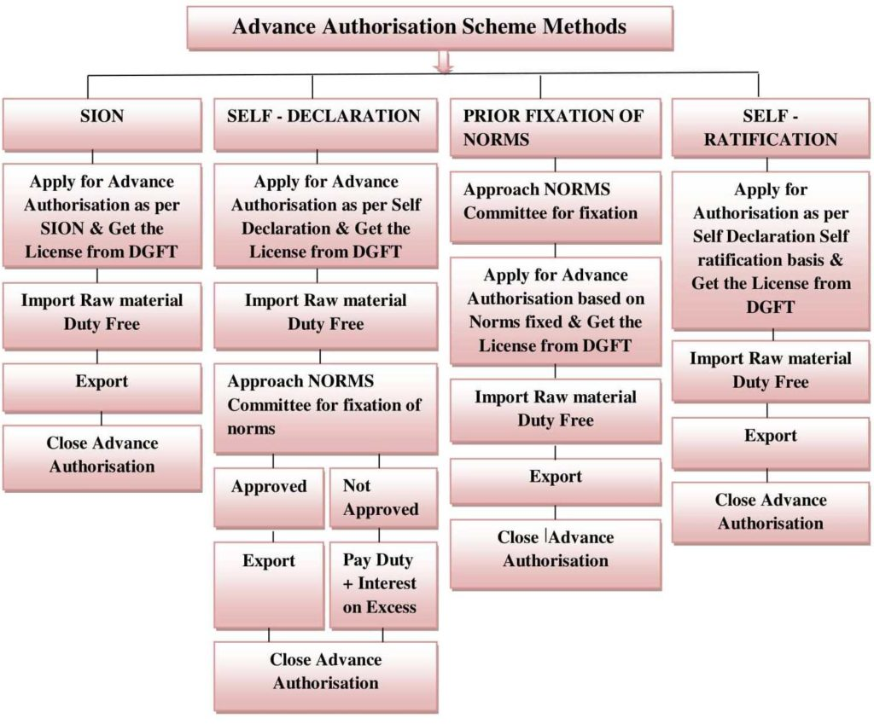

Slide 11
Advance Authorisation :
Application Form ANF- 4A
Fuel also allowed
Eligible for SION/ Non SION goods
Min. Value addition –15% Scheme/ inputs
never transferable

Slide 12
FTP - 4.03 Advance Authorisation
(a) Advance Authorisation is issued to allow duty free import of input,
which is physically incorporated in export product (making normal
allowance for wastage). In addition, fuel, oil, catalyst which is
consumed / utilized in the process of production of export product,
may also be allowed.
(b) Advance Authorisation is issued for inputs in relation to resultant
product, on the following basis:

Slide 13
i) As per Standard Input Output Norms (SION) notified (available in
Hand Book of Procedures);
OR
(ii) On the basis of self declaration as per paragraph 4.07 of Handbook of
Procedures.
OR
(iii) Applicant specific prior fixation of norm by the Norms Committee.
OR
(iv) On the basis of Self Ratification Scheme in terms of Para 4.07A of
Foreign Trade Policy.

Slide 14
FTP - 4.04
A Special Advance Authorisation Scheme for export of “Articles of Apparel and Clothing Accessories” is also available.
FTP - 4.06
Facility of “Annual Advance Authorisation” available
FTP - 4.10
Import of Mandatory Spares Permitted upto 10% of C.I.F. Value of Authorization.
FTP - 4.14
The details of “Duties” exempted are contained under this para

Slide 15
FTP - 4.15- Admissibility of Drawback
Advance Authorization Facility can be combined with Duty Drawback.
Drawback as per rate determined and fixed by Customs authority in terms of DoR Rules shall be available for duty paid imported or indigenous inputs (not specified in the norms) used in the export product.
For this purpose, applicant shall indicate clearly details of duty paid input in the application for Advance Authorisation.
As per details mentioned in the application,
Regional Authority shall also clearly endorse details of such duty paid inputs in the condition sheet of the Advance Authorisation.

Slide 16
FTP - 4.16
The Authorization is subject to “Actual User Condition

Slide 17
Details of duty exempted FTP 4.14
Imports are exempted from payment of:
Basic Customs Duty (BCD)
Additional Customs Duty
Education Cess
Anti-dumping Duty
Countervailing Duty
Safeguard Duty

Slide 18
Standard Input-Output Norms
WHAT ARE STANDARD INPUT-OUTPUT NORMS?
The DGFT issued the Standard Input-Output Norms (SION) with an aim to determine the number of inputs required for the production of a unit of output to be exported.
This method has pre-fixed norms for thousands of products of different segments such as Chemical and allied products, Electronics, Engineering, Food products, Handicrafts, Leather, Plastics, Sports, textile, etc.

Slide 19
Self Declaration
WHAT ARE SELF-DECLARED NORMS?
This method enables the exporter to apply for an Advanced Authorisation License on the basis of self-declaration.
This can be claimed by the exporter if the product isn’t eligible under SION or they aren’t satisfied with the import quantity allowed.
The Advance License would be close if the norms are accepted by the Norms Committee.
However, if the applied norms are rejected, the applicant will be paying Customs Duty along with Interest on the excess import quantity and further close the Advance License.

Slide 20
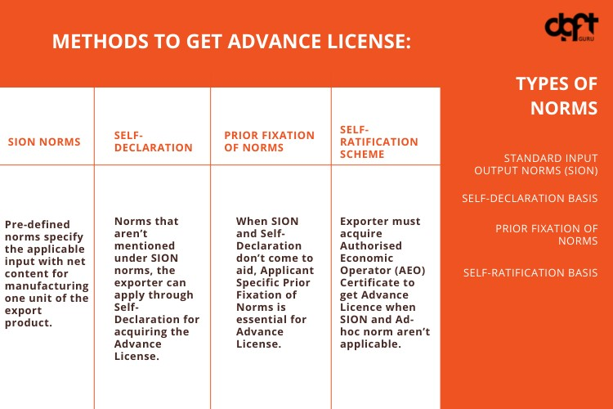

Slide 21
WHAT IS THE APPLICANT SPECIFIC-PRIOR FIXATION NORMS?
After getting the norms rectified by the Norms Committee the DGFT will provide the applicant an Advance License on the basis of the fixed norms. Except for this, the entire process remains the same.

Slide 22
SELF- RATIFICATION ADVANCE AUTHORISATION SCHEME
The DGFT instituted this scheme for the smooth functioning of business procedures. Under the Self -Ratification Advance Authorisation Scheme an Advance License is provided by the DGFT based on self-declaration without any direct involvement of the Norms Committee in Delhi for ratification of the norms. These are assumed to be self-ratified, thus, no further questioning is done. However, the eligibility of exporters under this method is limited, there are a few conditions to be adhered to by the exporters:
Only the exporter having an AEO (Authorised Economic Operator) can apply under this scheme.
The scheme isn’t available for all the export products mentioned in Chapters 1-24 and Chapter 71 of ITC HS, etc.
Before exporting, inputs must be imported and incorporated physically in the export product.
An audit may be held by the DGFT or the authority.
If the audit finds any misdeclaration or it’s found that the claimed inputs aren’t involved/utilized in the manufacturing process or excess quantity consumed is falsely mentioned, demand and recovery actions will be initiated.

Slide 23
List of items eligible to be imported without payment of duty under the scheme:
Physically incorporated inputs that have to be exported after making a normal allowance for wastage.
Fuel, oil, catalyst consumed/ utilized for acquiring the export product.
Spare that are mandatory to be exported along with the export product- up to 10% of the CIF value (Cost, Insurance, and Freight) of Authorisation.
Spices that are specified to be allowed for a duty-free import, only to be utilized in activities like crushing, grinding, sterilization, manufacture of oil or oleoresin and not for simpler activities like cleaning, grading, re-packing, etc.

Slide 24
Advance Authorization for Annual Requirement
Advance Authorization for Annual Requirement Advance Authorization can also be issued for annual requirement.
Status Certificate holder and all other categories of exporters having past export performance (in preceding two years) shall be entitled for Advance Authorization for annual requirement.
Entitlement in terms of CIF value of imports shall be up to 300% of the FOB value of physical export and / or FOR value of deemed export in preceding licensing year or Rs 1 crore, whichever is higher

Slide 25


Slide 26
Example:-
Consider an exporter importing the inputs worth Rs. 500
product made with the input for the export is worth Rs. 600,
Then the value addition would be calculated as follows -
VA ={(600-500)/500}*100
= {100/500} * 100
= 0.2*100
= 20%
Value Addition would be 20%.

Slide 27
Redemption/Closure of Advance License at DGFT
After Completion of the Export Obligation (EO), the exporter has to submit relevant proof of export to DGFT for the closure of the Advance License.
For the redemption of the advance License, the exporter has to submit the Application form ANF 4F to the regional authority of DGFT with the signature on each page of the form.
All the details about the authorization and the applicant need to be filled in the ANF such as Authorisation No, issuance date, CIF Value of the license, Export obligation, Norms Details.
Export details including the Shipping bills no, export quantity, FOB Value shall be specified in the application form. The form will also include the information about the Import Items such as Quantity and CIF value of import, bill of entry details, etc.
After checking the completeness of the application in every aspect the regional authority of DGFT will issue the Export Obligation Discharge Certificate/ Redemption Letter to the Authorisation holder.

Slide 28
Bond/BG Cancellation at Customs
After the redemption/closure of the Advance license from DGFT, the last and the important step in the Advance License procedure is the cancellation of the Bond/Bank Guarantee which has been executed at the time of Import. To complete the last step Redemption Letter/Original EODC has to be submitted to the customs with the following documents.
Original Advance License
ANF 4F duly Certified by Charted Accountant
Copy of Shipping bills
Copy of Bill of Entry
Other relevant documents submitted to DGFT

Slide 29
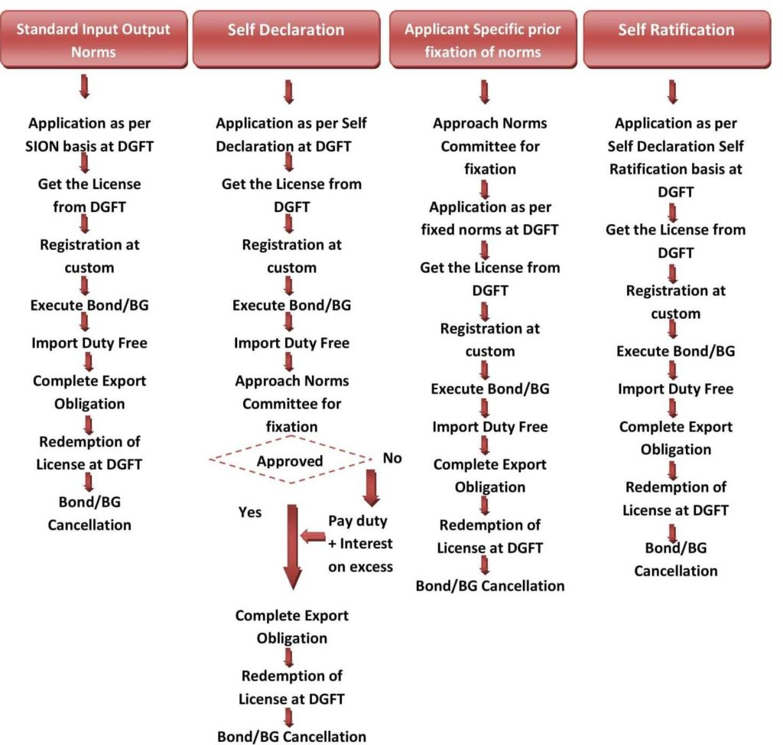

Slide 30
Export Obligation
The whole reason behind allowing duty-free inputs is to boost exports.
The entity will incorporate these acquired inputs into a product so that it may be exported.
Export Obligation (EO) in the case of Advance Authorisation is the value of export that needs to compulsorily be achieved within a prescribed time period.
The EO is usually mentioned in the Authorisation issued.
After achieving the EO, the entity has to provide evidence of the same.
Not achieving the EO in the prescribed time period could result in penalties.
Other export promotion schemes like the Export Promotion Capital Goods (EPCG) Scheme have different conditions when it comes to the export obligation.

Slide 31
DUTY FREE IMPORT AUTHORISATION

Slide 32
Advance Authorization ( AA) is issued generally before export where as DFIA is issued after export.
AA is subject to actual user condition even after export obligation where as DFIA is transferable.
The minimum value addition for AA is 15% where as for DFIA is 20%.

Slide 33
On the other hand DFIA is issued for inputs from exemption of only basic customs duty after discharge of export obligation.
The DFIA shall be granted only where Standard Input-Ouput Noms (SION ) are available.
The minimum value addition (VA) of 20% shall be required to be achieved.
The DFIA is transferable- DFIA or Goods imported under it are transferable.
The validity of DFIA is 12 months from the date of issue.

Slide 34
Duty Free Import Authorisation
Form ANF- 4G
Fuel not eligible to be imported free Only for SION products
Min. Value addition – 20% Scheme/ inputs
Both transferable after fulfilling export obligation
SION = Standard input and Output Norms

Slide 35
The broad differences between the Authorizations
Advance authorisation
Duty Free Import Authorisation
AA is issued for import of inputs at Zero duty (para 4.03 and 4.14 of current FTP 2015-20
It is granted prior to the completion of export obligation.
The initial export obligation period is 18 months the minimum value addition (VA) required to be achieved is 15%.
It is subject to actual user condition even after discharge of export obligation.
Application Form ANF- 4A
Fuel also allowed Eligible for SION/ Non SION goods
Scheme/ inputs never transferable
On the other hand DFIA is issued for inputs from exemption of only basic customs duty after discharge of export obligation.
The DFIA shall be granted only where Standard Input-Ouput Noms (SION ) are available.
The minimum value addition (VA) of 20% shall be required to be achieved.
The DFIA is transferable- DFIA or Goods imported under it are transferable.
The validity of DFIA is 12 months from the date of issue.
Form ANF- 4G

Slide 36
Duty Free Import Authorization
↓
Is A Post Export Facility
↓
To Import Inputs
↓
Used In Manufacturer of Export product
↓
Without Payment Of Import Duty
(Basic)
↓
Subject To 20% Value Addition

Slide 37
FTA - DFIA SCHEME
This is covered under FTA from section 4.24 to 4.29
a) Duty Free Import Authorisation is issued to allow duty free import of inputs. In addition, import of oil and catalyst which is consumed / utilised in the process of production of export product, may also be allowed.
(b) Duty Free Import Authorisation Scheme shall not be available for
import of raw sugar.

Slide 38
FTP - 4.27 - Eligibility
(i) Duty Free Import Authorisation shall be issued on post export basis for products for which Standard Input Output Norms have been notified.
(ii) Merchant Exporter shall be required to mention name and address of supporting manufacturer of the export product on the export document viz. Shipping Bill/ Bill of Export / Tax Invoice for export prescribed under the GST rules.
(iii) Application is to be filed with concerned Regional Authority before effecting export under Duty Free Import Authorisation.
(iv) No Duty Free Import Authorisation shall be issued for an input which is subjected to pre-import condition or where SION prescribes ‘Actual User’ condition or Appendix-4J prescribes pre import

Slide 39
FTP - 4.28 - Minimum Value Addition
Minimum value addition of 20% shall be required to be achieved.

Slide 40
FTP - 4.29 - Validity &Transferability of DFIA
(i) Applicant shall file online application to Regional Authority concerned before starting export under DFIA.
(ii) Export shall be completed within 12 months from the date of online filing of application and generation of file number.
(iii) While doing export/supply, applicant shall indicate file number on the export /supply documents viz. Shipping Bill / / Bill of Export / Tax invoice for supply prescribed under GST rules.

Slide 41
(iv) In terms of Para 4.12 of FTP, Wherever SION permits use of either (a) a generic input or (b) alternative input, the specific input together with quantity [which has been used in manufacturing the export product] should be indicated / endorsed in the relevant Shipping Bill / Bill of Export / Tax invoice for supply prescribed under GST rules . Only such inputs may be permitted for import in the authorisation in proportion to the quantity of these inputs actually used/consumed in production, within overall quantity against such generic input/alternative input.
(v) In addition, if in any SION, a single quantity has been indicated against a number of inputs (more than one input), then quantities of such inputs to be permitted for import shall be in proportion to the quantity of these inputs actually used/consumed in production and declared in Shipping Bill / Bill of Export / Tax invoice for supply prescribed under GST rules within overall quantity against such group of inputs. Proportion of these inputs actually used/consumed in production of export product shall be clearly indicated in Shipping Bill / Bill of Export / Tax invoice for supply prescribed under GST rules.

Slide 42
(vi) Separate DFIA shall be issued for each SION and each port.
(vii) Exports under DFIA shall be made from a single port as mentioned in paragraph 4.37 of Handbook of Procedures.
(viii) Regional Authority shall issue transferable DFIA with a validity of 12 months from the date of issue. No further revalidation shall be granted by Regional Authority.

Slide 43
HBPV.1 – 4.51 – Maintenance of Proper Accounts
Every Advance Authorization holder shall maintain a true and proper account of consumption and utilization of duty free imported / domestically procured goods against each authorization as prescribed in Appendix 4H or 4I, as applicable.
These records are required to be sent to the concerned Regional Authority at the beginning of each licensing year for all those authorizations, which have been redeemed in previous licensing year.
However, these records in said format are required to be submitted for authorizations issued on or after 13-5-2005.
Such records should be preserved for a period of at least three years from date of redemption.

Slide 44
Original DFIA holder shall maintain a true and proper account of consumption and utilization of duty free imported / domestically procured goods against each authorization as prescribed in Appendix 4H.
These records are required to be sent to Regional Authority concerned along with request for bond waiver / redemption / discharge of export obligation / transferability.
Such records be preserved for a period of at least three years from date of redemption.

Slide 45
EPCG

Slide 46
EXPORT PROMOTION CAPITAL GOODS SCHEME
E.P.C.G
↓
Is A Facility To Import
↓
Capital Goods (New)
↓
At Concessional Rate Of Import Duty
↓
Subject To Fulfillment Of
↓
Prescribed Export Obligation

Slide 47
FTP – Para 5.01
EPCG Scheme
a) EPCG Scheme allows import of capital goods (except those specified in negative list in Appendix 5 F) for preproduction, production and post-production at zero customs duty.
Capital goods imported under EPCG Authorisation for physical exports are also exempt from IGST and Compensation Cess, leviable thereon under the subsection (7) and subsection (9) respectively, of section 3 of the Customs Tariff Act, 1975 (51 of 1975), as provided in the notification issued by Department of Revenue.
Alternatively, the Authorisation holder may also procure Capital Goods from indigenous sources in accordance with provisions of paragraph 5.07 of FTP.
Capital goods for the purpose of the EPCG scheme shall include:

Slide 48
(i) Capital Goods as defined in Chapter 11 including
in CKD/SKD condition thereof;
(ii) Computer systems and software which are a part of the Capital Goods being imported;
(iii) Spares, moulds, dies, jigs, fixtures, tools & refractories; and
(iv) Catalysts for initial charge plus one subsequent charge.
(b) Import under EPCG Scheme shall be subject to an Export Obligation (EO) equivalent to 6 times of duties, taxes and cess saved on capital goods, to be fulfilled in 6 years reckoned from date of issue of Authorisation.

Slide 49
(c) Import/procurement under EPCG scheme shall also be subjected to Average Export Obligation (AEO) as given in para 5.04(c) of FTP.
(d) Authorisation shall be valid for import for 24 months from the date of issue of Authorisation. Revalidation of EPCG Authorisation shall not be permitted.
(e) In case Integrated Tax and Compensation Cess are paid in cash on imports under EPCG, incidence of the said Integrated Tax and Compensation Cess would not be taken for computation of net duty saved provided Input Tax Credit is not availed.
(f) Import of items which are restricted for import shall be permitted under EPCG Scheme only after approval from Exim Facilitation Committee (EFC) at DGFT Headquarters.

Slide 50
(g) If the goods proposed to be exported under EPCG Authorisation are restricted for export, the EPCG Authorisation shall be issued only after approval for issuance of Export Authorisation from Exim Facilitation Committee (EFC) at DGFT Headquarters.

Slide 51
FTP – Para 5.02
Coverage
(a) EPCG scheme covers manufacturer exporters with or without supporting manufacturer(s), merchant exporters tied to supporting manufacturer(s) and service providers. Name of supporting manufacturer(s) shall be endorsed on the EPCG Authorisation before installation of the capital goods in the factory / premises of the supporting manufacturer(s). In case of any change in supporting manufacturer(s), the RA shall intimate such change to jurisdictional Customs Authority of existing as well as changed supporting manufacturer(s) and the Customs at port of registration of Authorisation.

Slide 52
(b) Export Promotion Capital Goods (EPCG) Scheme also covers a service provider who is certified as a Common Service Provider (CSP) by the DGFT - HQs, Department of Commerce in a Town of Export Excellence or Prime Minister Mega Integrated Textile Region and Apparel Parks (PM MITRA) subject to provisions of Foreign Trade Policy/Handbook of Procedures with the following conditions:
(i) Common utility services like providing Electricity, Water, Gas, Sanitation, Sewerage, Telecommunication, Transportation etc. shall not considered for benefit of CSP;
(ii) Export by users of the common service shall be counted towards fulfillment of EO of the CSP provided the EPCG Authorisation details of the CSP is mentioned in the respective Shipping bills and concerned RA must be informed about the details of the users prior to such export;

Slide 53
(iii) Such export will not count towards fulfillment of specific export obligation in respect of other EPCG Authorisations of the user;
(iv) Authorisation holder shall be required to submit Bank Guarantee (BG) which shall be equivalent to the duty saved. BG can be given by CSP or by any one of the users or a combination thereof, at the option of the CSP; and
(v) Capital goods shall be installed within a Town of Export Excellence or PM MITRA.

Slide 54
FTP Para - 5.04
Export obligation
Following conditions shall apply to the fulfillment of Export obligation:-
(a) Export obligation shall be fulfilled by the Authorisation holder through export of goods which are manufactured by him or his supporting manufacturer / services rendered by him, for which the EPCG authorisation has been granted.
(b) For export of goods, EPCG Authorisation holder may export either directly or through third party(ies).

Slide 55
c) EO under the scheme shall be, over and above, the average level of exports achieved by the applicant in the preceding three licensing years for the same and similar products within the overall EO period including extended period, if any; except for categories mentioned in paragraph 5.12(a). Such average would be the arithmetic mean of export performance in the preceding three licensing years for same and similar products. The Average Export Obligation (AEO) shall be fulfilled every financial year, till export obligation is completed. Exports/supplies made over and above AEO shall only be considered for fulfillment of Export Obligation.
(d) In case of indigenous sourcing of Capital Goods, specific EO shall be 25% less than the EO stipulated in Para 5.01. There shall be no change in average EO imposed, if any, as stipulated in Para 5.04(c).

Slide 56
(e) Exports under Advance Authorisation, DFIA, Duty Drawback, RoSCTL and RoDTEP Schemes would also be eligible for fulfilment of EO under EPCG Scheme.
(f) Export obligation may be fulfilled both by physical exports as well as deemed exports. Deemed export supplies shall also be eligible for benefits available under paragraph 7.03 of FTP.
(g) Exports made from DTA units shall only be counted for calculation and/or fulfillment of AEO and/or EO.
(h) EO can also be fulfilled by the supply of ITA-I items to DTA, provided realization is in free foreign exchange.

Slide 57
(i)Royalty payments received by the Authorisation holder in freely convertible currency and foreign exchange received for R&D services shall also be counted for discharge under EPCG.
(j) Payment received in rupee terms for such Services as notified in Appendix 5D shall also be counted towards discharge of export obligation under the EPCG scheme.
(k) Export proceeds realized in Indian Rupees as per para 2.52(d)(ii) are also counted towards fulfillment of export obligation.
(l) Only one benefit specified in paras 5.04(d), 5.09, 5.10 and 5.11 shall be admissible.
m) Extension of EO period shall be permitted as prescribed in Handbook of Procedures

Slide 58
FTP – Para - 5.09
Incentive for early EO fulfillment
With a view to accelerating exports, in cases where Authorisation holder has fulfilled 75% or more of specific export obligation and 100% of Average Export Obligation till date, if any, in half or less than half the original export obligation period specified, remaining export obligation shall be condoned and the Authorisation redeemed by RA concerned.

Slide 59
FTP – Para - 5.12 Exemption from maintenance of average export obligation
(a) In case of export of goods relating to the following, the EPCG Authorisation holder shall not be required to maintain average export obligation. (i) Handicrafts, (ii) Handlooms, (iii) Industries covered under Khadi and Village Industries Commission (KVIC) (iv) Agriculture (v) Aquaculture (including Fisheries),Pisciculture, (vi) Animal husbandry and Dairying, (vii) Floriculture & Horticulture, (viii) Poultry, (ix) Viticulture, (x) Sericulture, (xi) Carpets, (xii) Coir, and (xiii) Jute

Slide 60
(b) However, this exemption from maintenance of average export obligation shall not be allowed for import of fishing trawlers, boats, ships and other similar items.
(c) Goods, excepting tools imported under EPCG scheme by sectors specified in sub-paragraph (a) above, shall not be allowed to be transferred for a period of five years from date of imports even in cases where export obligation has been fulfilled.

Slide 61
What is Export Obligation under EPCG Scheme?
EPCG scheme, as you all may know, allows duty-free import of capital goods/machinery for the production of high-quality export goods. EPCG scheme is introduced by the Government with a single aim to increase exports from India.
Therefore, by giving this concession of zero duty import, GOI is assigning a task/job to you. And your task is to increase export sales of your company after the installation of the said new machinery in comparison to earlier sales. This task/job assigned to you by the GOI is known as an export obligation. The export obligation under the EPCG scheme is compulsory and does not come with a choice. DGFT has the right to take action against any exporter who does not fulfil the export obligation.

Slide 62
EPCG Export Obligation
In the EPCG Scheme, the Export Obligation period is of 6 years.
Export Obligation is fulfiled by the authorisation holder only by exporting goods, which are manufactured using the said machinery. Export obligation cannot be fulfiled by the export of alternate products not mentioned on the EPCG License.
Export obligation can be completed either by direct export, third party export or deemed export.
The EPCG Authorisation holder should submit a report on the fulfilment of Export Obligation by 30th April of every year in hard copy to DGFT RA.
Shipping Bills containing details of Advance Authorisation, DFIA, MEIS, or any other reward scheme can be counted in Export Obligation fulfilment only if EPCG License details are mentioned in it.

Slide 63
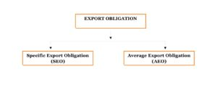
Export Obligation imposed in the EPCG Scheme is of two types-

Slide 64
Specific Export Obligation (SEO)
Under Specific export obligation, an exporter has to export goods equal to 6 times of the actual duty saved amount within 6 years starting from the EPCG license issue date.
In SEO, the Export Obligation should be completed block-wise:-
1st Block: The first four years from the issue of the license is said as 1st block and in this block, the exporter has to complete a minimum 50% of the Export Obligation.
2nd Block: The last two year i.e. 5th and 6th year from the issue of the license are said as 2nd block and in this block, the exporter has to complete the remaining Export Obligation.
If the Authorisation holder fails to fulfil the 1st block, he can extend by paying 2% of composition fees on the duty saved value proportionate to the unfulfilled portion of the Export Obligation.

Slide 65
Average Export Obligation (AEO)
In AEO, the average turnover of same & similar products maintained in the preceding three financial years before the license issued should be maintained in each financial year until we fulfill the Specific Export Obligation (SEO).
In this obligation, the DGFT wants you to maintain the export performance you already achieved in previous financial years.
The EPCG scheme is introduced with the objective to increase exports, therefore AEO makes sure the average is maintained and SEO makes sure that there is an increase in exports.

Slide 66
EPCG Export Obligation Calculation
Let us understand the calculation of export obligation under the EPCG scheme with the help of an example:
Let’s say Company ABC Pvt. Ltd. Is into exports of “Toothbrushes” and are going to import CNC tufting machine which binds Toothbrush handles with Bristles. They took the EPCG License of CIF value which is approximately 38,000 USD and below is the table for calculating Duty saved value.

Slide 67
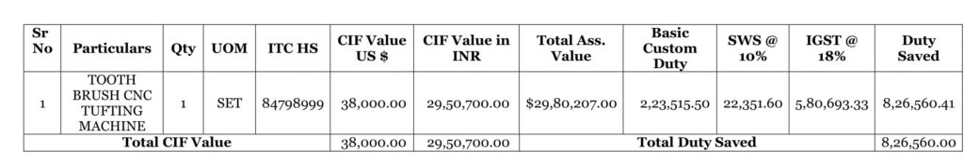

Slide 68
As per the above, the duty saved value is 8,26,560 INR i.e. the duty that they saved while importing the capital goods.
The specific export obligation is calculated as 6 times of duty saved value i.e. 8,26,560 *6 =49,59,360 INR to be completed in 6 years.
They applied for the license in F.Y. 2020-21, therefore to calculate the AEO, they have to check export turnover of “Toothbrush” for previous three F.Y. i.e. 2019-20, 2018-19, 2017-18. Suppose average comes out to be 1 Cr.
So, Total export obligation is - They have to export “Toothbrushes” worth 49,59,360 INR in 6 years and also maintain 1 Cr annual export of toothbrush for all 6 years.

Slide 69
Extension of EPCG Export Obligation
If An Authorisation holder fails to fulfill the Export Obligation in a given period of 6 years, then he/she can extend the Export Obligation period.
Request Period to DGFT:
The Authorisation Holder can request DGFT RA, before 90 days from the date of the expiry of the actual Export Obligation period. Also, the RA accepts the request for extension up to 180 days with an additional composition fee of Rs. 5,000/-
Regarding Extension:
The DGFT RA can provide two extensions of one year each and have to pay a composition fee of 5% in the first year and 10% in the Second year respectively of proportionate duty saved value depends on unfulfilled Export Obligation.
The minimum composition fee will be Rs. 10,000.
Automatic Export Obligation extension on the occurrence of Ban on export Product:
As per Para 5.20 FTP 2015-20, if there is a ban of an export product after issuance of the license, then the Export Obligation is extended automatically for a period equal to the period of the ban. The Authorisation holder is not required to maintain the average export obligation for the ban period.

Slide 70
Penalty for Non-Fulfilment of Export Obligation
DGFT RA may condone shortfall up to 5% in specific export obligation arising out of duty saved amount but average export obligation should be 100%.
If the EPCG License holder fails to fulfil the average export obligation in a given period, then he is liable to pay customs duties with 15% interest per year to the customs authority.
If the EPCG License holder has fulfiled 100 % AEO but is unable to fulfil SEO, then he is liable to pay proportionate duty saved amount with 15% annual interest.

Slide 71
Relaxation in Export Obligation under EPCG Scheme
The DGFT has given the benefit or advantage for the exporter if the license holder has fulfiled 100% Average Export Obligation in each financial year from the license issued and 75% or more of his Specific Export Obligation in half or less than half of the export obligation period. The Authorisation holder can redeem the license. No need to fulfil the remaining 25% SEO.
Relaxation in Export Obligation under EPCG Scheme
The DGFT has given the benefit or advantage for the exporter if the license holder has fulfiled 100% Average Export Obligation in each financial year from the license issued and 75% or more of his Specific Export Obligation in half or less than half of the export obligation period. The Authorisation holder can redeem the license. No need to fulfil the remaining 25% SEO.

Slide 72
Relief in Average Export Obligation (AEO)
As per para 5.19 FTP 2015-20, The DGFT has given relief in average Export Obligation for the Authorisation holder, where the particular sector experiences a downfall of more than 5% in Global trade, then Authorisation holder can approach DGFT to reduce the AEO by that much percentage.
As per para 5.19 A FTP 2015-20, If the Authorisation holder, has made excess average export obligation in one year and less in another year, then it can be combined if the overall average export obligation is maintained.

Slide 73
Our government has given an exemption to the authorization holder in maintaining the average export obligation for the given export products:–
Handicrafts
Handlooms
Cottage & Tiny sector
Agriculture
Aqua-culture (including Fisheries), Pisciculture
Animal husbandry
Floriculture & Horticulture
Poultry
Viticulture
Sericulture
Carpets
Coir and
Jute

Slide 74
EPCG Export Obligation fulfilment through Third Party Exports
The finished goods exported by third party exporter should be manufactured by EPCG License holder or supporting manufacturer where the imported capital goods are installed as per the license.
The Authorisation holder name with license no. and Supporting Manufacturer details should be mentioned on the Shipping Bill or Bill of Export.
BRC, GR declaration, export order, and invoice should be in the name of third party exporter.
Additional Documents required for the discharge of Export Obligation through the third party exports are:-

Slide 75
Copy of an agreement between the license holder and ultimate exporter, to export the finished goods manufactured by the authorization holder or supporting manufacturer for the fulfillment of export obligation against EPCG license.
Evidence of having dispatched the goods from authorization Holders factory premises to the ultimate exporter/port of export i.e. ARE-1 certificate issued by Central Excise / Tax invoice for export under GST rules certified by customs verifying the export with the shipping bill no., date and license no. or Invoice containing license no., date and time of dispatch in case factory unit is not registered with GST / Central Excise.

Slide 76
Lorry Receipt / Logistical proof for clarifying that the finished goods are moved from the premises of the authorization holder to the third party/port registered for export.
A disclaimer certificate from third party exporter that the shipping bills and E-BRC utilized shall not be used in any other EPCG License for the fulfilment of Export Obligation.

