Slide 1


Slide 2
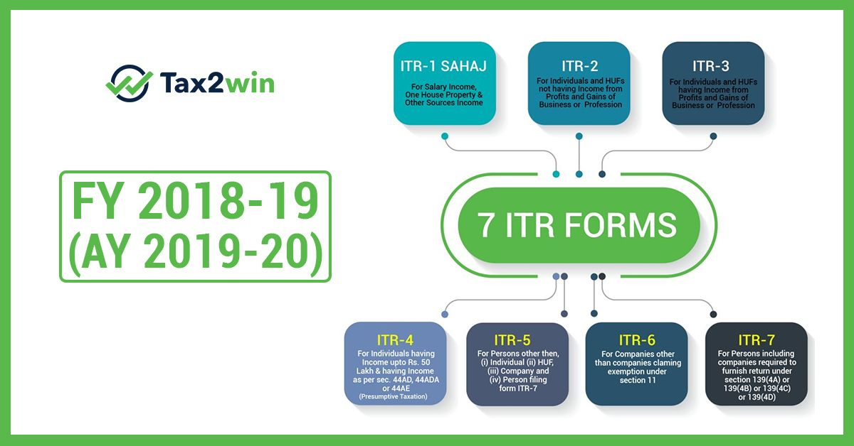

Slide 3
INCOME TAX RETURNS
ITR 1 (SAHAJ)
For Individuals having Income from Salaries, one house property (does not have any brought forward loss), other sources [Interest (does not have any loss under the head) etc. but except winnings from lottery or income from race horses] and having total income upto ` 50 lakh. However, the form is not to be used for an individual who is either Director in a company or has invested in unlisted equity shares or has any brought forward / carry forward loss under the head ‘Income from House Property’ or has to furnish return under seventh proviso to section 139(1) of the Income Tax Act
ITR 2
ITR 3
For Individuals and HUFs not carrying out business or profession under any proprietorship
ITR 4 (Sugam)
For Individuals and HUFs having income from a proprietary business or profession
For presumptive income from Business & Profession However, the form is not to be used for an individual who is either Director in a company or has invested in unlisted equity shares or has any brought forward / carry forward loss under the head ‘Income from House Property’

Slide 4
ITR 5
For person other than (i) Individual; (ii) HUF; (iii) Company; & (iv) Person filing Form ITR-7
ITR 6
For Companies other than companies claiming exemption u/s 11
ITR 7
For persons including companies required to furnish return u/s 139(4A) or 139(4B) or 139(4C) or139(4D) or 139(4F)
ITR- V
Income Tax Return Verification Form [Where the data of the aforesaid Return of Income has transmitted electronically without digital signature]

Slide 5

A SESSION ON FILING OF ITR 7

Slide 6
WHO IS ELIGIBLE TO FILE ITR 3 ?
Return under section 139(4A) is required to be filed by every person in receipt of income derived from property held under trust or other legal obligation wholly for charitable or religious purposes or in part only for such purposes.
Return under section 139(4B) is required to be filed by a political party if the total income without giving effect to the provisions of section 139A exceeds the maximum amount which is not chargeable to income-tax.
Return under section 139(4C) is required to be filed by every:-
scientific research association
news agency
association or institution referred to in section 10(23A);
institution referred to in section 10(23B);
fund or institution or university or other educational institution or any hospital or other medical institution.

Slide 7
Return under section 139(4D) is required to be filed by every university, college or other institution, which is not required to furnish return of income or loss under any other provision of this section.

Slide 8



Slide 9
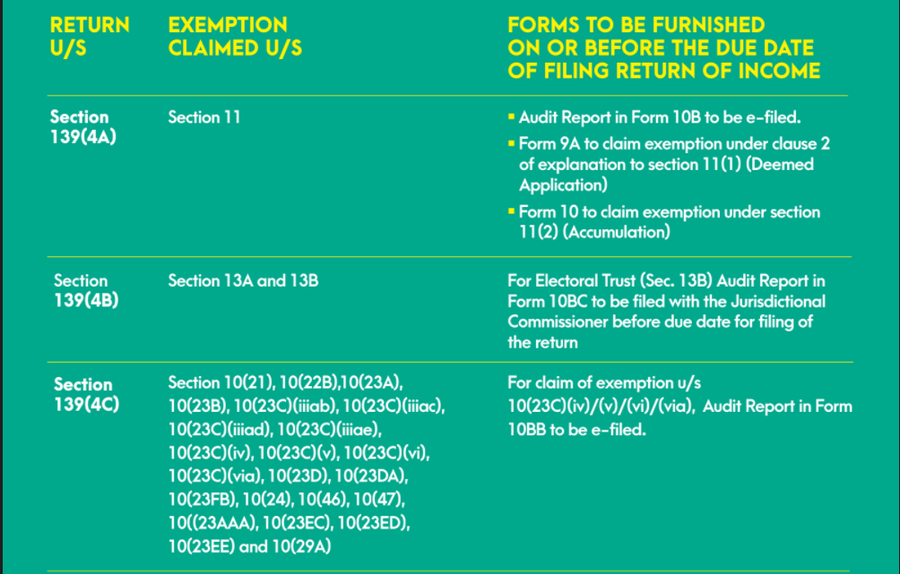

Slide 10
