Slide 1
INCOME TAX RETURNS - INTRODUCTION

Slide 2
PERSONS REQUIREDTO FILE INCOME TAX RETURNS
COMPANY
FIRM
ANY OTHER PERSON HAVING INCOME MORE THAN BASIC LIMIT BEFORE DEDUCTIONS.

Slide 3
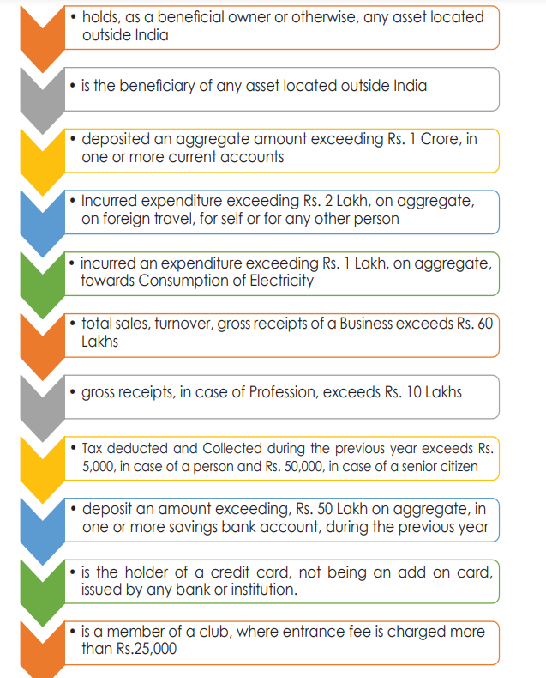

Slide 4
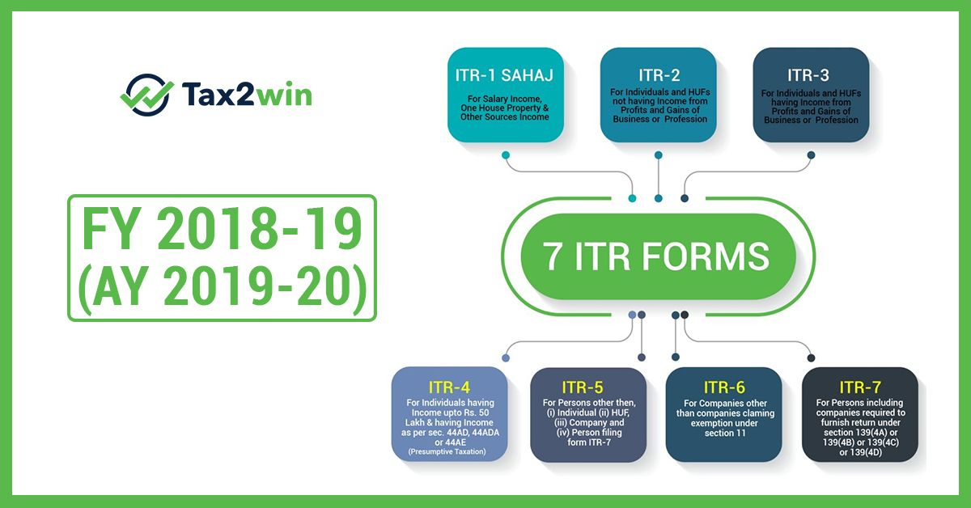
TYPES OF ITR FORMS

Slide 5
INCOME TAX RETURNS
ITR 1
For Individuals having Income from Salaries, one house property (does not have any brought forward loss), other sources [Interest (does not have any loss under the head) etc. but except winnings from lottery or income from race horses] and having total income upto ` 50 lakh. However, the form is not to be used for an individual who is either Director in a company or has invested in unlisted equity shares or has any brought forward / carry forward loss under the head ‘Income from House Property’ or has to furnish return under seventh proviso to section 139(1) of the Income Tax Act. 194N, 1cr deposit.
ITR 2
ITR 3
For Individuals and HUFs not carrying out business or profession under any proprietorship
ITR 4
For Individuals and HUFs having income from a proprietary business or profession
For presumptive income from Business & Profession However, the form is not to be used for an individual who is either Director in a company or has invested in unlisted equity shares or has any brought forward / carry forward loss under the head ‘Income from House Property’

Slide 6
ITR 5
For person other than (i) Individual; (ii) HUF; (iii) Company; & (iv) Person filing Form ITR-7
ITR 6
For Companies other than companies claiming exemption u/s 11
ITR 7
For persons including companies required to furnish return u/s 139(4A) or 139(4B) or 139(4C) or139(4D) or 139(4F)
ITR- V
Income Tax Return Verification Form [Where the data of the aforesaid Return of Income has transmitted electronically without digital signature]

Slide 7
ITR Filing- Sec 139
Voluntary Return
If the filing of income tax return is not mandatory for an individual, then the income tax filed by that individual will be termed as a voluntary return. Voluntary returns are also considered as valid returns of income tax.
Note: Under Section 139(1c), certain people are exempt from filing income tax. If these classes of people fulfil the prescribed conditions, the central government is empowered to grant them tax exemption.

Slide 8
ITR Filing- Sec 139
Due Dates for Filing Return
Section 139 contains various sub-sections that deal with different kinds of returns filed by different individuals related to late payments and mistakes. Hence, the due dates for filing their income tax returns are prescribed below:
July 31st
Any individuals who do not need an audit to be conducted for their books of account are required to file income tax returns by July 31, of every assessment year. This includes the following individuals (other than assessees who are required to furnish report under section 92E, for whom the due date is 30th November of the assessment year)
are specified below:
A person or employee who is paid with a wage.
Any self-employed individual.
Any consultant or freelancer.

Slide 9
ITR Filing- Sec 139
OCTOBER 31ST
All individuals who require an audit for their books of account must file their tax returns on OCTOBER 31ST of each assessment year.
The following individuals might come under this category:
(i) a company;
(ii) a person (other than company) whose accounts are required to be audited; or
(iii) a partner of a firm whose accounts are required to be audited.

Slide 10
ITR Filing- Sec 139
Section 139(3) – Filing Income Tax Return in Case of Loss
Section 139(3) deal with tax returns in case of loss incurred in a company or firm.
If losses are incurred in any income under the head “Profits and Gains of Business and Profession” or the head “Capital Gains”, then income tax return must be filed before the due date mentioned under section 139(1).
The following heads mentioned below will not be affected by the delayed filing of income tax return:
Any loss occurred under the heads of “House and residential property”.
Any loss occurred by the unabsorbed property as mentioned under section 139(3).

Slide 11
ITR Filing- Sec 139
Section 139(4) – Late Filing Income Tax Return(Belated Return)
Section 139(4) deals with late filing of income tax return. Its provisions have been described below:
The taxpayer can file late income tax returns before end of the relevant assessment year; or completion of Assessment u/s144.
The tax payer with late filing of income tax returns may incur a fee of 5,000, if the return is furnished on or before the 31st December of the assessment year under section 234F and Rs10000 in all other case
( maximum Rs.1000 for total Income below Rs.5.00 lakh).
However, no LATE FEE shall be levied on returns that were not required to be mandatorily filed as per Section 139(1).

Slide 12
ITR Filing- Sec 139
Section 139(5) – Revised Return
Section 139(5) deals with revised income tax return in case of any mistakes while filing the original income tax returns. The following are its provisions:
If the original or initial income tax return was filed by the assessee or entity as per Section 139(1) , he/she can file a revised income tax return before end of the relevant assessment year or completion of assessment, whichever is earlier.
A late income tax return cannot be revised. However, any loss return that was filed within the prescribed due date as mentioned in Section 139(1) can be revised.

Slide 13
ITR Filing- Sec 139
Section 139(4A) – Income Tax Return of Charitable and Religious Trust
Any individual whose income received from the property occupied by a public charity or religious trust and claims tax exemptions under Section 11 and Section 12 of the Income Tax Act are compulsorily required to file their tax returns, provided that the sum of the income collected prior to the provisions under section 11 and Section 12 is beyond the basic limit allowed for exemption.

Slide 14
ITR Filing- Sec 139
Section 139(4B) – Return of Income of a Political Party
Any political party will be required to mandatory file its tax returns provided that the sum of the income collected by the party is beyond the basic limit allowed for exemption without taking into consideration any benefits mentioned under section 13A.

Slide 15
ITR Filing- Sec 139
Section 139(4C) and (4D)- Claiming Exemption under Section 10
Section 139(4C) and Section 139(4D) deals with specific institutions who claim privileges as per the provision of Section 10 of the Income Tax Act 1961.
These sections state that an institution is mandatorily required to file its income tax returns provided that the sum of the income collected by the institution in question is beyond the basic limit allowed for exemption, without taking into consideration any other exemption benefits.

Slide 16
ITR Filing- Sec 139
Section 139(9) – Defective Returns
As per the provisions under section 139(9), income tax return is defective when specific documents are not attached with the income tax return. In case the return is considered defective by the tax officer, then the concerned tax payer will be informed by him and be allowed to rectify the defect within 15 days starting from the day of intimation.
In the request from tax payer through an application, the allowable period could be extended. The assessing officer intimates the tax payer about the defect through a simple letter.

Slide 17
UPDATED RETURN
To provide an opportunity to taxpayers,who have not filed the returns or who have committed omissions or mistakes in correctly estimating their income for tax payment, sub-section (8A) in section 139 is proposed to be inserted to permit them to file an Updated Return on payment of additional tax.

Slide 18
New sub-section 139(8A) w.e.f 1st April 2022
Within 24 months from end of relevant AY
FINANCIAL YEAR | 12 MONTHS | 24 MONTHS
2021-22 | N.A. | N.A.
2022-23 | PY 2020-21 | PY 2019-20
2023-24 | PY 2021-22 | PY 2020-21

Slide 19
NOT ALLOWED IF :
– Updated Return is a return of loss
– Effects in decrease of tax liability if ITR already filed
– Results in refund / increase in refund
Search u/s 132 or requisition u/s 132A
Survey u/s 133A (except 133A(2A))
An updated return already filed
Any proceeding for assessment or reassessment or recomputation or revision is pending or completed
Information for that AY is there u/s 90 / 90A and communicated to him

Slide 20
If no ITR filed earlier, fee for delay also to be paid
Additional Income Tax
Tax to be paid before filing return otherwise would be defective u/s 139(9). To be paid as per section 140B.
25% of tax & interest if ITR within 12 months
50% of tax & interest if ITR from 12 to 24 months

Slide 21
PROPOSED NEW ITR “COMMON FORM”
GENERAL INFORMATION
COMPUTATION OF TOTAL INCOME
COMPUTATION OF TAX
BANK ACCOUNT DETAILS
VERIFICATION
SCHEDULES

Slide 22
CHECKLIST
AIS
26AS
TAX PAID DETAILS
FORM 16, 16 A ETC
DEDUCTION DETAILS AND SUPPORTING DOCUMENTS.

Slide 23
FORM 10IE
115 BAC (5) Nothing contained in this section shall apply unless option is exercised in the prescribed manner⁷⁵ by the person,—
(i) having income from business or profession, on or before the due date specified under sub-section (1) of section 139 for furnishing the returns of income for any previous year relevant to the assessment year commencing on or after the 1st day of April, 2021, and such option once exercised shall apply to subsequent assessment years;
(ii) having income other than the income referred to in clause (i), alongwith the return of income to be furnished under sub-section (1) of section 139 for a previous year relevant to the assessment year:

Slide 24
FORM 10 IEA NOTIFIED ON 21.06.2023

Slide 25
Following sub-section (6) shall be inserted after sub-section (5) of section 115BAC by the Finance Act, 2023, w.e.f. 1-4-2024:
(6) Nothing contained in sub-section (1A) shall apply to a person where an option is exercised by such person, in the manner as may be prescribed, for any assessment year, and such option is exercised,
(i) on or before the due date specified under sub-section (1) of section 139 for furnishing the return of income for such assessment year, in case of a person having income from business or profession, and such option once exercised shall apply to subsequent assessment years; or
(ii) along with the return of income to be furnished under sub-section (1) of section 139 for such assessment year, in case of a person not having income referred to in clause (i):
Provided that the option under clause (i), once exercised for any previous year can be withdrawn only once for a previous year other than the year in which it was exercised and thereafter, the person shall never be eligible to exercise the option under this sub-section, except where such person ceases to have any income from business or profession in which case, option under clause (ii) shall be available.

Slide 26
DUE DATES FOR FILING ITR
31ST JULY
31ST OCTOBER
30TH NOVEMBER
TAX AUDIT APPLICABILITY – 44AB

Slide 27
ILLUSTRATIONS
APPLICABILITY OF SECTION 44AD(44ADA)/44AB
Mr. A started Mfg – 1st Year- Turnover (all cash)
– 150Lacs ; NP – 8 Lacs; TI - 8.50 Lacs
44AD-NO
44AB-YES
Ms. B – Trading - Turnover (all cash) – 90L; NP - 10L; Doctor– Fee – 45 L; NP- 25 L; TI -32L
44AD-NO
44ADA-YES
44AB-NO
44AD-NO
44AB-NO
Ms. C – First Year - Trading Turnover (all cash)– 80L NP – 4 L; TI- 3 L
Mr. D - Trading; Turnover (all cash) - 95L; Commission – 6 L; NP- 15L; TI - 14L
44AD-NO
44AB-YES

Slide 28





THRESHOLD LIMIT
Below 1 Cr
Audit
(Business)
Above 10 Cr
Between 1 to 2/3 Cr
Between 1 to 10 Cr

Slide 29
CARRY FORWADING TDS CREDIT.
Post-rule 37BA(3) credit for tax deducted at source and paid to the Central Government shall be given only for the assessment year for which such income is assessable and, accordingly, deductee would have to defer his claim of TDS credit till the revenue recognition in subsequent year/years.
To handle the situations and to make sub-rules (3) and (4) of rule 37BA workable, corresponding procedural changes have been made by CBDT in ITRs’ w.e.f. A.Y. 2014-15 to allow carry forward of TDS to next Assessment Year and credit of unclaimed TDS brought forward. CPC give credit for the brought forward TDS, provided the processing of the year in which TDS was deducted was done by CPC.
This facility is required to be extended by rectification for other cases. Column relating to ‘Credit of TDS brought forward’, if added in form 26AS, would serve the purpose

Slide 30
234F AND 271F
Late Fee u/s 234F: In view of the non-intrusive information-driven approach for improving tax compliance and effective utilization of information in tax administration, it is important that the returns are filed within the due dates specified in section 139(1) of the Income-tax Act.
Further, the reduced time limits provided for making of assessment are also based on pre-requisite that returns are filed on time. In order to ensure that return is filed within due date, a new section 234F has been inserted in the Income-tax Act to provide for fee for delay in filing returns.
Consequentially, it is also provided that the provisions of section 271F of the Income-tax Act in respect of penalty for failure to furnish return of income shall not apply in respect of assessment year 2018-19 and onwards.

Slide 31
BOOKS OF ACCOUNTS MAINTAINED
NON 44AD.

Slide 32
PROPER BUSINESS HEAD TO BE CHOSEN

Slide 33
NON GST REGISTRANTS
IMPACT OF AGRICULTURAL INCOME

Slide 34
EXEMPTED INCOME VS NON INCOME ITEMS
TRANSFER OF RURAL AGRICULTURAL LAND
COMPENSATIONS ETC.

Slide 35
SEC 44 AD
SPECIFIED PROFESSION
COMMISSION INCOME
FIVE YEAR CONDITION

Slide 36
UPDATED RETURN
NOT ALLOWED IF 140B TAX IS NIL.

Slide 37
PREVALIDATION OF BANK ACCOUNT
LINKING PAN AND BANK ACCOUNT
REFUND REISSUE.

Slide 38
CHRONOLOGY OF FORMS
3CA/3CB - 3CD
FORM 10B/10BB
FORM 10E
ETC.

Slide 39
CONSEQUENCES OF NON FILING
234 F
234 A,B,C
206 AB, 206 CCA.

Slide 40
NON LINKING OF AADHAR
206AA APPLICABILITY

Slide 41
OTHER FORMS

Slide 42
Form 10E
Income Tax Form 10E is a form that is essential to save taxes on the income generated as arrears by utilizing the provisions given by Section 89(1) of the Income Tax Act of 1961. The Income Tax Department has declared it mandatory for an individual claiming the relief under Section 89 to file an online Income Tax Form10E in the official e-filing portal of the Department.

Slide 43
Form 10H
Where any income, earned from outside India, is deductible under Section 80QQB or Section 80RRB of Chapter VI-A, the deduction is allowed on so much of the income earned in foreign exchange, which is brought in India within 6 months from the end of previous year (or within extended period as permitted by RBI). The deduction will be allowed only when the taxpayer furnishes electronically a certificate in Form10H.

Slide 44
Form 10BA
A declaration in Form No. 10BA has to be filed by the assessee as required under rule 11B of the Income Tax Rules, 1962 to claim deduction under Section 80GG. Section 80GG of the Income Tax Act provides deductions related to house rent based on certain conditions.

Slide 45
VERIFICATION
AADHAR OTP
EVC (BANK, E-BANKING, DEMAT)
DIGITAL SIGNATURE.
30 DAYS – SPEED POST.

Slide 46
SEC 139(9) – DEFECTIVE RETURNS

Slide 47
SEC 143(1) – DEMAND.
154
264
246
119(2)b

Slide 48
INCOME TAX WEB PORTAL.

