Slide 1
OVER VIEW

Slide 2
SEC - 10 (23 C)
Hospitals or Educational Institution
Hospitals or Educational institutions
Government Support
Annual Receipts
If wholly or substantially (more than 50% of total receipts) financed by government
If not supported by Govt. but aggregate annual receipts is below 5 Crores.

Slide 3
SEC 10 (23 C)
Any University or Educational Institution existing solely for educational purposes and not for the purpose of profit Wholly or Substantially financed by Government
Any Hospital or Medical Institution existing solely for medical relief wholly or substantially financed by Government
Any University or Educational Institution having the Gross Receipts less than the prescribed limit which is 5Cr now
Any Hospital or Medical Institution having the Gross Receipts less than the prescribed limit which is 5Cr now

Slide 4
5. Any other fund having regard to the objects of the fund or institution and its importance throughout India or throughout any state or states. Approval to be obtained from the prescribed authority
6. Any trust or institution wholly for public religious purposes or wholly for Public religious and charitable purposes. Approval to be obtained from the prescribed authority
Any university or other educational institution solely for the educational purposes (Not financed by government) and which maybe approved by the Principal Commissioner
(via) Any Hospital or other medical institution solely for the Medical purposes (Not financed by government) and which maybe approved by the Principal Commissioner.

Slide 5
An educational institution having annual receipts of ` 3.80 crore during the P.Y. 2023-24, has availed exemption under section 10(23C)(iiiad). The Assessing Officer has denied the exemption on the grounds that the educational institution has not made any application to the prescribed authority for approval under the said section 10(23C)(iiiad). Examine the action of the Assessing Officer in denying the exemption.
As per section 10(23C)(iiiad), income of any university or other educational institution existing solely for educational purposes and not for purposes of profit would be exempt if the aggregate annual receipts of such university or educational institution do not exceed ` 5 crore. Therefore, the exemption available under this section can be availed without making any application to the prescribed authority. Therefore, the action of the Assessing Officer in denying the exemption to the educational institution is not correct.

Slide 6
A not for profit trust undertakes philanthropic activities through an educational institution and a hospital. During the P.Y. 2023-24, the trust had annual receipts of ` 3 crore from its educational institution and ` 4 crore from the hospital. During the P.Y. 2023-24, it desires to avail exemption under section 10(23C)(iiiad) and 10(23C)(iiiae), as the individual threshold under each of the subclauses, is less than ` 5 crore. Can it do so? Examine.
As per Explanation below to section 10(23C)(iiiae), it has been clarified that the limit of annual receipts of ` 5 crore is qua ‘taxpayer’ and not qua ‘activity’. Therefore, if the aggregate annual receipts from educational activity and medical activity exceeds ` 5 crores, then, exemption under sub-clause (iiiad) and (iiiae) cannot be availed by the trust.
Since, in the present case, the aggregate annual receipt of ` 7 crores (` 3 crores of educational institution and ` 4 crores from hospital) exceeds the threshold of ` 5 crores, exemption under section 10(23C)(iiiad) and (iiiae) cannot be availed, even though the individual receipts from educational institution and hospital have not exceeded ` 5 crores.

Slide 7
TYPES OF CHARITABLE INSTITUTIONS
TRUST
SOCIETIES
SECTION 8 COMPANIES
HINDU MATH
WAKF BOARD

Slide 8
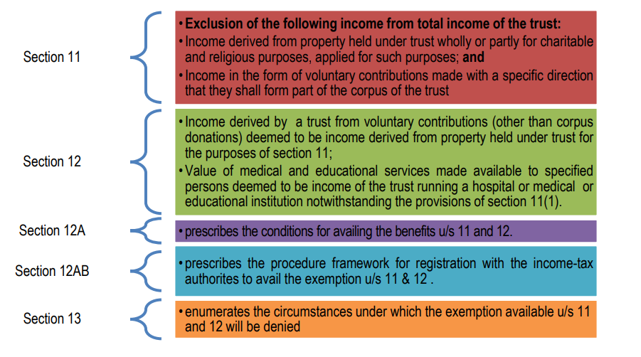

Slide 9
Conditions for availing exemption under First Regime and Second Regime
1. Approval/Registration for claiming exemption.
2. Mandatory filing of return
3. Maintenance of Books of account & Other Documents and Audit of accounts

Slide 10
Mandatory filing of return
In order to avail of exemption under any of these regimes, the entities approved under first regime and entities registered under second regime are required to file the return of income under section 139(4C) or under 139(4A), respectively within the time allowed under section 139(1) [i.e., on or before the due date of filing return of income] or section 139(4) [upto 31st December of the relevant assessment year], if the total income without giving effect to the provisions of
− section 10, in case of first regime approved entities or
− section 11 and 12 in case of second regime approved entities, exceeds the maximum amount which is not chargeable to income-tax.

Slide 11
Maintenance of Books of account & Other Documents and Audit of accounts
With effect from A.Y. 2023-24, where the total income of the trust or institution or fund referred under these two regimes without giving effect to the provisions of section 10(23C)(iv)/(v)(vi)(via) or section 11 and 12, as the case may be exceeds the maximum amount which is not chargeable to income-tax in any previous year, such entities shall
− keep and maintain books of account and other documents in such form and manner and at such place,
− get the accounts audited by a chartered accountant and the report of such audit in the prescribed form duly signed and verified by such accountant and setting forth such prescribed particulars, should be furnished on or before the specified date i.e., one month prior to the due date for filing return of income.

Slide 12
FORM 9A AND FORM 10
Where due to reason that whole or any part of the income has not been received during the year, the amount can be applied in the year of receipt or in the following year. However, intimation in writing must be sent to Assessing Officer (AO) in Form 9A before the expiry of TWO MONTHS from time allowed u/s. 139(1)(31st August) for furnishing the return of income. In case the amount is not applied, it will be deemed to be the income of previous year immediately following year of receipt [Explanation 1 to Section 11(1) & section 11(1B)].
Setting apart of funds with the specific purpose u/s.11(2) – for a period of 5 years:A charitable trust may opt for accumulating its income for a specific purpose to be spent in a period of 5 years. Trust should pass appropriate resolution for accumulation. The purpose of accumulation is to be specified to the Assessing Officer in Form No. 10 along with copy of resolution passed. If accumulated amount could not be applied due to order/ injunction of the court, such period will be excluded.

Slide 13
Examples of Condition - B
Scenario – 1 Income : 1,00,000/- Applied : 85,000/- Deemed apply : Nil |  | Scenario – 2 Income : 1,00,000/- Applied : 65,000/- Deemed apply : Nil |  | Scenario – 3 Income : 1,00,000/- Applied : 60,000/- Deemed apply : 12,000/- |  | Scenario – 4 Income : 1,00,000/- Applied : 60,000/- Deemed apply : 12,000/-
Particulars | Amount | Particulars | Amount | Particulars | Amount | Particulars | Amount
Income | 1,00,000/- | Income | 1,00,000/- | Income | 1,00,000/- | Income | 1,00,000/-
Application | 85,000/- | Application | 65,000/- | Application | 60,000/- | Application | 60,000/-
% applied | 85% | % applied | 65% | % applied | 60% | % applied | 60%
Reserve Accu. | 15,000/- | Reserve Accu. | 15,000/- | Reserve Accu. | 15,000/- | Reserve Accu. | 15,000/-
5 Year Accu. | Nil | 5 Year Accu. | 20,000/- | 5 Year Accu. | 13,000/- | 5 Year Accu. | 13,000/-
Form – 10 | Nil to filed | Form – 10 | Yes, 20,000/- | Form – 10 | Yes, 13,000/- | Form – 10 | Not submitted
Form – 9A | Nil to filed | Form – 9A | Nil to be filed | Form – 9A | Yes, 12,000/- | Form – 9A | Not submitted
Total Income | NIL | Total Income | NIL | Total Income | NIL | Total Income | 25,000/-

Slide 14
SEC 12 AB REGISTERED ENTITIES
01
Register under Income Tax:
To have a control over the trust by income tax department.
03
Need not apply balance 15%,
as it can be reserved without time limit.
05
If income not received or due to other reasons not applied,
Inform this in Form 9A before 139(1)- 2 months prior
Registration
Balance 15%
Deemed apply
Apply 85%
If 85% not applied
02
04
Invest the amount in modes of 11(5);
Inform % not applied to IT using Form 10 before 139(1), 2 months prior, Purpose & period upto 5 yrs.
Spent at least 85% of Income:
Wholly and exclusively for the purpose in India in the same year.

Slide 15

Charitable Purpose - Sec 2(15)
RELIEF OF POOR
MEDICAL RELIEF
PRESERVATION OF
ENVIRONMENT
Any other object of General Public Utility
Add a photo
EDUCATION
YOGA
PRESERVATION OF
MONUMENTS
Any other object of general public utility
It may include any activity in the nature of trade, commerce or business, but:
$) The activity carried out in the course of the charitable purpose other than GPU
$) Receipts from such activity shall not exceed 20% of total receipts.

Slide 16
Overview - Object of general public utility not to comprise receipts from trade, commerce, business etc.
There is no total embargo on commercial receipts. Receipts from these activities up to the following limits are acceptable
  AY 2009-10 to 2011-12: up to Rs. 10 lakhs/year
  AY 2012-13 to 2015-16: up to Rs. 25 lakhs/year
  From AY 2016-17: up to 20% of the total receipts
This embargo does not apply to
  Public religious trusts
  Charitable trusts carrying on the first five limbs of charity as defined in S. 2(15) – Circular 11/2008 dt 19.12.2008
Trade associations carrying out commercial activities will be hit – ACIT vs. Ahmedabad Urban Development Authority (SC) (2022) 143 taxmann.com 278 (SC) 19.10.2022
5

Slide 17
An institution having its main object as “advancement of general public utility” received ` 30 lakhs in aggregate during the P.Y.2023-24 from an activity in the nature of trade. The total receipts of the institution, including donations, was ` 140 lakhs. It applied 85% of its total receipts from such activity during the same year for its main object i.e., advancement of object of general public utility.
(i) What would be the tax consequence of such receipt and application thereof by the institution?
(ii) Would your answer be different if the institution’s total receipts had been ` 150 lakhs (instead of ` 140 lakhs) in aggregate during the P.Y.2023-24?
(iii) What would be your answer if the main object of the institution is “relief of the poor” and the institution receives` 30 lakhs from a trading activity, when its total receipts are ` 140 lakhs and applies 85% of the said receipts for its main object?

Slide 18
(i) As the main object of the institution is “advancement of object of general public utility”, the institution will lose its “charitable” status for the P.Y.2023-24, since it has received ` 30 lakhs from an activity in the nature of trade, which exceeds ` 28 lakhs, being 20% of the total receipts of the institution undertaking that activity for the previous year. The application of 85% of such receipt for its main object during the year would not help in retaining its “charitable” status for that year. The institution will lose its charitable status and consequently, the benefit of exemption of income for the P.Y.2023-24, irrespective of the fact that its approval is not withdrawn or its registration is not cancelled.

Slide 19
(ii) If the total receipt of the institution is ` 150 lakhs, and the institution receives ` 30 lakhs in aggregate from an activity in the nature of trade during the P.Y.2023-24, then it will not lose its “charitable” status since receipt of upto 20% of the total receipts of the institution in a year from such activity is permissible. The institution can claim exemption subject to fulfilment of other conditions under sections 11 to 13. Further, such activity should also be undertaken in the course of actual carrying out of such advancement of any other object of general public utility

Slide 20
(iii) The restriction regarding carrying on a trading activity for a cess, fee or other consideration will not apply if the main object of the institution is “relief of the poor”.
Therefore, receipt of ` 30 lakhs from a trading activity by such an institution will not affect its “charitable” status, even if it exceeds 20% of the total receipts of the institution. The institution can claim exemption subject to fulfilment of other conditions under sections 11 to 13.

Slide 21
Charitable trust engaged in business activity
- Section 11(4A) provides that the exemption under the respective regime, would be available in respect of income, being profits and gains from business activity if –– (a) such business is incidental to the attainment of the objects of the trust/institution; and (b) separate books of account are maintained by such trust/institution in respect of such business

Slide 22
Cases where trust property consists of a business undertaking
Section 11(4) clarifies that for the purposes of section 11, property held under trust may consist of a business undertaking so held. If that be so, the trustees may claim that the income of such undertaking enjoys exemption under section 11. Section 11(4) provides that –
(a) The Assessing Officer shall have the power to determine the income of the undertaking in accordance with the provisions of the Act relating to assessment, and
(b) Where the income determined by the Assessing Officer is in excess of that shown in the books of the undertaking, such excess shall be deemed to be applied to purposes other than charitable or religious purposes.

Slide 23
NSN, a charitable educational trust approved under section 10(23C)(vi), is running a school. It operates a stationery shop outside the school campus. A sum of ` 75 lakhs has been derived as net income from such business activity, which has been applied towards the objectives of the trust in providing education. The trust maintains separate books of accounts for the business activity. Examine the taxability of application of the income, if the income so derived relates to the previous year 2023-24.

Slide 24
The trust objective of providing education is a charitable purpose as per section 2(15). The trust in the given case runs a stationery shop business, whose income is applied towards the objectives of the trust. In this case, the business income from the stationery shop will be eligible to avail exemption in respect of profits and gains of business, if such business is incidental to the attainment of the objectives of the trust and separate books of account are maintained in respect of such business.
Therefore, in the given case, the profit from the business shall be eligible for exemption under section 11, assuming that the said business is incidental to the attainment of the objects of the trust (i.e., education) and books of account for such business activity is maintained separately.

Slide 25
Amounts not treated as application of income or not allowable as deduction
Amount credited or paid out of income of any trust by way of corpus donation not to be considered as application [Explanation 2 to section 11(1)]
Only 85% of the amount credited or paid by way of donation (other than corpus donations) to another trust or institution out of current year income would be considered as application [Explanation 4(iii) to section 11(1)]
Amount credited or paid, out of accumulated income of any trust, to any trust or institution registered under section 12AA/12AB or referred to in section 10(23C)(iv)/(v)/(vi)/ (via), not considered as application of income [Explanation to section 11(2)]
Provisions of sections 40(a)(ia), 40A(3) and 40A(3A) apply in case of application of income by trust [Explanation 3 to section 11(1)]

Slide 26
Corpus donations utilised by fund/trust/institution towards its objects shall not be treated as application of income.
Application out of loan/borrowings not to be treated as application of income.
No set off or deduction allowable of any excess application of earlier previous year [Explanation 5 to section 11(1)]
No deduction for depreciation where cost of asset has been claimed as application of income
Expenditure allowed only on actual payment basis

Slide 27
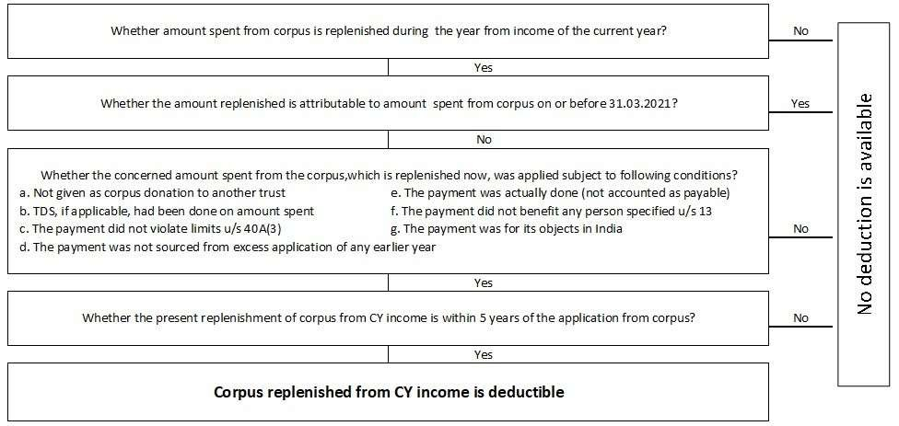

Slide 28
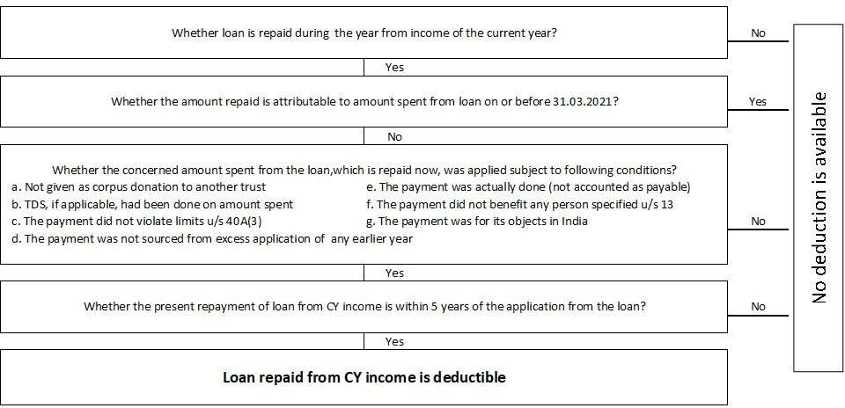
30

Slide 29
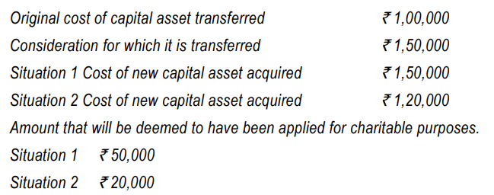
Transfer of a capital asset held under trust wholly for charitable or religious purposes [Section 11(1A)(a)]

Slide 30
Manner of computation of income of a trust violating certain conditions [Sections 13(10) & (11)]

Slide 31
Consequences of failure to comply with stipulated conditions:
With effect from A.Y.2023- 24, if a trust or an institution violates certain stipulated conditions, the income shall be chargeable to tax after allowing deduction for expenditure (other than capital expenditure) incurred in India for the objects of the trust/ institution.
The following are the violations:
- It has receipts from trade, commerce etc. while advancing the object of general public utility, in excess of 20% of total receipt; - It fails to maintain prescribed books of account;
- It fails to get its books of account audited and furnish audit report on or before the specified date;
- It fails to file return of income under section 139(4A) (or 139(4C), as the case may be, for the first regime trust) within the time stipulated under section 139(1) or 139(4).

Slide 32
Conditions to be fulfilled for claim of deduction of revenue expenditure
(a) such expenditure is not from the corpus standing to the credit of the trust or institution as on the end of the financial year immediately preceding the previous year relevant to the assessment year for which income is being computed;
(b) such expenditure is not from any loan or borrowing;
(c) there is no claim of depreciation on those assets, whose acquisition cost has been claimed as application of income in any previous year; and
(d) such expenditure is not in form of any contribution or donation to any person.

Slide 33
Disallowances:
(a) Capital expenditure is not allowed as a deduction.
(b) Disallowance under sections 40(a)(ia), on account of non-deduction of tax or nonpayment of tax deducted at source on or before the due date of filing of return, would be attracted
(c) Disallowance of expenditure in respect of cash payment in excess of `. 10,000 under section 40A(3) and 40A(3A) would be attracted .
(d) no deduction in respect of any expenditure or allowance or set-off of any loss shall be allowed to the assessee under any other provision of this Act.

Slide 34
Taxation of specified income of NPOs chargeable to tax by charitable trusts/institutions [Section 115BBI]
As per section 115BBI specified income of a trust/institution availing exemption under the first regime [section 10(23C)(iv)/(v)/(vi)/(via))] or second regime [Section 11], would be chargeable at the rate of 30%.

Slide 35
“Specified income” means:
(a) income accumulated or set apart in excess of 15% of the income, where such accumulation is not allowed under any specific provision of the Income-tax Act, 1961.
(b) deemed income on account of violation of certain conditions stipulated for accumulation of income under section 11(3) and corresponding provision in section 10(23C).
(c) deemed income on account of violation of deemed application provisions specified under 11(1B) read with Explanation 1 below to section 11(1).
(d) any income which is not exempt under section 10(23C) or section 11 on account of funds of the trust or institution invested otherwise in the forms and modes specified under section 11(5)
(e) any income which is applied for the benefit of any specified prohibited person referred to in section 13(3).
(f) any income derived from a property held under trust for a charitable purpose which tends to promote international welfare in which India is interested to the extent to which such income is not applied towards charitable purposes outside India.

Slide 36
Cancellation of Registration/approval
[Section 12AB(4) & (5)]
The registration can be cancelled in the following situations:
• The PCIT or CIT has noticed the occurrence of one or more specified violations during any previous year; or
• The PCIT or CIT has received a reference from an Assessing Officer under the second proviso to section 143(3) for any previous year to withdraw the approval or registration due to occurrence of a specific violation; or
• The case of the institution has been selected in accordance with risk management strategy, formulated by the CBDT from time to time for any previous year.

Slide 37
Procedure for cancellation
The PCIT or CIT in this regard shall
• call for such documents or information from the trust or institution, or make such inquiry as he thinks necessary in order to satisfy himself about the occurrence or otherwise of any specified violation;
• pass an order in writing, cancelling the registration or approval of such trust or institution, after affording a reasonable opportunity of being heard, for such previous year and all subsequent previous years, if he is satisfied that one or more specified violations have taken place;
• pass an order in writing, refusing to cancel the registration or approval of such trust or institution, if he is not satisfied with the occurrence of one or more specified violations;
• forward a copy of the order cancelling the registration or refusing to cancel the registration to the Assessing Officer and to such trust or institution.

Slide 38
Meaning of Specified Violation:
(a) where any income derived from property held under trust, wholly or in part for charitable or religious purposes, has been applied, other than for the objects of the trust or institution; or
(b) the trust or institution has income from profits and gains of business which is not incidental to the attainment of its objectives or separate books of account are not maintained by such trust or institution in respect of the business which is incidental to the attainment of its objectives; or
(c) the trust or institution has applied any part of its income from the property held under a trust for private religious purposes, which does not enSure for the benefit of the public; or
(d) the trust or institution established for charitable purpose created or established after the commencement of this Act, has applied any part of its income for the benefit of any particular religious community or caste; or

Slide 39
(e) any activity being carried out by the trust or institution— (i) is not genuine; or (ii) is not being carried out in accordance with all or any of the conditions subject to which it was registered; or
(f) the trust or institution has not complied with the requirement of any other law, and the order, direction or decree, by whatever name called, holding that such noncompliance has occurred, has either not been disputed or has attained finality.
(g) the application for approval under first regime or registration under second regime is not complete or it contains false or incorrect information. [This is considered as specified violation w.e.f. 1.4.2023]

Slide 40
Circumstances where levy of tax on accreted income is attracted – 115TD
The accreted income of a specified person shall be taxable at the maximum marginal rate(@34.944%) on
– (1) conversion into a form not eligible for grant of registration under section 12AA or section 12AB or approval under section 10(23C) (iv) /(v)/ (vi)/ (via); or
(2) merger with an entity not having similar objects and registered under section 12AA or section 12AB or approved under section 10(23C) (iv) /(v)/ (vi)/ (via); or
(3) non-distribution of assets on dissolution to any other specified person within a period of 12 months from the end of the month in which the dissolution takes place. This levy of exit tax shall be in addition to income chargeable in the hands of the entity.

Slide 41
Deemed conversion into non-eligible form - Circumstances:
(i) the registration granted to it under section 12AA or section 12AB or approval under section 10(23C) (iv) /(v)/ (vi)/ (via) has been cancelled; or
(ii) it has adopted or undertaken modification of its objects which do not conform to the conditions of registration and,— (a) it has not applied for fresh registration under section 12AA or section 12AB or approval under section 10(23C)(iv) /(v)/ (vi)/ (via) in the said previous year; or (b) it has filed application for fresh registration u/s 12AA or 12AB or approval under section 10(23C) (iv)/(v)/(vi)/(via) but the said application has been rejected; or
(iii) it has failed to make an application for – (a) reapproval/re-registration; or (b) renewal of approval/registration where the period of approval/registration is due to expire; or (c) final approval/registration within the period specified under clause (i)/(ii)/(iii) of the first proviso to section 10(23C) or clause (i)/(ii)/(iii) of section 12A(1)(ac), as the case may be, which expires in the said previous year.

Slide 42
Meaning of Accreted Income:
Aggregate FMV of total assets of the specified person as on the specified date
Less
Total liability of the specified person computed in accordance with the prescribed method of valuation [See Method of Valuation prescribed by CBDT given in pages 10.77 to 10.81]

Slide 43
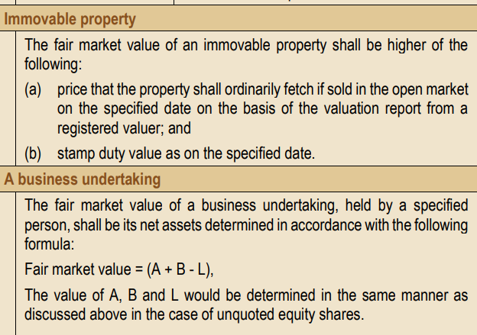

Slide 44
FA 2022: – Penalty for
of excessive
specified persons - Section 271 AAE
A trust/institution will be liable to penalty for diversion of income/provision of excessive benefits to trustees/ other specified persons.
The penalty will be equal to 100 percent of the amount diverted in case of the first instance and will go up to 200 percent of the amount diverted in case of violations in subsequent years.
This penalty will be in addition to any other penalties that may be levied under the existing law.

Slide 45
Overview – Anonymous Donations (S. 115 BBC)
Donation where donor’s identity is unknown (be careful with UPI and imps fund transfers)
Not taxable in the case of religious trusts and religious and charitable trusts receiving anonymous donations for religious purposes.
For others anonymous donations are taxable at 30% + SC + Cess
Threshold limit – Rs. 1,00,000 or 5% of total donations, whichever is higher
10

Slide 46
Circular No. 6 / 2023 dated 24.05.2023
Re-registration of trusts registered under the old regime – i.e. Form 10 A cases –
  Original due date 30.06.2021
  Extended to 31.08.2021 (C.12/2021 – 25.06.21)
  Extended to 31.03.2022 (C.16/2021 – 29.08.21)
  Extended to 25.11.2022 (C.22/2022 – 01.11.22)
  Now extended to 30.09.2023
Conversion of provisional registration to regular registration – Form 10AB cases –
  Original due date 31.03.2022
  Extended to 30.09.2022 (C.8/2022 – 31.03.22)
  Now extended to 30.09.2023
Consequent relief also provided to those who missed the deadline

Slide 47
Circular No. 6 / 2023 dated 24.05.2023 (contd…)
Accumulation – filing of Form 10 (s. 11 (2)) or Form 9A (Expln to S. 11(1)) – FA 2023 – due date is 2 months prior to ITR due date u.s. 139(1)
It is now clarified that accumulation / deemed application shall not be denied so long as Form 10 or Form 9A, as the case may be, is furnished on or before the ITR due date u.s. 139(1) – The clarification is not year specific

Slide 48
Circular No. 6 / 2023 dated 24.05.2023 (contd…)
Form 10 B / Form 10 BB require application of
income / payments to be reported as
‘by electronic modes’ and ‘other modes’. It is
clarified that electronic modes referred to in the form are in addition to account payee cheque / draft / ECS
Form 10 BD – statement of donations u.s. 80 G
– Form 10 BE certificate of said donation – cut off date is 31st May of subsequent year – For FY 2022-23, the due date is extended to 30.06.2023

Slide 49
Overview - Pitfalls
Religious trust can do charity but a charitable trust cannot pursue religious objects – Charitable trust having mixed objects – very dangerous scenario
Problem situations – Charitable trust with religious objects, public religious trusts with private religious objects, benefits given to specified persons, trust property misused, amounts not invested in specified mode, problems in accounts, audit, Violation of other allied laws, ITR / TAR non filing etc. – Can lead to cancellation of registration and accreted tax.
Denial of exemption vs. cancellation of regn
49

Slide 50
Secundrabad Club vs CIT (Supreme court)
Issue: Whether money received for club from members(individual corporate) would be taxable and if money is invested in fixed deposit would concept of doctrine of mutuality would apply?
Facts: The assessee is a club which has received money from members but invested in fixed deposit and money collected were not merely used for members but even some commercial substance was involved. Provision: As per Act the principle of mutuality applies only if fund are utilised for the purpose meant. If used for commercial activities the doctrine of mutuality ceases.

Slide 51
Conclusion:
It was held in Supreme court that by depositing funds in bank the first condition for the claim of mutuality is not satisfied”; SC states that when funds are deposited with banks, identicality between the contributors to the common fund and the participators in it which is a sine qua non for the application of the principle of mutuality would get ruptured, hence interest income is taxable. This ruling distinguishes from other club ruling but the litigation in the other cases were different. I would like to add upon that if only money is received from Members and utilised for purpose of club or say a room rent given on rent and money received is utilised only for the same then principle of mutuality hold good.

Slide 52
ACIT vs M/S Financial Inclusion trust (Delhi ITAT)
Issue: Whether corpus specific contribution by way of capital receipt is taxable.
Facts: Assessee, an unregistered trust under Section 12AA received Rs.44.25 Cr towards corpus donation grant from Bandhan-Konnagar trust (donor trust) being registered under Section 12A and declared it as ‘capital receipt’ in the return of income; Revenue treated the corpus donation grant as income of the Assessee on the premise that Assessee is not eligible for exemption under Section 11(1)(d) since it is not registered under Section 12A; CIT(A) allowed. Provision: Only a trust registered under 12A for which corpus donation is taxable for those otherwise not registered under 12A the corpus donation happens to be not taxable.

Slide 53
Conclusion:
Corpus specific voluntary contributions are outside the scope of taxation in case of an unregistered Trust under Section 12 or 12A since their nature is capital; Accordingly, upholds CIT(A) and dismisses Revenue’s appeal.

Slide 54
ACIT (Exemptions) v. Ahmedabad Urban Development Authority (and other appeals) (2022) 449 ITR 1 (SC)
When can an activity be considered as trade, commerce or business for attracting the provisions of the proviso to section 2(15)?

Slide 55
Conclusion:
The conclusions arrived at by way of this judgment, neither precludes any assessee (whether statutory or non-statutory) advancing objects of general public utility, from claiming exemption, nor the taxing authorities from denying exemption, in the future, if the receipts of the relevant year exceed the quantitative limit. The assessing authorities must on a yearly basis, scrutinize the record to discern whether the nature of the assessee's activities amount to "trade, commerce or business" based on its receipts and income (i. e., whether the amounts charged are on cost-basis, or significantly higher). If it is found that they are in the nature of "trade, commerce or business", then it must be examined whether the quantified limit (as amended from time to time) in proviso to section 2(15), has been breached, thus disentitling them to exemption.

Slide 56
CIT v. St. Peter’s Educational Society (2016) 385 ITR 66 (SC)
Would imparting education/training in specialized field like communication, advertising etc. and awarding diplomas/ certificates constitute an “educational purpose” for grant of exemption u/s 10(23C)(vi)?

Slide 57
DECISION:
Institutions engaged in providing specialized training in certain fields and awarding diplomas and certificates are also eligible for tax exemption in terms of section 10(23C)(vi). It is not mandatory for such institutions to impart education in formalized manner or conduct only recognized educational courses. Further, when corporates depute employees for gaining specialized knowledge, such imparting of knowledge by the institution would not mean that the institution is engaged in the activity of general public. Making of profit incidentally will not make the institution as existing for making profit.

Slide 58
THANK YOU

