Slide 1
INCOME TAX RETURN FILING AND
SUMMARY ASSESMENT – 143(1)
including procedure in e-filing response to notice u/s 139(9)
(DEFECTIVE RETURN)

Slide 2

WHAT IS AN INCOME TAX RETURN?
A tax return is a documentation filed with a tax authority that reports income, expenses, and other relevant financial information.

Slide 3
ITR Filing Procedures- Sec 139
Section 139 consists of various subsections which deals with different types of Income tax returns. These subsections are as follows:
Section 139(1) – Mandatory and Voluntary Returns
Section 139(1) deals with the mandatory and voluntary filing of income tax returns by the taxpayer:
Mandatory Return
The following taxpayers are required to file a mandatory income tax return are listed below:
Any private, public, foreign, domestic company.
Any Limited Liability Partnership (LLP) and unlimited liability partnership.
Any total individual income is exceeding the exemption limit.

Slide 4
ITR Filing- Sec 139
Voluntary Return
If the filing of income tax return is not mandatory for an individual, then the income tax filed by that individual will be termed as a voluntary return. Voluntary returns are also considered as valid returns of income tax.
Note: Under Section 139(1c), certain people are exempt from filing income tax. If these classes of people fulfil the prescribed conditions, the central government is empowered to grant them tax exemption.

Slide 5
ITR Filing- Sec 139
Section 139(3) – Filing Income Tax Return in Case of Loss
Section 139(3) deal with tax returns in case of loss incurred in a company or firm.
If losses are incurred in any income under the head “Profits and Gains of Business and Profession” or the head “Capital Gains”, then income tax return must be filed before the due date mentioned under section 139(1).
The following heads mentioned below will not be affected by the delayed filing of income tax return:
Any loss occurred under the heads of “House and residential property”.
Any loss occurred by the unabsorbed property as mentioned under section 139(3).

Slide 6
ITR Filing- Sec 139
Section 139(4) – Late Filing Income Tax Return
Section 139(4) deals with late filing of income tax return. Its provisions have been described below:
The taxpayer can file late income tax returns before end of the 31ST DECEMBER OF Assessment year or completion of Assessment u/s144.
The tax payer with late filing of income tax returns may incur a fee of Rs 5,000 as specified under Section 234F upto Dec and Rs10000 after Dec’21 ( maximum Rs.1000 for total Income below Rs.5.00 lakh).
However, no penalty shall be levied on returns that were not required to be mandatorily filed as per Section 139(1).

Slide 7
ITR Filing- Sec 139
Section 139(5) – Revised Return
Section 139(5) deals with revised income tax return in case of any mistakes while filing the original income tax returns. The following are its provisions:
If the original or initial income tax return was filed by the assessee or entity as per Section 139(1) , he/she can file a revised income tax return before end of the 31ST DECEMBER OF Assessment year of relevance or prior to the completion or conclusion of assessment, depending on which takes place sooner.
A late income tax return cannot be revised. However, any loss return that was filed within the prescribed due date as mentioned in Section 139(1) can be revised.

Slide 8
ITR Filing- Sec 139
Section 139(4a) – Income Tax Return of Charitable and Religious Trust
Any individual whose income received from the property occupied by a public charity or religious trust and claims tax exemptions under Section 11 and Section 12 of the Income Tax Act are compulsorily required to file their tax returns, provided that the sum of the income collected prior to the provisions under section 11 and Section 12 is beyond the basic limit allowed for exemption.

Slide 9
ITR Filing- Sec 139
Section 139(4B) – Return of Income of a Political Party
Any political party will be required to mandatory file its tax returns provided that the sum of the income collected by the party is beyond the basic limit allowed for exemption without taking into consideration any benefits mentioned under section 13A.

Slide 10
ITR Filing- Sec 139
Section 139(4C) and (4D)- Claiming Exemption under Section 10
Section 139(4C) and Section 139(4D) deals with specific institutions who claim privileges as per the provision of Section 10 of the Income Tax Act 1961.
These sections state that an institution is mandatorily required to file its income tax returns provided that the sum of the income collected by the institution in question is beyond the basic limit allowed for exemption, without taking into consideration any other exemption benefits.

Slide 11
ITR Filing- Sec 139
Section 139(9) – Defective Returns
As per the provisions under section 139(9), income tax return is defective when specific documents are not attached with the income tax return. In case the return is considered defective by the tax officer, then the concerned tax payer will be informed by him and be allowed to rectify the defect within 15 days starting from the day of intimation.
In the request from tax payer through an application, the allowable period could be extended. The assessing officer intimates the tax payer about the defect through a simple letter.

Slide 12
ITR Filing- Sec 139
Due Dates for Filing Return
Section 139 contains various sub-sections that deal with different kinds of returns filed by different individuals related to late payments and mistakes. Hence, the due dates for filing their income tax returns are prescribed below:
July 31st
Any individuals who do not need an audit to be conducted for their books of account are required to file income tax returns by July 31, of every assessment year. This includes the following individuals are specified below:
A person or employee who is paid with a wage.
Any self-employed individual.
Any consultant or freelancer.

Slide 13
ITR Filing- Sec 139
OCTOBER 31ST
All individuals who require an audit for their books of account must file their tax returns on OCTOBER 31ST of each assessment year.
The following individuals might come under this category:
A business entity.
A self-employed person or professional.
A working partner employed with a firm or a consultant who requires to have an audit performed on his accounting book.

Slide 14
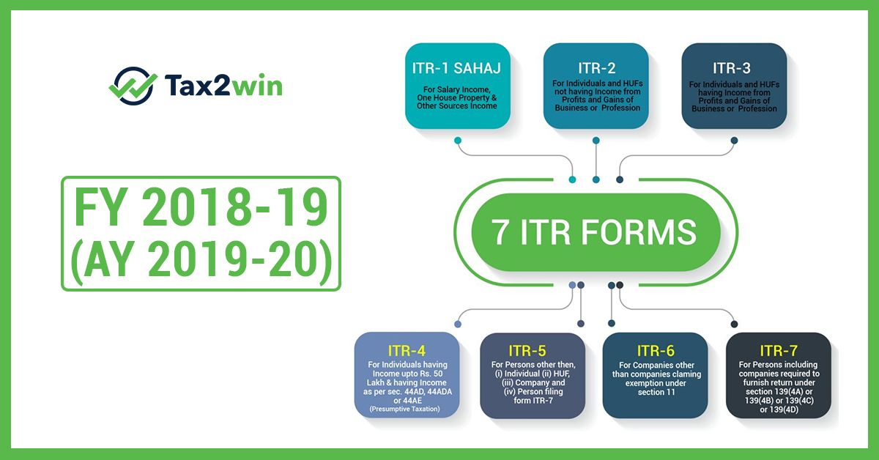
TYPES OF ITR FORMS

Slide 15
INCOME TAX RETURNS
ITR 1 (SAHAJ)
For Individuals having Income from Salaries, one house property (does not have any brought forward loss), other sources [Interest (does not have any loss under the head) etc. but except winnings from lottery or income from race horses] and having total income upto ` 50 lakh. However, the form is not to be used for an individual who is either Director in a company or has invested in unlisted equity shares or has any brought forward / carry forward loss under the head ‘Income from House Property’ or has to furnish return under seventh proviso to section 139(1) of the Income Tax Act
ITR 2
ITR 3
For Individuals and HUFs not carrying out business or profession under any proprietorship
ITR 4 (Sugam)
For Individuals and HUFs having income from a proprietary business or profession
For presumptive income from Business & Profession However, the form is not to be used for an individual who is either Director in a company or has invested in unlisted equity shares or has any brought forward / carry forward loss under the head ‘Income from House Property’

Slide 16
ITR 5
For person other than (i) Individual; (ii) HUF; (iii) Company; & (iv) Person filing Form ITR-7
ITR 6
For Companies other than companies claiming exemption u/s 11
ITR 7
For persons including companies required to furnish return u/s 139(4A) or 139(4B) or 139(4C) or139(4D) or 139(4F)
ITR- V
Income Tax Return Verification Form [Where the data of the aforesaid Return of Income has transmitted electronically without digital signature]

Slide 17
COMPULSORY FILING OF RETURN
Any person, being resident other than not ordinarily resident, shall furnish, a return, within due date, in respect of his income or loss for the previous year irrespective of the fact that his total income does not exceed basic exemption limit or does not have any taxable income, if he:
a) holds, as a beneficial owner or otherwise, any asset (including any financial interest in any entity) located outside India or has signing authority in any account located outside India; or
b) is a beneficiary of any asset (including any financial interest in any entity) located outside India.
Exception: An individual, being a beneficiary of any asset (including any financial interest in any entity) located outside India where, income, if any, arising from such asset is includible in the income of the person referred above in accordance with the provisions of this Act.

Slide 18
MANDATORY FURNISHING OF RETURN IN CASE OF HIGH VALUE TRANSACTIONS
A person (other than firm and company), who is not required to furnish a return as per aforesaid provision, and who during the previous year
1
Has deposited an aggregate amount exceeding Rs.1 crore in one or more current accounts maintained with a banking company or a co-operative bank : or
2
3
4
Has incurred expenditure of an aggregate amounts exceeding Rs.2 lakh for himself or any other person for foreign travel to a foreign country: or
Has incurred expenditure of an aggregate amount exceeding Rs. 1 lakh towards consumption of electricity; or
Fulfills such other conditions as may be prescribed,
shall furnish a return of his income on or before the due date in such form and verified in such manner and setting forth such other particulars, as may be prescribed.

Slide 19
HOW TO FILE ITR FORMS USING OFFLINE UTILITY?
ITR Form can be filed with the Income-tax Department electronically on the e-filing web portal of Income-tax Department
Below are the steps to follow for downloading ITRS:-
STEP 1: Visit--https://www.incometaxindiaefiling.gov.in/home

Slide 20
STEP 2:From the menu bar select “Downloads”; then go to “Offline Utilities” and select “Income Tax Return Preparation Utilities”.
STEP 3: Select your Assessment Year, i.e. 2021-22.
STEP 4: Depending on your income type, choose the right ITR form for IT returns filing. You will find ITR forms in both Java and Excel formats. Depending on your choice, select the right file type. Click on “Download Link” found under the Java or Excel formats.

Slide 21
STEP 5: The ITR return file will get downloaded in the ZIP file format. Extract the file at a relevant location in your computer.
For Excel File - Click ‘Import Personal / Tax Details from XML’, located at right side of the ‘Income Details’ tab. The side buttons (like validate, Next, Calculate Tax, etc.) of the excel file will work only if ‘Macros’ and ‘ActiveX’ function of the Excel workbook is enabled
STEP 6 : Attach the ‘Pre-filled XML’ file which has been downloaded

Slide 22
Login to ‘e-Filing’ Portal
Go to the ‘My Account’ menu located at upper-left side of the page -> Click ‘Download Pre-filled XML’
Select the ‘Assessment Year’ and ‘ITR Form Name’ from the dropdown list
Click ‘Continue’ ` Choose the type of details ` Click ‘Confirm’ ` Click ‘Download XML’
STEP 7: Attach the downloaded ‘Pre-fill XML’ file to populate the relevant details.

Slide 23
STEP 8: Enter all the Mandatory Fields ` Validate all the sheets`
STEP 9 : Calculate all the taxes and confirm all the pages.
STEP 10 : Then, click on “Generate XML”.

Slide 24
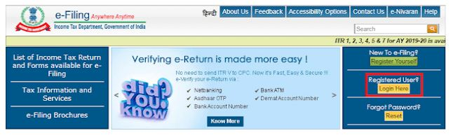
STEP 11 : Then, click on “Save XML” and save the file at the desired drive.
STEP 12 : Once you have calculated and filled in all the information correctly, log on to “www.incometaxindiaefiling.gov.in” once again.

Slide 25
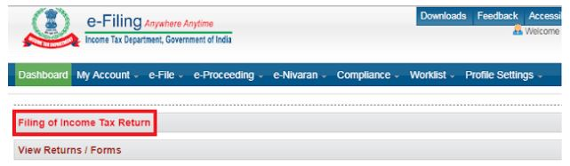
STEP 13 : Go to “E-file” select “Income Tax Return” or select the option “Filing of Income Tax Return” for income tax return filing online.
STEP 14 : Select “Assessment Year”.

Slide 26
STEP 15 : Select “ITR Form Name”.
STEP 16 : Then in “Submission Mode”, select “Upload XML”.
STEP 17 : Under the drop-down, select any one of the options and verify the returns.

Slide 27
Choose any one of the following option to verify the Income Tax Return:
• Digital Signature Certificate (DSC).
If you do not have DSC
• Aadhaar OTP
• EVC using Prevalidate Bank Account Details
• EVC using Prevalidate Demat Account Details
• Already generated EVC through My Account ` Generate EVC Option or Bank ATM. Validity of such EVC is 72 hours from the time of generation
• Don’t Want to e-verify this Income Tax Return and would like to send signed ITR-V to Bengaluru

Slide 28
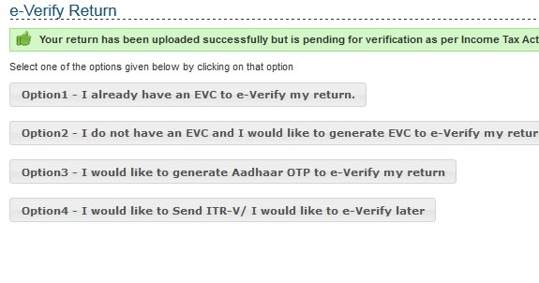
STEP 18 : Click on “Continue”
STEP 19 : Then attach the duly filled XML file

Slide 29
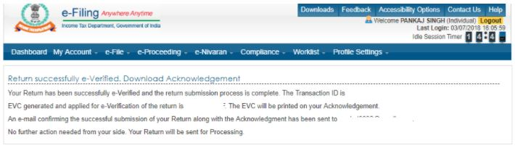
STEP 20 :Taxpayer will get an option to enter OTP for e-verifying the ITR, if an EVC or Aadhaar OTP option is chosen. Or To attach DSC, if DSC option is chosen to e-verify the ITR
STEP 21 :After successful submission, ITD will process your ITR and send an email confirmation stating the same

Slide 30
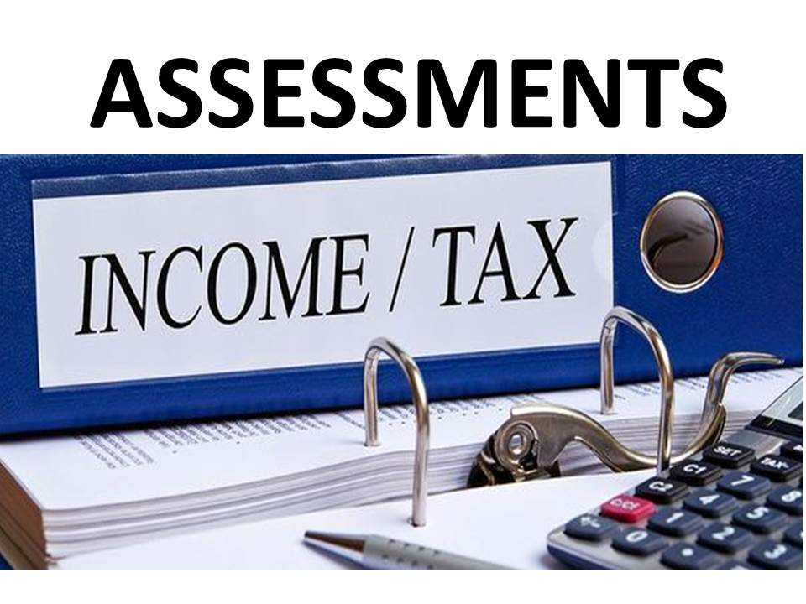

Slide 31
TYPES OF ASSESMENTS
Self Assessment
Summary Assessment
Regular Assessment
Best Judgement Assessment
Income Escaping Assessment

Slide 32
Summary Assessment
It is a type of assessment carried out without any human intervention. In this type of assessment, the information submitted by the assessee in his return of income is cross-checked against the information that the income tax department has access to. In the process, the reasonableness and correctness of the return are verified by the department.
The return gets processed online, and adjustment for arithmetical errors, incorrect claims, and disallowances are automatically done. Example, credit for TDS claimed by the taxpayer is found to be higher than what is available against his PAN as per department records. Making an adjustment in this regard can increase the tax liability of the taxpayer. After making the aforementioned adjustments, if the assessee is required to pay tax, he will be sent an intimation under Section 143(1). The assessee must respond to this intimation accordingly.

Slide 33
In this type of assessment, the information submitted by the assessee in his return of income is cross-checked against the information that the income tax department has access to.
It is a type of assessment carried out without any human intervention
If there arises tax liability/Refund on summary assessment an intimation U/s 143(1) will be sent to assessee through e-mail. These intimation should be treated as Demand Notice U/s 156(1) or refund order. No separate demand notice will be issued.
The acknowledgement of return shall be deemed to be the intimation in a case where no sum is payable by, or refundable to, the assessee and where no adjustment is required.
Time limit- Within 6 months from the end of the financial year in which return of income was filed.

Slide 34
Notice for defective return u/s 139(9)

Slide 35
Common errors that can make your return “defective”?
Not filling the annexure, statements and columns in the income tax return that must be duly filled wherever required. For example, while claiming deduction u/s 80G, the details in its schedule is not filled or wrongly filled.
Tax together with interest, if any is paid before filing the return and all the details relating to it is not filled. For example, BSR code, Date of challan should be correctly filled.
Tax actually paid does not match with the tax payable in the income tax return or taxes are not paid in full.
While filing ITR 4, total presumptive income is shown less than 8% or 6 %of gross turnover or receipts as the case may be then in that case ITR 3 should have been filed.
The Gross receipts is not mentioned in the Profit & Loss A/c Or the Gross receipt or income u/s 44AD is shown more than Rs. 2 Crore in ITR 4.
If you have filed your return u/s 44ADA with the gross receipt more than 50 Lakhs without Balance sheet and Profit & Loss, then notice will be received for filing ITR-3 with audited B/s and P&L Statement.

Slide 36
CONTD....
Where you’re required to maintain regular books of account such as Balance Sheet and Profit and Loss statement, but they have not been filled in the return while filing it.
Tax deducted has been claimed as a refund, but no income details are provided in the return.
No income details has been provided in ITR but details regarding taxes paid have been provided.
Gross income as referred to in 26AS has not been considered in the respective heads of ITR.
When the books of accounts have been audited but a copy of audit report and audited financial statements have not been filled in the return while filing it.
Name mismatch between PAN and Income Tax Return.

Slide 37
THINGS TO BE DONE
Once you’ve been served with notice of defective return u/s 139(9), then you must correct your return by revising it within 15 days from the receipt of notice by the Income Tax Department. You can also apply for extension by writing an application to the Assessing Officer (A.O.) requesting an extension of the deadline of filing a revised return. Practically, it is seen that even a taxpayer rectifies the defect after the expiry of fifteen days but before the assessment is made, the Assessing Officer may condone the delay and treat the return as a valid return.

Slide 38
NO RESPONSE
Your defective return will be treated as a non-filed or invalid return. This means the Income Tax Department will consider as if you’ve not filed a return for the year. Consequently, your refund will also be not processed by the Income Tax Department, if any.

Slide 39
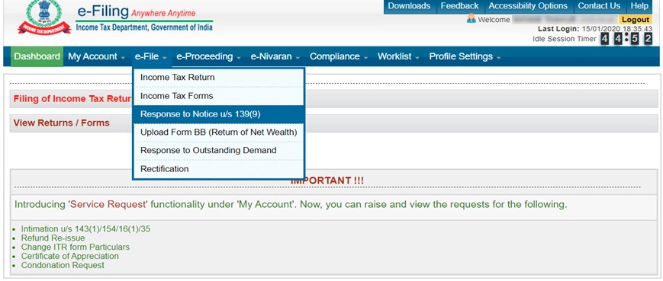
How to give a response to the Notice ?
Step 1: Login to www.incometaxindiaefiling.gov.in with your user ID [PAN] and Password.
Step 2: Click on tab “e-file” and in the drop-down select “e-File in Response to notice u/s 139(9)”.

Slide 40
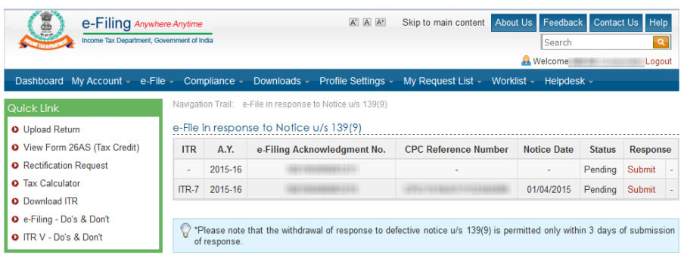
Step 3: On successful validation, you’ll find notice for defective return u/s 139(9) if any issued to you.

Slide 41
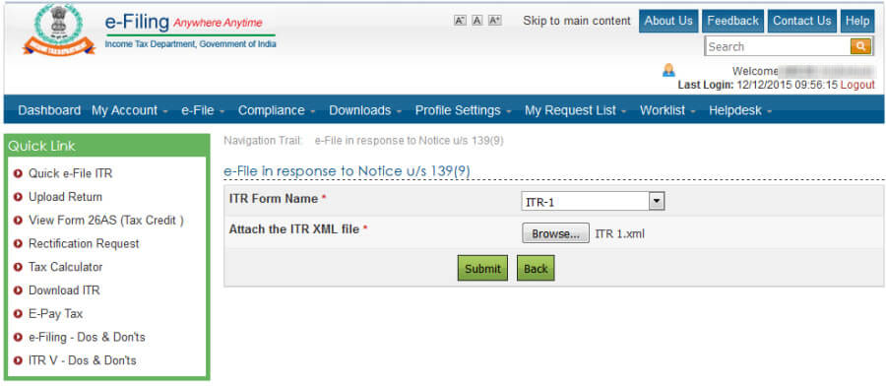
Step 4:In case, defective notice is raised by an Assessing Officer
Click on submit and you’ll see the below image if defective notice is raised by Assessing Officer (A.O.):

Slide 42
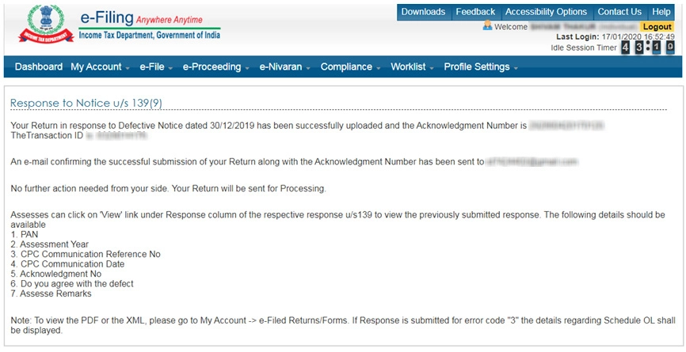
Step 5: Now fill your Income Tax Return by rectifying the defect by selecting “Return u/s 139(9) and mention date of original return and acknowledgement number. Once you do that then generate its xml file and upload it in the above screen. After that you’ll see the following message and your work is done.

Slide 43
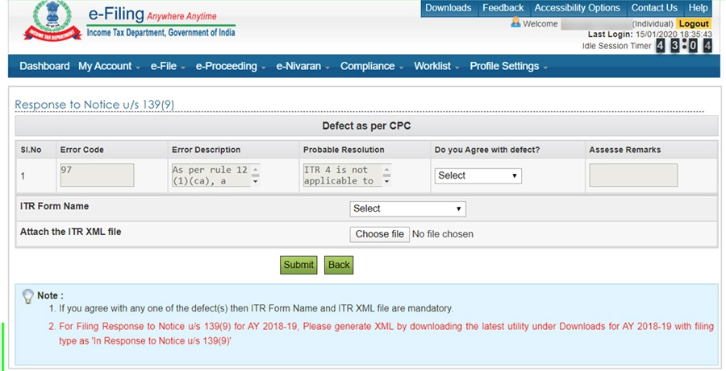
Step 6:In case, defective notice is raised by CPCFor defective notice raised by CPC, the below screen will be displayed:

Slide 44
Step 7:Now if you agree with the defect then just fill your Income Tax Return by rectifying the defect by selecting “Return u/s 139(9) and mention date of original return and acknowledgement number. Once you do that then generate its xml file and upload it in the above screen. After that you’ll see the screen below:

Slide 45
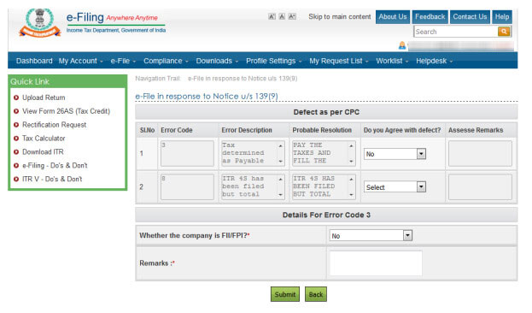
Step 8: But if you do not agree with the defect then select “No” and give “Assessee Remarks” and click submit. After that Income Tax Department, shall take follow up regarding it.

Slide 46
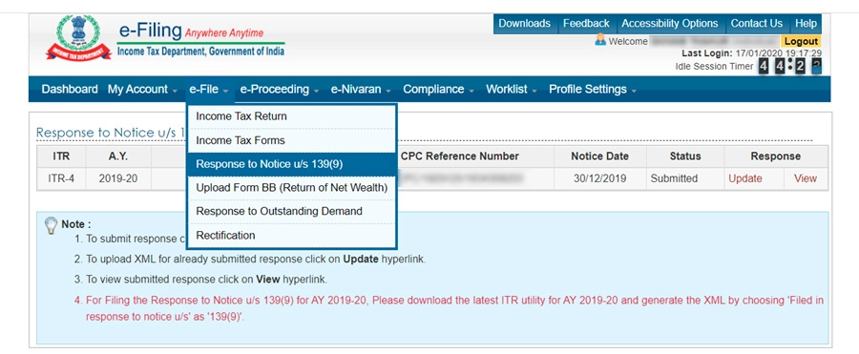
If selected the wrong ITR Form & also want to make some changes in XML. Can I update the responses submitted?You can update the response submitted by you by clicking on update link under Response to Notice u/s 139(9) as given below :
Step 1 : Click on tab “e-file” and in the drop-down select “Response to notice u/s 139(9)”

Slide 47
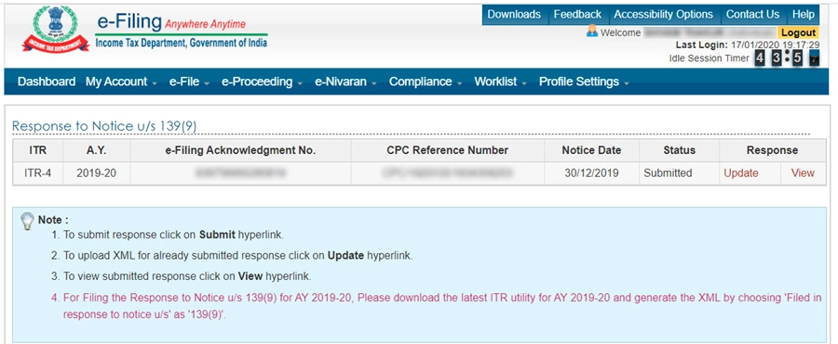
Step 2 : Click on update link

Slide 48
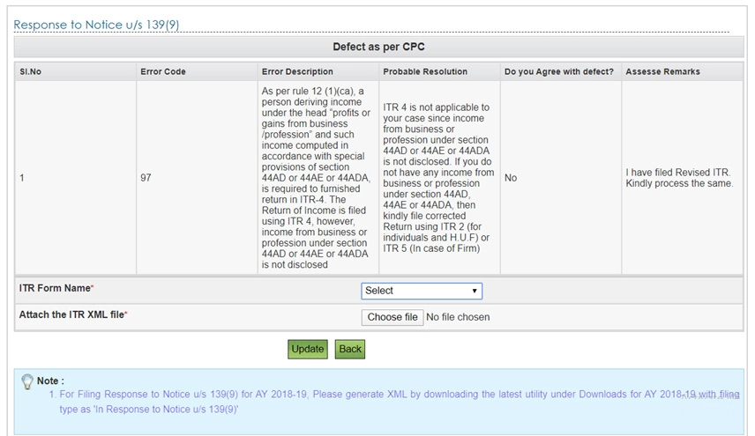
Step 3 : Select correct ITR Form & attach XML and click on update

Slide 49
Withdrawing the response made to defective notice u/s 139(9)?
Earlier it was possible to withdraw your response submitted to defective return notice under section 139(9). But this functionality is no more available. Hence, now you cannot withdraw the response made, instead you can update or view the same.

