Slide 1
GST: Annual Return 9 & 9A
CA Unnikrishnan M

Slide 2
Returns- Rectifications & Reconciliation
No Concept of Return Revision.
Corrections can be made by resorting to guidelines prescribed in Circular 26/2017

Slide 3
Circular 26/2017
Para 4
Form 3B doesn’t contain provision for reporting differential figures for past (months)
Said differences may be reported on net basis along with current month itself
Tax adjustment remaining for adjustment, may be adjusted in subsequent month(s).
If not feasible, claim refund.
Corresponding adjustments in GSTR-1 should also preferably be made in the corresponding months

Slide 4
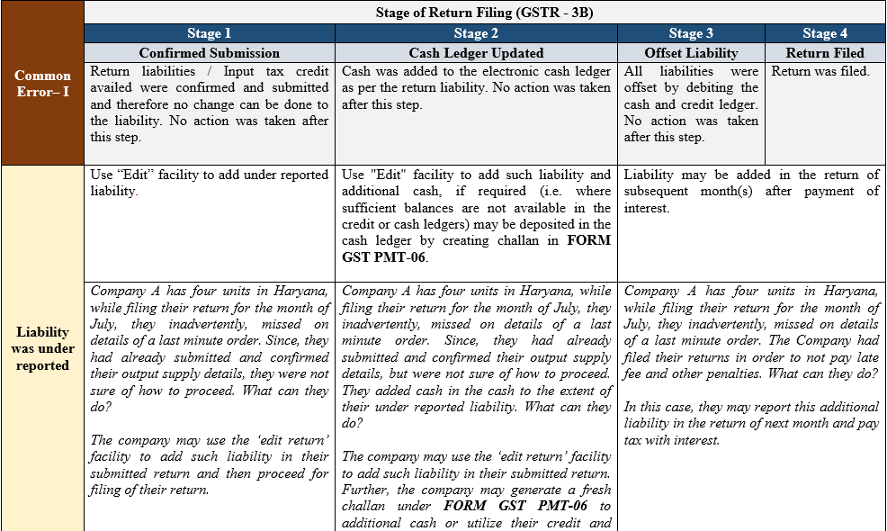
Common Errors 3B –Liability under reported

Slide 5
Common Errors 3B – Liability over reported

Slide 6
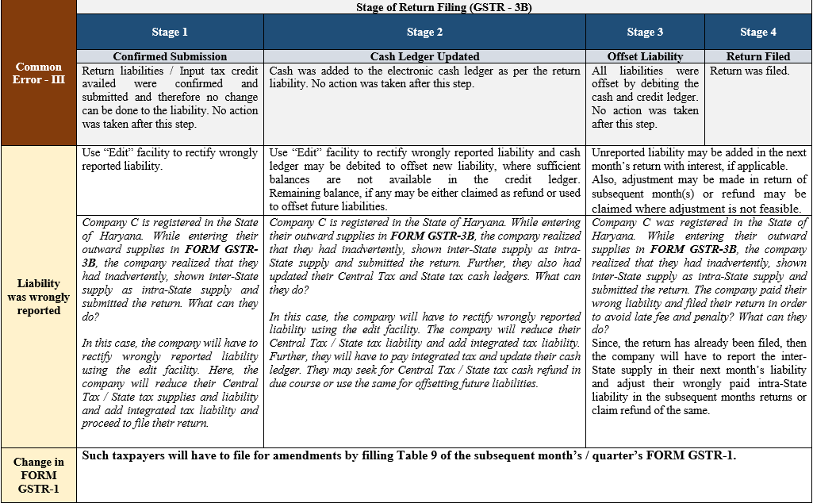
Common Errors 3B – Liability wrongly reported

Slide 7
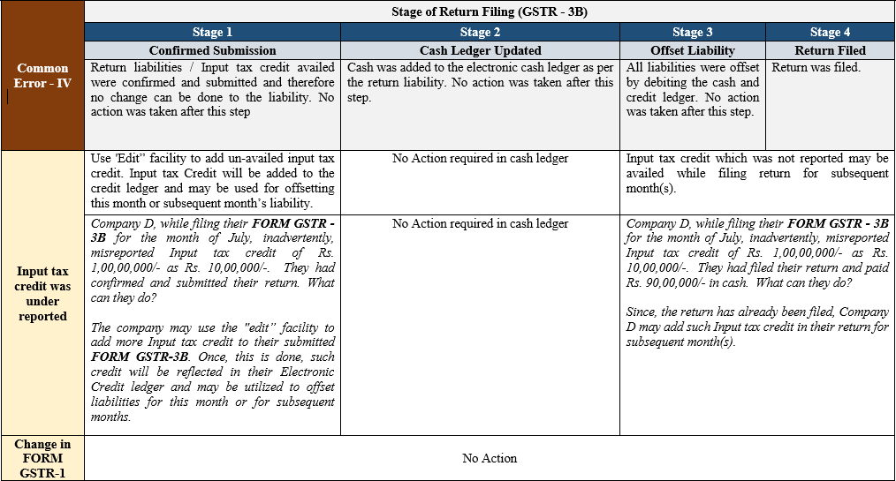
Common Errors 3B – ITC under reported

Slide 8
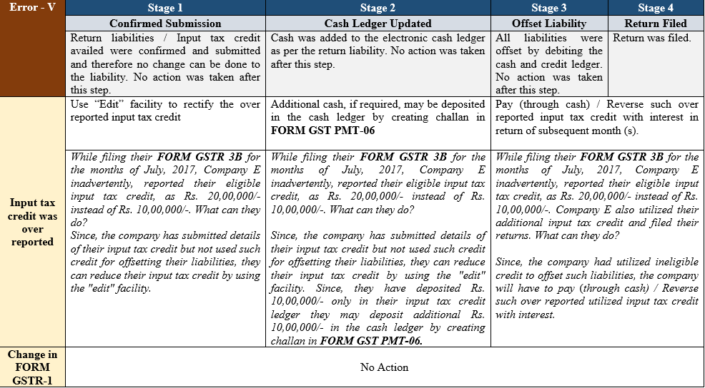
Common Errors 3B – ITC over reported

Slide 9
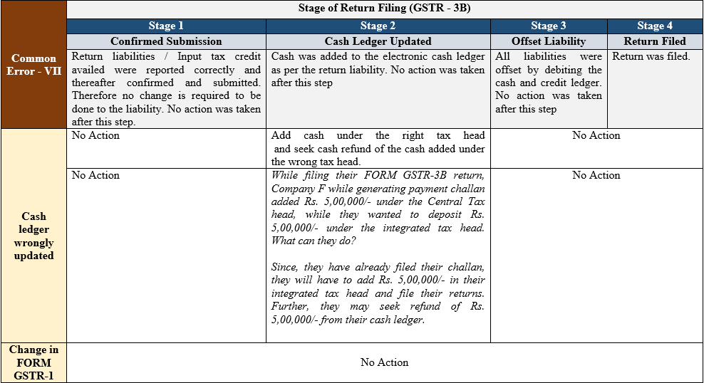
Common Errors 3B – ITC wrongly reported

Slide 10
Annual Return and GST Audit
Annual return is to be filed for every financial year or before 31st December following the end of each financial year
R.P having t/o exceeding prescribed limit ( presently 2 crore ) shall file copy of audited annual accounts and RECONCILIATION statement, reconciling the value of supplies declared in the return.

Slide 11
Applicability
Section 44(1):- Every registered person other than
ISD
TDS/TCS deductor.
CTP
NRPT
Shall furnish on Annual Return for every FY on or before the 31st December following end of the F.Y
Section 44(2):-
IF audit is required u/s 35(5) , copy of audit report + reconciliation statement in 9C is to be furnished

Slide 12
Annual Return- Extensions
Notification 39/2018 dated 04-09-2018 prescribed Form 9 and 9A to be filed by 31-12-2018 for FY 2017-18.
ROD Order 1/2018 dated 11-12-2018 extended due date from 31-12-2018 to 31-03-2019.
GST Council in 31st Council meeting dated 22-12-2018 recommended to extend date to 30-06-2019.
ROD Order 3/2018 dated 31-12-2018 extended date to 30-06-2019.

Slide 13
Annual Return- Changes
31st Council meeting recommendation made to bring about changes to notified Annual Return formats
New Annual return formats notified vide N.N 74/2018 dated 31-12-2018
“DECLARED in returns filed during year” substituted with “MADE during the year”.

Slide 14
Annual Return-Types
Rule 80:-
GSTR – 9 – Normal Regd.Persons u/s 44(1)
GSTR – 9A – Composition opted persons
GSTR- 9B ECO required to collect TCS
GSTR – 9C – Recon statement + Audit report by CA/CMA in case turnover exceeds prescribed limit of 2 crores

Slide 15
Annual Return- GSTR 9
Part I – Basic Details
Item 1- Financial Year
Item 2- GSTIN
Item 3A- Legal Name
Item 3B- Trade Name (if any)

Slide 16
Basic Details- Points
As indicated in Part 1, Annual return is a return pertaining to EACH GSTIN.
All assessees , except the excluded categories, must file Annual Return
Same assessee having multiple GSTIN, having multiple state registrations; provisions of law mandate that each GSTIN be considered separately and individual Annual return for each GSTIN to be filed.

Slide 17
Part II- Details of Outward &Inward supplies made during the FY
As per changes implemented in Notfn 74/2018 dated 31.12.2018
Item 4 – Details of advances, inward and outward supplies made during the FY on which tax is payable
Divided into14 sub headings

Slide 18
Item 4A –B2C supplies
Instructions
Aggregate value of supplies made to consumers & unregistered persons on which tax has been paid
Includes supplies through ECO.
Value to be declared NET of Dr/Cr notes.
Source data- GSTR-1 Tables 5,7,9 & 10.
Excludes Advances received.

Slide 19
Item 4A- Source data
GSTR-1 (including amendments from table 9&10).
Table 5A- Inter-state B2CL>2.5 L through ECO.
Table 5B- Inter-state B2CL>2.5L others.
Table 7A –Rate wise consolidated Intra- state supplies including through ECO.
Table 7B-Interstate <2.5L POS (State) wise including through ECO.

Slide 20
Item 4B-B2B Supplies
Instruction
Aggregate value of supplies to Registered Persons including UIN holders on which tax has been paid
Includes supplies made through ECO
Excludes supplies on which tax is to be paid by recipient of supply; RCM cases
Dr/Cr to be mentioned seperately and not to be netted of in 4B

Slide 21
Item 4B-B2B Supplies
Instruction
Aggregate value of supplies to Registered Persons including UIN holders on which tax has been paid.
Includes supplies made through ECO
Excludes supplies on which tax is to be paid by recipient of supply; RCM cases
Dr/Cr to be mentioned separately and not to be netted of in 4B

Slide 22
Item 4C- Export on payment of tax

Slide 23
Item 4C- Export on payment of tax
Instructions-
Only ACTUAL Export of G/S/B
Dr/Cr notes to be included separately.
Source data - Table 6A of GSTR-1
Inv/Shipping bill/BOE/IGST.

Slide 24
Item 4D- Supply to SEZ on payment of tax.
Aggregate value of supplies to be reported
Supplies made shall always be IGST
Source- Table 6B of GSTR-1
Dr/Cr notes to be disclosed separetely.
Excludes Advances.

Slide 25
Item 4E- Deemed Exports
“ Deemed exports” – As per Section 147 ready with Notfn 47/2018 dated 18.10.2018 (prospective)
(a) Supply of goods against Advance Authorization
(b) Supply of Capital goods against EPCG authorization
( c)Supply of goods to EOU
( d) Supply of gold by bank/PSU specified in Notfn No 50/2017-CUSTOMS dated 30.06.2017
Aggregate value to be reported.
Dr/Cr notes to be included in 4I/4J.

Slide 26
Item 4F – Advances on which tax has been paid but invoice not issued.
DOES NOT INCLUDE those covered under 4A to 4E.
Only details of UNADJUSTED advances as on 31.03.2018 are to be mentioned here.
Source - Table 11A of GSTR-1

Slide 27
Item 4G-Inward supplies on which tax is to be paid on RCM
Instruction
Section 9(3)/5(3)- Mandatory throughout
Section 9(4)/5(4)- from URP
01.07.2017 – 12.10.2017 - > Rs.5000 per day
13.10.2017 onwards exemted.

Slide 28
Item 4H – Sub Total
Item 4H = 4A + 4B +4C +4D +4E+ 4F+4G.

Slide 29
Item 4I-Credit Notes in respect of 4B to 4E.
4A is B2C and is shown net of credit notes.
Credit Note- Section 34- Only if
Tax charged exceeds tax payable
Taxable value exceeds valuation
Goods returned by recipient
G/S/B are found to be deficient.
To be adjusted by September return subsequent to FY to which supply pertains to or date of Annual return filing, whichever is earlier.

Slide 30
Item 4I – Credit notes
Excludes Financial or accounting credit notes.
4I also includes refund vouchers for advances made.
Credit notes pertaining to 0%/ exempted supplies also to be excluded.
Pertains to Credit notes “ISSUED” during FY 17-18 ONLY.

Slide 31
Item 4 J- Debit Notes in respect of 4B to 4E
4A is B2C and is shown net of debit notes.
Section 34 – Debit note- Only if
Tax charged or taxable value is to be increased.
No cut-off date like September like for Credit notes.
Dr notes pertaining to 0%/Exempted supplies not to be included here.
Pertains to Debit notes “ISSUED” during FY 17-18 ONLY

Slide 32
Item 4K & 4L – Supplies/tax declared through amendments.
4K (+), 4L (-).
Possible amendments with no impact on fig.
GSTIN
Inv No
Inv Date
Shipping Bill no
Shipping bill date.
Possible amendments with impact on fig.
Total Inv value
Taxable vale
Rate of Tax
POS
Tax amount

Slide 33
Item 4K & 4L
If value and taxes paid amendment
Within 17-18 amendment made- report here
Amendment made in FY18-19 – Taken to Part V and not reported here
Not affected-not to be reported here
* Amendment to 0%/exempted not included here.

Slide 34
Total of 4
Item 4M = 4I + 4J +4K + 4L
Item 4N = 4M + 4H

Slide 35
Item 5 –Details of outward supplies on which tax is NOT payable made during the f.Y
Item 5A – Export w/o payment of tax
Source- Table 6A of GSTR-1
Only against LUT
Excludes supply to SEZ/SEZ developers.

Slide 36
Item 5B – Supply to SEZ w/o payment of tax
Only to be made against LUT
As clarified in circular- substantive benefit of zero rating cannot be denied on procedural lapses.
Hence supplies made to SEZ before obtaining LUT may also be treated as Zero rated and included here

Slide 37
Item 5C– Supplies on which tax is paid by receipient under RCM
Aggregate value to be included here.
Dr/Cr notes to be shown separately
Source –Table 4B ( RCM Yes/No)

Slide 38
Item 5D- “Exempted” Item 5E- “Nil-rated” Item 5F – “Non GST supply”
“Exempted supply”- Defined u/s 2(47)
Any supply which attract nil rate of tax or which is wholly exempt u/s 11 or 6 of IGST and includes non-taxable supply.
Nil-rated”- Not Defined – any item with tariff rate nil.
Non-GST supply- Not defined

Slide 39
Item 5D,5E,5F
Source GSTR-1- Table 8
8A- Interstate R.P
8C- Inter-URP
8D- Intra-URP
8B- Intra-state R.P

Slide 40
Item 5- Others
Item 5 G = Sub Total 5A to 5F
Item 5H = Credit notes 5A to 5F
Item 5I = Debit notes 5A to 5F
(Both of the above –similar to 4J and 4K)
Item 5J & 5 K = (+) and (-) amendments made.
(Simlar to 4K and 4L)
Item 5L – Sub Total 5H to 5K
Item 5M = 5G+5L
TOTAL T/O = 4N + 5M – 4G

Slide 41
Part III- Details of ITC
Item 6- Details of ITC AVAILED during FY 17-18.
Item 6 A – Auto-populated from GSTR-2A irrespective of supplier filing corresponding invoice in ANY months GSTR-1.

Slide 42
Item 6B- Inward supplies other than imports & inward supplies liable to RCM , but including services received from SEZ
To be broken down into Input, Input services and Capital goods credit.
Instruction- Source- Table 4A(5) of GSTR-3B
Excludes re-claimed credits if any
Net value of credit notes by supplier to be adjusted (ie Purchase return)

Slide 43
Item 6C- Aggregate value of inward supplies liable to RCM from Unregistered persons.
Pertains to Sec 9(4)/ 5(4).
Instruction- Source – Table 4A (3)of GSTR-3B
Excludes Import of services
Inward supplies liable to GST under RCM which is NOT available as credit should NOT be disclosed here.

Slide 44
Item 6D- Inward supply liable to RCM from Registered Persons
Pertains to Section 9(3) and 5(3) cases.
Value declared in 6C + 6D should be less than or equal to sum total of Item 4G

Slide 45
Item 6E- Import of goods (including supply from SEZ)
- Source- Table 4A(1) of GSTR-3B
Item 6F- Import of services (excluding supply from SEZ)
- Source- Table 4A(2) of GSTR-3B
Item 6G- ISD credits
- Source- Table 4A(4) of GSTR-3B
Item 6H- ITC reclaimed after earlier reversal.
Note- 6B+6H should be equal to 4A(5) of 3B

Slide 46
Item 6I = Subtotal 6B to 6H
Item 6J = 6A-6I (ideally to be 0)
Item 6K = Tran -1 Credit (revised if any)
Item 6L = Tran -2 Credit ( As per ICAI GN- if Tran 2 credit claimed by filing in Apr 2018-June2018 , don’t include here)
Item 6M = Any other credit. ( Such as Section 18(1)(a) to (d), 18(3) cases through ITC 01,02 form filing credits.
Item 6N = Sub total 6K to 6M
ITEM 6O = ITEM 6I + ITEM 6N

Slide 47
Item 7-Details of ITC Reversed and Ineligible ITC.
Item 7A- Reversal u/r 37
Section 16(2) read with Rule 37- ITC to be reversed if payment of value + tax not made to supplier by recipient within 180days from date of invoice
Exceptions
(1)Sch-1 transactions
(2) Value of supply added for valuation purpose as per Section 15 (2)(b).
*Interest u/s 50 will be payable if not reversed. (Council decision to change this)
*Once reversed, re-credit is not hit by time limitation of Section 16(4)

Slide 48
Item 7B- Reversal u/r 39
Pertains to reversal of excess credits received from ISD.
Reversal may be required if ISD re-distributes credits covered u/s 17(5).

Slide 49
Item 7C- Rule 42 Reversals
Source- Part 4B of GSTR-3B
Applicable when common input credits are to be apportioned as per Section 17(2) and 17(3).
Exempt supply – For the purpose of Rule 42 includes
SCH III Item 5
Items subject to lower rate of tax on condition of no ITC taken. (Ex- F&B)

Slide 50
Item 7D- Rule 43 reversal
Source- Part 4B of GSTR-3B
Applicable when capital goods used for taxable and non-taxable outward supplies
% formula based on useful life of 60 months and reversal thereof across life.

Slide 51
Item 7E – 17(5) credit
Credits ‘in relation to’- Blocked credits.
Motor vehicles
Rent-a-cab
Life/Health insurance of staff
F&B, ODC
Cosmetic/Beauty treatment/Health services
Club/LTC/Travel benefit to EE
Works contract (Except for P&M)
Construction
Free/Destroyed/disposed
Personal use
Sec 10
Sec 74/129/130
Credits of NRTP except on imported goods.

Slide 52
Item 7F – Reversal of Tran 1 Credit
Reversal may be for any number of reasons
Examples
1 year + stocks taken for excise credit CGST
Retrospective amendment to Sec 140(1) for denial of EC,SHEC,KKC etc.
Item 7G – Reversal of TRAN-2 credits.
Item 7H- Any other reversal
Item 7I = Sub Total 7A to 7H
ITEM 7J = ITEM 6O – ITEM 7I . Being ITC available for utilziation.

Slide 53
Item 8 – Other ITC related info
Item 8A – ITC as per GSTR-2A auto-population.
As per 31st council meeting, 2A will be capturing details of suppliers’ uploads in GSTR-1 irrespective of the month in which he uploads the B2B invoice.
Item 8B = Item 6B + Item 6H
( tally to 4A(5) of GSTR-3B) )

Slide 54
Item 8C –ITC on inward supplies (other than imports & inward supplies liable toRCM, but include supply from SEZ)
Logic behind Table 8 is to isolate ITC from B2B invoices captured.
Such credits received in 17-18 but availed during April 2018 to September 2018

Slide 55
Item 8D = Item 8A –(8B+8C)
Item 8D
If 8D is (+)
Could be eligible but missed credits
Could be ineligible credit
If 8D is (-)
-Could be irregularly availed credit.
- Most probable- 2A is not fully populated on fault of other party

Slide 56
Part IV-Details of Tax payable and tax paid
Item 9
Breakup of IGST,CGST,SGST/UTGTS, Cess, Interest Penalty, Fee Payable and paid are to be included here.

Slide 57
Part V- Particulars of the transactions for the previous FY declared in returns of April to September of current FY or upto date of filing of annual return of previous FY whichever is earlier
Item 10 – Supplies/Tax declared through amendments (+) (net of DR notes)
Item 11- Supplies/Tax declared through amendments (-)(net of CR notes)

Slide 58
Item 12 – Reversal of ITC availed during previous F.Y
Item 13 – ITC availed from Previous F.Y
Item 14- Differential tax paid on account of Items 10 and 11.
No instruction given
Pending liability to be paid in cash through DRC-03

Slide 59
Part VI- Other Information
Refunds | Demands
Item 15A – Total refund CLAIMED (based on application filed and ARN received) | Item 15E- Total Demands (as per Orders served)
Item 15B- Total refund sanctioned | Item 15F- Total tax paid out of demand made
Item 15C-Total refund rejected | Item 15G –Total tax demand pending for payment
Item 15D-Total refund pending for processing

Slide 60
Item 16
Item 16A- Supplies received from Comp.tax payers – Source Table 5 of GSTR-3B
Item 16B- Deemed supply u/s 143
Principal – Job worker
Goods/Capital goods not received back 1yr/3yr time limit
Item 16C- Goods sent on approval basis not returned after 180 days
Section 142(12)
Section 31(7)

Slide 61
Item 17- HSN Summaries-Outward supply
Source- Table 12 of GSTR-1
Instructions
Upto 1.5 Cr – OPTIONAL
1.5 Cr upto 5 Cr – 2 digit HSN
5 Cr – 4 digit
*UQC not needed if SAC codes for services declared.

Slide 62
Item 18 – HSN wise summary of inward supply
31st Council meeting dated 22nd Dec 2018 clarified that only inward supply exceeding 10% of total inward supply will require HSN wise reporting under inward supply.

Slide 63
Item 19 –Late Fee
Late fee of GSTR-1 and 3B not to be taken here.
This field pertains to GSTR-9 only
Late fee Rs.100 for CGST and SGST each subject to maximum of 0.25% and 0.25% each of turnover of state.

Slide 64
Practical Cases
Case | Turnover FY 2017-18 |  |  | Turnover FY 2018-19
 | Books | 3B | GSTR1 | 3B | GSTR1
I | 1,00,000 | 1,00,000 | 1,00,000 | Nil | Nil
Remarks | There is No error in FY 17-18
 | Show entire Value in Table 4 or 5 as the case may be

Slide 65
Practical Cases
Case | Turnover FY 2017-18 |  |  | Turnover FY 2018-19
 | Books | 3B | GSTR1 | 3B | GSTR1
II | 1,00,000 | 80,0000 | 80,000 | 20,000 | 20,000
Remarks | Under-reported in returns of 17-18 rectified in 18-19 anytime till March 2019
 | Show 80,000 in Table 4 or 5 as the case may be. Show 20,000 in Table 10 (Part V)

Slide 66
Practical Cases
Case | Turnover FY 2017-18 |  |  | Turnover FY 2018-19
 | Books | 3B | GSTR1 | 3B | GSTR1
III | 1,00,000 | 80,0000 | 80,000 | Nil | Nil
Remarks | Under-reported in returns of 17-18 not rectified in 18-19 anytime till March 2019 ie Omission cases
 | Show 1,00,000 in Table 4 or 5 as the case may be. Show Nothing in Table 10 (Part V)
 | Difference TAX liability to be added to Table 9 and pay through DRC 03

Slide 67
Practical Cases
Case | Turnover FY 2017-18 |  |  | Turnover FY 2018-19
 | Books | 3B | GSTR1 | 3B | GSTR1
IV | 1,00,000 | 80,0000 | 80,000 | 15,000 | 15,000
Remarks | Under-reported in returns of 17-18 partially rectified in 18-19 anytime till March 2019 Ie Partial Omission cases
 | Show 85,000 in Table 4 or 5 as the case may be. (including omitted 5000 Show 15,000 in Table 10 (Part V)
 | Difference TAX liability to be added to Table 9 and pay through DRC 03 Liability Table of 10 needs to shown in Table as Tax payable and paid (provided both value and tax is shown)

Slide 68
Practical Cases
Case | Turnover FY 2017-18 |  |  | Turnover FY 2018-19
 | Books | 3B | GSTR1 | 3B | GSTR1
V | 1,00,000 | 1,00,000 | 80,000 | Nil | 20,000
Remarks | Short reporting in GSTR-1 subsequently rectified.
 | Show entire 1,00,000 in Table 4 or 5 as the case may be even though auto populated maybe 80,000 Nothing to be declared in Table 10

Slide 69
Practical Cases
Case | Turnover FY 2017-18 |  |  | Turnover FY 2018-19
 | Books | 3B | GSTR1 | 3B | GSTR1
VI | 1,00,000 | 80,000 | 1,00,000 | 20,000 | Nil
Remarks | Short reporting in GSTR-3B subsequently rectified.
 | Show entire 80,000 in Table 4 or 5 as the case may be even though auto populated maybe 1,00,000 20,000 to be declared in Table 10 Tax to be declared in 14

Slide 70
Practical Cases
Case | Turnover FY 2017-18 |  |  | Turnover FY 2018-19
 | Books | 3B | GSTR1 | 3B | GSTR1
VII | 1,00,000 | 1,20,000 | 1,20,000 | Nil | Nil
Remarks | Excess reporting / duplication
 | Show entire 1,00,000 in Table 4 or 5 as the case may be even though auto populated maybe 1,2 0,000 Refund application to be filed for excess remittance

Slide 71
Practical Cases
Case | Turnover FY 2017-18 |  |  | Turnover FY 2018-19
 | Books | 3B | GSTR1 | 3B | GSTR1
VIII | 1,00,000 | 1,20,000 | 1,20,000 | -20000 | Amended FY 17-18
Remarks | Excess reporting / duplication subsequently adjusted in 3B suo-moto and amended 17-18 through 18-19
 | Show entire 1,00,000 in Table 4 or 5 Refund application to be filed for excess remittance Short remittance of 18-19 to be rectified
 | Self adjustment not permitted by law

Slide 72
Practical Cases
Case | Turnover FY 2017-18 |  |  | Turnover FY 2018-19
 | Books | 3B | GSTR1 | 3B | GSTR1
IX | 1,00,000 | 80,000 | 90,000 | Nil | Nil
Remarks | Unreconciled returns v/s books
 | Show entire 1,00,000 in Table 4 or 5 Tax liability to be added to Table 9
 | Pay difference through DRC 03

Slide 73
Practical Cases
Q: B2B turnover wrongly reported in 17-18 GSTR1 as B2C, rectified in GSTR-1 of 18-19
A :This turnover should be declared in 4B and not 4A
Q: B2C Incorrectly shown as 5Lakhs in 17-18 rectified with value of 7Lakhs in
(i)17-18 (ii) 18-19
A : (i) 5 Lakhs in 4A + 2 Lakhs in 4K
(ii) 5 Lakhs in 4A + 2 Lakhs in 10

Slide 74
Practical Cases- Cr/Dr Note
Q: Credit Note- 2lakhs issued in March 2018 regarding(i) B2C Intrastate supply pertaining to Dec 2017 for 5 Lakhs // (ii) if B2B
A: Show 3 Lakhs in 4A
(ii) 5 Lakh in 4A + 2 Lakh in 4I
Q:If the above credit note was issued in April 2018
A: (i)5 Lakhs in 4A+ 2 Lakhs in 11 (also 5E of 9C)
(II)5 Lakhs in 4B + 2 Lakhs in 11 (also 5E of 9C)***
( Alternate view possible- Don’t consider 2 Lakh in FY 17-18 GSTR9 but in Fy 18-19 GSTR 9

Slide 75
Practical Cases- Cr/Dr Note
Q: Credit Note issued Rs.1 Lakh for B2B supply made in November 2017 for Rs.5 Lakh but was shown as GSTR-1 as debit note. This error was rectified in 18-19.
A: Show 5 Lakh in 4B +1 Lakh in 4 J + 2 lakh in 11.

Slide 76
Practical Cases- Cr/Dr Note
Q: Financial Credit Note issued Rs.1 Lakh for B2B supply made in November 2017 for Rs.5 Lakh . (Section 34 / 15(3) conditions unsatisfied)
A: Show 5 Lakh in 4B .
1 Lakh Credit Note will be a reconciliation item in 5J of 9C

Slide 77
Practical Cases- ITC
RCM declared in 17-18 and taken credit
RCM declared in 17-18 and taken credit in 18-19 upto Sept
RCM declared in 18-19 and taken credit upto 18-19 Sept
RCM not declared nor taken ITC

Slide 78
THANK YOU

