Slide 1
GST AUDIT – GSTR 9C
CMA vishwanath bhat,B.Com. Fcma

Slide 2
SYNOPSIS OF GST AUDIT (GSTR 9C)
What is GST Audit
Purpose of GST Audit
Type of GST Audit
Documents required for GST Audit
Content of GST Audit

Slide 3
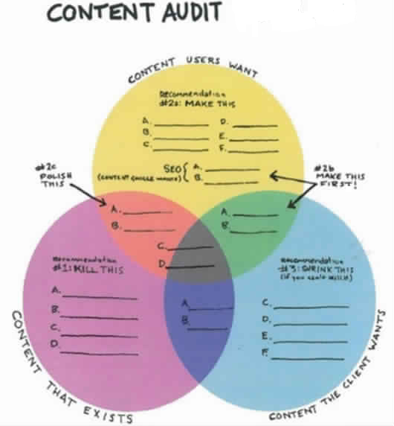
WHAT IS GST AUDIT
The process of examination of maintained by a taxable person
Records,
Returns and
Other documents

Slide 4
PURPOSES OF GST AUDIT
To verify the correctness of
Turnover declared,
Taxes paid,
Refund claimed,
Input tax credit availed, and
To assess the compliance with the provisions of GST

Slide 5
Type of Audit in GST
Audit under GST
Audit by GST tax authorities
General Audit U/S 65
[Order by Commissioner]
Special Audit u/s 66
[With prior approval of Commissioner]
Audit by CMA/CA
File audited returns U/S 35(5)
+
Audited Accounts
+
Reconciliation Statements

Slide 6
Documents Required for GST Audit
Audited Financials
Annual return in Form GSTR-9
All GSTR 1 , 3B & Reconciliations
Reconciliation statement, reconciling the value of supplies declared in the return furnished for the year with the audited annual financial statement in Form GSTR-9C.

Slide 7
Content of GST Audit
The Audit report consist of 5 Parts.
I) : Basic Details
II) : Reconciliation of turnover declared in AFS with turnover declared in
Annual Return (GSTR-9)
III) : Reconciliation of Tax Paid
IV) : Reconciliation of Input Tax Credit (ITC)
V ) : Auditor's recommendation on
additional liability due to Non-reconciliation

Slide 8
Form :GSTR 9C
Part-I

Slide 9
Part-1 Basic Details

Slide 10
Form: GSTR 9c
Part-II

Slide 11
Reconciliation of Turnover as per Audited Financial Statement and Annual Return [GSTR 9]
Part | Description of Part | Clause | Description of clause
II | Reconciliation of turnover declared in audited Annual Financial Statement with turnover declared in Annual Return (GSTR 9) | 5 | Reconciliation of Gross Turnover
 |  | 6 | Reasons for Un-Reconciled difference in Annual Gross Turnover
 |  | 7 | Reconciliation of Taxable Turnover
 |  | 8 | Reasons for Un-Reconciled difference in Taxable Turnover

Slide 12
SL No 5: Reconciliation of Gross Turnover (Details to be provided in 5 A to 5R)
Reconciliation of turnover as per audited Annual Financial Statement with turnover as per Annual Return (GSTR-9)
A | Turnover as per audited Financial Statements for the State
B | Unbilled revenue at the beginning of Financial Year | (+)
C | Unadjusted advances at the end of the Financial Year | (+)
D | Deemed Supply under Schedule-I | (+)
E | Credit Notes issued after the end of the financial year but reflected in the annual Return (Cir 26/26/17-29.12.2017) | (+)
F | Trade Discounts accounted for in the audited AFS but are not permissible under GST ( AR of Ultra Tech Cement) | (+)
G | Turnover from April 2017 to June 2017 | (-)
H | Unbilled revenue at the end of Financial Year | (-)
I | Unadjusted Advances at the beginning of the Financial Year | (-)

Slide 13
Sl no 5: Reconciliation of Gross Turnover (Details to be provided in Sl no 5 A to 5R)
Reconciliation of turnover as per audited Annual Financial Statement with turnover as per Annual Return (GSTR-9)
J | Credit Notes accounted for in the audited Annual financial Statement but are not permissible under GST | (-)
K | Adjustments on A/c of supply of goods by SEZ Units to DTA Units | (-)
L | Turnover for the period under composition scheme | (-)
M | Adjustments in turnover u/s 15 and Rules thereunder | (+/-)
N | Adjustments in turnover due to Foreign Exchange fluctuations | (+/-)
O | Adjustments in turnover due to reasons not listed above | (+/-)
P | Annual turnover after adjustments as above |  | Auto
Q | Turnover as declared in Annual Return (GSTR-9) |  | Manual
R | Un-Reconciled turnover (Q - P) |  | AT 1

Slide 14
Sl No 6: Reasons for Un-Reconciled difference in Annual Gross Turnover
6 | Reasons for Un-Reconciled difference in Annual Gross Turnover
A | Reason 1 | <Text>
B | Reason 2 | <Text>
C | Reason 3 | <Text>

Slide 15
SL No 7 : Reconciliation of Taxable Turnover

Slide 16
Sl No 8 : Reasons for Un-Reconciled Taxable Turnover
8 | Reasons for Un-Reconciled Taxable Turnover
A | Reason 1 | <Text>
B | Reason 2 | <Text>
C | Reason 3 | <Text>

Slide 17
Form : GSTR 9 C
Part-III

Slide 18
Reconciliation of Tax Paid
Part-III: Contains Sl No 9, 10, 11
Sl no 9 : Reconciliation of rate-wise liability and amount payable thereon.
Sl no 10: Reasons for un-reconciled Payment of Amount.
Sl no 11: Additional amount payable but not paid.

Slide 19
Sl no 9: Reconciliation of rate-wise liability and amount payable thereon (1/2)
Reconciliation of rate-wise liability and amount payable thereon
 | Description | Taxable Value | Tax Payable
 |  |  | CGST | SGST | IGST | Cess
A | 5%
B | 5% (RC)
C | 12%
D | 12% (RC)
E | 18%
F | 18% (RC)
G | 28%
H | 28% (RC)
I | 3%
J | 0.25%

Slide 20
Sl no 9: Reconciliation of rate-wise liability and amount payable thereon (2/2)
Reconciliation of rate-wise liability and amount payable thereon
 | Description | Taxable Value | Tax Payable
 |  |  | CGST | SGST | IGST | Cess
K | 0.10%
L | Interest
M | Late fee
N | Penalty
O | Others
P | Total Amount to be paid as above
Q | Total Amount to be paid as per Annual Return (GSTR-9)
R | Un-reconciled Payment of Amount

Slide 21
Sl No 10: Reasons for Un-Reconciled Taxable Turnover
10 | Reasons for Un-Reconciled Taxable Turnover
A | Reason 1 | <Text>
B | Reason 2 | <Text>
C | Reason 3 | <Text>

Slide 22
Sl no 11 : Additional amount payable but not paid( due to reason specified under tables 6, 8 and 10 above)
Additional amount payable but not paid
 | Description | Taxable Value | Tax Payable
 |  |  | CGST | SGST | IGST | Cess
A | 5%
B | 12%
C | 18%
D | 28%
E | 3%
F | 0.25%
G | 0.10%
H | 28% (RC)
I | Interest
J | Late fee
K | Penalty
L | Others

Slide 23
Form : GSTR 9 C
Part-Iv

Slide 24
Part-IV: Reconciliation of ITC
Part-IV: Contains Sl No 12, 13, 14,15,16
Sl no 12 : Reconciliation of Net Input Tax Credit (ITC)
Sl no 13 : Reasons for un-reconciled difference in ITC
Sl no 14 : Reconciliation of ITC declared in Annual Return (GSTR-9) with ITC availed on expenses as per audited AFS
Sl no 15 : Reasons for un-reconciled difference in ITC between eligible ITC as per audited AFS and ITC claimed in GSTR
Sl no 16 : Tax payable on un-reconciled difference in ITC

Slide 25
Sl no 12: Reconciliation of Net Input Tax Credit (ITC)
Reconciliation of Net Input Tax Credit (ITC)
A | ITC availed as per audited AFS
B | ITC booked in the earlier FY, but claimed in Current FY | (+)
C | ITC booked in current FY, but to be claimed in subsequent FY
D | ITC availed as per audited Financial Statement
E | ITC claimed in Annual return (GSTR 9)
F | Un-reconciled ITC

Slide 26
Sl no 13 : Reasons for un-reconciled difference in ITC
13 | Reasons for un-reconciled difference in ITC
A | Reason 1 | <Text>
B | Reason 2 | <Text>
C | Reason 3 | <Text>

Slide 27
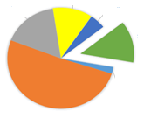
Sl 14: Reconciliation of ITC between GSTR-9 and ITC availed on expenses as per audited AFS
Reconciliation of ITC declared in GSTR-9 with ITC availed on expenses as per audited Annual Financial Statement or Books of Account
 | Description | Value | Amount of total ITC | Amount of eligible ITC availed
A | Purchases
B | Freight / Carriage
C | Power & Fuel
D | Imported Goods [Incl. receipts from SEZ]
E | Rent & Insurance
F | Goods lost, stolen, destroyed, written off or disposed of by way of gift or free samples

Slide 28
Sl no 14: Reconciliation of ITC between GSTR-9 and ITC availed on expenses as per audited AFS
Reconciliation of ITC declared in GSTR-9 with ITC availed on expenses as per audited Annual Financial Statement or Books of Account
 | Description | Value | Amount of total ITC | Amount of eligible ITC availed
G | Royalties
H | Employees' Cost (Salaries, wages, Bonus etc.)
I | Conveyance Charges
J | Bank Charges
K | Entertainment Charges
L | Stationery Expenses (including postage etc.)
M | Repair and Maintenance
N | Other Miscellaneous Expenses
O | Capital Goods

Slide 29
Sl no 14: Reconciliation of ITC between GSTR-9 and ITC availed on expenses as per audited AFS
Reconciliation of ITC declared in GSTR-9 with ITC availed on expenses as per audited Annual Financial Statement or Books of Account
 | Description | Value | Amount of total ITC | Amount of eligible ITC availed
P | Any Other Expense - 1
Q | Any Other Expense - 2
R | Total amount of eligible ITC availed
S | ITC claimed in GSTR 9
T | Un-reconciled ITC

Slide 30
Sl no 15 : Reasons for un-reconciled difference in ITC
15 | Reasons for un-reconciled difference in ITC
A | Reason 1 | <Text>
B | Reason 2 | <Text>
C | Reason 3 | <Text>

Slide 31
Sl no 16-Tax payable on un-reconciled difference in ITC ( due to 13 and 15)
Tax payable on un-reconciled difference in ITC
 | Description | Amount Payable
 | Central Tax
 | State/Union Territory Tax
 | Integrated Tax
 | Cess
 | Interest
 | Penalty

Slide 32
Form : GSTR 9C
Part-v

Slide 33
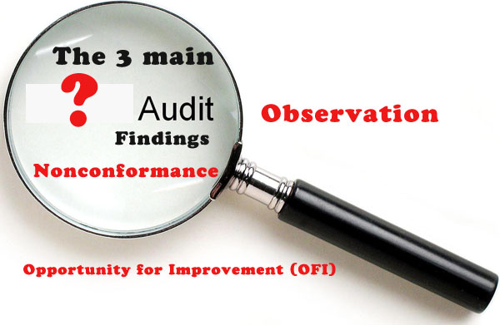
Part V: Auditor's recommendation on additional Liability due to Non-reconciliation
Auditor's recommendation on additional Liability due to Non-reconciliation
 | Description | Value | To be paid through Cash
 |  |  | CGST | SGST | IGST | Cess
A | 5%
B | 12%
C | 18%
D | 28%
E | 3%
F | 0.25%
G | 0.10%
H | 28%(RC)
I | Input Tax credit

Slide 34
Part V: Auditor's recommendation on additional Liability due to Non-reconciliation
Auditor's recommendation on additional Liability due to Non-reconciliation
 | Description | Value | To be paid through Cash
 |  |  | CGST | SGST | IGST | Cess
J | Interest
K | Late fee
L | Penalty
M | Others
N | Erroneous Refund to be paid back
O | Outstanding demands to be settled
P | Others (Specify)

Slide 35
Sl no 5: Explanation
5 (A) : Turnover of Audited Financial Statement need to be taken here.
If Financial Report consist of multiple GSTINs(State wise/Vertical GSTIN wise) then Turnover belongs to particular GSTIN which is subject Audit to be taken.
Continue…

Slide 36
Sl no 5: Explanation
Additions to Turnover as per Audited AFS
5 B). Unbilled Revenue which was accounted in the books of accounts of FY 2016-17 and carried forward to FY 2017-18.
Eg: If INR 10 Cr unbilled revenue exist in the FY 2016-17 and during the current FY 2017-18(July – March) GST was paid on INR 4Cr on such revenue , then value of INR 4Cr should be declared here.

Slide 37
Sl no 5: Explanation
Additions to Turnover as per Audited AFS
5 C) . Value of all unadjusted advance for which GST has been paid during the FY 2017-18 (July – March).
5 D) . Deemed Supply – Schedule I(Section 7)
Permanent transfer or disposal of Business Assets where ITC has been availed on such assets.
Supply between related persons/distinct person as specified in Sec 25.
Supply of goods by Principal to Agent or Agent to Principal.
Import of services by taxable person.

Slide 38
Sl no 5: Explanation
Additions to Turnover as per Audited AFS
5E). Credit notes issued after the end financial year but reflected in the annual return.
5 F). Trade discounts , accounted for in the audited AFS but on which GST was leviable.

Slide 39
Sl no 5: Explanation
Deductions from turnover as per audited AFS
5G) Turnover included in the audited AFS for April 2017 to June 2017.
5 H) Unbilled revenue recorded in the books of accounts during the FY 2017-18 but GST was not payable on such revenue in the same financial year.
5 I) Value of all advances for which GST has not been paid but the same has been recognized as revenue in the audited AFS.

Slide 40
Sl no 5: Explanation
Deductions from turnover as per audited AFS
5 J). Aggregate value of credit notes issued before 31st of March 2018 for the supply accounted in the FY 2017-18 and such credit notes are not permissible under GST.
5 K). Aggregate value of all goods supplied by SEZs to DTA units for which the DTA units have filed bill of entry.[Applicable to SEZ developers/SEZ units]
5L). If registered persons have opted out of the composition scheme during the FY 2017-18, the turnover for which GST was paid under the composition scheme.

Slide 41
Sl no 5: Explanation
Other adjustments (+/-) to turnover
5 M) Due to difference in valuation as per Sec.15 of CGST Act. (Time & Value of taxable supply)
5 N) Due to foreign exchange fluctuations.
5 O )Due to any other reasons not specified above.

Slide 42
GST Audit Guidelines
Prepare profile of Taxable person
Desk review
Understand nature of Industry
Evaluation Internal control

Slide 43
Understanding
Understand taxable events
Application of Schedule I and II of GST Act
Understand whether supply is Composite supply or Mixed supply
Accounting method of preparing AFS GST No wise

Slide 44
Time and Place of supply
Policy adopted for recognise Time of supply
Place of provision supply – Inter /Inter state
Export / Import
Intermediate Supplies
Ocean Freight Charges in
case CIF Value of Import
Foreign Bank Charges in
case of Import /Export

Slide 45
Accounts and Records under GST
Production or Manufacturer of goods
Inward and Outward supply of Goods /Services/both
Stock of goods
Input Tax credit availed
Output tax payable and paid

Slide 46
Outward Supplies
Sales – Regular/Reverse
Transfer – Agents
Transfer – Distant person
Barter
Exchange
Lease
Exchange
Recovery/Reimbursement

Slide 47
Input Tax credit
Condition and restriction for taking credit (Sec 16(2)
Documentary requirement for claiming input tax credit (Rule 36)
Reversal of input tax credit in case non payment of consideration
Blocked credit U/S 17(5)
ITC used for exemption supply party or fully, non business purposes , and personal use

Slide 48
RCM
Specified services –Section 9(3) & 9(4) of GST Act
9(3) :- Specified Services as notified by GST council such as GTA, Legal services, import of services, sponsorship & etc
9(4) Supply received from URD till 13th oct 2017.
Exemption upto Rs5000/- per day notification no 8 2017 dt 28/06/17.
Point to be noted :- bill issued before 13th Oct 2017 accounted after that to be considered for RCM

Slide 49
Refunds (1/2)
On account of export under LUT
On account of supplies to SEZ under LIY
On account of supplies to SEZ with payment of IGST
Export of services with payment of IGST
On account of deemed export
On account of inverted rate of duty – Doctrine of unjust enrichment
Refund in case of higher rate of duty drawback – July to Sept

Slide 50
Refunds (2/2)
Export with payment of IGST in case export is towards fulfilment of EO of EPCG , advance authorization, export from EOU and procured goods with 1% GST
Refund on account of credit balance in electronic cash ledger

Slide 51
Other Compliances
Job work Procedures
Export procedures
Maintenance of other records
2A reco
Quantitative details as a backup
E way reco

Slide 52
Happy GST Audit

