Slide 1
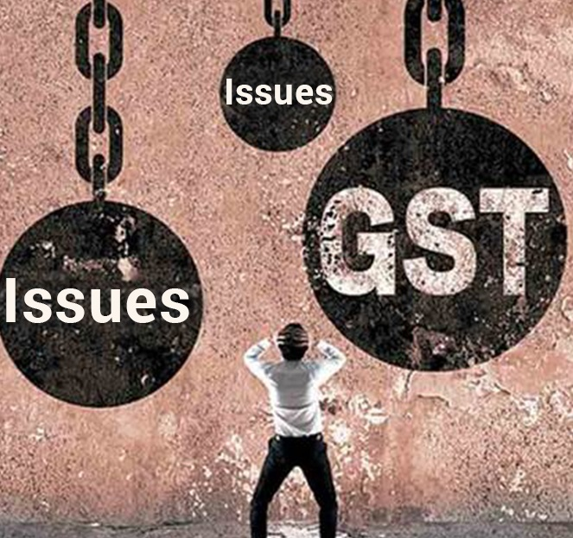
Goods and services tax act
Overview of GST and PRACTICAL DIFFICULTIES
SUNEEL KUMAR MANNEM
B.COM.,ACMA
- PRACTICING COST ACCOUNTANT

Slide 2
At Registration
Anyone can register with PAN, Rental agreement .. No field visit..
Recently sent notice for not displaying registration certificate in premises.
Tax payer can select the Ward..
Rejection- without D.No. in EB, GST registration for companies in other states.
Place of business for construction business.

Slide 3
GST Returns
GSTR 1
Purpose of Quarterly Return
No penalty for late filing/ non filing

Slide 4
GST Returns
GSTR 3B
Interest to be calculated and not automatic.
Values of exempt, nil-rated and non-GST inward supplies details
Server problems at due dates.
Registered persons rejecting gst invoices after filing return of 3B by supplier.
No matching with GSTR 1 and GSTR 2A.

Slide 5
ITC Credit Claimed and Due

Slide 6
GST Returns
GSTR 9
Due date for FY 2017-18- 30-06-2019.
GSTR 9C
GST Audit

Slide 7
GSTR 9

Slide 8
Anti Profiteering (Sec.171)
“Any reduction in rate of tax on any supply of goods or services or the benefit of input tax credit shall be passed on to the recipient by way of commensurate reduction in prices.”
Can appoint auditors to measure.

Slide 9
Some other issues
Petrol- Non Gst Good
Valuation of Natural stocks
RCM- EOU- ITC

Slide 10
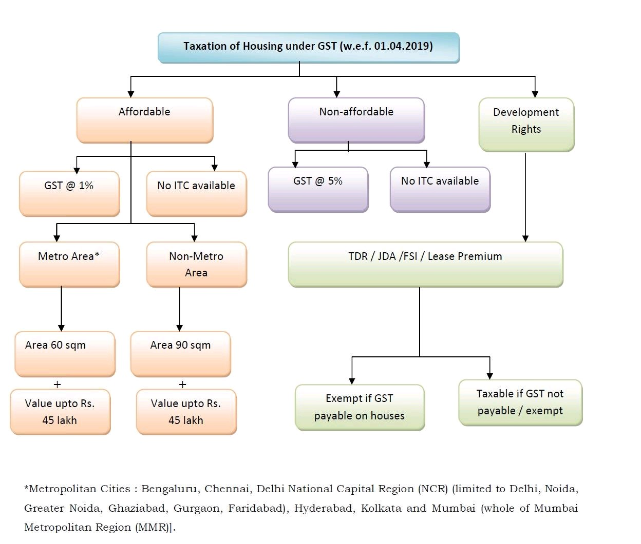
Recent Amendments

Slide 11
Other Amendments
Threshold limit- 40Lakhs ( Only for goods)
Threshold- Composition – 1.5 cr
Composition for Service providers- 50 lakshs-6%
Return for composition- Payment Quarterly, payment monthly
Effective Date- 01-04-2019

Slide 12
ITC Set off

Slide 13
ITC Claim amendment

Slide 14
Cost Audit Para 6B

Slide 15
How to enroll for GSTP
Online Exam conducting By CBIC (NACIN)
Minimum Qualification – Any recognized degree.
Web Link- https://www.gst.gov.in/

Slide 16
OPPORTUNITY TO US
GST Returns
GST audit
Anti Profiteering
Scrutiny cases
Appeals

Slide 17
Thank You …
17

