Slide 1
Practical Approach to Income Tax Return Filing By Dinesh J. Agrawal (FCMA, FCS, LLB, M.COM, GDCA)

Slide 2
Income Tax 298 sections (+) 14 Schedules

Slide 3
HEADS OF INCOME 1) SALARIES 2)INCOME FROM HOUSE PROPERTY 3)PROFITS AND GAINS FROM BUSINESS OR PROFESSION 4)CAPITAL GAINS 5) INCOME FROM OTHER SOURCES

Slide 4
The First Schedule to the Finance Act contains four parts which specify the rates of tax – Part I of the First Schedule to the Finance Act specifies the rates of tax applicable for the current Assessment Year. Part II specifies the rates at which tax is deductible at source for the current Financial Year. Part III gives the rates for calculating income-tax for deducting tax from income chargeable under the head “Salaries” and computation of advance tax. Part IV gives the rules for computing net agricultural income.

Slide 5
COMPUTATION OF TOTAL INCOME
Determine the residential status
Classify income under five heads
Salaries
Income from house property
Profits and gains from business or profession
Capital gains
Income from other sources
Compute income under each head applying the charging & deeming provisions and providing for permissible deductions/ exemptions thereunder
Apply clubbing provisions
Set-off/carry forward and set-off of losses as per the provisions of the Act
Compute Gross Total Income (GTI)
Total Income (TI)
Less: Deductions from GTI

Slide 6
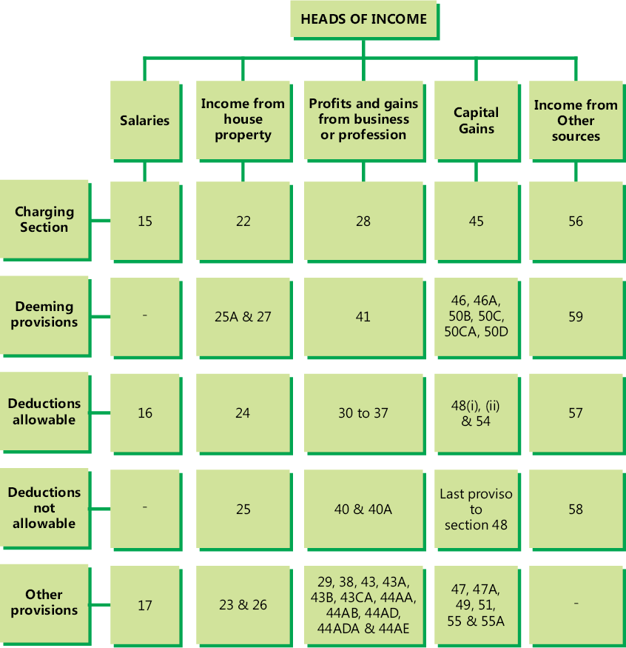

Slide 8
What is a return of income?
​ITR stands for Income Tax Return​.
It is a prescribed form through which the particulars of income earned by a person in a financial year and taxes paid on such income are communicated to the Income-tax Department.
It also allows carry -forward of loss and claim refund from income tax department.​
Different forms of returns of income are prescribed for filing of returns for different Status and Nature of income.
These forms can be downloaded from https://www.incometaxindiaefiling.gov.in/home
​

Slide 9
​ What are the forms of return prescribed under the Income-tax Law? https://www.incometaxindiaefiling.gov.in/main/ListOfITRsAndOtherForms https://www.incometaxindiaefiling.gov.in/downloads/incomeTaxReturnUtilities

Slide 10
​ What are the different modes of filing the return of income? https://www.incometaxindiaefiling.gov.in/home

Slide 11
What is e-filing utility provided by the Income-tax Department? The Income-tax Department has provided free e-filing utility (i.e., Java & excel) to generate e-return and furnishing of return electronically. The e-filing utility provided by Department is simple, easy to use and also contains instructions on how to use it. By using the e-filing utility, the taxpayers can easily file their returns of income. Utility can be downloaded from https://www.incometaxindiaefiling.gov.in/downloads/schema ​

Slide 12
Income Tax Department Help Desk Numbers:- https://www.incometaxindiaefiling.gov.in/main/contactUs?lang=eng

Slide 13
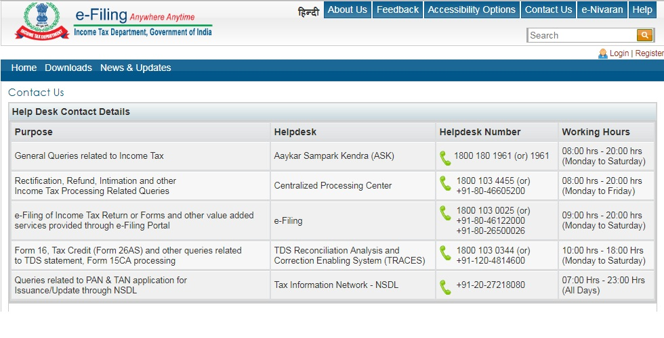

Slide 14
Income Tax Filing Process At a Glance

Slide 15
Step 1 Download the ITR preparation software for the relevant assessment year to your PC / Laptop from the "Downloads" page. https://www.incometaxindiaefiling.gov.in/downloads/schema

Slide 16
Step 2 Prepare the Return using the downloaded Software Gather all the information regarding your income, tax payments, deductions etc. Pre-populate the personal details and tax payments/TDS by clicking on the 'Pre-fill' button. Compare with the information you have to ensure that nothing is left out. Enter all data and click on 'Calculate' to compute the tax and interest liability and final figure of Refund or Tax payable If Tax is payable- remember to pay immediately and enter the details in appropriate schedule. Repeat above step so that tax payable becomes zero Generate and save the Income Tax Return data in XML format in the desired path/place on your PC/Laptop

Slide 17
Step 3 Login to e-Filing website with User ID, Password, Date of Birth /Date of Incorporation and enter the Captcha code

Slide 18
Step 4 Go to e-File and click on "Upload Return“

Slide 19
Step 5 Select the appropriate ITR, Assessment Year and XML file previously saved in Step 2 (using browse button).

Slide 20
Step 6 Click on "Submit" button.

Slide 21
E-verify Returns https://www.incometaxindiaefiling.gov.in/EVC/?lang=eng

Slide 22
Thanking You. Dinesh Jyotiprakash Agrawal (FCMA, FCS, LL.B, M.COM, GDCA) (M) 9860471376 Email:- Dineshjagrawal@gmail.com

