Slide 1
THE INSTITUTE OF COST ACCOUNTANTS OF INDIA
JAIPUR CHAPTER
UNION BUDGET 2019
Saturday, 06th February, 2019
By:
Tanuj Agrawal, Advocate
B.Com, LL.M, ACMA, FCA, CS, PGDFAC, PGDTL

Slide 2
BUDGET 2019
Interim Election Budget
5th Budget of NDA Govt.
Presented by a professional
Report Card of the Government
Thanked the taxpayers
Very few amendments proposed in direct taxes (8)
All amendments proposed beneficial for tax payers

Slide 3
India – 6th Largest Economy
5 trillion dollar economy in next 5 years
10 trillion dollar economy in next 8 years
Average Inflation rate down to 4.6%
FDI investment attracted $239 billion
RERA & Benami Laws
Focus on Farmers, Unorganised sector workers and Middle Class

Slide 4
Vision for 2030
To build physical and social Infrastructure
To create a Digital India
To make India Pollution Free
To expand Rural Industrialisation
To clean rivers and water bodies
To develop inland coastline and ocean water ways
To increase space program and place Indian Astronaut in space by 2022
To make India self sufficient in food
To make healthy India
To deliver these visions through minimum government and maximum governance

Slide 5
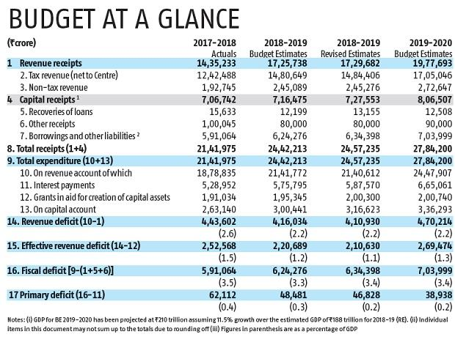

Slide 9
TAX PROPOSALS

Slide 10
UNION BUDGET 2019 DIRECT TAX PROPOSALS

Slide 11
INCOME TAX SLABS (A.Y. 2020-21)
No change
Individual, HUF, AOP, BOI & AJP :-
Nil Upto Rs.2,50,000 (3 lakhs for senior citizen & 5 lakhs for super senior citizens)
Rs.2,50,000 to 5,00,000 to be taxed @ 5%
Rs.5,00,001 to 10,00,000 to be taxed @ 20%
Above Rs.10,00,001 to be taxed @ 30%
Surcharge 10% on income between 50 lakhs to 1 crore.
Surcharge 15% on income above 1 crore.
Heath And Education Cess 4%
Rebate u/s 87A : Modified (discussed later)
Firms & Local Authority : 30%, 12% surcharge above 1 crore

Slide 12
TAX RATES FOR DOMESTIC COMPANY
A.Y. 2019-20 : Reporterd Turnover for FY 16-17 upto 250 crores : Tax @ 25%
A.Y. 2018-19 : Turnover upto 50 crores : Tax @ 25%
A.Y. 2017-18 : Turnover upto 5 crores : Tax @ 29%
Other Domestic Companies : 30%
Surcharge @ 7% (1 to 10 crores) and 12% (above 10 crores)

Slide 13
Rebate u/s 87A
Only resident individuals
Present limit – Rs.2,500/- upto Total Income of Rs.3,50,000/-
Limit proposed to be increased to Rs.12,500/- upto Total Income of Rs.5,00,000/-
Revenue Cost Rs. 18,500 crores
3 crores middle class tax payers to be benefitted
Smart move
To be considered for TDS by employer
Returns need to be filed u/s 139 for persons claiming rebate u/s 87A.
Practically, no difference w.r.t. tax liability of normal/senior citizens/super senior citizens having total income upto 5 lakhs.

Slide 14
Standard Deduction – Salaried
Limit raised to Rs.50,000/- from existing Rs.40,000/-
U/s section 16(ia)
Benefit also available to pensioners
Revenue cost Rs.4,500 crores
3 crores assessee will benefit
Wef 01.04.2020 i.e. AY 2020-21

Slide 15
Real Estate
Section 23
Section 24
Section 54
Section 80IBA

Slide 16
Section 23 - ALV
ALV of one more house (now two) can be claimed as NIL as SOP
Maintain families at two locations :
Job
Education of Children
Care of Parents
Stock in trade – Now ALV nil for two years (from existing one year) from the end of the FY in which the construction completion certificate obtained from the competent authority
To boost real estate sector

Slide 17
Section 24 – Interest on Borrowed Capital
“Aggregate amounts of deduction” substituted for “the amount of deduction”
Interest deduction on both SOP restricted to 2 lakhs
Interest in case of rented property – no limit subject to section 71(3A)

Slide 18
Section 54 – Rollover of capital gains
Residential House Property to Residential House Property
“A” substituted for “one” by Finance Act, 2014
Deduction proposed to be extended to purchase of two house properties :-
Capital Gains does not exceed 2 crores
Option – “may at his option”
Once in life time
WEF 01.04.2020 (AY 2020-21) – No retrospective application
No similar benefit in Section 54F

Slide 19
Interest on Borrowed Capital Comparative Analysis
Interest on Borrowed Capital | SOP 1 | SOP 2 | Rented Property | Deduction under House Property u/s 24
Case 1 | 100000 | 100000 | - | 200000
Case 2 | 150000 | 150000 | - | 200000
Case 3 | 250000 | 50000 | - | 200000
Case 4 | 150000 | - | 250000 | 400000 Subject to 71(3A)

Slide 20
Section 80IBA – Affordable Housing
Benefit extended for one more year upto 31.03.2020
Housing project approved by competent authority after 01.06.2016 but on or before 31.03.2019 (now 2020)
Other conditions same

Slide 21
TDS (tedious)
194A – TDS limit increased from 1000o to 40000 in case of other than senior citizens
In case of senior citizens, TDS limit already increased to 50000 by Finance Act, 2018
194I – TDS on rent, limit increased to 240000 from 180000

Slide 22
Administrative Front
All returns processing within 24 hours
Within next two years, scrutiny assessments will be electronically with anonymised back office without and physical interface between tax payers and tax officers

Slide 23
Queries

Slide 24
Thank You

