Slide 1
Presented by:
CA Vijay Kr Agrawal, JAIPUR
MCOM,FCA,DISA,DIRM,LLB,NDDY, CCCA, CCFAFD, DAT
Phone: +91 9828149043
Email: catvijay@yahoo.com

Slide 2
KEY CHANGES IN ITR FORM FOR A.Y. 2019-20

Slide 3
Identification of Ghost Directors and Shell Companies:
[ ITR 2, 3, 4 ]
The Government has taken many Initiatives to Curb the Black Money and Shell companies. One of such Initiatives is to Identify the Ghost Directors Who do not Even Know that they are Directors in Companies.
Accordingly, the Government has made Changes in ITR forms to Identify the Shell Companies and Ghost Directors.

Slide 4
A Person who is a Director in a Company shall not be able to use ITR-1 and ITR-4 for Filing of Return of Income and he has to use ITR-2 or ITR-3, as the case may be.
Further, if an Individual has been Director in a Company at any During the Previous Year, he has to provide the following information:
a) Name of Company
b) PAN
c) Whether Shares of the Company are Listed or Unlisted?
d) DIN

Slide 5
Investment in unlisted companies
[ ITR 2, 3, 5 ]
To Keep Check on Issue of Shares by a Closely Held Companies and Investment made therein, the Following Details in respect of Unlisted Equity Shares held at any time during the Previous Year has been asked:
a) Name of the Company
b) PAN of the Company

Slide 6
c) No. and Cost of Acquisition of Shares held at the Beginning of the year
d) No. of Shares, Face Value, Issue Price/Purchase Price and Date of Purchase of Shares Acquired During the Year
e) No. and Sale Consideration of Shares Sold during the year
f) No. and Cost of Acquisition of Shares held at the End of the Previous Year

Slide 7
Reporting of Salary Income in Detail
[ ITR 1, 2, 3, 4 ]
The New ITR Forms is now in Sync with Form 16, from AY 2019-20, an Individual has to mention his Gross Salary, Exempt Allowances, Perquisites & Profit In Lieu of Salary, Other Items Deducted or Added. Further, Separate Reporting
a) Standard deduction
b) Entertainment allowance
c) Professional tax

Slide 8
Buyer’s Information in Case of Transfer of Immovable Property
[ ITR 2, 3, 5, 6 ]
If Assessee Reports Capital Gain, from Transfer of an Immovable Property, it would be Mandatory to furnish the following information:
a) Name of Buyer
b) PAN of Buyer
c) Percentage Share
d) Amount

Slide 9
e) Address of Property
f) Pin Code
Mandatory to Furnish the PAN if Tax has been Deduced U/s 194-IA or PAN is Quoted in the Registry. PAN is otherwise mandatory if the Stamp Duty Value Exceeds Rs. 10 Lakhs.

Slide 10
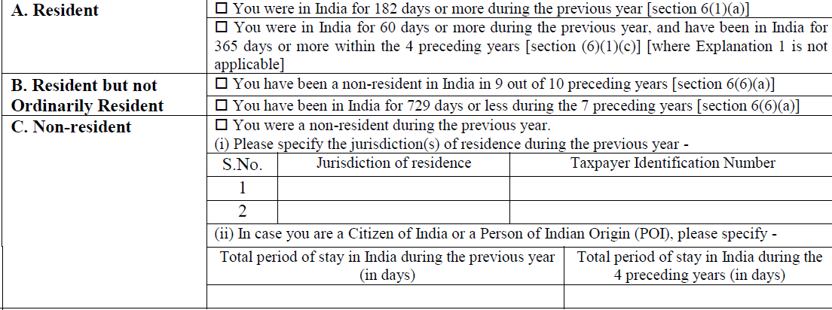
NON-RESIDENTS

Slide 11
Nature of Residuary Income:
[ITR 1 and ITR 4]
From AY 2019-20, Income Taxable Under the Head Income From Other Sources and the Deductions Claimed in respect of Family Pension in accordance with Section 57. Such Extra Disclosures have been asked by the Dept. to check that the Ineligible Persons are not using the ITR 1 and ITR 4 for Filing of Return.

Slide 12
AGRICULTURE INCOME:
[ITR 2,3,4 and ITR 5]
If Agricultural Income exceeds Rs. 5 Lakh
Furnish:
Furnish:
1. Name of District (with PIN Code) where Agricultural Land is Located
2. Measurement of agricultural land in acre
3. Whether Agricultural Land is Owned or Held on Lease
4. Whether Agricultural Land is Irrigated or Rain-fed

Slide 13
START UPs:
[ITR 5 and ITR 6]
To Check the 80IAC Deduction Eligibility:
Furnish:
Whether you are recognized as start up by DPIIT □ Yes □ No
1 If yes, please provide start up recognition number allotted by the DPIIT
2 Whether certificate from inter-ministerial board for certification is received? □ Yes □ No
3 If yes provide the certification number
4 Whether declaration in Form-2 in accordance with para 5 of DPIIT notification dated 19/02/2019 has been filed before filing of the return? □ Yes □ No
If yes, provide date of filing Form-2

Slide 14
Changes Related to Business Head
If an assessee is liable to Audit under any act other than the Income-Tax Act, then assessee has to mention the Act, Section and Date of furnishing the Audit Report
Reporting of Name, Address and PAN of the Debtor in case of Bad Debt (More than Rs. 1,00,000/- )
In new ITR forms, in place of existing Part A P&L, following new Parts have been inserted:
a) Manufacturing Account, b) Trading Account, c) Profit & Loss Account

Slide 15
Changes Related to Other Sources
Separate Reporting of Interest Income:
Saving bank deposits
Deposits (i.e., fixed deposits, etc.)
Income-tax Refund
In the nature of pass through income
Others

Slide 16
ITR-1
Who is not eligible to use this Return Form
A. This Return Form should not be used by an individual who –
(a) is a Director in a company;
(b) has held any unlisted equity shares at any time during the previous year;
(c) has any asset (including financial interest in any entity) located outside India;
(d) has signing authority in any account located outside India; or
(e) has income from any source outside India.

Slide 17
(f) Profits and gains from business and professions;
(g) Capital gains;
(h) Income from more than one house property;
(i) Income under the head other sources of following nature:-
(i) winnings from lottery;
(ii) activity of owning and maintaining race horses;
(iii) income taxable at special rates U/s 115BBDA /115BBE;
(j) income to be apportioned in accordance with provisions of section 5A; or
(k) agricultural income in excess of ₹5,000.

Slide 18
any brought forward loss or loss to be carried forward under Income from house property‘;
(m) loss under the head Income from other sources‘;
(n) any claim of relief U/s 90 and/or section 91;
(o) any claim of deduction under section 57, Except relating to family pension
(p) any claim of credit of tax deducted at source in the hands of any other person.

Slide 19
ITR-2
Who is eligible to use this Return Form?
This Return Form is to be used by an individual or HUF who is not eligible to file Form ITR-1 and who is not having any income under the head ―Profits or gains of business or profession.
3. Who is not eligible to use this Return Form?
This Return Form should not be used by an individual whose total income for the Assessment Year 2019-20 includes Income under the head ―Profits or Gains of Business or Profession.

Slide 20
Thank You

