Slide 1
Total Cost Management, Business Partnering & Power of Big Data
February 13, 2019

Slide 2
Points for Discussion
1
Technology & Human Competencies
2
Transformation of Management Accounting & Business Partnering
3
Big Data in Business
4
Benefits of Big Data
5
How Big Data will change the way we do Business
6
CFO’s Role in Digital Transformation

Slide 3
Points for Discussion
1
Technology & Human Competencies
2
Transformation of Management Accounting & Business Partnering
3
Big Data in Business
4
Benefits of Big Data
5
How Big Data will change the way we do Business
6
CFO’s Role in Digital Transformation

Slide 4
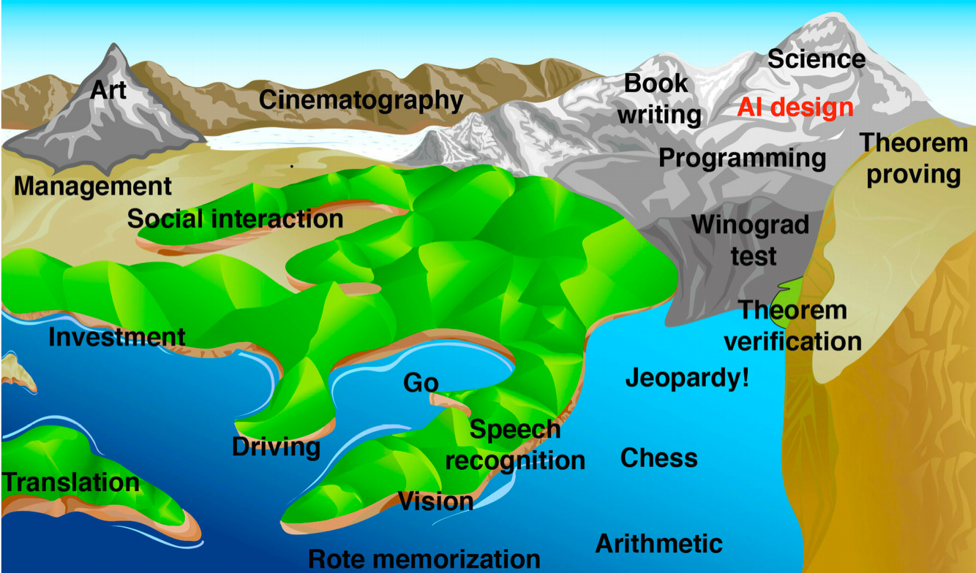
Hans Moravec’s Landscape of Human Competence
Illustration of Hans Moravec’s “landscape of human competence,” where elevation represents difficulty for computers to master a competency , and the rising sea level represents what computers are able to do.
Source : Life 3.0

Slide 5
Hans Moravec’s Landscape of Human Competence
Various Competencies mastered by Computers
Art, Book Writing, Science, Cinematography, Programming
Social Interaction, Management, Theorem Verification, Theorem Proving
Speech recognition, Translation, Vision, Driving, Investment
Rote Memorization, Arithmetic, Chess & Jeopardy

Slide 6
The Job Landscape in 2022
Data Entry Clerks
Accounting Book keeping & Payroll clerks
Administration & Executive Secretaries
Assembly & Factory Workers
Client Information & Customer Service Workers
Business Service & Administration Managers
Accountants & Auditors
Material Recording & Stock Keeping Clerks
General Operation Managers
Postal Service Clerks
Top 10 Emerging
Data Analytics & Scientist
AI & Machine learning specialist
General Operation Manager
Software & Application developer Analyst
Sales & Marketing Professional
Big Data Specialist
Digital Transformation Specialist
New Technology Specialist
Organisational Developer Specialist
Information Technology Specialist
Top 10 Declining

Slide 7
Points for Discussion
1
Technology & Human Competencies
2
Transformation of Management Accounting & Business Partnering
3
Big Data in Business
4
Benefits of Big Data
5
How Big Data will change the way we do Business
6
CFO’s Role in Digital Transformation

Slide 8
Transformation of Management Accounting
Strategic Business Partner
More focus on analyzing, planning, and strategizing
Value Creation through effective use of resources
Continuous improvement by searching of ways for increasing overall efficiencies and productivity of activities by reducing wastes, increasing quality and reducing costs
Performance & Management Accounting
Measure the performance of organization
Establishing and tracking performance standard;
Feedback to compare actual performance with planned performance and controlling to evaluate deviation from plans
Performance reports allows managers to take corrective actions
Management Accountant & Controller
Cost determination and Financial controlling
Information for Management Planning and Controlling for decision making
Information of costing of products & services of interest to management
Book Keeper & Cost Accountant
Books keeping and reporting
Key roles included collecting, measuring, storing and reporting financial status of organization

Slide 9
Role of Accountants
Finance should own the business intelligence role - for the good of accountants and the good of the organization
Financial Aspect Technical Aspect
Support to Various Functions
Industry expertise
Experience in activity-based costing
Treasury management
Strategic Planner
Harnessing AI & other technologies to give strategic direction to Company
Traditional Role of Steward / Controller
Focus on reporting and transaction processing
Book keeping
The trusted reporter role
Statutory Duties like Auditing
SOX Compliance
Reporting using IFRS & GAAP
Transactional Role Strategic Role

Slide 10
Role of Accountants
Reasons why finance should take over business intelligence
Information is everywhere, but it often lacks relevance, clarity, and accuracy
Confidence in information is high when it comes from accountants
The rise in analytics represents an opportunity for finance to shift toward a role of business partner

Slide 11
Changing scope of Management Accountants’ Roles
Traditional Finance Function
Emerging Future of Finance Function
Strategic Planning
< 7%
Strategic Planning
70%
Controlling Role
20% - 25%
Reporting Role
20% - 25%
Transactional Processing
> 50%
Controlling Role
10%
Reporting Role
10%
Transactional Processing
10%
By adopting Artificial Intelligence, Big data and Analytics, the value added by Accountants in organisation will shift from the role of transactional processor to that of strategic planner

Slide 12
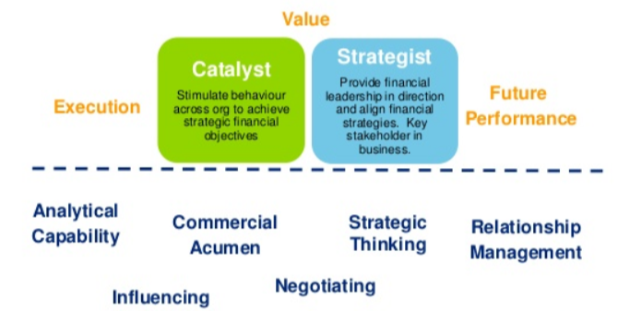
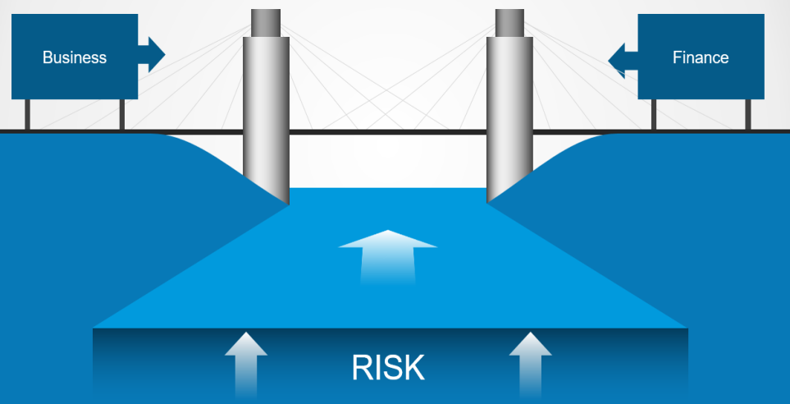
Actionable approach for the Business Partners
Get immersed in innovation by pushing the organization to understand the application of various technologies & their potential impact on the businesses
Build an ecosystem by assessing organization’s digital maturity to understand what might be feasible & what steps should be taken to build the necessary technological capabilities.
Scale at the edges by selecting the projects which are at the “edges” of the organization, where the strategies can be tested and refined with relatively fewer consequences
Start with one or two transformations to prove it works. Prioritize areas that can unlock several waves of potential value, & consider then building on those successes for exponential growth.
Don’t wait for perfect and keep reiterating. Learning from previous initiatives will help to prioritize the next set of initiatives.

Slide 13
Why are we talking about effective business partnering?
01
Rapid technological change, rise of emerging markets, more empowered consumers and employees, more active government intervention have all combined to disrupt traditional business models worldwide.
As their influence has grown, increasingly it falls upon the business partners to not only manage disruption, but to also identify and invest in the business models, products, and services that will lead to sustainable, profitable growth.
Volatility makes it more challenging to set priorities and plan for future investments.
Complex organizational structures hamper the ability of business partners to gain visibility into performance across the enterprise.
And disruptive technologies, such as big data, cloud computing, mobile and social media, have given rise to new forms of competition that are challenging even the most established enterprises.
02
03
04
05

Slide 14
Points for Discussion
1
Technology & Human Competencies
2
Transformation of Management Accounting & Business Partnering
3
Big Data in Business
4
Benefits of Big Data
5
How Big Data will change the way we do Business
6
CFO’s Role in Digital Transformation

Slide 15
Leveraging Analytics & Big data in Business
Analysis
Answers the Question
Practical Application of the Analysis
Descriptive Analysis
What happened?
This analysis provides a solution in a pre-determined manner
Reporting revenue for the previous year
Conducting financial ratio to compare RoI on historic performance using visualization and text mining tools
Diagnostic Analysis
How did it happen?
This involves conducting root-cause analysis and utilizing data to test a hypothesis
If there is reduced number of orders by a particular client in the previous year, the Diagnostic analysis will get to cause as to how and why it happened
It will also try to bring out solutions to stop such occurrences
Predictive Analysis
What will happen in future and when?
This involves the art of forecasting with the help of model or algorithm for identifying the various necessary components
The tools used for prescriptive analysis are genetic algorithms, log regression, time series regression and Monte Carlo simulations
Prescriptive Analysis
How can I make it happen?
Prescriptive analysis will help us to further understand the most appropriate course of action
Tools such as Machine Learning can help to come up with the optimal solution to the problems based on time, quality and revenue versus cost.

Slide 16
Framework for using Analytics in Management Accounting
Management Accounting
Enterprise
System
Cost Accounting
Performance Management
Planning & Decision Making
Balance Score Card
Financial Information
Financial
Internal Process
Customer Focus
Learning
Traditional method of Management accounting which includes Cost Accounting, Performance management and Planning & decision making, used for financial reporting & creating Balance score card
Deliverables of Management Accountants
Financial Reporting
Performance Reporting & Analysis
Decision Support with resource Planning

Slide 17
Framework for using Analytics in Management Accounting
Management Accounting
Enterprise
System
External Data
Market Analysis, Regulatory framework, Competition data, Customer preference, etc.
Internal Data
Sales data, Technology roadmap, Product information, employee strength, etc.
Cost Accounting
Performance Management
Planning & Decision Making
Application Data Analysis
Descriptive Analysis
Diagnostic Analysis
Predictive Analysis
Prescriptive Analysis
Data Warehouse with Big Data & AI
Balance Score Card
Financial Information
Financial
Internal Process
Customer Focus
Learning
With the help of Big Data & AI, External & internal data can be leveraged by analysis and creating Balance score card for the organisation
Deliverables of Management Accountants
Financial Reporting
Performance Reporting & Analysis
Decision Support with resource Planning

Slide 18
Phases of Digitization & Implementation of Analytics
1
Digitization
2
Digitalization
Digital Format: The process of transforming operating manuals, handbooks, documents, photographs and other informational resources into a digital format
Higher Efficiency: That process represents a big leap forward in terms of efficiency, making it possible for computers to search, access, store, exchange and integrate all that data
3
Digital Transformation
Optimization: This phase involves using digitized information to optimize production workflows, making them simpler, as well as more efficient and cost effective
Digital Bridge: It would build digital bridges to supply chain partners, consumers, banks and other financial partners, government agencies and other third parties
Higher Collaboration: This ensures more transparent communications, robust collaborations and better-streamlined transactions with partners
Business Expansion: A differentiated digital transformation offers opportunities to use data for expanding on new services and customizing current ones
Customer Focus: In this phase, all the function including R&D, operation, marketing, and finance work in tandem to customise their offering based on the customers needs
Better Bottom-line: This would help in increasing both market share and profit margins
True transformation happens when the physical and cyber worlds align with data analytics and cognitive computing technologies such as AI and machine learning to unlock the new realms of business opportunities

Slide 19
Points for Discussion
1
Technology & Human Competencies
2
Transformation of Management Accounting & Business Partnering
3
Big Data in Business
4
Benefits of Big Data
5
How Big Data will change the way we do Business
6
CFO’s Role in Digital Transformation

Slide 20
Benefits of Analytics in Management Accounting
Higher Compliance
Avoiding Discrepancies
Data Management
Automation: All the data handling and processing would be completely automated hence increasing the compliance
Accuracy: Every tax report would have data that has guaranteed accuracy levels, and has been generated quickly and reliably
Better Accounting: Bots could recognize and categorize data from various sources into the right accounting head
Enhanced Business process: Some dedicated tasks conventionally done by accountants, such as processing of accounts payables and receivables, would be done by AI, thereby leading to enhanced cost management by businesses
Data Discrepancies: A perennial problem in accounting is the frequent discrepancies between the internal accounts of a business and its bank accounts
Quality of Data: Even though cutting-edge software has made things a lot easier than what it was in the manual reconciliation period, the output by the software is only as good as the quality of data entry
Error Finding: AI could be taught to read accounting reports and bank statements so that it can configure everything and point out errors, if any
Fraud detection: Not only can the reconciliation process be done promptly every month, it can also pick up any fraudulent transactions quickly
Better reconciliation: Another accounting problem crops up when one payment is made to cover several bills or when one bill has several partial payments
For large companies with thousands of bills every month, the grouping of money owed and money paid can run into millions
Better Accounts Keeping: AI has the ability to find a combination of numbers that equal other numbers, and can quickly match payments to bills, keeping track of all outstanding

Slide 21
Points for Discussion
1
Technology & Human Competencies
2
Transformation of Management Accounting & Business Partnering
3
Big Data in Business
4
Benefits of Big Data
5
How Big Data will change the way we do Business
6
CFO’s Role in Digital Transformation

Slide 22
How Analytics will change the way we do Business
Accounts Audit to Process Audit
Optimizes costs and time
Track assets and inventory
Optimize performance
Provide more accurate Quotes
Keep employees healthier
Technology will help connect ledgers, journal entries, donations, and other transactions and track, sort and verify on the spot, rather than months later
IOT & Blockchain technology will lead to tighter books control overall
Leveraging connected tools will empower the CFOs
IoT will help us knowing what and where your employees are, analyze their downtime, their most productive hours, and areas in which certain work might be best handed off to another, more productive employee
This information will turns the company into a well-oiled machined
This will help us reduce the overheads by increasing the productivity
Connecting devices to the IoT or equipping inventory with RFID chips, tracking of inventory in real time is possible
Manual counting of product in store or shelves would be replaced by “smart” shelving or packaging
Accurate projection of product can be done preventing unused inventory from going to waste
Efficient asset management
IoT will help with predictive maintenance on machines and efficiencies in logistics leading to increased customer satisfaction
Accounting departments would have a better idea of how to allocate budgets if they knew about the predictive maintenance
This also results in less downtime and high productivity and ultimately customer satisfaction
IoT will help with historical analytics pulled from past jobs can help create an accurate quote
It would calculate the manpower, machine use, and time required to get the job done
This will reduce or eliminate unpaid hours
Employees using wearable devices can give huge insights into their workday whether they are too sedentary or they get enough breaks and physical activity
Wearables can help to use this data to build a culture with happier and healthier employees, fewer sick days, and less turnover
This will have a positive impact on the bottom line

Slide 23
Points for Discussion
1
Technology & Human Competencies
2
Transformation of Management Accounting & Business Partnering
3
Big Data in Business
4
Benefits of Big Data
5
How Big Data will change the way we do Business
6
CFO’s Role in Digital Transformation

Slide 24
CFO’s Role in Digital Transformation
Between 2018 and 2021, companies worldwide will collectively spent nearly $6 trillion on digital transformation initiatives. The need to decide what funding requests to prioritize and how much to invest puts finance chiefs squarely in the middle of digital transformation efforts
Digital Business Model Evaluator
Cross-Functional Digital Innovation Promoter
IT Operating Model Adviser
Finance Automater and Analyser
Digital business model innovators in all industries; Uber and Lyft in the taxi industry, Netflix in Hollywood, Facebook and Google as advertising media
Inorder to make existing business to be relevant, existing business leaders should develop next-generation business model is important way to drive growth
Various questions to be asked by C-suit leaders are “How will this market look different in five to seven years?”, “How do we define market share?”, “Are we defining the markets we are in too narrowly?”, “Who might be the new entrants?”, “Where might new revenue streams come from?”
The paybacks from the cross functional digital transformational initiatives can be much greater than those of within a single business function
CFOs act as the link between various functions by showing potential financial returns from cross-functional digital process reengineering
The meteoric growth of cloud computing technology and its advantages has enabled the shift of global manufacturing and service companies towards cloud computing
CFOs could help CIOs make a rigorous economic case for keeping or shifting the computing applications, IT-enabled business processes, IT infrastructure on cloud
Every company that anticipates its digital business or digital business processes will need compute-intensive resources should evaluate cloud vendors
CFOs can be a valuable resource to CIOs to evaluate the economics of this decision
Finally, CFOs can play huge role in digital transformation of Finance department
CFOs should use “machine-first” approach, which means determining what manual and knowledge work in finance could be automated using AI and other technologies
A machine-first approach doesn’t mean replacing every employee with a robot; It means shifting manual, paper-laden and low-value work to computers, and putting finance staff in higher-value strategic roles
This approach would enable finance department with data and analytics software so they can help product, marketing, sales, and other managers make more optimal decisions

Slide 25
A SELF THAT GOES ON CHANGING IS A SELF THAT GOES ON LIVING
- Virginia Woolf

Slide 26
Back Up

Slide 27
Snapshot of Various Technologies
Cloud Computing
Cloud computing is shared pools of configurable computer system resources and higher-level services that can be rapidly provisioned with minimal management effort, often over the Internet.
Cloud computing relies on sharing of resources to achieve coherence and economies of scale, similar to a public utility.
Internet of Things
IoT is the network of devices such as vehicles, and home appliances that contain electronics, software, actuators, and connectivity which allows these things to connect, interact and exchange data.
Embedded with technology, these devices can communicate and interact over the Internet, and they can be remotely monitored and controlled
Blockchain
The Blockchain is an incorruptible digital ledger of economic transactions that can be programmed to record not just financial transactions but virtually everything of value
Information held on a blockchain exists as a shared and continually reconciled database
Artificial Intelligence
AI is the ability of machines and software to display cognitive intelligence that promises to positively impact and raise operational efficiencies of many sectors
AI is considered to be a business tool that can enhance business performances exponentially, especially in areas that require a great deal of precision, accuracy, and analytical decision-making

