Slide 1


Competitive Strategies through Total Cost Management

Slide 2
A Compelling Imperative
In an increasingly VUCA environment, companies across the globe are under tremendous pressure to improve profitability
Organizations are increasingly looking for integrated and sustainable approaches to gain competitive cost advantage
*VUCA: Volatility, Uncertainty, Complexity, Ambiguity
2

Slide 3
Impact Drivers on Cost Structures
Surplus capacity in commodity type goods
Shorter product life cycles.
Product variety and customer segmentation.
Concept of average customer invalidated.
Branding and Channel management costs.
Rapidly changing technology and its costs.
Quality management and cost impact.
Price more related to value addition and not costs accounted in the financial system.

Slide 4
Myths About TCM
TCM is for Cost and Financial executives
TCM is a better way of accounting costs
A good cost control by Finance is TCM
A TPM/TQM firm does not need TCM
TCM is only for manufacturing business
ERP implementation also includes TCM
© Confederation of Indian Industry
Total Cost Management Division

Slide 5
Why special focus on Total Cost Management?
Cost Management practices are the key to sustainability and competitiveness
Traditionally, cost has always been seen as an OUTCOME and as an accounting domain
TCM looks at cost as a part of the managerial process
- It is a company-wide systematic and structured approach, which provides a holistic framework to control, reduce and eliminate costs throughout the value chain of business
- It recognizes that cost is incurred while creating value and brings cost dimension in the value creation process
- Visibility of algorithm based cost structure, cost ownership at functional levels, driving efficiency across the value chain, developing cost vision in business and deploying long term cost strategies are the building blocks of TCM architecture in business
TCM philosophy is fast catching up and organizations are increasingly incorporating TCM as a part of business strategy to gain sustainable cost competitiveness
TCM is NOT A Statutory effort.
5

Slide 6
TCM Framework
CAS lie in this circle
6

Slide 7
TCM & Strategy
Against the generalized view of cost management as a way to reduce cost, TCM should be aligned with business strategy to achieve long term sustainable competitive advantage without compromising on the profitability
Understanding customer requirements and embedding the required value proposition into the products and services helps in building competitive advantage
TCM’s core approach is to identify, analyze and address the differential cost of producing and servicing the strategic customer / market segments
TCM links cost to value creation and over time, helps increase the value per cost unit and also improve the bottom line
7

Slide 8
The Business Planning Cycle
Strategy Implementation
Tools
Target Markets
Product Targets
Entry /Growth
Strategy
Strategy Formulation
Risk Manage-ment
IT strategy
EBIDTA
RAROC
Market
Competition
Products/ Pricing
Distribution
Regulatory Issues
Financials
Customer Strategy
Internal Processes
Learning & Growth
Objectives
Measures
Targets
Initiatives
Sustainability
Target Processes

Slide 9
STRATEGY
Targeted Customers
Which customers are crucial to our business strategy ?
Existing Customers
New Customes
Desired Growth
Measurement is the language that gives clarity to vague concepts
Measurement is used to communicate, not simply to control
Building the cost management from strategy elevates costing to a board room framework.
Targeted Products
Desired profile of existing and new products
Target Cost
Current Cost
Quality levels
Desired Processes
What processes the business will need to execute the strategy both strategic and operational.
Strategic Process Cost
Operational process cost
Risk Impact Measures
“To achieve strategy execution what risks need to be evaluated ?
Strategic risks
Operational Risks
Risk factored cost structures
Sustainability runs through
The elements of business strategy should logically flow into the building blocks of cost management

Slide 10
    Cost Management Tools to align with business strategy.
Understand Strategy
Translate the Srategy
Develop and Align
Initiatives and Actions
Elements of Strategy
Customer Profitability
Customer Segments
Activity Based Costing
Strategy
“Existing customers and New Customers”
Activity Based Management
BPR
Product Segments
Risks
Target Costing
Cost of Quality
Existing Costs and Target Costs
“Impact of Risksnon Costs”
Cost Driver Analysis
Total cost of Buying
Shop Floor Cost Deployment
Processes
Vatiance Analysis
“Strategic Processes and Operational processes”
Continuous Improve-ment
THE DELIVERABLE WILL BE A DEPLOYABLE COST STRATEGY MAP

Slide 11
Cost Leadership Structure
DEPLOYING STRATEGIC COST GOALS
Corporate Objectives
----------------------------
Cost Leadership
Cost Leadership Goal Realisation
Strategic Cost Areas
Operational Cost Areas
• Localisation
• Alternate Sourcing
• ZBC
• Vendor Cost down
• ABC-Operation
Model
• Kaizen
Quality Circle
Material Cost
Manufacturing Cost
• Standardization
• Target Cost Setting
• VAVE
• Localisation at SOP
• Less Lead Time
•ABC-Strategic
Model
Cost Center base
Overhead Control
NPD & Break thru
Overhead Cost

Slide 12
TCM Principles
Resource Focus
Resource deployment in a business is purported to add value to the product or customer service offering
Resources entering the value chain of business either add value or cost; a clincher for managerial action to distinguish between 'value added activities or non-value added activities' in a business
Strategic Context
Historical cost structures driven by economies of scale and standard costing are factory oriented and will be narrow in vision
The start and finishing point of costs will be competitive strategy which subsumes factory which is a legacy thought
Aligning 'cost management' with building blocks of 'business strategy' - processes, products, markets and customers for creating 'cost advantage' in business is key
12

Slide 13
TCM Strategic Decisions & Operational Improvements
What activities should we perform?
Product design
Product-line and customer mix
Supplier relationships
Customer relationships
- Pricing
- Order size
- Delivery
- Packaging
Market segmentation
Distribution channel
Strategic
View
Total
Cost Management
Operational
View
Resources
Activities
Business processes
Cost drivers
Product costs
Customer costs
What drives activity cost?
Activity management
Business process reengineering
Total quality
Performance measurement
1996 Robert S. Kaplan
© Confederation of Indian Industry
Total Cost Management Division

Slide 14
ILLUSTRATION OF COQ IN MANAGING CUSTOMER RELATIONS
An enterprise pursuing TCM is a tier one vendor of several aircraft manufacturing companies in the west.
Quality as a stringent critical parameter.
Several quality management processes across enterprise value chain.
Differentiation in SOP for ensuring quality by different customers.
The enterprise was pursuing customer satisfaction goal and excelling sans knowledge of cost hidden in overheads..
Started measuring COQ , an operational tool from the costing architecture and became a talking point in managing customers.

Slide 15
TCM Principles
Future Outlook
Principles of 'business continuity' necessitate corporates to 'manage costs' on longer timelines
TCM Techniques enable business entities to gain insights into:
  Life cycle costing for identifying least cost alternatives,
  Target cost technique for achieving desired profit level (calculated in the early design and development cycle)
  DTC (Design To Cost) technique to engineer low cost into a product / service
Integration with other Initiatives
Core principles of TCM promulgate institutional architecture for managing costs
TCM aligns and does not overlap or compete with concurrent initiatives such as TQM, TPM, TOC, etc. in a business. Other frameworks are not substitutes or surrogate to TCM framework in business
Learning and Innovation
Embedding TCM framework with business strategy leads to continuous learning and innovation. TCM is a journey
*TQM: Total Quality Management ** TPM: Total Productive Maintenance
***TOC: Theory of Constraints
15

Slide 16
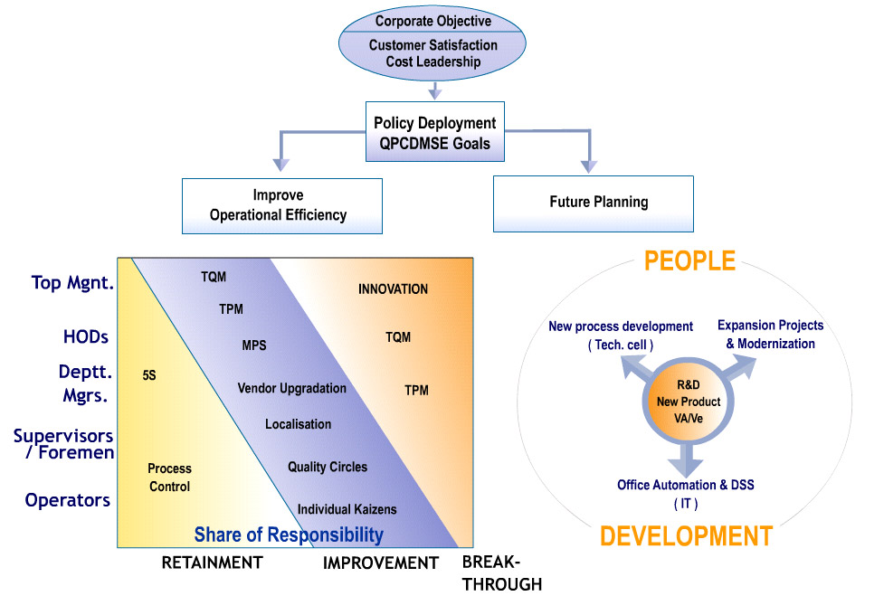
Sustenance Strategy – Continuous Improvement
Corporate Philosophy
ABC
6/22

Slide 17
TCM Principles
Enterprise wide Involvement
'Cost ownership' in a business was traditionally with few functions. 'Cost ownership' has to transcend into all functions of business
Maintaining sharp focus on 'costs' at all times; business cycle fluctuations, negative demand, price pressures and customer disruptions enrich the bottom lines
Functional excellence closely aligned to cost excellence is a clincher for design and drive to achieve 'cost economics'
Aligned to Policy Development(PD)
Policy deployment is a strategic improvement system in corporates
Leadership voice on TCM linked to business strategy to be communicated to all levels of hierarchy and functions
Mapping cost-based decision making points at customer, market and product level for the management team to address corrections and create profitability path
17

Slide 18
Illustrations of Enterprise wide involvement and Policy Deployment
In a FMCG company on TCM journey at a fairly high maturity, cost reduction targets are derived from Business Plan at a Product and Process level. These are then allocated as Cost Goals across the enterprise value chain. PDCA cycle is used by people to assess progress.
A OEM company manufacturing OTR and other earth moving equipments uses Policy Deployment Tool X matrix to transmit cost targets. For example Total Cost of Ownership is measured and deployed by marketing as a CRM tool.

Slide 19
TCM Principles
Process Orientation
Legacy view of 'cost flow' in a business is in the perspective of cost centers which is akin to cost pooling or cost allocation
'Cost incurrence' is across the value chain of business; sourcing, manufacturing, design, engineering, logistics, branding, sales & marketing etc.
Aligning cost information across the business processes & resources to product, customer and market segments provides holistic approach to cost management
Efficient monitoring is made possible through institutionalizing the cost captured across business processes
Performance Orientation
Measurement is the key to assessing performance. Cost focus should be ingrained as part of the KPIs
19

Slide 20
ILLUSTRATIONS OF PROCESS AND PERFORMANCE ORIENTATION.
A battery manufacturer faced lot of change overs in the order execution process due to small lots and product variety.
Resources incurred in change over did not happen in only one cost centre such as manufacturing.
Change over implications in various cost centres including Quality Assurance, Laboratory, Supply Chain and even in Finance function.
Started measuring Change over process costs by connecting supporting activity cost across cost centres customer wise and product wise.
A FMCG company with several product categories.
Resources spend on manufacturing pales in comparison with outlay on marketing, branding and channel management costs.
Cost Reduction was not the goal as and adverse impact was feared in category level strategies.
Brought in performance analysis category wise by bringing in spend analysis through Activity Based Costing vis a vis performance and various stages of category management.

Slide 21
TCM Process
Securing
governance
structure
Calibrating TCM
competency skills
among employees
IT enabled
architecture for
capturing cost
information
21

Slide 22
COST STRATEGY THROUGH A GOVERNANCE PROCESS
Company at the highest level of maturity in TCM journey.
Cost dimensions in business strategy converted into strategic and operational cost goals.
The strategic and operational goals placed at a Management Committee level structure and approved for deployment.
Deployment framework and manner of review also approved.
Periodic review of progress of the cost targets.
SAP configuration addressed to suit cost deployment through budgets.

Slide 23
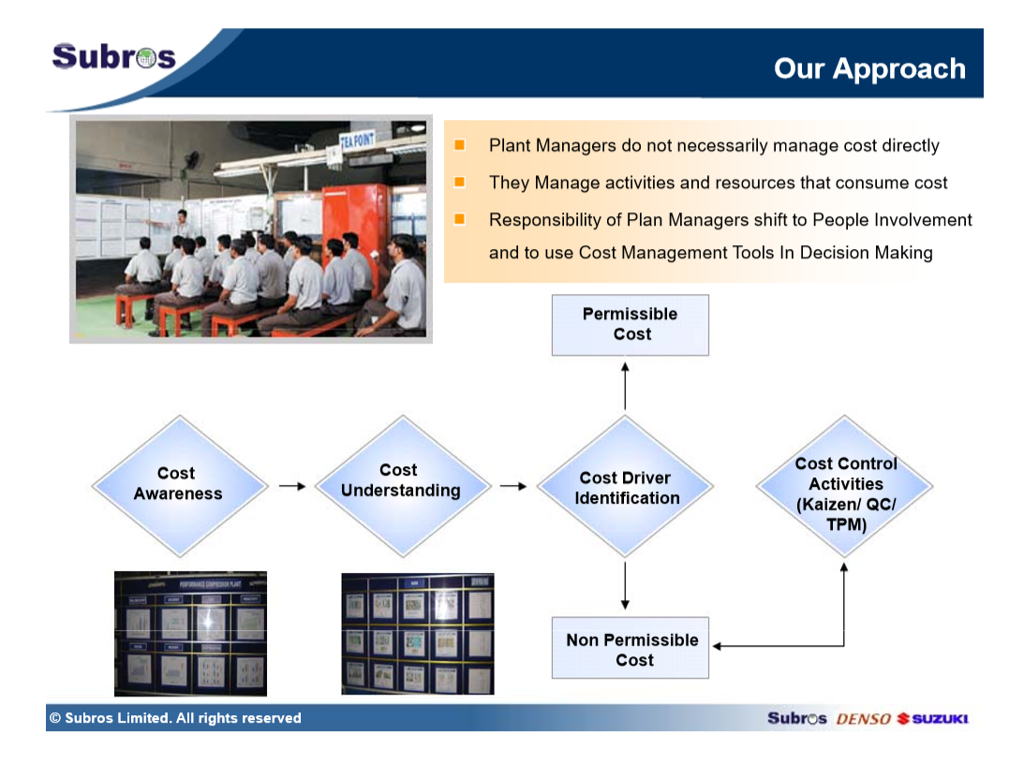
TCM
SKILL
DEVELOPMENT

Slide 24
TCM Maturity Levels
24

Slide 25






Companies pursuing TCM journey
Paper Board
Besides the above list which are fairly matured there are several other companies which are in varying degrees of maturity.
25

