Slide 1
TAXATION OF INDIVIDUALS (AY 2019-20)
& Return filing
CA P C Saini
(ACA,CS,CMA)

Slide 2
COVERAGE
Introduction
Why, Need
Heads of Income , Slab in India
Exemptions
Deduction
ITR filing procedures
ITR Filing claiming relief u/s 89

Slide 3
Introduction of Income Tax in India:
Tax is a mandatory liability for every citizen of the country. There are two types of tax in India i.e. direct and indirect.
Taxation in India is rooted from the period of Manu Smriti and Arthasastra. Present Indian tax system is based on this ancient tax system which was based on the theory of maximum social welfare.

Slide 4
Introduction of Income Tax in India:
In India, this tax was introduced for the first time in 1860, by Sir James Wilson in order to meet the losses sustained by the Government on account of the Military Mutiny of 1857.
In 1918, a new income tax was passed and again it was replaced by another new act which was passed in 1922. This Act remained in force up to the assessment year 1961-62 with numerous amendments.
In consultation with the Ministry of Law finally the Income Tax Act, 1961 was passed. The Income Tax Act 1961 has been brought into force with 1 April 1962. It applies to the whole of India and Sikkim (including Jammu and Kashmir).
Since 1962 several amendments of far-reaching nature have been made in the Income Tax Act by the Union Budget every year.

Slide 5
Present Scenario in India in case of ITR
ITR Wise receipt of e-Return July,2019
S.No. | ITR | FY 2017-18 | FY 2018-19 | FY 2019-20
1 | ITR-1 | 2,90,67,029 | 3,17,00,240 | 1,68,37,557
2 | ITR-2(Till AY 2016-17) | 3,76,948 | 43,752 | 14,404
3 | ITR-2(From AY 2017-18) | 46,55,177 | 47,77,808 | 20,02,244
4 | ITR-2A(For AY 2015-16 & 2016-17) | 3,13,934 | 5,460 | 233
5 | ITR-3(Till AY 2016-17) | 1,75,896 | 9,584 | 3,016
6 | ITR-3(From AY 2017-18) | 99,08,934 | 1,25,11,740 | 27,58,072
7 | ITR-4S(Till AY 2016-17) | 44,95,327 | 77,283 | 6,065
8 | ITR-4(Till AY 2016-17) | 29,85,995 | 1,21,011 | 20,109
9 | ITR-4(From AY 2017-18) | 1,27,61,551 | 1,47,73,246 | 47,90,834
10 | ITR-5 | 15,12,496 | 15,57,596 | 1,85,177
11 | ITR-6 | 9,38,620 | 9,62,573 | 27,850
12 | ITR-7 | 2,82,997 | 2,68,836 | 18,182
 | Total | 6,74,74,904 | 6,68,09,129 | 2,66,63,743

Slide 6
People raise the question 'Why should I pay tax?
They argue:
I have to pay for my food, for my house, for my travel, for my medical treatment, for owning a vehicle not only cost of vehicle but also vehicle tax and what not.
Even on many roads, one has to pay toll tax! They also say that if we compare with countries like USA and UK, the people get social security as also medical facilities virtually without any cost. But India does not offer such facilities.

Slide 7
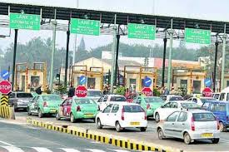

Slide 8
What Government Do from our TAX?
the major expenditure of Government has to be incurred on National Defense, Infrastructure Developments etc.
Taxes are used by the government for carrying out various welfare schemes including employment programs.
There are Lakhs of employees in various departments and the administrative cost has to be borne by the Government.
Though the judicial process involves delay, yet the Salaries, perks of Judges, Magistrates and judicial staff has also to be paid by the Government.
Thus on considering these various duties of the Government, we need to appreciate that we must pay tax as per law. We have to act like a responsible citizen.
The Government provide Health care through Government hospitals (usually they offer service without any cost), Education (In Municipal and Government schools the fee is negligible).
The Government also provides cooking gas at concessional rate or gives subsidy.

Slide 9
Tax Slab
Education Cess 3% +Health Cess of1 %
Surcharge of 10% on Rs. 50 Lakhs to Rs. 1 crore + Income earners
Surcharge of 15% on Rs. 1 Cr. Plus income earners
Tax credit of Rs. 2,500/- for income upto Rs. 3.5 Lakhs u/s 87A
Standard deduction of Rs. 40,000/-for Salaried and Pensioners
There are no separate slab for male & Female

Slide 11
Important Terms
Assessee
Assessment Year (A.Y. 2019‐20)
Previous Year (F.Y. 2018‐19)
Residential Status
Gross Total Income
Deductions
Total Income

Slide 12
Definition of 'Assessee' – Section 2(7) of Income Tax.
As per S. 2(7) of the Income Tax Act, 1961, unless the context otherwise requires, the term “assessee” means a person by whom any tax or any other sum of money is payable under this Act, and includes
Person in respect of whom any proceedings under this Act has been taken for assessment of his income
Deemed assessee under provisions of this Act
Any person deemed to be an assesse in default under any provisions of this Act
Assessment Year (A.Y. 2019‐20):
Assessment year means the period starting from April 1 and ending on March 31 of the next year.
Previous Year (F.Y. 2018‐19)
The financial year immediately preceding the assessment year

Slide 13
Important Terms
Residential Status of Individual:
Resident–World income is taxable in India
Non Resident(NRI)–Only income arising or accruing in India is taxable in India
Resident but Not Ordinarily Resident–Income accruing or arising outside India may also be taxable in India
Resident: On basis of stay in India computed separately every year
If satisfies any of the below condition:
1. He is in India for a period of 182 days or more in the FY
OR
2. He is in India for 60 days or more during that FY and has been in India for 365 days or more during 4 previous years immediately preceding the relevant Financial Year.
ROR or RNOR ?
He will be a ROR if he meets both of the following conditions:
1. Has been a resident of India in at least 2 out of 10 years immediately previous years and
2. Has stayed in India for at least 730 days in 7 immediately preceding years
Therefore, if any individual fails to satisfy even one of the above conditions, he would be an RNOR.

Slide 14
Gross Total Income
Deductions
Total Income

Slide 15
Income From Salary
Salary includes- Salary, Perquisite & Profit in lieu of Salary
Salary:
(i) wages;
(ii) any annuity or pension;
(iii) any gratuity;
(iv) any fees, commissions, perquisites or profits in lieu of or in addition to any salary or wages;
(v) any advance of salary;
(va) any payment received by an employee in respect of any period of leave not availed of by him;
(vi) the annual accretion to the balance at the credit of an employee participating in a recognised provident fund, to the extent to which it is chargeable to tax under rule 6 of Part A of the Fourth Schedule;
(vii) the aggregate of all sums that are comprised in the transferred balance as referred to in sub-rule (2) of rule 11 of Part A of the Fourth Schedule of an employee participating in a recognised provident fund, to the extent to which it is chargeable to tax under sub-rule (4) thereof; and
(viii) the contribution made by the Central Government or any other employer in the previous year, to the account of an employee under a pension scheme referred to in section 80CCD;

Slide 16
Income From Salary
"perquisite" includes —(i) the value of rent-free accommodation provided to the assessee by his employer;
(ii) the value of any concession in the matter of rent respecting any accommodation provided to the assessee by his employer;
(iii) the value of any benefit or amenity granted or provided free of cost or at concessional rate in any of the following cases—
(a) by a company to an employee who is a director thereof;
(b) by a company to an employee being a person who has a substantial interest in the company;
(c) by any employer (including a company) to an employee to whom the provisions of paragraphs (a) and (b) of this sub-clause do not apply and whose income under the head "Salaries"
(iv) any sum paid by the employer in respect of any obligation which, but for such payment, would have been payable by the assessee;

Slide 17
Income From Salary
(v) any sum payable by the employer, whether directly or through a fund, other than a recognised provident fund or an approved superannuation fund or a Deposit-linked Insurance Fund established under section 3G of the Coal Mines Provident Fund and Miscellaneous Provisions Act, 1948 (46 of 1948), or, as the case may be, section 6C of the Employees' Provident Funds and Miscellaneous Provisions Act, 1952 (19 of 1952), to effect an assurance on the life of the assessee or to effect a contract for an annuity;
(vi) the value of any specified security or sweat equity shares allotted or transferred, directly or indirectly, by the employer, or former employer, free of cost or at concessional rate to the assessee.
(vii) any contribution to an approved superannuation fund by the employer in respect of the assessee, to the extent it exceeds one lakh and fifty thousand rupees; and
(viii) the value of any other fringe benefit or amenity as may be prescribed:]

Slide 18
Income from Salary
Particulars | Amount
Basic Salary | —
Add: | —
1. Fees, Commission and Bonus | —
2. Allowances | —
3. Perquisites | —
4. Retirement Benefits | —
5. Fees, Commission and Bonus | —
Gross Salary | —
Less: Deductions from Salary | —
1. Entertainment Allowance u/s 16 | —
2. Professional Tax u/s 16 | —
Net Salary | —

Slide 19
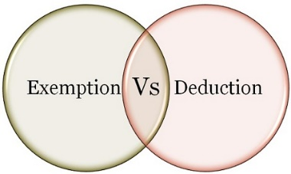
What is the difference between Exemption and deduction?
If an income is exempt from tax, then it is not included in the computation of income. However, the deduction is given from income chargeable to tax.
Exempt income will never exceed the amount of income. However, the deduct may be less than or equal to or more than the amount of income.
Exemption : Section 10 deals with exemptions
Deduction: Section 80 C to 80 U deals with deduction

Slide 20
Exemption
Section 10(1) to Section 10(38) Deals with exempt Income
Section 10(5)-Leave Travel Allowance*
The bills for your travel against LTA can be claimed for exemption. It is allowed to be claimed twice in a block of four years. The current block is 2018 to 2021.
is exempt from tax in the hands of employee as per following.
If journey by Air –Economy class fare of the national carrier( Air India) by shortest route or the amount spent whichever is less.
If journey by Rail – AC First class fare by shortest route or the amount spent whichever is less
Where places of origin of Journey and destination are connected by rail & journey is performed by any other mode of transport- AC First class fare by shortest route or the amount spent whichever is less.
Where places of origin of Journey and destination are not connected by rail,
a) Recognized public transport exists- First class or deluxe class fare by the shortest route or the amount spent, whichever is less.
b) No recognized public transport exists - AC First class rail fare by Shortest route or the amount spent whichever is less

Slide 21
Exemption
Section 10(1) to Section 10(38) Deals with exempt Income
Section 10(5)-Leave Travel Allowance
Conditions:*
LTA should be uniform to all the employees
employers need to collect and scrutinize the proof of travel (ticket etc.)
limited to the actual expenses incurred
Any Leave encashed for the purpose of Leave travel or home travel concession is taxable.
Foreign Travel – The exemption is not available in case of Foreign Travel
The Exemption is not available to more than 2 surviving children of an individual born after 1.10.1998. However, this restriction is not there in respect of children born before 1.10.1998.

Slide 22
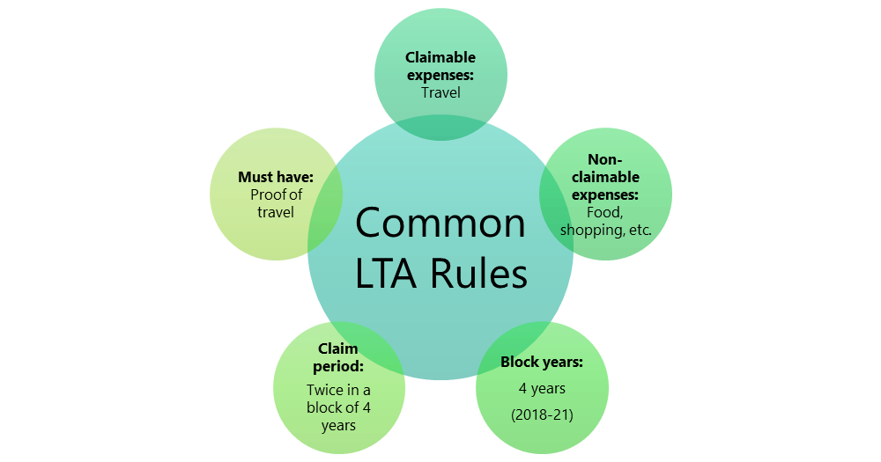
Section 10(5)-Leave Travel Allowance

Slide 23
Section 10(13A): House Rent Allowance(HRA)
This is the famous exemption which is used by many salaried individuals. However, the wrong belief is that whatever the rent they pay is actually exempted from their income. The reality is different. The amount of exemption is least of the following.
a) Actual HRA Received
b) 40% of Salary (50%, if house situated in Mumbai, Calcutta, Delhi or Madras)
c) Rent paid minus 10% of salary
(Salary= Basic + DA (if part of retirement benefit) + Turnover based Commission)

Slide 24
Allowances Exempt under Section 10(14)(I)-No limit
Travelling Allowance
Daily Allowance
Conveyance Allowance:-This is the different allowance than transport allowance. It is the expenditure granted to an employee to meet the expenses on conveyance in performing of his office duties.
Helper Allowance
Academic Allowance:- Allowance granted for encouraging academic, research & training pursuits in educational & research Institutional.
Uniform allowance

Slide 25
“standard deduction” of Rs. 40,000.
Particulars | Until AY 2018-19 | From AY 2019-20
Gross Salary (in Rs.) | 5,00, 000 | 5,00,000
(-) Transport Allowance | 19,200 | Not Applicable
(-) Medical Allowance | 15,000 | Not Applicable
(-) Standard Deduction | Not Applicable | 40,000
Net Salary | 4,65,800 | 4,60,000
Benefit of Extra 5,800 now available

Slide 26
Deduction U/s (16)
There are basically two deduction
1.) Entertainment Allowance [Section 16(ii)] -(Government Employees)
2.) Professional Tax [Section 16(iii)]

Slide 27
Income from House Property
Particulars | Amount (Rs.)
Gross Annual Value | xxx
Less: Municipal taxes | (xxx)
Net Annual Value | xxx
Less: Deductions u/s 24 Standard deduction Deduction on interest paid | (xxx) (xxx)
Taxable income from house property
Deductions: 1. Standard Deduction u/s 24@30% of Annual Value
2. Interest paid on home loan( Max Rs. 200,000/-)
3. Loan Principle payment u/s 80C
4. Deduction for fist time home buyer u/s 80EE

Slide 28
Deduction for fist time home buyer u/s 80EE
First time Home Buyers can claim an additional Tax deduction of up to Rs.50,000 on home loan interest payments under this section. Below are the few conditions for this.
He must be an individual (Resident or Non-Resident).
Loan must be taken for the acquisition of the property.
Loan should be sanctioned after 2016-17.
Loan amount should not exceed Rs. 35 Lakh.
The value of the house should not be more than Rs 50 Lakh.
The home buyer should not have any other existing residential house during the sanction of loan.
Do remember that if you claimed the interest under this section, then the same can’t be claimed under other sections for deductions.

Slide 29
Income from Other Sources
1.) Income:
Dividend
Interest- From Savings, Term deposit, income tax refund, other
Income of winnings from lotteries, crossword puzzles etc., excluding income from owning race horses
Income from the activity of owning and maintaining race horses

Slide 30
Income from Other Sources -DEDUCTIONS
Deduction on Interest Income Under Section 80TTA
For a residential individual (age of 60 years or less) or HUF, interest earned upto Rs 10,000 in a financial year is exempt from tax. The deduction is allowed on interest income earned from:
savings account with a bank;
savings account with a co-operative society carrying on the business of banking; or
savings account with a post office
Senior citizens are not entitled to benefits under section 80TTA.
Interest income in case of Fixed Deposit (PAN)
Tax on Fixed Deposits
Senior citizens, with effect from 1 April 2018, will enjoy an income tax exemption up to Rs. 50,000/- on the interest income they receive from fixed deposits with banks, post offices etc. under Section 80TTB.

Slide 31
Exempt Income
The PPF and EPF amount you withdraw after maturity is exempt from tax and must be declared as exempt income from income from other sources.
Note that: The EPF is only tax exempt after five years of continuous service.
Family Pension
If you are collecting pension on behalf of someone who is deceased, then you must show this income under income from other sources. There is a deduction of Rs 15,000 or one-third of the family pension received whichever is lower from the Family Pension Income. This will be added to the taxpayer’s income and tax must be paid at the tax rate that is applicable.
Taxation of Winnings from Lottery, Game Shows, Puzzles
If you receive money from winning the lottery, Online/TV game shows etc., it will be taxable under the head Income from other Sources. The income will be taxable at the flat rate of 30% which after adding cess will amount to 30.9%

Slide 32
Deductions under Chapter VI-A
Section 80C
Maximum Limit- Rs.1,50,000/-
You can save tax on salary income from this section alone
Different Investment in this section includes
Life Insurance premium (Paid by an individual, spouse, and child. In the case of HUF, on the life of any member of HUF).
EPF-Employee contribution can be claimed for deduction.
Public Provident Fund (Paid by an individual, spouse, and child. In the case of HUF, on the life of any member of HUF).
National Savings Certificate (NSC).
Sukanya Samriddhi Account
ELSS or Tax Saving Mutual Funds
Senior Citizen Savings Scheme
5-Years Post Office or Bank Deposits.
Tuition fee of kids.
Principal payment towards home loan.
Stamp duty and registration cost of the house.

Slide 33
Deductions under Chapter VI-A
Section 80CCC
Deduction under Sec.80CCC is available only for individuals. Contribution to an annuity plan of the LIC of India or any other insurer for receiving the pension. Do remember that the amount should be paid or deposited out of income chargeable to tax.
Note:- this is also the part of the combined limit of Rs.1.5 lakh available under Sec.80C Sec.80CCC, and Sec.80CCD(1)

Slide 34
Deductions under Chapter VI-A
NPS Tax Benefit-Section 80CCD1
An individual’s maximum 20% of annual income (Earlier it was 10% but after Budget 2017, it increased to 20%) or an employees (10% of Basic+DA) contribution will be eligible for deduction.
Note:- this is also the part of the combined limit of Rs.1.5 lakh available under Sec.80C Sec.80CCC, and Sec.80CCD(1)
NPS Tax Benefit-Section 80CCD2
There is a misconception among many that there is no upper limit for this section. However, the limit is least of 3 conditions.
1) Amount contributed by an employer,
2) 10% of Basic+DA and
3) Gross Total Income.
This is additional deduction which will not form the part of Sec.80C limit.
The deduction under this section will not be eligible for self-employed.

Slide 35
Deductions under Chapter VI-A
NPS Tax Benefit-Section 80CCD(1B)
This is the additional tax benefit of up to Rs.50,000 eligible for income tax deduction and was introduced in the Budget 2015, One can avail the benefit of this Sect.80CCD (1B) from FY 2015-16.
Both self-employed and employees are eligible for availing this deduction.
This is over and above Sec.80CCD (1).

Slide 36
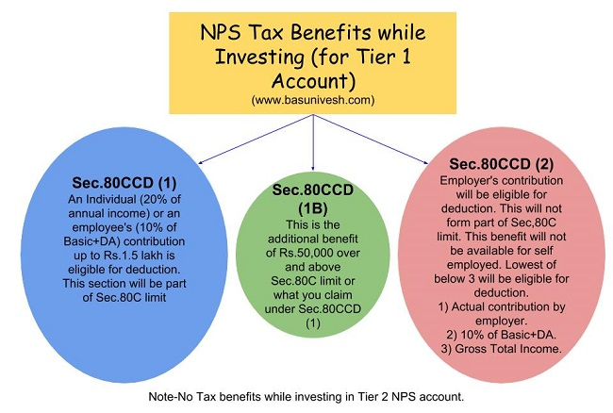
Deductions under Chapter VI-A
NPS Tax Benefit Summary

Slide 37
Deductions under Chapter VI-A
Section 80D
Deduction under this section is available if you satisfy the following conditions.
The taxpayer should be an individual (resident, NRI or Foreign Citizen) or HUF.
Payment should be made out of income chargeable to tax.
Payment should be in NON-CASH mode (for preventive health check up, you can pay either through cash or non-cash mode).
Changes from Budget 2018-
In Budget 2018, the maximum tax deduction limit for senior citizens under Sec.80D is raised to Rs.50,000. The earlier limit was Rs.30,000.
In case of single premium health insurance policies having a cover of more than one year, it is proposed that the deduction shall be allowed on a proportionate basis for the number of years for which health insurance cover is provided, subject to the specified monetary limit.

Slide 38
Deductions under Chapter VI-A
Section 80DD
A resident individual or HUF is allowed to claim the deduction
If incurred an expenditure for medical treatment, training, and rehabilitation of dependent relative (being a person with a disability).
Can be claimed only when deposited or paid for any approved scheme of LIC (or any other insurance) or UTI for the maintenance of such dependent relative.
Fixed deduction of Rs.75,000
Higher deduction of Rs.1,25,000 is available if such dependent relative is suffering from severe disability
NOTE:-dependent means spouse, children, parents, brothers, and sisters, who is wholly and mainly dependent upon the individual.

Slide 39
Deductions under Chapter VI-A
Section 80DDB
An Individual’s of HUFs expenses actually paid for medical treatment of specified diseases and ailments subject to certain conditions can be claimed under this section.
The maximum deduction is Rs. 40,000. This can also be claimed on behalf of the dependents. The tax deduction limit under this section for Senior Citizens and very Senior Citizens (above 80 years) is now revised to to Rs 1,00,000.
With effect from the assessment year 2016-17, the taxpayer shall be required to obtain a prescription from a specialist doctor (not necessarily from a doctor working in a Government hospital) for availing this deduction.
Can claim the deduction for the medical treatment of self, spouse, children, parents brothers, and sisters of the individual.

Slide 40
Deductions under Chapter VI-A
The ailments covered under this section are as below:
Section 80DDB
# Neurological Diseases where the disability level has been certified to be of 40% and above;
(a) Dementia (b) Dystonia Musculorum Deformans (c) Motor Neuron Disease (d) Ataxia (e) Chorea (f) Hemiballismus (g) Aphasia (h) Parkinson’s Disease
# Malignant Cancers
# Full Blown Acquired Immuno-Deficiency Syndrome (AIDS) ;
# Chronic Renal Failure
# Hematological disorders
a) Hemophilia
b) Thalassaemia

Slide 41
Deductions under Chapter VI-A
Section 80E
If the loan is taken by an individual for any study in India or outside India, then they can claim the deduction.
The interest part of the loan on such education loan can be claimed for deduction for pursuing individual’s own education or for the education of his relatives (Spouse, children or any student for whom the individual is legal guardian).
The entire interest is deductible in the year in which the individual starts to pay interest on the loan and subsequent 7 years or until interest is paid in full (i.e for total 8 years).
NOTE:-Interest should be paid out of the income of chargeable to tax.

Slide 42
Deductions under Chapter VI-A
Section 80G
Donations to certain approved funds, trusts, charitable institutions/donations for renovation or repairs of notified temples, etc can be claimed as a deduction under this section.
This deduction can only be claimed when the contribution made by cheque or draft or in cash. In-kind contributions like food material, clothes, medicines etc. do not qualify for deduction under this section.
The donations made to any Political party can be claimed under section 80GGC.
From FY 2017-18, the limit of deduction under section 80G / 80GGC for donations made in cash is reduced from current Rs 10,000 to Rs 2,000 only.

Slide 43
Deductions under Chapter VI-A
Section 80GG
This section only applies to those who have not availed HRA in their salary or not claiming the deduction on their rent in any of the other sections of income
Conditions:
Applicable to Individual or HUF.
Tax Payer may be either salaried or a self-employed. However, must not be getting HRA.
Tax Payer himself or spouse/Minor Child/HUF of which he is a member should not own any accommodation at a place where he is doing a job or business
If Tax Payer owns a house at a place other than the place noted above, then the concession in respect of self-occupied property is not claimed by him [Under Section 23 (2) (a) or 23 (4) (a)].
Tax Payer has to file a declaration in Form No.10BA regarding the expenditure incurred by him towards the payment of rent.

Slide 44
Deductions under Chapter VI-A
Section 80GG
How much amount of deduction one can avail under Sec. 80GG?
If the all five conditions are satisfied, the amount deductible under Section 80GG is LEAST OF THE FOLLOWING.
Rs.5, 000 per month;
25% of total income of taxpayer for the year; or
Rent Paid less 10% of total income (Rent Paid-10% of Total Income).

Slide 45
Deductions under Chapter VI-A
Section 80U
To claim tax benefits under Sec.80U, the taxpayer should be an individual and resident of India.
If he is suffering from 40% or more than 40% of any disability, then he can claim a tax deduction.
You can claim the fixed deduction of Rs.75,000. a higher deduction of Rs.1,25,000 is allowed in respect of a person with a severe disability (i.e. having a disability of 80% or above).

Slide 46
Rebate under Section 87A
The tax rebate of Rs.2,500 for individuals with income of up to Rs 3.5 Lakh has been proposed in Budget 2017-18.
To avail this benefit, there are certain conditions and they are as below.
The taxpayer must be a resident individual.
Your Total Income (Less Deductions from 80C to 80U) is equal to or less than Rs.3,50,000.
The rebate is the 100% of income tax on such income or Rs.2,500 (whichever is less).

Slide 47
ITR Filing Procedures- Sec 139
Section 139 consists of various subsections which deals with different types of Income tax returns. These subsections are as follows:
Section 139(1) – Mandatory and Voluntary Returns
Section 139(1) deals with the mandatory and voluntary filing of income tax returns by the taxpayer:
Mandatory Return
The following taxpayers are required to file a mandatory income tax return are listed below:
Any private, public, foreign, domestic company.
Any Limited Liability Partnership (LLP) and unlimited liability partnership.
Any total individual income is exceeding the exemption limit.

Slide 48
ITR Filing- Sec 139
Voluntary Return
If the filing of income tax return is not mandatory for an individual, then the income tax filed by that individual will be termed as a voluntary return. Voluntary returns are also considered as valid returns of income tax.
Note: Under Section 139(1c), certain people are exempt from filing income tax. If these classes of people fulfil the prescribed conditions, the central government is empowered to grant them tax exemption.

Slide 49
ITR Filing- Sec 139
Section 139(3) – Filing Income Tax Return in Case of Loss
Section 139(3) deal with tax returns in case of loss incurred in a company or firm.
If losses are incurred in any income under the head “Profits and Gains of Business and Profession” or the head “Capital Gains”, then income tax return must be filed before the due date mentioned under section 139(1).
The following heads mentioned below will not be affected by the delayed filing of income tax return:
Any loss occurred under the heads of “House and residential property”.
Any loss occurred by the unabsorbed property as mentioned under section 139(3).

Slide 50
ITR Filing- Sec 139
Section 139(4) – Late Filing Income Tax Return
Section 139(4) deals with late filing of income tax return. Its provisions have been described below:
The taxpayer can file late income tax returns before end of the Assessment year or completion of Assessment u/s144.
The tax payer with late filing of income tax returns may incur a fee of Rs 5,000 as specified under Section 234F upto Dec and Rs10000 after Dec’19 ( maximum Rs.1000 for total Income below Rs.5.00 lakh).
However, no penalty shall be levied on returns that were not required to be mandatorily filed as per Section 139(1).

Slide 51
ITR Filing- Sec 139
Section 139(5) – Revised Return
Section 139(5) deals with revised income tax return in case of any mistakes while filing the original income tax returns. The following are its provisions:
If the original or initial income tax return was filed by the assessee or entity as per Section 139(1) , he/she can file a revised income tax return before end of the Assessment year of relevance or prior to the completion or conclusion of assessment, depending on which takes place sooner.
A late income tax return cannot be revised. However, any loss return that was filed within the prescribed due date as mentioned in Section 139(1) can be revised.

Slide 52
ITR Filing- Sec 139
Section 139(4a) – Income Tax Return of Charitable and Religious Trust
Any individual whose income received from the property occupied by a public charity or religious trust and claims tax exemptions under Section 11 and Section 12 of the Income Tax Act are compulsorily required to file their tax returns, provided that the sum of the income collected prior to the provisions under section 11 and Section 12 is beyond the basic limit allowed for exemption.

Slide 53
ITR Filing- Sec 139
Section 139(4B) – Return of Income of a Political Party
Any political party will be required to mandatory file its tax returns provided that the sum of the income collected by the party is beyond the basic limit allowed for exemption without taking into consideration any benefits mentioned under section 13A.

Slide 54
ITR Filing- Sec 139
Section 139(4C) and (4D)- Claiming Exemption under Section 10
Section 139(4C) and Section 139(4D) deals with specific institutions who claim privileges as per the provision of Section 10 of the Income Tax Act 1961.
These sections state that an institution is mandatorily required to file its income tax returns provided that the sum of the income collected by the institution in question is beyond the basic limit allowed for exemption, without taking into consideration any other exemption benefits.

Slide 55
ITR Filing- Sec 139
Section 139(9) – Defective Returns
As per the provisions under section 139(9), income tax return is defective when specific documents are not attached with the income tax return. In case the return is considered defective by the tax officer, then the concerned tax payer will be informed by him and be allowed to rectify the defect within 15 days starting from the day of intimation.
In the request from tax payer through an application, the allowable period could be extended. The assessing officer intimates the tax payer about the defect through a simple letter.

Slide 56
ITR Filing- Sec 139
Due Dates for Filing Return
Section 139 contains various sub-sections that deal with different kinds of returns filed by different individuals related to late payments and mistakes. Hence, the due dates for filing their income tax returns are prescribed below:
July 31st
Any individuals who do not need an audit to be conducted for their books of account are required to file income tax returns by July 31, of every assessment year. This includes the following individuals are specified below:
A person or employee who is paid with a wage.
Any self-employed individual.
Any consultant or freelancer.

Slide 57
ITR Filing- Sec 139
September 30th
All individuals who require an audit for their books of account must file their tax returns on September 30th of each assessment year. The following individuals might come under this category:
A business entity.
A self-employed person or professional.
A working partner employed with a firm or a consultant who requires to have an audit performed on his accounting book.

Slide 58
ITR Filing- Sec 139
Form ITR 7
Income Tax Department made Form ITR 7 is applicable for all individuals, institutions and entities who require to file a return under Sections 139(4a), 139(4b), 139(4c) and 139(4d). Taxpayers are suggested to match the tax values as collected, paid or deducted amounts with Form 26AS, the Tax Credit Statement. ITR-7 could be filed with IT Department by any of the following manners:
Filing in a paper form.
Filing electronically using a digital signature.
Electronically transmitting data followed by Submission of Verification of return in the Form ITR-V.
Furnishing return that is bar-coded.

Slide 59
ITR Filing- Sec 139
Section 139(4e)
This section is for furnishing return for income by business trusts which are not needed to furnish the return for profit or loss following some other provision under section 139(4e).

Slide 60
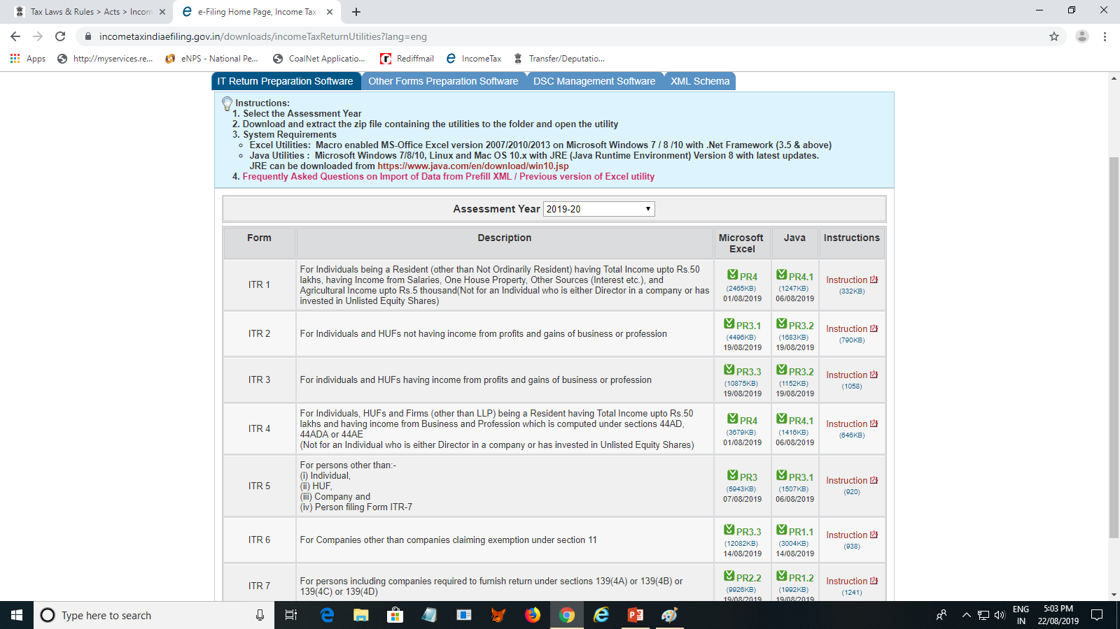
ITR FORMS

Slide 61
Income Tax E-Filing ( ITR-1)
Total ITRs are – ITR 1 to ITR 7
ITR-1
i. Earlier ITR-1 was applicable for both Residents, Residents Not ordinarily resident (RNOR) and also Non-residents. Now, this form has been made applicable only for resident individuals ii. The condition of the individual having income from salaries, one house property, other income and having total income up to Rs 50 lakhs continues iii. There is a requirement to furnish a break-up of salary. Until now, these details would appear only in Form 16 and the requirement to disclose them in the return had never arisen iv. There is also a requirement to furnish a break up of Income under House Property which was earlier mandatory only for ITR -2 and other forms

Slide 62
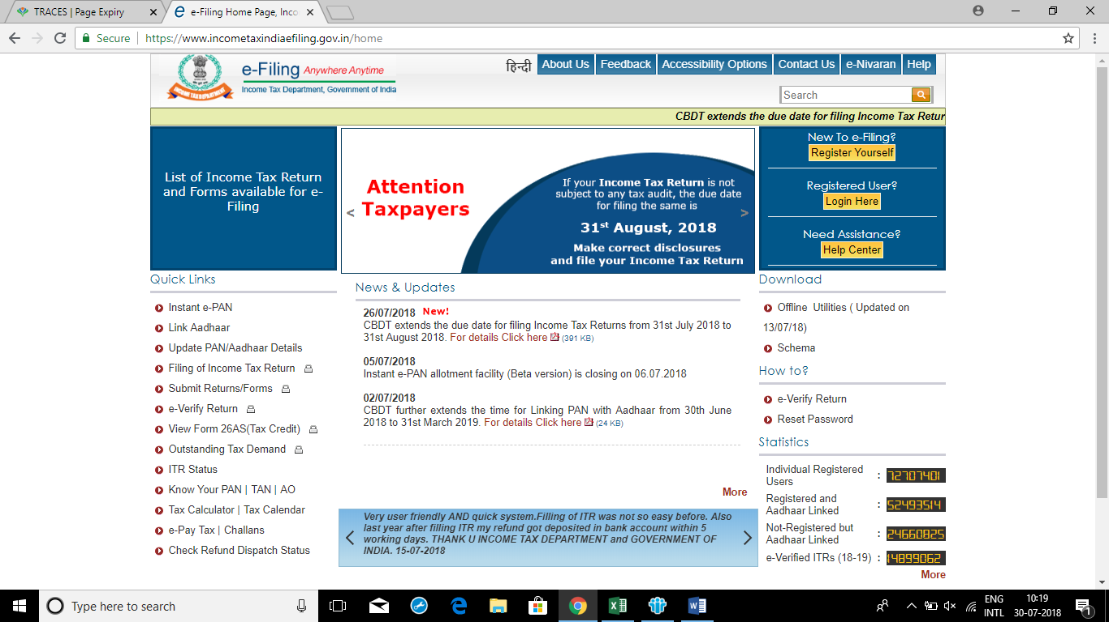
Income Tax E-Filing ( ITR-1)

Slide 63
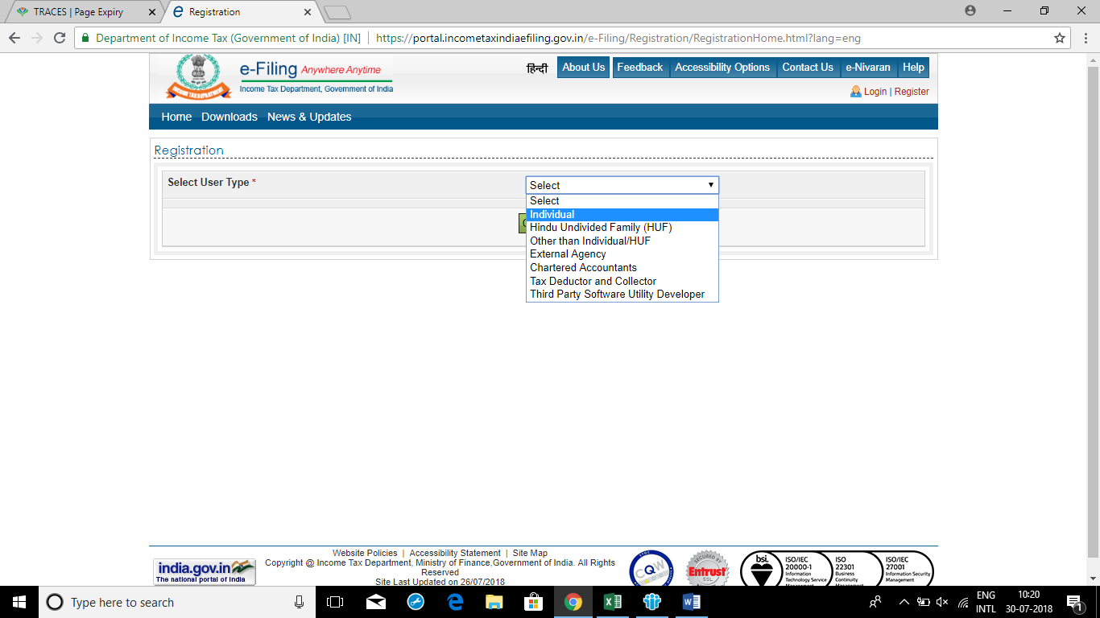
Income Tax E-Filing ( ITR-1)

Slide 64
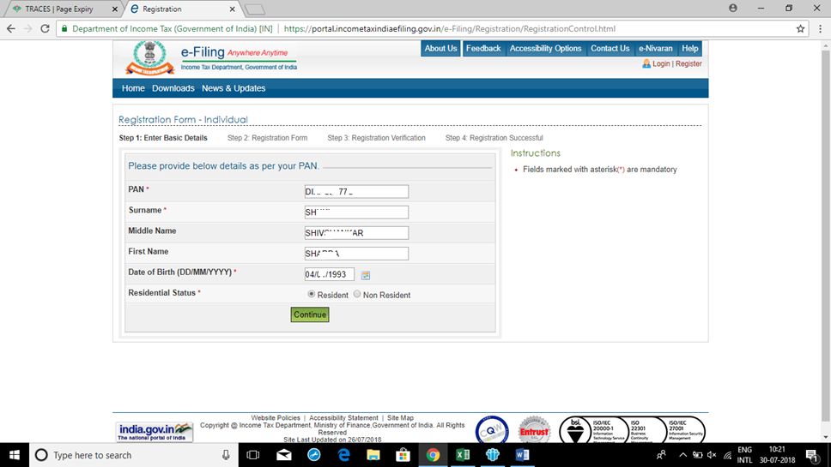
Income Tax E-Filing ( ITR-1)

Slide 65
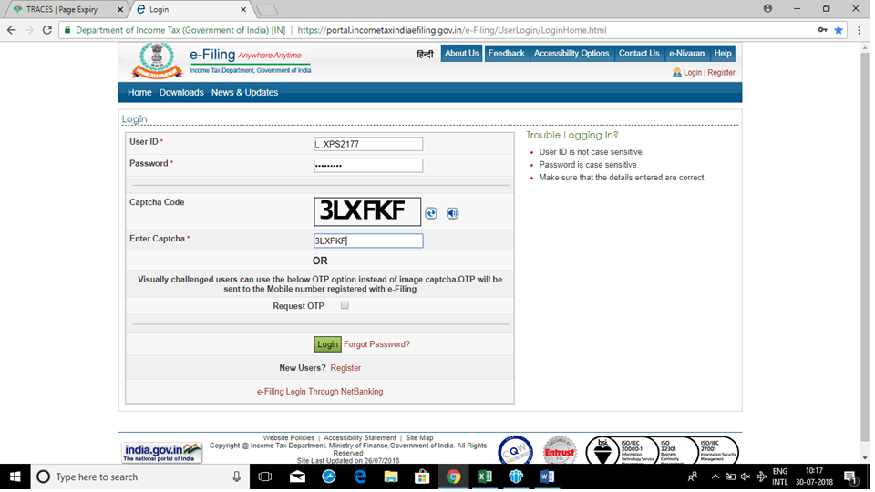
Income Tax E-Filing ( ITR-1)

Slide 66
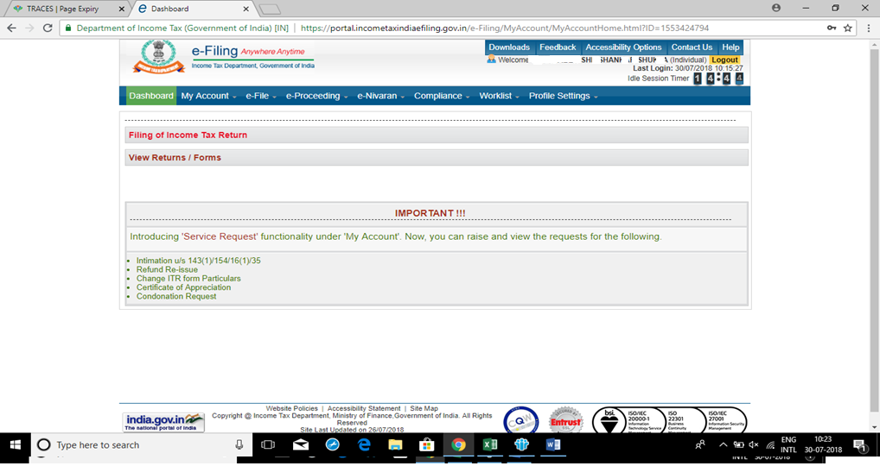
Income Tax E-Filing ( ITR-1)

Slide 67
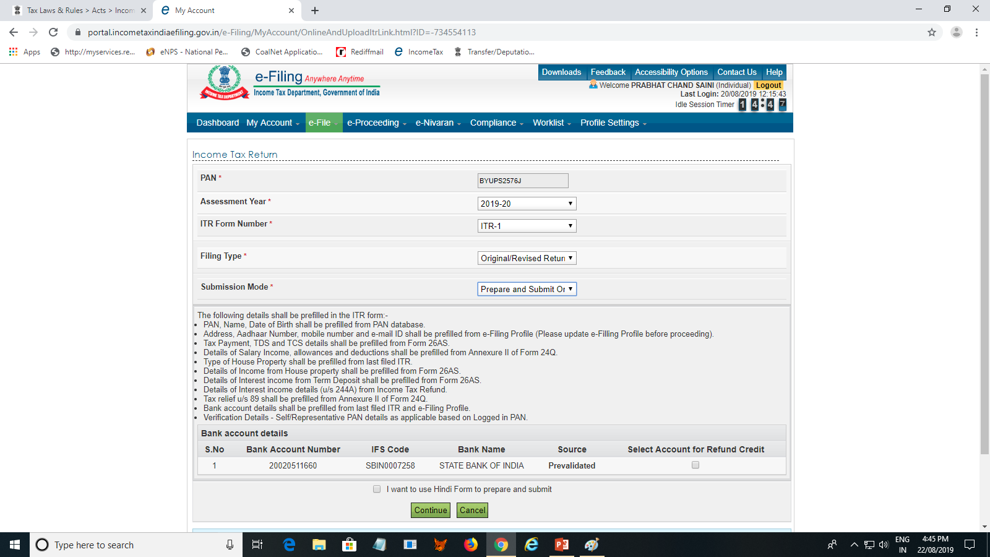
Income Tax E-Filing ( ITR-1)

Slide 68
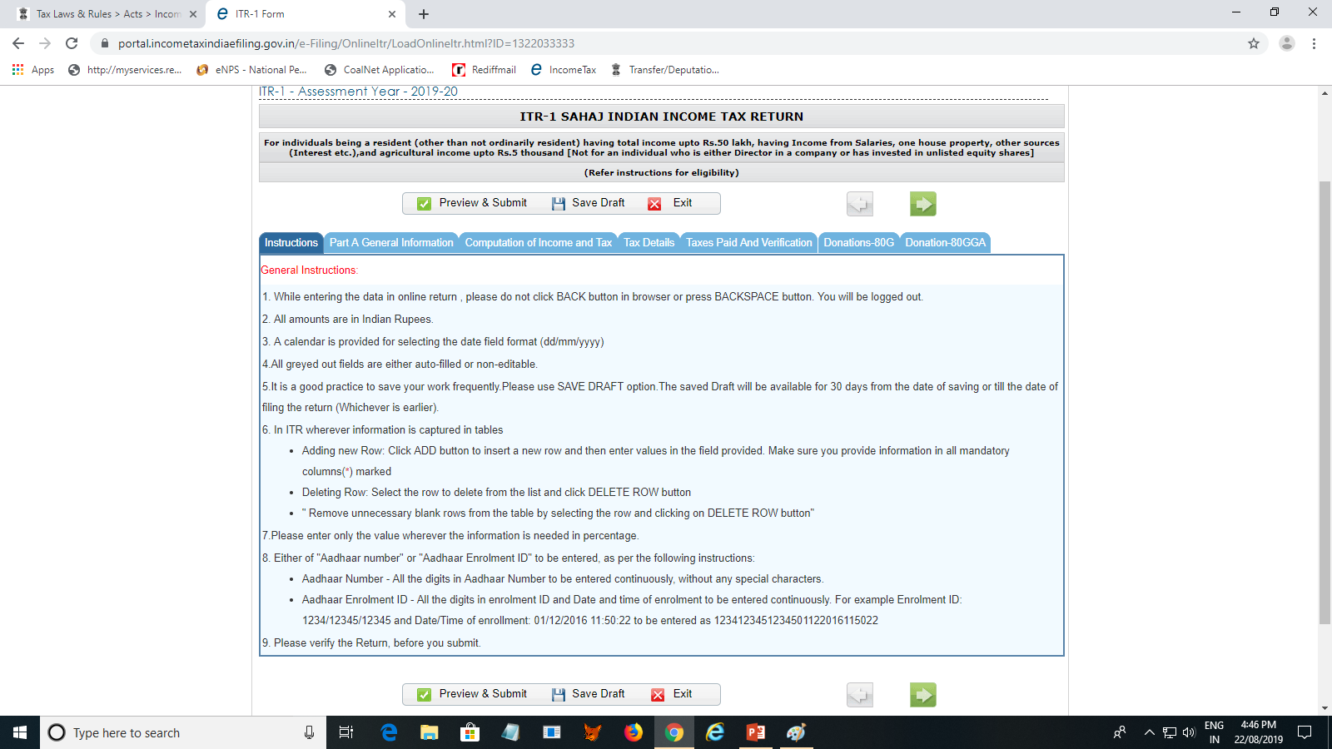
Income Tax E-Filing ( ITR-1)

Slide 69
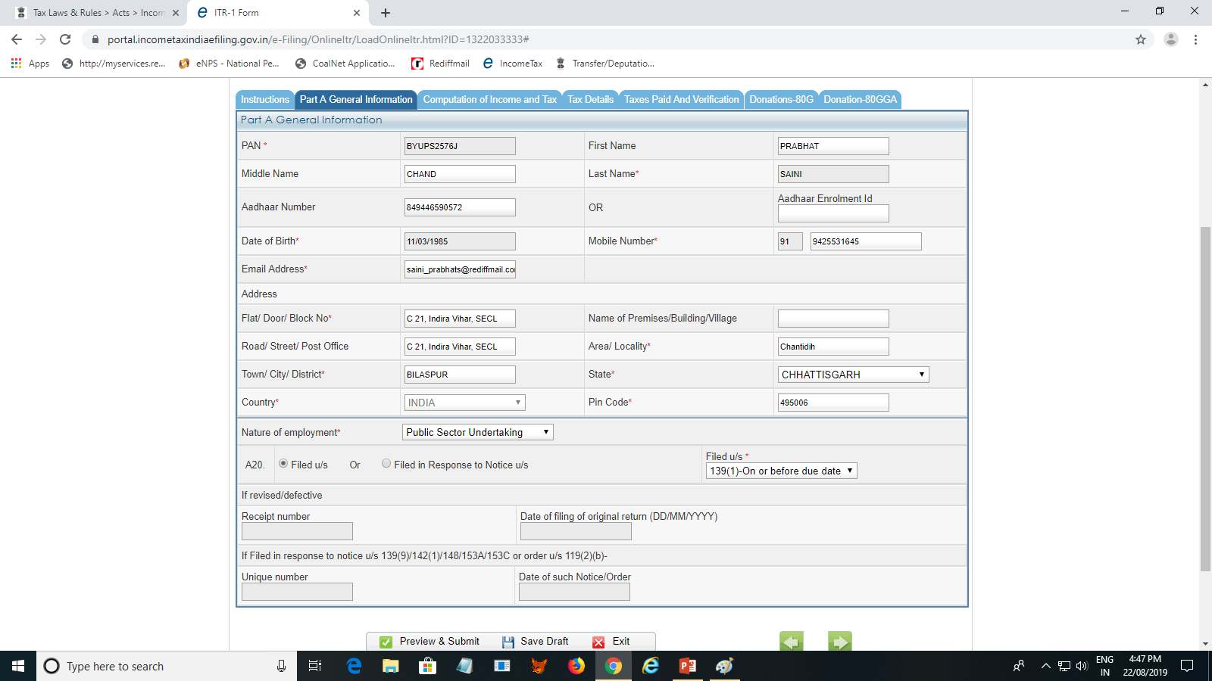
Income Tax E-Filing ( ITR-1)

Slide 70
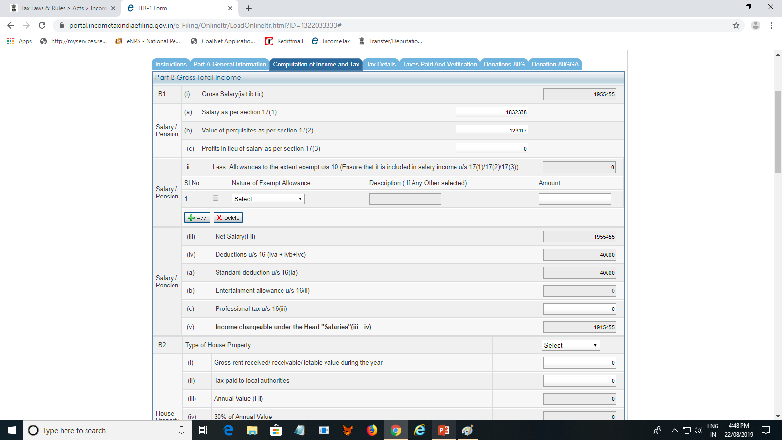
Income Tax E-Filing ( ITR-1)

Slide 71
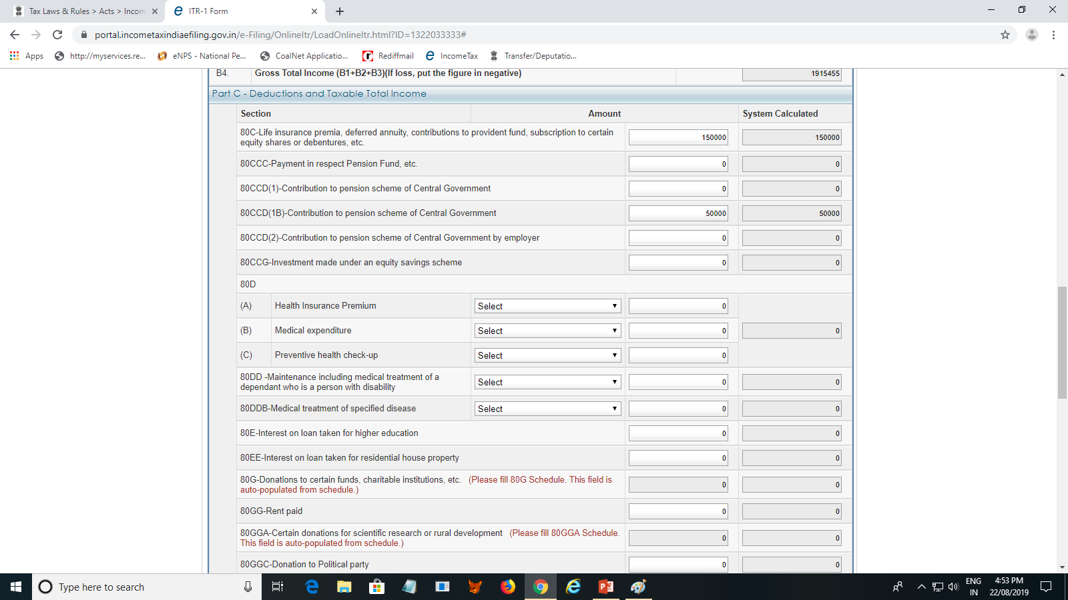
Income Tax E-Filing ( ITR-1)
Limit- Rs. 1,50,000/-

Slide 72
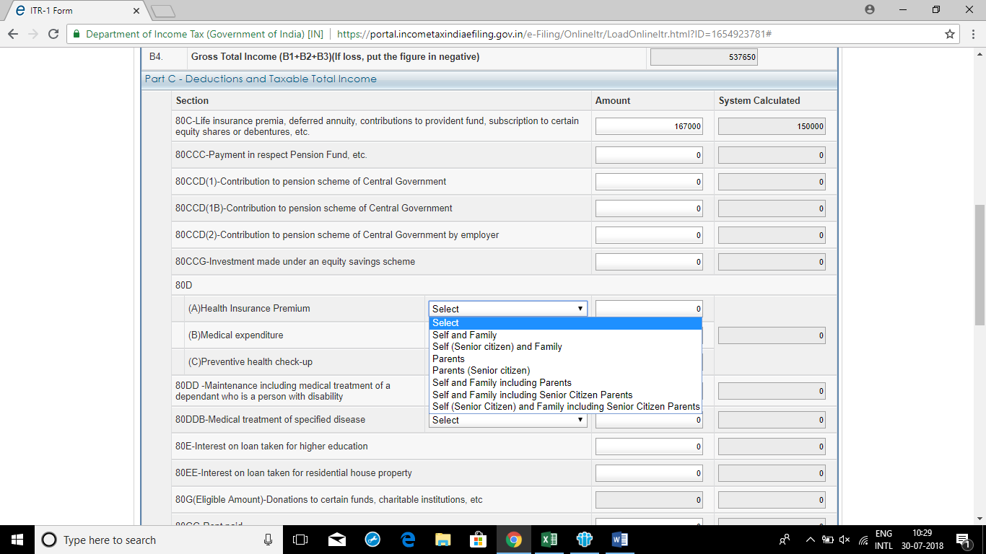
Income Tax E-Filing ( ITR-1)

Slide 73
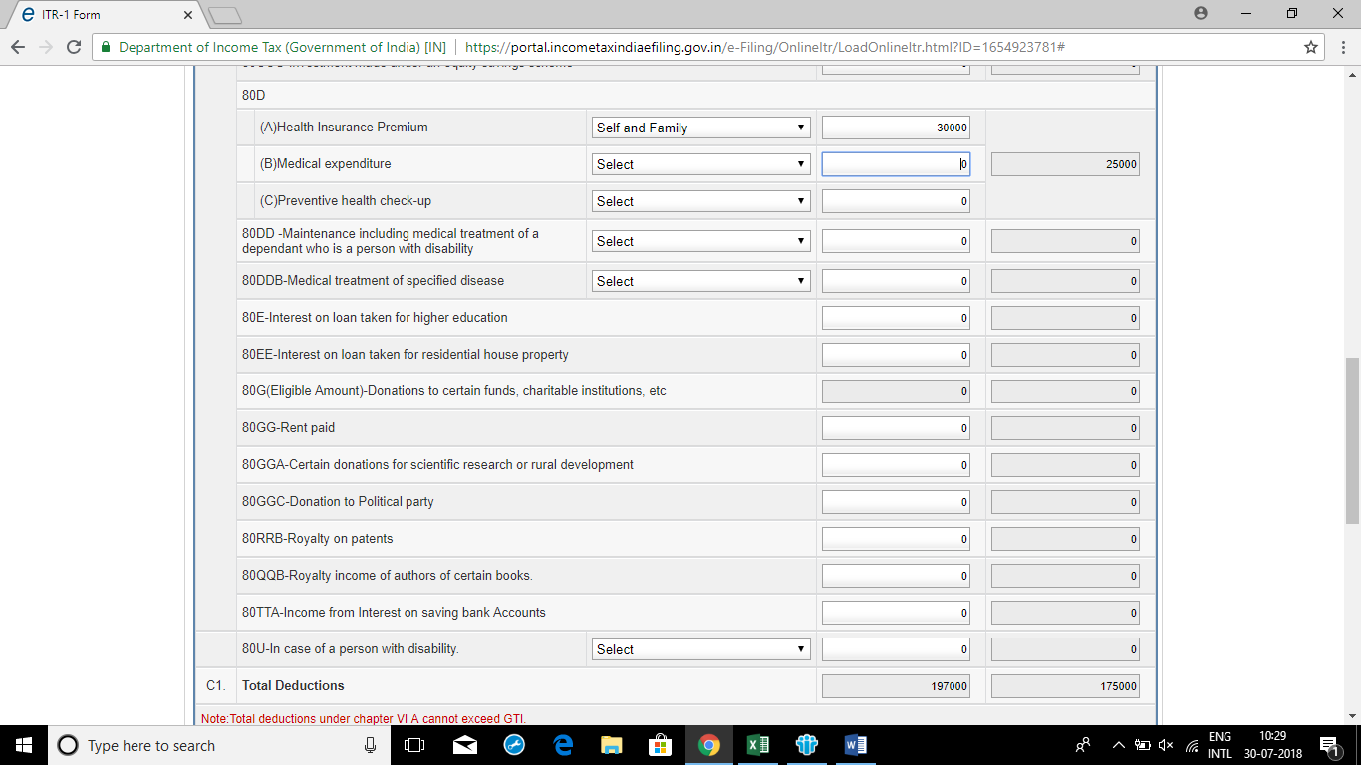
Income Tax E-Filing ( ITR-1)

Slide 74
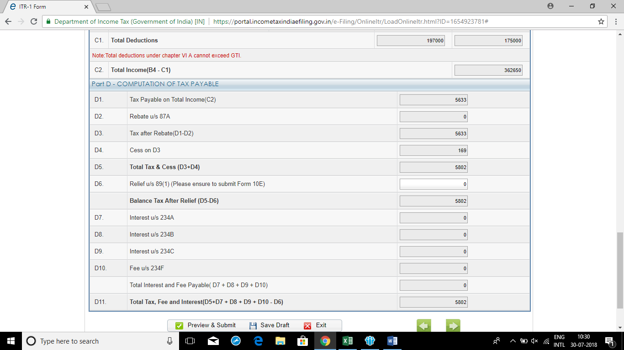
Income Tax E-Filing ( ITR-1)

Slide 75
Income Tax E-Filing ( ITR-1)
Rebate u/s 87A
Limit- Taxable Income-Rs.3,50,000/-

Slide 76
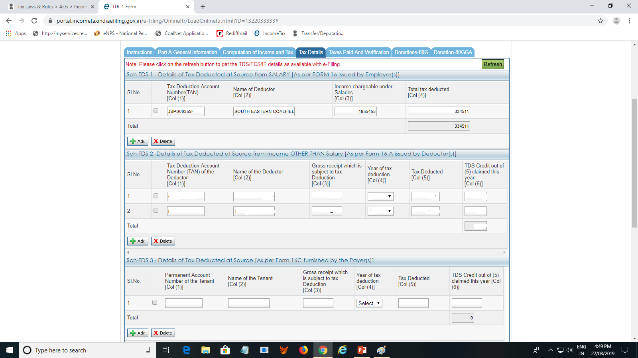
Income Tax E-Filing ( ITR-1)

Slide 77
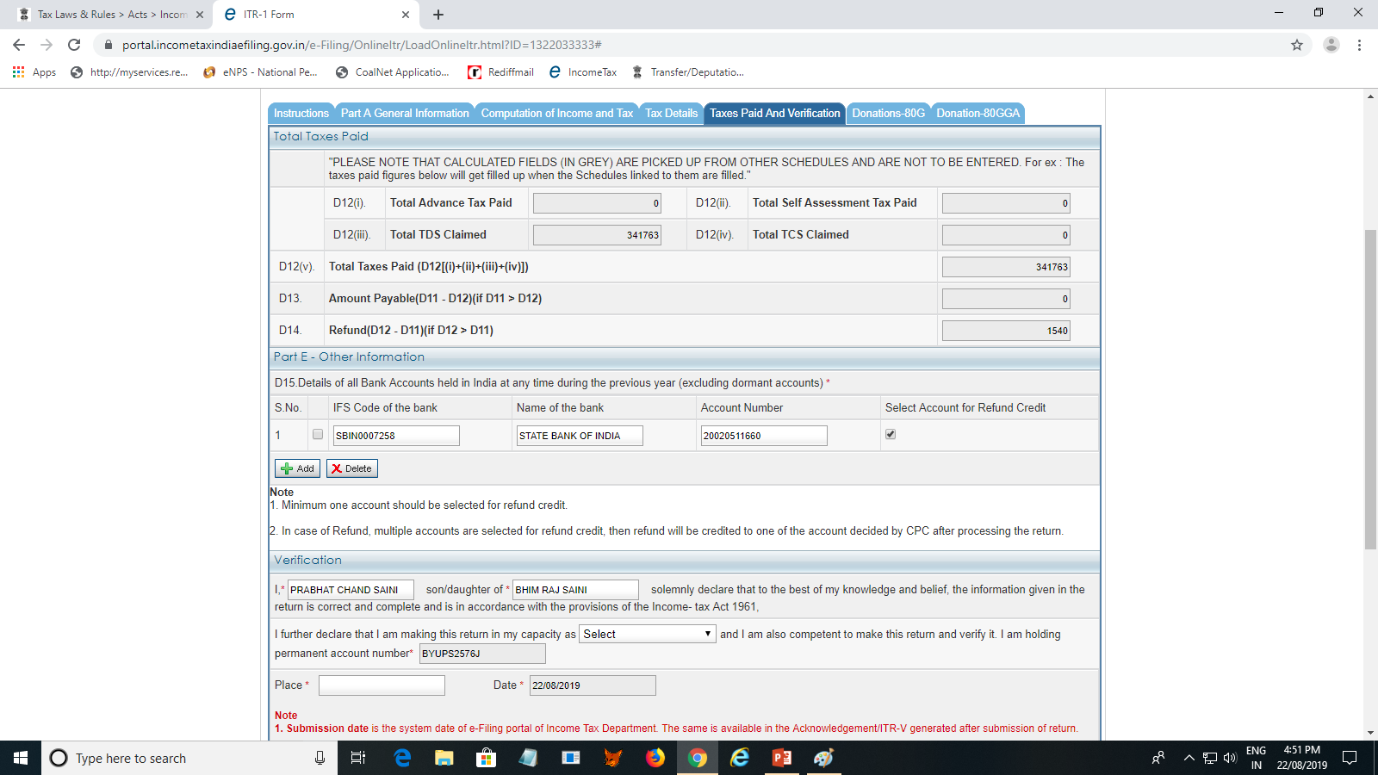
Income Tax E-Filing ( ITR-1)

Slide 78
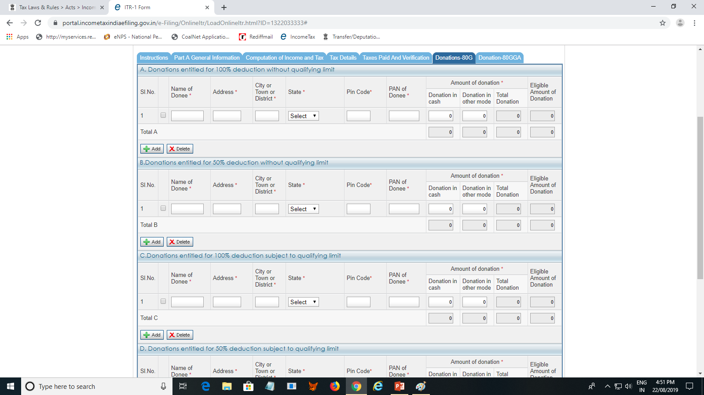
Income Tax E-Filing ( ITR-1)

Slide 79
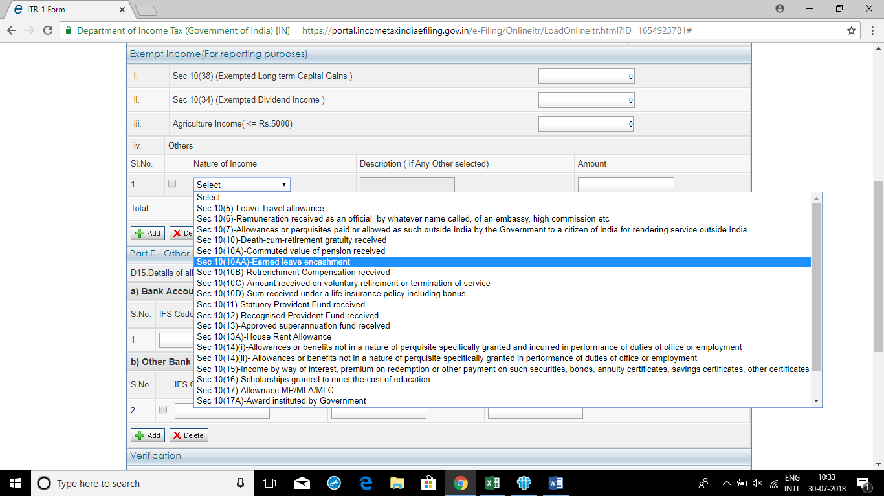
Income Tax E-Filing ( ITR-1)

Slide 80
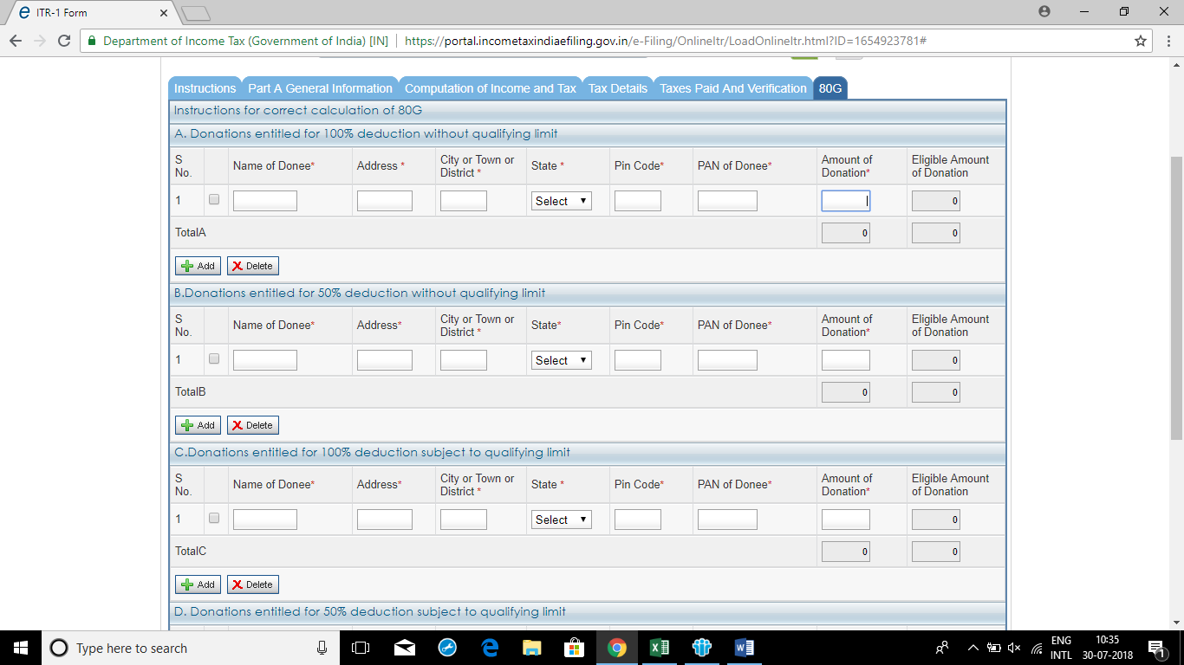
Income Tax E-Filing ( ITR-1)

Slide 81
Relief U/s 89
Relief when Salary is paid in Arrear or in Advance, etc. [Section 89 / Rule 21A]
Where any portion of the Assessee's Salary is Received in Arrears or in Advance. Where the Payment is in the nature of Gratuity other than Exempt under Section 10(10) [Rule 21A(3)]: Where the payment is in the nature of Taxable Compensation Received from the Employer or former Employer at or in connection with the Termination of his Employment [Rule 21A(4)]: Where Payment is for Commutation of Pension [Rule 21A(5)] Where the Payment is of a nature other than given under Rule 21A(2) to 21A(5) discussed above [Rule 21A(6)]

Slide 82
Relief U/s 89
Where, by reason of any portion of an assessee's salary being paid in arrears or in advance or by reason of his having received in any one financial year salary for more than twelve months or a payment which under the provisions of section 17(3) is a profit in lieu of salary, his income is assessed at a rate higher than that at which it would otherwise have been assessed, the relief to be granted under section 89 shall be as under:
(A) Where any portion of the Assessee's Salary is Received in Arrears or in Advance.
Step 1: Calculate the Tax Payable of the Previous Year in which the Arrears/ Advance Salary is Received on:
Total Income inclusive of additional salary.
Total Income exclusive of additional salary.
The difference between (a) and (b) is the tax on additional salary included in the total income.
Step 2: Calculate the Tax Payable of every Previous Year to which the Additional Salary relates :
on total income including additional salary of that particular previous year.
on total income excluding additional salary.
Calculate the difference between (a) and (b) for every previous year to which the additional salary relates and aggregate the same.

Slide 83
Relief U/s 89
Step 3: The Excess between the Tax on Additional Salary as calculated under Step 1 and 2 shall be the Relief Admissible under Section 89.
If there is no excess, no relief is admissible. If the tax calculated in step 1 is less than tax calculated in step 2, the assessee need not apply for relief.

Slide 84
Relief U/s 89
(B). Where the Payment is in the nature of Gratuity other than Exempt under Section 10(10) [Rule 21A(3)]:
Relief is available only if the gratuity is received in respect of past services of the assessee extended over a period of not less than 5 years. ( No Relief is Admissible if the period of service is Less than 5 years). The amount of relief is calculated as under:
(a) Where Gratuity is paid in respect of past services of 15 Years or more :
Step 1 : Calculate the tax on total income (including gratuity) in the year of receipt of gratuity and calculate the average rate of tax i.e.
(Total Tax / Total Income) x 100
Step 2 : Calculate the tax on gratuity on basis of average rate of tax computed in step 1.
Step 3 : Calculate the tax liability by adding 1/3 of the gratuity to the total income of each of the preceding 3 years and calculate the average rate of tax for each year separately.
Step 4 : Calculate the average of the three average rates computed in step 3 above and compute the tax on gratuity at that average rate.
Step 5: The excess, if any, of the tax on gratuity computed at step 2 over step 4 will be the relief admissible under section 89

Slide 85
Relief U/s 89
(b) Where Gratuity is paid in respect of past services of 5 years or more but less than 15 years.
The procedure for computation of relief is same except that in step 3 the number of years for calculating average rate of tax shall be taken as 2 instead of 3 and thus 1/2 of the gratuity will be added in the total income of the preceding 2 years instead of 3 years.

Slide 86
Relief U/s 89
(C) Where the payment is in the nature of Taxable Compensation Received from the Employer or former Employer at or in connection with the Termination of his Employment [Rule 21A(4)]:
Relief will be available only if the following conditions are satisfied:
Compensation is received after continuous services of not less than 3 years.
The unexpired portion of the term of employment is also not less than 3 years.
The procedure for calculating the relief is same as given in Case (a), above, i.e. gratuity paid to the employee in respect of services rendered for a period of 15 years or more.

Slide 87
Relief U/s 89
D) Where Payment is for Commutation of Pension [Rule 21A(5)]
The procedure for calculating the relief is same as given in case (a) of para (B) i.e. gratuity paid to the employee in respect of services rendered for a period of 15 years or more.
(E) Where the Payment is of a nature other than given under Rule 21A(2) to 21A(5) discussed above [Rule 21A(6)]
In these cases, the CBDT may, having regard to the circumstances of each case, allow such relief as it deems fit.

Slide 88
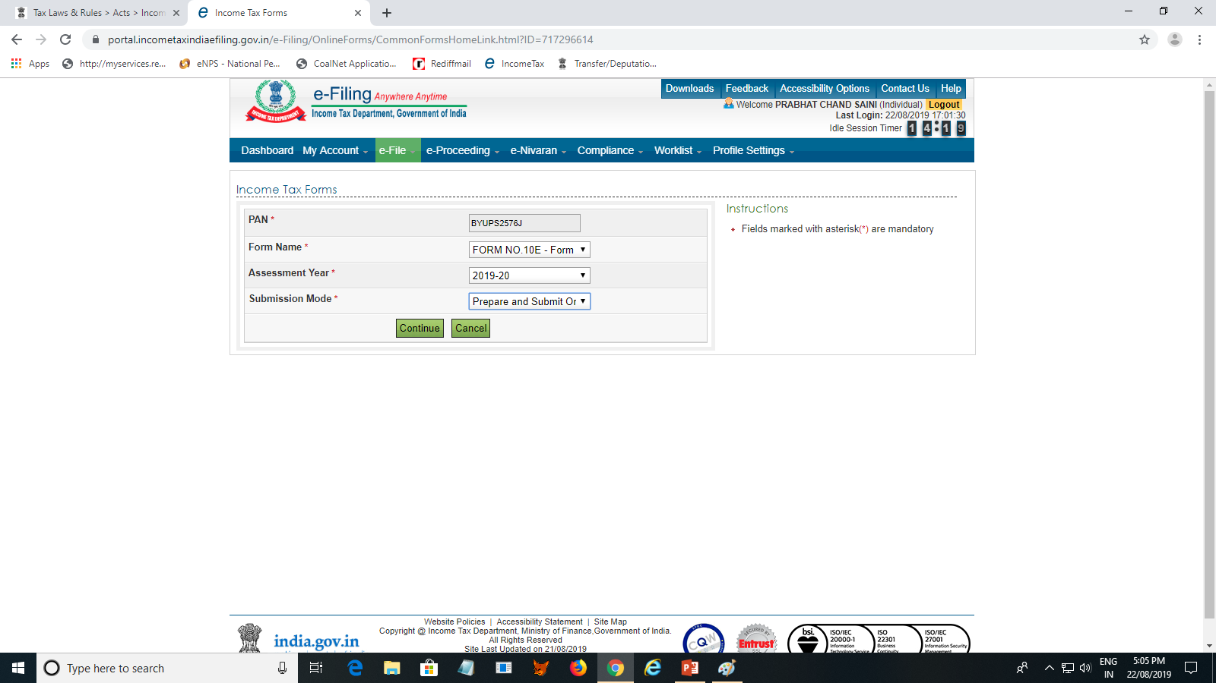
FORM 10E

Slide 89
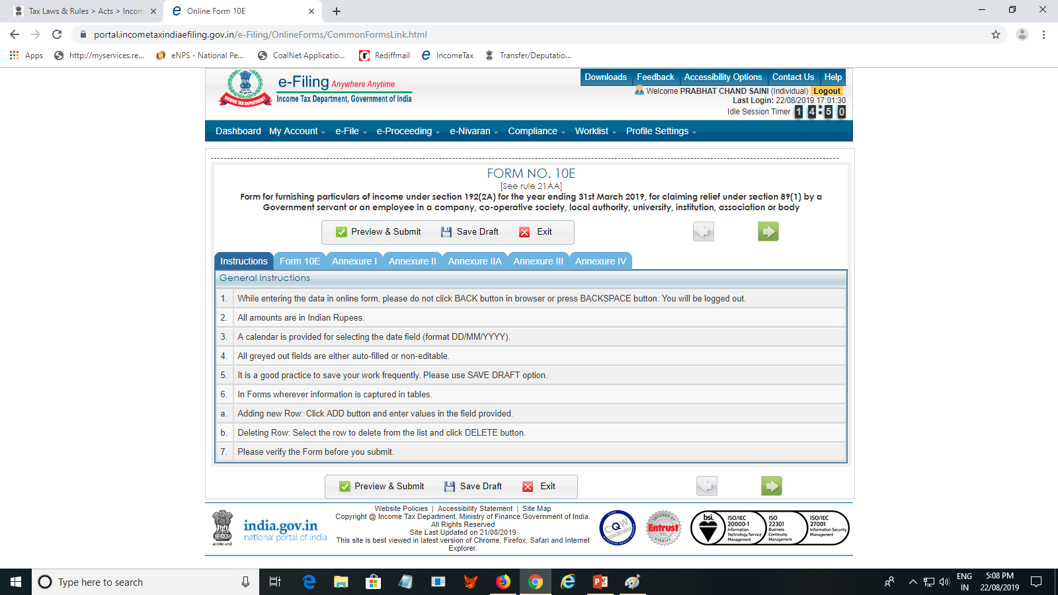
FORM 10E

Slide 90
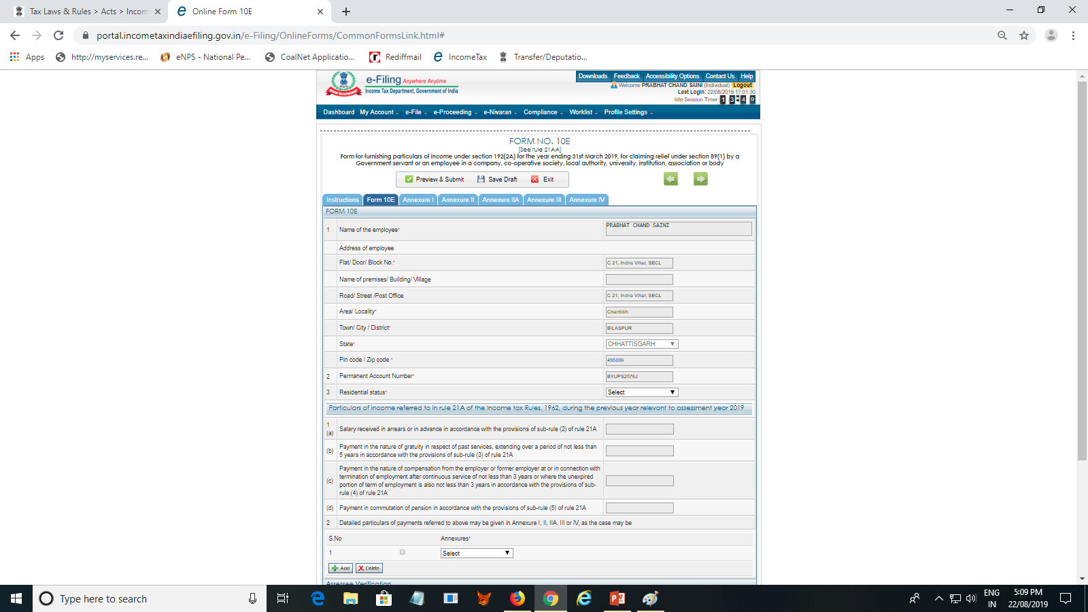
FORM 10E

Slide 91
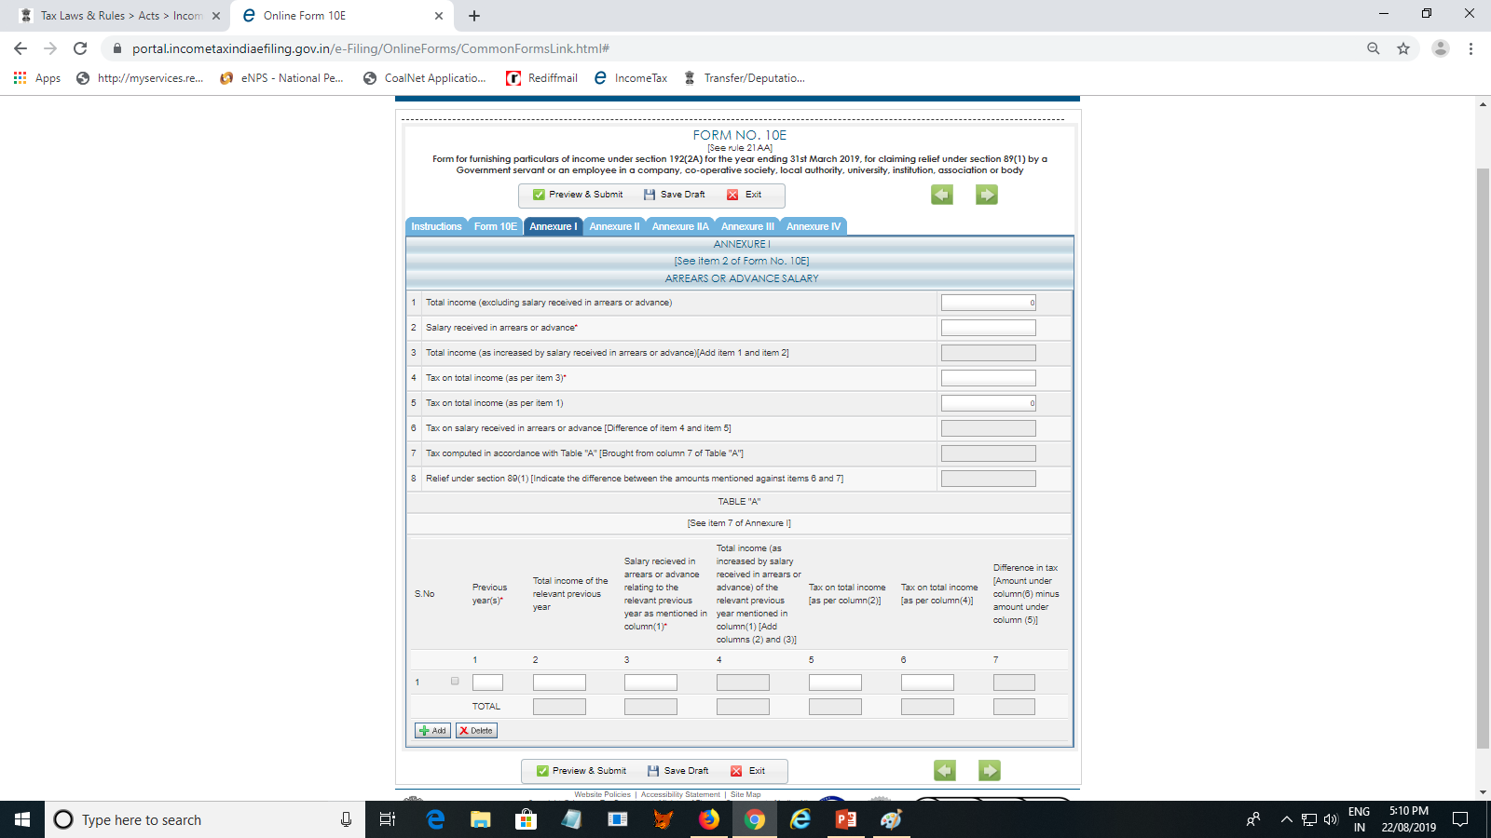
FORM 10E

Slide 92
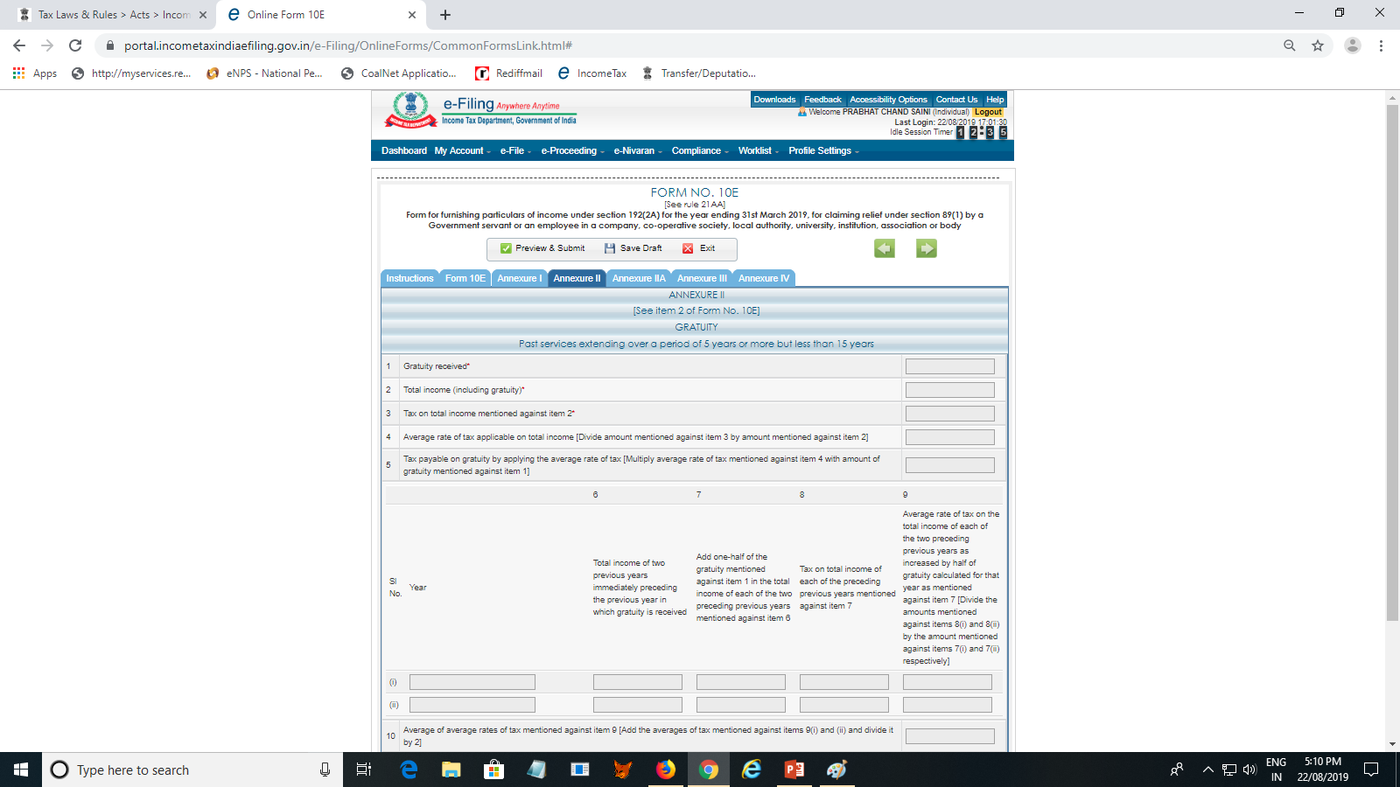
FORM 10E

Slide 93
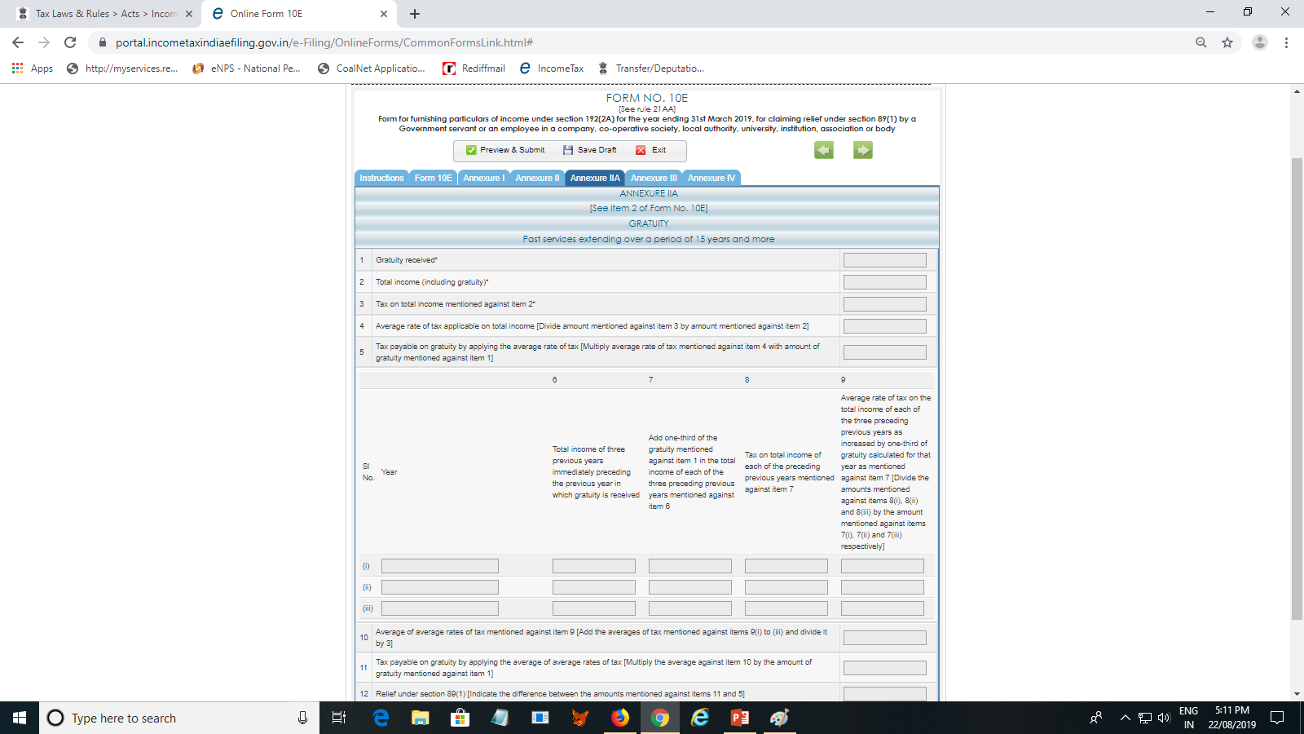
FORM 10E

Slide 94
FORM 10E

Slide 95
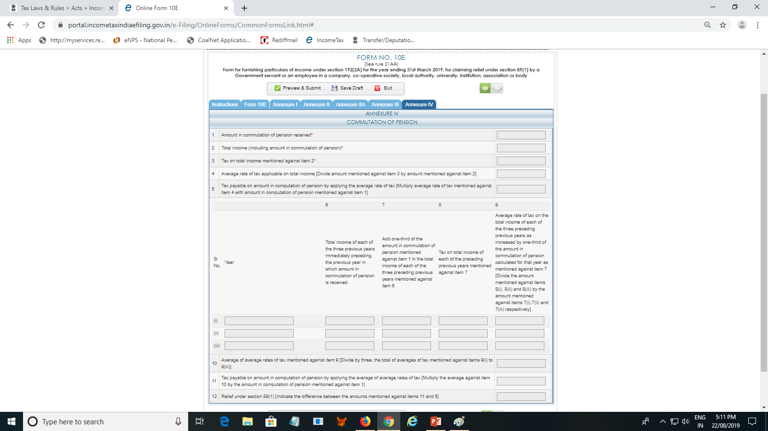
FORM 10E

