Slide 1
Indian Accounting Standrad
(Ind AS)
Key Highlights
and
Coal India outlook
by
CA Samiran Dutta
General Manager
Coal India Limited

Slide 2
IND AS
Key Highlights
India deciding to converge with IFRS and not Adopt IFRS
Convergence with IFRS means that IFRS as issued by the International Body would not be applied but India made its own accounting standards in sync with the International Financial Reporting Standards. And these synced Indian Accounting Standards are named as ‘Ind-AS’.

Slide 3
IND AS 1
Key Highlights
Presentation of Financial Statements
Components of financial statements
A complete set of financial statements under Ind AS comprises
a balance sheet as at the end of the period;
statement of profit and loss;
statement of changes in equity;
a statement of cash flows;
notes including summary of accounting policies and other explanatory information.
Comparative figures are presented for one year. When a change in accounting policy has been applied retrospectively or items of financial statements have been restated/
reclassified, a balance sheet is required as at the beginning of the earliest period presented.
Entities should present an analysis of expenses recognised in profit or loss using a classification based only on the nature of expense.
An entity is required to present all items of income and expense including components of other comprehensive income in a period in a single statement of profit and loss.

Slide 4
IND AS 1
Key Highlights
Presentation of Financial Statements
The statement of changes in equity includes the following information:
• total comprehensive income for the period;
• the effects on each component of equity of retrospective application or retrospective
restatement in accordance with Ind AS 8; and
• for each component of equity, a reconciliation between the opening and closing
balances, separately disclosing each change.
Presentation of any items of income or expense as extraordinary is prohibited.
When comparative amounts are reclassified, nature, amount and reason for reclassification are disclosed.
Requires disclosure of critical judgements made by management in applying accounting policies.

Slide 5
IND AS 8
Key Highlights
Accounting Policies, Changes in Accounting Estimates and Errors
Requires retrospective application of changes in accounting policies by adjusting the opening balance of each affected component of equity for the earliest prior period presented and the other comparative amounts for each period presented as if the new accounting policy had always been applied
Prior period errors
An entity shall correct material prior period errors (unless impracticable to do so) retrospectively in the first set of financial statements approved for issue after their discovery by:
restating the comparative amounts for the prior period(s) presented in which the error occurred; or
if the error occurred before the earliest prior period presented, restating the opening balances of assets, liabilities and equity for the earliest prior period presented.

Slide 6
IND AS 8
All such items added together,except which have already been considered as prior period and material as per limit of 2% or Rs. 10 Lakh or 10% as per previous steps, for total aggregation level check is immaterial and may be charged to current year profit.
No
All items added together are material and treatment of prior period error shall be done as per Ind AS
Yes
If all such Prior period item of all account head added together exceeds 0.1% of total expenditure
All Such item added together is immaterial at account aggregation level including the items which have already been considered as prior period and material as per limit of 2% or Rs. 10 Lakh or 10% as per previous steps
No
No Further Check, treatment of prior period error shall be done as per Ind AS
The Materiality test is positive and all such prior period added together forms material prior period item
Yes
if all such prior period error in that account head added together exceeds 10% of the amount of that account head
Key Highlights
Materiality Policy followed at CIL
Materiality Check
Whether an individual item of Prior period is more than 2% or 10 lacs whichever is lower
Yes
No
The item is Material
The item is Immaterial at individual level however Aggregate level to be checked
No Further Check, treatment of prior period error shall be done as per Ind AS
Add all such Prior Period vouchers in that account head and check
if all such prior period error in that account head added together exceeds 10% of the amount of that account head

Slide 7
IND AS 10
Key Highlights
Events After the Reporting Period
Liability for dividends declared to holders of equity instruments are recognised in the period when declared. It is a non-adjusting event.
Proposed Dividend will no longer be recognised as an liability but a mere disclosure of the amount of proposed dividend in the financial statement will be sufficient

Slide 8
IND AS 16
Key Highlights
Property, Plant and Equipment

Slide 9
IND AS 16
Key Highlights
Property, Plant and Equipment
Para - D7AA
a first-time adopter to Ind ASs may elect to continue with the carrying value for all of its property, plant and equipment as recognised in the financial statements as at the date of transition to Ind ASs, measured as per the previous GAAP and use that as its deemed cost as at the date of transition

Slide 10
IND AS 16
Key Highlights
Property, Plant and Equipment

Slide 11
IND AS 16
Key Highlights
Property, Plant and Equipment

Slide 12
IND AS 16
Key Highlights
Property, Plant and Equipment
Stand By Equipment, Spare parts are recognised in accordance with Ind AS 16 when they meet the definition of property, plant and equipment. Otherwise, such items are classified as inventory.
The initial estimate of the costs of dismantling and removing the item and restoring the site on which it is located is required to be included in the cost of the respective item of property plant and equipment.
Property, plant and equipment are componentised and are depreciated separately.
Replacement cost of an item of property, plant and equipment is capitalized if replacement meets the recognition criteria. Carrying amount of items replaced is derecognized.

Slide 13
IND AS 16
Key Highlights
Property, Plant and Equipment
Changes in Existing Decommissioning, Restoration and Similar Liabilities -
Provisions for decommissioning, restoration and similar liabilities that have previously been recognised as part of the cost of an item of property, plant and equipment are adjusted for changes in the amount or timing of future costs and for changes in market-based discount rates.

Slide 14
IND AS 37
Key Highlights
Provisions, Contingent Liabilities and Contingent Assets
Provision
Liability of uncertain timing or amount
Present obligation from past event
or Outflow of benefits
Legal obligation
Constructive obligation

Slide 15
Site Restoration Provision
Coal India Outlook
With guidance from IND AS 16, 37
Site Restoration Liability for -
Closing The Mine and restoring the site to reverse the environmental damage done.
Technical assessment
Estimation of the long term liability due to legal obligation - requires following things in consideration
The Calculated present value is recognised in Financial Statement as an PPE and Provision is recognised.
Inflation during the period of operation of mine
Site restoration Asset is amortised over the mine life.
In case of change in initial estimates accounting is done as per guidance in Appendix A of Ind AS 16 PPE.
Provision for site restoration is unwinded and unwinding is charged to Profit and Loss and credited to Provision
Guidelines from Government on Mine Closure
Calculation of Present Value of Liability assessed at the end of the mine life

Slide 16
Site Restoration Provision
Coal India Outlook
With guidance from IND AS 16, 37
Let us assume an Opencast mine X has 2382.763 hectares of land and its life as on 01.04.2010 is 31 years escalation rate for inflation is @5% and discounting rate is 8%
Example

Slide 17
Investment property is land or building (or part thereof) or both held (whether by owner or by a lessee under a finance lease) to earn rentals or for capital appreciation
or both.
Investment properties are measured using the cost model. Fair value model is not permitted. Detailed disclosures pertaining to fair value have to be given.
IND AS 40
Key Highlights
Investment property

Slide 18
Ind AS 105
Non-current Assets Held for Sale and Discontinued Operations
Key Highlights
Non-current assets to be disposed of are classified as held for sale when the asset is available for immediate sale and the sale is highly probable. Depreciation ceases on the date when the assets (individually or as part of a disposal group) are classified as held for sale.
Non-current assets classified as held for sale are measured at the lower of its carrying value and fair value less costs to sell. Non-current assets classified as held for sale, and the assets and liabilities in a disposal group classified as held for sale, are presented separately in the statement of financial position

Slide 19
Ind AS 106
Non-current Assets Held for Sale and Discontinued Operations
Key Highlights
Definition of EEA
Measurement
Presentation
Derecognition
Disclosure
Expenditures incurred by an entity in connection with the exploration for and evaluation of mineral resources before the technical feasibility and commercial viability of extracting a mineral resource are demonstrable.
EEA shall be measured at cost.
Classify EEA as Tangible or Intangible
An EEA shall no longer be classified as such when the technical feasibility and commercial viability of extracting a mineral resource are demonstrable.
Accounting policy of EEA
Amounts of assets, liabilities, income and expense and operating and investing cash flows arising from the EEA.
EEA shall be assessed for impairment,

Slide 20
IND AS 32
Key Highlights
Coal India Outlook
Financial Instruments: Presentation
compound financial instrument
compound financial instrument is a non-derivative financial instrument that, from the issuer’s perspective, contains both liability and an equity component.
Redeemable Preference Share with Non-Mandatory Dividend
Liability
issuer’s obligation to pay Cash on redemption
Equity
Non-mandatory Dividend (i.e. residual interest)
Example

Slide 21
IND AS 32
Key Highlights
Coal India Outlook
Accounting treatment in issuer’s financial statements
Step 1: Identify the various components of the compound financial instrument
That’s obvious. The issuer must clearly identify what the liability element is and what the equity element is—just refer to examples above.
Step 2: Determine the fair value of the liability component.
Step 3: Determine the fair value of the equity component.
Determine the fair value of the liability component that does not have an associated equity conversion feature but includes any embedded non-equity derivatives features.
Determine the equity component as a residual amount by deducting the fair value of the liability component
Financial Instruments: Presentation

Slide 22
IND AS 32
Key Highlights
Financial Instruments: Presentation
Financial assets are:
Cash,
Equity instruments of another entity (e.g. shares),
Contractual right To receive cash or another financial asset of another entity (e.g. trade receivable);
To exchange financial assets or financial liabilities with another entities under potentially favorable conditions
Financial liability is:
A contractual obligation To deliver cash or another financial asset to another entity (e.g. loan taken, ,trade payable), or
A contractual obligation To exchange financial assets or financial liabilities other than the entity’s own equity under potentially unfavorable conditions.

Slide 23
IND AS 109
Key Highlights
Financial Instruments
Recognition of a financial instrument
a financial asset or a financial liability in the statement of financial should be recognised when the entity becomes a party to the contractual provisions of the instrument
Derecognition of financial assets
An entity should derecognise a financial asset when -
Contractual rights to the cash flows from the financial asset expire
The entity transfers
Financial Asset
Risk and reward of ownership

Slide 24
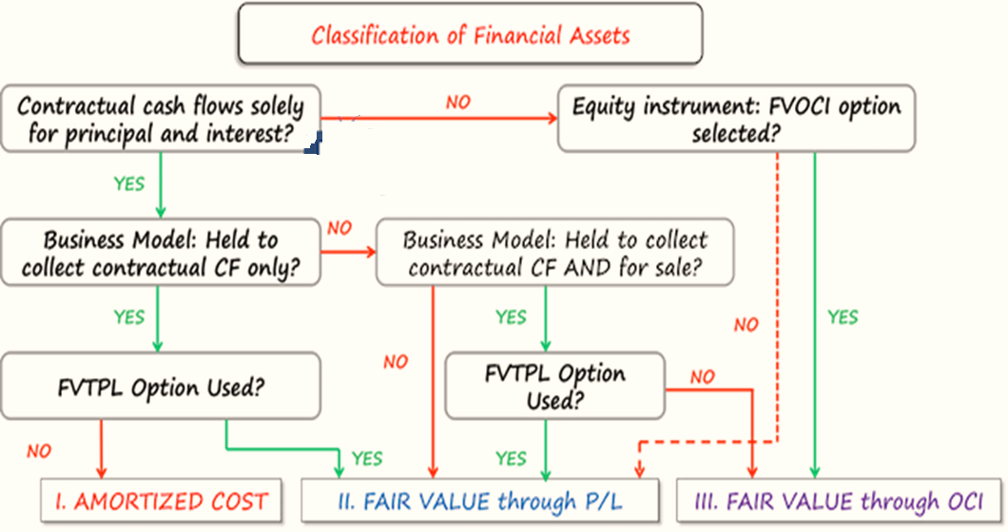
IND AS 109
Key Highlights
Financial Instruments
Classification of financial instruments

Slide 25
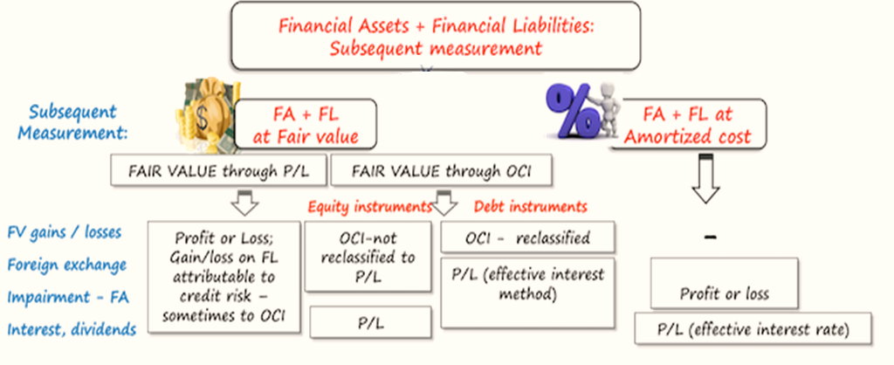
IND AS 109
Key Highlights
Financial Instruments
Initial measurement of financial instruments
Financial asset or financial liability shall be initially measured at:
Fair value: all financial instruments at fair value through profit or loss;
Fair value plus transaction cost: all other financial instruments (at amortized cost or fair value through other comprehensive income).
Subsequent measurement of financial instruments

Slide 26
IND AS 115
Key Highlights
Revenue from Contracts with Customers
There are many situations where guidance is not straightforward and entities recognize revenues differently in these cases, for example:
Buy 1+get 1 free;
Buy monthly prepaid plan + get handset for free;
Earn loyalty points and cash them out/receive free goods later on;
Get bonuses for delivery on time; etc.
Ind AS 115, is extensive and provides guidance on above also.

Slide 27
IND AS 115
Key Highlights
Revenue from Contracts with Customers
Ind AS 115, provides the following to consider while reporting revenue from customers –
the nature;
the amount;
the timing; and
the uncertainty of revenue and cash flows from a contract with a customer.

Slide 28
IND AS 115
Key Highlights
Revenue from Contracts with Customers
5 step model for revenue recognition
Identify the Contract with a Customer
Step 1
Identify performance obligations (PO) in the contract
Step 2
Determine the transaction price (TP)
Step 3
Allocate the TP to the PO in the Contract
Step 4
Recognise revenue when an entity satisfies a PO
Step 5

Slide 29
IND AS 115
Key Highlights
Revenue from Contracts with Customers
Step 1: Identify the contract with the customer
A contract is an agreement between two parties that creates enforceable rights and obligations
The contract has a commercial substance; and
Ind AS 115, applies to All contracts that have the following 5 attributes :
Parties to the contract has approved it and are committed to perform;
Each party’s rights to the goods/services transferred are identified;
The payment terms are identified;
The contract has a commercial substance; and
It is probable that an entity will collect the consideration –evaluate the customer’s ability and intention to pay

Slide 30
IND AS 115
Key Highlights
Revenue from Contracts with Customers
Step 2: Identify the performance obligations in the contract
Performance obligation is any good or service that contract promises to transfer to the customer.
Performance Obligation
Goods/Service (or bundle) that is distinct
Series of distinct goods/services that are substantially the same and have the same pattern of transfer

Slide 31
IND AS 115
Key Highlights
IND AS 115
Key Highlights
Revenue from Contracts with Customers
Revenue from Contracts with Customers
Step 3: Determine the transaction price
The transaction price is the amount of consideration than an entity expects to be entitled in exchange for transferring promised goods or services to a customer, excluding amounts collected on behalf of third parties.
Accordingly, transaction price will be estimated considering following factors:
Variable consideration
Constraining estimates in variable consideration
Significant financing component
Non-cash consideration
Consideration payable to a customer

Slide 32
IND AS 115
Key Highlights
IND AS 115
Key Highlights
Revenue from Contracts with Customers
Revenue from Contracts with Customers
Step 4: Allocate the transaction price to the performance obligations
Determined transaction price of different contract‘s performance obligations will be allocated to the individual performance obligations.

Slide 33
IND AS 115
Key Highlights
IND AS 115
Key Highlights
Revenue from Contracts with Customers
Revenue from Contracts with Customers
Step 5 Recognize revenue when (or as) the entity satisfies a performance obligation
A performance obligation is satisfied (and revenue is recognized) when a promised good or service is transferred to a customer. This happens when control is passed.
A performance obligation can be satisfied either:
Over time
In this case, control is passed to the customer over some period of time (e.g. contract term); or
At the point of time
in this case, control is retained by the supplier until it is transferred at some moment.

Slide 34
IND AS 115
Key Highlights
IND AS 115
Key Highlights
Revenue from Contracts with Customers
Revenue from Contracts with Customers
Example: Ind AS 18 vs. Ind AS 115
Johnny enters into a 12-month telecom plan with the local mobile operator ABC. The terms of plan are as follows:
Johnny’s monthly fixed fee is CU 100.
Johnny receives a free handset at the inception of the plan.
ABC sells the same handsets for CU 300 and the same monthly prepayment plans without handset for CU 80/month.
How should ABC recognize the revenues from this plan in line with Ind AS 18 and Ind AS 115?

Slide 35
IND AS 115
Key Highlights
IND AS 115
Key Highlights
Revenue from Contracts with Customers
Revenue from Contracts with Customers
Revenue under Ind AS 18
Current rules of Ind AS 18 say that ABC should apply the recognition criteria to the separately identifiable components of a single transaction (here: handset + monthly plan).
However, Ind AS 18 does not give any guidance on how to identify these components and how to allocate selling price and as a result, there were different practices applied.
For example, telecom companies recognized revenue from the sale of monthly plans in full as the service was provided, and no revenue for handset – they treated the cost of handset as the cost of acquiring the customer.
Revenue from monthly plan is recognized on a monthly basis. The journal entry is to debit receivables or cash and credit revenues with CU 100.

Slide 36
IND AS 115
Key Highlights
IND AS 115
Key Highlights
Revenue from Contracts with Customers
Revenue from Contracts with Customers
Revenue under Ind AS 115
No of Step | Name of Step | Application
step 1 | ABC needs to identify the contract | 12-month plan with Johnny
step 2 | identify all performance obligations | 1. Obligation to deliver a handset 2. Obligation to deliver network services over 1 year
step 3 | transaction price | CU 1 200, calculated as monthly fee of CU 100 times 12 months

Slide 37
IND AS 115
Key Highlights
IND AS 115
Key Highlights
Revenue from Contracts with Customers
Revenue from Contracts with Customers
Revenue under Ind AS 115
No of Step | Name of Step | Application
step 4 | allocate that transaction price | See Table Below
Performance obligation | Stand-alone selling price | % on total | Revenue (=relative selling price = 1 200*%)
Handset | 300.00 | 23.8% | 285.60
Network services | 960.00 (=80*12) | 76.2% | 914.40
Total | 1 260.00 | 100.0% | 1 200.00

Slide 38
IND AS 115
Key Highlights
IND AS 115
Key Highlights
Revenue from Contracts with Customers
Revenue from Contracts with Customers
Revenue under Ind AS 115
No of Step | Name of Step | Application
step 5 | recognize the revenue when ABC satisfies the performance obligations | When ABC gives a handset to Johnny, it needs to recognize the revenue of CU 285.60; When ABC provides network services to Johnny, it needs to recognize the total revenue of CU 914.40. It’s practical to do it once per month as the billing happens.
The journal entries are summarized in the following table:
Description | Debit | Credit | Amount | When
 | Unbilled revenue | P/L – Revenue from sale of goods | 285.60 | When handset is given to Johnny
Network services | Receivable to Johnny |  | 100.00 (= monthly billing to Johnny) | When network services are provided; on a monthly basis according to contract with Johnny
 |  | P/L – Revenue from network services | 76.20 (=914.40/12)
 |  | Unbilled revenue | 23.80 (=285.60/12)

Slide 39
THANK YOU !!!!!

Slide 40
