Slide 1
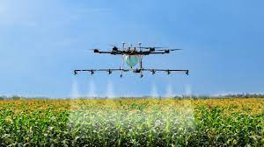
CMA (Dr. )P. Siva Rama Prasad
M.Com., MBA (Finance)., FCMA., FCS., FIIBF., FIII (Life & General Insurance)., MAIMA.,
Insolvency Professional
Asst. General Manager (Retd.)
State Bank of India
Hyderabad
“Drones” Finance
(Corporate, MSME and Agriculture Segments by Commercial Banks)
&
(Future ‘Drone’ Market in India)

Slide 2
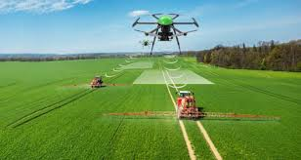
Future ‘Drone’ Market in India
Agenda
About ‘Drones’.
Basic Features of Drones.
Drone Price & Technicalities (Agriculture Drone Prices).
What are Kisan Drones?
Top 10 Drone Manufacturing Companies in India.
Guidelines of Sub-Mission on Agricultural Mechanization (SMAM).
Union Kisan ‘Pushpak’.
Drones Finance-‘Corporate’, ‘MSME’, ‘Agriculture’ Segments-Commercial Banks.
Conclusion.

Slide 3
Future ‘Drone’ Market in India
Benefits of Technology in any Sector:
Reduction of Operational Costs.
Reduction in Wastages.
Increase in Productivity.
Increase in Profit.
It absorbs Volumes of Transactions.
Convenience to the Users.
No Timings in Usage. It is available for 24/7.

Slide 4
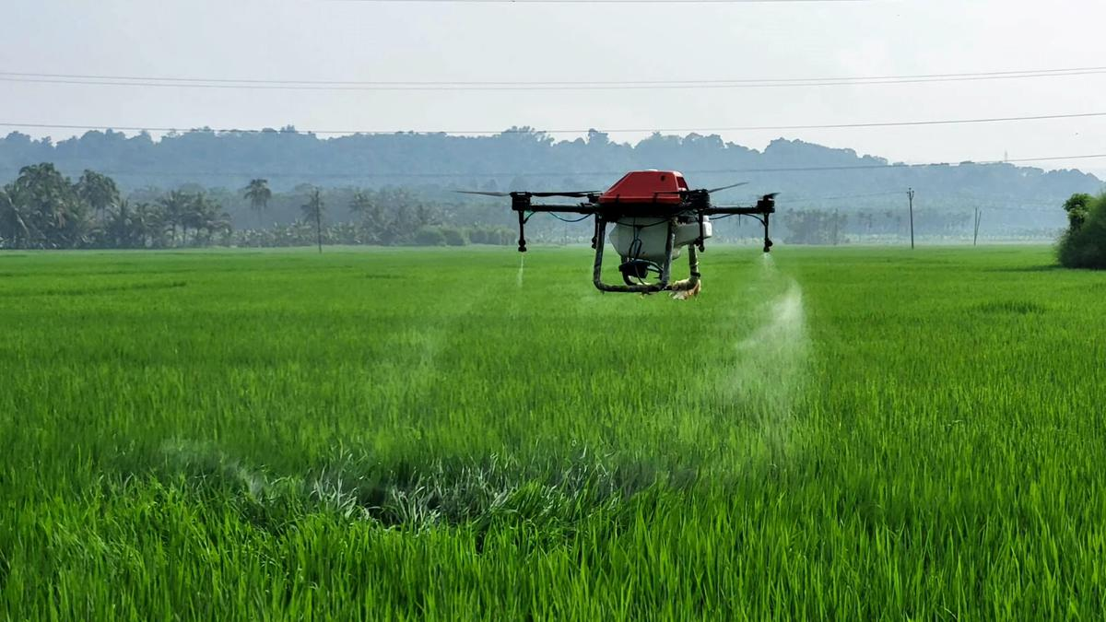
Future ‘Drone’ Market in India
Union Government provide 15,000 Progressive Women Self-help Groups (SHG) with Drones to be Rented out to Farmers for Agricultural Purposes. The Drone Services are envisaged to be used by the Farmers for Nano Fertilizer and Pesticide Applications

Slide 5
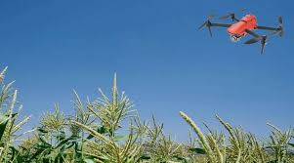
Future ‘Drone’ Market in India
About ‘Drones’

Slide 6
Future ‘Drone’ Market in India
Until recently, there was a Conception that Drones were meant for ‘Armed Forces’ and ‘Fighting Enemies’.
Medicines, Vaccines are being supplied to Various Parts of the Country and it is also being used for ‘Sprinkling Pesticides, Fertilizers etc.’ on Crops.

Slide 7
Future ‘Drone’ Market in India
However, the ‘Kisan Drone Suvidha’ has added a “New Chapter” in the ‘Farming Sector’ and it will prove to be a ‘Milestone for Drone Technology’.
Experts in the Agricultural Sector enlightened Skeptical About the Benefits of Drones and How they will increase Farmers’ Income.

Slide 8
Future ‘Drone’ Market in India
Adequate and Timely ‘Spraying of Pesticides’ and ‘Fertilizers’ may help in increase Crop Production.
In Farming, apart from Fertilizers and Seeds, the Next Highest Input Cost is the ‘Labour Cost / Wages’.

Slide 9
Future ‘Drone’ Market in India
‘Leaving Few Rich’ States like Punjab and Haryana, even State like Bihar do not get enough Labour at the Time of Farming (Sowing / Harvesting).
In such a Situation, Technology has Stood in Favour to the Farmers.

Slide 10
Future ‘Drone’ Market in India
But the Use of Technology in Farming is a “Little Bit Expensive at Initial Stages” & “Knowledge” is required to operate the New Systems.
But Long Run Benefits like increase in Productivity and Economies of Large Scale.

Slide 11
Future ‘Drone’ Market in India
Hence, the Government is Promoting / Focusing the Usage of Drones to Reduce the ‘Agricultural Cost of Farmers’ and Inculcate the Farm Mechanization in Agriculture Sector.
And also use for Water Management Techniques (Certain Crops requires Sprinkler Irrigation).

Slide 12

Future ‘Drone’ Market in India
Under the “SVAMITVA Scheme”, Land Records are being Documented through ‘Drone Technology’.
‘SVAMITVA SCHEME
(Survey of Villages Abadi and Mapping with Improvised Technology in Village Areas)

Slide 13
Future ‘Drone’ Market in India
‘Garud Aerospace’ (Manufacturers of Drones) has set a Goal of Developing ‘One Lakh Drones’, which are being used for ‘Diverse Purposes’.

Slide 14
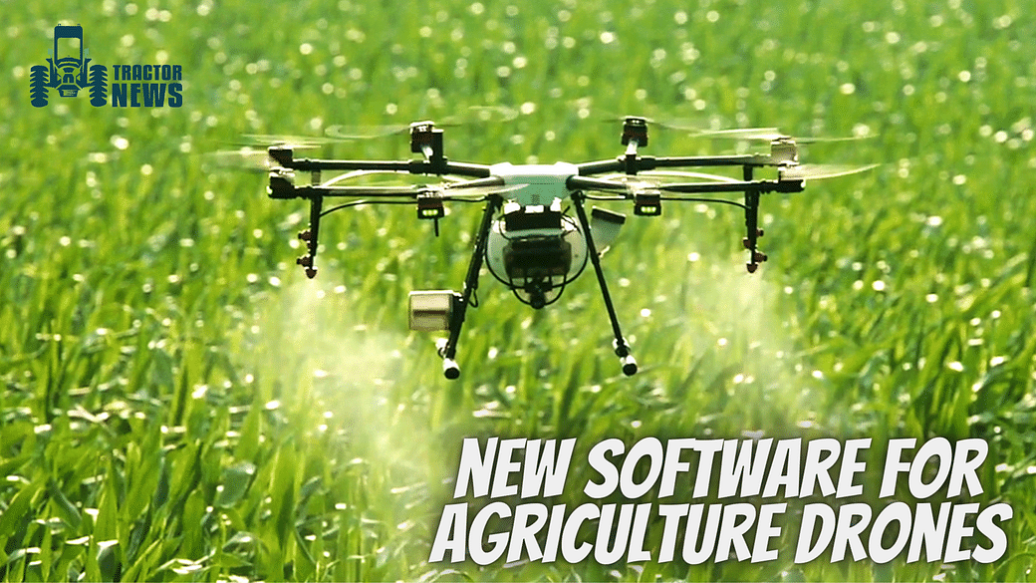
Future ‘Drone’ Market in India
Basic Features
of
Drones

Slide 15
Future ‘Drone’ Market in India
A Drone is an Unmanned Small Aircraft that can be Controlled Remotely or it can Fly Autonomously.
It Consists of a ‘GPS Based Navigation System,’ a Variety of ‘Sensors and a Controller.’

Slide 16
Future ‘Drone’ Market in India
It Works on Chargeable Battery-based Energy (With Less Electricity Cost.
It is Flown and Controlled by the Remote Controller (With limited Skills are sufficient).
Depending on the End Use, many Types of Equipment such as Cameras, Insecticide, Fertilizers Spraying Devices etc. are also Installed on it.

Slide 17
Future ‘Drone’ Market in India
The Uses of Drone has Some Distinct Features such as:
High Field Capacity and Efficiency.
Less Turnaround Time and other Field Operational Delays.
Wastage Reduction of Pesticide and Fertilizers Due to High Degree of Atomization.

Slide 18
Future ‘Drone’ Market in India
The Uses of Drone has Some Distinct Features such as:
Water Saving due to Ultra-low Volume Spraying Technology in Comparison to Traditional Spraying Methods.
Reduction in Cost of Spraying and Fertilizer Application in Comparison to Conventional Methods etc.

Slide 19
Future ‘Drone’ Market in India
The Uses of Drone has Some Distinct Features such as:
Besides Reduction of “Human Exposure” to “Hazardous Chemicals”.
Scientific Studies are carried out and Data Supporting the Drone Application are Generated.

Slide 20
Future ‘Drone’ Market in India
“Pilot Studies” with Different Approaches like use of:
Remote Sensing Technology including Satellite Data and Drone Based Images Especially for Crop Cutting Experiments Planning.
Direct Yield Estimation at Gram Panchayat Level.
Risk Mapping of District and for Dispute / Area Discrepancy Resolution etc.

Slide 21
Future ‘Drone’ Market in India
“Pilot Studies” with Different Approaches like use of:
Standard Operating Procedures (SOPs) which provide Concise instructions for “Effective and Safe Operations of Drones for Pesticides” and “Nutrient Application” have been Released.
The Awareness among Farmers is being created through “Demonstration and Capacity Building Programmes by Government of India”.
The above are conducted by Mahalanobis National Crop Forecasting Centre (MNCFC).

Slide 22
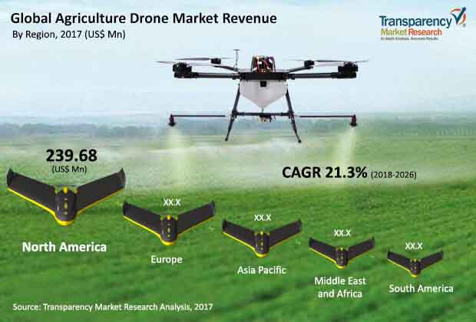
Future ‘Drone’ Market in India
Drone Price
&
Technicalities
(Agriculture Drone Price)

Slide 23
Future ‘Drone’ Market in India
Flying Height: Drones can Fly around 50-100m Height. Above 50m, a Special Authorization is required.
License Required: Currently, Flying Agricultural Drones Depends on National Laws.
For Non-commercial Use, No Pilot License is required if Tiny Rating Nano and Micro Drones, (Government Rules).

Slide 24
Future ‘Drone’ Market in India
Weather: A Drone can Fly under any Weather Condition. Drones are Water Resistant, but Image Quality can be Damaged if Pictures are taken during Rainy Weather.
Distances: It depends on the Drone Capability and Size. Fixed Wings Drones have Longer Flight Time and can cover More Field in One Flight. For instance, 50 Minutes Flight Time will Cover up to 12 km².

Slide 25
Future ‘Drone’ Market in India
Drone Cost: Cost of Drones used in Agriculture. A Standard Drone for Public Use with the Capacity of 12 Liters Starts at ₹3.45 Lakhs.

Slide 26
Future ‘Drone’ Market in India
In the Agricultural Sector, Small Drones without Specific Technology can go from ₹ 3.60 Lakhs to ₹ 10 Lakhs according to its Water-holding Capacity.
The Higher Technological Drones used specifically for Agriculture Start at ₹ 15 lakhs.

Slide 27
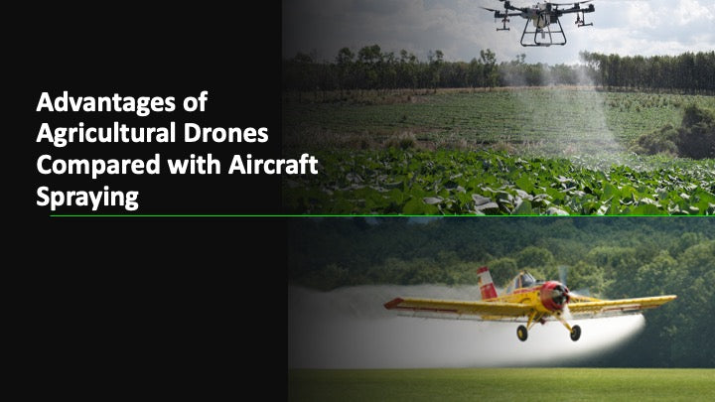
Future ‘Drone’ Market in India
What
are
Kisan Drones?

Slide 28
Future ‘Drone’ Market in India
The Kisan Drone will have an Unmanned Tank Filled with Insecticides and Nutrients.
The Drones are Expected to have a High Capacity of 5 to 10 kgs.
The Drone will Spray the same amount of Pesticides on about One Acre of Land in Just 15 Minutes.

Slide 29
Future ‘Drone’ Market in India
It will Save Time, will require Less Effort and Spraying will be done Uniformly.
They will also be used to Carry Vegetables, Fruits, Fish, etc. to the Markets from the Farms.
These Items will be Supplied Directly to the Market with Minimal Damage, Consuming Lesser Time, resulting in more Profits to Farmers and Fishermen.

Slide 30
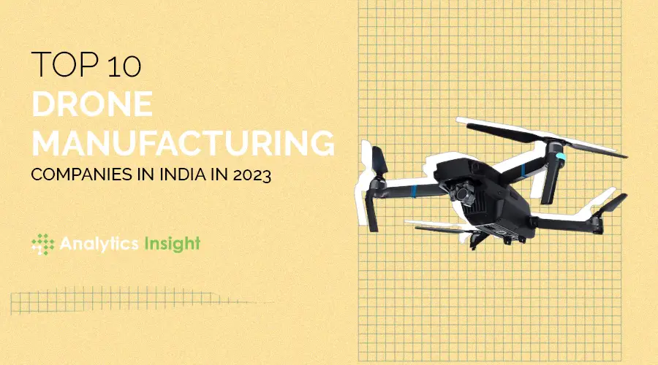
Future ‘Drone’ Market in India

Slide 31

Future ‘Drone’ Market in India
Aero360
Aero360 is one of the Leading Drone Manufacturing Companies in India.
They have been in the Industry for Several Years and have Established themselves as a Pioneer in developing Innovative Drone Solutions for various Industries.
They Specialize in providing Drone Solutions for Agriculture, Surveying, Mapping, and Infrastructure Development.
Their Drones are Designed to be Efficient, Cost-effective, and Reliable, making them a Top Choice for many Businesses.

Slide 32

Future ‘Drone’ Market in India
Skylark Drones
Skylark Drones is another Leading Drone Manufacturing Company in India.
They Provide Drone Solutions for Industries such as Mining, Construction, Agriculture, and Defense.
They have been at the Forefront of the Drone Industry in India, providing Cutting-edge Technology that enables Businesses to Operate more Efficiently and Effectively.

Slide 33

Future ‘Drone’ Market in India
ideaForge
ideaForge is a Leading Drone Manufacturer in India that has been in the Industry for Several Years.
They Specialize in Developing Drones for Defense, Law Enforcement, and other Security-related Industries.
Their Drones are Designed to be Rugged, Durable, and Capable of withstanding Harsh Weather Conditions.

Slide 34

Future ‘Drone’ Market in India
Quidich Innovation Labs
Quidich Innovation Labs is a Drone Manufacturing Company in India that Specializes in providing Drone Solutions for the Film and Television Industry.
They have Developed a Range of Drones that are Specifically designed for Aerial Filming and provide High-quality, Stable Footage.

Slide 35

Future ‘Drone’ Market in India
DJI
DJI is a Global Leader in Drone Manufacturing and has a Significant presence in India.
They provide Drone Solutions for Various Industries such as Agriculture, Construction, and Surveying.
Their Drones are Designed to be User-friendly, Reliable, and Equipped with Advanced Technology that enables Businesses to Operate more Efficiently.
DJI has been at the Forefront of the Drone Industry Globally and Continues to Innovate and Develop New Drone Solutions.

Slide 36

Future ‘Drone’ Market in India
Asteria Aerospace
Asteria Aerospace is a Drone Manufacturing Company in India that provides Drone Solutions for Defense, Security, and Infrastructure Development.
They have been in the Industry for Several Years and have established themselves as a Leading provider of Drone Solutions in India.

Slide 37
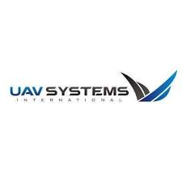
Future ‘Drone’ Market in India
Om UAV Systems
Om UAV Systems is a Drone Manufacturing Company in India that Specializes in providing Drone Solutions for Agriculture, Mining, and Construction.
They have Developed a Range of Drones that are Designed to be Efficient, Reliable, and Capable of withstanding Harsh Weather Conditions.
Their Drones are Equipped with Advanced Imaging Solutions that enable Businesses to Gather Accurate Data and make Informed Decisions.

Slide 38
Future ‘Drone’ Market in India
Chennai Microelectronics
Chennai Microelectronics is a Drone Manufacturing Company in India that provides Drone Solutions for Various Industries such as Agriculture, Construction, and Surveying.
They have been in the Industry for Several Years and have established themselves as a Leading Provider of Drone Solutions in India.
Their Drones are Designed to be User-friendly, Reliable, and Equipped with Advanced Technology that enables Businesses to Operate more Efficiently.

Slide 39

Future ‘Drone’ Market in India
Tech Eagle
Tech Eagle is a Drone Manufacturing Company in India that provides Drone Solutions to Various Industries, including Agriculture, Construction, and Infrastructure.
They Offer a Range of Products that Cater to Different Needs, such as Aerial Photography and Videography, Surveying and Mapping, and Inspections.

Slide 40
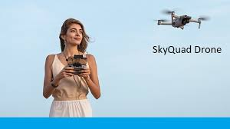
Future ‘Drone’ Market in India
Skyquad
Skyquad is a Drone Manufacturing Company based in Bangalore that Specializes in Producing Customized Drones.
Skyquad was Founded in 2015 and has Quickly become One of the Leading Drone Manufacturers in India.
They have a Team of Highly Skilled Engineers Who Design and Build Drones for a Wide Range of Applications, including Aerial Photography, Surveying, Mapping, and Inspections.

Slide 41
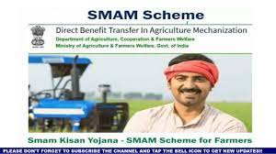
Future ‘Drone’ Market in India
Guidelines
of
Sub-Mission on Agricultural Mechanization (SMAM)

Slide 42
Future ‘Drone’ Market in India
To Promote of Kisan Drones, Guidelines Issued by Sub-Mission on Agricultural Mechanization (SMAM).

Slide 43
Future ‘Drone’ Market in India
Financial Assistance @ 100% of the Cost of Drone up to a Maximum of ₹10 Lakhs Per Drone is provided for Purchase of Drones for their Demonstration by Institutes under:
Indian Council of Agricultural Research (ICAR).
Farm Machinery Training & Testing Institutes.
Krishi Vigyan Kendras (KVKs).
State Agriculture Universities (SAUs).
State and other Central Government Agricultural Institutions / Departments and Public Sector Undertakings (PSUs) of Government of India engaged in Agricultural Activities.

Slide 44
Future ‘Drone’ Market in India
The Farmers Producers Organizations (FPOs) are Provided Grants up to 75% of the Cost of Agriculture Drone for its Demonstrations on the Farmers’ Fields.
A Contingency Expenditure of ₹ 6,000 Per Hectare is provided to these Implementing Agencies that do not want to Purchase Drones but will Hire Drones for Demonstrations from Custom Hiring Centres (CHCs), Hi-Tech Hubs, Drone Manufacturers and Start-Ups.
The Contingent Expenditure to Implementing Agencies that Purchases Drones for Drone Demonstrations is Limited to ₹ 3,000 Per Hectare.

Slide 45
Future ‘Drone’ Market in India
In order to make available Drone Services to Farmers on Rental Basis, Financial Assistance @ 40% up to a Maximum of ₹ 4.00 lakhs are provided for Purchase of Drones by CHCs under Cooperative Society of Farmers, FPOs and Rural Entrepreneurs.
Agriculture Graduates Establishing CHCs are Eligible to receive Financial Assistance @ 50% of the Cost of Drone up to a Maximum of ₹ 5.00 Lakhs per Drone.

Slide 46
Future ‘Drone’ Market in India
For Purchase of Drones on Individual Ownership Basis, the Small and Marginal, Scheduled Caste / Scheduled Tribe, Women and North Eastern State Farmers are provided Financial Assistance @ 50% of the Cost up to a Maximum of ₹ 5.00 Lakhs and Other Farmers @ 40% up to a Maximum of ₹ 4.00 lakhs.

Slide 47
Future ‘Drone’ Market in India
Funds Amounting to ₹129.19 Crores have been released towards Kisan Drone Promotion which include ₹ 52.50 Crores released to the ICAR for Purchase of 300 Kisan Drones and Organizing their Demonstrations on the Farmers’ Fields in 75,000 Hectares through 100 KVKs, 75 ICAR Institutions and 25 SAUs (State Agricultural Universities (SAUs) by Government of India.

Slide 48
Future ‘Drone’ Market in India
Government of India also released Funds to Various State Governments for Supply of more than 240 Kisan Drone to Farmers on Subsidy and Establishment of more than 1,500 Kisan Drone CHCs to provide Drone Services to the Farmers.

Slide 49
Future ‘Drone’ Market in India
ICAR in their Demonstration Project included Four SAUs, Two ICAR Institutes and Five KVKs of the Gujarat State and a Total of 13 Kisan Drones have been sanctioned to them recently by Government of India.

Slide 50
Future ‘Drone’ Market in India
Drone have Some Distinct Advantages such as:
High Field Capacity and Efficiency.
Less Turnaround Time and
Other Field Operational Delays
Wastage Reduction of Pesticide and Fertilizers due to High Degree of Atomization.
Water Saving due to Ultra-low Volume Spraying Technology in Comparison to Traditional Spraying methods,
Reduction in Cost of Spraying and Fertilizer Application in Comparison to Conventional Methods etc. besides Reduction of Human Exposure to Hazardous Chemicals.

Slide 51
Future ‘Drone’ Market in India
Different Approaches like use of Remote Sensing Technology including Satellite Data and Drone Based Images especially for Crop Cutting Experiments Planning.
Direct Yield Estimation at Gram Panchayat Level, Risk Mapping of District and for Dispute / Area Discrepancy Resolution etc.

Slide 52

Future ‘Drone’ Market in India
Union Kisan ‘Pushpak’

Slide 53
Future ‘Drone’ Market in India
Introduction of New Scheme “Union Kisan Pushpak” Scheme for Financing Drones for Agriculture Purposes under:
‘Custom Hiring’ Activity.
Own ‘Agriculture Purpose’.

Slide 54
Future ‘Drone’ Market in India
Details of the Scheme Features

Slide 55
Future ‘Drone’ Market in India
For Purchase of ‘New Drones for Agriculture Usages’ under Custom Hiring Activity / Own Agriculture Purpose on PAN India Basis by Commercial Banks.

Slide 56
Future ‘Drone’ Market in India
Purpose: Purchase of Drones with Equipment / Accessories for Agriculture Usages such as:
Spraying Pesticides.
Fertilizers.
Anti-locust Spraying.
Mapping of Farmlands, etc. under Custom Hiring Activity / Own Agriculture Purpose.

Slide 57
Future ‘Drone’ Market in India
Financing Bank Branches
All the Branches in India

Slide 58
Future ‘Drone’ Market in India
Eligibility: Applicant shall be Individual / Joint Individual Farmers / Proprietorship / Partnerships / Companies / Co-operative Societies, FPO’s / FPC, etc. Involved in Custom Hiring Activity and for own Agriculture Purpose.
In case of Joint individuals, there should not be more than 2 Individuals.
Custom Hiring Centres / Hi-Tech Hubs will also be Eligible for “Interest Subventions Benefits / CGTMSE Coverage” under Agriculture Infrastructure Fund (AIF) Scheme.

Slide 59
Future ‘Drone’ Market in India
Eligibility: In case of Individuals, Applicant should Possess Remote Pilot License from Institute specified by the Director General of Civil Aviation (DGCA) or from any Authorised Remote Pilot Training Organisation and should have passed the Class Tenth Examination or its Equivalent from a Recognized Board.
In case Joint Individuals, at Least One Individual should Possess the above Licence and prescribed Education Qualification.

Slide 60
Future ‘Drone’ Market in India
In Case of Other Constitutions, it is to be ensured that the Person Employed to use the Drones for Agriculture Purpose, Should Possess the above License and Prescribed Education Qualification.
A Suitable Undertaking to be obtained by Banks in this regard from the Borrower.

Slide 61
Future ‘Drone’ Market in India
Applicants shall have Good Reputation in the Market.
Age of the Farmers should be in the Range of 25 Years to 60 Years.
In case of Joint Individuals (Not More than Two), the Age Criteria to be Complied with at Least for One Individual.

Slide 62
Future ‘Drone’ Market in India
Margin: 25% of the Unit Cost including other Accessories and Equipment. (Insurance and AMC will be Considered as part of Project Cost).
Loan Amount: Maximum 75% of Unit Cost (Including other Accessories and Equipment) based on Quotation subject to maximum of ₹12.00 Lakhs for Purchase of Upto 2 Drones.
Nature of loan: Term loan

Slide 63
Future ‘Drone’ Market in India
Security:
Loan limit: Upto Max Loan Amount of ₹20.00 lakhs.
Security: Primary Security-“Hypothecation of Asset” Created out of Bank Finance.

Slide 64
Future ‘Drone’ Market in India
Collateral Security:
Eligible Borrowers shall be covered under the Credit Guarantee Scheme of CGTMSE in lieu of Collateral Security.
For covering the Borrower under CGTMSE, obtention of Udyami Registration Certificate is mandatory along with other Criteria to be Complied with.

Slide 65
Future ‘Drone’ Market in India
In case NO CGTMSE Coverage is available, Mortgage of Land or Cash / Liquid Collateral (With Accepted Value of Land should be more than 100% of the Loan Amount) is Mandatory.

Slide 66
Future ‘Drone’ Market in India
Assessment: Based on the “Projected Cash Flows” submitted by the Borrower from the Activity.
Service Charges: As Per Extant Guidelines on Service Charges of Banks.

Slide 67
Future ‘Drone’ Market in India
Repayment Period:
Maximum Repayment Period of 3 Years and Interest / Instalment is to be Serviced Monthly Including the Maximum Moratorium Period of 3 Months.
Moratorium Period allowed Judiciously wherever required by the Banks.

Slide 68
Future ‘Drone’ Market in India
The Drone should be Comprehensively Insured by the Borrower with Bank Clause for its Full Cost.

Slide 69
Future ‘Drone’ Market in India
Any other Guidelines issued by the DGCA or the Concerned Authority such as Ministry of Agriculture and Farmers Welfare, etc. from Time to Time Governing the Drone Operations are to be Strictly Complied with.

Slide 70
Future ‘Drone’ Market in India
Standard Operating Procedure (SOP) for use of :
“Drone Application with Pesticides for Crop Protection and for Spraying Soil & Crop Nutrients in Agricultural, Forestry, Non-cropped Areas, etc.” is to be followed and Complied by the Borrowers.

Slide 71
Future ‘Drone’ Market in India
A Model Cost Benefit Analysis of Expected Revenues of the Basic and Advanced Drones through Hiring Process are to be submitted by the Applicant while availing Loans from the Banks.

Slide 72
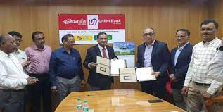
Future ‘Drone’ Market in India
Drones Finance
Under ‘Corporate’ Segment
‘MSME’ Segment
‘Agriculture’ Segment
By
Indian Commercial Banks

Slide 73

Future ‘Drone’ Market in India
Under Corporate Segment, Commercial Banks are Financing (Project Finance) to:
Industries who manufacture the Drones in India.
“Corporate Dealership Finance” those Drone Dealers (All India Base).
These may be Classified as under:
Corporates (SME).
Mid-Corporates.
Large Corporates.

Slide 74
Future ‘Drone’ Market in India
Under MSME Segment, the Commercial Banks are Financing to:
Drone Sub-dealer Outlets.
Drone Hiring Shops.
Drone Spare Parts Dealer Finance.
Drone Servicing Centres (Repairs).
Drone Custom Hiring Centres located in Villages etc.

Slide 75
Future ‘Drone’ Market in India
Under Agriculture Segment, the Commercial Banks are sanctioning Loans to:
Agriculturists.
Self-help Groups.
Joint Liability Groups.
Farmer Producer Organizations.
Krishi Vigyan Kendras etc.

Slide 76
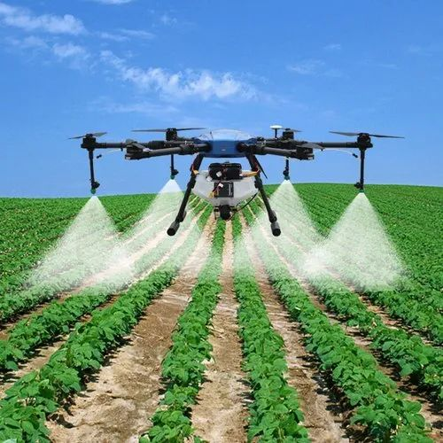
Conclusion

Slide 77
Future ‘Drone’ Market in India
The Drone Industry continues to evolve at Breakneck Speed. This Remarkable Technology has Already Proven its worth in Various Sectors, such as:
Agriculture.
Construction.
Delivery and
Public Safety ETC.
However, the Future holds even Greater Possibilities as New Applications and Advancements Emerge.

Slide 78
Future ‘Drone’ Market in India
Drones will Eliminate the Need to Visually Inspecting the Crops by the Farmers.
They Can Monitor the Horticultural Crops or Other Crops Present in Remote areas like Mountainous Regions.
They can also Monitor the Tall Crops and Trees Efficiently, which are otherwise Challenging to Scout Physically by Farmers.
Being an Equipment for Agriculture Operations, Banks are financing this Equipment under Priority Sector Advances.
Government is encouraging by providing Subsidy / CGTMSE etc.

Slide 79
Future ‘Drone’ Market in India
The CMAs can educate to their Clients in this New Business Opportunity through Consultancy Services in addition to the Core Areas of their Practice.
It is WIN-WIN Situation to Both to CMA and their Client to enjoy the Benefits of New Opportunities.
As Government of India is Encouraging “Drones” Usage in different Sectors with Incentives / Subsidies.
Banks are also encouraging to finance for Drones under Corporate Segment Loans (For Manufacturing) / MSME – For Hiring and Servicing / Agriculture Sector.

Slide 80
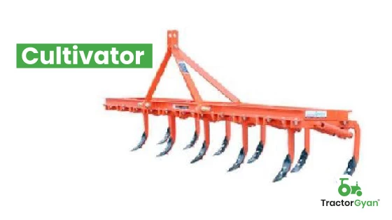
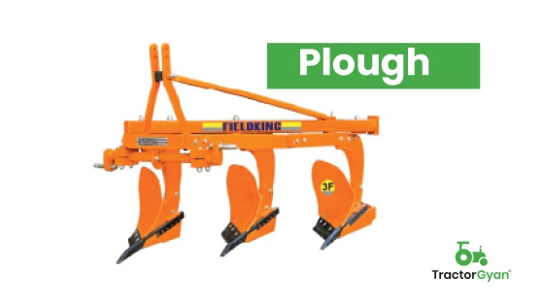
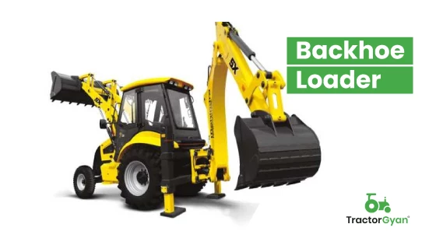
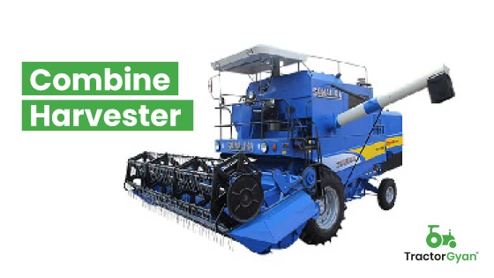
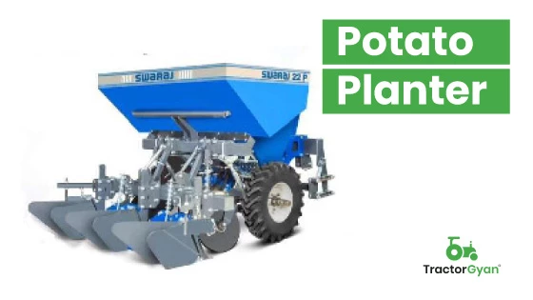
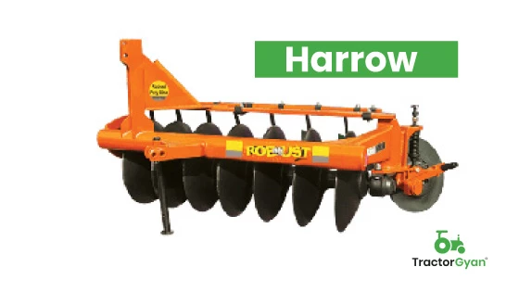
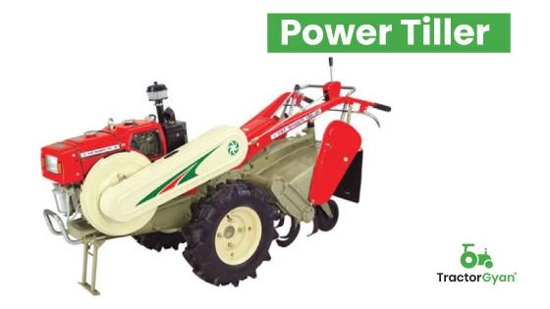
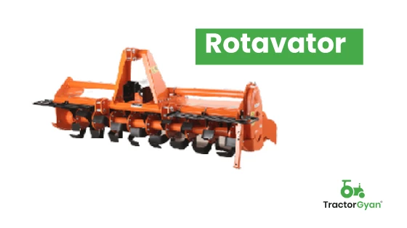
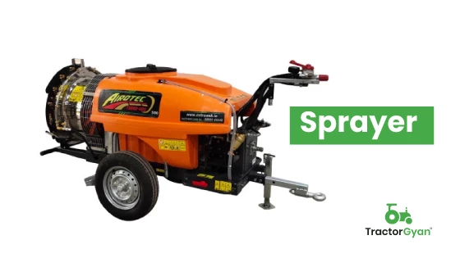
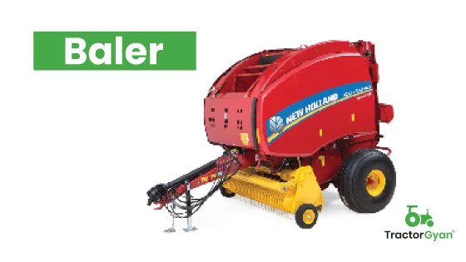
Future ‘Drone’ Market in India
Present Agriculture Equipment's Using by Indian Agriculturists

Slide 81
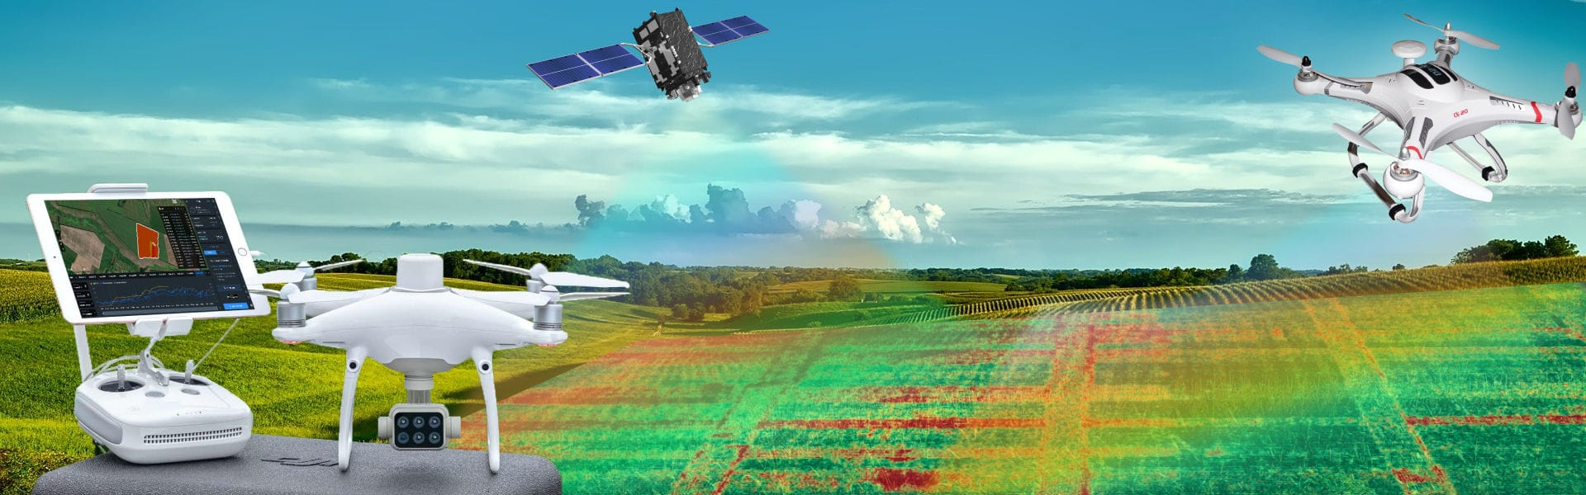
Future ‘Drone’ Market in India
Aerial Imagery is Popular for Fun or Commercial Use in many Verticals, with Diverse Applications in Agriculture New Equipment for Agriculture Operations Drones

Slide 82
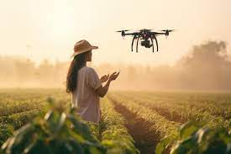
CMA Dr. P. Siva Rama Prasad
M.Com., MBA (Finance)., FCMA., FCS., FIIBF., FIII (Life & General Insurance)., MAIMA.,
Former Asst. General Manager
State Bank of India
Hyderabad
THANK YOU

