Slide 1
Open Banking Architecture
CMA (Dr.) Siva Rama Prasad Puvvala
M.Com., MBA., FCMA., FCS., FIIBF., FIII (Life & General)., MAIMA.,

Slide 2
Open Banking Architecture
Loan From Banks in Minutes
 | SBI Launch SME Digital Loans Programme using Data from Tax and GST Returns for Quick Credit Assessment and Loan Approval up to ₹50 lakhs In “10 Seconds” without Human Intervention.

Slide 3
Open Banking Architecture
Earlier Banks are in ‘Closed System’
Now Banks are in ‘Open System’

Slide 4
Open Banking Architecture
In the Past “Bank Managers” are Called “Agents”
Banks are Maintain Confidentiality
With regard to Customer Deposits / Loans / Transactions etc.

Slide 5
Open Banking Architecture
Today Financial Sector Customer Data Accessed by (Manually / Physically) By:
Third Party Payment Systems “Service Providers”.
Third Party ATM Service Providers (White / Brown Labelled / Micro ATMs.
Third Party Point of Sale (PoS) Merchants.
Third Party Product – Service Providers like Insurance, Mutual Funds etc.
Third Parities like Credit Rating Agencies.
The Customer Information shared to ED, FIU Ind, Income Tax Authorities etc.
Centralized Clearing Systems in case of CTS.
Third Party Service Providers like Wealth Management etc.

Slide 6
Open Banking Architecture
Open Banking “Reduces” the Following:
Cheque Culture.
Visiting to the Bank for Bank Operations. Thereby footfalls of the Customer to Bank Premises Gradually reduced.
Physical to Electronic Payments.
Reduction in Cash Transactions.
More Investment Opportunities.
Increase in Customer Awareness in Technology Products.
Increase in Alternate / Alternative Delivery Channels in Banking System.

Slide 7
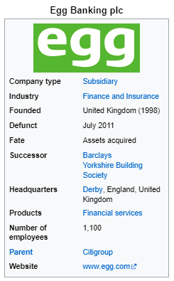
Open Banking Architecture
 | Egg was an Internet Bank Headquartered in Derby, that is now a Trading Name of Yorkshire Building Society. Egg was born out of the Banking Arm in the United Kingdom of Prudential PLC, which was established in 1996, and the Egg brand was Launched in October 1998. The first Online Credit Card was Launched in September 1999.

Slide 8
Open Banking Architecture
Hence, it is Called Open Banking
And It is a Great Opportunity
For
“Startups” like “FinTech” Companies in India

Slide 9
Open Banking Architecture
Banks have Understood that the FinTechs
Are
“Here to Stay” and thus have “Shifted Their Approach”
From
‘Competition’ To ‘Collaboration’

Slide 10
Open Banking Architecture
Name of the Bank | Collaboration with FinTech
DBS Bank | CredAble
Kotak Mahindra Bank | Pine Labs
Federal Bank | CredAvenue
HDFC Bank | Paytm
ICICI Bank | Niyo
Axix Bank | BharatPe
IDBI Bank | U GRO Capital
SBM Bank India | Drip Capital

Slide 11
Open Banking Architecture
Hence
The Banks of the Future will be Software Companies

Slide 12
Open Banking Architecture
“Open Banking” is Changing the “Financial Services Sector”.
Paving the way for Innovations that are:
“Redefining How Businesses and Financial Institutions Interact”

Slide 13
Open Banking Architecture
The Shift Towards a more “Open Infrastructure” has Created:
“Opportunities for Accelerated Modernization and Service Diversity”

Slide 14
Open Banking Architecture
Regulatory Trends are Driving Adoption Rates
“A 2023 Report by Juniper Research Predicting that ‘Open Banking Payment Transaction Values’ will Exceed US$330 Billion Globally by 2027”

Slide 15
Open Banking Architecture
Data Plays an Important Role in the Shift to ‘Open Banking’.
With Access to ‘Detailed Financial Data’, Companies can make more Informed Strategic Decisions, from ‘Risk Mitigation’ to ‘Investment Planning’.
However, it’s About More Than ‘Data Access’.

Slide 16
Open Banking Architecture
Speed.
Adaptability and a
Comprehensive set of Offerings - Are Equally Important.
The Financial Services Market is ‘Transitioning from Siloed Operations’ to a more Interconnected Environment, where:
‘Financial Institutions and Tech Companies Work Together’
To Offer Broader Services

Slide 17
Open Banking Architecture
But ‘Open Banking’ is Not Without its ‘Challenges’.
Issues such as:
Data Privacy.
Inconsistent Service Quality and
Potential Security Vulnerabilities - Require Careful Consideration.
As Developments in Financial Services Continue to Evolve, Businesses Need to Stay Ahead of These Challenges “In Order to Fully Access”
Open Banking’s Potential

Slide 18
Open Banking Architecture
What is Open Banking?

Slide 19
Open Banking Architecture
‘Open Banking’ is a ‘Financial Services Model’ that allows:
Third-party Developers to Access Financial Data in Traditional Banking Systems.
Through Application Programming Interfaces (APIs).
This Model Completely Changes the Way Financial Data is Shared and Accessed.

Slide 20
Open Banking Architecture
‘Open Banking’ Can Give Consumers:
“More Control Over their Financial Information” and
“Provide New Services and Applications”.

Slide 21
Open Banking Architecture
For Non-financial Companies:
This Shift Means they are able to Offer “Customised Financial Services” to “Their Customers”.
Make more “Data-driven Decisions”, and “Innovate in Payments and Account Management”.

Slide 22
Open Banking Architecture
With Better Access to Financial Data:
Businesses Can also “Simplify Payment Processes” and
Generate “New Revenue Streams”.

Slide 23
Open Banking Architecture
How does ‘Open Banking’ Work?

Slide 24
Open Banking Architecture
‘Open Banking’ enables Interoperable ‘Financial Services’ through the Use of APIs (Application Programming Interface).
These APIs (Application Programming Interface) Facilitate the “Secure Exchange of Financial Information” between “Banks and Authorised Third-party Providers”.
Unlike Traditional Banking Services, which often “Operate within a Closed Environment”, Open Banking Decentralises Financial Services.

Slide 25
Open Banking Architecture
In Traditional Banking, Data is often Siloed (Operate Independently and Avoid Sharing Information) within Individual Institutions, making it Challenging for Outside Applications to Interact Directly with Financial Accounts.
‘Open Banking’ Disrupts this by ‘Mandating Standardised Data Formats’ and Secure Communication Protocols.

Slide 26
Open Banking Architecture
This Creates a Level Playing Field where “Third-party Services” can Integrate with Multiple Banks under a “Common Set of Rules”, “Regulations and Technical Standards”.

Slide 27
Open Banking Architecture
APIs (Application Programming Interface)
In ‘Open Banking’
Are
Typically Categorised into “Three Main Types”

Slide 28
Open Banking Architecture
Data APIs | These Provide Read-only Access to Account Information, Balances and Transaction History.

Slide 29
Open Banking Architecture
Transaction APIs | These APIs allow for Transferring Funds, Setting-up Direct Debits and Initiating Payments.

Slide 30
Open Banking Architecture
Product APIs | These Enable Third Parties to “List Financial Products, Rates and Terms”. They’re Often Used for Comparison Websites or Marketplaces.

Slide 31
Open Banking Architecture
In breaking down data barriers and enabling interoperability between platforms:
“Open Banking” can Accelerate “Innovation in the Financial Services” Industry by Providing Businesses with more “Granular Data Insights” and an “Expanded Range of Financial Services Options”.

Slide 32
Open Banking Architecture
Examples of “Open Banking” Services

Slide 33
Open Banking Architecture
Open banking is not one discrete product or service.
Rather, it's a framework within which any number of financial services can be enabled.
This is an actively evolving field, so the scope of financial services coming to market is likely to expand.

Slide 34
Open Banking Architecture
“Ways” in Which “Open Banking”
is
Currently Used

Slide 35
Open Banking Architecture
Payment Initiation Services | Retailers can initiate payments directly from a customer's bank account, bypassing the need for a traditional payment gateway. This method could lead to faster settlements and reduced transaction fees.

Slide 36
Open Banking Architecture
Account Aggregation | Financial advisors and wealth management firms can pull in data from multiple accounts, giving them a more comprehensive view of a client's financial status. This enables more accurate and personalized advice.

Slide 37
Open Banking Architecture
Automated Budgeting | Businesses can offer their employees a smart expense management system that automatically categorises and tracks spend from multiple bank accounts, simplifying financial reporting and oversight.

Slide 38
Open Banking Architecture
Instant Loans and Credit Scoring | Financial institutions can access real-time data to assess credit more accurately, speeding up loan approval processes.

Slide 39
Open Banking Architecture
Automated Invoice Reconciliation | Businesses can use open banking APIs to automate the process of matching invoices to transactions, reducing administrative work and improving accuracy.

Slide 40
Open Banking Architecture
Multi-banking Platforms | A corporation operating in multiple markets could consolidate its accounts from different banks into a single dashboard, making it easier to monitor global operations.

Slide 41
Open Banking Architecture
Personalized Marketing | Retailers can analyse transaction data to provide targeted promotions or loyalty rewards that are directly relevant to an individual's spending habits.

Slide 42
Open Banking Architecture
Account Aggregation | Financial advisors and wealth management firms can pull in data from multiple accounts, giving them a more comprehensive view of a client's financial status. This enables more accurate and personalized advice.

Slide 43
Open Banking Architecture
Real-time fraud Detection | By analyzing transaction data instantaneously, businesses can detect unusual activity quicker than ever before to reduce the risk of financial loss.

Slide 44
Open Banking Architecture
Though these examples are just the Start of What’s Possible, they Offer a Glimpse into how Open Banking can Change the Financial Services Industry.

Slide 45
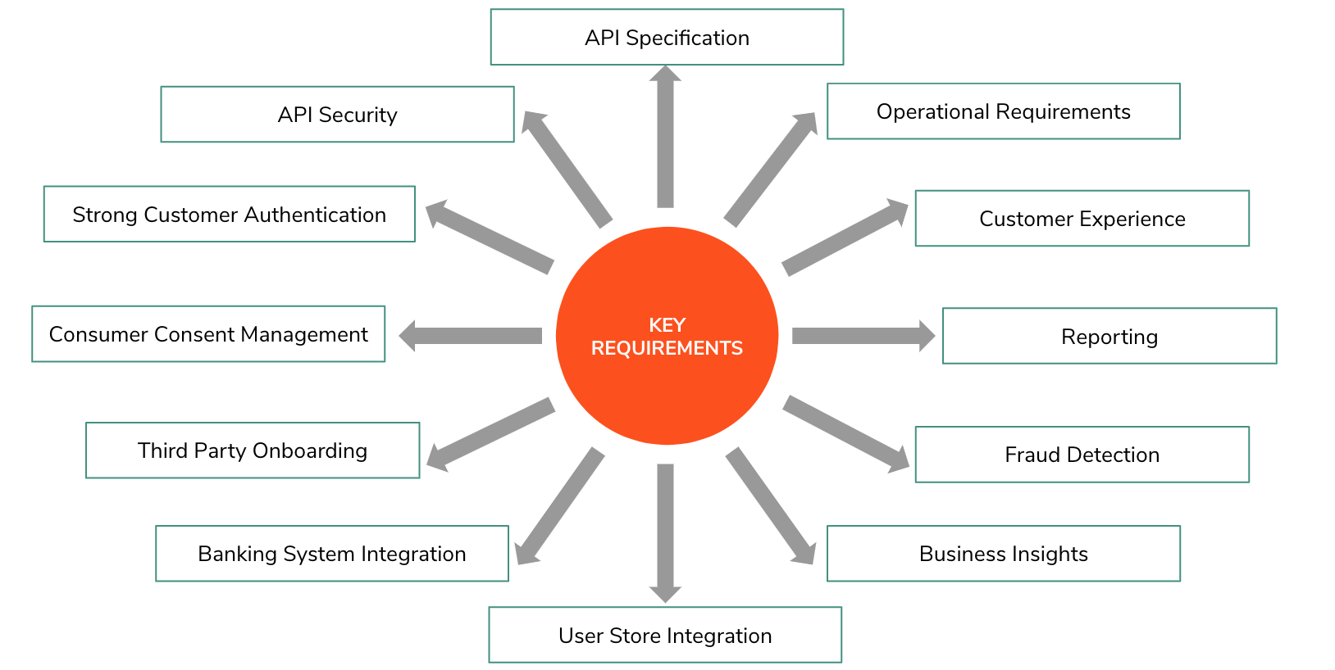
Open Banking Architecture
Key Requirements

Slide 46
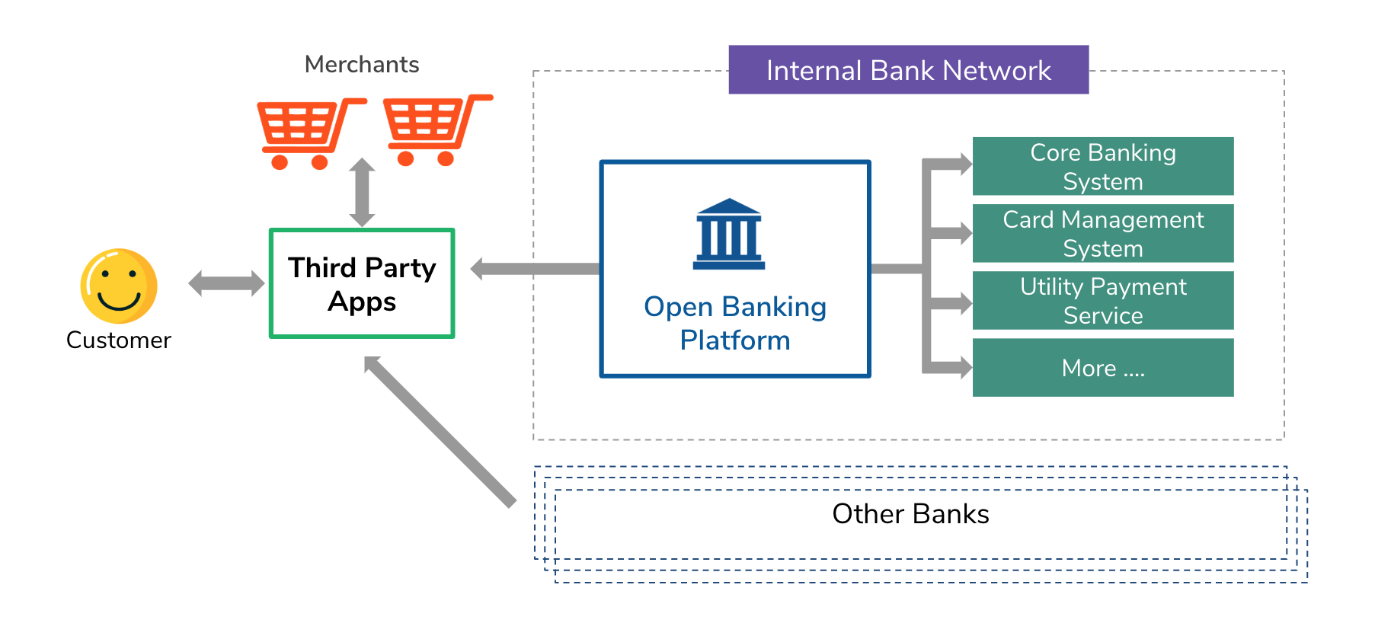
Open Banking Architecture
Open Banking Architecture

Slide 47
Open Banking Architecture
Who Uses Open Banking?

Slide 48
Open Banking Architecture
Open banking completely restructures How Businesses and Customers Access and use Financial Data.
Within the Open Banking Framework, there are New Financial Services that cater for Nearly Every Customer and B2B Segment.

Slide 49
Open Banking Architecture
Individual Customers | People use Open Banking to access a wide range of financial services through third-party applications. They can review their spending patterns, get highly personalized financial advice, or automate transactions such as bill payments.

Slide 50
Open Banking Architecture
Financial Institutions | Traditional Banks, Credit Unions and other Financial Service Providers use open banking to modernize their offerings and create better customer experiences. They can also collaborate with smaller technology companies to bring innovative services to the market.

Slide 51
Open Banking Architecture
Fintech Companies | Newer, Technology-focused Companies use the Secure Data-sharing features of open banking to Create Specialized Services. These range from budgeting apps to complex financial management solutions for businesses.

Slide 52
Open Banking Architecture
Small and Medium-sized Businesses (SMBs) | These Organizations use Open Banking to Automate various Tasks, such as Reconciling Invoices with Bank Transactions and Gaining a Clearer Picture of their Financial Status.

Slide 53
Open Banking Architecture
Regulatory Bodies | The Organizations that set and Enforce Financial Rules find Open Banking useful for Creating a Standardised Environment. This Helps Protect Customers and Ensure Secure Data Handling Practices within the Financial Services Industry.

Slide 54
Open Banking Architecture
E-commerce Companies | Businesses Selling Products or Services Online can Process Transactions more Directly, Often Bypassing Traditional Payment Systems and Reducing Costs.

Slide 55
Open Banking Architecture
Accounting Platforms | Financial Software can access Real-time Transaction Data, Making it easier to Manage Accounts and Reducing the need for Manual Data Entry.

Slide 56
Open Banking Architecture
Software Developers | With Open Banking APIs, Software Developers can create a Range of Beneficial Services and Tools for Both Individual Customers and Businesses, Opening up New Avenues for Innovation.

Slide 57
Open Banking Architecture
Credit and Lending Institutions | These Entities can make Faster and more Accurate decisions by Accessing Financial Data Quickly, Optimising Loan Provision and Credit Scoring Procedures.

Slide 58
Open Banking Architecture
Benefits of Open Banking

Slide 59
Open Banking Architecture
Open banking provides businesses with a variety of opportunities to improve operations, comply more easily with regulations, and offer value-added services that can position them effectively for the future.

Slide 60
Open Banking Architecture
Data-Driven Decision-making | Open banking allows businesses to obtain detailed financial data that can inform strategic choices, from risk assessment to investment planning. The depth of available information surpasses that of traditional financial statements.

Slide 61
Open Banking Architecture
Operational Agility | Open banking offers accelerated data flow, expediting transactions and enabling quicker reconciliation. This speed translates into greater adaptability in fast-paced market conditions.

Slide 62
Open Banking Architecture
Interoperable Collaboration | Open Banking creates an environment where financial institutions and tech-driven companies can innovate jointly. This translates into a broader and more sophisticated service offering for business customers.

Slide 63
Open Banking Architecture
Optimised Payment Processes | Open Banking APIs allow for more direct payment methods, often bypassing Traditional Gateways and resulting in Lower Transaction Costs.

Slide 64
Open Banking Architecture
Regulatory Alignment | Open Banking frequently incorporates Standardized protocols and strong data protection measures, helping businesses meet regulatory requirements more easily.

Slide 65
Open Banking Architecture
Customer Personalization | Businesses can offer customized financial services to their customers, from specialized lending solutions to treasury services, all enabled by the rich data accessible via open banking.

Slide 66
Open Banking Architecture
Resource Allocation | Simplified financial operations mean staff can focus on other areas of the business. Whether it’s Automating Reconciliation or Smoothing out Invoicing Processes, Open Banking APIs can lead to more effective use of Human Resources.

Slide 67
Open Banking Architecture
Market Penetration | Open Banking can help Businesses Enter New Markets, facilitated by Partnerships with local FinTech Companies and easier Access to Customer Data for Localized Customization.

Slide 68
Open Banking Architecture
Innovation Catalyst | For Businesses in the Tech and Financial Sectors, Open Banking provides a Dynamic Way to offer New Services that can be monetized, increasing Revenue Streams and Customer Retention.

Slide 69
Open Banking Architecture
Challenges of “Open Banking”

Slide 70
Open Banking Architecture
While Open Banking offers many Benefits and Opportunities for Innovation, it also has Challenges that Businesses and Financial Institutions need to be aware of. From Integration Issues to Security Vulnerabilities, here are some of the Potential Drawbacks of Open Banking:

Slide 71
Open Banking Architecture
Inconsistent Quality | While some third-party services are excellent, others may not meet the strictest standards. Inconsistencies in quality could lead to service interruptions or unreliable data, causing operational difficulties and necessitating costly adjustments.

Slide 72
Open Banking Architecture
Integration Issues | Combining multiple third-party services and APIs might cause unanticipated technical challenges. These complications often require specialized expertise and additional hours to troubleshoot, affecting operational timelines and potentially increasing costs.

Slide 73
Open Banking Architecture
Limited Standardization | The absence of universal standards complicates the way services talk to each other. This lack of consistency may require manual intervention to ensure that the systems are compatible and functional.

Slide 74
Open Banking Architecture
Regulatory Hurdles | As open banking evolves, so do its regulations. Keeping up to date with these changes can be a resource-intensive task, requiring a dedicated internal team or external experts to help your business stay compliant. Failing to adapt can result in penalties or legal issues.

Slide 75
Open Banking Architecture
Accountability Gaps | With various parties involved, determining fault in the case of an error or security breach is more complex. This ambiguity can slow down problem-solving and lead to prolonged downtimes or unresolved customer issues.

Slide 76
Open Banking Architecture
Hidden Costs | Beyond API subscription fees, there may be hidden costs tied to compliance or technical adjustments. These expenses can mount over time, possibly offsetting any cost-saving benefits of open banking.

Slide 77
Open Banking Architecture
Dependency Risks | Outsourcing core financial functions to third-party services puts businesses under their control, to some extent. Any change in their service availability or terms of use could necessitate an abrupt shift in the operations that use those services, which could become costly and time consuming.

Slide 78
Open Banking Architecture
Market Uncertainties | Open banking is still an evolving field, subject to changes in technology and public sentiment. These unpredictable factors could influence long-term strategies, making it challenging to plan with certainty.

Slide 79
Open Banking Architecture
Security Vulnerabilities | Despite best efforts to keep systems safe, potential gaps in data protection and security protocols could be exploited. The repercussions of a data or other security breach could extend beyond financial loss to reputational damage, affecting customer trust and possibly leading to legal consequences.

Slide 80
Open Banking Architecture
Conclusion

Slide 81
Open Banking Architecture
The Potential of Open Banking to elevate Customer Service and Generate New Revenue Sources is not without Added Risks.

Slide 82
Open Banking Architecture
Businesses should exercise prudence when adopting this Technology and take Stringent Steps to Safeguard Security and Privacy.

Slide 83
Open Banking Architecture
Many Benefits to be Gained for Businesses that Enter this Space Thoughtfully, Strategically and with the Right Risk-mitigation Measures in Place.

Slide 84
Digital Transformation of Banks From Caterpillar to a Butterfly
To Know More of Tomorrow’s ‘Banking System’
BFSI Board of The Institute of Cost Accountants of India Offers
“FinTech” Course

Slide 85
Digital Transformation of Banks From Caterpillar to a Butterfly

Slide 86
Digital Transformation of Banks From Caterpillar to a Butterfly
Next Webinar
On 02.08.2024
“White Label Banking”

Slide 87
Thank You
CS (Dr.) P. Siva Rama Prasad
Asst. General Manager (Retd.)
State Bank of India
M.Com., MBA (Finance)., FCMA., FIIBF., FCS., FIII (Life & General)., MAIMA.,

