Slide 1
Internal Audit in Life Insurance
Centre for Insurance and Risk Management
Koushal Vikas Foundation ®
From CMA Perspective
Prof. CMA P N Murthy
M Com, FCMA, FIII, FLMI(USA), ARA(USA),ACII(UK),MIMA,AIV,AMT
Cost Accountant and Management Consultant
Chartered Insurer (London)
Insurance and Reinsurance Specialist
Accredited Management Teacher

Slide 2
Prof. CMA P N Murthy
Cost Accountant
FCMA,FIII,FLMI (USA), ACII (UK),ARA (USA), AMT
With 34 years of domain experience in Insurance Sector in various capacities
In LIC, MetLife India, RGA Re, MMC & NASIER, KVF, SPI
Held positions in Finance, Underwriting, Servicing, Claims, Admin, Systems, Audit, Training, BA/QA,PMO
Conversant with Global best practices
Visiting Faculty & Research Guide for Insurance
ceo@koushalvikasfoundation.org cma.pnmurthy@gmail.com

Slide 3
So far, we have proved that
Now….We need to demonstrate that
CMAs are behind successful India

Slide 4
Companies Act 2013

Slide 5
“There is no business like Life Insurance business because there is nothing like Life Insurance”
Fred A Lumb CLU

Slide 6
Opportunities & Challenges
Job and Career opportunities
Existing (acute shortage of skilled resources)
Huge Potential to create
Economic Opportunities
Lowest penetrations
Augmenting national investments
Socio cultural
Strengthens households
Reduced dependency on Budgetary Funds

Slide 7
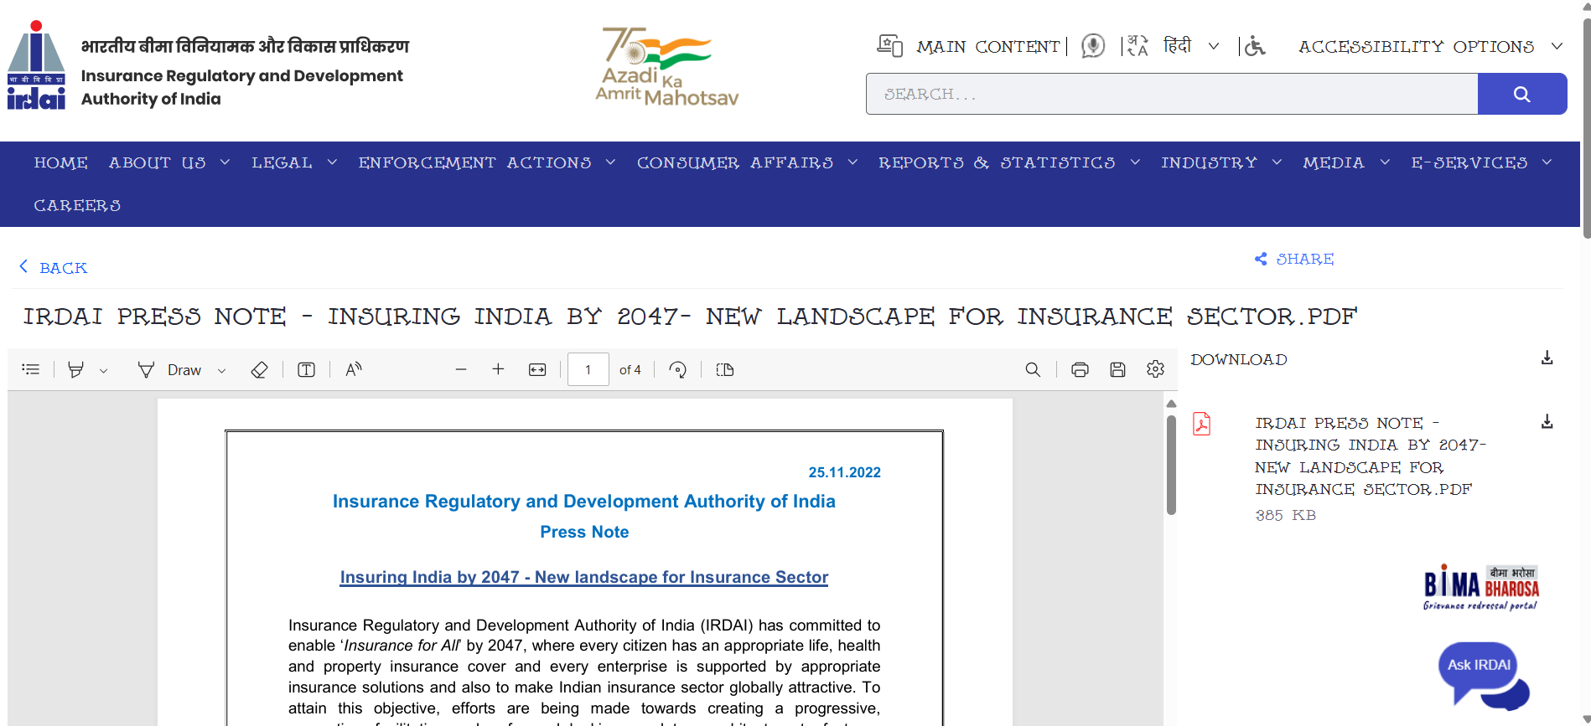
Regulatory Scenario

Slide 8
Focus Areas

Slide 9
Some important proposals approved in the 120th Meeting of the Authority held at its headquarters in Hyderabad on Friday, 25th November 2022:
1. Registration of Indian Insurance companies
2. Increase in tie-up limits for intermediaries :the maximum number of tie ups for Corporate Agents (CA) and Insurance Marketing Firms (IMF) have been increased. Now, a CA can tie up with 9 insurers (earlier 3 insurers) and IMF can tie up with 6 insurers (earlier 2 insurers) in each line of business of life, general and health for distribution of their insurance products.
3. Regulatory sandbox :The Regulatory sandbox is a framework which provides a testing environment to the companies to enable them to test their innovative products, technologies, etc., in a controlled regulatory setting. It promotes innovation and technological solutions in the industry.
4. Other forms of capital :In order to facilitate ease of raising other forms of capital viz., subordinated debt and/or preference shares, the requirement of prior approval from IRDAI is dispensed with.
5. Appointed Actuary : the experience and qualification requirements have been made flexible.
6. Solvency Norms for General Insurers
7. Solvency Norms for Life Insurers

Slide 10
Other major interventions
8. Listing of Insurance Companies: Listing of insurers in the stock exchanges allows the insurers to raise capital.
9. Merger of Exide Life Insurance Co. Ltd. with HDFC Life Insurance Co. Ltd.
10. Registration of Kshema General Insurance Co. Ltd.
Other reforms on the anvil
Exposure drafts on Expenses of Management Regulations and Commission Regulations

Slide 11
At a glance

Slide 13
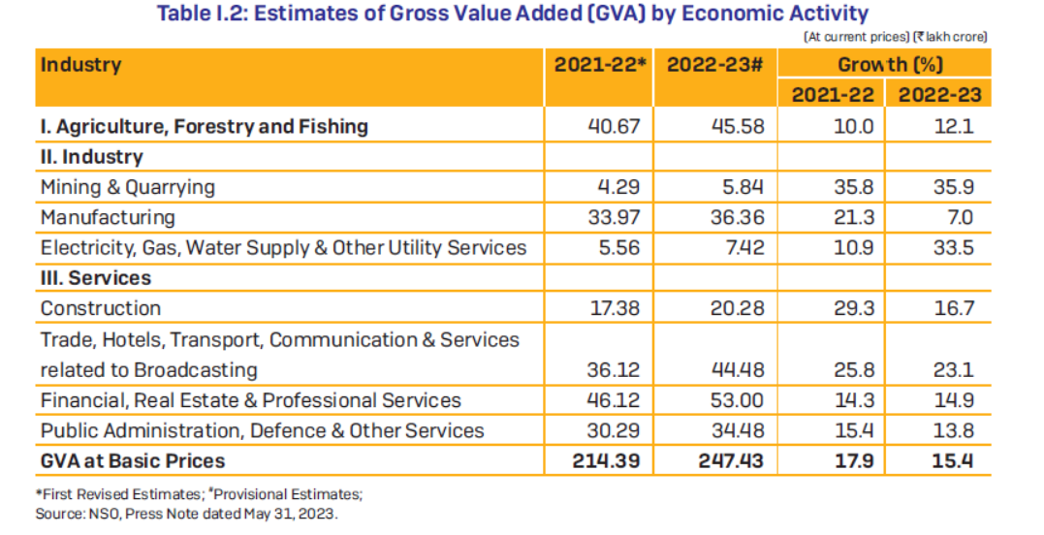

Slide 14
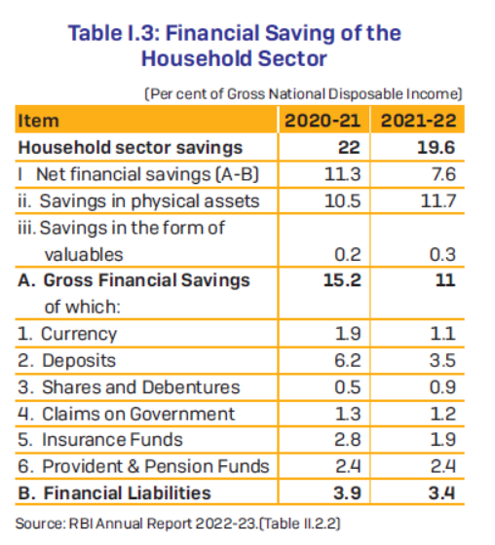
%of IF to GFS
=1.9/11*100
=17.3%
% of IF to FL
=1.9/3.4*100
=55.9%

Slide 15
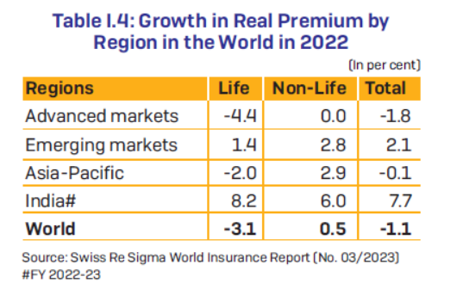

Slide 17
Measures : Insurance
Insurance penetration is measured as the percentage of insurance premiums to GDP
Insurance density is calculated as the ratio of premium to population (per capita premium).

Slide 18
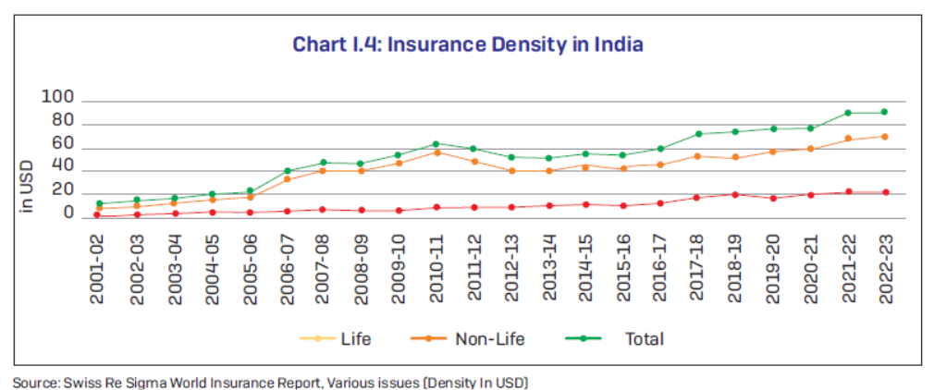

Slide 19
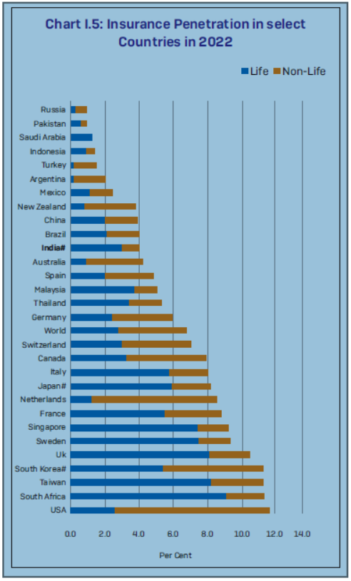
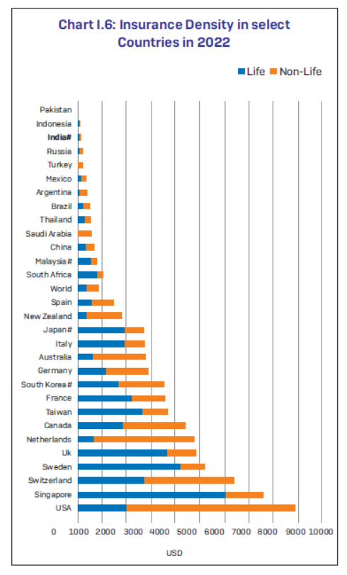

Slide 20
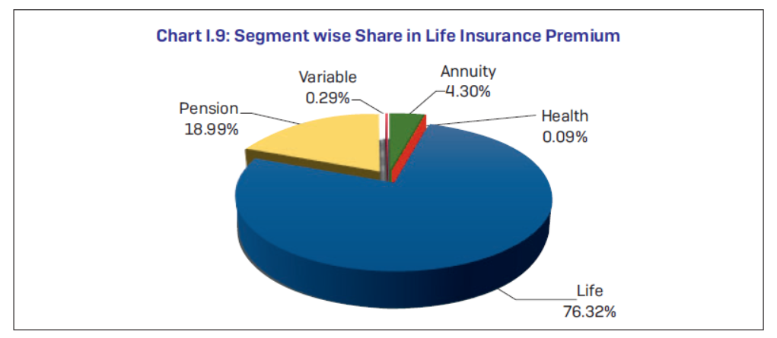

Slide 21
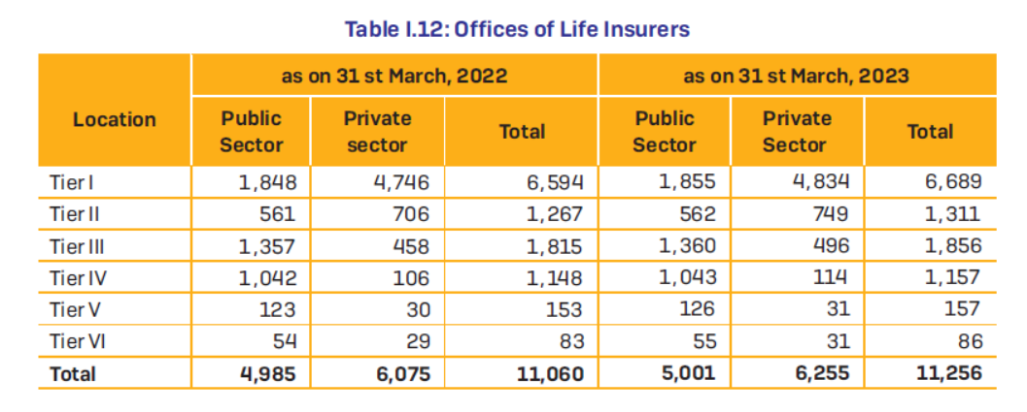

Slide 23
Overview of Discussion
Over View
Gen Admin
Sales/Marketing
Underwriting & Contract Issue
General Servicing
Alteration, revival, Nomination, Assignments
Death Claims, Maturity,SB,Surrenders, Bonus, Early Claims Investigations
Actuarial: Pricing, Valuation
Investments
Legal & Regulatory Compliance
Systems
HR
GRM
F&A
Risk Control& Audit

Slide 24
Internal Audit Perspective
Internal audit in life insurance companies
Business
Compliance
Risk

Slide 25
Overview
Financial Services Industry
Transaction oriented
Highly technical domain
Process centric
Cash/Assets rich
Need Good/Efficient Processes
Unique decision making
Systems not a solution
Human intelligence is required
Auditor to have domain, process, analytical, holistic perspective

Slide 26
General Administration
SOP/Admin Manual/Circulars/Instructions/In charge/GRM/Adherence
Compliance Officers/GRM/PGA/Display/Notice Boards
DRM Process- Accident Control: Fire, Theft etc
Office/Building Security
Surveillance: Guard/Automated system/Control
Emergency Exit-fire Exit- Fire Extinguishers- Emergency Indicators
Office Keys
Key Movement Register/Access Control
Office Access- Control
Vaults/Safe/access Control/Register
Storage-Records-Warehouse- Stock of Records/Stationery/Access Control
Health & Hygiene: Office upkeep- Maintenance, Water, Seating, BayCare/Women’s care/Visitor's lounge
Budget Control

Slide 27
Sales & Marketing
SOP/Admin Manual/Authority/Control Process
Sales or Marketing Policy
Intermediary Recruitment/Management/Terminations Control
Agency Registers/records/Access control
Remuneration to intermediaries, Recoveries/control
Maker Checker- control Register
Advances to intermediaries
Saleable items/Literature/Indent, Stock, disposal control
Free-distribution material, literature, Stock, control, Advertisements, SOP, Payments, Verification, control
New Business –Receipt, process, control, hierarchy
Control on Registered Business
Business Movement Register/Access, Control

Slide 28
Underwriting
SOP, Admin Manual, Circulars & Instructions, control, authority- UW Policy
Underwriting Process, Authorities, Limits, Control
Inward NB, Access and Control on NB record
Acceptance, Process, Updation, Policy No generation, Movement control
Postponements, intimations, adherence, control, recall, disposal
Rating/Restrictions, recording decision, intimations, receipt of documents, UW decisions, clauses in policies,
Declinature, decisions, intimations, control recordings in system, red-flag intimations to controlling offices
Decision limits, hierarchy, Collective decisions, referrals to HOs, receipts, movement control, MC decisions
Recording decisions in systems, File Movement
Commission release control
Medical fees: release special reports on request
Empanelment, roster, terminations of medical examiners, Visiting & decision charges

Slide 29
Contract Issuances
SOP-Admin Manual, guidelines, circulars etc
Inward control on files
Control on pre-printed stationery, access, usage records
Control on Printing process, Cost control, wastage, recycling
Contract Printing,
Amendments, clauses, addendums, insertions,
Contract scrutiny/Verification
Stamping: Stock control including purchases, access
Signing, sealing, authority,
Despatch, returns, control, intimations, destructions, Red-flag on fruads, lapses
Outward control register

Slide 30
Policy Servicing- General
SOP, Admin Manual, circulars- Servicing Policy
Customer Orientation, care
Protection of Policy Holders regulations- compliance
Inward, disposal and communications on customer requests
Adherence to TAT
Confidentiality of customer information, Data protection
Disposal of old Records

Slide 31
Policy Servicing- Alterations
SOP, Admin Manual, circulars
Customer Centric approach
Adherence to rules- permissible & non permissible
Communications to customers
System intimations

Slide 32
Policy Servicing- Revivals
SOP, Admin Manual, circulars
Customer Orientation, care
Novation of contract
Underwriting, limits, restrictions, intimations
Endorsements on Policies
System intimations, Commission impact
MIS on in force
Campaigns, interest waivers, accounting
Public awareness, Campaigns

Slide 33
Policy Servicing- Nomination
SOP, Admin Manual, circulars
Customer Orientation, care
Sec 39, Insurance Act
Notice of change or cancellation of nomination
Nomination or cancellation by will – animus revocandi- intention to revoke, express or implied
Several Nominees
JLP policy – Joint Nomination- only if both Las die in same event
No Nomination- on Policies on lives of others
Stranger Nominee- Sec 30 Indian Contract Act, Insurable Interest must exist
Minor Nominee – Appointee
Date of Registration: Date of Policy- Cancellation/change of nomination: Date of receipt of policy or notice whichever is later is the date of registration
MWP Act Policies: Policy a trust- No direct reference of Sec 39

Slide 34
Policy Servicing-Assignment
SOP, Admin Manual, circulars
Customer Orientation, care
Sec 38, Insurance Act- Conveyance of right, property, ownership in policy
Types conditional or absolute
Conditional: Transfer of Property Act Sec 126:@donor or done may agree that on the happening of a specified event, which does not depend on the will of the donor, a gift shall be suspended/revoked wholly or in part.
Premium/ Loan Interest Notices: Absolute Assignment: normally to assignee uncles specified by assignor, in writing.
Assignment, by endorsement/separate endorsement
Stamping: if separate endorsement
Notice of Assignment received by Insurer
Register of assignment, system intimations, policy endorsements
Reassignment

Slide 35
Policy Servicing-Death Claims
SOP, Admin Manual, circulars- claims Policy
Claims Register
Claims Intimation
Requirements, compliance
Title discharge
Recovery of unpaid premiums in policy anniversary
Computation, Bonus element
Payments
Rival Claims
Disputes, Early Claims, suicide, Homicide
Investigation, Repudiation, Rejections

Slide 36
Policy Servicing-Maturity Claims
SOP, Admin Manual, circulars
Requirements, Valid discharge, policy documents
Computation, due premiums, loan, interest
LA reported missing and not heard of: Indian evidence Act Provisions
Policy Document is lost
Assignments,

Slide 37
Actuarial- Pricing and Valuation
SOP, Admin Manuals- Actuarial Policy
Product Policy- investment decisions
Regulatory Requirements: Actuarial regulations by IRDA
Market Research
Pricing : Financial Models
Assumptions: Consultative, realistic
Valuation: Accounting Standards adherence
Appointed Actuary Regulations
Actuarial Report Regulations

Slide 38
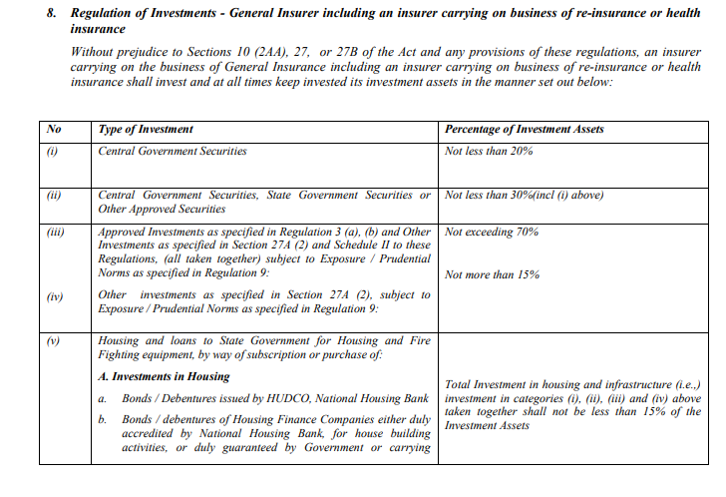
Investments

Slide 39
Regulatory & Compliance- Insurance Act,1938
Reference | Details
Sec 2 | Definition & Scope of Insurer
Sec 2(10) | Right of an agent to receive commission
Sec 10 | Separation of accounts and funds.
Sec 11 | Accounts and balance-sheet.
Sec 12 | Audit.
Sec 13 | Actuarial report and abstract.
Sec14 | Record of policies and claims.
Sec 15(1) | Submission of returns.
Sec 21&22 | Regulator to accept the above reports & return or call for details if not found suitable
Sec 32B | Insurance business in rural and social sectors

Slide 40
Regulatory & Compliance- Insurance Act,1938
Reference | Details
Sec 33 | Power of investigation & inspection of Insurance cos by the authority
Sec 38 | Assignment of a Life Policy
Sec 39 | Nomination by policy-holder
Sec 40 | Prohibition of payment by way of commission or otherwise for procuring business
Sec 41 | Prohibition of rebates.
Sec 42 | Appointment of insurance agents
Sec 43 | Register of insurance agents.
Sec 45 | Indisputability of Policies after 2 years
Sec 46 | Regulator’s right to take decisions in claims disputes
Sec 64V. | Assets and liabilities how to be valued.

Slide 41
Regulatory & Compliance- Insurance Act,1938
Reference | Details
Sec 64VA. | Sufficiency of assets
Sec 64VB. | No risk to be assumed unless premium is received in advance
Sec 113. | Acquisition of surrender value by policy
Sec 102,103,104,105 | Penalties for failure to supply any info or act as per direction of regulator, or maintain solvency Margins etc

Slide 42
IRDAI Regulations

Slide 43
Systems, HR, GRM
System, User Licenses
Login control
Network Control
Authority control: Limits on financial powers
Safety Lock
Environmental control
Maintenance
Backups
Inventory control,
Transit control
Cyber Risk

Slide 44
HR & GRM
Background checks
Access control
Payroll control
Performance Measures control
Whistle-blower
Vishaka-Team
Customer Orientation
Logging, investigation, disposal of complaints
Escalation matrix
Transparency of Process

Slide 45
F&A
Cash : Safety, Control
Cash in transit
Bash box, safe,
Keys, KMR
Lodgements, control,
Banking, BRS, Investments
Budget Control
Control on payments
Maker checker
Transaction authorisation
Control on float

Slide 46
Fin &Accounts
Control and clearance of extraneous items in Reconciliations
Reconciliation of functional schedules
Payments by cheque
Restrictive endorsement
Duplicate keys
Stock of Printed receipts
Stock of Stamps
Control on IBT
Control on Inter Office Transaction
Control on imprest
Principle Ledger

Slide 47
Audit & Compliance
Financial discrepancies, responsibility fixing, rectifications
Audit Queries
Audit Observations
Compliance filing
Rectification/indemnification
Fixing the system
Repeated offences
Punishments, Censures, dismissal
Inspection of Processes
Identifying process violations, responsibility fixing
Corrective steps in processes

Slide 48
Some Computations
Disclaimer: Academic Purposes only

Slide 49
General Computations
1.Age
2.Date of maturity
3.Due date of last premium
4.Date of vesting
5.Office Year of Birth (OYB)
6.Office Year of Maturity (OYM)
7.Office Year of Last Payment plus One (OYLP +1)
8.Simple Interest
9.Compound Interest
10.Premium
11.Agent’s Commission
12.Revival or Reinstatements
13.Paid Up Amount
14.Surrender Value
15.Loan
16.Settlement Options
17.Computation of BMI
18.Estimated Weight , Numerical Rating, EMRs
19.Miscellaneous Topics

Slide 50
Age, Dates etc

Slide 51
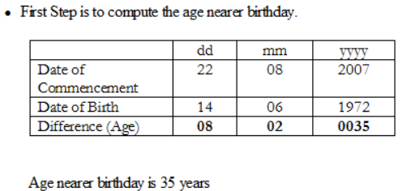
Premium Computation

Slide 52
Paid Up Computation
Solution: In the given case due date of first unpaid premium needs to be computed, which is nothing but, date of last premium paid + Mode. In other words the FUP is 11-11-1991 + (half year) = 11-05-1992. Paid up value computation is required when the policy is in inforce condition.

Slide 53
Call for Action for CMAs
Develop domain and analytical skillsets in Life Insurance industry. •
Explore new options by diving deep into the Ocean of Insurance

Slide 54
Thank You

