Slide 1
Decentralized Finance (DeFi)
CMA (Dr.) Siva Rama Prasad Puvvala
M.Com., MBA., FCMA., FCS., FIIBF., FIII (Life & General)., MAIMA.,

Slide 2
Decentralized Finance (DeFi)
Disclaimer
The following statements do not constitute Investment Advice or any other Advice on Financial Services, Financial Instruments, Financial Products, or Digital Assets.
They are intended to Provide General Information Only. Noting else.

Slide 3
Decentralized Finance (DeFi)
Simple Case Study on Technology Products
An individual promptly expresses the desire to travel to Chennai from Mumbai via Air to participate in an Interview Scheduled for the following day.
The individual endeavors to Secure an Air Ticket using Online Banking (Internet Banking) with the available funds in their Savings Account Amounting to ₹ 10,000, while the Airfare Costs ₹ 9,000.

Slide 4
Decentralized Finance (DeFi)
Case Study --- Contd.. ..
Owing to a Bandwidth issue within the realm of Information Technology, originating from either the Bank's end or the Airline's end, the individual's Account was Debited without the issuance of the Ticket by the Airline (Amount will be refund within 7 days). And due to out of funds, he unable to purchase Air Ticket from other Air Lines.

Slide 5
Decentralized Finance (DeFi)
Case Study --- Contd.. ..
Consequently, the Individual lodged a complaint / grievance seeking redress for being unable to attend the Interview at the Designated Time Due to Technological Issues, Addressing both the Bank and the Airlines (Compensation Amount of ₹ 5.00 Lacs).

Slide 6
Decentralized Finance (DeFi)
Case Study --- Contd.. ..
Both entities invoked the Disclaimer Clause, stipulating that the Organization bears No Responsibility for Technological or Communication Impediments, thereby denying any form of Compensation.

Slide 7
Decentralized Finance (DeFi)
Moral of the Case Study
The “Underlying Lesson” derived from this Scenario Underscores the Dual Nature of Technology, Encompassing both Advantages and Disadvantages.
Hence, Future FinTechs are also No Exemption in this type of Events / Situations.

Slide 8
Decentralized Finance (DeFi)
Digital Currency / Virtual Currency

Slide 9
Decentralized Finance (DeFi)
The Global Shift Towards ‘Digital Currency’, initiated by Central Banks of the Worldwide to Transition away from “Physical Currency”, is Underpinned by the Backing of these Currencies by the Central Banks of the World.

Slide 10
Decentralized Finance (DeFi)
Digital Currency / Virtual Currency
Digital Currency is any Currency that’s available Exclusively in Electronic Form.
Electronic Versions of Currency already Dominate Most Countries’ Financial Systems.

Slide 11
Decentralized Finance (DeFi)
Central Bank Digital Currency (CBDC)?
A Central Bank Digital Currency is a Digital Currency (CBDC) that is Issued and Overseen by a Country’s Central Bank.
More than 100 Countries are Exploring CBDCs at One Level or Another.

Slide 12
Decentralized Finance (DeFi)
CBDC is available include the Central Bank of The Bahamas (Sand Dollar), the Eastern Caribbean Central Bank (DCash), the Central Bank of Nigeria (e-Naira) and the Bank of Jamaica (JamDex), and in Our Country Reserve Bank of India (e₹) to Name Just a Few.

Slide 13
Decentralized Finance (DeFi)
China’s Digital Yuan, One of the Largest CBDC launched its Pilot Project way back in 2014.

Slide 14
Decentralized Finance (DeFi)
India’s Digital Rupee
e ₹ (R/W)

Slide 15
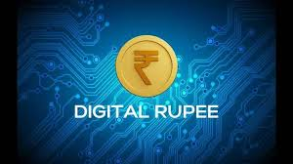
Decentralized Finance (DeFi)

Slide 16
Decentralized Finance (DeFi)
India’s E-Rupee Launch
With the Advent of Smartphones and Rise of Digital Payment Systems, India has also Rolled Out its own CBDC, Known as e-Rupee (e₹).

Slide 17
Decentralized Finance (DeFi)
India’s E-Rupee Launch
e-₹ is in the form of a Digital Tokens which represents Legal Tender in India (₹ 1, ₹ 2, ₹ 5, ₹ 10, ₹ 20, ₹ 50, ₹ 100, ₹ 200, ₹ 500) leading to Gradual Phasing Out of Physical Currency Denominations in the Country.

Slide 18
Decentralized Finance (DeFi)
India’s E-Rupee Launch
Reserve Bank of India has launched CBDC Pilot in 1st November, 2022 (e₹ Wholesale) and 1st December, 2022 (e-₹ Retail) and thus marked a New Milestone for Digital Payments of our Country.
Presently, the CBDC has its components based entirely on Blockchain Technology.

Slide 19
Decentralized Finance (DeFi)
Current Information on CBDC in India:
Achievement to Push up Transactions by offering incentives to Retail Users and Disbursing a Portion of Bank Employees’ Salaries using the e-Rupee.
Push up Transactions Target about 2,50,000 to 3,00,000 Per Day.

Slide 20
Decentralized Finance (DeFi)
CBDC in India
At present, If You Wish to have the “Digital Currency” in the Form of e₹ Retail can be facilitated at:
Public Sector and Private Sector Banks in India.

Slide 21
Decentralized Finance (DeFi)
Benefits of Digital Currency (CBDC):
Faster Payments.
Cheaper International Transfers.
24/7 Access.
Support for the Unbanked and Underbanked (Without Internet).
More efficient Government Payments.

Slide 22
Decentralized Finance (DeFi)
UPI vs CBDC
Localized Usage: Currently Limited to India.
Digital Connection Required: An Internet Connection is a Must.
Tracking: How One Person funds are Moved to Another.

Slide 23
Decentralized Finance (DeFi)
UPI vs CBDC
Chargeable: In future, UPI if it is Chargeable. Like Physical Currency “No Charges to CBDC”.
Third Party Involvement: Intermediaries like Google Pay, RuPay, Paytm etc.

Slide 24
Decentralized Finance (DeFi)
More Advantages of CBDC
ATMs, Currency Chests, Cash Counters will Disappear once Full-fledged implementation of CBDC.
Printing 1,000 notes of ₹100 costs ₹ 1,770. Printing 1,000 notes of ₹ 200 costs ₹ 2,370. Printing 1,000 notes of ₹ 500 costs ₹ 2,290.

Slide 25
Decentralized Finance (DeFi)
More Advantages of CBDC
RBI spent ₹ 4,984.8 Crores on Security Printing from April 1, 2021, to March 31, 2022, against ₹ 4,012.1 Crores in the Previous Year (July 1, 2020, to March 31, 2021) + Transportation Costs from Printing Press to Currency Chests + Security / Escort Charges etc.

Slide 26
Decentralized Finance (DeFi)
Private Currencies
Simultaneously in the World:
Private Currencies, like Crypto Currency, have Emerged Globally.
(Both CBDC and Private Currencies are Virtual Currency)

Slide 27
Decentralized Finance (DeFi)
Intermediaries

Slide 28
Decentralized Finance (DeFi)
More Channels of Distribution in the Products Supplied by Companies to Customers Increased the Price / Delay / Costs.
(Like Manufacturer to Whole Seller to Retailer to Consumer etc.)
In the Similar manner More Financial Intermediaries can include in the Financial Services, the Possibility of Lower Investment Returns, Mismatched Goals, Credit Risk, and Market Risk etc.

Slide 29
Decentralized Finance (DeFi)
Top Direct Selling Companies in India
Mi Life Style Amway Forever Living
IMC Vestige Herbalife
ETC.,

Slide 30
Decentralized Finance (DeFi)
Intermediaries in Financial Sector
Financial Service | Intermediary | RegulatorsM
To Keep Your Savings | Banks | Central Banks like RBI
To Invest Your Savings-Mutual Funds | Fund Managers | AMFI / SEBI
For Trading of Your Shares | Stock Exchanges | SEBI / MoC
To Cover Insurance of Your Assets | Insurance Companies | IRDAI / GoI
More Intermediaries leads Decrease in Margins, Increase in Cost, Transaction Delay etc.

Slide 31
Decentralized Finance (DeFi)
Intermediaries in Financial Sector
Currently, Your Savings, are being Deposited in the Bank, which Subsequently Lends these Funds By Banks to Others in the Form of Various Loans and Advances.
Hence, we are using the Banks to Act as Intermediary for Savings.

Slide 32
Decentralized Finance (DeFi)
Intermediaries in Financial Sector
This Process involves placing Trust in the Bank, for Your Invested Funds.
In Case of Intermediary Failure:
You will Receive DICGC Coverage up to ₹ 5.00 Lacs from RBI Subsidiary (DICGC).

Slide 33
Decentralized Finance (DeFi)
Opting to Directly Engage with Borrowers instead of through Banks can result in:
Higher Interest Returns,
Risk Assessment of the Borrower by You etc.,
Given the Absence of an Intermediary in Your Direct Lending Activities.

Slide 34
Decentralized Finance (DeFi)
Smart Contracts

Slide 35
Decentralized Finance (DeFi)
Smart Contracts are Digital Programs Stored on Blockchain Networks.
When Predetermined Terms and Conditions are met, these Contracts are Automatically Executed.

Slide 36
Decentralized Finance (DeFi)
It's a Straightforward Concept with Huge Implications.
The Number of Smart Contract use Cases Grows Daily as More People see the Tremendous Potential of Smart Contract Technology.

Slide 37
Decentralized Finance (DeFi)
If there’s a Dispute between the Two Parties, a Governmental Third Party must get involved.
In many cases, this Third Party will also Play a Role in the Creation of the Contract.

Slide 38
Decentralized Finance (DeFi)
Fortunately, in Distributed Ledger Technology, Intermediaries are NO Longer needed to Oversee Contracts.
Using Smart Contracts is a Gamechanger for Many Companies / Sectors / Industries.

Slide 39
Decentralized Finance (DeFi)
The Entire System is Essentially Trustless.
You do not need to Trust any Other Parties, such as Brokers or Lawyers, to Enforce or Carry out the Transaction.
This means Smart Contracts are Fast and Disruption-free.

Slide 40
Decentralized Finance (DeFi)
Blockchain Technology Powering Smart Contracts creates immutable Data that Nobody can Change.
Encrypted Data Adds a Layer of Security to the Transaction.

Slide 41
Decentralized Finance (DeFi)
Smart Contracts can Run Simple Transactions, but Blockchain Technology also Works Well for Detailed Transactions with Exchanges Involving Multiple Parties.

Slide 42
Decentralized Finance (DeFi)
What's a dapp?

Slide 43
Decentralized Finance (DeFi)
A dapp is a Decentralized Application that you Access by Logging in Directly with Your Wallet.

Slide 44
Decentralized Finance (DeFi)
Dapps exist Across Many Blockchains that support Smart Contracts, like Ethereum, Avalanche, Polygon or the BNB Chain etc.
Connecting Your wallet to dapps, TO Earn Interest, Take out a Crypto Loan, or Secure Insurance against a Crypto Investment.

Slide 45
Decentralized Finance (DeFi)
Decentralized Exchanges (DEXs) are 151 Decentralized Exchanges (DEXs) across the most popular web3 ecosystems with Alchemy's Dapp Store.

Slide 46
Decentralized Finance (DeFi)
Future Banking Services “Self-Service”
(Without Intermediaries)

Slide 47
Decentralized Finance (DeFi)
By 2025
India’s Fintech Market is Expected to Reach
₹ 6.2 Trillion
(US$ 83.48 Billion)

Slide 48
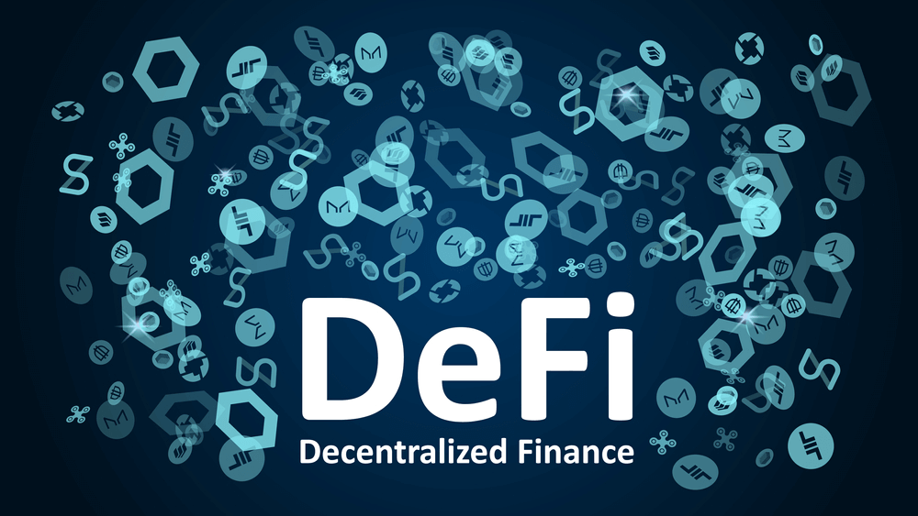
Decentralized Finance (DeFi)

Slide 49
Decentralized Finance (DeFi)
Decentralized finance (DeFi) is a New Way of Handling Money Online without Banks, using Blockchain Technology to Let People Deal with Each other Directly.
It makes Many Financial Services like Loans, Trades, and Insurance Quicker, Cheaper, and Open to More People than in Traditional Finance.

Slide 50
Decentralized Finance (DeFi)
‘Ethereum’ is a Decentralized Blockchain Platform that Establishes a Peer-to-Peer Network that Securely Executes and Verifies Application Code, Called “Smart Contracts”.

Slide 51
Decentralized Finance (DeFi)
DeFi (Pronounced dee-fy) is short for Decentralized Finance.
It’s an Emerging Field that Participants Cut out the Middleman and make Financial Transactions Directly with others, and it’s Quickly Gaining in Popularity as an Alternative to Traditional Financial Services.

Slide 52
Decentralized Finance (DeFi)
DeFi Already Lets You Do most things offered by Traditional Banks and Centralized Financial Institutions, with New Products and Transactions Available each Day.

Slide 53
Decentralized Finance (DeFi)
It lets Participants Use Cryptocurrency to Provide most Services that Traditional Banks offer with Government-issued Fiat Currencies, Lend, Borrow, Earn Interest, Trade Assets, Buy Insurance, and More.
DeFi Services tend to be Faster, Cheaper, and More Simple, with New Advantages and Services being offered Each Day.

Slide 54
Decentralized Finance (DeFi)
Decentralized Finance, on the other hand, delivers a Whole host of Advantages by Enabling People to Transact through Financial Applications via a Blockchain Network, Cutting out Intermediaries, such as Traditional Banking Groups.

Slide 55
Decentralized Finance (DeFi)
DeFi uses Smart Contracts that Don’t require Traditional Financial Institutions to Act as Guarantors for Transactions, Participants in the Decentralized Finance Ecosystem instead transact with Each Other Directly, and Transactions are Secured through Blockchain Technology.
Most DeFi Products don’t take Custody of Your Funds, allowing You to remain in Control of Your Assets.

Slide 56
Decentralized Finance (DeFi)
This Emerging System “DiFI System”, offering a “Technology Platform” for “Proper Use of Your Funds” Towards:
Investments.
Trading.
Lending, and
Other Related Financial Activities.

Slide 57
Decentralized Finance (DeFi)
A Significant Development within India’s Crypto Landscape, the Securities and Exchange Board of India (SEBI) has Recommended Several Regulators Oversees Crypto Trade Nationwide.
May 17, 2024

Slide 58
Decentralized Finance (DeFi)
Latest Cryptocurrency Prices based on Market Cap, as of 16th July, 2024, indicate a Global Crypto Market Cap of $2.32T, reflecting a 1.07% Increase from the Previous Day (Every Day Values are Declaring by Exchanges).

Slide 59
Decentralized Finance (DeFi)
Furthermore, the Total Crypto Market Volume within the Past 24 Hours Stands at $91.87B.
Notably, the DeFi Sector Currently Contributes $5.5B in Volume, representing 5.98% of the Total Crypto Market's 24-Hour Volume.

Slide 60
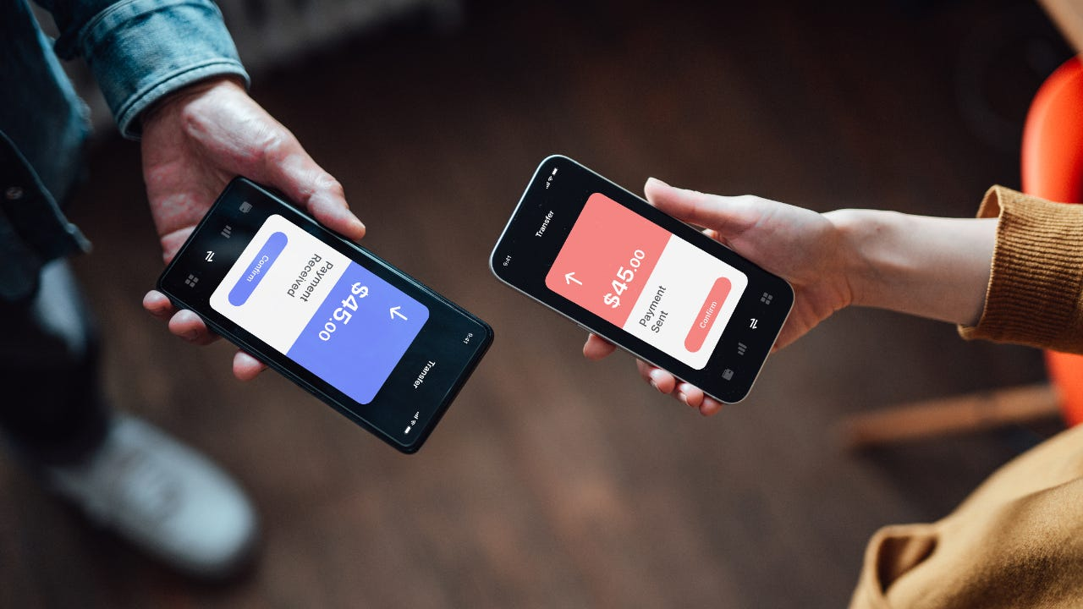
Decentralized Finance (DeFi)

Slide 61
Decentralized Finance (DeFi)
Decentralized Finance, DeFi is an Umbrella term for Peer-to-Peer (Individual to Individual) Financial Services on Public Blockchains, Primarily “Ethereum”.
Ethereum is a Decentralized Global Software Platform powered by Blockchain Technology. It is most commonly known by investors for its Native Cryptocurrency, ether (ETH), and by Developers for its use in Blockchain and Decentralized Finance Application Development.

Slide 62
Decentralized Finance (DeFi)
As a blockchain platform that supports decentralized apps (dApps) and smart contracts, Ethereum is naturally suited to DeFi.
The Ethereum Blockchain maintains the transaction history and status of accounts while Ether and other cryptocurrencies are used as assets.

Slide 63
Decentralized Finance (DeFi)
Smart Contracts are in-turn used by decentralized applications, giving way to New Innovative Smart Contracts.
As DeFi is an open-source movement, its protocols and applications are widely accessible.

Slide 64
Decentralized Finance (DeFi)
Ethereum is known for its flexibility, enabling developers to build dApps with ease.
This flexibility means there’s already a DeFi solution for most financial services, with the ongoing possibility of creating new, innovative financial products.
Since so many DeFi applications are built on the Ethereum platform, many of these products can work together seamlessly.

Slide 65
Decentralized Finance (DeFi)
DeFi Lending:
Rapidly growing in popularity, DeFi lending allows you to lend digital assets to others while earning interest.
Lenders can pool their assets with others, setting terms through smart contracts.
Borrowers generally need to post collateral in digital currency to secure a loan.

Slide 66
Decentralized Finance (DeFi)
This means that borrowers can, for instance, access funds in a major coin such as Bitcoin, while posting collateral in a more unclear cryptocurrency.
If you borrow through DeFi, provided you make the interest payments, you can access Bitcoin without having to sell your collateral.
In some cases, you can even borrow an amount larger than the collateral you provided.

Slide 67
Decentralized Finance (DeFi)
How does DeFi make money?
DeFi makes money in several ways, including transaction fees and through investments in DeFi platforms that grow in value.
Participants can earn returns by providing liquidity, borrowing, lending, or trading assets on decentralized exchanges.

Slide 68
Decentralized Finance (DeFi)
DeFi takes the Basic Premise of Bitcoin (Digital Money) and expands on it, creating an entire Digital Alternative to Stock Exchanges etc., but without all the Associated Costs (Like Office Towers, Trading Floors, Banker Salaries).
This has the Potential to Create more Open, Free, and Fair Financial Markets that are Accessible to Anyone With an Internet Connection.

Slide 69
Decentralized Finance (DeFi)
DeFi Benefits

Slide 70
Decentralized Finance (DeFi)
Open: You don’t need to apply for anything or “open” an account. You just get access by creating a wallet.
Pseudonymous: You don’t need to provide your name, email address, or any personal information.

Slide 71
Decentralized Finance (DeFi)
Flexible: You can move your assets anywhere at any time, without asking for permission, waiting for long transfers to finish, and paying expensive fees.
Fast: Interest Rates and Rewards often Update Rapidly (As Quickly as every 15 seconds), and can be significantly higher than traditional Stock Exchanges.

Slide 72
Decentralized Finance (DeFi)
Transparent: Everyone involved can see the full set of transactions (Private Corporations Rarely Grant that Kind of Transparency)

Slide 73
Decentralized Finance (DeFi)
Conclusion

Slide 74
Decentralized Finance (DeFi)
Here are Some of the Ways People are Engaging with DeFi Today:
Lending: Lend out your crypto and earn interest and rewards every minute - Not Once Per Month.
Getting a Loan: Obtain a Loan Instantly without Filling in Paperwork, including Extremely Short-term “Flash Loans” that Traditional Financial Institutions Don’t Offer.

Slide 75
Decentralized Finance (DeFi)
Here are some of the Ways People are Engaging with DeFi Today:
Trading: Make Peer-to-Peer Trades of Certain Crypto Assets, as if you could Buy and Sell Stocks without any Kind of Brokerage.
Saving for the Future: Put some of Your Crypto into Savings Account Alternatives and Earn Better Interest Rates than you’d typically Get from a Bank.

Slide 76
Decentralized Finance (DeFi)
Here are some of the Ways People are Engaging with DeFi Today:
Buying Derivatives: Make Long or Short Bets on Certain Assets. Think of these as the Crypto Version of Stock Options or Futures Contracts.

Slide 77
Digital Transformation of Banks From Caterpillar to a Butterfly
To Know More of Tomorrow’s ‘Banking System’
BFSI Board of The Institute of Cost Accountants of India Offers
“FinTech” Course

Slide 78
Digital Transformation of Banks From Caterpillar to a Butterfly

Slide 79
Thank You
CS (Dr.) P. Siva Rama Prasad
Former Asst. General Manager
State Bank of India
M.Com., MBA (Finance)., FCMA., FIIBF., FCS., FIII (Life & General)., MAIMA.,
Hyderabad

